Slide 1

THE BOOK OF DANIEL
Dr. Andy Woods

Slide 2
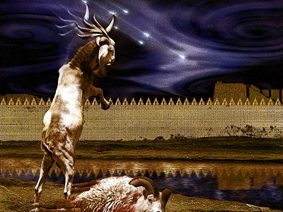
DANIEL 10-12
THE FINAL VISION

Slide 3
CHAPTER AND VERSE IN DANIEL | CHRONOLOGICAL DATE | BIBLICAL DATE
1:1 | 605 | 3rd year of Jehoiakim
2:1 | 603 | 2nd year of Nebuchadnezzar
5 | Sat. night 10/12/539 (Hoehner)
7:1 | 553 | 1st year of Belshazzar
8:1 | 551 | 3rd year of Belshazzar
9:1 | 538 | 1st year of Darius
10:1 | 536 | 3rd year of Cyrus

Slide 4

Chapter 10–12 Outline
The Setting (10:1-3)
Arrival of the Heavenly Messenger (10:4-9)
Explanation of the Heavenly Messenger (10:10–11:1)
The Prophecy of the Heavenly Messenger (11:2–12:13)

Slide 5

IV. The Prophecy of the Heavenly Messenger (11:2–12:13)
Persia (11:2)
Greece (11:3-4)
Ptolemies & Seleucids (11:5-20)
Antiochus IV (11:21-35)
Antichrist (11:36-45)
Tribulation & Millennium (12:1-13)

Slide 6
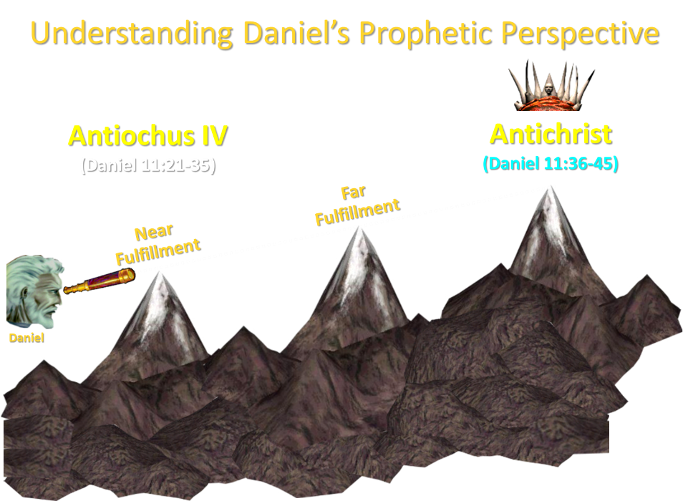

Slide 7
IV. The Prophecy of the Heavenly Messenger (11:2–12:13)
Persia (11:2)
Greece (11:3-4)
Ptolemies & Seleucids (11:5-20)
Antiochus IV (11:21-35)
Antichrist (11:36-45)
Tribulation & Millennium (12:1-13)

Slide 8
IV. The Prophecy of the Heavenly Messenger (11:2–12:13)
Persia (11:2)
Greece (11:3-4)
Ptolemies & Seleucids (11:5-20)
Antiochus IV (11:21-35)
Antichrist (11:36-45)
Tribulation & Millennium (12:1-13)

Slide 9

The Tribulation & Millennium
Daniel 12:1-13
Description of the End Times (1-4)
  The Suffering (1)
  The Separation (2)
  The Shining (3)
  The Sealing (4)
Harold Wilmington, The Outline Bible, pp. 418-19

Slide 10
The Tribulation & Millennium
Daniel 12:1-13
Duration of the End Times (5-13)
  Round 1 (5-7)
    Question (5-6)
    Answer (7)
  Round 2 (8-13)
    Question (8)
    Answer (9-13)
Harold Wilmington, The Outline Bible, pp. 418-19

Slide 11
The Tribulation & Millennium
Daniel 12:1-13
Duration of the End Times (5-13)
  Round 1 (5-7)
    Question (5-6)
    Answer (7)
  Round 2 (8-13)
    Question (8)
    Answer (9-13)
Harold Wilmington, The Outline Bible, pp. 418-19

Slide 12
The Tribulation & Millennium
Daniel 12:1-13
Duration of the End Times (5-13)
  Round 1 (5-7)
    Question (5-6)
    Answer (7)
  Round 2 (8-13)
    Question (8)
    Answer (9-13)
Harold Wilmington, The Outline Bible, pp. 418-19

Slide 13
The Tribulation & Millennium
Daniel 12:1-13
Duration of the End Times (5-13)
  Round 1 (5-7)
    Question (5-6)
    Answer (7)
  Round 2 (8-13)
    Question (8)
    Answer (9-13)
Harold Wilmington, The Outline Bible, pp. 418-19

Slide 14

Matthew 24:15
“Therefore when you see the abomination of desolation which was spoken of through Daniel the prophet, standing in the holy place (let the reader understand).”

Slide 15

Diversity of Topics in Daniel
Prophecy
Eschatology
Confidence that the Bible is God’s word
Knowledge of Intertestamental Period
Angelology
Spiritual Warfare
Living for God in a Pagan Society
God’s Sovereignty Over Empires

Slide 16
Diversity of Topics in Daniel
Prophecy
Eschatology
Confidence that the Bible is God’s word
Knowledge of Intertestamental Period
Angelology
Spiritual Warfare
Living for God in a Pagan Society
God’s Sovereignty Over Empires

Slide 17
Diversity of Topics in Daniel
Prophecy
Eschatology
Confidence that the Bible is God’s word
Knowledge of Intertestamental Period
Angelology
Spiritual Warfare
Living for God in a Pagan Society
God’s Sovereignty Over Empires

Slide 18
CHAPTER AND VERSE IN DANIEL | CHRONOLOGICAL DATE | BIBLICAL DATE
1:1 | 605 | 3rd year of Jehoiakim
2:1 | 603 | 2nd year of Nebuchadnezzar
5 | Sat. night 10/12/539 (Hoehner)
7:1 | 553 | 1st year of Belshazzar
8:1 | 551 | 3rd year of Belshazzar
9:1 | 538 | 1st year of Darius
10:1 | 536 | 3rd year of Cyrus

Slide 19
Chapter 10–12 Outline
The Setting (10:1-3)
Arrival of the Heavenly Messenger (10:4-9)
Explanation of the Heavenly Messenger (10:10–11:1)
The Prophecy of the Heavenly Messenger (11:2–12:13)

Slide 20
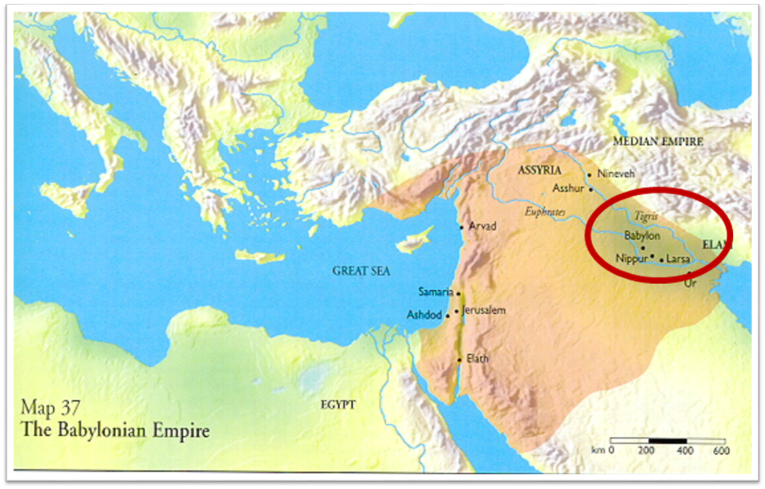

Slide 21
The Tribulation & Millennium
Daniel 12:1-13
Duration of the End Times (5-13)
  Round 1 (5-7)
    Question (5-6)
    Answer (7)
  Round 2 (8-13)
    Question (8)
    Answer (9-13)
Harold Wilmington, The Outline Bible, pp. 418-19

Slide 22
The Tribulation & Millennium
Daniel 12:1-13
Duration of the End Times (5-13)
  Round 1 (5-7)
    Question (5-6)
    Answer (7)
  Round 2 (8-13)
    Question (8)
    Answer (9-13)
Harold Wilmington, The Outline Bible, pp. 418-19

Slide 23
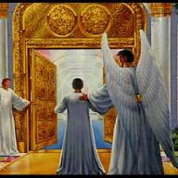
John 5:24
“Truly, truly, I say to you, he who hears My word, and believes Him who sent Me, has eternal life, and does not come into judgment, but has passed out of death into life.”

Slide 24

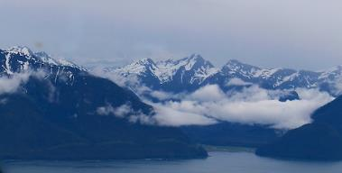
Psalm 90:2
“Before the mountains were born Or You gave birth to the earth and the world, Even from everlasting (olam) to everlasting (olam), You are God.”

Slide 25

Two Basic Truths of Daniel 12:7
Duration of the Time Period (7a)
The Conversion of Israel (7b)

Slide 26
Two Basic Truths of Daniel 12:7
Duration of the Time Period (7a)
The Conversion of Israel (7b)

Slide 27

Prophetic Synonyms
  Time, times, half a time (Dan. 7:25; Rev. 12:14)
  42 months (Rev. 11:2; 13:5)
  1260 days Division of the Tribulation into two 3½ year periods (Rev. 11:3; 12:6)

Slide 28
Daniel 9:27
And he will make a firm covenant with the many for one week, but in the middle of the week he will put a stop to sacrifice and grain offering; and on the wing of abominations will come one who makes desolate, even until a complete destruction, one that is decreed, is poured out on the one who makes desolate.

Slide 29


Slide 30
Two Basic Truths of Daniel 12:7
Duration of the Time Period (7a)
The Conversion of Israel (7b)

Slide 31
Sovereignty (Rom. 9–11)
Israel in the past: elected (Rom 9)
Israel in the present: rejected (Rom 10)
Israel in the future: accepted (Rom 11)

Slide 32
Two Problems with the Hebrew Nation
Spiritual blindness
Self sufficiency

Slide 33
Two Problems with the Hebrew Nation
Spiritual blindness
Self sufficiency

Slide 34
Two Problems with the Hebrew Nation
Spiritual blindness
Self sufficiency

Slide 35
Ezekiel 38:12
“to capture spoil and to seize plunder, to turn your hand against the waste places which are now inhabited, and against the people who are gathered from the nations, who have acquired cattle and goods, who live at the center of the world.”

Slide 36

Mark Twain
The Innocents Abroad, Complete, 1st ed. (A Public Domain Book, 1869), 267, 285, 302. These quotes can be found in chapters 47, 49, 52.
“... A desolate country whose soil is rich enough, but is given over wholly to weeds… a silent mournful expanse…. a desolation is here that not even imagination can grace with the pomp of life and action…. we never saw a human being on the whole route…. there was hardly a tree or shrub anywhere. Even the olive tree and the cactus, those fast friends of a worthless soil, had almost deserted the country.”

Slide 37
Why?
COUNTRY | GROSS DOMESTIC PRODUCT
ISRAEL | $123 BILLION
Egypt | $81 billion
Syria | $26 billion
Lebanon | $21 billion
Jordan | $12 billion
Source: CIA World Fact Book, 2005

Slide 38

Matthew Kreiger
Jerusalem Post, cited in David Jeremiah, What in the World Is Going On? 10 Prophetic Clues You Cannot Afford to Ignore (Nashville: Nelson, 2008), 175.
“Despite a population of only slightly more than 7 million people...Israel is now home to more than 7,200 millionaires...Of the 500 wealthiest people in the world, six are now Israeli, and all told, Israel's rich had assets in 2007 of more than $35 billion dollars... Israel's GDP is almost double that of any other Middle Eastern country.”

Slide 39
The Rothschild’s Palestine, All Roads Lead to Jerusalem
http://www.matterofprinciple.net/ 011/11/rothschilds-palestine.html (accessed December 15, 2011). Although there is a wide variation of estimates, many different sources estimate the mineral wealth of the Dead Sea in the trillions of dollars.
“The value of the minerals of the Dead Sea is estimated at five trillion dollars. This estimate appears to be optimistic but it is supported in part by the report of the Crown Agents of the British Colonies entitled ‘Production of Minerals From the Waters of the Dead Sea’.... This official report estimates the minerals, except oil, in 1925 as follows: Magnesium Chloride, 22,000 tons, value 600 billion dollars; Potassium Chloride, 20,000 tons, value 75 billion dollars; other minerals valued at 1,200 billion dollars; or a total of about three trillion dollars, exclusive of oil.”

Slide 40
Todd Strandberg
“Could Israel Become a Major Oil Exporter,” online: www.bibleprophecy.com, accessed 26 May 2015.
In the summer of 2010, "...huge deposits of natural gas were found along Israel's northern coastline…Israel is actually sitting on top of a vast amount of oil. According to Harold Vinegar, the former chief scientist of Royal Dutch Shell, the Shefla Basin holds the world’s second-largest shale deposits outside the United States, from which around 250 billion barrels of oil–about the same as Saudi Arabia’s proven reserves...Estimates of global deposits range from 2.8 trillion to 3.3 trillion barrels of recoverable oil...The technology curb has now reached the point where shale is becoming an exploitable resource...the Shefla shale is in a hospitable location. It also contains oil of the light, sweet variety that is easy to refine into gasoline or other common end products. Most of all, the Jews have proven themselves to be very talented at exploiting resources. If they can't make shale oil work, I doubt any nation can.”

Slide 41
Oil Discovery in Israel?
Globes Correspondent, “Huge Oil Discovery on Golan Heights,” online: http://www.globes.co.il/en/article-huge-oil-discovery-on-golan-heights-1001071698, accessed 09 October 2015.
“After more than a year of round-the-clock drilling, large amounts of oil have been found on the Golan Heights. Estimates are that the amount of oil discovered will make Israel self sufficient for very many years to come. Afek Oil and Gas chief geologist Dr. Yuval Bartov told Channel 2 News, "We are talking about a strata which is 350 meters thick and what is important is the thickness and the porosity. On average in the world strata are 20-30 meters thick, so this is ten times as large as that, so we are talking about significant quantities. The important thing is to know the oil is in the rock and that's what we now know." Three drillings have so far taken place in the southern Golan Heights which have found large reserves of oil. Potential production is dramatic - billions of barrels, which will easily provide all Israel's oil needs...”

Slide 42
Oil Discovery in Israel?
Globes Correspondent, “Huge Oil Discovery on Golan Heights,” online: http://www.globes.co.il/en/article-huge-oil-discovery-on-golan-heights-1001071698, accessed 09 October 2015.
“Israel consumes 270,000 barrels of oil per day. Although the existence of the oil in the ground is a fact, the critical phase now is to check how easily it can be extracted and whether it involves high production costs. In a period of very low oil prices, extraction will have to be relatively cheap to make exploitation of the field profitable. Just as Israel's offshore Mediterranean gas discoveries have created an entire energy industry, so the Golan oil find could also generate a new industry around it. But while the gas has been found dozens of kilometers from Israel, the Golan find is much closer...Bartov said, "There is enormous excitement. It's a fantastic feeling. We came here thinking maybe yes or maybe no and now things are really happening.”

Slide 43
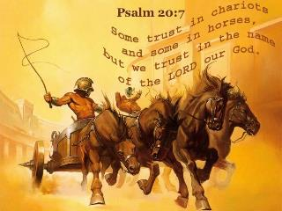
Psalm 20:7
“Some boast in chariots and some in horses,
But we will boast in the name of the Lord, our God.”

Slide 44

Zechariah 13:8-9
⁸“It will come about in all the land,” Declares the Lord, “That two parts in it will be cut off and perish; But the third will be left in it. ⁹“And I will bring the third part through the fire, Refine them as silver is refined, And test them as gold is tested. They will call on My name, And I will answer them; I will say, ‘They are My people,’ And they will say, ‘The Lord is my God.’ ”

Slide 45
Ephesians 3:3-6
“that by revelation there was made known to me the mystery, as I wrote before in brief. ⁴ By referring to this, when you read you can understand my insight into the mystery of Christ, ⁵ which in other generations was not made known to the sons of men, as it has now been revealed to His holy apostles and prophets in the Spirit; ⁶ to be specific, that the Gentiles are fellow heirs and fellow members of the body, and fellow partakers of the promise in Christ Jesus through the gospel”.

Slide 46

Ephesians 3:9
“and to bring to light what is the administration of the mystery which for ages has been hidden in God who created all things.”

Slide 47
“Mystery” Defined
“In the N.T, it [mystērion] denotes, not the mysterious (as with the Eng. word), but that which, being outside the range of unassisted natural apprehension, can be made known only by Divine revelation, and is made known in a manner and at a time appointed by God, and to those who are illumined by His Spirit.”
W. E. Vine, Merrill F. Unger, and William White, Vine's Complete Expository Dictionary of the Old and New Testament Words (Nashville: Nelson, 1996), 424.

Slide 48
When Will the Rapture Take Place Relative to the Tribulation Period?
Pre-tribulation rapture theory
Mid-tribulation rapture theory
Post-tribulation rapture theory
Pre-wrath rapture theory
Partial rapture theory

Slide 49
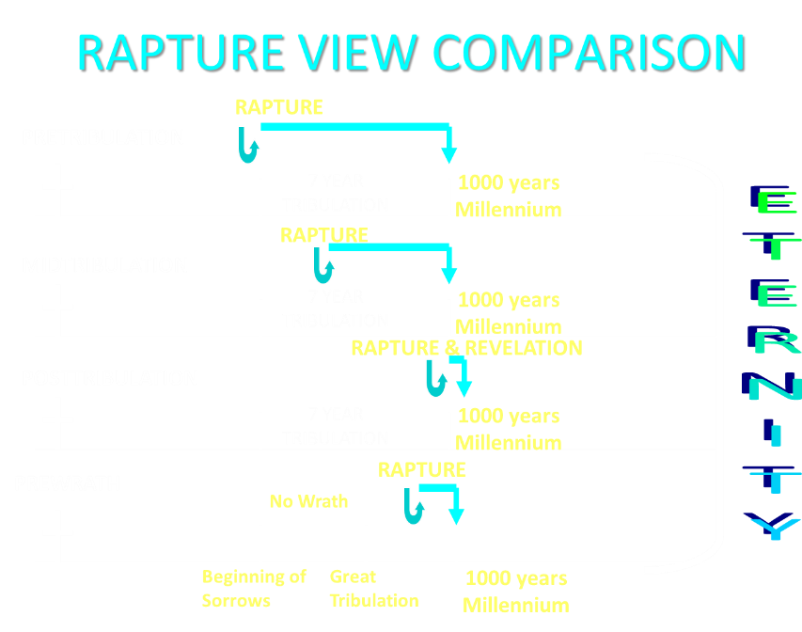

Slide 50
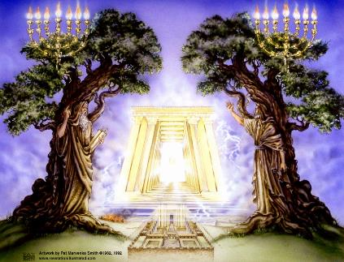
The Tribulation's Concerns Israel!
Jer 30:7; Dan 9:24
God uses Israel and the church on a mutually exclusive basis

Slide 51


Jeremiah 30:7
“Alas! for that day is great, There is none like it; And it is the time of Jacob’s distress, But he will be saved from it.”

Slide 52
Daniel 9:24
“Seventy weeks have been decreed for your people and your holy city, to finish the transgression, to make an end of sin, to make atonement for iniquity, to bring in everlasting righteousness, to seal up vision and prophecy and to anoint the most holy place.”

Slide 53
Promised Exemption from Divine Wrath
The promise (1 Thess 1:10; 5:9; Rom 5:9; Rev 3:10)
Tribulation = divine wrath (Rev 6:16-17; 11:18; 15:1, 7; 16:19)

Slide 54
Daniel 9:24
“Seventy weeks have been decreed for your people and your holy city, to finish the transgression, to make an end of sin, to make atonement for iniquity, to bring in everlasting righteousness, to seal up vision and prophecy and to anoint the most holy place.”

Slide 55

6 Prophecies WILL BE fulfilled V.24c
  “to finish transgression”
  “to make an end of sin”
  “to make atonement for iniquity”
  “to bring in everlasting righteousness”
  “to seal up vision and prophecy”
  “to anoint the most holy place”
Arnold Fructenbaum, Footsteps of the Messiah, p.191-4

Slide 56
The Tribulation & Millennium
Daniel 12:1-13
Duration of the End Times (5-13)
  Round 1 (5-7)
    Question (5-6)
    Answer (7)
  Round 2 (8-13)
    Question (8)
    Answer (9-13)
Harold Wilmington, The Outline Bible, pp. 418-19

Slide 57
The Tribulation & Millennium
Daniel 12:1-13
Duration of the End Times (5-13)
  Round 1 (5-7)
    Question (5-6)
    Answer (7)
  Round 2 (8-13)
    Question (8)
    Answer (9-13)
Harold Wilmington, The Outline Bible, pp. 418-19

Slide 58
The Tribulation & Millennium
Daniel 12:1-13
Duration of the End Times (5-13)
  Round 1 (5-7)
    Question (5-6)
    Answer (7)
  Round 2 (8-13)
    Question (8)
    Answer (9-13)
Harold Wilmington, The Outline Bible, pp. 418-19

Slide 59
Conclusion

Slide 60

“The Lord bless you and keep you; the Lord make his face shine on you and be gracious to you; the Lord turn his face toward you and give you peace.” (NIV)

