Slide 1
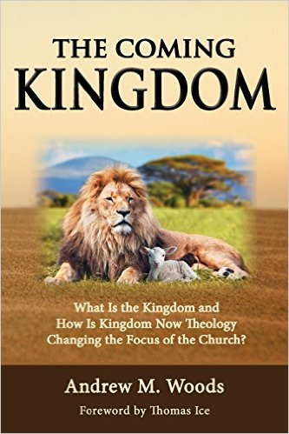

Slide 2

The Coming Kingdom
Chapter 16
Dr. Andy Woods
Senior Pastor – Sugar Land Bible Church
President – Chafer Theological Seminary

Slide 3
1. Kingdom Throughout the Bible
Eden Abrahamic Covenant Mosaic Covenant Divided Kingdom Times of the Gentiles | Old Testament Prophets Post exile Offer of the King / Kingdom Rejection of the Offer Interim Age

Slide 4
1. Kingdom Throughout the Bible
Kingdom Mysteries Church Israel’s Discipline & Restoration Re-offer of the King/Kingdom | Transfer of Kingdom Authority Kingdom Establishment Eternal State Testimony of Early Church History

Slide 5

Kingdom Study Outline
What does the Bible Say About the Kingdom?
The Main Problem with Kingdom Now NT interpretations
Why do some believe that we are in the kingdom now?
Why does it matter?

Slide 6
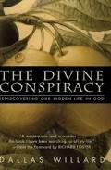
Kingdom Now?
“Sometimes the places where God’s effective or actual rule is not yet carried out, and His will is not yet done, lie within the lives and little kingdoms of those who truly have been invaded by the eternal kind of life itself‒those who really do belong to Christ because His life is already present and growing within them. The “interior castle” of the human soul, as Teresa of Avila called it, has many rooms, and they are slowly occupied by God, allowing us time and room to grow. That is a crucial aspect of the conspiracy. But even this does not detract from the reality of the ‘kingdom among us.’ Nor does it destroy the choice that all have to accept it and bring their life increasingly into it.”
Dallas Willard, The Divine Conspiracy, p. 30.

Slide 7

2. The Main Problem with Kingdom Now NT interpretations
The kingdom is always earthly (Gen. 15:18-21) over a repentant Israel (Ezek. 36‒37)
The kingdom will only manifest after at time of tribulation (Jer. 30:7; Dan. 9:24-27)

Slide 8
2. The Main Problem with Kingdom Now NT interpretations
The kingdom is always earthly (Gen. 15:18-21) over a repentant Israel (Ezek. 36‒37)
The kingdom will only manifest after at time of tribulation (Jer. 30:7; Dan. 9:24-27)

Slide 9

Renald Showers
Renald Showers, “Critique of Progressive Dispensationalism,” Friends of Israel National Conference (June 2003), 5.
“Several items of Scripture reveal that no form of the future Kingdom of God foretold in the Old Testament will be established before the Second Coming of Christ. . . . No Old Testament revelation concerning the future Kingdom of God indicated that the Kingdom would consist of two forms, one spiritual and the other political, established at two different points of time in the future.”

Slide 10

Arnold Fruchtenbaum
Arnold G. Fruchtenbaum, “Israel’s Right to the Promised Land,” 17–18, accessed March 9, 2013, http://www.pre-trib.org.com.
“[I]t is incorrect to say that the Old Testament should be interpreted by the New Testament because if that is the case, the Old Testament had no meaning and seemed to be irrelevant to the ones to whom it was spoken. On the contrary, the validity of the New Testament is seen by how it conforms to what was already revealed in the Old Testament. The Book of Mormon and other books by cultic groups fail to stand because they contradict the New Testament. By the same token, if the New Testament contradicts the Old Testament, it cannot stand. It is one thing to see fulfillment in the New Testament, but it is quite another to see the New Testament so totally reinterpret the Old Testament that what the Old Testament says carries no meaning at all.”

Slide 11

Colin Chapman
Colin Chapman, Whose Promised Land? The Continuing Conflict over Israel and Palestine (Oxford, England: Lion, 2015), 262.
“When the New Testament writers like John had seen the significance of the land and the nation in the context of the kingdom of God which had come into being in Jesus of Nazareth, they ceased to look forward to a literal fulfillment of Old Testament prophecies of a return to the land and a restoration of a Jewish state. The one and only fulfillment of all promises and prophecies was already there before their eyes in the person of Jesus. The way they interpreted the Old Testament should be the norm for the Christian interpretation of the Old Testament today.”

Slide 12

Naim Ateek
Naim Ateek, Justice, and Only Justice: A Palestinian Theology of Liberation (Maryknoll, NY: Ortis, 1990), 81–82.
“The use of this “new” hermeneutic is accessible to all Christians, even to the simple of faith. . . . The constant application of this hermeneutic, therefore, is the best key for Christians to interpreting and understanding the biblical message. Furthermore, this theological understanding can determine the validity and authority of the Scriptures for the life of the Christian. It is grounded in the knowledge and love of God as revealed in the life, death, and resurrection of Jesus Christ. The revelation of God, God’s nature, purpose, and will as revealed in Christ, becomes the criterion by which Christians can measure the validity and authority of the biblical message for their life. When confronted with a difficult passage in the Bible . . . one needs to ask such simple questions as: Is the way I am hearing this the way I have come to know God in Christ? Does this fit the picture I have of God that Jesus has revealed to me? Does it match the character of God whom I have come to know through Christ? If it does, then that passage is valid and authoritative. If not, then I cannot accept its validity or authority.”

Slide 13

“Complementary Hermeneutics” in Progressive Dispensationalism
“…the New Testament does introduce change and advance; it does not merely repeat Old Testament revelation. In making complementary additions, however, it does not jettison Old Testament promises. The enhancement is not at the expense of the original promise.”
Craig Blaising and Darrell Bock, “Dispensationalism, Israel and the Church: Assessment and Dialogue,” in Dispensationalism, Israel and the Church, ed. Craig Blaising and Darrell Bock (Grand Rapids: Zondervan, 1992), 392–93.
Notes:
WRONG!!!

Slide 14

Spiritual Form of the Kingdom
Some Problems
God cannot lie (Num. 23:19; Titus 1:2; Heb. 6:18)
Truth is determined by its conformity to prior Scripture (Deut. 13:1-5; Acts 17:11; Gal. 1:6-9; 1 Thess. 5:21; 1 Cor. 14:29; 1 John 4:1; Rev. 2:2)
Overwhelming NT kingdom references are future (Matt. 6:10; Acts 14:22)

Slide 15
Spiritual Form of the Kingdom
Some Problems
God cannot lie (Num. 23:19; Titus 1:2; Heb. 6:18)
Truth is determined by its conformity to prior Scripture (Deut. 13:1-5; Acts 17:11; Gal. 1:6-9; 1 Thess. 5:21; 1 Cor. 14:29; 1 John 4:1; Rev. 2:2)
Overwhelming NT kingdom references are future (Matt. 6:10; Acts 14:22)

Slide 16
Spiritual Form of the Kingdom
Some Problems
God cannot lie (Num. 23:19; Titus 1:2; Heb. 6:18)
Truth is determined by its conformity to prior Scripture (Deut. 13:1-5; Acts 17:11; Gal. 1:6-9; 1 Thess. 5:21; 1 Cor. 14:29; 1 John 4:1; Rev. 2:2)
Overwhelming NT kingdom references are future (Matt. 6:10; Acts 14:22)

Slide 17

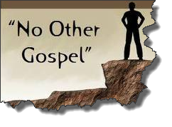
Galatians 1:8–9
⁸ But even if we, or an angel from heaven, should preach to you a gospel contrary to what we have preached to you, he is to be accursed! ⁹ As we have said before, so I say again now, if any man is preaching to you a gospel contrary to what you received, he is to be accursed!

Slide 18
Spiritual Form of the Kingdom
Some Problems
God cannot lie (Num. 23:19; Titus 1:2; Heb. 6:18)
Truth is determined by its conformity to prior Scripture (Deut. 13:1-5; Acts 17:11; Gal. 1:6-9; 1 Thess. 5:21; 1 Cor. 14:29; 1 John 4:1; Rev. 2:2)
Overwhelming NT kingdom references are future (Matt. 6:10; Acts 14:22)

Slide 19
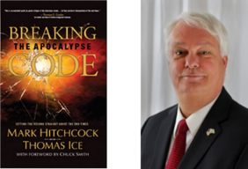
Thomas Ice
Thomas Ice, “Amillennialism,” in The Popular Encyclopedia of Bible Prophecy (Eugene, OR: Harvest House, 2004), 20.
Acts 14:22-“strengthening the souls of the disciples, encouraging them to continue in the faith, and saying, ‘Through many tribulations we must enter the kingdom of God.’” "If they were in the kingdom, this statement would make no sense.”

Slide 20
2. The Main Problem with Kingdom Now NT interpretations
The kingdom is always earthly (Gen. 15:18-21) over a repentant Israel (Ezek. 36‒37)
The kingdom will only manifest after at time of tribulation (Jer. 30:7; Dan. 9:24-27)

Slide 21


Jeremiah 30:7
“ Alas! for that day is great, There is none like it; And it is the time of Jacob’s distress, But he will be saved from it.”

Slide 22


Slide 23

Daniel 9:24
Seventy weeks have been decreed for your people and your holy city, to finish the transgression, to make an end of sin, to make atonement for iniquity, to bring in everlasting righteousness, to seal up vision and prophecy and to anoint the most holy place.

Slide 24

6 Prophecies WILL BE fulfilled V.24c
  “to finish transgression”
  “to make an end of sin”
  “to make atonement for iniquity”
  “to bring in everlasting righteousness”
  “to seal up vision and prophecy”
  “to anoint the most holy place”
Arnold Fructenbaum, Footsteps of the Messiah, p.191-4

Slide 25

Daniel 9:27
And he will make a firm covenant with the many for one week, but in the middle of the week he will put a stop to sacrifice and grain offering; and on the wing of abominations will come one who makes desolate, even until a complete destruction, one that is decreed, is poured out on the one who makes desolate.

Slide 26


Slide 27
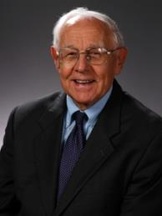
Stanley D. Toussaint
Stanley D. Toussaint, “Israel and the Church of a Traditional Dispensationalist,” in Three Central Issues in Contemporary Dispensationalism, ed. Herbert W. Bateman (Grand Rapids: Kregel, 1999), 231.
“If the kingdom began in the ministry of Christ, where is the prophesied judgment in the Gospels? Were the Old Testament prophets and John incorrect in their message?”

Slide 28
CONCLUSION

Slide 29
Kingdom Study Outline
What does the Bible Say About the Kingdom?
The Main Problem with Kingdom Now NT interpretations
Why do some believe that we are in the kingdom now?
Why does it matter?

Slide 30
Response to Kingdom Now Problem Passages
Passages from Christ’s ministry
Passages from Acts
Passages from Paul
Passages from the General letters
Passages from Revelation
Miscellaneous Arguments

