Slide 1
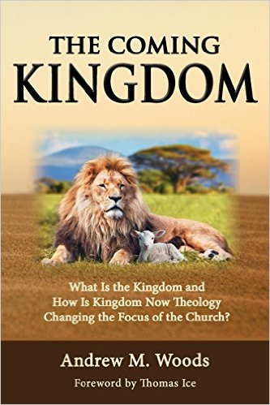

Slide 2

The Coming Kingdom
Chapter 15
Dr. Andy Woods
Senior Pastor – Sugar Land Bible Church
President – Chafer Theological Seminary

Slide 3

Kingdom Study Outline
What does the Bible Say About the Kingdom?
The Main Problem with Kingdom Now NT interpretations
Why do some believe that we are in the kingdom now?
Why does it matter?

Slide 4
1. Kingdom Throughout the Bible
Eden Abrahamic Covenant Mosaic Covenant Divided Kingdom Times of the Gentiles | Old Testament Prophets Post exile Offer of the King / Kingdom Rejection of the Offer Interim Age

Slide 5
1. Kingdom Throughout the Bible
Kingdom Mysteries Church Israel’s Discipline & Restoration Re-offer of the King/Kingdom | Transfer of Kingdom Authority Kingdom Establishment Eternal State Testimony of Early Church History

Slide 6
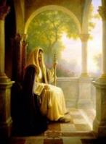
The Eternal State
Rev. 21-22
After Theocratic Administrator Restoration
New Creation & Not Renovation
Eternal State’s Literal Nature
Continuation of the Davidic Throne
Eternal State’s Description

Slide 7
1. Kingdom Throughout the Bible
Kingdom Mysteries Church Israel’s Discipline & Restoration Re-offer of the King/Kingdom | Transfer of Kingdom Authority Kingdom Establishment Eternal State Testimony of Early Church History

Slide 8
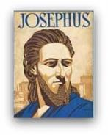
Josephus
Josephus, Antiquities 18.3.3 § 63-64
“Mara Bar-Serapion, a Syrian philosopher, wrote: ‘What advantage came to the Jews by the murder of their Wise King, seeing that from that very time their kingdom was driven away from them?’”

Slide 9

Justin Martyr
Dialogue with Trypho, 80.
“But I and every other completely orthodox Christian feel certain that there will be a resurrection of the flesh, followed by a thousand years in the rebuilt, embellished, and enlarged city of Jerusalem as was announced by the prophets Ezekiel, Isaiah, and the others.”

Slide 10

Schaff
History of the Christian Church, vol. 2 , p. 614.
“The most striking point in the eschatology of the ante-Nicene age (A.D. 100–325) is the prominent chiliasm, or millenarianism, that is the belief of a visible reign of Christ in glory on earth with the risen saints for a thousand years, before the general resurrection and judgment. It was indeed not the doctrine of the church embodied in any creed or form of devotion, but a widely current opinion of distinguished teachers, such as Barnabas, Papias, Justin Martyr, Irenaeus, Tertullian, Methodius, and Lactantius.”

Slide 11
Edward Gibbon
History of Christianity (NY: Eckler, 1916), 141-44.
“The ancient and popular doctrine of the Millennium was intimately connected with the second coming of Christ. As the works of the creation had been finished in six days, their duration in their present state, according to a tradition which was attributed to the prophet Elijah, was fixed to six thousand years. By the same analogy it was inferred, that this long period of labor and contention, which was now almost elapsed, would be succeeded by a joyful Sabbath of a thousand years; and that Christ, with the triumphant band of the saints and the elect who had escaped death, or who had been miraculously revived, would reign upon earth till the time appointed for the last and general resurrection…The assurance of such a Millennium was carefully inculcated by…

Slide 12
Edward Gibbon
History of Christianity (NY: Eckler, 1916), 141-44.
…a succession of fathers from Justin Martyr, and Irenaeus, who conversed with the immediate disciples of the apostles, down to Lactantius, who was preceptor to the son of Constantine. Though it might not be universally received, it appears to have been the reigning sentiment of the orthodox believers; and it seems so well adapted to the desires and apprehensions of mankind, that it must have contributed in a very considerable degree to the progress of the Christian faith.”

Slide 13
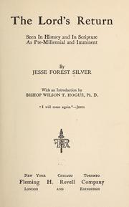
Jesse Forest Silver
The Lord’s Return: Seen in History and in Scripture as Premillennial and Imminent (NY: Revell, 1914), 62-64.
Silver says of the apostolic fathers that "they expected the return of the Lord in their day…They believed the time was imminent because the Lord had taught them to live in a watchful attitude." Concerning the ante Nicene fathers, he says: "by tradition they knew the faith of the apostles. They taught the doctrine of the imminent and pre-millennial return of the Lord.”

Slide 14
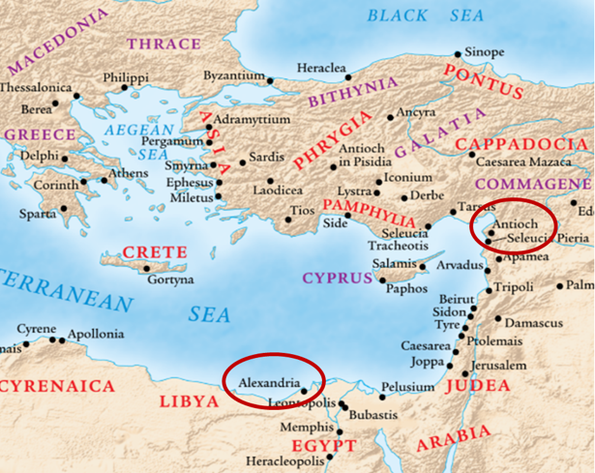

Slide 15
The Coming Kingdom
Chapter 16
Dr. Andy Woods
Senior Pastor – Sugar Land Bible Church
President – Chafer Theological Seminary

Slide 16
Kingdom Study Outline
What does the Bible Say About the Kingdom?
The Main Problem with Kingdom Now NT interpretations
Why do some believe that we are in the kingdom now?
Why does it matter?

Slide 17
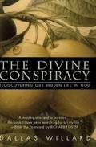
Kingdom Now?
“Sometimes the places were God’s effective or actual rule is not yet carried out, and His will is not yet done, lie within the lives and little kingdoms of those who truly have been invaded by the eternal kind of life itself‒those who really do belong to Christ because His life is already present and growing within them. The “interior castle” of the human soul, as Teresa of Avila called it, has many rooms, and they are slowly occupied by God, allowing us time and room to grow. That is a crucial aspect of the conspiracy. But even this does not detract from the reality of the ‘kingdom among us.’ Nor does it destroy the choice that all have to accept it and bring their life increasingly into it.”
Dallas Willard, The Divine Conspiracy, p. 30.

Slide 18
2. The Main Problem with Kingdom Now NT interpretations
The kingdom is always earthly (Gen. 15:18-21) over a repentant Israel (Ezek. 36‒37)
The kingdom will only manifest after at time of tribulation (Jer. 30:7; Dan. 9:24-27)

Slide 19
2. The Main Problem with Kingdom Now NT interpretations
The kingdom is always earthly (Gen. 15:18-21) over a repentant Israel (Ezek. 36‒37)
The kingdom will only manifest after at time of tribulation (Jer. 30:7; Dan. 9:24-27)

Slide 20

Renald Showers
Renald Showers, “Critique of Progressive Dispensationalism,” Friends of Israel National Conference (June 2003), 5.
“Several items of Scripture reveal that no form of the future Kingdom of God foretold in the Old Testament will be established before the Second Coming of Christ. . . . No Old Testament revelation concerning the future Kingdom of God indicated that the Kingdom would consist of two forms, one spiritual and the other political, established at two different points of time in the future.”

Slide 21

Arnold Fruchtenbaum
Arnold G. Fruchtenbaum, “Israel’s Right to the Promised Land,” 17–18, accessed March 9, 2013, http://www.pre-trib.org.com.
“[I]t is incorrect to say that the Old Testament should be interpreted by the New Testament because if that is the case, the Old Testament had no meaning and seemed to be irrelevant to the ones to whom it was spoken. On the contrary, the validity of the New Testament is seen by how it conforms to what was already revealed in the Old Testament. The Book of Mormon and other books by cultic groups fail to stand because they contradict the New Testament. By the same token, if the New Testament contradicts the Old Testament, it cannot stand. It is one thing to see fulfillment in the New Testament, but it is quite another to see the New Testament so totally reinterpret the Old Testament that what the Old Testament says carries no meaning at all.”

Slide 22

Colin Chapman
Colin Chapman, Whose Promised Land? The Continuing Conflict over Israel and Palestine (Oxford, England: Lion, 2015), 262.
“When the New Testament writers like John had seen the significance of the land and the nation in the context of the kingdom of God which had come into being in Jesus of Nazareth, they ceased to look forward to a literal fulfillment of Old Testament prophecies of a return to the land and a restoration of a Jewish state. The one and only fulfillment of all promises and prophecies was already there before their eyes in the person of Jesus. The way they interpreted the Old Testament should be the norm for the Christian interpretation of the Old Testament today.”

Slide 23

Naim Ateek
Naim Ateek, Justice, and Only Justice: A Palestinian Theology of Liberation (Maryknoll, NY: Ortis, 1990), 81–82.
“The use of this “new” hermeneutic is accessible to all Christians, even to the simple of faith. . . . The constant application of this hermeneutic, therefore, is the best key for Christians to interpreting and understanding the biblical message. Furthermore, this theological understanding can determine the validity and authority of the Scriptures for the life of the Christian. It is grounded in the knowledge and love of God as revealed in the life, death, and resurrection of Jesus Christ. The revelation of God, God’s nature, purpose, and will as revealed in Christ, becomes the criterion by which Christians can measure the validity and authority of the biblical message for their life. When confronted with a difficult passage in the Bible . . . one needs to ask such simple questions as: Is the way I am hearing this the way I have come to know God in Christ? Does this fit the picture I have of God that Jesus has revealed to me? Does it match the character of God whom I have come to know through Christ? If it does, then that passage is valid and authoritative. If not, then I cannot accept its validity or authority.”

Slide 24

Spiritual Form of the Kingdom
Some Problems
God cannot lie (Num. 23:19; Titus 1:2; Heb. 6:18)
Truth is determined by its conformity to prior Scripture (Deut. 13:1-5; Acts 17:11; Gal. 1:6-9; 1 Thess. 5:21; 1 Cor. 14:29; 1 John 4:1; Rev. 2:2)
Overwhelming NT kingdom references are future (Matt. 6:10; Acts 14:22)

Slide 25
Spiritual Form of the Kingdom
Some Problems
God cannot lie (Num. 23:19; Titus 1:2; Heb. 6:18)
Truth is determined by its conformity to prior Scripture (Deut. 13:1-5; Acts 17:11; Gal. 1:6-9; 1 Thess. 5:21; 1 Cor. 14:29; 1 John 4:1; Rev. 2:2)
Overwhelming NT kingdom references are future (Matt. 6:10; Acts 14:22)

Slide 26
Spiritual Form of the Kingdom
Some Problems
God cannot lie (Num. 23:19; Titus 1:2; Heb. 6:18)
Truth is determined by its conformity to prior Scripture (Deut. 13:1-5; Acts 17:11; Gal. 1:6-9; 1 Thess. 5:21; 1 Cor. 14:29; 1 John 4:1; Rev. 2:2)
Overwhelming NT kingdom references are future (Matt. 6:10; Acts 14:22)

Slide 27
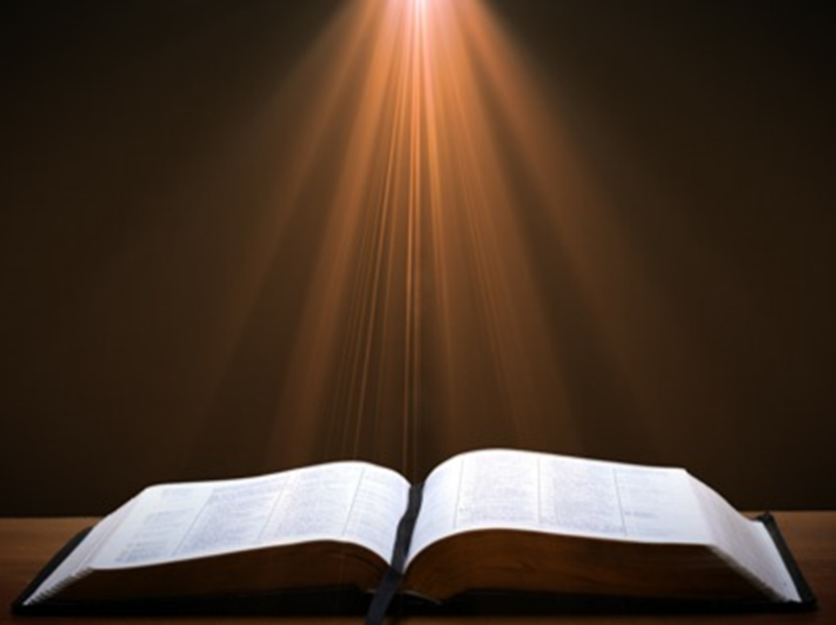

Galatians 1:8–9
⁸ But even if we, or an angel from heaven, should preach to you a gospel contrary to what we have preached to you, he is to be accursed! ⁹ As we have said before, so I say again now, if any man is preaching to you a gospel contrary to what you received, he is to be accursed!

Slide 28
Spiritual Form of the Kingdom
Some Problems
God cannot lie (Num. 23:19; Titus 1:2; Heb. 6:18)
Truth is determined by its conformity to prior Scripture (Deut. 13:1-5; Acts 17:11; Gal. 1:6-9; 1 Thess. 5:21; 1 Cor. 14:29; 1 John 4:1; Rev. 2:2)
Overwhelming NT kingdom references are future (Matt. 6:10; Acts 14:22)

Slide 29
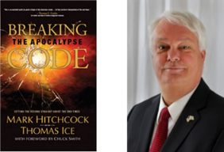
Thomas Ice
Thomas Ice, “Amillennialism,” in The Popular Encyclopedia of Bible Prophecy (Eugene, OR: Harvest House, 2004), 20.
Acts 14:22-“strengthening the souls of the disciples, encouraging them to continue in the faith, and saying, ‘Through many tribulations we must enter the kingdom of God.’” "If they were in the kingdom, this statement would make no sense.”

Slide 30
2. The Main Problem with Kingdom Now NT interpretations
The kingdom is always earthly (Gen. 15:18-21) over a repentant Israel (Ezek. 36‒37)
The kingdom will only manifest after at time of tribulation (Jer. 30:7; Dan. 9:24-27)

Slide 31

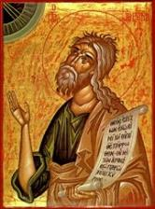
Jeremiah 30:7
“ Alas! for that day is great, There is none like it; And it is the time of Jacob’s distress, But he will be saved from it.”

Slide 32


Slide 33
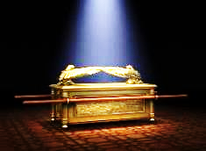
Daniel 9:24
Seventy weeks have been decreed for your people and your holy city, to finish the transgression, to make an end of sin, to make atonement for iniquity, to bring in everlasting righteousness, to seal up vision and prophecy and to anoint the most holy place.

Slide 34

6 Prophecies WILL BE fulfilled V.24c
  “to finish transgression”
  “to make an end of sin”
  “to make atonement for iniquity”
  “to bring in everlasting righteousness”
  “to seal up vision and prophecy”
  “to anoint the most holy place”
Arnold Fructenbaum, Footsteps of the Messiah, p.191-4

Slide 35

Daniel 9:27
And he will make a firm covenant with the many for one week, but in the middle of the week he will put a stop to sacrifice and grain offering; and on the wing of abominations will come one who makes desolate, even until a complete destruction, one that is decreed, is poured out on the one who makes desolate.

Slide 36
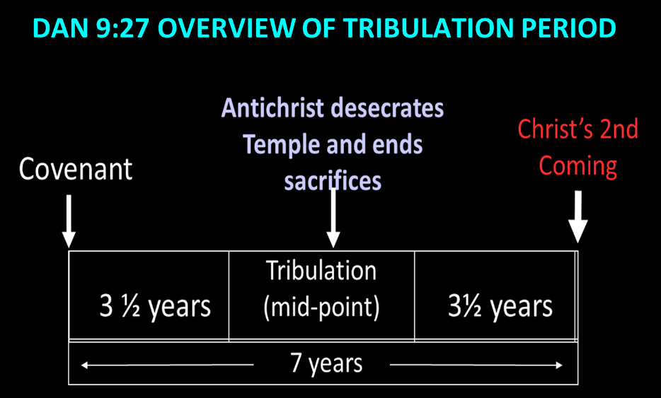

Slide 37
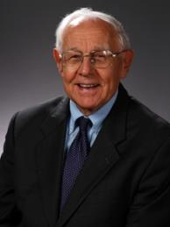
Stanley D. Toussaint
Stanley D. Toussaint, “Israel and the Church of a Traditional Dispensationalist,” in Three Central Issues in Contemporary Dispensationalism, ed. Herbert W. Bateman (Grand Rapids: Kregel, 1999), 231.
“If the kingdom began in the ministry of Christ, where is the prophesied judgment in the Gospels? Were the Old Testament prophets and John incorrect in their message?”

Slide 38
CONCLUSION

Slide 39
Kingdom Study Outline
What does the Bible Say About the Kingdom?
The Main Problem with Kingdom Now NT interpretations
Why do some believe that we are in the kingdom now?
Why does it matter?

