Slide 1

THE BOOK OF DANIEL
Dr. Andy Woods

Slide 2
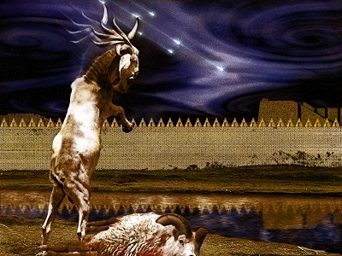
DANIEL 10-12
THE FINAL VISION

Slide 3
CHAPTER AND VERSE IN DANIEL | CHRONOLOGICAL DATE | BIBLICAL DATE
1:1 | 605 | 3rd year of Jehoiakim
2:1 | 603 | 2nd year of Nebuchadnezzar
5 | Sat. night 10/12/539 (Hoehner)
7:1 | 553 | 1st year of Belshazzar
8:1 | 551 | 3rd year of Belshazzar
9:1 | 538 | 1st year of Darius
10:1 | 536 | 3rd year of Cyrus

Slide 4

Chapter 10–12 Outline
The Setting (10:1-3)
Arrival of the Heavenly Messenger (10:4-9)
Explanation of the Heavenly Messenger (10:10–11:1)
The Prophecy of the Heavenly Messenger (11:2–12:13)

Slide 5

IV. The Prophecy of the Heavenly Messenger (11:2–12:13)
Persia (11:2)
Greece (11:3-4)
Ptolemies & Seleucids (11:5-20)
Antiochus IV (11:21-35)
Antichrist (11:36-45)
Tribulation & Millennium (12:1-13)

Slide 6












Understanding Daniel’s
Prophetic Perspective
Antichrist
Antiochus IV
(Daniel 11:36-45)
(Daniel 11:21-35)
Far
Fulfillment
Near
Fulfillment
Daniel

Slide 7
IV. The Prophecy of the Heavenly Messenger (11:2–12:13)
Persia (11:2)
Greece (11:3-4)
Ptolemies & Seleucids (11:5-20)
Antiochus IV (11:21-35)
Antichrist (11:36-45)
Tribulation & Millennium (12:1-13)

Slide 8
IV. The Prophecy of the Heavenly Messenger (11:2–12:13)
Persia (11:2)
Greece (11:3-4)
Ptolemies & Seleucids (11:5-20)
Antiochus IV (11:21-35)
Antichrist (11:36-45)
Tribulation & Millennium (12:1-13)

Slide 9

The Tribulation & Millennium
Daniel 12:1-13
Description of the End Times (1-4)
  The Suffering (1)
  The Separation (2)
  The Shining (3)
  The Sealing (4)
Harold Wilmington, The Outline Bible, pp. 418-19

Slide 10
The Tribulation & Millennium
Daniel 12:1-13
Duration of the End Times (5-13)
  Round 1 (5-7)
    Question (5-6)
    Answer (7)
  Round 2 (8-13)
    Question (8)
    Answer (9-13)
Harold Wilmington, The Outline Bible, pp. 418-19

Slide 11
The Tribulation & Millennium
Daniel 12:1-13
Description of the End Times (1-4)
  The Suffering (1)
  The Separation (2)
  The Shining (3)
  The Sealing (4)
Harold Wilmington, The Outline Bible, pp. 418-19

Slide 12
The Tribulation & Millennium
Daniel 12:1-13
Description of the End Times (1-4)
  The Suffering (1)
  The Separation (2)
  The Shining (3)
  The Sealing (4)
Harold Wilmington, The Outline Bible, pp. 418-19

Slide 13
The Tribulation & Millennium
Daniel 12:1-13
Description of the End Times (1-4)
  The Suffering (1)
  The Separation (2)
  The Shining (3)
  The Sealing (4)
Harold Wilmington, The Outline Bible, pp. 418-19

Slide 14

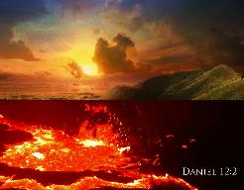
Daniel 12:2
“Many of those who sleep in the dust of the ground will awake, these to everlasting life, but the others to disgrace and everlasting contempt.”

Slide 15
1 Corinthians 15:20-23
“²⁰-But now Christ has been raised from the dead, the first fruits of those who are asleep. ²¹-For since by a man came death, by a man also came the resurrection of the dead. ²²-For as in Adam all die, so also in Christ all will be made alive. ²³-But each in his own order: Christ the first fruits, after that those who are Christ’s at His coming.”

Slide 16
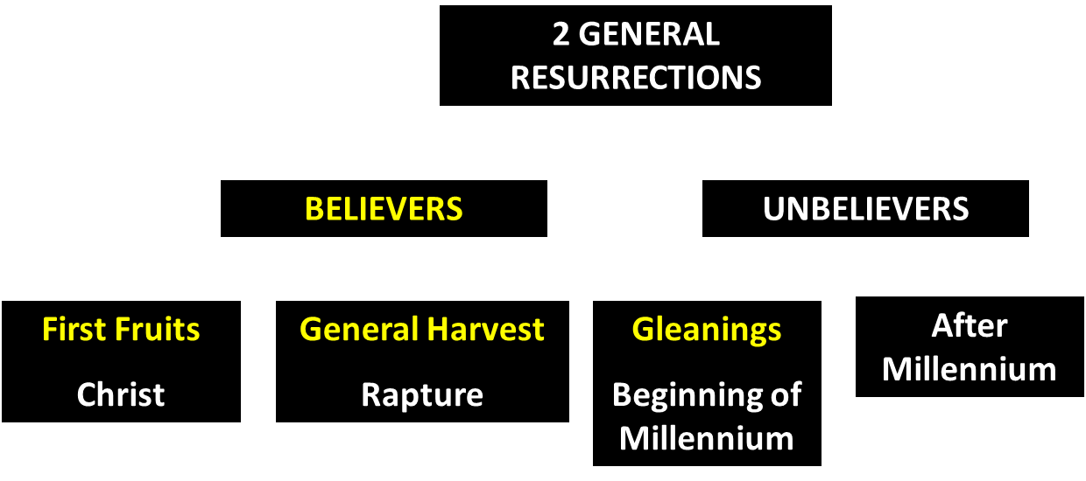
God’s Resurrection Program

Slide 17
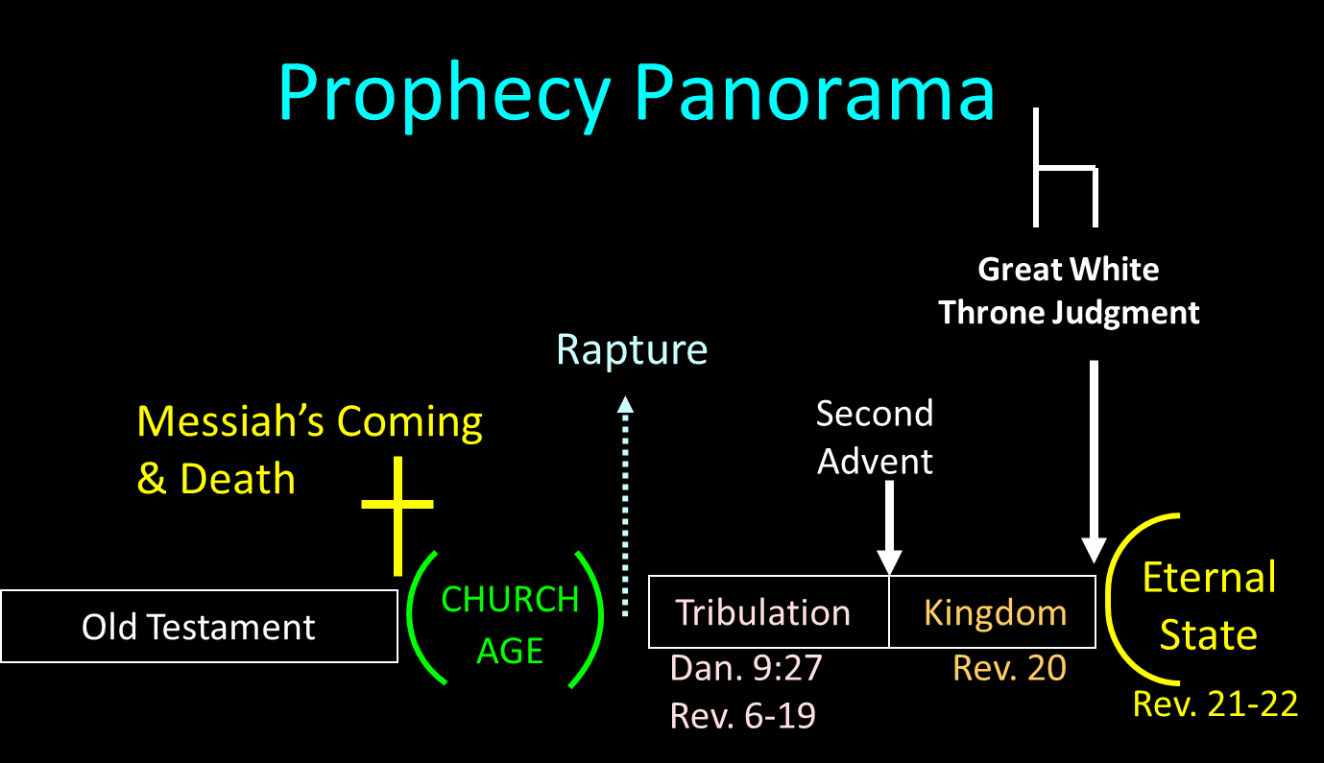

Slide 18
The Tribulation & Millennium
Daniel 12:1-13
Description of the End Times (1-4)
  The Suffering (1)
  The Separation (2)
  The Shining (3)
  The Sealing (4)
Harold Wilmington, The Outline Bible, pp. 418-19

Slide 19
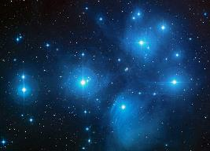
Daniel 12:3
“Those who have insight will shine brightly like the brightness of the expanse of heaven, and those who lead the many to righteousness, like the stars forever and ever.”

Slide 20
Daniel 12:3
“Those who have insight will shine brightly like the brightness of the expanse of heaven, and those who lead the many to righteousness, like the stars forever and ever.”

Slide 21
Daniel 12:3
“Those who have insight will shine brightly like the brightness of the expanse of heaven, and those who lead the many to righteousness, like the stars forever and ever.”

Slide 22


Slide 23
Six Questions
When?
Where?
Who?
Why?
What?
How?
Outline adapted from Mark Hitchcock, The End: A Complete Overview of Bible Prophecy and the End of Days (Carol Stream, IL: Tyndale, 2012), 207-17.

Slide 24
Six Questions
When?
Where?
Who?
Why?
What?
How?
Outline adapted from Mark Hitchcock, The End: A Complete Overview of Bible Prophecy and the End of Days (Carol Stream, IL: Tyndale, 2012), 207-17.

Slide 25
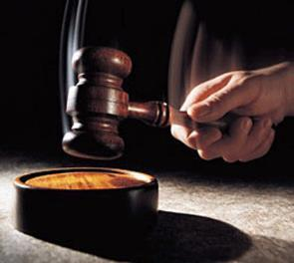
When?
After the Rapture
Rewards are associated with the day of the Lord’s coming for the church (1 Cor. 4:5; 2 Tim. 4:8)
Bride is already rewarded (Rev. 19:8)

Slide 26
1 Corinthians 4:5
“Therefore do not go on passing judgment before the time, but wait until the Lord comes who will both bring to light the things hidden in the darkness and disclose the motives of men’s hearts; and then each man’s praise will come to him from God.”

Slide 27
2 Timothy 4:8
“In the future there is laid up for me the crown of righteousness, which the Lord, the righteous Judge, will award to me on that day; and not only to me, but also to all who have loved His appearing.”

Slide 28
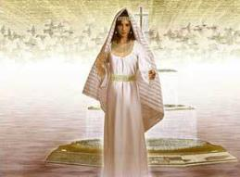
Revelation 19:8
“It was given to her to clothe herself in fine linen, bright and clean; for the fine linen is the righteous acts of the saints.”

Slide 30
When?
After the Rapture
Rewards are associated with the day of the Lord’s coming for the church (1 Cor. 4:5; 2 Tim. 4:8)
Bride is already rewarded (Rev. 19:8)

Slide 31
Six Questions
When?
Where?
Who?
Why?
What?
How?
Outline adapted from Mark Hitchcock, The End: A Complete Overview of Bible Prophecy and the End of Days (Carol Stream, IL: Tyndale, 2012), 207-17.

Slide 32
Where?
In heaven
1 Thess. 4:17

Slide 33
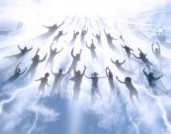
1 Thessalonians 4:17
“Then we who are alive and remain will be caught up together with them in the clouds to meet the Lord in the air, and so we shall always be with the Lord.”

Slide 35
Six Questions
When?
Where?
Who?
Why?
What?
How?
Outline adapted from Mark Hitchcock, The End: A Complete Overview of Bible Prophecy and the End of Days (Carol Stream, IL: Tyndale, 2012), 207-17.

Slide 36
Who?
Church Age believers
2 Cor. 5:10

Slide 37
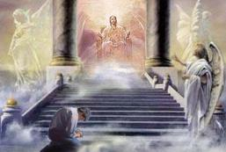
2 Corinthians 5:10
“For we must all appear before the judgment seat of Christ, so that each one may be recompensed for his deeds in the body, according to what he has done, whether good or bad.”

Slide 38
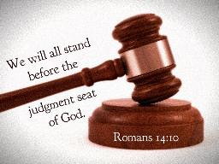
Romans 14:10, 12
“¹⁰…For we will all stand before the judgment seat of God…¹² So then each one of us will give an account of himself to God.”

Slide 39
Six Questions
When?
Where?
Who?
Why?
What?
How?
Outline adapted from Mark Hitchcock, The End: A Complete Overview of Bible Prophecy and the End of Days (Carol Stream, IL: Tyndale, 2012), 207-17.

Slide 40
Why?
Not to judge sin (John 19:30)
Not to determine salvation (John 5:24)
But rather to give or not give rewards

Slide 41
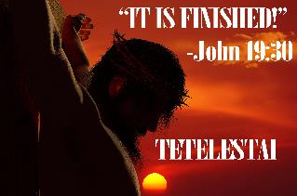
John 19:30
“Therefore when Jesus had received the sour wine, He said, ‘It is finished!’ And He bowed His head and gave up His spirit.”

Slide 42
Why?
Not to judge sin (John 19:30)
Not to determine salvation (John 5:24)
But rather to give or not give rewards

Slide 43
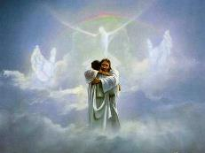
John 5:24
“Truly, truly, I say to you, he who hears My word, and believes Him who sent Me, has eternal life, and does not come into judgment, but has passed out of death into life.”

Slide 44
Why?
Not to judge sin (John 19:30)
Not to determine salvation (John 5:24)
But rather to give or not give rewards

Slide 45
Scripture’s Four Judgments
Name | Sheep and Goat | Judgment of the Jews | Bema Seat | Great White Throne
Scripture | Matt 25:31-46 | Ezek 20:33-44 | 1 Cor 3:10-15 | Rev 20:11-15
Place | Earth, Jerusalem | Earth, wilderness | Heaven | Earth
Audience | Gentile Tribulation survivors | Jewish Tribulation survivors | Church Age believers | All unsaved
When | After Tribulation | After Tribulation | After rapture | After Millennium
Purpose | Saved Gentiles enter kingdom | Saved Jews enter kingdom | Reward believers | Degree of punishment in hell
Evaluation | Treatment of Christ’s brethren | Passing under shepherd’s rod | Works taken through fire | Not in the book; judged by books

Slide 46
Scripture’s Five Crowns (Rev 4:10: 3:11; 2 John 8)
Scripture | Crown | Purpose
1 Cor. 9:24-27 | Incorruptible | Gaining mastery over the flesh
1 Thess. 2:19-20 | Rejoicing | Soul winning
Jas. 1:12; Rev. 2:10 | Life | Enduring trials
1 Pet. 5:2-4 | Glory | Shepherding God’s people
2 Tim. 4:8 | Righteousness | Longing for His appearing

Slide 47
Six Questions
When?
Where?
Who?
Why?
What?
How?
Outline adapted from Mark Hitchcock, The End: A Complete Overview of Bible Prophecy and the End of Days (Carol Stream, IL: Tyndale, 2012), 207-17.

Slide 48
What?
Athletic contest (1 Cor 9:24-27)
Steward (1 Cor 4:2)
Building (1 Cor 3:10-15)

Slide 49
What?
Athletic contest (1 Cor 9:24-27)
Steward (1 Cor 4:2)
Building (1 Cor 3:10-15)

Slide 50
1 Corinthians 9:24-27
“Do you not know that those who run in a race all run, but only one receives the prize? Run in such a way that you may win. ²⁵ Everyone who competes in the games exercises self-control in all things. They then do it to receive a perishable wreath, but we an imperishable. ²⁶ Therefore I run in such a way, as not without aim; I box in such a way, as not beating the air; ²⁷ but I discipline my body and make it my slave, so that, after I have preached to others, I myself will not be disqualified.”

Slide 51
What?
Athletic contest (1 Cor 9:24-27)
Steward (1 Cor 4:2)
Building (1 Cor 3:10-15)

Slide 52

1 Corinthians 4:2
“In this case, moreover, it is required of stewards that one be found trustworthy.”

Slide 53
What?
Athletic contest (1 Cor 9:24-27)
Steward (1 Cor 4:2)
Building (1 Cor 3:10-15)

Slide 54
1 Corinthians 3:10-15
“¹⁰ According to the grace of God which was given to me, like a wise master builder I laid a foundation, and another is building on it. But each man must be careful how he builds on it. ¹¹ For no man can lay a foundation other than the one which is laid, which is Jesus Christ. ¹² Now if any man builds on the foundation with gold, silver, precious stones, wood, hay, straw…”

Slide 55
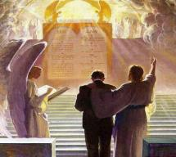
1 Corinthians 3:10-15
“¹⁴ If any man’s work which he has built on it remains, he will receive a reward. ¹⁵ If any man’s work is burned up, he will suffer loss; but he himself will be saved, yet so as through fire.”

Slide 56

Samuel Hoyt
“The Judgment Seat of Christ in Theological Perspective,” Part 2, Bibliotheca Sacra, electronic media.
“The judgment seat of Christ might be compared to a commencement ceremony. At graduation there is some measure of disappointment and remorse that one did not do better and work harder. However, at such an event the overwhelming emotion is joy, not remorse. The graduates do not leave the auditorium weeping because they did not earn better grades. Rather, they are thankful that they have been graduated, and they are grateful for what they did achieve. To overdo the sorrow aspect of the judgment seat of Christ is to make heaven hell. To under do the sorrow aspect is to make faithfulness inconsequential” (underlining mine).

Slide 57
Six Questions
When?
Where?
Who?
Why?
What?
How?
Outline adapted from Mark Hitchcock, The End: A Complete Overview of Bible Prophecy and the End of Days (Carol Stream, IL: Tyndale, 2012), 207-17.

Slide 58
How?
Individually (Rom 14:12)
Stewardship over time, talent, treasure (1 Cor 4:2)
Motivation (1 Cor 4:5)
Reliance upon divine grace or human enablement (John 15:1-8)

Slide 59
How?
Individually (Rom 14:12)
Stewardship over time, talent, treasure (1 Cor 4:2)
Motivation (1 Cor 4:5)
Reliance upon divine grace or human enablement (John 15:1-8)

Slide 60
2 Corinthians 5:10
“For we must all appear before the judgment seat of Christ, so that each one may be recompensed for his deeds in the body, according to what he has done, whether good or bad.”

Slide 61
Romans 14:10, 12
“¹⁰…For we will all stand before the judgment seat of God…¹² So then each one of us will give an account of himself to God.”

Slide 62
How?
Individually (Rom 14:12)
Stewardship over time, talent, treasure (1 Cor 4:2)
Motivation (1 Cor 4:5)
Reliance upon divine grace or human enablement (John 15:1-8)

Slide 63
1 Corinthians 4:2
“In this case, moreover, it is required of stewards that one be found trustworthy.”

Slide 64
How?
Individually (Rom 14:12)
Stewardship over time, talent, treasure (1 Cor 4:2)
Motivation (1 Cor 4:5)
Reliance upon divine grace or human enablement (John 15:1-8)

Slide 65
1 Corinthians 4:5
“Therefore do not go on passing judgment before the time, but wait until the Lord comes who will both bring to light the things hidden in the darkness and disclose the motives of men’s hearts; and then each man’s praise will come to him from God.”

Slide 66
How?
Individually (Rom 14:12)
Stewardship over time, talent, treasure (1 Cor 4:2)
Motivation (1 Cor 4:5)
Reliance upon divine grace or human enablement (John 15:1-8)

Slide 67

Galatians 3:3
“Are you so foolish? Having begun by the Spirit, are you now being perfected by the flesh?”

Slide 68
Conclusion

Slide 69
Six Questions
When?
Where?
Who?
Why?
What?
How?
Outline adapted from Mark Hitchcock, The End: A Complete Overview of Bible Prophecy and the End of Days (Carol Stream, IL: Tyndale, 2012), 207-17.

Slide 70

“The Lord bless you and keep you; the Lord make his face shine on you and be gracious to you; the Lord turn his face toward you and give you peace.” (NIV)

