Slide 1
THE BOOK OF DANIEL
Dr. Andy Woods

Slide 2
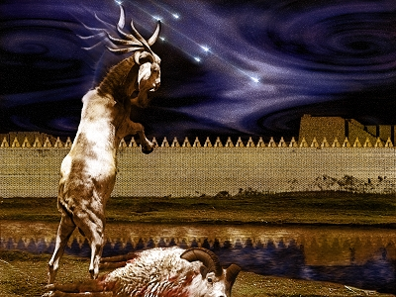
DANIEL 10-12 THE FINAL VISION

Slide 3
CHAPTER AND VERSE IN DANIEL | CHRONOLOGICAL DATE | BIBLICAL DATE
1:1 | 605 | 3rd year of Jehoiakim
2:1 | 603 | 2nd year of Nebuchadnezzar
5 | Sat. night 10/12/539 (Hoehner)
7:1 | 553 | 1st year of Belshazzar
8:1 | 551 | 3rd year of Belshazzar
9:1 | 538 | 1st year of Darius
10:1 | 536 | 3rd year of Cyrus

Slide 4
Chapter 10–12 Outline
The Setting (10:1-3)
Arrival of the Heavenly Messenger (10:4-9)
Explanation of the Heavenly Messenger (10:10–11:1)
The Prophecy of the Heavenly Messenger (11:2–12:13)

Slide 5
IV. The Prophecy of the Heavenly Messenger (11:2–12:13)
Persia (11:2)
Greece (11:3-4)
Ptolemies & Seleucids (11:5-20)
Antiochus IV (11:21-35)
Antichrist (11:36-45)
Tribulation & Millennium (12:1-13)

Slide 6
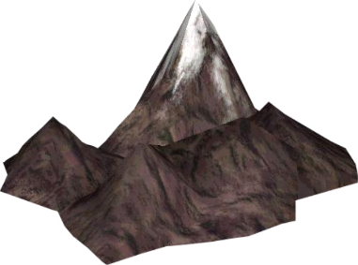
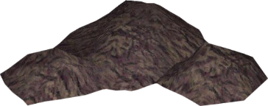
Understanding Daniel’s
Prophetic Perspective
Antichrist
Antiochus IV
(Daniel 11:36-45)
(Daniel 11:21-35)
Far
Fulfillment
Near
Fulfillment
Daniel

Slide 7
IV. The Prophecy of the Heavenly Messenger (11:2–12:13)
Persia (11:2)
Greece (11:3-4)
Ptolemies & Seleucids (11:5-20)
Antiochus IV (11:21-35)
Antichrist (11:36-45)
Tribulation & Millennium (12:1-13)

Slide 8
IV. The Prophecy of the Heavenly Messenger (11:2–12:13)
Persia (11:2)
Greece (11:3-4)
Ptolemies & Seleucids (11:5-20)
Antiochus IV (11:21-35)
Antichrist (11:36-45)
Tribulation & Millennium (12:1-13)

Slide 9
The Tribulation & Millennium Daniel 12:1-13
Description of the End Times (1-4)
The Suffering (1)
The Separation (2)
The Shining (3)
The Sealing (4)
Harold Wilmington, The Outline Bible, pp. 418-19

Slide 10
The Tribulation & Millennium Daniel 12:1-13
Duration of the End Times (5-13)
Round 1 (5-7)
Question (5-6)
Answer (7)
Round 2 (8-13)
Question (8)
Answer (9-13)
Harold Wilmington, The Outline Bible, pp. 418-19

Slide 11
I. Description of the End Times Daniel 12:1-4
The Suffering (1)
The Prince (1a)
The Pain (1b)
The Perseverance (1c)
The Separation (2)
The Shining (3)
The Sealing (4)
Harold Wilmington, The Outline Bible, pp. 418-19

Slide 12
I. Description of the End Times Daniel 12:1-4
The Suffering (1)
The Prince (1a)
The Pain (1b)
The Perseverance (1c)
The Separation (2)
The Shining (3)
The Sealing (4)
Harold Wilmington, The Outline Bible, pp. 418-19

Slide 13
I. Description of the End Times Daniel 12:1-4
The Suffering (1)
The Prince (1a)
The Pain (1b)
The Perseverance (1c)
The Separation (2)
The Shining (3)
The Sealing (4)
Harold Wilmington, The Outline Bible, pp. 418-19

Slide 14
I. Description of the End Times Daniel 12:1-4
The Suffering (1)
The Prince (1a)
The Pain (1b)
The Perseverance (1c)
The Separation (2)
The Shining (3)
The Sealing (4)
Harold Wilmington, The Outline Bible, pp. 418-19

Slide 16
I. Description of the End Times Daniel 12:1-4
The Suffering (1)
The Prince (1a)
The Pain (1b)
The Perseverance (1c)
The Separation (2)
The Shining (3)
The Sealing (4)
Harold Wilmington, The Outline Bible, pp. 418-19

Slide 17
I. Description of the End Times Daniel 12:1-4
The Suffering (1)
The Prince (1a)
The Pain (1b)
The Perseverance (1c)
The Separation (2)
The Shining (3)
The Sealing (4)
Harold Wilmington, The Outline Bible, pp. 418-19

Slide 18
Revelation 20:4-6
“⁴ Then I saw thrones, and they sat on them, and judgment was given to them. And I saw the souls of those who had been beheaded because of their testimony of Jesus and because of the word of God, and those who had not worshiped the beast or his image, and had not received the mark on their forehead and on their hand; and they came to life [zaō] and reigned with Christ for a thousand years….

Slide 19
Revelation 20:4-6
…⁵ The rest of the dead did not come to life [zaō] until the thousand years were completed. This is the first resurrection [anastasis]. ⁶ Blessed and holy is the one who has a part in the first resurrection [anastasis]; over these the second death has no power, but they will be priests of God and of Christ and will reign with Him for a thousand years.”

Slide 21
Isaiah 9:6-7
⁶ For a child will be born to us, a son will be given to us; And the government will rest on His shoulders; And His name will be called Wonderful Counselor, Mighty God, Eternal Father, Prince of Peace.⁷ There will be no end to the increase of His government or of peace, On the throne of David and over his kingdom, To establish it and to uphold it with justice and righteousness From then on and forevermore. The zeal of the Lord of hosts will accomplish this.

Slide 22
Daniel 12:2
“Many of those who sleep in the dust of the ground will awake, these to everlasting (olam) life, but the others to disgrace and everlasting (olam) contempt.”

Slide 23
Psalm 90:2
“Before the mountains were born Or You gave birth to the earth and the world, Even from everlasting (olam) to everlasting (olam), You are God.”

Slide 24
Matthew 25:46
“These will go away into eternal (aiōnios) punishment (kolasis), but the righteous into eternal life.

Slide 25
Dr. Alan W. Gomes (Summer 1991). “Evangelicals and the Annihilation of Hell” (Part 2). In the Christian Research Journal. Page 11.
“A punishment [such as torment] that is not felt is not a punishment. It is an odd use of language to speak of an insensate state (i.e., unfeeling), an inanimate object receiving punishment. To say, ‘I punished my car for not starting by slowly plucking out it’s spark plug wires, one by one,’ would invoke laughter, not serious consideration.”

Slide 26
Matthew 25:46
“These will go away into eternal (aiōnios) punishment, but the righteous into eternal (aiōnios) life.

Slide 27
Romans 16:26
“but now is manifested, and by the Scriptures of the prophets, according to the commandment of the eternal (aiōnios) God, has been made known to all the nations, leading to obedience of faith

Slide 28
Revelation 14:11
“And the smoke of their torment goes up forever (aiōn) and ever (aiōn); they have no rest day and night, those who worship the beast and his image, and whoever receives the mark of his name.”

Slide 29
Revelation 20:10
“And the devil who deceived them was thrown into the lake of fire and brimstone, where the beast and the false prophet are also; and they will be tormented day and night forever (aiōn) and ever (aiōn).”

Slide 30
Dominoes in a Row

Slide 31
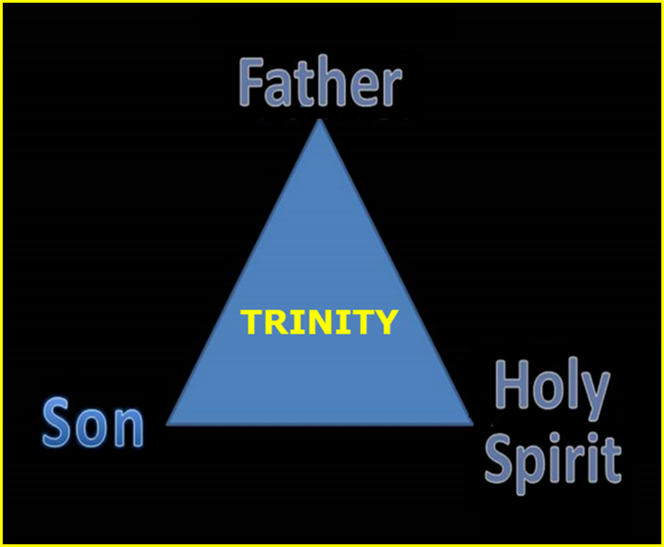

Slide 32
1 Corinthians 15:20-23
“²⁰-But now Christ has been raised from the dead, the first fruits of those who are asleep. ²¹-For since by a man came death, by a man also came the resurrection of the dead. ²²-For as in Adam all die, so also in Christ all will be made alive. ²³-But each in his own order: Christ the first fruits, after that those who are Christ’s at His coming.”

Slide 33
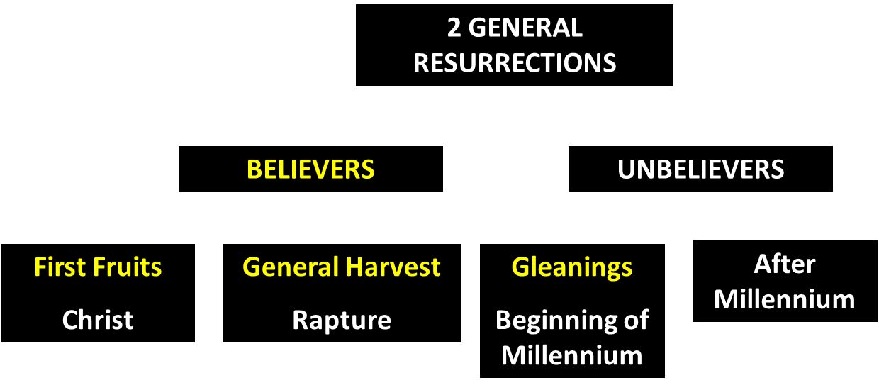
God’s Resurrection Program

Slide 35
Revelation 20:4-6
“⁴ Then I saw thrones, and they sat on them, and judgment was given to them. And I saw the souls of those who had been beheaded because of their testimony of Jesus and because of the word of God, and those who had not worshiped the beast or his image, and had not received the mark on their forehead and on their hand; and they came to life [zaō] and reigned with Christ for a thousand years….

Slide 36
Revelation 20:4-6
…⁵ The rest of the dead did not come to life [zaō] until the thousand years were completed. This is the first resurrection [anastasis]. ⁶ Blessed and holy is the one who has a part in the first resurrection [anastasis]; over these the second death has no power, but they will be priests of God and of Christ and will reign with Him for a thousand years.”

Slide 38
1 Corinthians 15:20-23
“²⁰-But now Christ has been raised from the dead, the first fruits of those who are asleep. ²¹-For since by a man came death, by a man also came the resurrection of the dead. ²²-For as in Adam all die, so also in Christ all will be made alive. ²³-But each in his own order (tagma): Christ the first fruits, after that those who are Christ’s at His coming.”

Slide 39
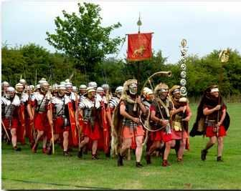
Order or Tagma (1 Cor. 15:23)
General – Christ’s resurrection (1 Cor 15:23)
Officer – Rapture (1 Thess 4:13-18)
Soldiers – OT saints & Tribulation martyrs (Rev 20:4)
Captives – Unsaved of all ages (Rev 20:5)

Slide 41
I. Description of the End Times Daniel 12:1-4
The Suffering (1)
The Prince (1a)
The Pain (1b)
The Perseverance (1c)
The Separation (2)
The Shining (3)
The Sealing (4)
Harold Wilmington, The Outline Bible, pp. 418-19

Slide 42
I. Description of the End Times Daniel 12:1-4
The Suffering (1)
The Prince (1a)
The Pain (1b)
The Perseverance (1c)
The Separation (2)
The Shining (3)
The Sealing (4)
Harold Wilmington, The Outline Bible, pp. 418-19

Slide 43
Conclusion

Slide 44
I. Description of the End Times Daniel 12:1-4
The Suffering (1)
The Prince (1a)
The Pain (1b)
The Perseverance (1c)
The Separation (2)
The Shining (3)
The Sealing (4)
Harold Wilmington, The Outline Bible, pp. 418-19

Slide 45
Chapter 10–12 Outline
The Setting (10:1-3)
Arrival of the Heavenly Messenger (10:4-9)
Explanation of the Heavenly Messenger (10:10–11:1)
The Prophecy of the Heavenly Messenger (11:2–12:13)

Slide 46
IV. The Prophecy of the Heavenly Messenger (11:2–12:13)
Persia (11:2)
Greece (11:3-4)
Ptolemies & Seleucids (11:5-20)
Antiochus IV (11:21-35)
Antichrist (11:36-45)
Tribulation & Millennium (12:1-13)

Slide 47
Purpose
To encourage Judah by emphasizing the sovereignty of God during the Babylonian captivity and to teach Judah how to live while outside the land

Slide 48
“The Lord bless you and keep you; the Lord make his face shine on you and be gracious to you; the Lord turn his face toward you and give you peace.” (NIV)

