Slide 1


Slide 2

The Coming Kingdom
Chapter 15
Dr. Andy Woods
Senior Pastor – Sugar Land Bible Church
President – Chafer Theological Seminary

Slide 3

Kingdom Study Outline
What does the Bible Say About the Kingdom?
The Main Problem with Kingdom Now NT interpretations
Why do some believe that we are in the kingdom now?
Why does it matter?

Slide 4
1. Kingdom Throughout the Bible
Eden Abrahamic Covenant Mosaic Covenant Divided Kingdom Times of the Gentiles | Old Testament Prophets Post exile Offer of the King / Kingdom Rejection of the Offer Interim Age

Slide 5
1. Kingdom Throughout the Bible
Kingdom Mysteries Church Israel’s Discipline & Restoration Re-offer of the King/Kingdom | Transfer of Kingdom Authority Kingdom Establishment Eternal State Testimony of Early Church History

Slide 6
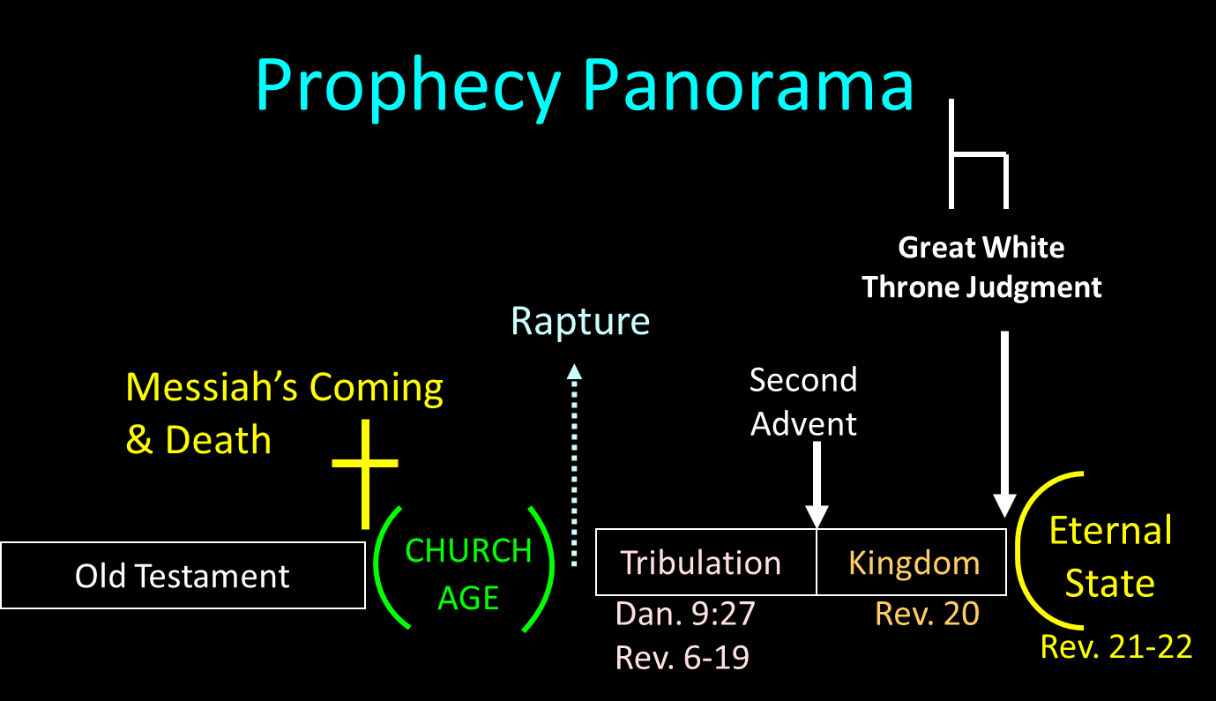

Slide 7

The Eternal State
Rev. 21-22
After Theocratic Administrator Restoration
New Creation & Not Renovation
Eternal State’s Literal Nature
Continuation of the Davidic Throne
Eternal State’s Description

Slide 8
The Eternal State
Rev. 21-22
After Theocratic Administrator Restoration
New Creation & Not Renovation
Eternal State’s Literal Nature
Continuation of the Davidic Throne
Eternal State’s Description

Slide 9
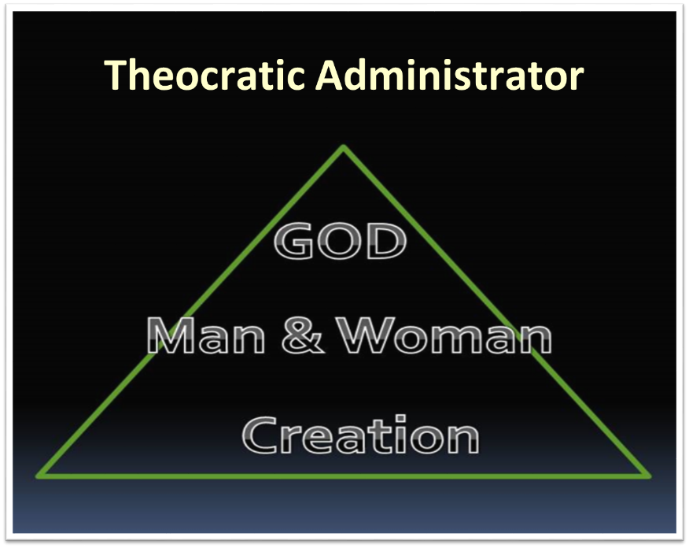

Slide 10
The Eternal State
Rev. 21-22
After Theocratic Administrator Restoration
New Creation & Not Renovation
Eternal State’s Literal Nature
Continuation of the Davidic Throne
Eternal State’s Description

Slide 11
2. New Creation & Not Renovation
Sin’s contamination of the present world
Peter’s description (2 Peter 3:7, 10-11, 13)
Topographical changes
apérchomai (Rev. 21:1, 4)
Analogy with the flood?

Slide 12
The Eternal State
Rev. 21-22
After Theocratic Administrator Restoration
New Creation & Not Renovation
Eternal State’s Literal Nature
Continuation of the Davidic Throne
Eternal State’s Description

Slide 13
3. The Eternal State’s Literal Nature
“river” | (22:1) | “seventy-two yards” | (21:17)
“city,” “Jerusalem” | (21:2) | “gold,” “jasper,” “glass,” “wall” | (21:18)
“high” | (21:12) | “pearls” | (21:21)
“gates” | (21:12) | “street” | (21:21)
“tribes” | (21:12) | “tree of life” | (22:2)
“foundations,” “apostles” | (21:14) | “fruit,” “month,” “nations,” “leaves” | (22:2)
“square,” “miles” | (21:16)

Slide 14
The Eternal State
Rev. 21-22
After Theocratic Administrator Restoration
New Creation & Not Renovation
Eternal State’s Literal Nature
Continuation of the Davidic Throne
Eternal State’s Description

Slide 15

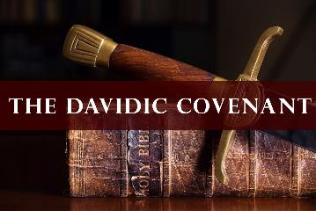
2 Samuel 7:16
Your house and your kingdom shall endure before Me forever; your throne shall be established forever.”

Slide 16
Revelation 3:21
“He who overcomes, I will grant to him to sit down with Me on My throne, as I also overcame and sat down with My Father on His throne.”

Slide 17
Revelation 22:3
“There will no longer be any curse; and the throne of God and of the Lamb will be in it, and His bond-servants will serve Him.”

Slide 18
The Eternal State
Rev. 21-22
After Theocratic Administrator Restoration
New Creation & Not Renovation
Eternal State’s Literal Nature
Continuation of the Davidic Throne
Eternal State’s Description

Slide 19

5. Eternal State’s Description
Different than the Millennial Kingdom
Significance of the Eternal State
Things absent from the Eternal State
Things present in the Eternal State
Life in the Eternal State
Admission into the Eternal State

Slide 20
5. Eternal State’s Description
Different than the Millennial Kingdom
Significance of the Eternal State
Things absent from the Eternal State
Things present in the Eternal State
Life in the Eternal State
Admission into the Eternal State

Slide 21
Millennium Rev.20 | Eternal State Rev.21-22
Sin restrained | Sin removed
Curse restrained | Curse removed
Death | No death
Mortals / resurrected | Resurrected only
Destinies undecided | Destinies sealed
Renovation | Recreation
Temporary | Eternal
Transitional | Non-transitional

Slide 22
Millennium and Eternal State
 | Rev 20:1-10 | Rev 21–22
Time | 20:4 | 22:5
Luminaries | Isa 30:26 | 21:23; 22:5
Temple | Ezek 40–48 | 21:22
Death | Isa 65:20 | 21:4
Satanic activity | 20:7 | 20:10
Rebellion | 20:8-9 | 21:27

Slide 23
5. Eternal State’s Description
Different than the Millennial Kingdom
Significance of the Eternal State
Things absent from the Eternal State
Things present in the Eternal State
Life in the Eternal State
Admission into the Eternal State

Slide 24
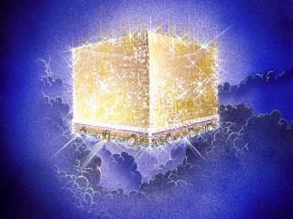
B. What Is Its Theological Significance?
A reminder that evil is finite
Not a dispensation
Greater than the millennial kingdom
Notes:
Outline

Slide 25
B. What Is Its Theological Significance?
A reminder that evil is finite
Not a dispensation
Greater than the millennial kingdom
Notes:
Outline

Slide 26
B. What Is Its Theological Significance?
A reminder that evil is finite
Not a dispensation
Greater than the millennial kingdom
Notes:
Outline

Slide 27
Eden = Probationary Environment
Eden (Genesis 1-2) | Eternal State (Rev 21-22)
Division: light/darkness 1:4 | No night 21:25
Division: land/sea 1:10 | No sea 21:1
Sun & moon 1:16 | No sun & moon 21:23
Garden 2:8-9 | City (21:2)
River flowing out of Eden 2:10 | River flowing from throne 22:1
Gold in the land 2:12 | Gold in the city 21:21
Tree of life in the middle of garden 2:9 | Tree of life throughout city 22:2
Bdellium and onyx stone 2:12 | All manner of stones 21:19
God walking in the garden 3:8 | God dwelling with His people 21:3
Henry Morris, Genesis Record, p.33

Slide 28
B. What Is Its Theological Significance?
A reminder that evil is finite
Not a dispensation
Greater than the millennial kingdom
Notes:
Outline

Slide 30

OT PROPHETS DESCRIBE THE KINGDOM
Established by God (Dan. 2:44)
Eternal (Dan. 7:27)
Christ’s direct rule (Zech. 9:9-10)
Earthly (Zech. 14:9)
Land promises realized (Gen. 15:18-21)
Israel’s preeminence (Isa. 49:22-23)
Millennial Temple (Ezek. 40‒46)

Slide 31
OT PROPHETS DESCRIBE THE KINGDOM
Millennial David (Jer. 30:9)
Righteousness (Isa. 9:6-7)
Curse curtailed (Isa. 65:20, 22)
Peace (Isa. 2:4)
Prosperity (Amos 9:13-14; Isa 65:22)
Topographical changes (Ezek. 47:1-12)
Immediate answers to prayer (Isa. 65:24)

Slide 32
5. Eternal State’s Description
Different than the Millennial Kingdom
Significance of the Eternal State
Things absent from the Eternal State
Things present in the Eternal State
Life in the Eternal State
Admission into the Eternal State

Slide 33
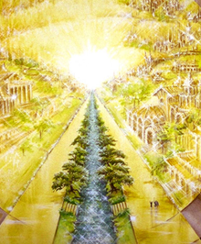
Absent from the Eternal State
No Satan (Rev 20:10)
No sea (Rev 21:1)
No death, crying, or pain (Rev 21:4)
No Sun (Rev 22:5)
No Moon (Rev 21:23)
No temple (Rev. 21:22)
No night (Rev 21:25)
No evil (Rev 21:27)
No curse (Rev 22:3)

Slide 34

Satan’s Progressive Defeat
Initial eviction from heaven (Isa 14:12-15; Ezek 28:12-17)
Eden (Gen 3:15)
Pre-diluvian world (1 Pet 3:19-20)
Cross (John 12:31; 16:11; Col 2:15; Heb 2:14; 1 John 3:8)
Mid point of the Tribulation (Rev 12:9)
Beginning of millennium (Rev 20:2-3)
End of millennium (Rev 20:10)

Slide 35

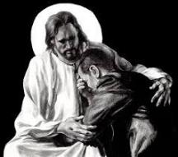
Revelation 21:4
“and He will wipe away every tear from their eyes; and there will no longer be any death; there will no longer be any mourning, or crying, or pain; the first things have passed away.”

Slide 36
Revelation 21:4
“and He will wipe away every tear from their eyes; and there will no longer be any death; there will no longer be any mourning, or crying, or pain; the first things have passed away.”

Slide 37
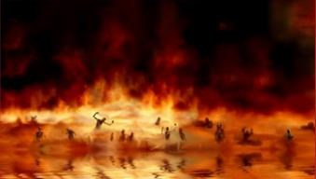
Revelation 21:8
“But for the cowardly and unbelieving and abominable and murderers and immoral persons and sorcerers and idolaters and all liars, their part will be in the lake that burns with fire and brimstone, which is the second death.”

Slide 38
Revelation 21:8
“But for the cowardly and unbelieving and abominable and murderers and immoral persons and sorcerers and idolaters and all liars, their part will be in the lake that burns with fire and brimstone, which is the second death.”

Slide 39
5. Eternal State’s Description
Different than the Millennial Kingdom
Significance of the Eternal State
Things absent from the Eternal State
Things present in the Eternal State
Life in the Eternal State
Admission into the Eternal State

Slide 40

D. What Will Be Present In It?
God’s presence (Rev. 21:23)
God’s glory (Rev. 21:23)
God’s holiness (Rev. 21:27)
God’s people (Heb. 12:22-23)
God’s city (Rev. 21:2)
Notes:
Outline

Slide 41
D. What Will Be Present In It?
God’s presence (Rev. 21:23)
God’s glory (Rev. 21:23)
God’s holiness (Rev. 21:27)
God’s people (Heb. 12:22-23)
God’s city (Rev. 21:2)
Notes:
Outline

Slide 42
Hebrews 12:22-23
²² “But you have come to Mount Zion and to the city of the living God, the heavenly Jerusalem, and to myriads of angels, ²³ to the general assembly and church of the firstborn who are enrolled in heaven, and to God, the Judge of all, and to the spirits of the righteous made perfect.”

Slide 43
Hebrews 12:22-23
²² “But you have come to Mount Zion and to the city of the living God, the heavenly Jerusalem, and to myriads of angels, ²³ to the general assembly and church of the firstborn who are enrolled in heaven, and to God, the Judge of all, and to the spirits of the righteous made perfect.”

Slide 44
D. What Will Be Present In It?
God’s presence (Rev. 21:23)
God’s glory (Rev. 21:23)
God’s holiness (Rev. 21:27)
God’s people (Heb. 12:22-23)
God’s city (Rev. 21:2)
Notes:
Outline

Slide 45
5. God’s City
Its existence (Rev 21:2)
Its name (Rev 21:2)
Its dimensions (Rev. 21:16)
Its wall (Rev 21:12, 16-17)
Its gates (Rev 21:12)
Its foundation stones (Rev. 21:14)

Slide 46
5. God’s City
Its existence (Rev 21:2)
Its name (Rev 21:2)
Its dimensions (Rev. 21:16)
Its wall (Rev 21:12, 16-17)
Its gates (Rev 21:12)
Its foundation stones (Rev. 21:14)

Slide 47
Jerusalem Descending
Notes:
The descending city is described as being like a stone called Jasper, only unlike the earthly stone, this one is clear as crystal. The ultimate state of heaven sounds more like a diamond, doesn’t it?

Slide 48
5. God’s City
Its existence (Rev 21:2)
Its name (Rev 21:2)
Its dimensions (Rev. 21:16)
Its wall (Rev 21:12, 16-17)
Its gates (Rev 21:12)
Its foundation stones (Rev. 21:14)

Slide 49
5. God’s City
Its existence (Rev 21:2)
Its name (Rev 21:2)
Its dimensions (Rev. 21:16)
Its wall (Rev 21:12, 16-17)
Its gates (Rev 21:12)
Its foundation stones (Rev. 21:14)

Slide 50
Revelation 21
¹⁶ The city was laid out like a square, as long as it was wide. He measured the city with the rod and found it to be [1500 miles] in length, and as wide and high as it is long. ¹⁷ He measured its wall and it was 144 cubits thick, by man's measurement, which the angel was using.
Notes:
READ…

Slide 51
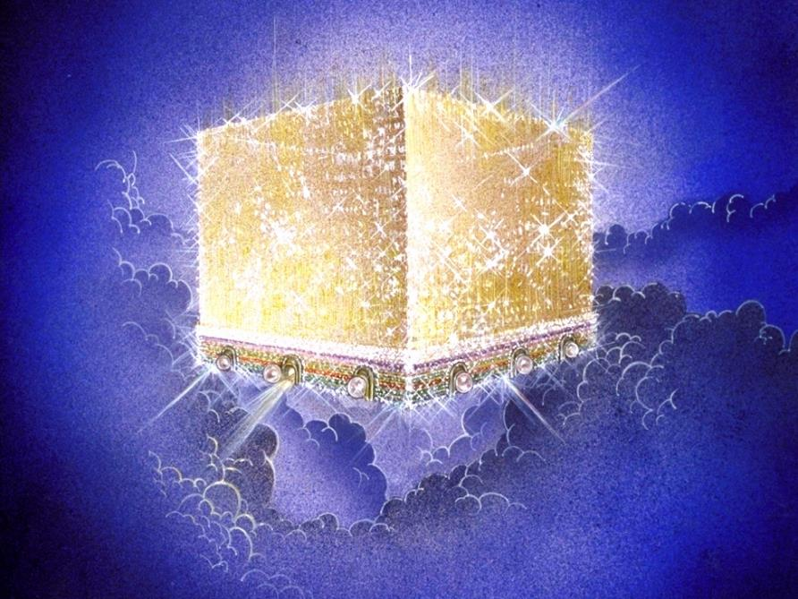
Notes:
Every city needs light. God, the ultimate source of power, illumines the city from his glory. Have you ever taken time to look at a sunset just after it has rained? As the sun sets, there is a kind of a glow cast on everything. It captures the spirit. This is just a little foretaste of the glory and splendor of heaven.

Slide 52
The New Jerusalem

Slide 53
Paul Lee Tan
Cited in, The Interpretation of Prophecy (Winona Lake, IN: BMH, 1974), 285-86.
    Swete: “Such dimensions defy imagination and are permissible only in the language of symbolism.”
    Barnes: “Of course, this must preclude all idea of there being such a city literally in Palestine…this cannot be understood literally; and the very idea of a literal fulfillment of this shows the absurdity of that method of interpretation…this cannot be taken literally; and an attempt to explain all of this literally would show that that method of interpreting the Apocalypse is impracticable.”

Slide 54
Paul Lee Tan
Cited in, The Interpretation of Prophecy (Winona Lake, IN: BMH, 1974), 285-86.
    Grant: “no clearer proof…that all is figurative. Such a height is simply out of harmony with the constitution of our world.”
    Boettner: “Neither the shape nor the dimensions of the city can be taken with mathematical exactness, as if it were a gigantic apartment house.”

Slide 55
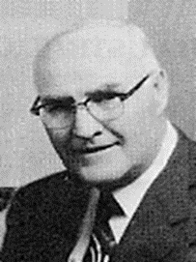
“When the plain sense of Scripture makes common sense, seek no other sense; therefore, take every word at its primary, ordinary, usual, literal meaning unless the facts of the immediate context, studied in light of related passages and axiomatic and fundamental truths, indicate clearly otherwise.”
David L. Cooper
The World’s Greatest Library Graphically Illustrated (Los Angeles: Biblical Research Society, 1970), 11.

Slide 56
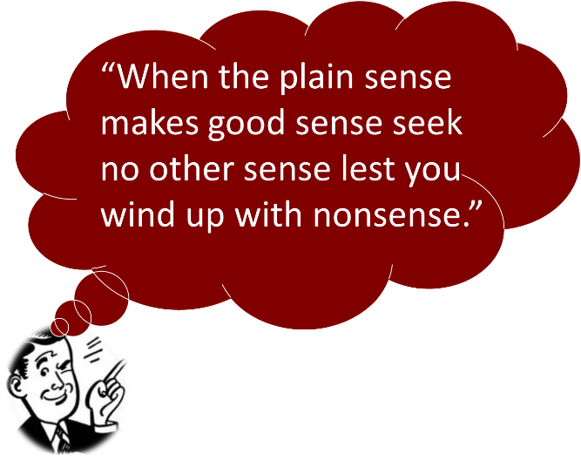

Slide 57
“He (or she) who spiritualizes tells spiritual lies.”

Slide 58
5. God’s City
Its existence (Rev 21:2)
Its name (Rev 21:2)
Its dimensions (Rev. 21:16)
Its wall (Rev 21:12, 16-17)
Its gates (Rev 21:12)
Its foundation stones (Rev. 21:14)

Slide 59
Revelation 21
¹⁶ The city was laid out like a square, as long as it was wide. He measured the city with the rod and found it to be [1500 miles] in length, and as wide and high as it is long. ¹⁷ He measured its wall and it was 144 cubits thick, by man's measurement, which the angel was using.
Notes:
READ…

Slide 60
5. God’s City
Its existence (Rev 21:2)
Its name (Rev 21:2)
Its dimensions (Rev. 21:16)
Its wall (Rev 21:12, 16-17)
Its gates (Rev 21:12)
Its foundation stones (Rev. 21:14)

Slide 61
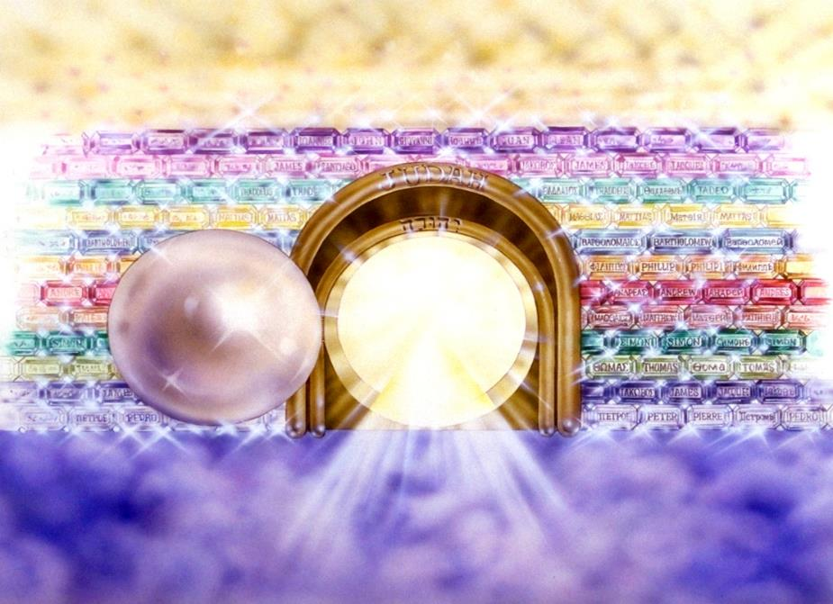
Notes:
Here you see an artist’s ideas of…
12 Gates = 12 Tribes of Israel
12 Foundation Stones = 12 Apostles of the Church

Slide 62
Notes:
Every city needs light. God, the ultimate source of power, illumines the city from his glory. Have you ever taken time to look at a sunset just after it has rained? As the sun sets, there is a kind of a glow cast on everything. It captures the spirit. This is just a little foretaste of the glory and splendor of heaven.

Slide 63
5. God’s City
Its existence (Rev 21:2)
Its name (Rev 21:2)
Its dimensions (Rev. 21:16)
Its wall (Rev 21:12, 16-17)
Its gates (Rev 21:12)
Its foundation stones (Rev. 21:14)

Slide 64
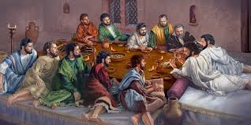
Ephesians 2:20
“having been built on the foundation of the apostles and prophets, Christ Jesus Himself being the corner stone.”

Slide 65
5. God’s City
Its influence
Its character (Rev. 21:2)
Its glory (Rev. 21:11)
Its colors (Rev 21:18-21)
Its street (Rev 21:21)
Its water of life (Rev. 22:1)
Its tree of life (Rev. 22:2)

Slide 66
5. God’s City
Its influence
Its character (Rev. 21:2)
Its glory (Rev. 21:11)
Its colors (Rev 21:18-21)
Its street (Rev 21:21)
Its water of life (Rev. 22:1)
Its tree of life (Rev. 22:2)

Slide 67
Notes:
Here you see an artist’s ideas of…
12 Gates = 12 Tribes of Israel
12 Foundation Stones = 12 Apostles of the Church

Slide 68
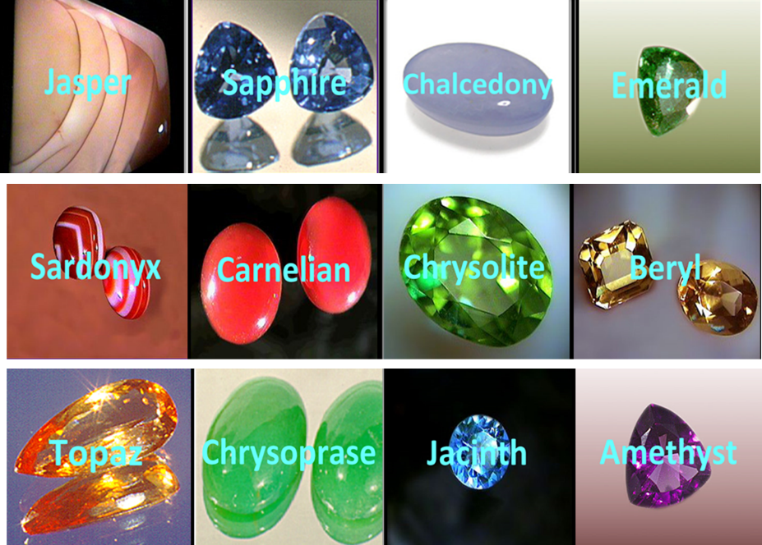

Slide 69
5. God’s City
Its influence
Its character (Rev. 21:2)
Its glory (Rev. 21:11)
Its colors (Rev 21:18-21)
Its street (Rev 21:21)
Its water of life (Rev. 22:1)
Its tree of life (Rev. 22:2)

Slide 70

Notes:
And the streets are made of what? Gold. When a man heard he was about to die, he desperately gathered up his life’s greatest accumulation—gold bars. When he did finally enter heaven, toting the heaven load, one angel poked another angel in the ribs. He said, “Hey, look, that guy brought pavement!”

Slide 71
Notes:
Here you see an artist’s ideas of…
12 Gates = 12 Tribes of Israel
12 Foundation Stones = 12 Apostles of the Church

Slide 72
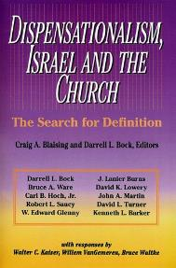
David L. Turner
“The New Jerusalem in Revelation 21:1-22:5; Consummation of a Biblical Continuum,” Dispensationalism, Israel, and the Church, ed., Craig A. Blaising and Darrell L. Bock (Grand Rapids: Zondervan, 1992), 277.
“Perhaps the absence of oysters large enough to produce such pearls and the absence of sufficient gold to pave such a city (viewed literally 1380 miles squared and high) is viewed as sufficient reason not to take these images as fully literal!…the preceding discussion serves to warn against a ‘hyper-literal’ approach to apocalyptic imagery….”

Slide 73
5. Eternal State’s Description
Different than the Millennial Kingdom
Significance of the Eternal State
Things absent from the Eternal State
Things present in the Eternal State
Life in the Eternal State
Admission into the Eternal State

Slide 74
E. What Will Life Be Like In It?
Fellowship (Rev. 21:3)
Service (Rev. 22:3)
Fulfillment (Rev. 22:17)
Satisfaction (Rev. 7:16-17)
Rest (Rev. 14:13)
Knowledge (1 Cor. 13:12)
Notes:
Outline

Slide 75
E. What Will Life Be Like In It?
Fellowship (Rev. 21:3)
Service (Rev. 22:3)
Fulfillment (Rev. 22:17)
Satisfaction (Rev. 7:16-17)
Rest (Rev. 14:13)
Knowledge (1 Cor. 13:12)
Notes:
Outline

Slide 76
Creativity
Notes:
God created us—he is creative! And he made us in his image, to be creative too! Once sin is limited, we will be free to turn to the problems of this world and use our creativity to solve them.
The Millennium is written about a lot in the OT. Consider these passages….

Slide 77
E. What Will Life Be Like In It?
Fellowship (Rev. 21:3)
Service (Rev. 22:3)
Fulfillment (Rev. 22:17)
Satisfaction (Rev. 7:16-17)
Rest (Rev. 14:13)
Knowledge (1 Cor. 13:12)
Notes:
Outline

Slide 78

Joy
Notes:
There will be joy.
And one thing we will do is enjoy God. “The mere words, “enjoyment of God,” makes sense only to those who already enjoy God; the vast majority of us seem to enjoy the vast majority of things vastly more than we enjoy God. –Heaven…Kreeft, p. 52
We miss the fact that it is God who made all things for us to enjoy.

Slide 79
E. What Will Life Be Like In It?
Fellowship (Rev. 21:3)
Service (Rev. 22:3)
Fulfillment (Rev. 22:17)
Satisfaction (Rev. 7:16-17)
Rest (Rev. 14:13)
Knowledge (1 Cor. 13:12)
Notes:
Outline

Slide 80
E. What Will Life Be Like In It?
Fellowship (Rev. 21:3)
Service (Rev. 22:3)
Fulfillment (Rev. 22:17)
Satisfaction (Rev. 7:16-17)
Rest (Rev. 14:13)
Knowledge (1 Cor. 13:12)
Notes:
Outline

Slide 81
Peaceful
Notes:
Imagine a time in your life with genuine peace. That’s one thing we will experience too.

Slide 82
E. What Will Life Be Like In It?
Fellowship (Rev. 21:3)
Service (Rev. 22:3)
Fulfillment (Rev. 22:17)
Satisfaction (Rev. 7:16-17)
Rest (Rev. 14:13)
Knowledge (1 Cor. 13:12)
Notes:
Outline

Slide 83
Heaven
Q: Will we know everything there?
2
E=MC
Notes:
Will we know everything there?
No. Only God knows all. We will grow in our understanding. We will learn of the grace of God—we are trophies of his grace. Perhaps we will share with one another and learn all about one another. Maybe we will scoot all over the universe learning about it, and about God’s great wisdom and power.

Slide 84
E. What Will Life Be Like In It?
Ruling and reigning (Rev. 22:5)
Worship (Rev. 7:11-12)
In a glorified body (1 Cor. 15:42-44)
No consequences of sin (Rev. 22:2)
Eternal (Rev. 22:2, 5)
Notes:
Outline

Slide 85
E. What Will Life Be Like In It?
Ruling and reigning (Rev. 22:5)
Worship (Rev. 7:11-12)
In a glorified body (1 Cor. 15:42-44)
No consequences of sin (Rev. 22:2)
Eternal (Rev. 22:2, 5)
Notes:
Outline

Slide 86
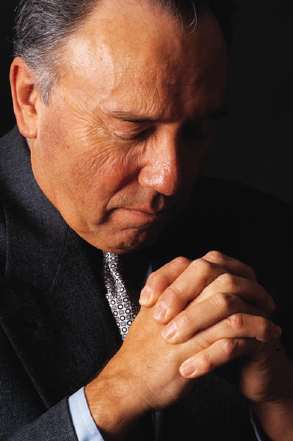

Worship
Notes:
Obviously we will worship. The music at rock concerts is powerful, though it is an acquired taste. Not all of you like it. And they have fog machines. Sometimes there are mirrored globes that make light seem to dance. The music in heaven will be dynamic, and finally everyone there will like the choice of songs! Fire and smoke are symbols of God, so we may see those. However God is present there. That will be the biggest charge. He will make the best shows on earth seem puny by comparison.

Slide 87
E. What Will Life Be Like In It?
Ruling and reigning (Rev. 22:5)
Worship (Rev. 7:11-12)
In a glorified body (1 Cor. 15:42-44)
No consequences of sin (Rev. 22:2)
Eternal (Rev. 22:2, 5)
Notes:
Outline

Slide 88


Heaven
Q: Will we have bodies in Heaven?
or
Notes:
The ancient philosopher Plato taught that thought is good, material is evil. Since bodies are material, they thought bodies were bad. They looked forward to release from evil bodies. The Bible paints a very different picture. God created material. After each creation, he said it was “good.” Likewise he created man and woman. He gave them bodies. Originally his creation was without sin. Bodies are not bad. In fact, God gives us a great deal of joy through them. I can eat a peach, smell a flower and hold my wife’s hand. We will have bodies in Heaven, but they will be resurrected. They will never get sick or die. Our heavenly bodies will be free of pain and most important, they will be like the body that Jesus has throughout eternity.

Slide 89
Differences Between the Earthly and Heavenly Bodies (15:42-44)
Earthly Body | Heavenly Body
Weak | Powerful
Perishable | Imperishable
Lowly | Glorious
Natural | Spiritual

Slide 90

Notes:
Time permitting, close with tape of Joni Erikson Tada on heaven.

Slide 91
E. What Will Life Be Like In It?
Ruling and reigning (Rev. 22:5)
Worship (Rev. 7:11-12)
In a glorified body (1 Cor. 15:42-44)
No consequences of sin (Rev. 22:2)
Eternal (Rev. 22:2, 5)
Notes:
Outline

Slide 92
God’s Doctrine of Nations
Since Babel | Deut. 32:8; Acts 17:26
Millennium | Isaiah 2:4; 66:18; Zech. 14:16-18 Rev.12:5; 20:3
Eternal State | Rev. 21:24, 26

Slide 93
E. What Will Life Be Like In It?
Ruling and reigning (Rev. 22:5)
Worship (Rev. 7:11-12)
In a glorified body (1 Cor. 15:42-44)
No consequences of sin (Rev. 22:2)
Eternal (Rev. 22:2, 5)
Notes:
Outline

Slide 94
Heaven
Q: Will there be time in Heaven?
Notes:
Will there be time in heaven?
Revelation talks about the leaves of trees bearing fruit each month. The breakdown into months reflects time. So I believe there will be time in heaven.

Slide 95
5. Eternal State’s Description
Different than the Millennial Kingdom
Significance of the Eternal State
Things absent from the Eternal State
Things present in the Eternal State
Life in the Eternal State
Admission into the Eternal State

Slide 96

Philippians 3:9
“and may be found in Him, not having a righteousness of my own derived from the Law, but that which is through faith in Christ, the righteousness which comes from God on the basis of faith.”

Slide 97
Conclusion

Slide 98
The Eternal State
After Theocratic Administrator Restoration
New Creation & Not Renovation
Eternal State’s Literal Nature
Continuation of the Davidic Throne
Eternal State’s Description

