Slide 1
THE BOOK OF DANIEL
Dr. Andy Woods

Slide 2
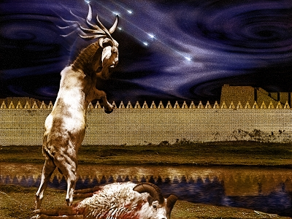
DANIEL 10-12 THE FINAL VISION

Slide 3
CHAPTER AND VERSE IN DANIEL | CHRONOLOGICAL DATE | BIBLICAL DATE
1:1 | 605 | 3rd year of Jehoiakim
2:1 | 603 | 2nd year of Nebuchadnezzar
5 | Sat. night 10/12/539 (Hoehner)
7:1 | 553 | 1st year of Belshazzar
8:1 | 551 | 3rd year of Belshazzar
9:1 | 538 | 1st year of Darius
10:1 | 536 | 3rd year of Cyrus

Slide 4
Chapter 10–12 Outline
The Setting (10:1-3)
Arrival of the Heavenly Messenger (10:4-9)
Explanation of the Heavenly Messenger (10:10–11:1)
The Prophecy of the Heavenly Messenger (11:2–12:13)

Slide 5
IV. The Prophecy of the Heavenly Messenger (11:2–12:13)
Persia (11:2)
Greece (11:3-4)
Ptolemies & Seleucids (11:5-20)
Antiochus IV (11:21-35)
Antichrist (11:36-45)
Tribulation & Millennium (12:1-13)

Slide 6
Understanding Daniel’s
Prophetic Perspective
Antichrist
Antiochus IV
(Daniel 11:36-45)
(Daniel 11:21-35)
Far
Fulfillment
Near
Fulfillment
Daniel

Slide 7
IV. The Prophecy of the Heavenly Messenger (11:2–12:13)
Persia (11:2)
Greece (11:3-4)
Ptolemies & Seleucids (11:5-20)
Antiochus IV (11:21-35)
Antichrist (11:36-45)
Tribulation & Millennium (12:1-13)

Slide 8
IV. The Prophecy of the Heavenly Messenger (11:2–12:13)
Persia (11:2)
Greece (11:3-4)
Ptolemies & Seleucids (11:5-20)
Antiochus IV (11:21-35)
Antichrist (11:36-45)
Tribulation & Millennium (12:1-13)

Slide 9
The Tribulation & Millennium Daniel 12:1-13
Description of the End Times (1-4)
The Suffering (1)
The Separation (2)
The Shining (3)
The Sealing (4)
Duration of the End Times (5-13)
Round 1 (5-7)
Question (5-6)
Answer (7)
Round 2 (8-13)
Question (8)
Answer (9-13)

Slide 10
I. Duration of the End Times Daniel 12:1-4
The Suffering (1)
The Prince (1a)
The Pain (1b)
The Perseverance (1c)
The Separation (2)
The Shining (3)
The Sealing (4)
Harold Wilmington, The Outline Bible, pp. 418-19

Slide 11
I. Duration of the End Times Daniel 12:1-4
The Suffering (1)
The Prince (1a)
The Pain (1b)
The Perseverance (1c)
The Separation (2)
The Shining (3)
The Sealing (4)
Harold Wilmington, The Outline Bible, pp. 418-19

Slide 12
I. Duration of the End Times Daniel 12:1-4
The Suffering (1)
The Prince (1a)
The Pain (1b)
The Perseverance (1c)
The Separation (2)
The Shining (3)
The Sealing (4)
Harold Wilmington, The Outline Bible, pp. 418-19

Slide 13
I. Duration of the End Times Daniel 12:1-4
The Suffering (1)
The Prince (1a)
The Pain (1b)
The Perseverance (1c)
The Separation (2)
The Shining (3)
The Sealing (4)
Harold Wilmington, The Outline Bible, pp. 418-19

Slide 16
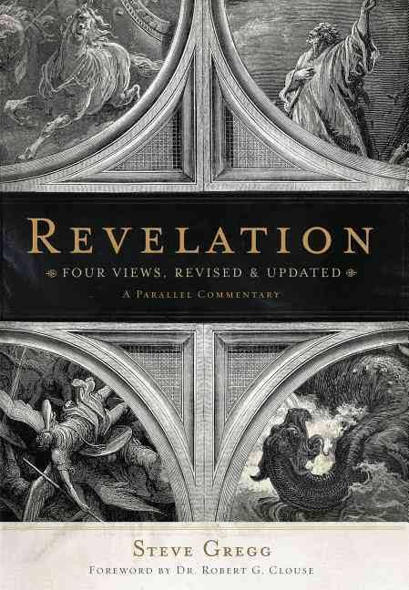
Methods of Interpretation
Preterism
Historicism
Idealism
Futurism

Slide 17
Methods of Interpretation
Preterism
Historicism
Idealism
Futurism

Slide 18
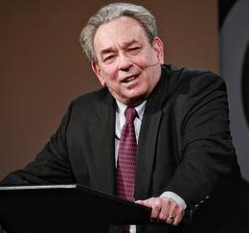
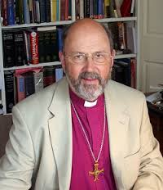
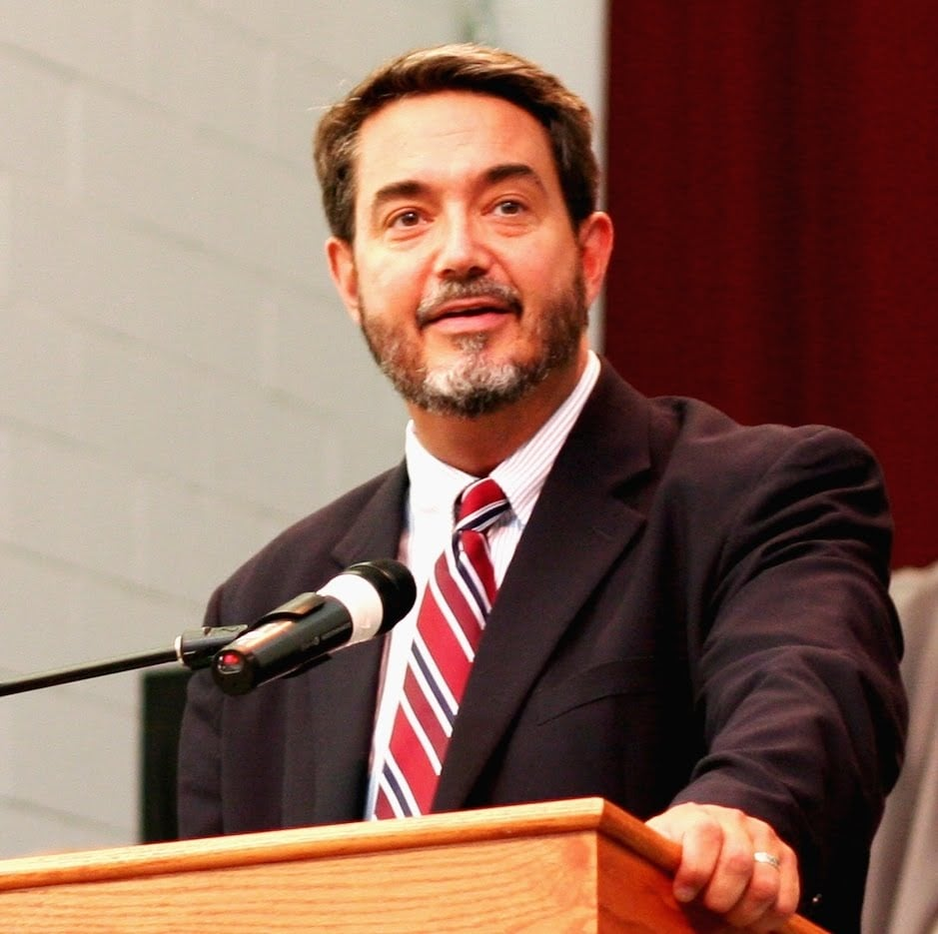
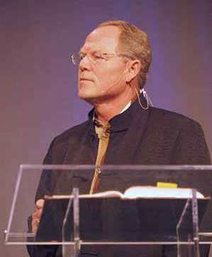
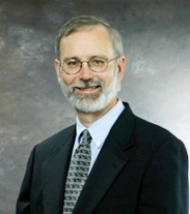
Preterism Advocates
Recent Preterist Commentators
R.C. Sproul
N.T. Wright
Scott Hahn
J. Massyngbaerde Ford
David Chilton
Hank Hanegraaff
Kenneth Gentry

Slide 19
Kenneth Gentry
Four Views of Revelation, p. 38.
“…the preterist view does understand Revelation’s prophecies as strongly reflecting actual historical events in John’s near future, though they are set in apocalyptic drama and clothed in poetic hyperbole.”

Slide 20
R. C. Sproul
The Last Days According to Jesus, 45.
“Russell and Calvin agree that the language employed in biblical prophecy is not always cold and logical as is common in the western world, but adopts a kind of fervor common to the East.”

Slide 21
Methods of Interpretation
Preterism
Historicism
Idealism
Futurism

Slide 22
Methods of Interpretation
Preterism
Historicism
Idealism
Futurism

Slide 23
I. Duration of the End Times Daniel 12:1-4
The Suffering (1)
The Prince (1a)
The Pain (1b)
The Perseverance (1c)
The Separation (2)
The Shining (3)
The Sealing (4)
Harold Willmington, The Outline Bible, pp. 418-19

Slide 24
Zechariah 13:8-9
⁸“It will come about in all the land,” Declares the Lord, “That two parts in it will be cut off and perish; But the third will be left in it. ⁹“And I will bring the third part through the fire, Refine them as silver is refined, And test them as gold is tested. They will call on My name, And I will answer them; I will say, ‘They are My people,’ And they will say, ‘The Lord is my God.’ ”

Slide 25
I. Duration of the End Times Daniel 12:1-4
The Suffering (1)
The Prince (1a)
The Pain (1b)
The Perseverance (1b)
The Separation (2)
The Shining (3)
The Sealing (4)
Harold Wilmington, The Outline Bible, pp. 418-19

Slide 26
Revelation 20:4-6
“⁴ Then I saw thrones, and they sat on them, and judgment was given to them. And I saw the souls of those who had been beheaded because of their testimony of Jesus and because of the word of God, and those who had not worshiped the beast or his image, and had not received the mark on their forehead and on their hand; and they came to life [zaō] and reigned with Christ for a thousand years….

Slide 27
Revelation 20:4-6
…⁵ The rest of the dead did not come to life [zaō] until the thousand years were completed. This is the first resurrection [anastasis and not palingenesia]. ⁶ Blessed and holy is the one who has a part in the first resurrection [anastasis and not palingenesia]; over these the second death has no power, but they will be priests of God and of Christ and will reign with Him for a thousand years.”

Slide 28
Daniel 12:2
“Many of those who sleep in the dust of the ground will awake, these to everlasting (olam) life, but the others to disgrace and everlasting (olam) contempt.”

Slide 29
Psalm 90:2
“Before the mountains were born Or You gave birth to the earth and the world, Even from everlasting (olam) to everlasting (olam), You are God.”

Slide 30
Matthew 25:46
^{“T}hese will go away into eternal (aiōnios) punishment, but the righteous into eternal (aiōnios) life.

Slide 31
Romans 16:26
“but now is manifested, and by the Scriptures of the prophets, according to the commandment of the eternal (aiōnios) God, has been made known to all the nations, leading to obedience of faith

Slide 32
Revelation 14:11
“And the smoke of their torment goes up forever (aiōn) and ever (aiōn); they have no rest day and night, those who worship the beast and his image, and whoever receives the mark of his name.”

Slide 33
Dominoes in a Row

Slide 34
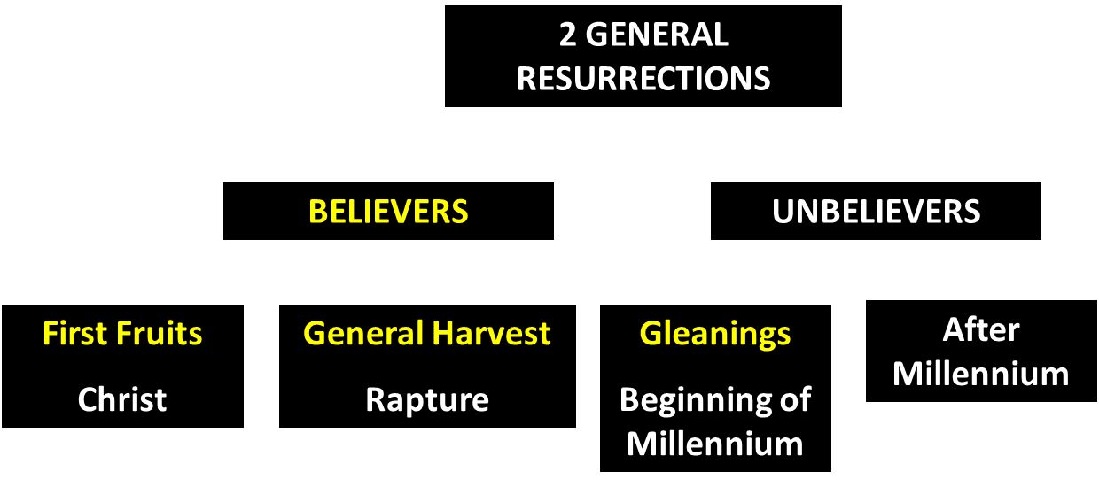
God’s Resurrection Program

Slide 35
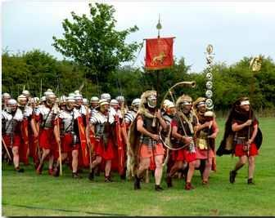
Order or Tagma (1 Cor. 15:23)
General – Christ’s resurrection (1 Cor 15:23)
Officer – Rapture (1 Thess 4:13-18)
Soldiers – OT saints & Tribulation martyrs (Rev 20:4)
Captives – Unsaved of all ages (Rev 20:5)

Slide 36
I. Duration of the End Times Daniel 12:1-4
The Suffering (1)
The Prince (1a)
The Pain (1b)
The Perseverance (1c)
The Separation (2)
The Shining (3)
The Sealing (4)
Harold Wilmington, The Outline Bible, pp. 418-19

Slide 37
I. Duration of the End Times Daniel 12:1-4
The Suffering (1)
The Prince (1a)
The Pain (1b)
The Perseverance (1c)
The Separation (2)
The Shining (3)
The Sealing (4)
Harold Wilmington, The Outline Bible, pp. 418-19

Slide 38
Conclusion

Slide 39
I. Duration of the End Times Daniel 12:1-4
The Suffering (1)
The Prince (1a)
The Pain (1b)
The Perseverance (1c)
The Separation (2)
The Shining (3)
The Sealing (4)
Harold Wilmington, The Outline Bible, pp. 418-19

Slide 40
Chapter 10–12 Outline
The Setting (10:1-3)
Arrival of the Heavenly Messenger (10:4-9)
Explanation of the Heavenly Messenger (10:10–11:1)
The Prophecy of the Heavenly Messenger (11:2–12:13)

Slide 41
IV. The Prophecy of the Heavenly Messenger (11:2–12:13)
Persia (11:2)
Greece (11:3-4)
Ptolemies & Seleucids (11:5-20)
Antiochus IV (11:21-35)
Antichrist (11:36-45)
Tribulation & Millennium (12:1-13)

Slide 42
Purpose
To encourage Judah by emphasizing the sovereignty of God during the Babylonian captivity and to teach Judah how to live while outside the land

Slide 43
“The Lord bless you and keep you; the Lord make his face shine on you and be gracious to you; the Lord turn his face toward you and give you peace.” (NIV)

