Slide 1

Ecclesiology
Session 16
Dr. Andy Woods
Senior Pastor – Sugar Land Bible Church
President – Chafer Theological Seminary

Slide 2


Areas of Systematic Theology
Prolegomena – Introduction
Theology – Study of God
Christology – Study of Christ
Pneumatology – Study of the Holy Spirit
Anthropology – Study of Man
Hamartiology – Study of sin
Soteriology – Study of salvation
Angelology – Study of angels
Ecclesiology – Study of the Church
Eschatology – Study of the end

Slide 3
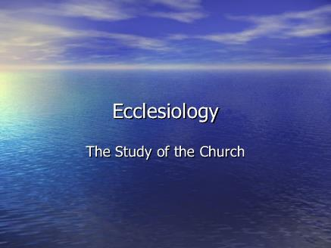
Ecclesiology Overview
Definition
Universal vs. local
Word pictures
Origin
Israel – Church differences
Intercalation
Purposes
Activities
Government
Officers
Ordinances
Purity

Slide 4
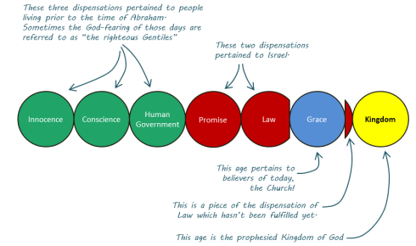
Intercalation
Unconditional program for Israel
Unfulfilled program for Israel
Literal program for Israel
Truthful program for Israel
Future program for Israel
Three inadequate explanations
God is at work today
Present work of God is an interruption, interval, parenthesis, or intercalation in God’s work with Israel
The church will play a role in the millennial kingdom
Dispensational vs. Reformed Theology

Slide 5
Intercalation
Unconditional program for Israel
Unfulfilled program for Israel
Literal program for Israel
Truthful program for Israel
Future program for Israel
Three inadequate explanations
God is at work today
Present work of God is an interruption, interval, parenthesis, or intercalation in God’s work with Israel
The church will play a role in the millennial kingdom
Dispensational vs. Reformed Theology

Slide 6
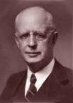
Lewis Sperry Chafer vol. 4, Systematic Theology (Grand Rapids, MI: Kregel Publications, 1993), 41.
“In fact, the new, hitherto unrevealed purpose of God in the out calling of a heavenly people from Jews and Gentiles is so divergent with respect to the divine purpose toward Israel, which purpose preceded it and will yet follow it, that the term parenthetical, commonly employed to describe the new age purpose, is inaccurate. A parenthetical portion sustains some direct and indirect relation to that which goes before or that which follows; but the present age-purpose is not thus related and…

Slide 7
Lewis Sperry Chafer vol. 4, Systematic Theology (Grand Rapids, MI: Kregel Publications, 1993), 41.
…therefore is more properly termed an intercalation. The appropriateness of this word will be seen in the fact that, as an interpolation is formed by inserting a word or phrase into a context, so when intercalation is formed by introducing a day or a period of time into the calendar. The present age of the church is an intercalation into the revealed calendar or program of God as that program was foreseen by the prophets of old. Such, indeed, is the precise character of the present age.”

Slide 8
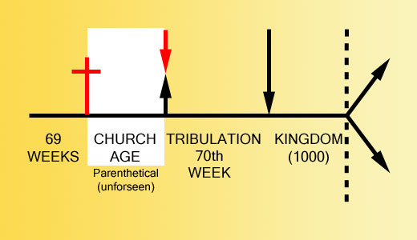

Slide 9
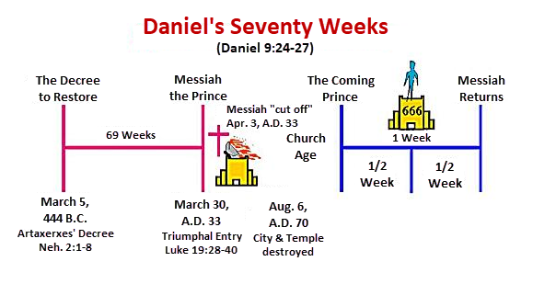

Slide 10
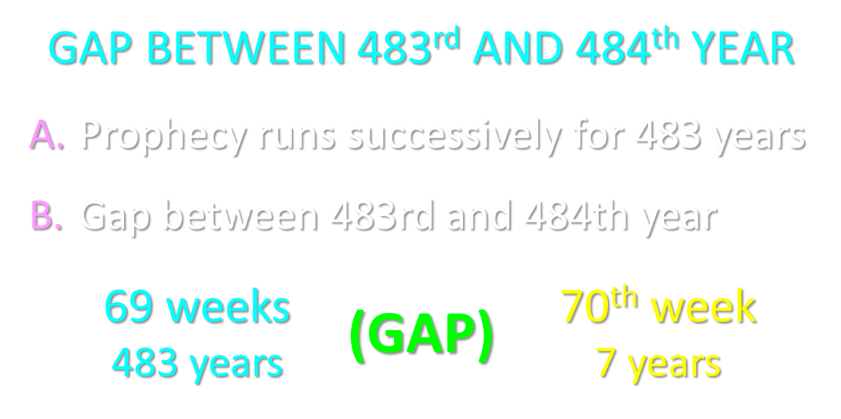

Slide 11
Reformed Theology’s Denial of the Church as an Intercalation
“We’re not dispensationalists here....We believe that the church is essentially Israel. We believe that the answer to, ‘What about the Jews?’ is, ‘Here we are.’ We deny that the church is God’s ‘plan B.’ We deny that we are living in God’s redemptive parenthesis. There, we are again one people. In His holy and heavenly temple there is neither Jew nor Greek, male nor female, pre-mil nor post-mil. There, we are all together, the Israel of God, princes with God, and the ekklesia, the set apart ones.”
From Table Talk magazine, Spring of 1999, p. 2 (inside cover), by R. C. Sproul Jr., editor, emphasis is mine

Slide 12


Ephesians 3:11
“This [the Church] was in accordance with the eternal purpose which He carried out in Christ Jesus our Lord.”

Slide 13
Intercalation
Unconditional program for Israel
Unfulfilled program for Israel
Literal program for Israel
Truthful program for Israel
Future program for Israel
Three inadequate explanations
God is at work today
Present work of God is an interruption, interval, parenthesis, or intercalation in God’s work with Israel
The church will play a role in the millennial kingdom
Dispensational vs. Reformed Theology

Slide 14
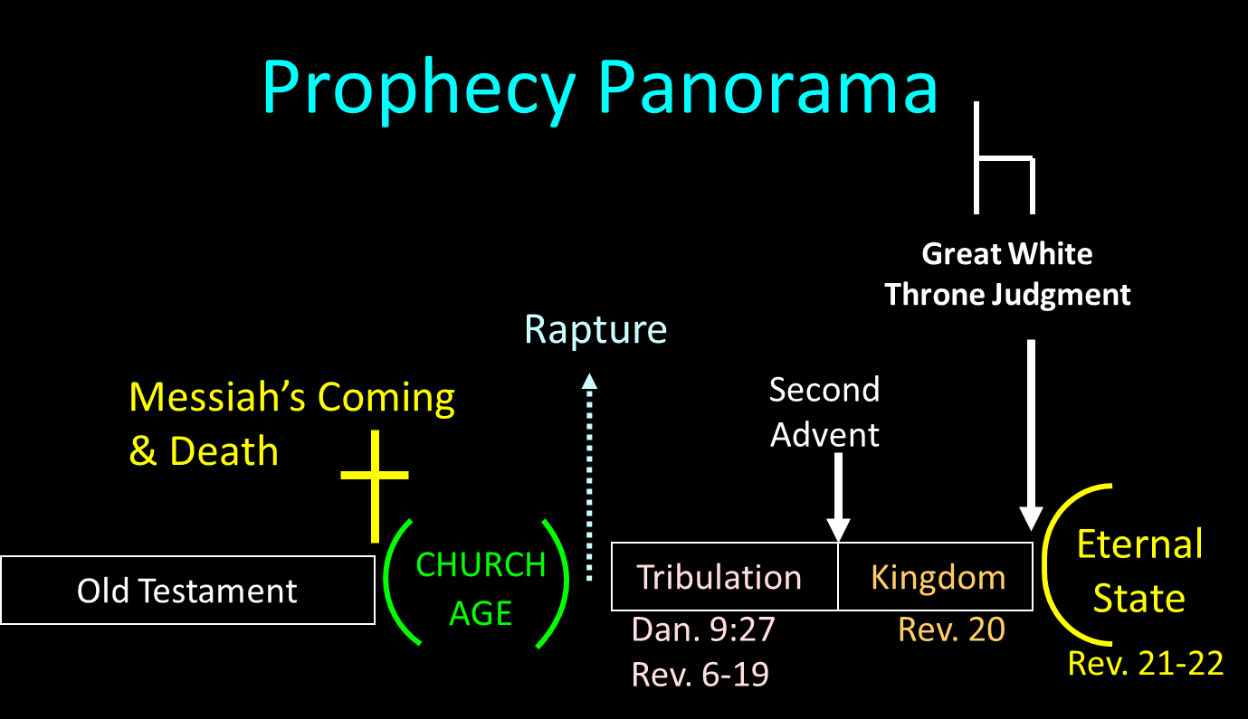

Slide 15
1 Corinthians 6:1-3
¹ “Does any one of you, when he has a case against his neighbor, dare to go to law before the unrighteous and not before the saints? ² Or do you not know that the saints will judge the world? If the world is judged by you, are you not competent to constitute the smallest law courts? ³ Do you not know that we will judge angels? How much more matters of this life?”

Slide 16
2 Timothy 2:11-13
“¹¹ It is a trustworthy statement: For if we died with Him, we will also live with Him; ¹²If we endure, we will also reign with Him; If we deny Him, He also will deny us; ¹³If we are faithless, He remains faithful, for He cannot deny Himself.”

Slide 17
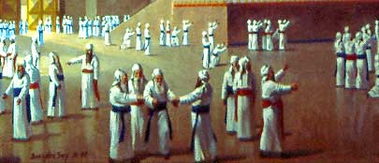
Revelation 5:10
¹⁰ “You have made them to be a kingdom and priests to our God; and they will reign upon the earth.”

Slide 18
Intercalation
Unconditional program for Israel
Unfulfilled program for Israel
Literal program for Israel
Truthful program for Israel
Future program for Israel
Three inadequate explanations
God is at work today
Present work of God is an interruption, interval, parenthesis, or intercalation in God’s work with Israel
The church will play a role in the millennial kingdom
Dispensational vs. Reformed Theology

Slide 19
Reformed Theology’s Denial of the Church as an Intercalation
“We’re not dispensationalists here....We believe that the church is essentially Israel. We believe that the answer to, ‘What about the Jews?’ is, ‘Here we are.’ We deny that the church is God’s ‘plan B.’ We deny that we are living in God’s redemptive parenthesis. There, we are again one people. In His holy and heavenly temple there is neither Jew nor Greek, male nor female, pre-mil nor post-mil. There, we are all together, the Israel of God, princes with God, and the ekklesia, the set apart ones.”
From Table Talk magazine, Spring of 1999, p. 2 (inside cover), by R. C. Sproul Jr., editor, emphasis is mine

Slide 20

Arnold G. Fruchtenbaum
George Zeller, “Is R. C. Sproul Jr. Really A Jew?,” online: http://www.middletownbiblechurch.org/reformed/sprouljr.htm, accessed 17 February 2018.
“We believe that the answer to, ‘What about the Jews?’ is, ‘Here we are.’ I shared this comment with a friend of mine who is a converted Jew. He was born in Russia after his parents were released from a Communist prison. With the help of the Israeli underground, his family escaped from behind the Iron Curtain. He received Orthodox Jewish training while living in Germany from 1947 to 1951 and then his family immigrated to New York. He is a dedicated servant of Christ and a respected author. When told about Sproul Jr.’s comment ‘Here we are. [We are the Jews]’ he commented, ‘It’s a good thing he was not declaring this on the streets of Berlin, Germany around 1941!’”

Slide 21
IS THE CHURCH, ISRAEL?
Galatians 6:16

Slide 22
INTRODUCTION
Covenant Theology vs. Dispensational Theology
One group or two? Galatians 6:16
  NIV: “peace and mercy to all who follow this rule, even to the Israel of God.”

Slide 23
Church = Israel

Slide 24

“The story of the church begins with Israel, the Old Testament people of God…The identity of the church is necessary for the mission of the church. Only as a holy nation, called out of the darkness into the light of God‘s presence, can the church discharge it’s mission…Peter affirms that the church’s right to the titles of Israel, then describes the church’s witness of praise (1st Peter 2:9–10)...This understanding of the church as the new and true Israel of Christ must inspire our mission in the contemporary world.”
Edmund P. Clowney
Edmund P. Clowney, The Church, ed. Gerald Bray, Contours of Christian Theology (Downers Grove, ILL: InterVarsity Press, 1995), 28, 162-63.

Slide 25

“That is, we believe in the unfolding plan of God in history, the Christian Church is the very fruition of the redemptive purpose of God. As such, the multi-racial, international Church of Jesus Christ supersedes racial, national Israel as the focus of the kingdom of God. Indeed, we believe that the church becomes ‘the Israel of God’ (Gal. 6:16)…”
Kenneth L. Gentry Jr.
“The Iceman Cometh! Mormonism Reigneth!,” Dispensationalism in Transition, Vol 6, No.1; Jan. 1993 p. 1. Italics mine

Slide 26

Hans K. LaRondelle
The Israel of God in Prophecy: Principles of Prophetic Interpretation (Berrien Springs, Mich.: Andrews University U., 1983), pp. 110-11. Italics mine
“Paul’s benediction in Galatians 6:16 becomes, then, the chief witness in the New Testament declaring that the universal church is the Israel of God, the seed of Abraham, the heir to Israel’s covenant promise (c.f. Gal. 3:29; 6:16).”

Slide 27
INTRODUCTION
Covenant Theology vs. Dispensational Theology
One group or two?
  NIV: “peace and mercy to all who follow this rule, even to the Israel of God.”
  NASB: “And to those who will walk by this rule, peace and mercy be upon them, and upon the Israel of God.”

Slide 28

Church
Hebrew Christians

Slide 29
The Galatians 6:16 ‘καί’ Controversy
Translation of kai | “even” | “and”
Use of καί | appositional | continuative
Bible version | NIV | NASB
“Israel of God” | Church | Hebrew-Christians within the Church
Israel and Church | Equated | “Israel of God” is a subset within the church
Theology | Replacement Theology | Dispensational Theology

Slide 30
10 Facts Favoring the Dispensational Interpretation of Galatians 6:16
Continuative καί is the most common in NT
Appositional καί is the rarest in the NT
Point easier made by eliminating καί
“Israel” always = national, ethnic Israel
Israel not equated with the church until A.D. 160
Why introduce theological point in conclusion?
Two-fold repetition of upon (καί ἐπὶ)?
Paul designates two groups elsewhere (Gal. 6:15; 2:7-8)
Paul singles out believing Jews elsewhere
Paul is not anti-Semitic

Slide 31
10 Facts Favoring the Dispensational Interpretation of Galatians 6:16
Continuative καί is the most common in NT
Appositional καί is the rarest in the NT
Point easier made by eliminating kai
“Israel” always = national, ethnic Israel
Israel not equated with the church until A.D. 160
Why introduce theological point in conclusion?
Two-fold repetition of upon (καί ἐπὶ)?
Paul designates two groups elsewhere (Gal. 6:15; 2:7-8)
Paul singles out believing Jews elsewhere
Paul is not anti-Semitic

Slide 32
10 Facts Favoring the Dispensational Interpretation of Galatians 6:16
Continuative καί is the most common in NT
Appositional καί is the rarest in the NT
Point easier made by eliminating kai
“Israel” always = national, ethnic Israel
Israel not equated with the church until A.D. 160
Why introduce theological point in conclusion?
Two-fold repetition of upon (καί ἐπὶ)?
Paul designates two groups elsewhere (Gal. 6:15; 2:7-8)
Paul singles out believing Jews elsewhere
Paul is not anti-Semitic

Slide 33

S. Lewis Johnson
“Paul and the 'Israel of God': An Exegetical and Eschatological Case-Study,” in Essays in Honor of J. Dwight Pentecost, ed. Stanley D. Toussaint and Charles H. Dyer (Chicago: Moody, 1986), 187.
“It is necessary to begin this part of the discussion with a basic but often neglected hermeneutical principle. It is this: in the absence of compelling exegetical and theological considerations, we should avoid the rare grammatical usages when the common ones make good sense.”

Slide 34
S. Lewis Johnson
“Paul and the 'Israel of God': An Exegetical and Eschatological Case-Study,” in Essays in Honor of J. Dwight Pentecost, ed. Stanley D. Toussaint and Charles H. Dyer (Chicago: Moody, 1986), 187.
“An extremely rare use has been made to replace the common usage, even in spite of the fact that the common and frequent usage makes perfectly good sense in Galatians 6:16.”

Slide 35
10 Facts Favoring the Dispensational Interpretation of Galatians 6:16
Continuative καί is the most common in NT
Appositional καί is the rarest in the NT
Point easier made by eliminating kai
“Israel” always = national, ethnic Israel
Israel not equated with the church until A.D. 160
Why introduce theological point in conclusion?
Two-fold repetition of upon (καί ἐπὶ)?
Paul designates two groups elsewhere (Gal. 6:15; 2:7-8)
Paul singles out believing Jews elsewhere
Paul is not anti-Semitic

Slide 36

Galatians 6:16 (NIV)
“And to those who will walk by this rule, peace and mercy to all who follow this rule, even to the Israel of God.”

Slide 37
Galatians 6:16
“And to those who will walk by this rule, peace and mercy be upon them, and upon the Israel of God.”

Slide 38
Galatians 6:16
“And as many as shall walk by this rule, peace be upon them and mercy, upon the Israel of God.”

Slide 39
Matthew 4:4
“But He answered and said, “It is written, ‘Man shall not live on bread alone, but on every word that proceeds out of the mouth of God.’”

Slide 40
Matthew 5:18
“For truly I say to you, until heaven and earth pass away, not the smallest letter or stroke shall pass from the Law until all is accomplished.”

Slide 41
10 Facts Favoring the Dispensational Interpretation of Galatians 6:16
Continuative καί is the most common in NT
Appositional καί is the rarest in the NT
Point easier made by eliminating kai
“Israel” always = national, ethnic Israel
Israel not equated with the church until A.D. 160
Why introduce theological point in conclusion?
Two-fold repetition of upon (καί ἐπὶ)?
Paul designates two groups elsewhere (Gal. 6:15; 2:7-8)
Paul singles out believing Jews elsewhere
Paul is not anti-Semitic

Slide 42

Israel Means Israel
15x elsewhere in Paul’s writings
72x elsewhere in the New Testament
1800x in the Old Testament
“Israel” or “Israelite” used 2500x in the OT

Slide 43
10 Facts Favoring the Dispensational Interpretation of Galatians 6:16
Continuative καί is the most common in NT
Appositional καί is the rarest in the NT
Point easier made by eliminating kai
“Israel” always = national, ethnic Israel
Israel not equated with the church until A.D. 160
Why introduce theological point in conclusion?
Two-fold repetition of upon (καί ἐπὶ)?
Paul designates two groups elsewhere (Gal. 6:15; 2:7-8)
Paul singles out believing Jews elsewhere
Paul is not anti-Semitic

Slide 44
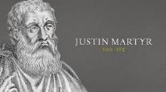
Justin Martyr
“Dialogue with Trypho” 123, 135
“As therefore from the one man Jacob, who was surnamed Israel, all your nation has been called Jacob and Israel; so we from Christ, who begat us unto God, (like Jacob, and Israel, and Judah, and Joseph, and David,) are called and are the true sons of God, and keep the commandments of Christ"… "As, therefore, Christ is the Israel and the Jacob, even so we, who have been quarried out from the bowels of Christ, are the true Israelitic race.”

Slide 45
Order of Paul’s Letters
Galatians (A.D. 49)
1‒2 Thessalonians (A.D. 51)
1‒2 Corinthians (A.D. 56)
Romans (A.D. 57)
Ephesians, Colossians, Philemon, Philippians (A.D. 60‒62)
1 Timothy, Titus (A.D. 62‒66)
2 Timothy (A.D. 67)

Slide 46
Order of Paul’s Letters
Galatians (A.D. 49)
1‒2 Thessalonians (A.D. 51)
1‒2 Corinthians (A.D. 56)
Romans (A.D. 57)
Ephesians, Colossians, Philemon, Philippians (A.D. 60‒62)
1 Timothy, Titus (A.D. 62‒66)
2 Timothy (A.D. 67)

Slide 47
10 Facts Favoring the Dispensational Interpretation of Galatians 6:16
Continuative καί is the most common in NT
Appositional καί is the rarest in the NT
Point easier made by eliminating kai
“Israel” always = national, ethnic Israel
Israel not equated with the church until A.D. 160
Why introduce theological point in conclusion?
Two-fold repetition of upon (καί ἐπὶ)?
Paul designates two groups elsewhere (Gal. 6:15; 2:7-8)
Paul singles out believing Jews elsewhere
Paul is not anti-Semitic

Slide 48
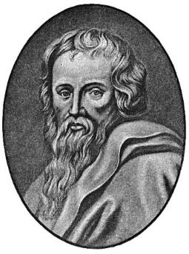
What is Inside? Galatians Structure
Chaps. 1–2: Autobiographical section
Chaps. 3–4: Doctrinal section
Chaps. 5–6: Practical section

Slide 49
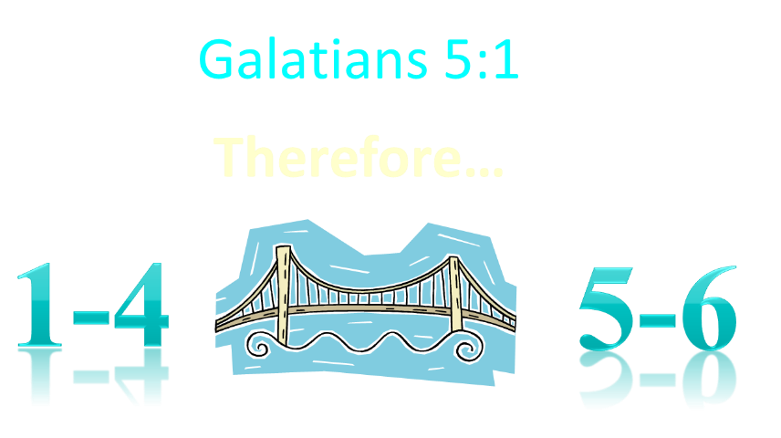

Slide 50
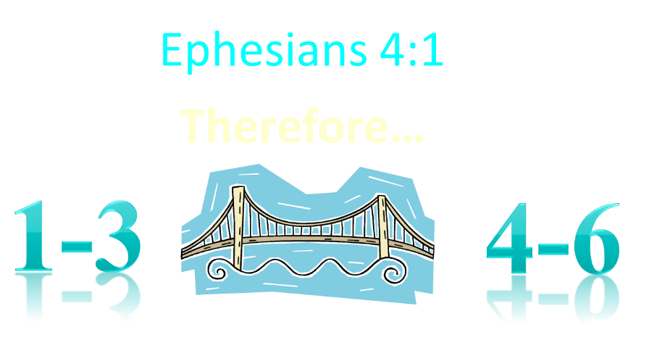

Slide 51
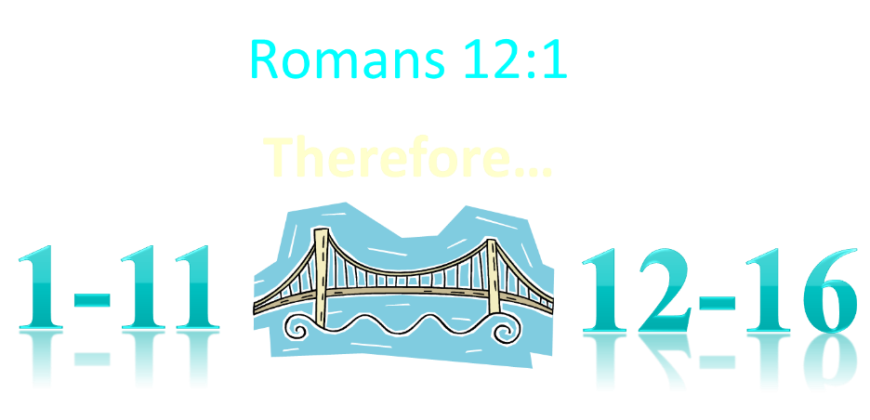

Slide 52
10 Facts Favoring the Dispensational Interpretation of Galatians 6:16
Continuative καί is the most common in NT
Appositional καί is the rarest in the NT
Point easier made by eliminating kai
“Israel” always = national, ethnic Israel
Israel not equated with the church until A.D. 160
Why introduce theological point in conclusion?
Two-fold repetition of upon (καί ἐπὶ)?
Paul designates two groups elsewhere (Gal. 6:15; 2:7-8)
Paul singles out believing Jews elsewhere
Paul is not anti-Semitic

Slide 53
Galatians 6:16
“And to those who will walk by this rule, peace and mercy be upon (epi) them, and upon (epi) the Israel of God.”

Slide 54
10 Facts Favoring the Dispensational Interpretation of Galatians 6:16
Continuative καί is the most common in NT
Appositional καί is the rarest in the NT
Point easier made by eliminating kai
“Israel” always = national, ethnic Israel
Israel not equated with the church until A.D. 160
Why introduce theological point in conclusion?
Two-fold repetition of upon (καί ἐπὶ)?
Paul designates two groups elsewhere (Gal. 6:15; 2:7-8)
Paul singles out believing Jews elsewhere
Paul is not anti-Semitic

Slide 55

Galatians 6:15
“For neither is circumcision anything, nor uncircumcision, but a new creation.”

Slide 56
Galatians 2:7-8
⁷ But on the contrary, seeing that I had been entrusted with the gospel to the uncircumcised, just as Peter had been to the circumcised ⁸ (for He who effectually worked for Peter in his apostleship to the circumcised effectually worked for me also to the Gentiles)…

Slide 57
Galatians 6:16
“And to those who will walk by this rule, peace and mercy be upon them, and upon the Israel of God.”

Slide 58
10 Facts Favoring the Dispensational Interpretation of Galatians 6:16
Continuative καί is the most common in NT
Appositional καί is the rarest in the NT
Point easier made by eliminating kai
“Israel” always = national, ethnic Israel
Israel not equated with the church until A.D. 160
Why introduce theological point in conclusion?
Two-fold repetition of upon (καί ἐπὶ)?
Paul designates two groups elsewhere (Gal. 6:15; 2:7-8)
Paul singles out believing Jews elsewhere
Paul is not anti-Semitic

Slide 59
Galatians 6:16
“And to those who will walk by this rule, peace and mercy be upon them, and upon the Israel of God.”

Slide 60

Romans 2:28-29
“²⁸ For he is not a Jew who is one outwardly, nor is circumcision that which is outward in the flesh. ²⁹ But he is a Jew who is one inwardly; and circumcision is that which is of the heart, by the Spirit, not by the letter; and his praise is not from men, but from God.”

Slide 61
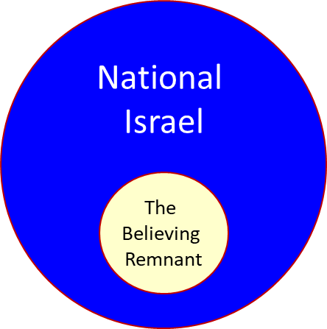
Romans 9:6
“But it is not as though the word of God has failed. For they are not all Israel who are descended from Israel.”

Slide 62
10 Facts Favoring the Dispensational Interpretation of Galatians 6:16
Continuative καί is the most common in NT
Appositional καί is the rarest in the NT
Point easier made by eliminating kai
“Israel” always = national, ethnic Israel
Israel not equated with the church until A.D. 160
Why introduce theological point in conclusion?
Two-fold repetition of upon (καί ἐπὶ)?
Paul designates two groups elsewhere (Gal. 6:15; 2:7-8)
Paul singles out believing Jews elsewhere
Paul is not anti-Semitic

Slide 63

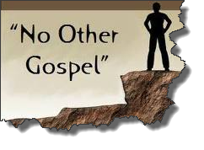
Galatians 1:8–9
⁸ But even if we, or an angel from heaven, should preach to you a gospel contrary to what we have preached to you, he is to be accursed! ⁹ As we have said before, so I say again now, if any man is preaching to you a gospel contrary to what you received, he is to be accursed!

Slide 64

“In view of the apostle's previous strong anti-Judaistic expressions, he feels impelled by the insertion of ‘and’, to emphasize this expression of his true attitude towards his people” (emphasis mine).
Burton
Galatians, p.358

Slide 65
Conclusion

Slide 66
10 Facts Favoring the Dispensational Interpretation of Galatians 6:16
Continuative καί is the most common in NT
Appositional καί is the rarest in the NT
Point easier made by eliminating kai
“Israel” always = national, ethnic Israel
Israel not equated with the church until A.D. 160
Why introduce theological point in conclusion?
Two-fold repetition of upon (καί ἐπὶ)?
Paul designates two groups elsewhere (Gal. 6:15; 2:7-8)
Paul singles out believing Jews elsewhere
Paul is not anti-Semitic

Slide 67

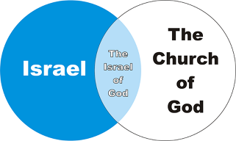
D.W.B Robinson
“The Distinction Between Jewish and Gentile Believers in Galatians,” Australian Biblical Review 13 (1965): 29-48
“The glib citing of Gal. vi: 16 to support the view that ‘the church is the new Israel’ should be vigorously challenged. There is weighty support for a limited interpretation.”

Slide 68
Church = Israel

Slide 69
Church
Hebrew Christians

Slide 70
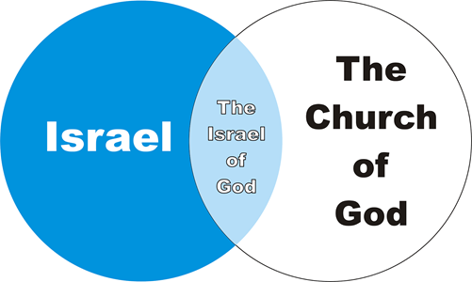

Slide 71
Conclusion
Who’s Who?
  Chrysostom
  Calvin
  Lightfoot
  Stott
  Guthrie
  Luther
  Lenski
  Hendricksen
Amillennial exegetical bias

Slide 72
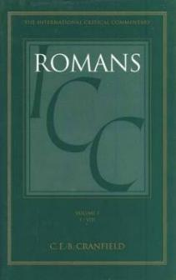
C.E.B. Cranfield
A Critical and Exegetical Commentary on the Epistle to the Romans p.448
“These 3 chapters (Rom 9-11) emphatically forbid us to speak of the church as having once and for all taken the place of the Jewish people…But the assumption that the church has simply replaced Israel as the people of God is extremely common…And I confess with shame to having also myself used in print on more than one occasion this language of the replacement of Israel by the Church.”

Slide 73
Conclusion

Slide 74
Intercalation
Unconditional program for Israel
Unfulfilled program for Israel
Literal program for Israel
Truthful program for Israel
Future program for Israel
Three inadequate explanations
God is at work today
Present work of God is an interruption, interval, parenthesis, or intercalation in God’s work with Israel
The church will play a role in the millennial kingdom
Dispensational vs. Reformed Theology

Slide 75
Ecclesiology Overview
Definition
Universal vs. local
Word pictures
Origin
Israel – Church differences
Intercalation
Purposes
Activities
Government
Officers
Ordinances
Purity

