Slide 1
GOD’S DESIGN FOR PLEASURE
March 4, 2018
Alex Garcia

Slide 2
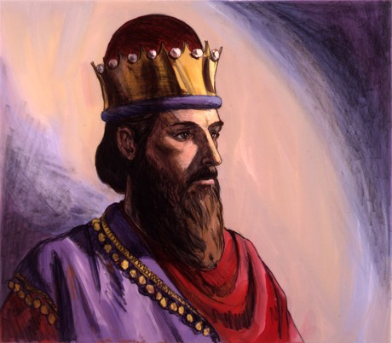
King Solomon

Slide 3
GOD’S DESIGN FOR PLEASURE
Pleasure created by God.
Created for temporary enjoyment only.
God’s creation distorted into many lusts, including pleasure-lust.
Hard-wired to worship God, not pleasure.
Life of pleasure-lust is wasted, painful life.
Self-restraint and thankfulness toward God help us avoid making pleasure our god.

Slide 4
1 Kings 10
“¹⁴ Now the weight of gold which came in to Solomon in one year was 666 talents of gold, ¹⁵ besides that from the traders and the wares of the merchants and all the kings of the Arabs and the governors of the country. . .²¹All King Solomon’s drinking vessels were of gold, and all the vessels of the house of the forest of Lebanon were of pure gold. None was of silver; it was not considered valuable in the days of Solomon. . . . ²⁷ The king made silver as common as stones in Jerusalem . . .”

Slide 5
Hevel (הבל)
breath, vapor

Slide 6
Hevel (הבל)
breath, vapor
idol

Slide 7
Hevel (הבל)
breath, vapor
idol
vanity, emptiness

Slide 8
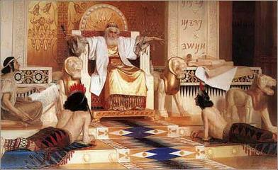
Ecclesiastes 1:2
“’Vanity of vanities,’ says the Preacher, ’Vanity of vanities! All is vanity.’”

Slide 9
Ecclesiastes 1:2; 12:8
^{1:2} “’Vanity of vanities,’ says the Preacher, ’Vanity of vanities! All is vanity.’”
^{12:8} “’Vanity of vanities,’ says the Preacher, ‘all is vanity!’

Slide 10
Ecclesiastes 2:1
“I said to myself, ‘Come now, I will test you with pleasure. So enjoy yourself.’ And behold, it too was futility.”

Slide 11
Ecclesiastes 2:2
“I said of laughter, ‘It is madness,’ and of pleasure, ‘What does it accomplish?’”

Slide 12
Psalm 16:11
“In Your right hand, there are pleasures forever.”

Slide 13
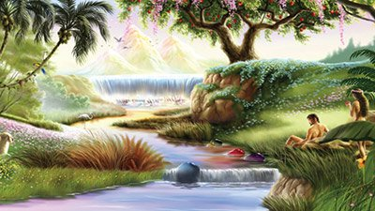
Genesis 2:15
“Then the LORD God took the man and put him into the garden of Eden to cultivate it and keep it.”

Slide 14
Thomas Constable
“Pleasure produces no lasting accomplishment... That is, while it has some temporary, immediate value (e.g., relieving grief or boredom), it does not produce anything permanently or ultimately worthwhile.”

Slide 15
Ecclesiastes 2:3
“I explored with my mind how to stimulate my body with wine while my mind was guiding me wisely, and how to take hold of folly, until I could see what good there is for the sons of men to do under heaven the few years of their lives.”

Slide 16
Ecclesiastes 2:4-6
“⁴ I enlarged my works: I built houses for myself, I planted vineyards for myself; ⁵ I made gardens and parks for myself and I planted in them all kinds of fruit trees; ⁶ I made ponds of water for myself from which to irrigate a forest of growing trees.”

Slide 17
1 John 2:15-17
“¹⁵ Do not love the world nor the things in the world. If anyone loves the world, the love of the Father is not in him. ¹⁶ For all that is in the world, the lust of the flesh and the lust of the eyes and the boastful pride of life, is not from the Father, but is from the world. ¹⁷ The world is passing away, and also its lusts . . ..”

Slide 18
Ecclesiastes 2:4-6
“⁴ I enlarged my works: I built houses for myself, I planted vineyards for myself; ⁵ I made gardens and parks for myself and I planted in them all kinds of fruit trees; ⁶ I made ponds of water for myself from which to irrigate a forest of growing trees.”

Slide 19
John Rockefeller

Slide 20
John Rockefeller: “Just a little bit more”

Slide 21
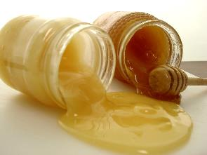
Proverbs 25:16
“Have you found honey? Eat only what you need, that you not have it in excess and vomit it.”

Slide 22
Derek Kidner
“Since Eden, man has wanted the last ounce out of life, as though beyond God's 'enough' lay ecstasy, not nausea.”

Slide 23
Oscar Wilde

Slide 24
Oscar Wilde: “Moderation is a fatal thing. Nothing succeeds like excess!”

Slide 25
1 Corinthians 9:26-27
“ ²⁶ Therefore I run in such a way, as not without aim; I box in such a way, as not beating the air; ²⁷ but I discipline my body and make it my slave, so that, after I have preached to others, I myself will not be disqualified.”

Slide 26
Ecclesiastes 2:7-8
“⁷ I bought male and female slaves and I had homeborn slaves. Also I possessed flocks and herds larger than all who preceded me in Jerusalem. ⁸ Also, I collected for myself silver and gold and the treasure of kings and provinces. . .”

Slide 27
Ecclesiastes 2:8
“... I provided for myself male and female singers and the pleasures of men—many concubines.”

Slide 28
Ecclesiastes 2:9
“Then I became great and increased more than all who preceded me in Jerusalem. My wisdom also stood by me.”

Slide 29
Ecclesiastes 2:10
“All that my eyes desired I did not refuse them. I did not withhold my heart from any pleasure, for my heart was pleased because of all my labor and this was my reward for all my labor.”

Slide 30
Ecclesiastes 2:11
“Thus I considered all my activities which my hands had done and the labor which I had exerted, and behold all was vanity and striving after wind and there was no profit under the sun.”

Slide 31
Ecclesiastes 2:24-25
“²⁴ There is nothing better for a man than to eat and drink and tell himself that his labor is good. This also I have seen that it is from the hand of God. ²⁵ For who can eat and who can have enjoyment without Him? ”

Slide 32
Ecclesiastes 2:26
“For to a person who is good in His sight He has given wisdom and knowledge and joy, while to the sinner He has given the task of gathering and collecting so that he may give to one who is good in God’s sight. This too is vanity and striving after wind.”

Slide 33
Ecclesiastes 12:13-14
“¹³ The conclusion, when all has been heard, is: fear God and keep His commandments, because this applies to every person. ¹⁴ For God will bring every act to judgment, everything which is hidden, whether it is good or evil.”

Slide 34
GOD’S DESIGN FOR PLEASURE
Pleasure created by God.
Created for temporary enjoyment only.
God’s creation distorted into many lusts, including pleasure-lust.
Hard-wired to worship God, not pleasure.
Life of pleasure-lust is wasted, painful life.
Self-restraint and thankfulness toward God help us avoid making pleasure our god.

