Slide 1
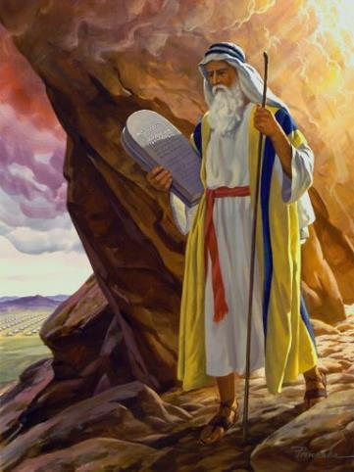
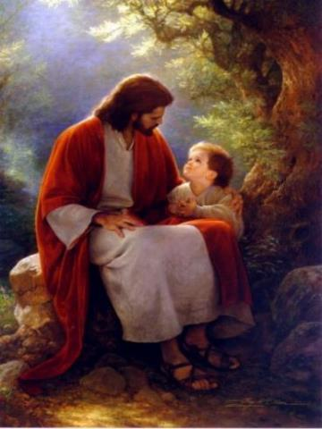
Law & Grace: An Overview Jim McGowan, Th.D. Sugar Land Bible Church 03-04-2018
…but grace & truth were realized through Jesus Christ - John 1:17
For the Law was given through Moses…
Special thanks to Dr. Vern Peterman for access to his insights and resources.

Slide 2
Session 6 Outline
Review
Purpose, Aim, and Objective
Session 5
A Mountaintop Experience – Part 2 (Exo. 20:1-21)
General Information
Contrast & Comparison of Law & Grace
Conclusion

Slide 3
Session 6 Outline
Review
Purpose, Aim, and Objective
Session 5
A Mountaintop Experience – Part 2 (Exo. 20:1-21)
General Information
Contrast & Comparison of Law & Grace
Conclusion

Slide 4
OUR PURPOSE, AIM AND OBJECTIVE
Law & Grace
…is to Compare and Contrast Law and Grace so as to properly understand these two important themes and how they are related to the life of the New Testament Believer.

Slide 5
C. I. SCOFIELD, D. D.
The Grace of God, The Fundamentals Vol. 3, Chapter VII, p. 98
We have, most of us, been reared and now live under the influence of Galatianism. Protestant theology, alas, is for the most part, thoroughly Galatianized, in that neither law nor grace are given their distinct and separated places, as in the counsels of God, but are mingled together in one incoherent system. The law is no longer, as in the Divine intent, a ministration of death (2 Cor. 3:7), of cursing (Gal. 3:10), of conviction (Rom. 3:19), because we are taught that we must try to keep it, and that by Divine help we may. Nor, on the other hand, does grace bring us blessed deliverance from the dominion of sin, for we are kept under the law as a rule of life despite the plain declaration, “Sin shall not have dominion over you: for ye are not under the law, but under grace” (Rom. 6:14).

Slide 6
TEACHINGS OF LAW | TEACHINGS OF GRACE
Written with ink. | Written with the Spirit of the living God.
In tables of stone. | In fleshy tables of the heart.
The letter killeth. | The Spirit giveth life.
The ministration of death. | The ministration of the Spirit.
Was glorious. | Is rather glorious.
Done away. | Remaineth.
Abolished. | We have such hope.
L. S. CHAFER, Systematic theology (Vol. 4, p. 242). (1993). Grand Rapids, MI: Kregel Publications.

Slide 7
Session 6 Outline
Review
Purpose, Aim, and Objective
Session 5
A Mountaintop Experience – Part 2 (Exo. 20:1-21)
General Information
Contrast & Comparison of Law & Grace
Conclusion

Slide 8
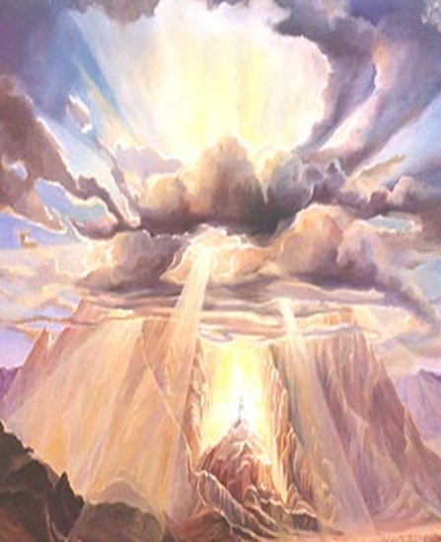
Moses on the Mountain
Law & Grace: Lesson 5 Review

Slide 9
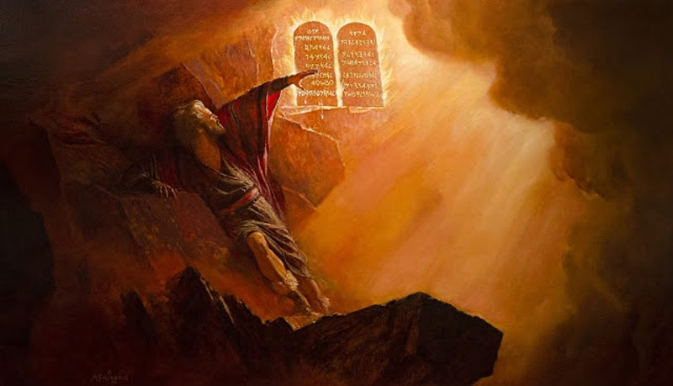
Moses on the Mountain
Law & Grace: Lesson 5 Review

Slide 10
Law & Grace: Lesson 5 Review

Slide 11
Consecration – who does it?
Law & Grace: Lesson 5 Review
To consecrate is to set apart & dedicate for a holy purpose…
Under the Law… | Under Grace…
…it was the entire responsibility of the people to set themselves apart (Exodus 19:10, 14, 22). | …it is God who has sanctified and set us apart in our eternal position in Christ (1 Cor. 1:2, 6:11; Heb. 2:11), and He also continues to sanctify each of us (Heb. 10:14).

Slide 12
Stay away… or draw near?
Law & Grace: Lesson 5 Review
Under the Law… | Under Grace…
…all of the people were to keep away, under penalty of death, from the mountain where God was to give a portion of the Law to Moses. | …we are called to draw near to God & are given access to God by His own accomplishment - all we did was to believe Him.

Slide 13
Death Threatened vs. Death Accomplished
Law & Grace: Lesson 5 Review
Under the Law… | Under Grace…
…the Israelites were to remain holy and sanctified entirely through their own efforts. The penalty for failure was death to be carried out by the community. | …believers are made holy & sanctified in Christ, since they have already died with Christ -an accomplishment of God Himself and in which the we had no part.

Slide 14
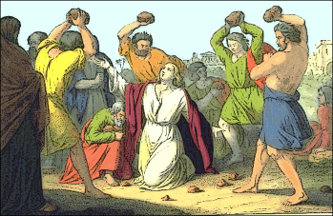
Death: A Bad Thing or Death: A Good Thing?
Law & Grace: Lesson 5 Review
Under the Law… | Under Grace…
…from the very giving of it, the Israelites were threatened with the death if they came too close to the mountain. | …as a result of having died with Christ, believers have also died in relationship to Law.
Under the Law, dying was not good or desirable, …but under Grace our death with Christ is phenomenally good!

Slide 15
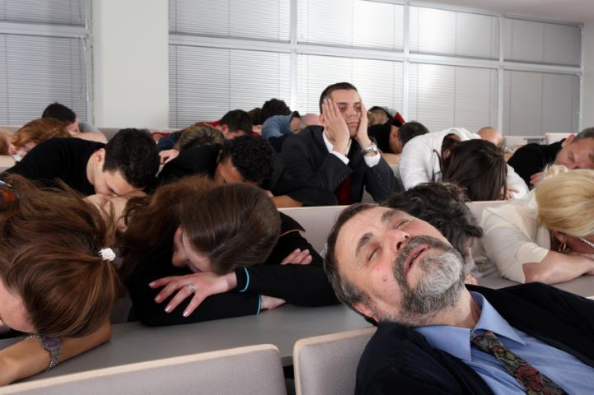
END OF REVIEW
FINALLY

Slide 16
Session 6 Outline
Review
Purpose, Aim, and Objective
Session 5
A Mountaintop Experience – Part 2 (Exo. 20:1-21)
General Information
Contrast & Comparison of Law & Grace
Conclusion

Slide 17
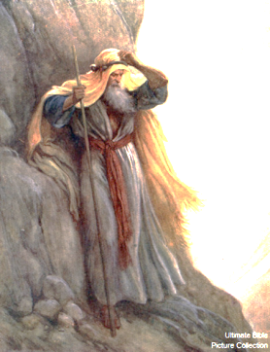
Law & Grace: Lesson 6 A Mountaintop Experience – Part 2
A Mountaintop Experience – Part 2
Exodus 20:1-21

Slide 18
Exodus 20:1-21
¹ Then God spoke all these words, saying, ² “I am the Lord your God, who brought you out of the land of Egypt, out of the house of slavery. ³ “You shall have no other gods before Me. ⁴ “You shall not make for yourself an idol, or any likeness of what is in heaven above or on the earth beneath or in the water under the earth. ⁵ “You shall not worship them or serve them; for I, the Lord your God, am a jealous God, visiting the iniquity of the fathers on the children, on the third and the fourth generations of those who hate Me, ⁶ but showing lovingkindness to thousands, to those who…

Slide 19
Exodus 20:1-21
…love Me and keep My commandments. ⁷ “You shall not take the name of the Lord your God in vain, for the Lord will not leave him unpunished who takes His name in vain. ⁸ “Remember the sabbath day, to keep it holy. ⁹ “Six days you shall labor and do all your work, ¹⁰ but the seventh day is a sabbath of the Lord your God; in it you shall not do any work, you or your son or your daughter, your male or your female servant or your cattle or your sojourner who stays with you. ¹¹ “For in six days the Lord made the heavens and the earth, the sea and all that is in them, and rested on …

Slide 20
Exodus 20:1-21
…the seventh day; therefore the Lord blessed the sabbath day and made it holy. ¹² “Honor your father and your mother, that your days may be prolonged in the land which the Lord your God gives you. ¹³ “You shall not murder. ¹⁴ “You shall not commit adultery. ¹⁵ “You shall not steal. ¹⁶ “You shall not bear false witness against your neighbor. ¹⁷ “You shall not covet your neighbor’s house; you shall not covet your neighbor’s wife or his male servant or his female servant or his ox or his donkey or anything that belongs to your neighbor.” ¹⁸ All the people perceived the thunder …

Slide 21
Exodus 20:1-21
…and the lightning flashes and the sound of the trumpet and the mountain smoking; and when the people saw it, they trembled and stood at a distance. ¹⁹ Then they said to Moses, “Speak to us yourself and we will listen; but let not God speak to us, or we will die.” ²⁰ Moses said to the people, “Do not be afraid; for God has come in order to test you, and in order that the fear of Him may remain with you, so that you may not sin.” ²¹ So the people stood at a distance, while Moses approached the thick cloud where God was.

Slide 22
Session 6 Outline
Review
Purpose, Aim, and Objective
Session 5
A Mountaintop Experience – Part 2 (Exo. 20:1-21)
General Information
Contrast & Comparison of Law & Grace
Conclusion

Slide 23
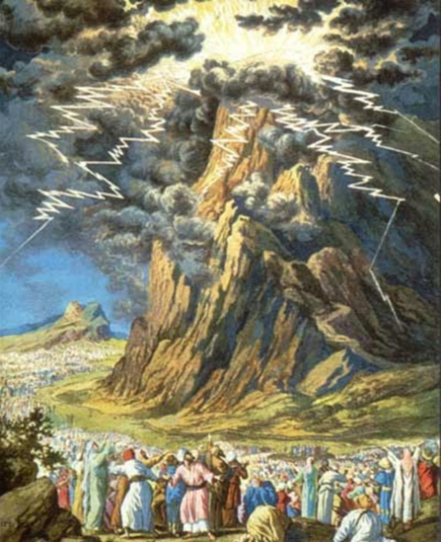
Law & Grace: Lesson 6 A Mountaintop Experience – Part 2
Keep Your Distance!

Slide 24
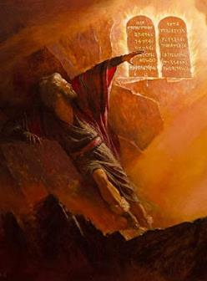
The 10 Commandments
Law & Grace: Lesson 6 A Mountaintop Experience – Part 2
Exodus 20:1-21 presents what has come to be called ‘The 10 Commandments’.
It also includes some interactions between Moses and the people that follows ‘the 10’.
In this, the very first presentation of ‘The 10 Commandments’, the words of ‘The 10’ are simply spoken by God directly to Moses on Mt Sinai.
Then Moses goes down to speak with the people of Israel.

Slide 25
Law & Grace: Lesson 6 A Mountaintop Experience – Part 2
DIVISION OF THE 10 COMMANDMENTS BY RELIGION/DENOMINATION
Commandment | Jewish (Talmudic) | Anglican, Reformed, & others | Orthodox & others | Roman Catholic & Lutheran
I am the LORD your God | 1 | preface | 1 | 1
You shall have no other gods before Me |  | 1
You shall not make for yourself an idol | 2 | 2 | 2
You shall not take the name of the LORD in vain | 3 | 3 | 3 | 2
Remember the sabbath day, to keep it holy | 4 | 4 | 4 | 3
Honor your father and your mother | 5 | 5 | 5 | 4
You shall not murder | 6 | 6 | 6 | 5
You shall not commit adultery | 7 | 7 | 7 | 6
You shall not steal | 8 | 8 | 8 | 7
You shall not bear false witness against your neighbor | 9 | 9 | 9 | 8
You shall not covet your neighbor’s wife | 10 | 10 | 10 | 9
You shall not covet anything that belongs to your neighbor |  |  |  | 10
http://www.sundaysoftware.com/ten/number.htm

Slide 26
Were you aware that…
Law & Grace: Lesson 6 A Mountaintop Experience – Part 2
…what we have come to call ‘The 10 Commandments’ as originally given had additional spoken commandments, at the end of chapter, after V. 21?
…what we have come to call ‘The 10 Commandments’ was later called (literally) ‘The 10 words’ (cf. Exo. 34:28; Deu. 4:13; 10:4)?
…as God spoke them first, in Exodus 20:1-21 ‘The 10’ were not given any special name?

Slide 27
Were you aware that…
Law & Grace: Lesson 6 A Mountaintop Experience – Part 2
…what we have come to call ‘The 10 Commandments’ as originally given had additional spoken commandments, at the end of chapter, after V. 21?
…what we have come to call ‘The 10 Commandments’ was later called (literally) ‘The 10 words’ (cf. Exo. 34:28; Deu. 4:13; 10:4)?
…as God spoke them first, in Exodus 20:1-21 ‘The 10’ were not given any special name?

Slide 28
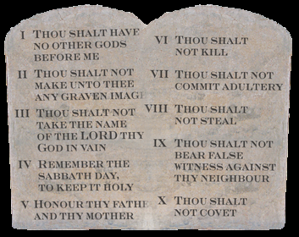
Exodus 34:28b
…And he wrote on the tablets the words of the covenant, the Ten Commandments (literally words!).

Slide 29
Deuteronomy 4:13
“So He declared to you His covenant…that is, the Ten Commandments (literally words!).

Slide 30
Deuteronomy 10:4
“He wrote on the tablets, like the former writing, the Ten Commandments (literally words!)…

Slide 31
Were you aware that…
Law & Grace: Lesson 6 A Mountaintop Experience – Part 2
…what we have come to call ‘The 10 Commandments’ as originally given had additional spoken commandments, at the end of chapter, after V. 21?
…what we have come to call ‘The 10 Commandments’ was later called (literally) ‘The 10 words’ (cf. Exo. 34:28; Deu. 4:13; 10:4)?
…as God spoke them first, in Exodus 20:1-21 ‘The 10’ were not given any special name?

Slide 32
Were you aware that…
Law & Grace: Lesson 6 A Mountaintop Experience – Part 2
…the words of ‘The 10 Commandments’ were first SPOKEN by God, later WRITTEN down by Moses, then WRITTEN by God on tablets of stone?
…those tablets of stone were broken by Moses
…new tablets of stone were written again by God and placed in the Ark
…the “10 Words” were later spoken by Moses to the Children of Israel before they crossed the Jordan River?

Slide 33
Exodus 31:18
When He had finished speaking with him upon Mount Sinai, He gave Moses the two tablets of the testimony, tablets of stone, written by the finger of God.
Deuteronomy 9:10
“The Lord gave me the two tablets of stone written by the finger of God; and on them were all the words which the Lord had spoken with you at the mountain from the midst of the fire on the day of the assembly.

Slide 34
Figure of Speech
Law & Grace: Lesson 6 A Mountaintop Experience – Part 2
A figure is simply a word or a sentence thrown into a peculiar form, different from its original or simplest meaning or use....It may be asked, “How are we to know, then, when words are to be taken in their simple, original form (i.e., literally), and when they are to be taken in some other and peculiar form (i.e., as a Figure)?” The answer is that, whenever and wherever it is possible, the words of Scripture are to be understood literally, but when a statement appears to be contrary to our experience, or to known fact, or revealed truth; or seems to be at variance with the general teaching of the Scriptures, then we may reasonably expect that some figure is employed. And as it is employed only to call our attention to some specially designed emphasis, we are at once bound to diligently examine the figure for the purpose of discovering and learning the truth that is thus emphasized.
Bullinger, E. W. (1898). (p. xv). Figures of Speech Used in the Bible (p. xv).
London; New York: Eyre & Spottiswoode; E. & J. B. Young & Co.

Slide 35
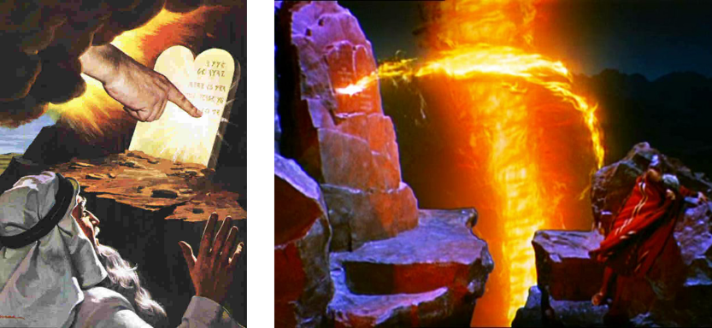
Figure of Speech “Synecdoche of the Part” - where a part is put for the whole
Law & Grace: Lesson 6 A Mountaintop Experience – Part 2
“A finger is attributed to God, to denote the putting forth of His formative power, and the direct and immediate act of God.”

Slide 36
Figure of Speech “the shadow of Your wings” (Psa. 17:8; 36:7; 57:1)
Law & Grace: Lesson 6 A Mountaintop Experience – Part 2

Slide 37
Were you aware that…
Law & Grace: Lesson 6 A Mountaintop Experience – Part 2
…the words of ‘The 10 Commandments’ were first spoken by God, and later written down by Moses, then written by God on tablets of stone?
…those tablets of stone were broken by Moses
…new tablets of stone were written again by God and placed in the Ark
…the “10 Words” were later spoken by Moses to the Children of Israel before they crossed the Jordan River?

Slide 38
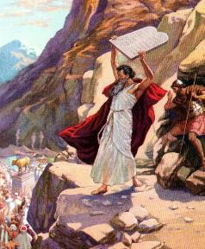
Exodus 32:19
“It came about, as soon as Moses came near the camp, that he saw the calf and the dancing; and Moses’ anger burned, and he threw the tablets from his hands and shattered them at the foot of the mountain.”

Slide 39
Were you aware that…
Law & Grace: Lesson 6 A Mountaintop Experience – Part 2
…the words of ‘The 10 Commandments’ were first spoken by God, and later written down by Moses, then written by God on tablets of stone?
…those tablets of stone were broken by Moses
…new tablets of stone were written again by God and placed in the Ark
…the “10 Words” were later spoken by Moses to the Children of Israel before they crossed the Jordan River?

Slide 40
Deuteronomy 10:1–4
¹ “At that time the Lord said to me, ‘Cut out for yourself two tablets of stone like the former ones, and come up to Me on the mountain, and make an ark of wood for yourself. ² ‘I will write on the tablets the words that were on the former tablets which you shattered, and you shall put them in the ark.’ ³ “So I made an ark of acacia wood and cut out two tablets of stone like the former ones, and went up on the mountain with the two tablets in my hand. ⁴ “He wrote on the tablets, like the former writing, the Ten Commandments which the Lord had spoken to you on the mountain from the midst of the fire on the day of the assembly; and the Lord gave them to me.

Slide 41
Were you aware that…
Law & Grace: Lesson 6 A Mountaintop Experience – Part 2
…the words of ‘The 10 Commandments’ were first spoken by God, and later written down by Moses, then written by God on tablets of stone?
…those tablets of stone were broken by Moses
…new tablets of stone were written again by God and placed in the Ark
…the “10 Words” were later spoken by Moses to the Children of Israel before they crossed the Jordan River?

Slide 42
Deuteronomy 11:31-32
³¹ “For you are about to cross the Jordan to go in to possess the land which the Lord your God is giving you, and you shall possess it and live in it, ³² and you shall be careful to do all the statutes and the judgments which I am setting before you today.

Slide 43
Were you aware that…
Law & Grace: Lesson 6 A Mountaintop Experience – Part 2
…all of ‘The 10 Commandments’ were also clarified with additional laws? (i.e., how those presumed guilty were to be presented, charged, proven guilty, and punished)
…all of the rest of the laws in regard to ‘The 10’ were to be followed with equal attention to detail and ‘weight’, even in regards to the execution of the prescribed punishments?

Slide 44
John 8:1–5
¹ But Jesus went to the Mount of Olives. ² Early in the morning He came again into the temple, and all the people were coming to Him; and He sat down and began to teach them. ³ The scribes and the Pharisees brought a woman caught in adultery,…⁴ in the very act. ⁵ “Now in the Law Moses commanded us to stone such women;…
Leviticus 20:10
If there is a man who commits adultery with another man’s wife, one who commits adultery with his friend’s wife, the adulterer and the adulteress shall surely be put to death.

Slide 45
Law & Grace: Lesson 6 A Mountaintop Experience – Part 2
Were you aware that…
…when God gave Moses ‘the 10’, He commanded Moses to teach the Children of Israel, all 613 of the statutes and judgments of the Law (Deu. 4:14)?
…the reason that ‘The 10”’ were written on tablets of stone, by the finger of God, was specifically so that they could be placed in the Ark of the Covenant –as a representation of ‘the whole Law’?

Slide 46
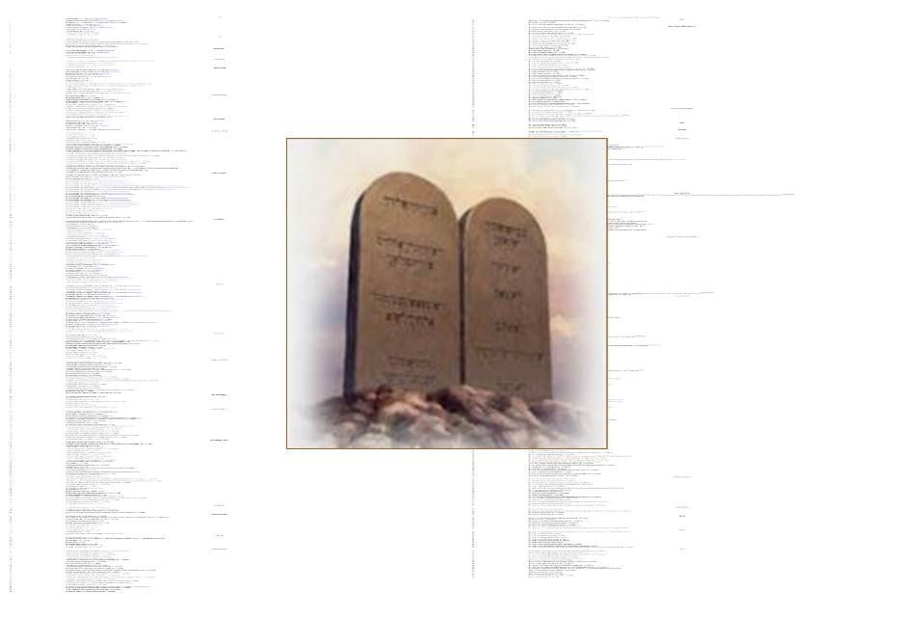
All 613 Laws!

Slide 47
Law & Grace: Lesson 6 A Mountaintop Experience – Part 2
Were you aware that…
…when God gave Moses ‘the 10’, He commanded Moses to teach the Children of Israel, all 613 of the statutes and judgments of the Law (Deu. 4:14)?
…the reason that ‘The 10’ were written on tablets of stone, by the finger of God, was specifically so that they could be placed in the Ark of the Covenant – as a representation of ‘the whole Law’?

Slide 48
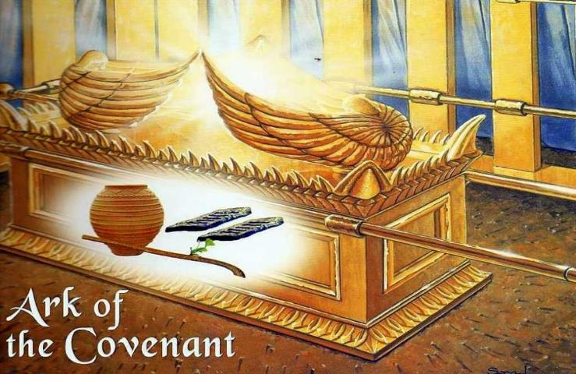
Law & Grace: Lesson 6 A Mountaintop Experience – Part 2
The Ark of the Covenant
Exodus 25:10-22

Slide 49
Law & Grace: Lesson 6 A Mountaintop Experience – Part 2
Were you aware that…
…‘The 10’ were not the first commands given in the Bible? – being fruitful and multiplying (Gen. 1:28; 9:1, 7), and male circumcision (Gen. 17:1-14) and observing Passover (Exo. 12:1) were all given beforehand.
…the statutes in the Law of Moses that were not revealed to Moses by prior revelation, by the contents of ‘The 10’ or by God speaking, were revealed by angels? (c.f. Acts 7:53; Galatians 3:19; Hebrews 2:2)

Slide 50
Law & Grace: Lesson 6 A Mountaintop Experience – Part 2
Were you aware that…
…‘The 10’ were not sequentially, the first laws given in the Law of Moses? – being fruitful and multiplying (Gen. 1:28; 9:1, 7), and male circumcision (Gen. 17:1-14) and observing Passover (Exo. 12:1) were all given before.
…the statutes in the Law of Moses that were not revealed by 1) prior revelation, 2) in the contents of ‘The 10’ or 3) by God directly speaking, were revealed by angels? (c.f. Acts 7:53; Galatians 3:19; Hebrews 2:2)

Slide 51
Acts 7:53
you who received the law as ordained by angels, and yet did not keep it.”
Galatians 3:19
Why the Law then? It was added because of transgressions, having been ordained through angels by the agency of a mediator, until the seed would come to whom the promise had been made.
Hebrews 2:2
For if the word spoken through angels proved unalterable, and every transgression and disobedience received a just penalty,

Slide 52
Session 6 Outline
Review
Purpose, Aim, and Objective
Session 5
A Mountaintop Experience – Part 2 (Exo. 20:1-21)
General Information
Contrast & Comparison of Law & Grace
Conclusion

Slide 53
Law & Grace: Lesson 6 A Mountaintop Experience – Part 2
We have died to the Law
including ‘The 10’
We have died in relationship to the entire Law of Moses (Rom. 7:4; Gal. 2:19).
We have been released from the Law to be joined to Christ (Rom. 7:4, 6).
The singular reigning principal or rule of life during the Church Age, is GRACE (Rom. 5:20-21).

Slide 54
Romans 7:4, 6
⁴ Therefore, my brethren, you also were made to die to the Law through the body of Christ, so that you might be joined to another, to Him who was raised from the dead, in order that we might bear fruit for God….⁶ But now we have been released from the Law, having died to that by which we were bound, so that we serve in newness of the Spirit and not in oldness of the letter.
Galatians 2:19
For through the Law I died to the Law, so that I might live to God.

Slide 55
Law & Grace: Lesson 6 A Mountaintop Experience – Part 2
We have been released from the Law
including ‘The 10’
We have died in relationship to the entire Law of Moses (Rom. 7:4; Gal. 2:19).
We have been released from the Law to be joined to Christ (Rom. 7:4, 6).
The singular reigning principal or rule of life during the Church Age, is GRACE (Rom. 5:20-21).

Slide 56
Romans 7:4, 6
⁴ Therefore, my brethren, you also were made to die to the Law through the body of Christ, so that you might be joined to another, to Him who was raised from the dead, in order that we might bear fruit for God….⁶ But now we have been released from the Law, having died to that by which we were bound, so that we serve in newness of the Spirit and not in oldness of the letter.

Slide 57
Law & Grace: Lesson 6 A Mountaintop Experience – Part 2
Grace - the Church’s Reigning Principal!
We have died in relationship to the entire Law of Moses (Rom. 7:4; Gal. 2:19).
We have been released from the Law to be joined to Christ (Rom. 7:4, 6).
The singular reigning principal or rule of life during the Church Age, is GRACE (Rom. 5:20-21).

Slide 58
Romans 5:20–21
²⁰ The Law came in so that the transgression would increase; but where sin increased, grace abounded all the more, ²¹ so that, as sin reigned in death, even so grace would reign through righteousness to eternal life through Jesus Christ our Lord.

Slide 59
Tom Constable Expository Notes on the Bible (Ro 5:20). Galaxie Software. (2003).
One of the purposes of the Mosaic Law was to increase the sinfulness of people. It did so at least by exposing behavior that was until then not obviously contrary to God’s will. God did this to prove man’s sinfulness to him…However when God provided Jesus Christ, He provided grace (favor) that far exceeded the sin that He exposed when He provided the Law.

Slide 60
Law & Grace: Lesson 6 A Mountaintop Experience – Part 2
The Law is a ministry of death and condemnation – including ‘The 10’
‘The 10 Commandments’ as given are holy and righteous and good (Rom. 7:12-16).
The Law demands obedience but provides no power to comply with those demands so, the Law becomes fatal.
That is why Paul called even ‘The 10 Commandments’ a ministry of death and condemnation (2 Cor. 3:7-11: ‘tablets’ and ‘letters engraved in stone’ refers specifically to ‘The 10’).

Slide 61
Rom. 7:12-16
¹² So then, the Law is holy, and the commandment is holy and righteous and good. ¹³ Therefore did that which is good become a cause of death for me? May it never be! Rather it was sin, in order that it might be shown to be sin by effecting my death through that which is good, so that through the commandment sin would become utterly sinful. ¹⁴ For we know that the Law is spiritual, but I am of flesh, sold into bondage to sin. ¹⁵ For what I am doing, I do not understand; for I am not practicing what I would like to do, but I am doing the very thing I hate. ¹⁶ But if I do the very thing I do not want to do, I agree with the Law, confessing that the Law is good.

Slide 62
Law & Grace: Lesson 6 A Mountaintop Experience – Part 2
The Law is a ministry of death and condemnation – including ‘The 10’
‘The 10 Commandments’ as given are holy and righteous and good (Rom. 7:12-16).
The Law demands obedience but provides no power to comply with those demands so, the Law becomes fatal.
That is why Paul called even ‘The 10 Commandments’ a ministry of death and condemnation (2 Cor. 3:7-11: ‘tablets’ and ‘letters engraved in stone’ refers specifically to ‘The 10’).

Slide 63
Law & Grace: Lesson 6 A Mountaintop Experience – Part 2
The Law is a ministry of death and condemnation – including ‘The 10’

Slide 64
Exodus 35:2–3
² “For six days work may be done, but on the seventh day you shall have a holy day, a sabbath of complete rest to the LORD; whoever does any work on it shall be put to death. ³ “You shall not kindle a fire in any of your dwellings on the sabbath day.”

Slide 65
Numbers 15:32–36
³² Now while the sons of Israel were in the wilderness, they found a man gathering wood on the sabbath day. ³³ Those who found him gathering wood brought him to Moses and Aaron and to all the congregation; ³⁴ and they put him in custody because it had not been declared what should be done to him. ³⁵ Then the Lord said to Moses, “The man shall surely be put to death; all the congregation shall stone him with stones outside the camp.” ³⁶ So all the congregation brought him outside the camp and stoned him to death with stones, just as the Lord had commanded Moses.

Slide 66
Law & Grace: Lesson 6 A Mountaintop Experience – Part 2
The Law is a ministry of death and condemnation – including ‘The 10’
‘The 10 Commandments’ as given are holy and righteous and good (Rom. 7:12-16).
The Law demands obedience but provides no power to comply with those demands so, the Law becomes fatal.
That is why Paul called even ‘The 10 Commandments’ a ministry of death and condemnation (2 Cor. 3:7-11: ‘tablets’ and ‘letters engraved in stone’ refers specifically to ‘The 10’).

Slide 67
2 Corinthians 3:7-9
⁷ But if the ministry of death, in letters engraved on stones, came with glory, so that the sons of Israel could not look intently at the face of Moses because of the glory of his face, fading as it was, ⁸ how will the ministry of the Spirit fail to be even more with glory? ⁹ For if the ministry of condemnation has glory, much more does the ministry of righteousness abound in glory.

Slide 68
2 Corinthians 3:12-16
¹² Therefore having such a hope, we use great boldness in our speech, ¹³ and are not like Moses, who used to put a veil over his face so that the sons of Israel would not look intently at the end of what was fading away. ¹⁴ But their minds were hardened; for until this very day at the reading of the old covenant the same veil remains unlifted, because it is removed in Christ. ¹⁵ But to this day whenever Moses is read, a veil lies over their heart; ¹⁶ but whenever a person turns to the Lord, the veil is taken away.

Slide 69
2 Corinthians 3:12-16
¹² Therefore having such a hope, we use great boldness in our speech, ¹³ and are not like Moses, who used to put a veil over his face so that the sons of Israel would not look intently at the end of what was fading away. ¹⁴ But their minds were hardened; for until this very day at the reading of the old covenant the same veil remains unlifted, because it is removed in Christ. ¹⁵ But to this day whenever Moses is read, a veil lies over their heart; ¹⁶ but whenever a person turns to the Lord, the veil is taken away.

Slide 70
2 Corinthians 3:12-16
¹² Therefore having such a hope, we use great boldness in our speech, ¹³ and are not like Moses, who used to put a veil over his face so that the sons of Israel would not look intently at the end of what was fading away. ¹⁴ But their minds were hardened; for until this very day at the reading of the old covenant the same veil remains unlifted, because it is removed in Christ. ¹⁵ But to this day whenever Moses is read, a veil lies over their heart; ¹⁶ but whenever a person turns to the Lord, the veil is taken away.

Slide 71
2 Corinthians 3:12-16
¹² Therefore having such a hope, we use great boldness in our speech, ¹³ and are not like Moses, who used to put a veil over his face so that the sons of Israel would not look intently at the end of what was fading away. ¹⁴ But their minds were hardened; for until this very day at the reading of the old covenant the same veil remains unlifted, because it is removed in Christ. ¹⁵ But to this day whenever Moses is read, a veil lies over their heart; ¹⁶ but whenever a person turns to the Lord, the veil is taken away.

Slide 72
2 Corinthians 3:17-18
¹⁷ Now the Lord is the Spirit, and where the Spirit of the Lord is, there is liberty. ¹⁸ But we all, with unveiled face, beholding as in a mirror the glory of the Lord, are being transformed into the same image from glory to glory, just as from the Lord, the Spirit.

Slide 73
2 Corinthians 3:17-18
¹⁷ Now the Lord is the Spirit, and where the Spirit of the Lord is, there is liberty. ¹⁸ But we all, with unveiled face, beholding as in a mirror the glory of the Lord, are being transformed into the same image from glory to glory, just as from the Lord, the Spirit.

Slide 74
2 Corinthians 3:17-18
¹⁷ Now the Lord is the Spirit, and where the Spirit of the Lord is, there is liberty. ¹⁸ But we all, with unveiled face, beholding as in a mirror the glory of the Lord, are being transformed into the same image from glory to glory, just as from the Lord, the Spirit.

Slide 75
2 Corinthians 3:17-18
¹⁷ Now the Lord is the Spirit, and where the Spirit of the Lord is, there is liberty. ¹⁸ But we all, with unveiled face, beholding as in a mirror the glory of the Lord, are being transformed into the same image from glory to glory, just as from the Lord, the Spirit.

Slide 76
Why are 9 of ‘The 10’ quoted in the New Testament?
Law & Grace: Lesson 6 A Mountaintop Experience – Part 2
Some of the quotes of the ‘The 10’ are quoted in the New Testament because Christ was speaking to the Jews in Israel, when they were under the Law of Moses (Mat. 5:27; 15:4).
Other quotes in the New Testament are to convey the moral and evident principles of the Law to us in Christ’s Body so that we will incorporate them. (2 Cor. 13:1; Eph. 6:1-3; 1 Tim. 5:19)

Slide 77
Why are 9 of ‘The 10’ quoted in the New Testament?
Law & Grace: Lesson 6 A Mountaintop Experience – Part 2
Some of the quotes of the ‘The 10’ are quoted in the New Testament because Christ was speaking to the Jews in Israel, when they were under the Law of Moses (Mat. 5:27; 15:4).
Other quotes in the New Testament are to convey the moral and evident principles of the Law to us in Christ’s Body so that we will incorporate them. (2 Cor. 13:1; Eph. 6:1-3; 1 Tim. 5:19)

Slide 78
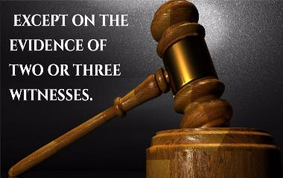
1 Tim. 5:19
Do not receive an accusation against an elder except on the basis of two or three witnesses.

Slide 79
Why are 9 of ‘The 10’ quoted in the New Testament?
Law & Grace: Lesson 6 A Mountaintop Experience – Part 2
But some quotes of and references to ‘The 10’ are to show that we cannot live out the Law of Moses as an act of our own wills alone and that we are not under the Law of Moses (Romans 7:7-8).

Slide 80
Romans 7:7-8b
⁷ What shall we say then? Is the Law sin? May it never be! On the contrary, I would not have come to know sin except through the Law; for I would not have known about coveting if the Law had not said, “You shall not covet.” ⁸ But sin, taking opportunity through the commandment, produced in me coveting of every kind…

Slide 81
Sabbath Set Aside
Law & Grace: Lesson 6 A Mountaintop Experience – Part 2
We’ve made reference to the fact that one of the 10 is not quoted in the New Testament, namely the Sabbath. (Colossians 2:16-17)

Slide 82
Colossians 2:16-17
¹⁶ Therefore no one is to act as your judge in regard to food or drink or in respect to a festival or a new moon or a Sabbath day-- ¹⁷ things which are a mere shadow of what is to come; but the substance belongs to Christ.

Slide 83
Because of Love, we’re under Grace
Law & Grace: Lesson 6 A Mountaintop Experience – Part 2
Salvation by grace through faith was, and is, and will always be, the means of salvation…from the Garden of Eden until the very end of this present heaven and earth.
But Grace is not just the means of our salvation, but also the motive for living, as well as the means for living and the source of opportunity, within the church body.

Slide 84
Ephesians 2:10
For we are His workmanship, created in Christ Jesus for good works, which God prepared beforehand so that we would walk in them.

Slide 85
Ephesians 2:4-7
⁴ But God, being rich in mercy, because of His great love with which He loved us, ⁵ even when we were dead in our transgressions, made us alive together with Christ (by grace you have been saved), ⁶ and raised us up with Him, and seated us with Him in the heavenly places in Christ Jesus, ⁷ so that in the ages to come He might show the surpassing riches of His grace in kindness toward us in Christ Jesus.

Slide 86
Session 6 Outline
Review
Purpose, Aim, and Objective
Session 5
A Mountaintop Experience – Part 2 (Exo. 20:1-21)
General Information
Contrast & Comparison of Law & Grace
Conclusion

Slide 87
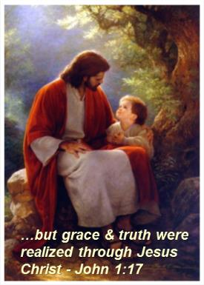
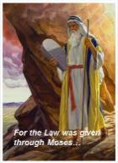
Law & Grace: Lesson 6 A Mountaintop Experience – Part 2
CONCLUSION

Slide 88
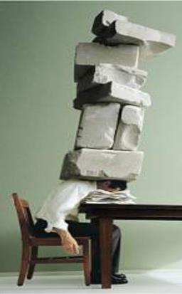
LIVING UNDER LAW OR UNDER GRACE?
Law & Grace: Lesson 6 A Mountaintop Experience – Part 2
What’s your pleasure?

