Slide 1


Slide 2

The Coming Kingdom
Chapter 13
Dr. Andy Woods
Senior Pastor – Sugar Land Bible Church
President – Chafer Theological Seminary

Slide 3

Kingdom Study Outline
What does the Bible Say About the Kingdom?
The Main Problem with Kingdom Now NT interpretations
Why do some believe that we are in the kingdom now?
Why does it matter?

Slide 4
1. Kingdom Throughout the Bible
Eden Abrahamic Covenant Mosaic Covenant Divided Kingdom Times of the Gentiles | Old Testament Prophets Post exile Offer of the King / Kingdom Rejection of the Offer Interim Age

Slide 5
1. Kingdom Throughout the Bible
Kingdom Mysteries Church Israel’s Discipline & Restoration Re-offer of the King/Kingdom | Transfer of Kingdom Authority Kingdom Establishment Eternal State Testimony of Early Church History

Slide 6

The Coming of the Kingdom
Re-offer of the kingdom
Transfer of earthly authority
Establishment of the kingdom
Duration of the kingdom

Slide 7
The Coming of the Kingdom
Re-offer of the kingdom
Transfer of earthly authority
Establishment of the kingdom
Duration of the kingdom

Slide 8
Messengers of the Kingdom In Matthew
John the Baptist – 3:2
Jesus Christ – 4:17
12 Apostles – 10:5-7
Seventy – Luke 10:1, 9
Toussaint, Behold the King, 18-20

Slide 9


Matthew 12:24
“But when the Pharisees heard this, they said, “This man casts out demons only by Beelzebul the ruler of the demons.”

Slide 10
Matthew 24:14
“This gospel of the kingdom shall be preached in the whole world as a testimony to all the nations, and then the end will come.”

Slide 11
The Coming of the Kingdom
Re-offer of the kingdom
Transfer of earthly authority
Establishment of the kingdom
Duration of the kingdom

Slide 12
Revelation 11:15
“Then the seventh angel sounded; and there were loud voices in heaven, saying, ‘The kingdom of the world has become the kingdom of our Lord and of His Christ; and He will reign forever and ever.’”

Slide 13
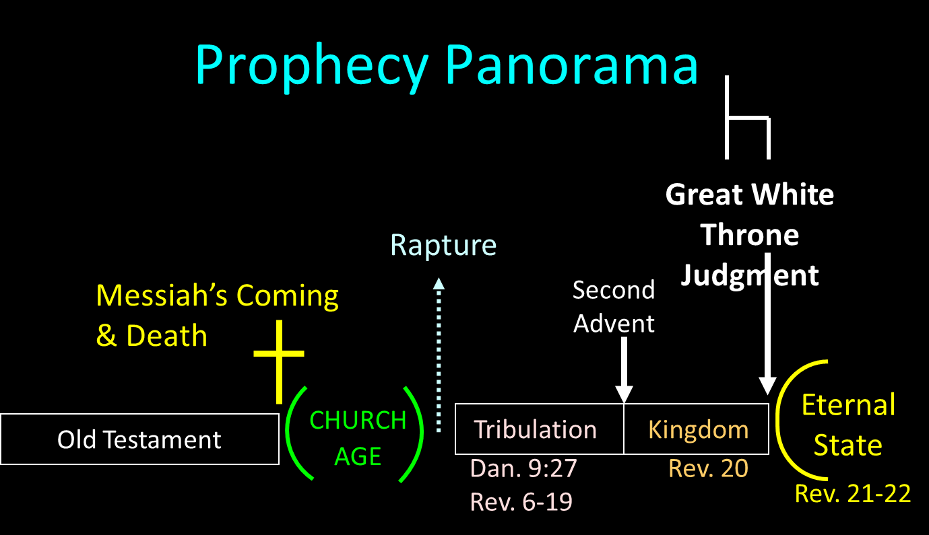

Slide 14
The Coming of the Kingdom
Re-offer of the kingdom
Transfer of earthly authority
Establishment of the kingdom
Duration of the kingdom

Slide 15
Genesis 1:26-28
²⁶ Then God said, “Let Us make man in Our image, according to Our likeness; and let them rule over the fish of the sea and over the birds of the sky and over the cattle and over all the earth, and over every creeping thing that creeps on the earth.” ²⁷ God created man in His own image, in the image of God He created him; male and female He created them. ²⁸ God blessed them; and God said to them, …

Slide 16
Genesis 1:26-28
…“Be fruitful and multiply, and fill the earth, and subdue it; and rule over the fish of the sea and over the birds of the sky and over every living thing that moves on the earth.”

Slide 17
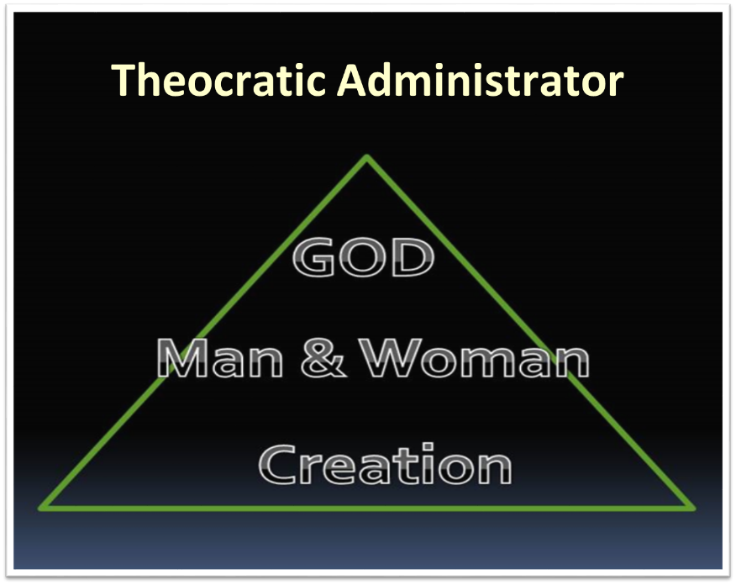

Slide 18
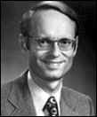
Charles Ryrie
Basic Theology, Page 511
“Why is an earthly kingdom necessary? Did He not receive His inheritance when He was raised and exalted in heaven? Is not His present rule His inheritance? Why does there need to be an earthly kingdom? Because He must be triumphant in the same arena where He was seemingly defeated. His rejection by the rulers of this world was on this earth (1Cor. 2:8). His exaltation must also be on this earth. And so it shall be when He comes again to rule this world in righteousness. He has waited long for His inheritance; soon He shall receive it.”

Slide 19


Slide 20

Matthew 25:31
“³¹ But when the Son of Man comes in His glory, and all the angels with Him, then He will sit on His glorious throne. ³² All the nations will be gathered before Him; and He will separate them from one another, as the shepherd separates the sheep from the goats; ³³ and He will put the sheep on His right, and the goats on the left. ³⁴ Then the King will say to those on His right, ‘Come, you who are blessed of My Father, inherit the kingdom prepared for you from the foundation of the world.’”

Slide 21
Exodus 19:5-6
“Now then, if you will indeed obey My voice and keep My covenant, then you shall be My own possession among all the peoples, for all the earth is Mine; and you shall be to Me a kingdom of priests and a holy nation.’ These are the words that you shall speak to the sons of Israel.”

Slide 22


Statue
&
Stone

Slide 23

2 Peter 1:19
“So we have the prophetic word made more sure, to which you do well to pay attention as to a lamp shining in a dark place, until the day dawns and the morning star arises in your hearts.”

Slide 24

OT PROPHETS DESCRIBE THE KINGDOM
Kingdom Characteristics
Is. 2:1-4; 11:6-9; 65:17-25
  Jerusalem = center of world spiritual and political authority
  Perfect justice
  World peace
  Peace in the animal kingdom
  Universal spiritual knowledge.

Slide 25
OT Prophets Describe the Kingdom
Established by God (Dan. 2:44) Eternal (Dan. 7:27) Christ’s direct rule (Zech. 9:9-10) Earthly (Zech. 14:9) Land promises realized (Gen. 15:18-21) Israel’s preeminence (Isa. 49:22-23) Immediate answered prayers (Isa. 65:24) | Millennial Temple (Ezek. 40‒46) Millennial David (Jer. 30:9) Righteousness (Isa. 9:6-7) Curse curtailed (Isa. 65:20, 22) Peace (Isa. 2:4) Prosperity (Amos 9:13-14; Isa 65:22) Topographical changes (Ezek. 47:1-12)

Slide 26
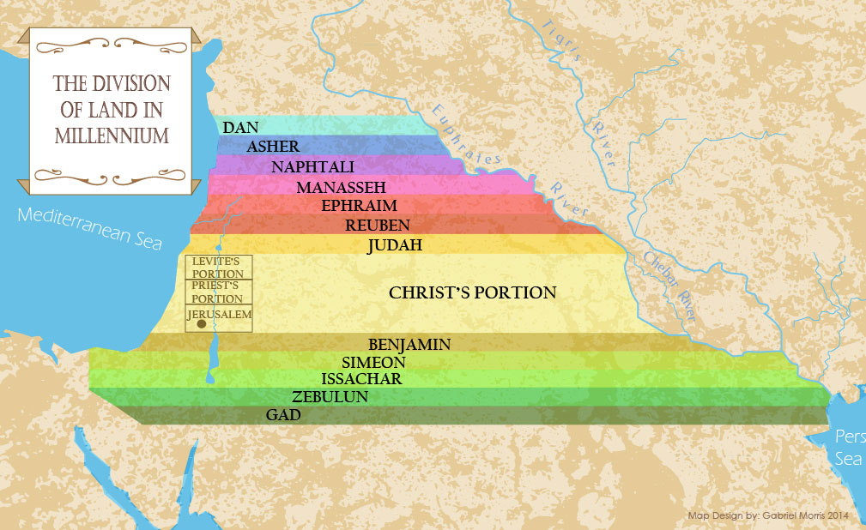

Slide 27
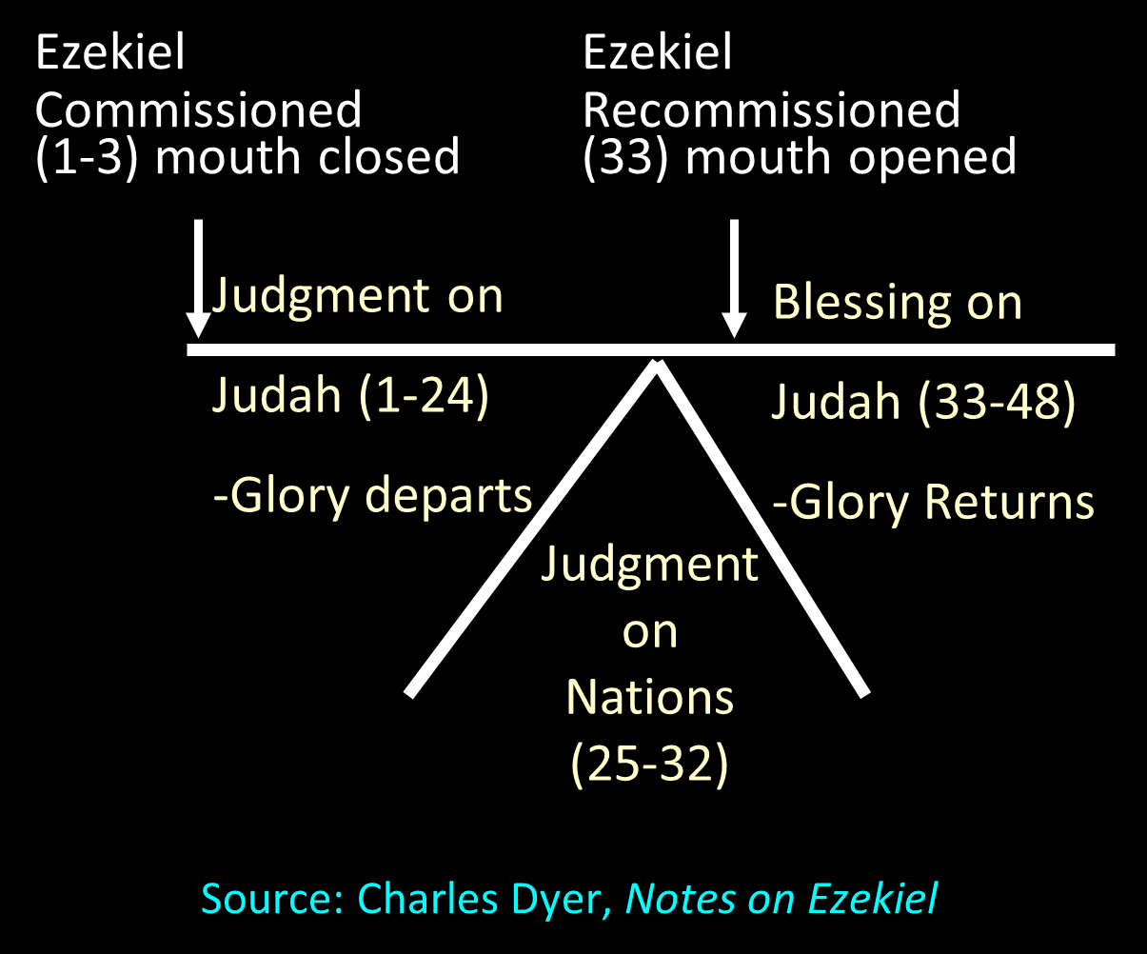

Slide 28


Slide 29


Slide 30
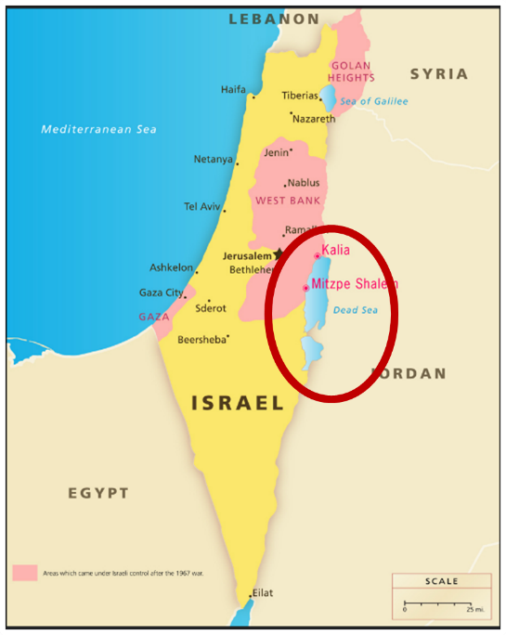


The Dead Sea

Slide 31


Slide 32
Romans 8:19-22
¹⁹ For the anxious longing of the creation waits eagerly for the revealing of the sons of God. ²⁰ For the creation was subjected to futility, not willingly, but because of Him who subjected it, in hope ²¹ that the creation itself also will be set free from its slavery to corruption into the freedom of the glory of the children of God. ²² For we know that the whole creation groans and suffers the pains of childbirth together until now.

Slide 33

Names & Titles Demonstrating Satan’s Post-Fall, Earthly Authority
(Job 1:7; 2:2; Luke 4:5-8; Rom. 8:19-22)
Prince of this world (John 12:31; 14:30; 16:11)
God of this world (2 Cor. 4:4)
Prince and power of the air (Eph. 2:2)
Who the believer wrestles with (Eph. 6:12)
Roaring lion (1 Pet. 5:8)
Whole world lies in his power (1 John 5:19)

Slide 34

Satan’s Progressive Defeat
Initial eviction from heaven (Isa 14:12-15; Ezek 28:12-17)
Eden (Gen 3:15)
Pre-diluvian world (1 Pet 3:19-20)
Cross (John 12:31; 16:11; Col 2:15; Heb 2:14; 1 John 3:8)
Mid point of the Tribulation (Rev 12:9)
Beginning of millennium (Rev 20:2-3)
End of millennium (Rev 20:10)

Slide 35
Satan’s Progressive Defeat
Initial eviction from heaven (Isa 14:12-15; Ezek 28:12-17)
Eden (Gen 3:15)
Pre-diluvian world (1 Pet 3:19-20)
Cross (John 12:31; 16:11; Col 2:15; Heb 2:14; 1 John 3:8)
Mid point of the Tribulation (Rev 12:9)
Beginning of millennium (Rev 20:2-3)
End of millennium (Rev 20:10)

Slide 36
Matthew 23:37-39
“Jerusalem, Jerusalem, who kills the prophets and stones those who are sent to her! How often I wanted to gather your children together, the way a hen gathers her chicks under her wings, and you were unwilling. ³⁸ Behold, your house is being left to you desolate! ³⁹ For I say to you, from now on you will not see Me until you say, ‘Blessed is He who comes in the name of the Lord!’”

Slide 37
Acts 1:6-8
“⁶ So when they had come together, they were asking Him, saying, ‘Lord, is it at this time You are restoring the kingdom to Israel?’ ⁷ He said to them, ‘It is not for you to know times or epochs which the Father has fixed by His own authority; ⁸ but you will receive power when the Holy Spirit has come upon you; and you shall be My witnesses both in Jerusalem, and in all Judea and Samaria, and even to the remotest part of the earth.’”

Slide 38
The Coming of the Kingdom
Re-offer of the kingdom
Transfer of earthly authority
Establishment of the kingdom
Duration of the kingdom

Slide 39
Revelation 20:1-3
¹“Then I saw an angel coming down from heaven, holding the key of the abyss and a great chain in his hand. ² And he laid hold of the dragon, the serpent of old, who is the devil and Satan, and bound him for a thousand years; ³ and he threw him into the abyss, and shut it and sealed it over him, so that he would not deceive the nations any longer, until the thousand years were completed; after these things he must be released for a short time.”

Slide 40
Revelation 20:4-6
“⁴ Then I saw thrones, and they sat on them, and judgment was given to them. And I saw the souls of those who had been beheaded because of their testimony of Jesus and because of the word of God, and those who had not worshiped the beast or his image, and had not received the mark on their forehead and on their hand; and they came to life and reigned with Christ for a thousand years. ⁵ The rest of the dead did not come to life until the thousand years were completed….

Slide 41
Revelation 20:4-6
…This is the first resurrection. ⁶ Blessed and holy is the one who has a part in the first resurrection; over these the second death has no power, but they will be priests of God and of Christ and will reign with Him for a thousand years.”

Slide 42
Revelation 20:7-10
“⁷ When the thousand years are completed, Satan will be released from his prison, ⁸ and will come out to deceive the nations which are in the four corners of the earth, Gog and Magog, to gather them together for the war; the number of them is like the sand of the seashore. ⁹ And they came up on the broad plain of the earth and surrounded the camp of the saints and the beloved city, and fire came down from heaven and devoured them. ¹⁰ And the devil…

Slide 43
Revelation 20:7-10
…who deceived them was thrown into the lake of fire and brimstone, where the beast and the false prophet are also; and they will be tormented day and night forever and ever.”

Slide 44
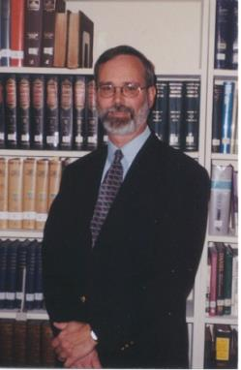
Kenneth L. Gentry
He Shall Have Dominion: A Post Millennial Eschatology (Tyler, Texas: Institute for Christian economics, 1992), page 335.
“The proper understanding of the thousand-year time frame in Revelation 20 is that it is representative of a long and glorious era and is not limited to a literal 365,000 days. The figure represents a perfect cube of 10, which is the number of quantitative perfection.”

Slide 45
Reasons for Understanding 1000 Literally
John’s use of indefinite concepts elsewhere
  Revelation 20:8, 20:3
Exception to the “# of years” examples?
Other numbers are taken literally
  Two witnesses (11:3), 7000 people (11:13), 4 Angels (7:1) 7 Angels (8:6),144,000 Jews (7:4), 42 months (11:2), 1260 days (11:3)
Not always a symbolic interpretation
  (Rev. 17:18)

Slide 46
Reasons for Understanding 1000 Literally
John’s use of indefinite concepts elsewhere
  Revelation 20:8, 20:3
Exception to the “# of years” examples?
Other numbers are taken literally
  Two witnesses (11:3), 7000 people (11:13), 4 Angels (7:1) 7 Angels (8:6),144,000 Jews (7:4), 42 months (11:2), 1260 days (11:3)
Not always a symbolic interpretation
  (Rev. 17:18)

Slide 47
Revelation 20:7-10
“⁷ When the thousand years are completed, Satan will be released from his prison, ⁸ and will come out to deceive the nations which are in the four corners of the earth, Gog and Magog, to gather them together for the war; the number of them is like the sand of the seashore. ⁹ And they came up on the broad plain of the earth and surrounded the camp of the saints and the beloved city, and fire came down from heaven and devoured them. ¹⁰ And the devil…

Slide 48
Revelation 20:1-3
¹“Then I saw an angel coming down from heaven, holding the key of the abyss and a great chain in his hand. ² And he laid hold of the dragon, the serpent of old, who is the devil and Satan, and bound him for a thousand years; ³ and he threw him into the abyss, and shut it and sealed it over him, so that he would not deceive the nations any longer, until the thousand years were completed; after these things he must be released for a short time [mikros chronos].”

Slide 49
Matthew 25:19
“Now after a long time [polus chronos] the master of those slaves came and settled accounts with them.”

Slide 50
Reasons for Understanding 1000 Literally
John’s use of indefinite concepts elsewhere
  Revelation 20:8, 20:3
Exception to the “# of years” examples?
Other numbers are taken literally
  Two witnesses (11:3), 7000 people (11:13), 4 Angels (7:1) 7 Angels (8:6),144,000 Jews (7:4), 42 months (11:2), 1260 days (11:3)
Not always a symbolic interpretation
  (Rev. 17:18)

Slide 51
Reasons for Understanding 1000 Literally
John’s use of indefinite concepts elsewhere
  Revelation 20:8, 20:3
Exception to the “# of years” examples?
Other numbers are taken literally
  Two witnesses (11:3), 7000 people (11:13), 4 Angels (7:1) 7 Angels (8:6),144,000 Jews (7:4), 42 months (11:2), 1260 days (11:3)
Not always a symbolic interpretation
  (Rev. 17:18)

Slide 52
Reasons for Understanding 1000 Literally
John’s use of indefinite concepts elsewhere
  Revelation 20:8, 20:3
Exception to the “# of years” examples?
Other numbers are taken literally
  Two witnesses (11:3), 7000 people (11:13), 4 Angels (7:1) 7 Angels (8:6),144,000 Jews (7:4), 42 months (11:2), 1260 days (11:3)
Not always a symbolic interpretation
  (Rev. 17:18)

Slide 53
Revelation 20:1-3
¹“Then I saw an angel coming down from heaven, holding the key of the abyss and a great chain in his hand. ² And he laid hold of the dragon, the serpent of old, who is the devil and Satan, and bound him for a thousand years; ³ and he threw him into the abyss, and shut it and sealed it over him, so that he would not deceive the nations any longer, until the thousand years were completed; after these things he must be released for a short time.”

Slide 54
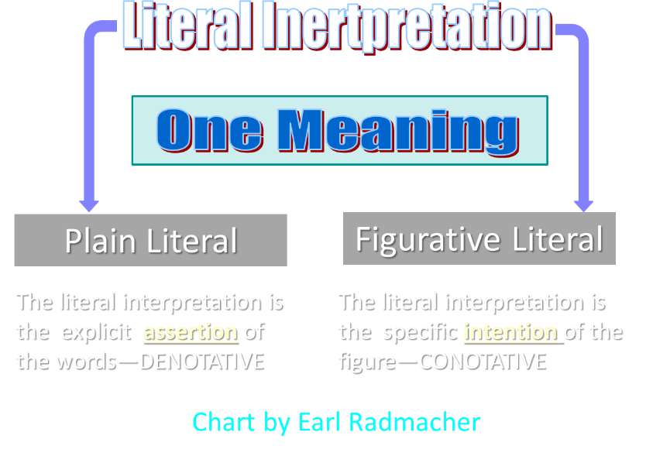

Slide 55
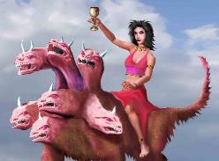
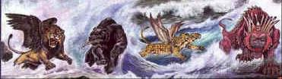
Revelation's Symbols and Figures of Speech
“Spiritually” (11:8)
“Sign” (12:1)
“Like” or “as” (8:8)
OT correspondence (Rev 13:2; Dan 7)
Contextual interpretations (17:18)
Absurdity (12:1)

Slide 56
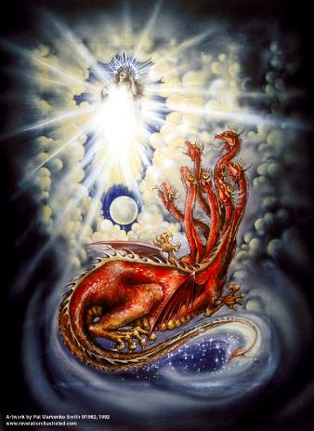
Assigning Meaning to Revelation’s Symbols and Figures of Speech
Context (Rev 12:3, 9)
Old Testament (Rev 12:1; Gen 37:9-10)
Comparison (Rev 8:8)

Slide 57
Reasons for Understanding 1000 Literally
John’s use of indefinite concepts elsewhere
  Revelation 20:8, 20:3
Exception to the “# of years” examples?
Other numbers are taken literally
  Two witnesses (11:3), 7000 people (11:13), 4 Angels (7:1) 7 Angels (8:6),144,000 Jews (7:4), 42 months (11:2), 1260 days (11:3)
Not always a symbolic interpretation
  (Rev. 17:18)

Slide 58

Robert Thomas
Revelation 8 to 22: An Exegetical Commentary (Chicago: Moody Press, 1992), 408.
Robert Thomas observes that, "no number in Revelation is verifiably a symbolic number.”

Slide 59
Psalm 50:10
“For every beast of the forest is Mine,
The cattle on a thousand hills.”

Slide 60
Revelation 20:4-6
“⁴ Then I saw thrones, and they sat on them, and judgment was given to them. And I saw the souls of those who had been beheaded because of their testimony of Jesus and because of the word of God, and those who had not worshiped the beast or his image, and had not received the mark on their forehead and on their hand; and they came to life [zaō] nd reigned with Christ for a thousand years….

Slide 61
Revelation 20:4-6
…⁵ The rest of the dead did not come to life [zaō] until the thousand years were completed. This is the first resurrection [anastasis and not palingenesia]. ⁶ Blessed and holy is the one who has a part in the first resurrection [anastasis and not palingenesia]; over these the second death has no power, but they will be priests of God and of Christ and will reign with Him for a thousand years.”

Slide 62
Conclusion

Slide 63
The Coming of the Kingdom
Re-offer of the kingdom
Transfer of earthly authority
Establishment of the kingdom
Duration of the kingdom

