Slide 1
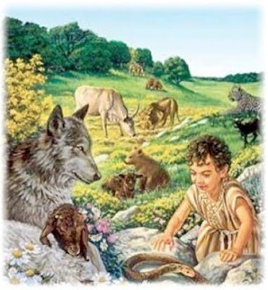
A Review of The Millennial Kingdom Part 2
Jim McGowan, Th.D. Sugar Land Bible Church 02-28-2017
This presentation was compiled using the following resources: Charting the End Times; Major Bible Themes, Not By Bread Alone: An Outlined Guide to Bible Doctrine, The Footsteps of the Messiah: A Study of the Sequence of Prophetic Events, The Prophecy Knowledge Handbook, and materials provided by Dr. Andy Woods and Dr. Vern Peterman.

Slide 2
Outline
Overview of the Millennial Kingdom
Millennial Views of the Kingdom
Nature of Millennium

Slide 3
Outline
Overview of the Millennial Kingdom
Millennial Views of the Kingdom
Nature of Millennium

Slide 4
Overview of the Millennial Kingdom
From the 2nd Coming to the Millennial Kingdom
A Panoramic View of the Millennial Kingdom

Slide 5
From the 2nd Coming to the Millennial Kingdom
Notes:
Daniel 12:11–12 and Revelation 11:3: Here is a summary timeline:
Sometime after the rapture of the church, the Antichrist enters a treaty with Israel. This begins the seven-year tribulation.
At the midpoint of the tribulation (1,260 days later), the Antichrist breaks the treaty, desecrates the temple, and begins to persecute the Jews.
At the end of the tribulation (1,260 days after the desecration of the temple), Jesus Christ returns to earth and defeats the forces of the Antichrist.
During the next 30 days (leading up to 1,290 days after the desecration of the temple), Israel is rebuilt and the earth is restored.
During the next 45 days (leading up to 1,335 days after the desecration of the temple), the Gentile nations are judged for their treatment of Israel.
The dispensation of the millennium begins, and it will last for 1,000 years (Revelation 20:3, 5–6).
https://www.gotquestions.org/tribulation-1260-1290-1335-days.html

Slide 6
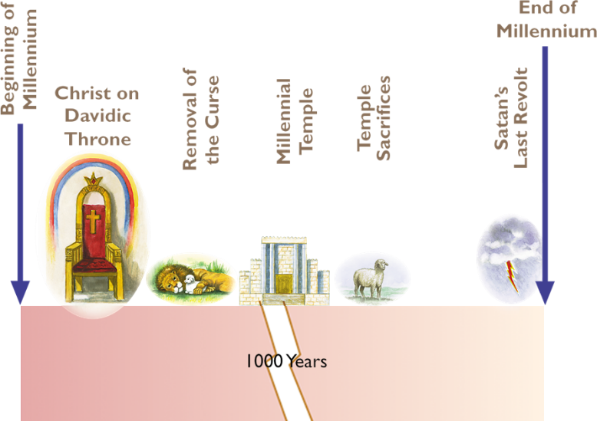
A Panoramic View of the Millennial Kingdom

Slide 7
Outline
Overview of the Millennial Kingdom
Millennial Views of the Kingdom
Nature of Millennium

Slide 8
Millennial Views of the Kingdom
Amillennial
Post-Millennial
Pre-Millennial

Slide 9
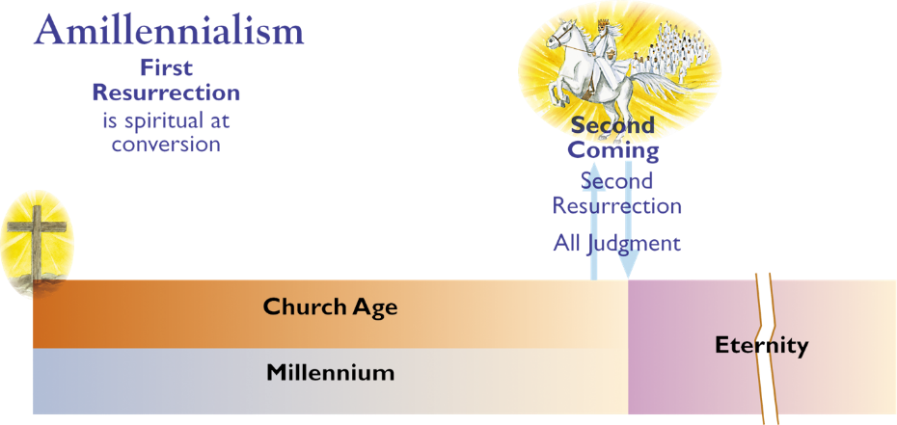
Millennial Views of the Kingdom
There will be no literal future thousand-year reign of Christ on earth. The Millennium refers to the present age or possibly the last thousand years of the present age.

Slide 10
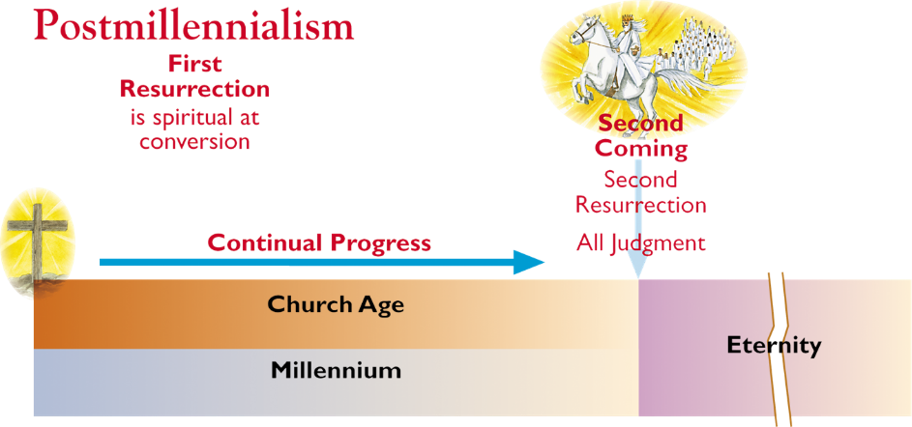
Millennial Views of the Kingdom
The whole world will be Christianized, bringing in a golden age which will correspond to the millennial kingdom. The Millennium will be the last 1,000 years of the present age.

Slide 11
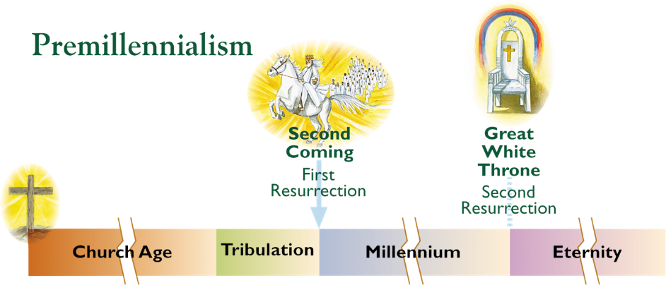
Millennial Views of the Kingdom
This was the predominant view of the early church as witnessed by the early church fathers. It wasn’t until the 3rd century, under the influence of the Alexandria school of theology, that it was displaced.

Slide 12
Outline
Overview of the Millennial Kingdom
Millennial Views of the Kingdom
Nature of Millennium

Slide 13
Nature of Millennium
Duration of the Kingdom
General Conditions
Political Conditions
Governors, Governed In Millennium
Spiritual Conditions

Slide 14
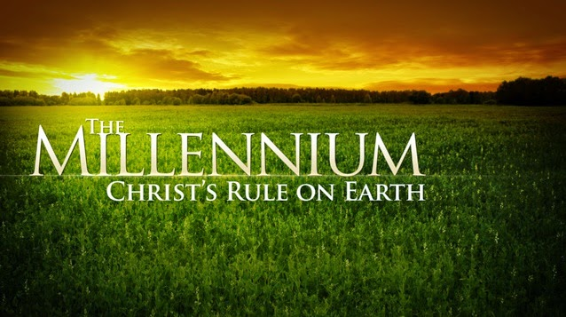
Duration of the Kingdom
1000 years
Eternal

Slide 15
Nature of Millennium
Duration of the Kingdom
General Conditions
Political Conditions
Governors, Governed In Millennium
Spiritual Conditions

Slide 16
General Conditions
Better Health Conditions
Increased Fertility
Labor and Productivity
Partial Removal of Curse
Glory
Joy
Wealth

Slide 17
END OF PART 1 REVIEW

Slide 18
Nature of Millennium
Duration of the Kingdom
General Conditions
Political Conditions
Governors, Governed In Millennium
Spiritual Conditions

Slide 19
Political Conditions
Perfect, Lasting Peace
Kingdom Judicial System
Individual Welfare Priority
Millennial Government Dictatorial

Slide 20
Political Conditions
Perfect, Lasting Peace
War is generated by man’s selfishness (James 4:1-2).
Without a change in man’s sin nature, there can be no peace (Isa. 57:21).
Christ predicted an increase of wars in the end times (Matt. 24:6-7).
Only the “Prince of Peace” can create and maintain world peace under a perfect government.
World peace brings security, protection and comfort for God’s chosen nation, Israel.

Slide 21
Political Conditions
Perfect, Lasting Peace
Psa. 72:7; Isa. 2:4 (Micah 4:3); 9:6-7; 12:1-2; 29:22; 30:26; 32:17-18; 40:1-2; 49:13; 51:3; 54:13-14; 60:18; 66:12; 60:21; 61:4 and 7; 62:8a and 9; 65:21ff.; 66:13-14; Jer. 23:6; Ezek. 28:26; 34:25, 27, 28; Hosea 2:18; Joel 3:16-17; Amos 9:15; Zeph. 3:18-20; Zech. 8:14-15; 9:8-10; 14:11).

Slide 22
Political Conditions
Kingdom Judicial System
Christ’s administration of justice with a “rod of iron,” in the courts will ensure accurate verdicts and fair sentences.
Christ will have authority over both political and spiritual realms in the Millennium so there will be no “separation of church and state”.
As the world’s center for worship, Jerusalem will also be the world’s political capital.
There is a need for a judicial system in the Millennium because the unglorified peoples of the world will still have a sin nature.

Slide 23
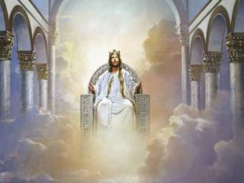
Political Conditions
Kingdom Judicial System (cont’d)
Christ’s perfect government will include capital punishment.
Psa. 96:13; Isa. 2:3b-4a; 9:7; 11:3b-5; 32:16; 33:5; 42:1-4; Isa. 65:20; 66:24 Jer. 23:5-6; 31:30; 33:15; Micah 4:2d-3

Slide 24
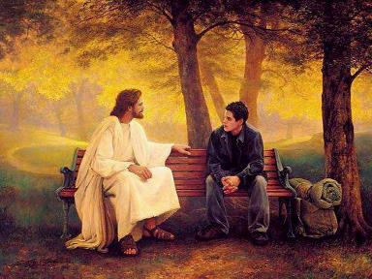
Political Conditions
Individual Welfare Priority
Political repression will be a thing of the past. As benevolent dictator, Christ will govern with a balance of justice and mercy, caring for the individual needs of His people (Isa. 40:11).

Slide 25
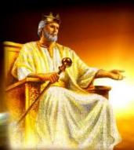
Political Conditions
Millennial Government Dictatorial
Christ will rule as the perfect, theocratic, dictator with complete and absolute power over the entire world.
Psa. 2:8-9; 22:27-28; Psa. 72:8; Isa. 2:4; 11:9b-10; 60:11-12; Dan. 2:35; Dan. 7:14, 27; Micah 4:2-3; 5:2; Hab. 2:14; Zeph. 3:9; Zech. 8:20-23; 9:10; 14:9; Rev. 2:26-27; 11:15; 17:14; 19:15-16

Slide 26
Nature of Millennium
Duration of the Kingdom
General Conditions
Political Conditions
Governors, Governed In Millennium
Spiritual Conditions

Slide 27
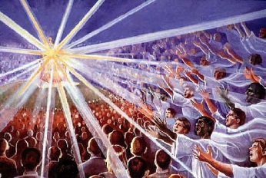
Governors, Governed In Millennium
Authorities
Those Governed

Slide 28
Governors, Governed In Millennium
Authorities
Messiah
King David
Twelve Apostles
Other Lesser Nobles, Judges

Slide 29
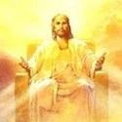
Governors, Governed In Millennium
Authorities
Messiah – is the ultimate sovereign in the millennial Kingdom exercising ultimate control as “judge, lawgiver, and king”.
Names expressing His authority (Branch, The Lord Our Righteousness, Jehovah, Rod of Jesse, Son of Man, King, Judge, Lawgiver, King of kings and Lord of lords, Shepherd, The Light, Stone, Redeemer, Sun of Righteousness, Son of David).

Slide 30
Governors, Governed In Millennium
Authorities
In many respects the rule of Christ as the last Adam fulfills what God had intended for Adam who was placed in charge of the Garden of Eden.
(Psa. 2:6; Isa. 9:6-7; Isa. 33:22; Dan. 7:14; Luke 1:31-33; Matt. 19:28; 25:31; 1 Cor. 15:24, etc.).

Slide 31
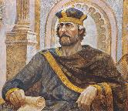
Governors, Governed In Millennium
Authorities
King/Prince David – Resurrected David will have an extremely high position in the millennium. From the viewpoint of Israel, David will be their king ruling over them. But from the viewpoint of the Messiah, David will be a prince.
Isa. 55:3-4; Jer. 30:9; 33:15-17; Ezek. 34:23-24; 37: 24-25; Hos. 3:5; Amos 9:11

Slide 32
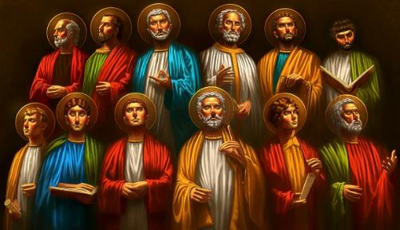
Governors, Governed In Millennium
Authorities
Twelve Apostles – The twelve apostles will serve as judges for Israel’s twelve tribes. (Matt. 19:28; Luke 22:28–30; Revelation 4:4)

Slide 33
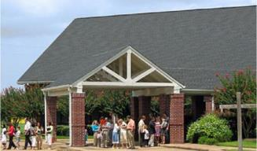
Governors, Governed In Millennium
Authorities
Other Lesser Nobles, Judges – Several passages mention lesser millennial rulers in general terms.
The Bible promises a role for glorified church saints in sharing in Christ’s rule.
Isa. 32:1; Obadiah v. 21; Luke 19:17,19; 1 Cor. 6:2; 2 Tim. 2:12; Rev. 2:26-27; 5:10; 20:4, 6

Slide 34
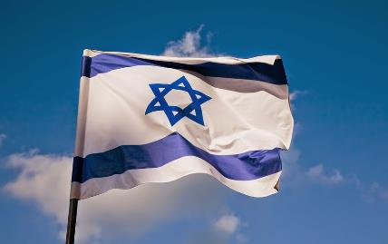
Governors, Governed In Millennium
Those Governed
Israel Restored
Israel Reunited
Israel Regenerated
Israel’s Prominence
God’s Presence, Israel
Jerusalem, Capital

Slide 35
Governors, Governed In Millennium
Israel Restored
The restoration of Israel’s people to the Promised Land is a prominent subject in Biblical prophecy.
Complete fulfillment of these predictions has never taken place up to the present time.
Isa. 11:11-12.; 27:12; 43:5-7; Jer. 30:18, 31:8-9; 32:36-40; 33:11ff.; Ezek. 11:16ff.; 20:34,42; 28:25-26; 34:12ff.; 36:24ff.; all of Ezek. 37; Hosea 1:11; Joel 3:1; Amos 9:14-15; Obadiah v. 17; Micah 4:6-7; Zeph. 3:20; Zech. 8:8, 10:10

Slide 36
Governors, Governed In Millennium
Israel Reunited
The prophets teach that when the Jews return to their land in the end times it will be as one united nation.
Jer. 3:18; 33:14; Ezek. 37:16-18, 21-22; 39:25; Hosea 1:11

Slide 37
Governors, Governed In Millennium
Israel Regenerated
While a significant “stage setting” event, the creation of the State of Israel in 1948 is not in mind.
The nation of Israel is currently in the land in “unbelief”. The nation of Israel at the time of the Second Coming of Christ, will believe in Him and enter the Millennial Kingdom as a saved nation.
In the Kingdom, Israel will be dedicated to her Messiah.
Rom. 11:26-27; Jer. 31:34; Ezek. 20:38, 40

Slide 38
Governors, Governed In Millennium
Israel’s Prominence
During the Millennium Israel will be the most powerful and prominent nation in the world. It will be the ultimate “superpower.” Many verses specifically teach that all other nations (i.e., Egypt [Isa. 19:21] and Assyria [Isa.19:22-25]) will be subordinate to Israel.
Isa. 14:1-2; 49:22-23; 60:9-15-17; 61:5-6; 62:2-5; Micah 7:12; Zech. 8:23

Slide 39
Governors, Governed In Millennium
God’s Presence, Israel
The prophets predict that God Himself will dwell in Israel during the coming Kingdom.
While glorified saints will be rulers in the Kingdom, Israel’s prominence will largely be due to the presence of God Himself in her midst.
Joel 3:17; Obadiah v. 21; Isa. 2:2-4; Micah 4:2-3, 7c; Zeph. 3:14-17a; Zech. 2:10, 12; 8:2-3; 14:3-4, 9;

Slide 40
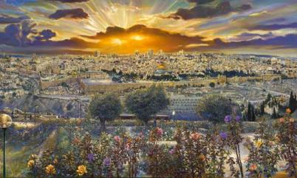
Governors, Governed In Millennium
Jerusalem, Capital
Jerusalem will be a world power center both politically and spiritually and the entire world will be governed from Jerusalem.
Isa. 2:1-4 (Micah 4:1-3); 62:6-7; Jer. 3:17; Zech. 8:22; 14:16-17

Slide 41
Nature of Millennium
Duration of the Kingdom
General Conditions
Political Conditions
Governors, Governed In Millennium
Spiritual Conditions

Slide 42
Spiritual Conditions
Satan Bound
Curse Partially Lifted
God The Son Resides On Earth
All Unsaved People Excluded at Beginning
Great Outpouring of The Spirit
Unified Worship, Jerusalem
Abundant Spirituality
Full Knowledge in Word
Millennial Temple, Worship

Slide 43
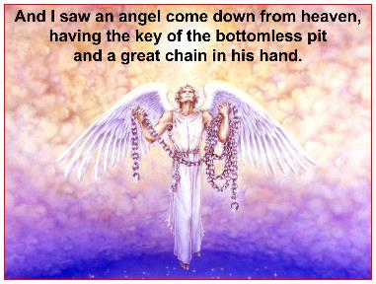
Spiritual Conditions
Satan Bound
Satan will be bound for the entire 1,000 years (cf. Rev. 20:1-3), which will cause spiritual improvement in the Kingdom’s unglorified people groups, however, unglorified persons will still have a sin nature.

Slide 44
Spiritual Conditions
Curse Partially Lifted
While death will still occur in the Millennium, there will be an increase in lifespans, fertility, productivity, a reduction of sickness, changes in animal behavior, and a general lessening of sin’s harmful affects.
Isa. 11:6-9; 35:9; 65:20, 25; Ezek. 34:25; Hosea 2:18.

Slide 45
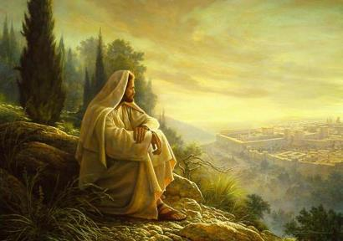
Spiritual Conditions
God The Son Resides On Earth
Israel’s prominence will largely be due to the presence of God Himself in her midst.
Joel 3:17; Obadiah v. 21; Isa. 2:2-4; Micah 4:2-3, 7c; Zeph. 3:14-17a; Zech. 2:10-12; 8:2-3; 14:3-4, 9;

Slide 46
Spiritual Conditions
All Unsaved People Excluded at Beginning
The Judgment of Israel - all the unsaved Jews who have survived the Tribulation will be excluded from the Kingdom and cast into punishment. (Eze. 20:33-44; Mal. 3:1-6)

Slide 47
Spiritual Conditions
All Unsaved People Excluded at Beginning
The Judgment of the Gentiles (Nations) deals with those who have lived through the Tribulation and how they dealt with Israel, under the Antichrist (Matt. 25:31-46 ).

Slide 48
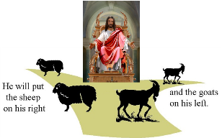
Spiritual Conditions
All Unsaved People Excluded (cont’d)
The gentile “sheep” are believers and they enter the Kingdom.
The gentile “goats” are unbelievers who are cast directly into the eternal Lake of Fire.
John 3:3; Matt. 13:41-42, 49; 18:3; Matt. 25:31-46; Matt. 8:11-12; Luke 13:28-29

Slide 49
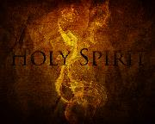
Spiritual Conditions
Great Outpouring of the Spirit
It is likely that the Holy Spirit’s millennial work will reflect what would have happened had Christ been accepted as King.
God will pour out the Holy Spirit upon all Kingdom saints.
Isa. 44:3; Ezek. 36:26-27; 39:29; Joel 2:28-29 (see time frame context in Joel 2:30-3:2).

Slide 50
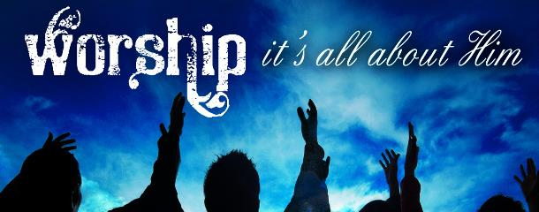
Spiritual Conditions
Unified Worship, Jerusalem
Many of the same verses which teach that Jerusalem will be a world political capital also teach that it will be a worldwide center for worship (see Isa. 2:2-4 (Micah 4:1-3); Zeph. 3:9-10; Zech. 8:20-23, 14:16-21).

Slide 51
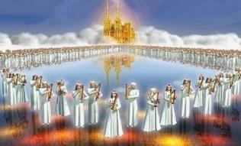
Spiritual Conditions
Abundant Spirituality
The Kingdom will begin with believing survivors of the Tribulation and resurrected and glorified believers. (cf. Matt. 13:41-43, 49-50; 25:34,41,46).
Isa. 1:26-27; 4:3-4; 35:8-9; 52:1; 60:18, 21; 61:11; Jer. 31:33-34; Jer. 31:33-34; Ezek. 36:24-31; 37:23-24; 43:7, 10; Zeph. 3:11, 13; 8:3; Zech. 13:1,9; Rom. 11:26

Slide 52
Spiritual Conditions
Full Knowledge in Word
With Christ ruling from Jerusalem and the Holy Spirit poured out upon all flesh, there will be widespread knowledge of God’s truth.
Isa. 11:9b; 29:24; 32:2-4; 54:13; Jer. 3:15, 17; 23:4; Jer. 31:34 (cf. Heb. 8:8-12); Hab. 2:14

Slide 53
Spiritual Conditions
Millennial Temple, Worship
The millennial temple will be glorious in its construction (Ezekiel 40-43).
The glory of God which departed Solomon’s temple before (Ezek. 10:18-19; 11:23) will be restored to the millennial temple (Ezek. 43:5-7).
Life and physical blessing will be contingent upon conformity to the ceremonial law. The Kingdom sacrifices will be multipurposed.
Isa. 66:21; Jer. 33:18; Ezek. 20:40-41; 40:39; 42:13; 43:18-19; 45:21-25; 46:1, 13, 17; Zech. 14:16-19, 21

Slide 54
Spiritual Conditions
Millennial Temple, Worship
There are at least four reasons to take the Millennial System of Priesthood and Sacrifice literally (Eze. 44:1-46:24):
This is the normal hermeneutic used elsewhere in Scripture…the Dispensationalist uses the literal approach consistently. Such a consistent usage leads to the conclusion that there will be a Millennial Temple and sacrifice.

Slide 55
Spiritual Conditions
Millennial Temple, Worship
…Other prophets spoke of these things in a non-apocalyptic context. The Millennial Temple is spoken of in Isaiah 2:3; 60:13; Daniel 9:24; Joel 3:18; and Haggai 2:7, 9. The millennial sacrifices are mentioned in Isaiah 56:6–7; 60:7; 66:18–23; Jeremiah 33:18; Malachi 3:3–4; and Zechariah 14:16–21…

Slide 56
Spiritual Conditions
Millennial Temple, Worship
The Millennial Temple is not the only temple that Ezekiel describes. In chapters 8–11, he describes the departure of the Shechinah Glory from Israel, from the First Temple. All agree that his description of the Temple and the events that happen there are very literal. In chapters 40–48, Ezekiel describes the future return of the Shechinah Glory into the Fourth Temple. If what he said about the First Temple was literal, then what he says about the Fourth Temple should also be taken literally.

Slide 57
Spiritual Conditions
Millennial Temple, Worship
Ezekiel provides a tremendous amount of detail which includes specific measurements and types of sacrifices. All accept the details of the sacrifices of the Law of Moses to be very literal. All accept the detailed measurements of the Tabernacle and the First Temple to be very literal. There is no good reason not to accept the details of the Fourth Temple to be equally literal….
Fruchtenbaum, A. G. (2003). The Footsteps of the Messiah: A Study of the Sequence of Prophetic Events (Rev. ed., pp. 455–456). Tustin, CA: Ariel Ministries.

Slide 58
Spiritual Conditions
Millennial Temple, Worship – 3 Main Objections
This would mean a return to the sacrificial system of the Mosaic Law which ended when Messiah died and therefore violates all that the New Testament teaches about the termination of the Law as a rule of life.
Answer: Similar ≠ Same! While there are many similarities with the…Mosaic Law,…the differences show they are not the same….this…is a new system under Kingdom Law and so it does not violate what the N.T. teaches concerning the termination of the [Mosaic ] Law with Messiah’s death.

Slide 59
Spiritual Conditions
Millennial Temple, Worship – 3 Main Objections
The measurements given by Ezekiel will not fit the Temple Mount, and therefore cannot be literal.
Answer: It is true that the size of the Ezekiel Temple will not fit the Temple Mount but it is a misconception that the Ezekiel Temple was intended to be built on that mount. The details Ezekiel gives shows that there will be some major geographical changes resulting from the Second Coming….these changes will create a new temple mount altogether.

Slide 60
Spiritual Conditions
Millennial Temple, Worship – 3 Main Objections
To believe in the reinstitution of the blood sacrifices is heresy.
Answer: Just because there are no blood sacrifices for the Church does not mean there cannot be such sacrifices for Israel (in the kingdom). Just because there is no physical temple, priesthood, and sacrifice for the Church does not mean the same will be true for Israel.
Fruchtenbaum, A. G. (2003). The Footsteps of the Messiah: A Study of the Sequence of Prophetic Events (Rev. ed., pp. 458). Tustin, CA: Ariel Ministries.

Slide 61
Spiritual Conditions
Millennial Temple, Worship
There are at least 4 purposes for the sacrificial system that can be suggested:
A memorial of the death of the Messiah…a similar role that Communion plays for the Church.
The means of restoring fellowship for the millennial saint….In this age, fellowship for the believer is restored by confession (1 John 1:9).

Slide 62
Spiritual Conditions
Millennial Temple, Worship
Ritual cleansing for ritual uncleanness. Since the Shechinah Glory will be within the Holy of Holies of the Millennial Temple, it would be impossible to approach the Temple compound in a state of ritual impurity and therefore the sacrifices will be for the cleansing of ceremonial uncleanness.
…all the sacrifices of Ezekiel [40-48] relate to purification of the priests for Temple service….

Slide 63
Spiritual Conditions
Millennial Temple, Worship
The privilege of life and physical blessing in a theocratic kingdom.…just as in Old Testament times, the privilege of life and physical blessing in the theocratic kingdom will be contingent upon outward conformity to the ceremonial law. Such conformity did not bring salvation in Old Testament times…It is a serious mistake, therefore, to insist that these sacrifices will be expiatory. They were certainly not expiatory in the Mosaic economy… and they will not be so in the Millennium.

Slide 64
Spiritual Conditions
Millennial Temple, Worship
For a detailed defense of this position see the pdf:
Christ’s Atonement and Animal Sacrifices in Israel - John C. Whitcomb in Grace Theological Journal 6.2 (1985) 201-217.
https://biblicalstudies.org.uk/pdf/gtj/06-2_201.pdf
Fruchtenbaum, A. G. (2003). The Footsteps of the Messiah: A Study of the Sequence of Prophetic Events (Rev. ed., pp. 463). Tustin, CA: Ariel Ministries.

Slide 65
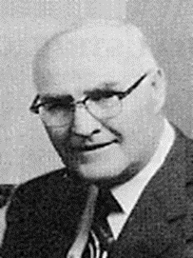
“When the plain sense of Scripture makes common sense, seek no other sense; therefore, take every word at its primary, ordinary, usual, literal meaning unless the facts of the immediate context, studied in light of related passages and axiomatic and fundamental truths, indicate clearly otherwise.”
David L. Cooper
The World’s Greatest Library Graphically Illustrated (Los Angeles: Biblical Research Society, 1970), 11.

Slide 67
Spiritual Conditions
Final Satanic Rebellion

Slide 68
Spiritual Conditions
Final Satanic Rebellion
Rev. 20:7-10 teaches that God allows Satan a short release during the transition from the Theocratic kingdom to the Eternal State.
The devil will find enough disgruntled people to initiate a rebellion against Christ the King demonstrating another measure of sin’s insanity as the devil and his allies have no hope of winning.
Encircling Jerusalem, fire from heaven consumes them; and the devil’s career is finished as he is cast into the eternal Lake of Fire.

Slide 69
Spiritual Conditions
Final Satanic Rebellion
It may be that God allows this final revolt to demonstrate Satan’s incurable evil and to illustrate the righteousness in giving eternal punishment for the devil and his unsaved human followers.
These incorrigible unsaved human followers willfully choose the devil and hell over an ideal world with Christ as King! They reap the condemnation of their personal choice and join the devil in the eternal Lake of Fire.

Slide 70
Spiritual Conditions
Final Satanic Rebellion
“The expression Gog and Magog points to the extent of the work of deception reaching the extremities of the earth and hints at a similarity with the invasion described in Ezekiel 38:1–39:16, which will occur prior to the Great Tribulation. The similarity is that this, too, will be an invasion of Israel.”
Fruchtenbaum, A. G. (2003). The Footsteps of the Messiah: A Study of the Sequence of Prophetic Events (Rev. ed., p. 512). Tustin, CA: Ariel Ministries.

Slide 71
CONCLUSION - PART 2
An Review of The Millennial Kingdom

Slide 72
Outline
Overview of the Millennial Kingdom
Millennial Views of the Kingdom
Nature of Millennium

Slide 73
Nature of Millennium
Duration of the Kingdom
General Conditions
Political Conditions
Governors, Governed In Millennium
Spiritual Conditions

Slide 74
