Slide 1


Slide 2

The Coming Kingdom
Chapter 13
Dr. Andy Woods
Senior Pastor – Sugar Land Bible Church
President – Chafer Theological Seminary

Slide 3

Kingdom Study Outline
What does the Bible Say About the Kingdom?
The Main Problem with Kingdom Now NT interpretations
Why do some believe that we are in the kingdom now?
Why does it matter?

Slide 4
1. Kingdom Throughout the Bible
Eden Abrahamic Covenant Mosaic Covenant Divided Kingdom Times of the Gentiles | Old Testament Prophets Post exile Offer of the King / Kingdom Rejection of the Offer Interim Age

Slide 5
1. Kingdom Throughout the Bible
Kingdom Mysteries Church Israel’s Discipline & Restoration Re-offer of the King/Kingdom | Transfer of Kingdom Authority Kingdom Establishment Eternal State Testimony of Early Church History

Slide 6


Roman 11:25b
“For I do not want you, brethren, to be uninformed of this mystery—so that you will not be wise in your own estimation—that a partial hardening has happened to Israel until the fullness of the Gentiles has come in.”

Slide 7
Exodus 2:24
“So God heard their groaning; and God remembered His covenant with Abraham, Isaac, and Jacob.”

Slide 8
Ezek. 36:22
“Therefore say to the house of Israel, ‘Thus says the Lord God, “It is not for your sake, O house of Israel, that I am about to act, but for My holy name, which you have profaned among the nations where you went.”

Slide 9

The Coming of the Kingdom
Re-offer of the kingdom
Transfer of earthly authority
Establishment of the kingdom
Duration of the kingdom

Slide 10
The Coming of the Kingdom
Re-offer of the kingdom
Transfer of earthly authority
Establishment of the kingdom
Duration of the kingdom

Slide 11
Messengers of the Kingdom In Matthew
John the Baptist – 3:2
Jesus Christ – 4:17
12 Apostles – 10:5-7
Seventy – Luke 10:1, 9
Toussaint, Behold the King, 18-20

Slide 12

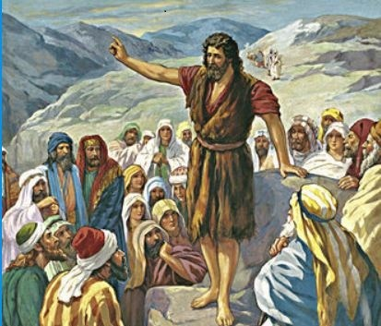
Matthew 3:1-2
¹ “Now in those days John the Baptist came, preaching in the wilderness of Judea, saying, ² ‘Repent, for the kingdom of heaven is at hand.’”

Slide 13
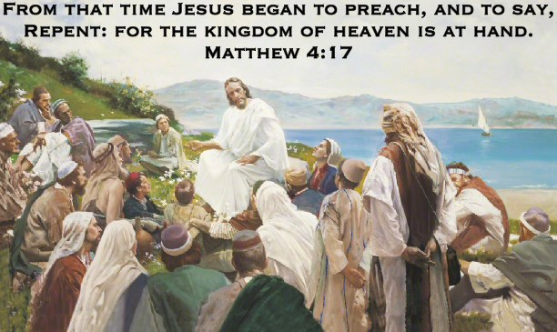
Matthew 4:17
“From that time Jesus began to preach and say, ‘Repent, for the kingdom of heaven is at hand.’”

Slide 14
Matthew 10:5-7
⁵ These twelve Jesus sent out after instructing them: “Do not go in the way of the Gentiles, and do not enter any city of the Samaritans; ⁶ but rather go to the lost sheep of the house of Israel. ⁷ “And as you go, preach, saying, ‘The kingdom of heaven is at hand.’

Slide 15

Matthew 12:24
“But when the Pharisees heard this, they said, “This man casts out demons only by Beelzebul the ruler of the demons.”

Slide 16
Transition from Public to Private Ministry
 | Public | Private
Scripture | Matt. 1–12 | Matt. 13–28
Focus | Nation | Remnant
Miracles | Proof to nation | Training for remnant
Offer | Prominent | Disappears
Teaching | Discourse | Parabolic
Interim program | Not mentioned | Prominent
Crucifixion; Resurrection | Not mentioned (4:17) | Prominent (16:21)

Slide 17
Matthew Outline
Pedigree of the king (1–2)
  Preparation of the king (3–4)
    Pedagogy of the king (5–7)
      Power of the king (8–9)
        Program of the king (10)
          Progressive rejection of the king (11–12)
        Preparation of the king’s disciples (13–20)
      Presentation & rejection of the king (21–23)
    Prophecies of the king (24–25)
  Passion of the king (26–27)
Proof of the king (28)

Slide 18
Matthew Outline
Pedigree of the king (1–2)
  Preparation of the king (3–4)
    Pedagogy of the king (5–7)
      Power of the king (8–9)
        Program of the king (10)
          Progressive rejection of the king (11–12)
        Preparation of the king’s disciples (13–20)
      Presentation & rejection of the king (21–23)
    Prophecies of the king (24–25)
  Passion of the king (26–27)
Proof of the king (28)

Slide 19
Matthew 24:14
¹⁴ “This gospel of the kingdom shall be preached in the whole world as a testimony to all the nations, and then the end will come.”

Slide 20
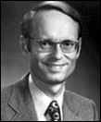
Charles Ryrie
So Great A Salvation, Page 37
“So the kingdom did not arrive because the people would not prepare properly for it. But this did not mean that there would never be a Davidic, millennial kingdom. The Lord taught that it would not appear immediately (Luke 19:11), but he also predicted that the gospel, the good news of the kingdom, would be preached yet again in the future period of the Great Tribulation (Matthew 24:14). And in that wicked time when Satan and the forces of evil will have almost total free reign, it will be very good news to know that the Messiah will soon rule on the earth.”

Slide 21
Matthew 23:37-39
“Jerusalem, Jerusalem, who kills the prophets and stones those who are sent to her! How often I wanted to gather your children together, the way a hen gathers her chicks under her wings, and you were unwilling. ³⁸ Behold, your house is being left to you desolate! ³⁹ For I say to you, from now on you will not see Me until you say, ‘Blessed is He who comes in the name of the Lord!’”

Slide 22


Slide 23
Acts 7-Stephen’s Speech
7:1-5 – Abraham’s partial obedience
7:6-38 – Israel’s initial rejections and later acceptances
7:39-41 – Israel’s early rebellion against Moses
7:42-45 – Israel reinterpreted Moses’ teachings though a polytheistic framework
7:46-50 – Neither the Tabernacle nor Temple were intended as permanent habitations of God
7:51-53 – Current generation imitating these same rebellions

Slide 24
Acts 7-Stephen’s Speech
7:1-5 – Abraham’s partial obedience
7:6-38 – Israel’s initial rejections and later acceptances
7:39-41 – Israel’s early rebellion against Moses
7:42-45 – Israel reinterpreted Moses’ teachings though a polytheistic framework
7:46-50 – Neither the Tabernacle nor Temple were intended as permanent habitations of God
7:51-53 – Current generation imitating these same rebellions

Slide 25
The Coming of the Kingdom
Re-offer of the kingdom
Transfer of earthly authority
Establishment of the kingdom
Duration of the kingdom

Slide 26

Names & Titles Demonstrating Satan’s Post-Fall, Earthly Authority
(Job 1:7; 2:2; Luke 4:5-8; Rom. 8:19-22)
Prince of this world (John 12:31; 14:30; 16:11)
God of this world (2 Cor. 4:4)
Prince and power of the air (Eph. 2:2)
Who the believer wrestles with (Eph. 6:12)
Roaring lion (1 Pet. 5:8)
Whole world lies in his power (1 John 5:19)

Slide 27
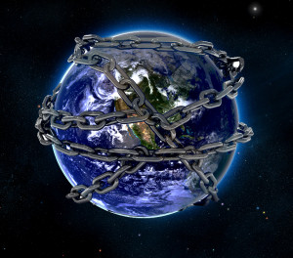

Slide 28

Romans 8:19-22
¹⁹ For the anxious longing of the creation waits eagerly for the revealing of the sons of God. ²⁰ For the creation was subjected to futility, not willingly, but because of Him who subjected it, in hope ²¹ that the creation itself also will be set free from its slavery to corruption into the freedom of the glory of the children of God. ²² For we know that the whole creation groans and suffers the pains of childbirth together until now.

Slide 29

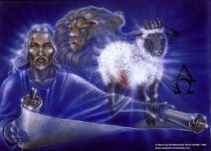
God’s Role in Redemption (Rev 5)
Seven sealed scroll (5:1)
John weeps (5:2-4)
Christ is qualified to open the scroll (5:5-6)
Christ takes the scroll (5:7)
Christ praised by various entities (5:8-14)

Slide 30
God’s Role in Redemption (Rev 5)
Seven sealed scroll (5:1)
John weeps (5:2-4)
Christ is qualified to open the scroll (5:5-6)
Christ takes the scroll (5:7)
Christ praised by various entities (5:8-14)

Slide 31
God’s Role in Redemption (Rev 5)
Seven sealed scroll (5:1)
John weeps (5:2-4)
Christ is qualified to open the scroll (5:5-6)
Christ takes the scroll (5:7)
Christ praised by various entities (5:8-14)

Slide 32
God’s Role in Redemption (Rev 5)
Seven sealed scroll (5:1)
John weeps (5:2-4)
Christ is qualified to open the scroll (5:5-6)
Christ takes the scroll (5:7)
Christ praised by various entities (5:8-14)

Slide 33
God’s Role in Redemption (Rev 5)
Seven sealed scroll (5:1)
John weeps (5:2-4)
Christ is qualified to open the scroll (5:5-6)
Christ takes the scroll (5:7)
Christ praised by various entities (5:8-14)

Slide 34
God’s Role in Redemption (Rev 5)
Seven sealed scroll (5:1)
John weeps (5:2-4)
Christ is qualified to open the scroll (5:5-6)
Christ takes the scroll (5:7)
Christ praised by various entities (5:8-14)

Slide 35
Ultimate Exodus (Rev 11:15)
Sores: 6th plague (Ex 9:8-12), 1st bowl (Rev 16:1-2)
Rivers to blood: 1st plague (Ex 7:19-21), 3rd bowl (Rev 16:4-7)
Darkness: 9th plague (Ex 10:21-23), 5th bowl (Rev 16:10-11)
Hail: 7th plague (Ex 9:22-26), 7th bowl (Rev 16:17-21)

Slide 36
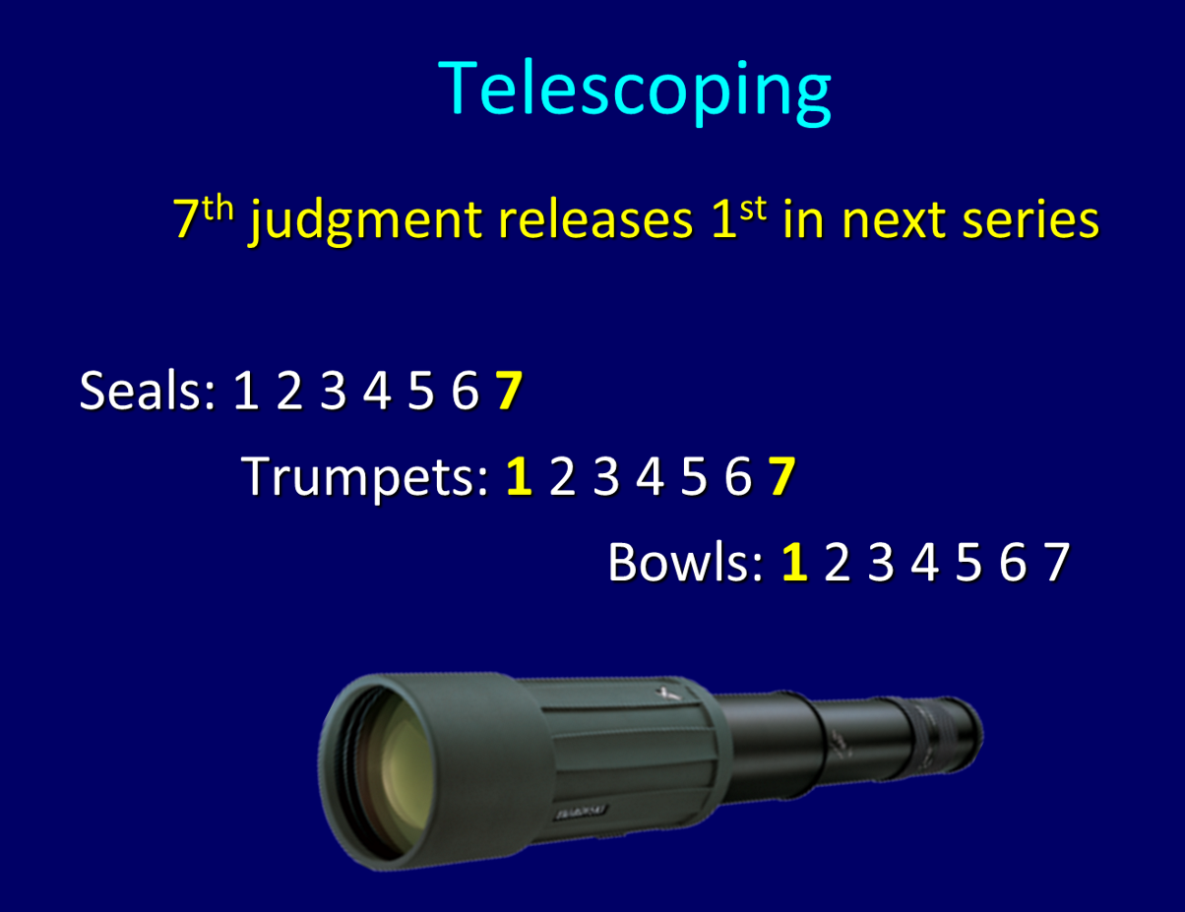

Slide 37
Revelation 5:10
¹⁰ “You have made them to be a kingdom and priests to our God; and they will reign upon the earth.”

Slide 38
Revelation 11:15
¹⁵ “Then the seventh angel sounded; and there were loud voices in heaven, saying, ‘The kingdom of the world has become the kingdom of our Lord and of His Christ; and He will reign forever and ever.’”

Slide 39
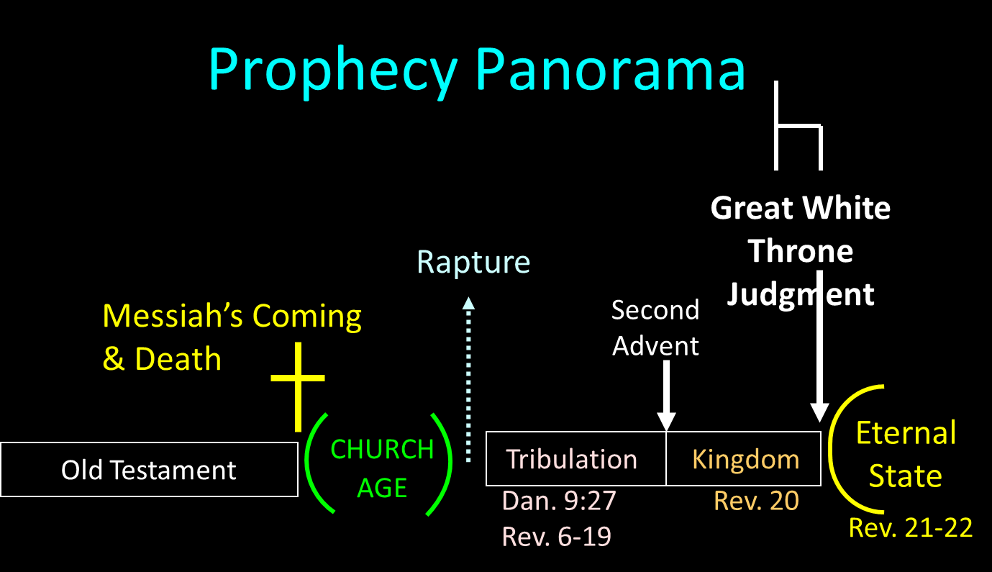

Slide 40
Revelation 20:1-3
“Then I saw an angel coming down from heaven, holding the key of the abyss and a great chain in his hand. ² And he laid hold of the dragon, the serpent of old, who is the devil and Satan, and bound him for a thousand years; ³ and he threw him into the abyss, and shut it and sealed it over him, so that he would not deceive the nations any longer, until the thousand years were completed; after these things he must be released for a short time.”

Slide 41
Revelation 20:4-6
“⁴ Then I saw thrones, and they sat on them, and judgment was given to them. And I saw the souls of those who had been beheaded because of their testimony of Jesus and because of the word of God, and those who had not worshiped the beast or his image, and had not received the mark on their forehead and on their hand; and they came to life and reigned with Christ for a thousand years. ⁵ The rest of the dead did not come to life until the thousand years were completed. This is . . .

Slide 42
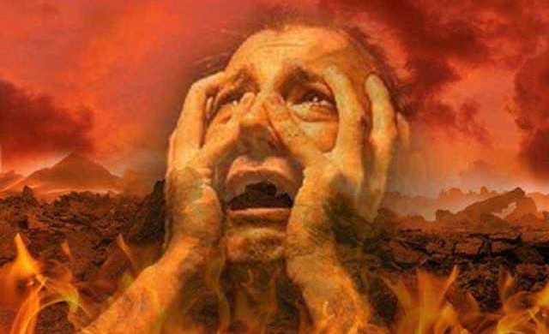
Revelation 20:4-6
… first resurrection. ⁶ Blessed and holy is the one who has a part in the first resurrection; over these the second death has no power, but they will be priests of God and of Christ and will reign with Him for a thousand years.”

Slide 43
Revelation 20:7-10
“⁷ When the thousand years are completed, Satan will be released from his prison, ⁸ and will come out to deceive the nations which are in the four corners of the earth, Gog and Magog, to gather them together for the war; the number of them is like the sand of the seashore. ⁹ And they came up on the broad plain of the earth and surrounded the camp of the saints and the beloved city, and fire came down…

Slide 44
Revelation 20:7-10
…from heaven and devoured them. ¹⁰ And the devil who deceived them was thrown into the lake of fire and brimstone, where the beast and the false prophet are also; and they will be tormented day and night forever and ever.”

Slide 45

Satan’s Progressive Defeat
Initial eviction from heaven (Isa 14:12-15; Ezek 28:12-17)
Eden (Gen 3:15)
Pre-diluvian world (1 Pet 3:19-20)
Cross (John 12:31; 16:11; Col 2:15; Heb 2:14; 1 John 3:8)
Mid point of the Tribulation (Rev 12:9)
Beginning of millennium (Rev 20:2-3)
End of millennium (Rev 20:10)

Slide 46
Satan’s Progressive Defeat
Initial eviction from heaven (Isa 14:12-15; Ezek 28:12-17)
Eden (Gen 3:15)
Pre-diluvian world (1 Pet 3:19-20)
Cross (John 12:31; 16:11; Col 2:15; Heb 2:14; 1 John 3:8)
Mid point of the Tribulation (Rev 12:9)
Beginning of millennium (Rev 20:2-3)
End of millennium (Rev 20:10)

Slide 47

Genesis 12:3
“And I will bless those who bless you, And the one who curses you I will curse. And in you all the families of the earth will be blessed.”

Slide 48
Isaiah 42:6
“I am the Lord, I have called You in righteousness, I will also hold You by the hand and watch over You, And I will appoint You as a covenant to the people, As a light to the nations.”

Slide 49

Isaiah 49:6
He says, “It is too small a thing that You should be My Servant To raise up the tribes of Jacob and to restore the preserved ones of Israel; I will also make You a light of the nations So that My salvation may reach to the end of the earth.”

Slide 50
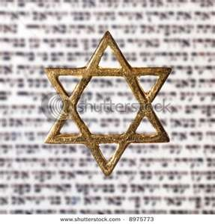
Israel’s Three Blessings to the World
(Gen 12:3b)
Scripture (Rom 3:2)
Savior (John 4:22)
Kingdom (Isa 2:2-3)

Slide 51
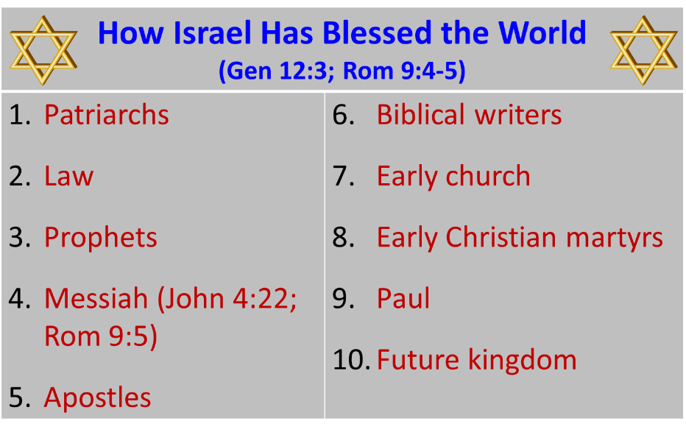

Slide 52

Revelation 12:1-5
¹And a great sign appeared in heaven: a woman clothed in the sun, and the moon under her feet, and upon her head a crown of twelve stars; ²and she was with child; and she cried out, being in labor pain to give birth. ³And another sign was seen in heaven: and behold, a great red dragon, having seven heads and ten horns, and upon his heads seven diadems.

Slide 53

Revelation 12:1-5 (cont’d)
⁴And his tail swept a third part of the stars of heaven, and did cast them to the earth: and the dragon stood before the woman that is about to give birth, so that when she gave birth he may devour her child. ⁵And she gave birth to a son, a man child, who is to rule all the nations with a rod of iron: and her child was caught up unto God, and to his throne.

Slide 54
Revelation: 12 Symbols
Son = Messiah (Rev 12:5; Ps. 2:9; Acts 1:9)
Dragon = Satan (Rev 12:3, 9)
Woman = Israel (Rev 12:1; Gen 37:9-10)

Slide 55

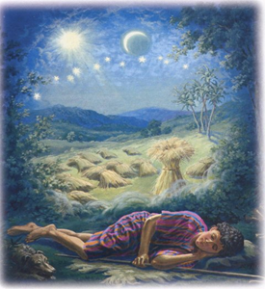
Genesis 37:9
Now he had still another dream, and related it to his brothers, and said, “Lo, I have had still another dream; and behold, the sun and the moon and eleven stars were bowing down to me.

Slide 56

Genesis 37:10
He related it to his father and to his brothers; and his father rebuked him and said to him, “What is this dream that you have had? Shall I and your mother and your brothers actually come to bow ourselves down before you to the ground?”

Slide 57
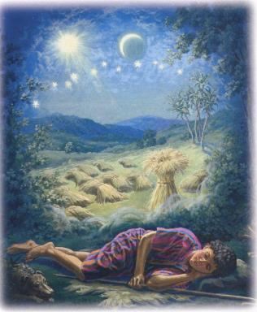
Genesis 37:9-10
Sun = Jacob
Moon = Leah
11 Stars = Joseph’s brothers
12th Star = Joseph
12 Stars = Israel’s twelve tribes

Slide 58
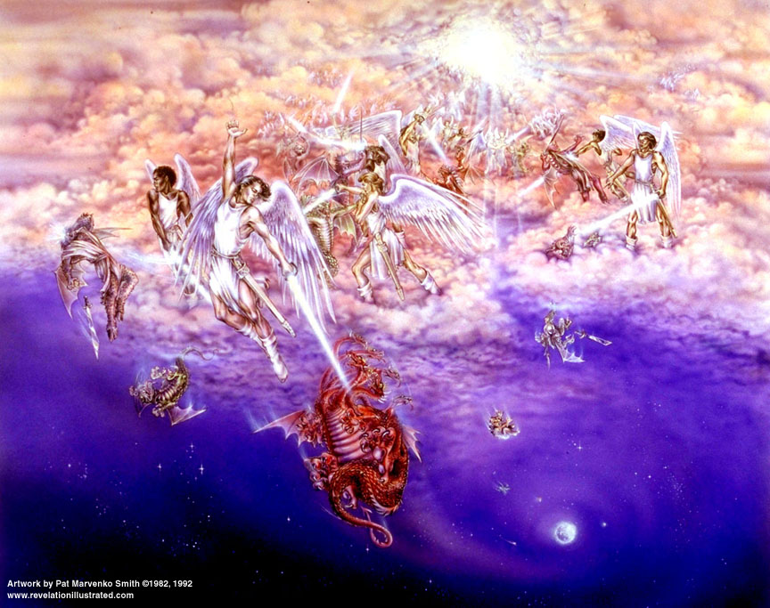
Satan’s Two Strategies
Rev 12:1-5 - Past failed strategy
Rev 12:6-17 - Present & future strategy

Slide 59
Descriptions of Satanic Hatred
(Revelation 12:12-17)
Wrath 12:12
Persecution 12:13
Sweep away 12:15
Enraged 12:17
War 12:17

Slide 60
Matthew 23:37-39
“Jerusalem, Jerusalem, who kills the prophets and stones those who are sent to her! How often I wanted to gather your children together, the way a hen gathers her chicks under her wings, and you were unwilling. ³⁸ Behold, your house is being left to you desolate! ³⁹ For I say to you, from now on you will not see Me until you say, ‘Blessed is He who comes in the name of the Lord!’”

Slide 61
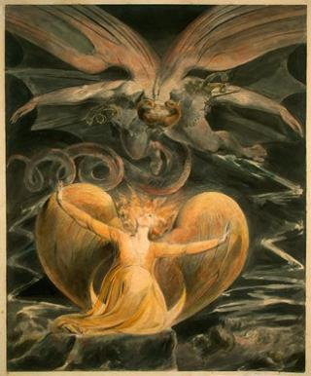
2 CYCLES OF SATANIC PERSECUTION
(Revelation 12:13-16)
“Pursues the woman” = persecution of Israel 12:13-14
“Flood from his mouth” = tries to destroy Israel 12:15-16

Slide 62

Zechariah 13:8-9
⁸“It will come about in all the land,” Declares the Lord, “That two parts in it will be cut off and perish; But the third will be left in it. ⁹And I will bring the third part through the fire, Refine them as silver is refined, And test them as gold is tested. They will call on My name, And I will answer them; I will say, ‘They are My people,’ And they will say, ‘The Lord is my God.’ ”

Slide 63


Slide 64
The Coming of the Kingdom
Re-offer of the kingdom
Transfer of earthly authority
Establishment of the kingdom
Duration of the kingdom

Slide 65

Genesis 1:26-28
²⁶ Then God said, “Let Us make man in Our image, according to Our likeness; and let them rule over the fish of the sea and over the birds of the sky and over the cattle and over all the earth, and over every creeping thing that creeps on the earth.” ²⁷ God created man in His own image, in the image of God He created him; male and female He created them. ²⁸ God blessed them; and God said to them, …

Slide 66
Genesis 1:26-28
…“Be fruitful and multiply, and fill the earth, and subdue it; and rule over the fish of the sea and over the birds of the sky and over every living thing that moves on the earth.”

Slide 67
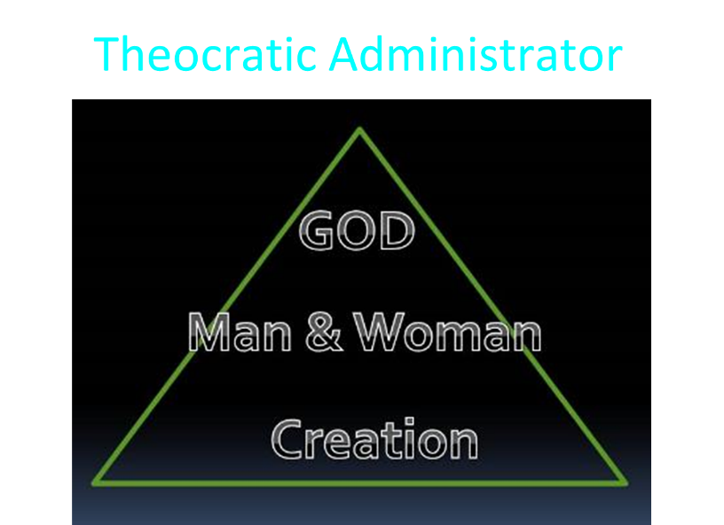

Slide 68
Charles Ryrie
Basic Theology, Page 511
“Why is an earthly kingdom necessary? Did He not receive His inheritance when He was raised and exalted in heaven? Is not His present rule His inheritance? Why does there need to be an earthly kingdom? Because He must be triumphant in the same arena where He was seemingly defeated. His rejection by the rulers of this world was on this earth (1Cor. 2:8). His exaltation must also be on this earth. And so it shall be when He comes again to rule this world in righteousness. He has waited long for His inheritance; soon He shall receive it.”

Slide 70
Exodus 19:5-6
“Now then, if you will indeed obey My voice and keep My covenant, then you shall be My own possession among all the peoples, for all the earth is Mine; and you shall be to Me a kingdom of priests and a holy nation.’ These are the words that you shall speak to the sons of Israel.”

Slide 71
Matthew 23:37-39
“Jerusalem, Jerusalem, who kills the prophets and stones those who are sent to her! How often I wanted to gather your children together, the way a hen gathers her chicks under her wings, and you were unwilling. ³⁸ Behold, your house is being left to you desolate! ³⁹ For I say to you, from now on you will not see Me until you say, ‘Blessed is He who comes in the name of the Lord!’”

Slide 72


Statue
&
Stone

Slide 73


2 Peter 1:19
“So we have the prophetic word made more sure, to which you do well to pay attention as to a lamp shining in a dark place, until the day dawns and the morning star arises in your hearts.”

Slide 74

OT PROPHETS DESCRIBE THE KINGDOM
Kingdom Characteristics
Is. 2:1-4; 11:6-9; 65:17-25
  Jerusalem = center of world spiritual and political authority
  Perfect justice
  World peace
  Peace in the animal kingdom
  Universal spiritual knowledge.

Slide 75
OT Prophets Describe the Kingdom
Established by God (Dan. 2:44) Eternal (Dan. 7:27) Christ’s direct rule (Zech. 9:9-10) Earthly (Zech. 14:9) Land promises realized (Gen. 15:18-21) Israel’s preeminence (Isa. 49:22-23) | Millennial Temple (Ezek. 40‒46) Millennial David (Jer. 30:9) Righteousness (Isa. 9:6-7) Curse curtailed (Isa. 65:20, 22) Peace (Isa. 2:4) Prosperity (Amos 9:13-14; Isa 65:22) Topographical changes (Ezek. 47:1-12)

Slide 76

OT PROPHETS DESCRIBE THE KINGDOM
Established by God (Dan. 2:44)
Eternal (Dan. 7:27)
Christ’s direct rule (Zech. 9:9-10)
Earthly (Zech. 14:9)
Land promises realized (Gen. 15:18-21)
Israel’s preeminence (Isa. 49:22-23)
Millennial Temple (Ezek. 40‒46)

Slide 77
OT PROPHETS DESCRIBE THE KINGDOM
Millennial David (Jer. 30:9)
Righteousness (Isa. 9:6-7)
Curse curtailed (Isa. 65:20, 22)
Peace (Isa. 2:4)
Prosperity (Amos 9:13-14; Isa 65:22)
Topographical changes (Ezek. 47:1-12)
Immediate answers to prayer (Isa. 65:24)

Slide 78
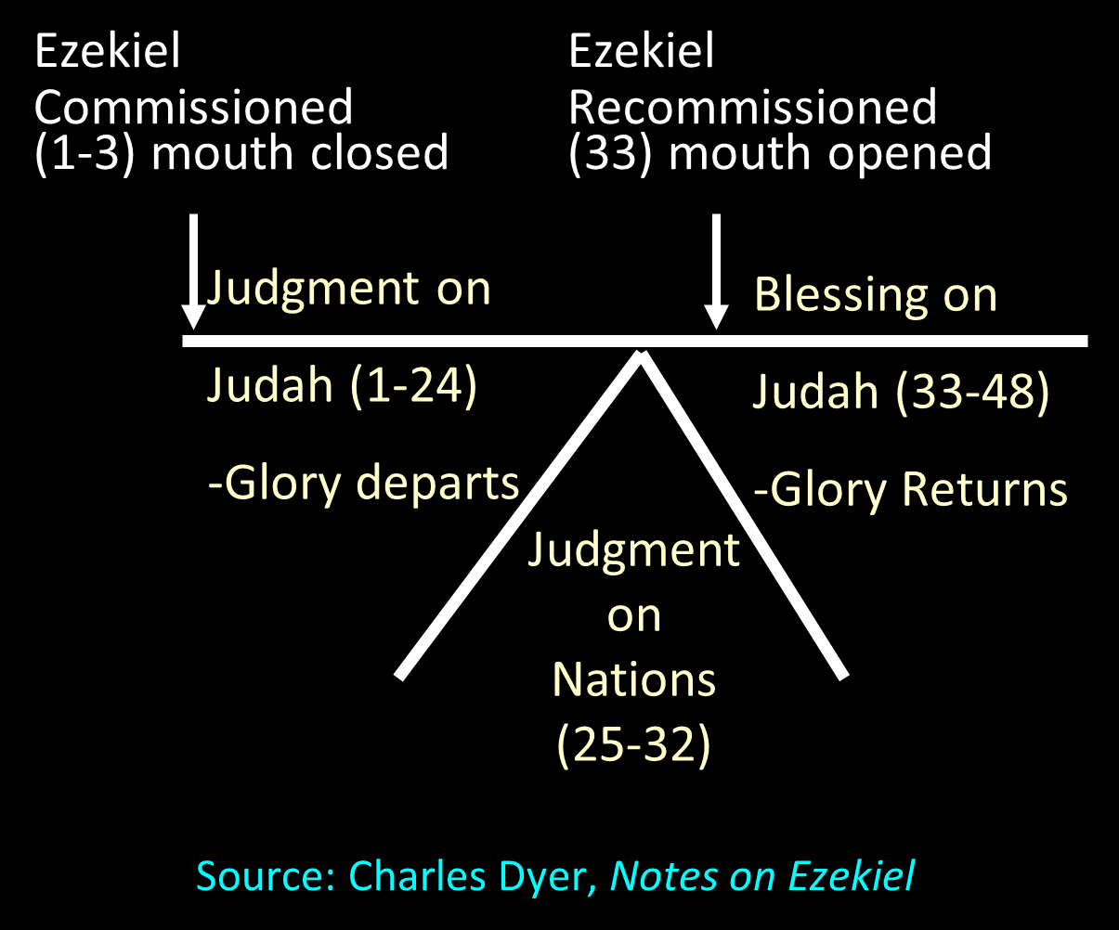

Slide 79
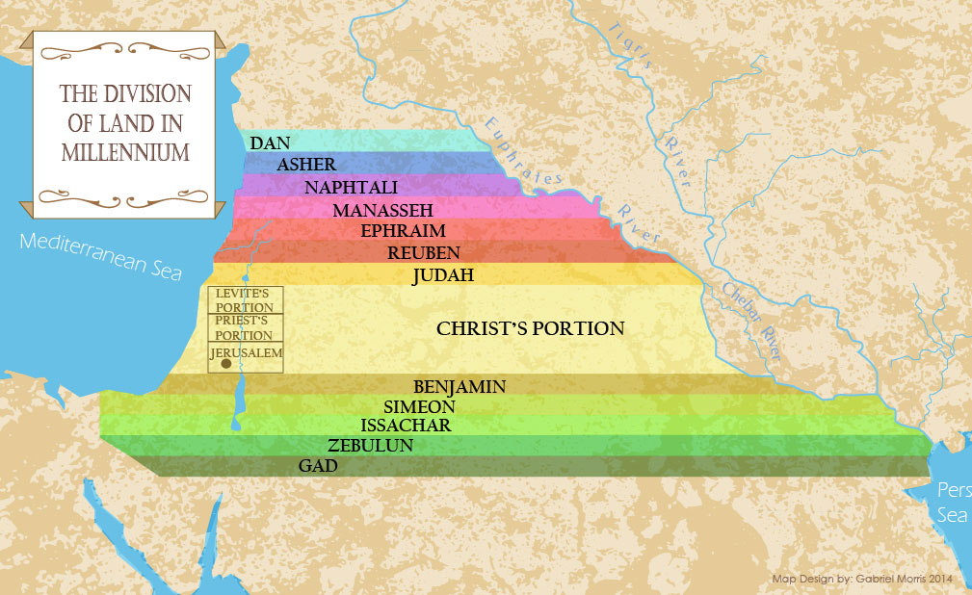

Slide 80


Slide 81


Slide 82
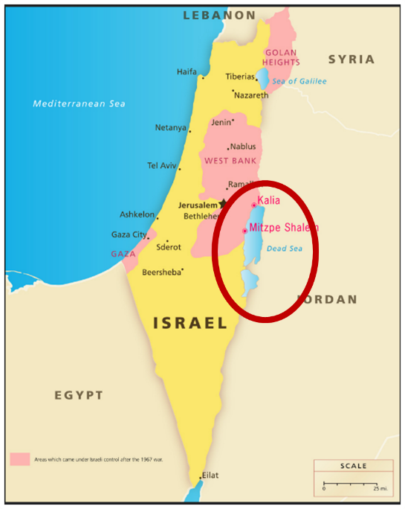
The Dead Sea

Slide 83
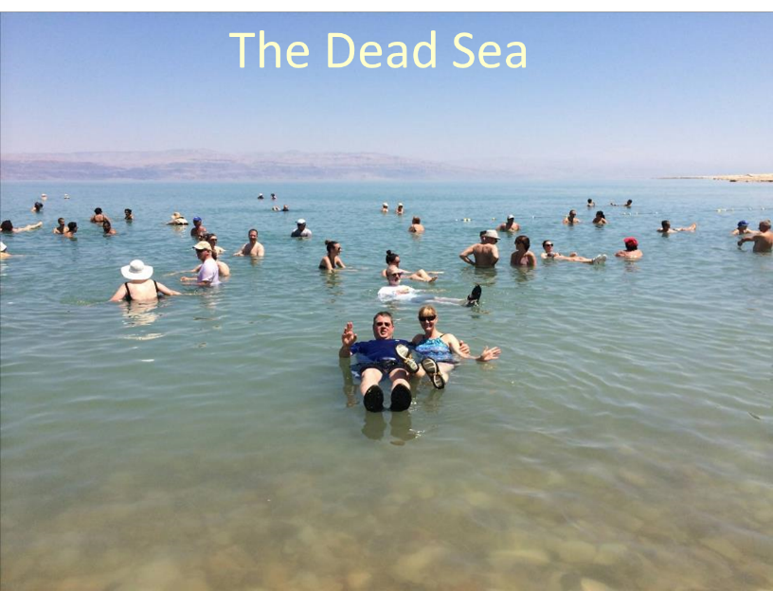

Slide 84
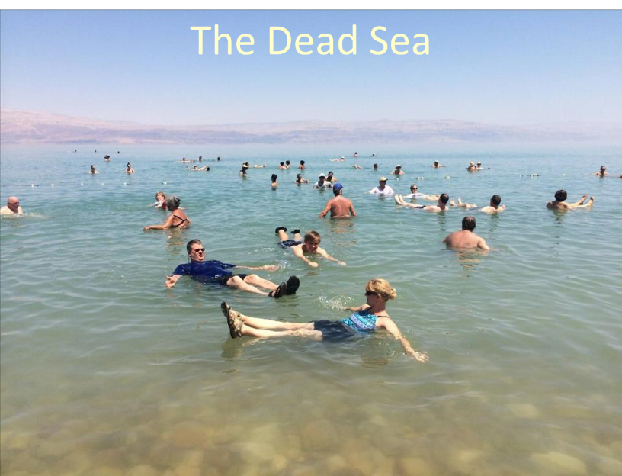

Slide 86
Romans 8:19-22
¹⁹ For the anxious longing of the creation waits eagerly for the revealing of the sons of God. ²⁰ For the creation was subjected to futility, not willingly, but because of Him who subjected it, in hope ²¹ that the creation itself also will be set free from its slavery to corruption into the freedom of the glory of the children of God. ²² For we know that the whole creation groans and suffers the pains of childbirth together until now.

Slide 87
Names & Titles Demonstrating Satan’s Post-Fall, Earthly Authority
(Job 1:7; 2:2; Luke 4:5-8; Rom. 8:19-22)
Prince of this world (John 12:31; 14:30; 16:11)
God of this world (2 Cor. 4:4)
Prince and power of the air (Eph. 2:2)
Who the believer wrestles with (Eph. 6:12)
Roaring lion (1 Pet. 5:8)
Whole world lies in his power (1 John 5:19)

Slide 88
Satan’s Progressive Defeat
Initial eviction from heaven (Isa 14:12-15; Ezek 28:12-17)
Eden (Gen 3:15)
Pre-diluvian world (1 Pet 3:19-20)
Cross (John 12:31; 16:11; Col 2:15; Heb 2:14; 1 John 3:8)
Mid point of the Tribulation (Rev 12:9)
Beginning of millennium (Rev 20:2-3)
End of millennium (Rev 20:10)

Slide 89
Satan’s Progressive Defeat
Initial eviction from heaven (Isa 14:12-15; Ezek 28:12-17)
Eden (Gen 3:15)
Pre-diluvian world (1 Pet 3:19-20)
Cross (John 12:31; 16:11; Col 2:15; Heb 2:14; 1 John 3:8)
Mid point of the Tribulation (Rev 12:9)
Beginning of millennium (Rev 20:2-3)
End of millennium (Rev 20:10)

Slide 90
Matthew 23:37-39
“Jerusalem, Jerusalem, who kills the prophets and stones those who are sent to her! How often I wanted to gather your children together, the way a hen gathers her chicks under her wings, and you were unwilling. ³⁸ Behold, your house is being left to you desolate! ³⁹ For I say to you, from now on you will not see Me until you say, ‘Blessed is He who comes in the name of the Lord!’”

Slide 91
Acts 1:6-8
“⁶ So when they had come together, they were asking Him, saying, ‘Lord, is it at this time You are restoring the kingdom to Israel?’ ⁷ He said to them, ‘It is not for you to know times or epochs which the Father has fixed by His own authority; ⁸ but you will receive power when the Holy Spirit has come upon you; and you shall be My witnesses both in Jerusalem, and in all Judea and Samaria, and even to the remotest part of the earth.’”

Slide 92
The Coming of the Kingdom
Re-offer of the kingdom
Transfer of earthly authority
Establishment of the kingdom
Duration of the kingdom

Slide 93
Revelation 20:1-3
“Then I saw an angel coming down from heaven, holding the key of the abyss and a great chain in his hand. ² And he laid hold of the dragon, the serpent of old, who is the devil and Satan, and bound him for a thousand years; ³ and he threw him into the abyss, and shut it and sealed it over him, so that he would not deceive the nations any longer, until the thousand years were completed; after these things he must be released for a short time.”

Slide 94
Revelation 20:4-6
“⁴ Then I saw thrones, and they sat on them, and judgment was given to them. And I saw the souls of those who had been beheaded because of their testimony of Jesus and because of the word of God, and those who had not worshiped the beast or his image, and had not received the mark on their forehead and on their hand; and they came to life and reigned with Christ for a thousand years. ⁵ The rest of the dead did not come to life until the thousand years were completed….

Slide 95
Revelation 20:4-6
…This is the first resurrection. ⁶ Blessed and holy is the one who has a part in the first resurrection; over these the second death has no power, but they will be priests of God and of Christ and will reign with Him for a thousand years.”

Slide 96
Revelation 20:7-10
“⁷ When the thousand years are completed, Satan will be released from his prison, ⁸ and will come out to deceive the nations which are in the four corners of the earth, Gog and Magog, to gather them together for the war; the number of them is like the sand of the seashore. ⁹ And they came up on the broad plain of the earth and surrounded the camp of the saints and the beloved city, and fire came down from heaven and devoured them. ¹⁰ And the devil…

Slide 97
Revelation 20:7-10
…who deceived them was thrown into the lake of fire and brimstone, where the beast and the false prophet are also; and they will be tormented day and night forever and ever.”

Slide 98
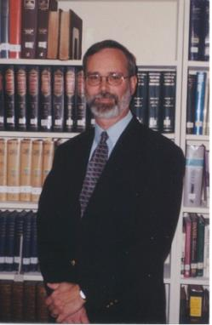
Kenneth L. Gentry
He Shall Have Dominion: A Post Millennial Eschatology (Tyler, Texas: Institute for Christian economics, 1992), page 335.
“The proper understanding of the thousand-year time frame in Revelation 20 is that it is representative of a long and glorious era and is not limited to a literal 365,000 days. The figure represents a perfect cube of 10, which is the number of quantitative perfection.”

Slide 99
Reasons for Understanding 1000 Literally
John’s use of indefinite concepts elsewhere
  Revelation 20:8, 20:3
Exception to the “# of years” examples?
Other numbers are taken literally
  Two witnesses (11:3), 7000 people (11:13), 4 Angels (7:1) 7 Angels (8:6),144,000 Jews (7:4), 42 months (11:2), 1260 days (11:3)
Not always a symbolic interpretation
  (Rev. 17:18)

Slide 100
Reasons for Understanding 1000 Literally
John’s use of indefinite concepts elsewhere
  Revelation 20:8, 20:3
Exception to the “# of years” examples?
Other numbers are taken literally
  Two witnesses (11:3), 7000 people (11:13), 4 Angels (7:1) 7 Angels (8:6),144,000 Jews (7:4), 42 months (11:2), 1260 days (11:3)
Not always a symbolic interpretation
  (Rev. 17:18)

Slide 101
Revelation 20:7-10
“⁷ When the thousand years are completed, Satan will be released from his prison, ⁸ and will come out to deceive the nations which are in the four corners of the earth, Gog and Magog, to gather them together for the war; the number of them is like the sand of the seashore. ⁹ And they came up on the broad plain of the earth and surrounded the camp of the saints and the beloved city, and fire came down from heaven and devoured them. ¹⁰ And the devil…

Slide 102
Revelation 20:1-3
“Then I saw an angel coming down from heaven, holding the key of the abyss and a great chain in his hand. ² And he laid hold of the dragon, the serpent of old, who is the devil and Satan, and bound him for a thousand years; ³ and he threw him into the abyss, and shut it and sealed it over him, so that he would not deceive the nations any longer, until the thousand years were completed; after these things he must be released for a short time [mikros chronos].”

Slide 103
Matthew 25:19
“Now after a long time [polus chronos] the master of those slaves came and settled accounts with them.”

Slide 104
Reasons for Understanding 1000 Literally
John’s use of indefinite concepts elsewhere
  Revelation 20:8, 20:3
Exception to the “# of years” examples?
Other numbers are taken literally
  Two witnesses (11:3), 7000 people (11:13), 4 Angels (7:1) 7 Angels (8:6),144,000 Jews (7:4), 42 months (11:2), 1260 days (11:3)
Not always a symbolic interpretation
  (Rev. 17:18)

Slide 105
Reasons for Understanding 1000 Literally
John’s use of indefinite concepts elsewhere
  Revelation 20:8, 20:3
Exception to the “# of years” examples?
Other numbers are taken literally
  Two witnesses (11:3), 7000 people (11:13), 4 Angels (7:1) 7 Angels (8:6),144,000 Jews (7:4), 42 months (11:2), 1260 days (11:3)
Not always a symbolic interpretation
  (Rev. 17:18)

Slide 106
Reasons for Understanding 1000 Literally
John’s use of indefinite concepts elsewhere
  Revelation 20:8, 20:3
Exception to the “# of years” examples?
Other numbers are taken literally
  Two witnesses (11:3), 7000 people (11:13), 4 Angels (7:1) 7 Angels (8:6),144,000 Jews (7:4), 42 months (11:2), 1260 days (11:3)
Not always a symbolic interpretation
  (Rev. 17:18)

Slide 107
Revelation 20:1-3
“Then I saw an angel coming down from heaven, holding the key of the abyss and a great chain in his hand. ² And he laid hold of the dragon, the serpent of old, who is the devil and Satan, and bound him for a thousand years; ³ and he threw him into the abyss, and shut it and sealed it over him, so that he would not deceive the nations any longer, until the thousand years were completed; after these things he must be released for a short time.”

Slide 108
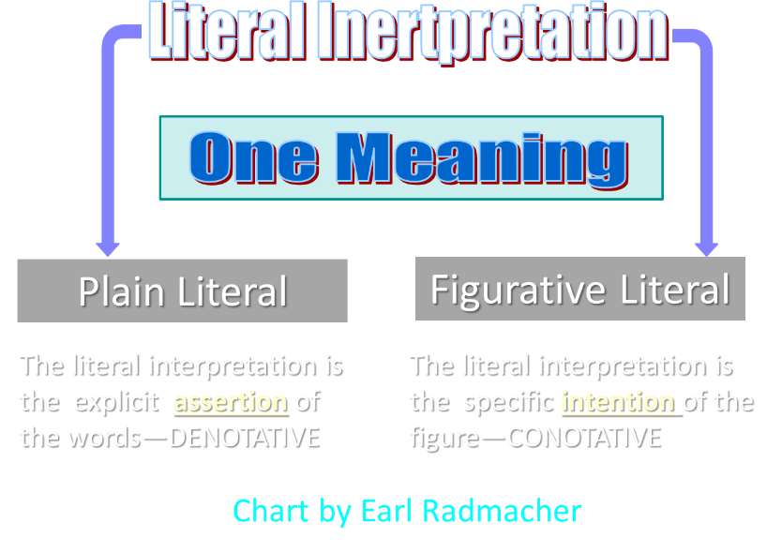

Slide 109
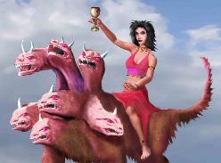
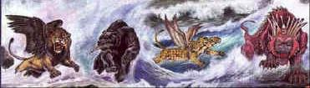
Revelation's Symbols and Figures of Speech
“Spiritually” (11:8)
“Sign” (12:1)
“Like” or “as” (8:8)
OT correspondence (Rev 13:2; Dan 7)
Contextual interpretations (17:18)
Absurdity (12:1)

Slide 110
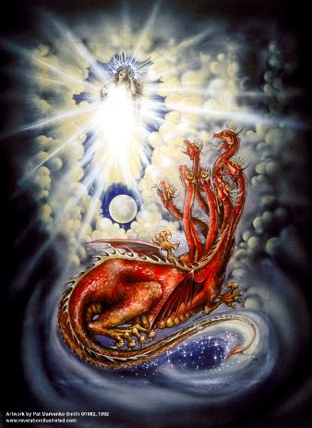
Assigning Meaning to Revelation’s Symbols and Figures of Speech
Context (Rev 12:3, 9)
Old Testament (Rev 12:1; Gen 37:9-10)
Comparison (Rev 8:8)

Slide 111
Reasons for Understanding 1000 Literally
John’s use of indefinite concepts elsewhere
  Revelation 20:8, 20:3
Exception to the “# of years” examples?
Other numbers are taken literally
  Two witnesses (11:3), 7000 people (11:13), 4 Angels (7:1) 7 Angels (8:6),144,000 Jews (7:4), 42 months (11:2), 1260 days (11:3)
Not always a symbolic interpretation
  (Rev. 17:18)

Slide 112

Robert Thomas
Revelation 8 to 22: An Exegetical Commentary (Chicago: Moody Press, 1992), 408.
Robert Thomas observes that, "no number in Revelation is verifiably a symbolic number.”

Slide 113
Psalm 50:10
“For every beast of the forest is Mine,
The cattle on a thousand hills.”

Slide 114
Revelation 20:4-6
“⁴ Then I saw thrones, and they sat on them, and judgment was given to them. And I saw the souls of those who had been beheaded because of their testimony of Jesus and because of the word of God, and those who had not worshiped the beast or his image, and had not received the mark on their forehead and on their hand; and they came to life [zaō] nd reigned with Christ for a thousand years….

Slide 115
Revelation 20:4-6
…⁵ The rest of the dead did not come to life [zaō] until the thousand years were completed. This is the first resurrection [anastasis]. ⁶ Blessed and holy is the one who has a part in the first resurrection [anastasis]; over these the second death has no power, but they will be priests of God and of Christ and will reign with Him for a thousand years.”

Slide 116
Conclusion

Slide 117
The Coming of the Kingdom
Re-offer of the kingdom
Transfer of earthly authority
Establishment of the kingdom
Duration of the kingdom

