Slide 1
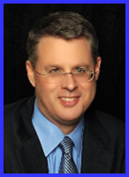
Ecclesiology Session 12
Dr. Andy Woods
Senior Pastor – Sugar Land Bible Church
President – Chafer Theological Seminary

Slide 2
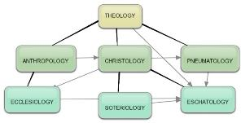
Areas of Systematic Theology
Prolegomena – Introduction
Theology – Study of God
Christology – Study of Christ
Pneumatology – Study of the Holy Spirit
Anthropology – Study of Man
Hamartiology – Study of sin
Soteriology – Study of salvation
Angelology – Study of angels
Ecclesiology – Study of the Church
Eschatology – Study of the end

Slide 3
Ecclesiology Overview
Definition
Universal vs. local
Word pictures
Origin
Israel – Church differences
Intercalation
Purposes
Activities
Government
Officers
Ordinances
Purity

Slide 4
Discontinuity Between Israel & the Church
 | ISRAEL | CHURCH
Marriage | Wife | Bride
Christ | Birthed Christ | Birthed by Christ
Return | 2nd advent | Rapture
Leader | King | Head, Groom
Beginning | Gen 12 | Acts 2
Scripture | 4/5 | 1/5
Covenants | Parties | Beneficiaries
Nation | Political | Spiritual

Slide 5
Discontinuity Between Israel & the Church
 | ISRAEL | CHURCH
Wars | Political | Spiritual
Timing | A quo / ad quem | No time indicators
Priesthood | Have a priesthood | Are a priesthood
Temple | Physical | Body
Resurrection | 1st resurrection | Rapture
Judgment | Earthly (Ezek. 20:33-44) | Heavenly (Bema)
New Jerusalem | Gates | Foundations
Entrance | Physical birth | Spiritual birth

Slide 6
Discontinuity Between Israel & the Church
 | ISRAEL | CHURCH
Governing principle | OT Mosaic Law | NT Law of Christ (Spirit)
Relation to HS | Selective, temporary, subsequent | Universal, permanent, at moment of salvation
Farewell address | Olivet Discourse | Upper Room Discourse
Designation | First Born Son | Bride of Christ
Revealed in OT | Yes | No
Evangelism | Come & See | Go & Proclaim
Blessings | Earthly | Heavenly
Composition | Believers & Unbelievers | Believers Only

Slide 7
Discontinuity Between Israel & the Church
 | ISRAEL | CHURCH
Governing principle | Law | NT
Relation to HS | Selective, temporary, subsequent | Universal, permanent, at moment of salvation
Farewell address | Olivet Discourse | Upper Room Discourse
Designation | First Born Son | Bride of Christ
Revealed in OT | Yes | No
Evangelism | Come & See | Go & Proclaim
Blessings | Earthly | Heavenly
Composition | Believers & Unbelievers | Believers Only

Slide 8
Discourse
 | OLIVET | UPPER ROOM
SCRIPTURE | Matt 24─25 | John 13─17
LOCATION | Mount of Olives | Upper Room
PASSION WEEK | Third day | Sixth day
GENERAL FOCUS | Farewell: Israel | Hello: Church
SPECIFIC FOCUS | Israel’s future | Divine provisions
PROMPTING | Temple's destruction | Christ's imminent departure
EXPLANATIONS | Written OT | Unwritten NT

Slide 9
Discontinuity Between Israel & the Church
 | ISRAEL | CHURCH
Governing principle | Law | NT
Relation to HS | Selective, temporary, subsequent | Universal, permanent, at moment of salvation
Farewell address | Olivet Discourse | Upper Room Discourse
Designation | First Born Son | Bride of Christ
Revealed in OT | Yes | No
Evangelism | Come & See | Go & Proclaim
Blessings | Earthly | Heavenly
Composition | Believers & Unbelievers | Believers Only

Slide 10
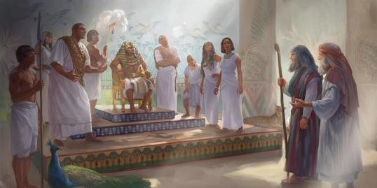
Exodus 4:22
“Then you shall say to Pharaoh, ‘Thus says the Lord, “Israel is My son, My firstborn.”

Slide 11
Discontinuity Between Israel & the Church
 | ISRAEL | CHURCH
Governing principle | Law | NT
Relation to HS | Selective, temporary, subsequent | Universal, permanent, at moment of salvation
Farewell address | Olivet Discourse | Upper Room Discourse
Designation | First Born Son | Bride of Christ
Revealed in OT | Yes | No
Evangelism | Come & See | Go & Proclaim
Blessings | Earthly | Heavenly
Composition | Believers & Unbelievers | Believers Only

Slide 12
Matthew 16:18
I also say to you that you are Peter, and upon this rock I will build [oikodomeō] My church; and the gates of Hades will not overpower it.

Slide 13
Ephesians 3:3-6
“³that by revelation there was made known to me the mystery, as I wrote before in brief. ⁴ By referring to this, when you read you can understand my insight into the mystery of Christ, ⁵ which in other generations was not made known to the sons of men, as it has now been revealed to His holy apostles and prophets in the Spirit; ⁶ to be specific, that the Gentiles are fellow heirs and fellow members of the body, and fellow partakers of the promise in Christ Jesus through the gospel”.

Slide 14
Ephesians 3:9
“and to bring to light what is the administration of the mystery which for ages has been hidden in God who created all things.”

Slide 15
“Mystery” Defined
“In the N.T, it [mystērion] denotes, not the mysterious (as with the Eng. word), but that which, being outside the range of unassisted natural apprehension, can be made known only by Divine revelation, and is made known in a manner and at a time appointed by God, and to those who are illumined by His Spirit.”
W. E. Vine, Merrill F. Unger, and William White, Vine's Complete Expository Dictionary of the Old and New Testament Words (Nashville: Nelson, 1996), 424.

Slide 16
Colossians 1:26
“that is, the mystery which has been hidden from the past ages and generations, but has now been manifested to His.”

Slide 17
Discontinuity Between Israel & the Church
 | ISRAEL | CHURCH
Governing principle | Law | NT
Relation to HS | Selective, temporary, subsequent | Universal, permanent, at moment of salvation
Farewell address | Olivet Discourse | Upper Room Discourse
Designation | First Born Son | Bride of Christ
Revealed in OT | Yes | No
Evangelism | Come & See | Go & Proclaim
Blessings | Earthly | Heavenly
Composition | Believers & Unbelievers | Believers Only

Slide 18
Genesis 12:3
“And I will bless those who bless you, And the one who curses you I will curse. And in you all the families of the earth will be blessed.”

Slide 19
Isaiah 42:6
“I am the Lord, I have called You in righteousness, I will also hold You by the hand and watch over You, And I will appoint You as a covenant to the people, As a light to the nations.”

Slide 20
Isaiah 49:6
He says, “It is too small a thing that You should be My Servant To raise up the tribes of Jacob and to restore the preserved ones of Israel; I will also make You a light of the nations So that My salvation may reach to the end of the earth.”

Slide 21
Isaiah 2:1-4
“The word which Isaiah the son of Amoz saw concerning Judah and Jerusalem.² Now it will come about that In the last days The mountain of the house of the Lord Will be established as the chief of the mountains, And will be raised above the hills; And all the nations will stream to it.³ And many peoples will come and say, “Come, let us go up to the mountain of the Lord, To the house of the…

Slide 22
Isaiah 2:1-4
...God of Jacob; That He may teach us concerning His ways And that we may walk in His paths.” For the law will go forth from Zion And the word of the Lord from Jerusalem.⁴ And He will judge between the nations, And will render decisions for many peoples; And they will hammer their swords into plowshares and their spears into pruning hooks. Nation will not lift up sword against nation, And never again will they learn war.”

Slide 23
Zechariah 14:16-18
“Then it will come about that any who are left of all the nations that went against Jerusalem will go up from year to year to worship the King, the Lord of hosts, and to celebrate the Feast of Booths. ¹⁷ And it will be that whichever of the families of the earth does not go up to Jerusalem to worship the King, the Lord of hosts, there will be no rain on them. ¹⁸ If the family of Egypt does not go up or enter, then no rain will fall on them; it will be the plague with which the Lord smites the nations who do not go up to celebrate the Feast of Booths.”

Slide 24
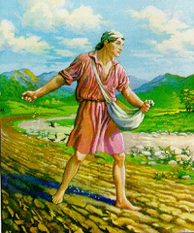
Matthew 13:3
“And He spoke many things to them in parables, saying, “Behold, the sower went out to sow.”

Slide 25
The Prophetic Parables of
Matthew Thirteen - A. W. Pink
“The words ‘went forth to sow,’ or as Mark’s Gospel puts it ‘went out’ were indicative of the great dispensational change which was soon to be introduced. There was no longer to be a planting of vines or fig-trees in Israel, but a going out of the mercy of God unto the Gentiles; therefore what we have here is the broadcast sowing of the Seed in the field at large, for as verse 38 tells us ‘the field is the world.’”
A. W. Pink (2005). The Prophetic Parables of Matthew Thirteen. Bellingham, WA: Logos Bible Software.

Slide 26
Matthew 28:18-20
¹⁸ And Jesus came up and spoke to them, saying, “All authority has been given to Me in heaven and on earth. ¹⁹ Go therefore and make disciples of all the nations, baptizing them in the name of the Father and the Son and the Holy Spirit, ²⁰ teaching them to observe all that I commanded you; and lo, I am with you always, even to the end of the age.”

Slide 27
Mark 16:15
“Go into all the world and preach the gospel to all creation.”

Slide 28
Acts 1:8
“but you will receive power when the Holy Spirit has come upon you; and you shall be My witnesses both in Jerusalem, and in all Judea and Samaria, and even to the remotest part of the earth.”

Slide 29
Discontinuity Between Israel & the Church
 | ISRAEL | CHURCH
Governing principle | Law | NT
Relation to HS | Selective, temporary, subsequent | Universal, permanent, at moment of salvation
Farewell address | Olivet Discourse | Upper Room Discourse
Designation | First Born Son | Bride of Christ
Revealed in OT | Yes | No
Evangelism | Come & See | Go & Proclaim
Blessings | Earthly | Heavenly
Composition | Believers & Unbelievers | Believers Only

Slide 30
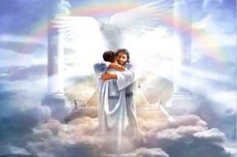
Ephesians 1:3
“Blessed be the God and Father of our Lord Jesus Christ, who has blessed us with every spiritual blessing in the heavenly places in Christ.”

Slide 31
Revelation 2:9
“I know your tribulation and your poverty (but you are rich), and the blasphemy by those who say they are Jews and are not, but are a synagogue of Satan.”

Slide 32
Discontinuity Between Israel & the Church
 | ISRAEL | CHURCH
Governing principle | Law | NT
Relation to HS | Selective, temporary, subsequent | Universal, permanent, at moment of salvation
Farewell address | Olivet Discourse | Upper Room Discourse
Designation | First Born Son | Bride of Christ
Revealed in OT | Yes | No
Evangelism | Come & See | Go & Proclaim
Blessings | Earthly | Heavenly
Composition | Believers & Unbelievers | Believers Only

Slide 33
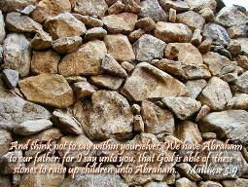
Matthew 3:9
“and do not suppose that you can say to yourselves, ‘We have Abraham for our father’; for I say to you that from these stones God is able to raise up children to Abraham.”

Slide 34
Romans 2:28-29
“²⁸ For he is not a Jew who is one outwardly, nor is circumcision that which is outward in the flesh. ²⁹ But he is a Jew who is one inwardly; and circumcision is that which is of the heart, by the Spirit, not by the letter; and his praise is not from men, but from God.”

Slide 35
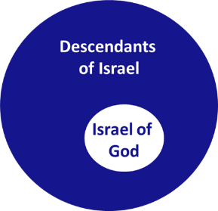
Romans 9:6
“But it is not as though the word of God has failed. For they are not all Israel who are descended from Israel.”

Slide 36
Revelation 2:9
“I know your tribulation and your poverty (but you are rich), and the blasphemy by those who say they are Jews and are not, but are a synagogue of Satan.”

Slide 37
Zechariah 13:8-9
⁸“It will come about in all the land,” Declares the Lord, “That two parts in it will be cut off and perish; But the third will be left in it. ⁹“And I will bring the third part through the fire, Refine them as silver is refined, And test them as gold is tested. They will call on My name, And I will answer them; I will say, ‘They are My people,’ And they will say, ‘The Lord is my God.’ ”

Slide 38
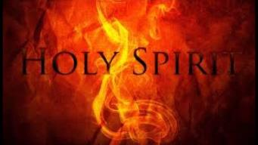
1 Corinthians 12:13
“For by one Spirit we were all baptized into one body, whether Jews or Greeks, whether slaves or free, and we were all made to drink of one Spirit.”

Slide 39
1 Corinthians 3:1-3 (NKJV)
¹ And I, brethren, could not speak to you as to spiritual people but as to carnal, as to babes in Christ. ² I fed you with milk and not with solid food; for until now you were not able to receive it, and even now you are still not able; ³ for you are still carnal. For where there are envy, strife, and divisions among you, are you not carnal and behaving like mere men?

Slide 40
Notes:
Ray Steadman – “1st Californians”
Unbelievers vs Categories of Believers
Unbelievers – ψυχικός psuchikós; Natural, pertaining to the natural as distinguished from the spiritual
Spiritual Believers – πνευματικός pneumatikós; of persons who are spiritual, enlightened by the Holy Spirit
Infant Believers – σάρκινος sárkinos; with propensities of the flesh unto sin; νήπιος nḗpios; an infant, child, baby without any definite limitation of age. (This relates to immaturity and lack of instruction)
Carnal Believers – σαρκικός sarkikós; tendency to satisfy the flesh, implying sinfulness, sinful propensity, carnal (This relates to disobedience and open rebellion)

Slide 41
Conclusion

Slide 42
Discontinuity Between Israel & the Church
 | ISRAEL | CHURCH
Marriage | Wife | Bride
Christ | Birthed Christ | Birthed by Christ
Return | 2nd advent | Rapture
Leader | King | Head, Groom
Beginning | Gen 12 | Acts 2
Scripture | 4/5 | 1/5
Covenants | Parties | Beneficiaries
Nation | Political | Spiritual

Slide 43
Discontinuity Between Israel & the Church
 | ISRAEL | CHURCH
Wars | Political | Spiritual
Timing | A quo / ad quem | No time indicators
Priesthood | Have a priesthood | Are a priesthood
Temple | Physical | Body
Resurrection | 1st resurrection | Rapture
Judgment | Earthly (Ezek. 20:33-44) | Heavenly (Bema)
New Jerusalem | Gates | Foundations
Entrance | Physical birth | Spiritual birth

Slide 44
Discontinuity Between Israel & the Church
 | ISRAEL | CHURCH
Governing principle | Law | NT
Relation to HS | Selective, temporary, subsequent | Universal, permanent, at moment of salvation
Farewell address | Olivet Discourse | Upper Room Discourse
Designation | First Born Son | Bride of Christ
Revealed in OT | Yes | No
Evangelism | Come & See | Go & Proclaim
Blessings | Earthly | Heavenly
Composition | Believers & Unbelievers | Believers Only

Slide 45
Ephesians 3:10
“so that the manifold wisdom of God might now be made known through the church to the rulers and the authorities in the heavenly places.”

Slide 46
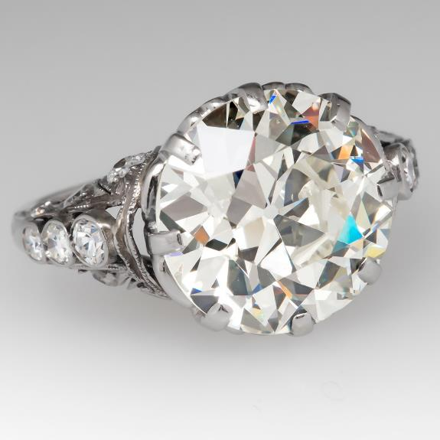

Slide 47
Ecclesiology Overview
Definition
Universal vs. local
Word pictures
Origin
Israel – Church differences
Intercalation
Purposes
Activities
Government
Officers
Ordinances
Purity

