Slide 1
THE BOOK OF DANIEL
Dr. Andy Woods

Slide 2
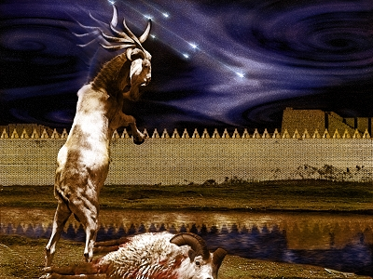
DANIEL 10-12 THE FINAL VISION

Slide 3
CHAPTER AND VERSE IN DANIEL | CHRONOLOGICAL DATE | BIBLICAL DATE
1:1 | 605 | 3rd year of Jehoiakim
2:1 | 603 | 2nd year of Nebuchadnezzar
5 | Sat. night 10/12/539 (Hoehner)
7:1 | 553 | 1st year of Belshazzar
8:1 | 551 | 3rd year of Belshazzar
9:1 | 538 | 1st year of Darius
10:1 | 536 | 3rd year of Cyrus

Slide 4
Chapter 10–12 Outline
The Setting (10:1-3)
Arrival of the Heavenly Messenger (10:4-9)
Explanation of the Heavenly Messenger (10:10–11:1)
The Prophecy of the Heavenly Messenger (11:2–12:13)

Slide 5
IV. The Prophecy of the Heavenly Messenger (11:2–12:13)
Persia (11:2)
Greece (11:3-4)
Ptolemies & Seleucids (11:5-20)
Antiochus IV (11:21-35)
Antichrist (11:36-45)
Tribulation & Millennium (12:1-13)

Slide 6
IV. The Prophecy of the Heavenly Messenger (11:2–12:13)
Persia (11:2)
Greece (11:3-4)
Ptolemies & Seleucids (11:5-20)
Antiochus IV (11:21-35)
Antichrist (11:36-45)
Tribulation & Millennium (12:1-13)

Slide 7
PERSIA 11:2
Cambyses 530-523 BC
Pseudo-Smerdis 522 BC
Darius I Hystaspes 521-486 BC
Xerxes 485-465 BC
Aka. “Ahasuerus” in Esther

Slide 8
IV. The Prophecy of the Heavenly Messenger (11:2–12:13)
Persia (11:2)
Greece (11:3-4)
Ptolemies & Seleucids (11:5-20)
Antiochus (11:21-35)
Antichrist (11:36-45)
Tribulation & Millennium (12:1-13)

Slide 9
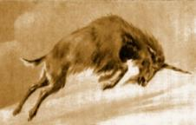
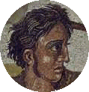
GREECE 11:3-4
Alexander the Great
Died at age 33 in 323 BC
No heirs
Kingdom divided among his 4 generals
Daniel 7:6, 8:5-8

Slide 10
IV. The Prophecy of the Heavenly Messenger (11:2–12:13)
Persia (11:2)
Greece (11:3-4)
Ptolemies & Seleucids (11:5-20)
Antiochus (11:21-35)
Antichrist (11:36-45)
Tribulation & Millennium (12:1-13)

Slide 11
PTOLEMIES AND SELEUCIDS 11:5-20
History of warfare between the 2 dynasties
Ptolemies of Egypt vs. Seleucids of Syria
King of the South vs. King of the North
From 323 BC – 175 BC
The beautiful land = Israel
Cassander and Lysimachus not in view
Key transition in 198 B.C.
Selective and non-comprehensive history
What is at stake?

Slide 12
Intertestamental Chronology (Dates BC)
SELEUCIDS
Seleucus I 312-281
Antiochus I 281-261
Antiochus II 261-246
Seleucus II 246-226
Seleucus III 226-223
Antiochus III 223-187
Seleucus IV Philapator 187-175
Antiochus IV Epiphanes 175-163

Slide 13
IV. The Prophecy of the Heavenly Messenger (11:2–12:13)
Persia (11:2)
Greece (11:3-4)
Ptolemies & Seleucids (11:5-20)
Antiochus IV (11:21-35)
Antichrist (11:36-45)
Tribulation & Millennium (12:1-13)

Slide 14
The Career of Antiochus IV Epiphanes Daniel 11:21-35
His rise to power (21)
His initial and general military successes (22-24)
His 1st military activities concerning Egypt & Israel (25-28)
His desecration of the Jewish Temple (29-31)
The reaction of Israel to the Temple’s desecration (32-25)

Slide 15
IV. The Prophecy of the Heavenly Messenger (11:2–12:13)
Persia (11:2)
Greece (11:3-4)
Ptolemies & Seleucids (11:5-20)
Antiochus IV (11:21-35)
Antichrist (11:36-45)
Tribulation & Millennium (12:1-13)

Slide 16
Understanding Daniel’s
Prophetic Perspective
Antichrist
Antiochus IV
(Daniel 11:36-45)
(Daniel 11:21-35)
Far
Fulfillment
Near
Fulfillment
Daniel

Slide 17
Why is Daniel 11:36-45 About Antichrist and not Antiochus IV?
It does not fit the known facts of history
The king is not from the North only but is in conflict with both the North and the South
It is consistent with the prophecies about the future Antichrist (Dan. 7; 2 Thess. 2; Rev. 13; 17)
The Antichrist is prominent in Daniel's earlier prophecies (“little horn” of Dan. 7)
Prophetic gaps are common in Scripture

Slide 18
6 Reasons for Gap in the 70 Weeks Prophecy
(Dan. 9:24-27)
Events prophesied v.26
Messiah crucified v.26a
70 AD holocaust v.26b
Prophecies in Dan. 9:24 would have been fulfilled 7 years after Palm Sunday
Jesus indicated a gap - (Matt. 24:15, 21-22, 29-30)
Daniel 9:27 was never fulfilled historically
Gap occurs elsewhere - (Is. 61:1-2; Luke 4:16-21; Isaiah 9:6)
Early church fathers indicated a gap

Slide 20
Zechariah 9:9-10
⁹ Rejoice greatly, O daughter of Zion! Shout in triumph, O daughter of Jerusalem! Behold, your king is coming to you; He is just and endowed with salvation, Humble, and mounted on a donkey, Even on a colt, the foal of a donkey.¹⁰ I will cut off the chariot from Ephraim And the horse from Jerusalem; And the bow of war will be cut off. And He will speak peace to the nations; And His dominion will be from sea to sea, And from the River to the ends of the earth.

Slide 21
Isaiah 9:6-7
⁶ For a child will be born to us, a son will be given to us; And the government will rest on His shoulders; And His name will be called Wonderful Counselor, Mighty God, Eternal Father, Prince of Peace.⁷ There will be no end to the increase of His government or of peace, On the throne of David and over his kingdom, To establish it and to uphold it with justice and righteousness From then on and forevermore. The zeal of the Lord of hosts will accomplish this.

Slide 22
Isaiah 61:1-2
¹ The Spirit of the Lord God is upon me, Because the Lord has anointed me To bring good news to the afflicted; He has sent me to bind up the brokenhearted, To proclaim liberty to captives And freedom to prisoners;² To proclaim the favorable year of the Lord And the day of vengeance of our God; To comfort all who mourn.

Slide 23
Luke 4:16-21
¹⁶ And He came to Nazareth, where He had been brought up; and as was His custom, He entered the synagogue on the Sabbath, and stood up to read. ¹⁷ And the book of the prophet Isaiah was handed to Him. And He opened the book and found the place where it was written,¹⁸ “The Spirit of the Lord is upon Me, Because He anointed Me to preach the gospel to the poor. He has sent Me to proclaim release to the captives, And recovery of sight to the blind, To set …

Slide 24
Luke 4:16-21
…free those who are oppressed,¹⁹ To proclaim the favorable year of the Lord.” ²⁰ And He closed the book, gave it back to the attendant and sat down; and the eyes of all in the synagogue were fixed on Him. ²¹ And He began to say to them, “Today this Scripture has been fulfilled in your hearing.”

Slide 25
Isaiah 61:1-2
¹ The Spirit of the Lord God is upon me, Because the Lord has anointed me To bring good news to the afflicted; He has sent me to bind up the brokenhearted, To proclaim liberty to captives And freedom to prisoners;² To proclaim the favorable year of the Lord And the day of vengeance of our God; To comfort all who mourn.

Slide 26
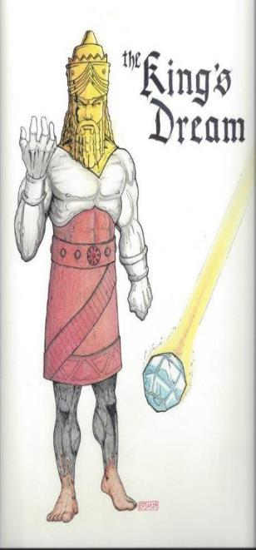
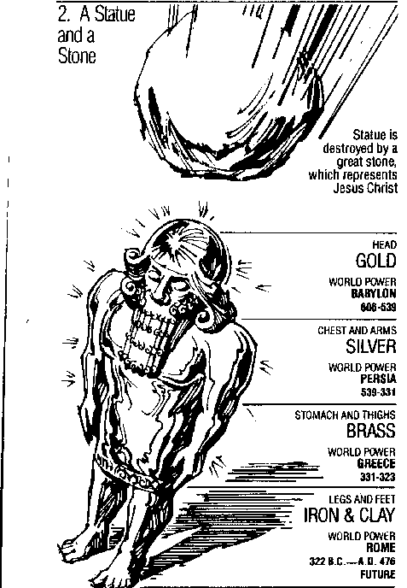
Statue
&
Stone

Slide 27
1 Peter 1:10-11
¹⁰ As to this salvation, the prophets who prophesied of the grace that would come to you made careful searches and inquiries, ¹¹ seeking to know what person or time the Spirit of Christ within them was indicating as He predicted the sufferings of Christ and the glories to follow.

Slide 28
Why is Daniel 11:36-45 about Antichrist and not Antiochus IV?
Many reputable commentators have interpreted these verses as referring to the future Antichrist (Jerome; Luther)
Contextual indicators
“At that time” (12:1)
“Latter days” (10:14)
“At the time of the end” (11:40)
“The indignation” (11:36)

Slide 29
The Career of the Antichrist Daniel 11:36-45
His self-magnification (36-37)
His military power (38-39)
His military successes (40-43)
His military defeat (44-45)

Slide 30
The Career of the Antichrist Daniel 11:36-45
His self-magnification (36-37)
His military power (38-39)
His military successes (40-43)
His military defeat (44-45)

Slide 31
Statue
&
Stone

Slide 33
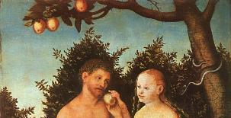
Genesis 3:15
“And I will put enmity between you and the woman, and between your seed and her seed; He shall bruise you on the head, and you shall bruise him on the heel.”

Slide 34
Genesis 4:1
“Now the man had relations with his wife Eve, and she conceived and gave birth to Cain, and she said, “I have gotten a manchild with the help of the Lord.”

Slide 35
Genesis 5:29
“Now he called his name Noah, saying, “This one will give us rest from our work and from the toil of our hands arising from the ground which the Lord has cursed.”

Slide 36
The Career of the Antichrist Daniel 11:36-45
His self-magnification (36-37)
His military power (38-39)
His military successes (40-43)
His military defeat (44-45)

Slide 37
The Career of the Antichrist Daniel 11:36-45
His self-magnification (36-37)
His military power (38-39)
His military successes (40-43)
His military defeat (44-45)

Slide 38
The Career of the Antichrist Daniel 11:36-45
His self-magnification (36-37)
His military power (38-39)
His military successes (40-43)
His military defeat (44-45)

Slide 39
Conclusion

Slide 40
Chapter 10–12 Outline
The Setting (10:1-3)
Arrival of the Heavenly Messenger (10:4-9)
Explanation of the Heavenly Messenger (10:10–11:1)
The Prophecy of the Heavenly Messenger (11:2–12:13)

Slide 41
IV. The Prophecy of the Heavenly Messenger (11:2–12:13)
Persia (11:2)
Greece (11:3-4)
Ptolemies & Seleucids (11:5-20)
Antiochus IV (11:21-35)
Antichrist (11:36-45)
Tribulation & Millennium (12:1-13)

Slide 42
Purpose
To encourage Judah by emphasizing the sovereignty of God during the Babylonian captivity and to teach Judah how to live while outside the land

Slide 43
“The Lord bless you and keep you; the Lord make his face shine on you and be gracious to you; the Lord turn his face toward you and give you peace.” (NIV)

