Slide 1
BELIEVERS’ REWARDS
February 4, 2018
Alex Garcia

Slide 2
Believers’ Rewards
1. Christ evaluates our lives (our works).
2. Scripture teaches what are good works.
3. Christ rewards good works.

Slide 3
Believers’ Rewards
1. Christ evaluates our lives (our works).
2. Scripture teaches what are good works.
3. Christ rewards good works.
So do good works and be rewarded!

Slide 4
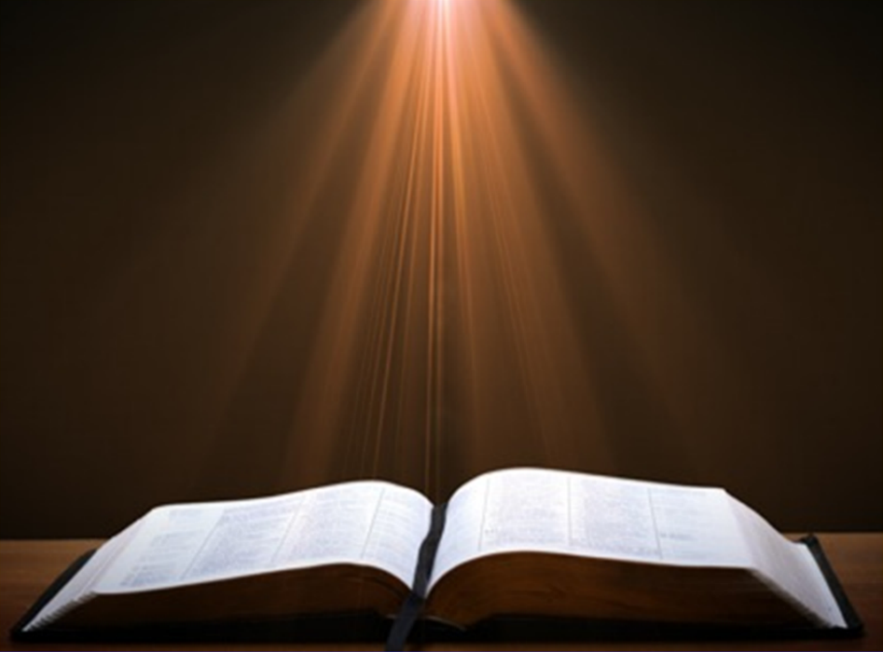
1 Corinthians 3:12
¹²“Now if any man builds on the foundation with gold, silver, precious stones, wood, hay, straw,”

Slide 5
1 Corinthians 3:13
¹³“each man’s work will become evident; for the day will show it because it is to be revealed with fire, and the fire itself will test the quality of each man’s work.”

Slide 7
Ephesians 2:8-9
⁸“For by grace you have been saved through faith; and that not of yourselves, it is the gift of God; ⁹not as a result of works, so that no one may boast.”

Slide 8
Ephesians 2:10
¹⁰“For we are His workmanship, created in Christ Jesus for good works, which God prepared beforehand so that we would walk in them.”

Slide 9
Colossians 3:23-24
²³“Whatever you do, do your work heartily, as for the Lord rather than for men, ²⁴knowing that from the Lord you will receive the reward of the inheritance. It is the Lord Christ whom you serve.”

Slide 10
1 Corinthians 3:8
⁸“Now he who plants and he who waters are one; but each will receive his own reward according to his own labor.”

Slide 11
Matthew 5:11-12
¹¹“Blessed are you when people insult you and persecute you, and falsely say all kinds of evil against you because of Me.¹²Rejoice and be glad, for your reward in heaven is great; for in the same way they persecuted the prophets who were before you.”

Slide 12
Jack Phillips (Cake Maker)

Slide 13
Mark 9:41
⁴¹“For whoever gives you a cup of water to drink because of your name as followers of Christ, truly I say to you, he will not lose his reward.”

Slide 14
Matthew 6:1
¹“Beware of practicing your righteousness before men to be noticed by them; otherwise you have no reward with your Father who is in heaven.”

Slide 15
1 Corinthians 3:13
¹³“each man’s work will become evident; for the day will show it because it is to be revealed with fire, and the fire itself will test the quality of each man’s work.”

Slide 16
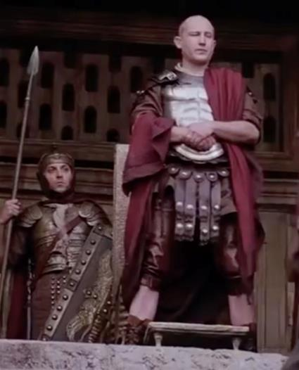
Pilate’s Bema
“Passion of the Christ” – Mel Gibson

Slide 17
1 Corinthians 3:13
¹³“each man’s work will become evident; for the day will show it because it is to be revealed with fire, and the fire itself will test the quality of each man’s work.”

Slide 18
1 Corinthians 3:14
¹⁴“If any man’s work which he has built on it remains, he will receive a reward.”

Slide 19
Heavenly Crowns
Imperishable: for self control—mastery of the sin nature (1Cor 9:24-27)
Rejoicing: for winning souls (1 Thess 2:19)
Righteousness: for living with eyes on Christ’s return (2 Tim 4:8)
Glory: for shepherding God’s people (1 Pet 5:4)
Life: for persevering under trials (James 1:12; Rev 2:10)

Slide 20
1 Corinthians 3:15
¹⁵“If any man’s work is burned up, he will suffer loss; but he himself will be saved, yet so as through fire.”

Slide 21
Conclusion

Slide 22
Believers’ Rewards
1. Christ evaluates our lives (our works).
2. Scripture teaches what are good works.
3. Christ rewards good works.

Slide 23
“The Lord bless you and keep you; the Lord make his face shine on you and be gracious to you; the Lord turn his face toward you and give you peace.” (NIV)

