Slide 1
Law & Grace: An Overview Jim McGowan, Th.D. Sugar Land Bible Church 02-04-2018
…but grace & truth were realized through Jesus Christ - John 1:17
For the Law was given through Moses…
Special thanks to Dr. Vern Peterman for access to his insights and resources.

Slide 2
Session 5 Outline
Review
Purpose, Aim, and Objective
Session 4
A Mountaintop Experience – Part 1 (Exo. 19:10-25)
General Information
Contrast & Comparison of Law & Grace
Conclusion

Slide 3
Session 5 Outline
Review
Purpose, Aim, and Objective
Session 4
A Mountaintop Experience – Part 1 (Exo. 19:10-25)
General Information
Contrast & Comparison of Law & Grace
Conclusion

Slide 4
OUR PURPOSE, AIM AND OBJECTIVE
Law & Grace
…is to Compare and Contrast Law and Grace so as to properly understand these two important themes and how they are related to the life of the New Testament Believer.

Slide 5
C. I. SCOFIELD, D. D.
The Grace of God, The Fundamentals Vol. 3, Chapter VII, p. 98
We have, most of us, been reared and now live under the influence of Galatianism. Protestant theology, alas, is for the most part, thoroughly Galatianized, in that neither law nor grace are given their distinct and separated places, as in the counsels of God, but are mingled together in one incoherent system. The law is no longer, as in the Divine intent, a ministration of death (2 Cor. 3:7), of cursing (Gal. 3:10), of conviction (Rom. 3:19), because we are taught that we must try to keep it, and that by Divine help we may. Nor, on the other hand, does grace bring us blessed deliverance from the dominion of sin, for we are kept under the law as a rule of life despite the plain declaration, “Sin shall not have dominion over you: for ye are not under the law, but under grace” (Rom. 6:14).

Slide 6
TEACHINGS OF LAW | TEACHINGS OF GRACE
Written with ink. | Written with the Spirit of the living God.
In tables of stone. | In fleshy tables of the heart.
The letter killeth. | The Spirit giveth life.
The ministration of death. | The ministration of the Spirit.
Was glorious. | Is rather glorious.
Done away. | Remaineth.
Abolished. | We have such hope.
L. S. CHAFER, Systematic theology (Vol. 4, p. 242). (1993). Grand Rapids, MI: Kregel Publications.

Slide 7
Session 5 Outline
Review
Purpose, Aim, and Objective
Session 4
A Mountaintop Experience – Part 1 (Exo. 19:10-25)
General Information
Contrast & Comparison of Law & Grace
Conclusion

Slide 8
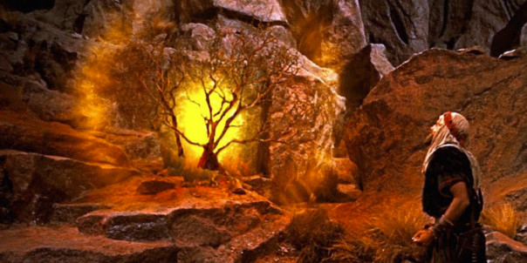
Law & Grace: Lesson 4 Review
“Do not come near…!”
“…Then Moses hid his face, for he was afraid
to look at God.” Exodus 3:5-6
Notes:
“Do not come near…!”
“…Then Moses hid his face, for he was afraid to look at God.” Exodus 3:5-6
COMPARE THIS TO WHAT IS WRITTEN IN THE BOOK OF HEBREWS…WRITTEN TO BELIEVING JEWS!!!

Slide 9
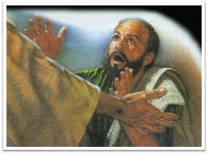
Hebrews 4:16
Therefore let us draw near with confidence to the throne of grace, so that we may receive mercy and find grace to help in time of need.
Notes:
Hebrews 4:16 (NASB95) - Therefore let us draw near with confidence to the throne of grace, so that we may receive mercy and find grace to help in time of need.

Slide 10
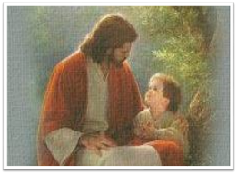
Hebrews 7:19
(for the Law made nothing perfect), and on the other hand there is a bringing in of a better hope, through which we draw near to God.
Notes:
Hebrews 7:19 (NASB95) - (for the Law made nothing perfect), and on the other hand there is a bringing in of a better hope, through which we draw near to God.

Slide 11
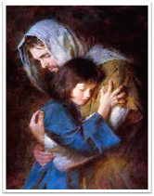
Hebrews 7:25
Therefore He is able also to save forever those who draw near to God through Him, since He always lives to make intercession for them. (cf. Heb. 10:1; 22)
Notes:
Hebrews 7:25 (NASB95) - Therefore He is able also to save forever those who draw near to God through Him, since He always lives to make intercession for them. (cf. Heb. 10:1; 22)

Slide 12
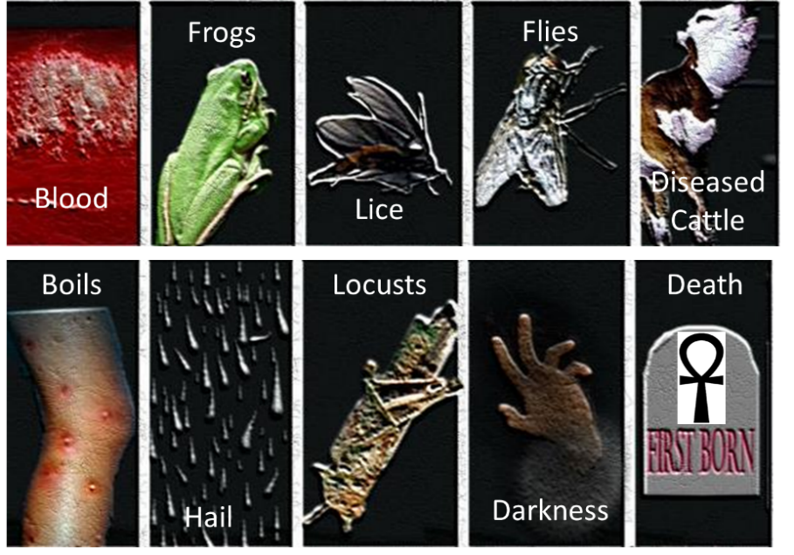
Law & Grace: Lesson 4 Review

Slide 13
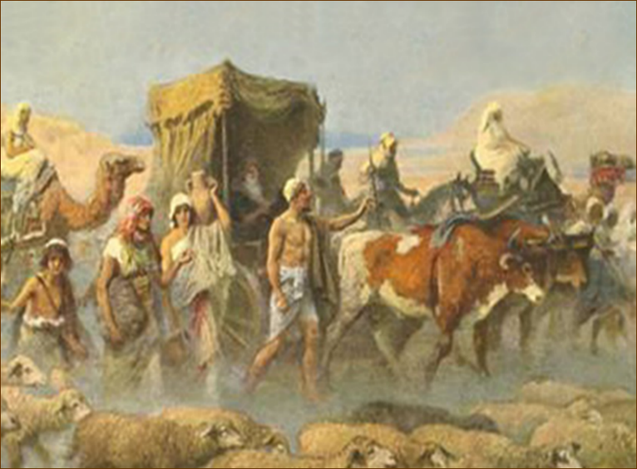
GET OUT OF DODGE!
Law & Grace: Lesson 4 Review

Slide 14
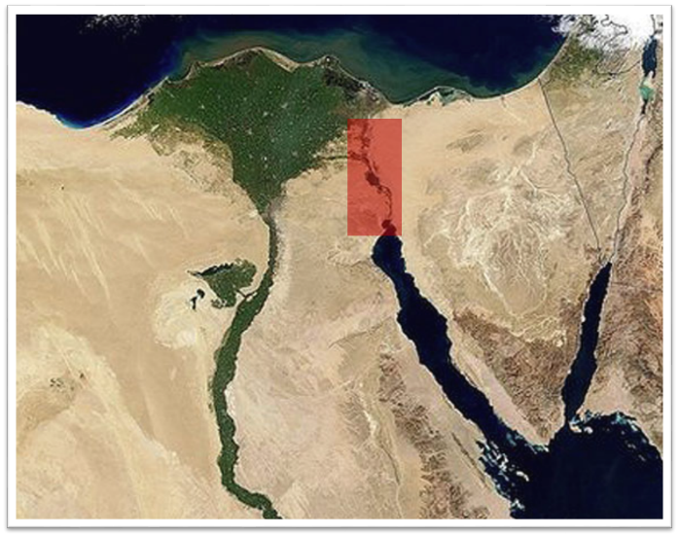
THE NILE DELTA AND LAND OF GOSHEN
Law & Grace: Lesson 4 Review

Slide 15
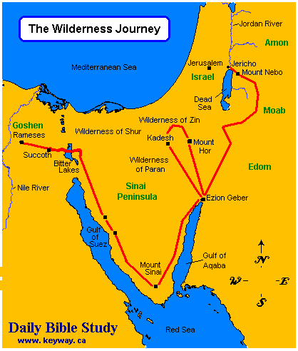
Law & Grace: Lesson 4 Review
POSSIBLE EXODUS ROUTES

Slide 16
Law & Grace: Lesson 4 Review

Slide 17
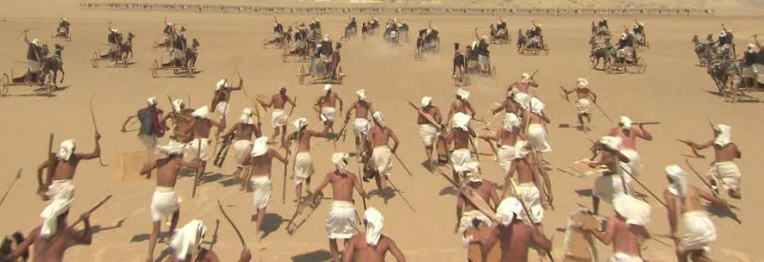
Law & Grace: Lesson 4 Review
WHAT WERE WE THINKING?
‘Then the Egyptians took up the pursuit…’ Exo. 14:23

Slide 18
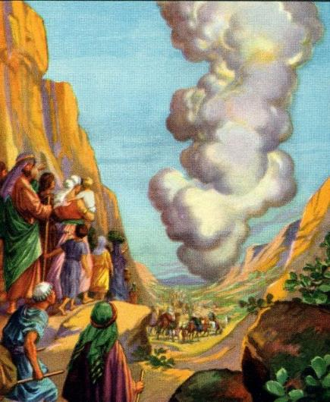
Cloud by Day
Law & Grace: Lesson 4 Review

Slide 19
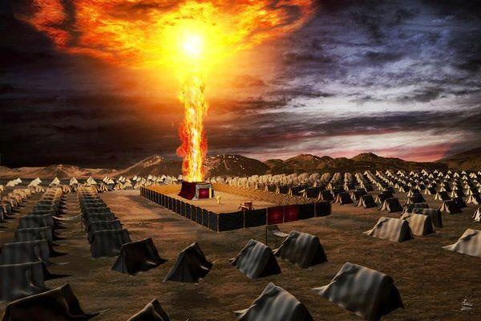
Pillar of Fire by Night
Law & Grace: Lesson 4 Review

Slide 20
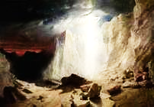
Pillar of Fire by Night
Law & Grace: Lesson 4 Review
IF REPRESENTING THE SHEKINAH IT MIGHT HAVE LOOKED SOMETHING LIKE THIS…

Slide 21
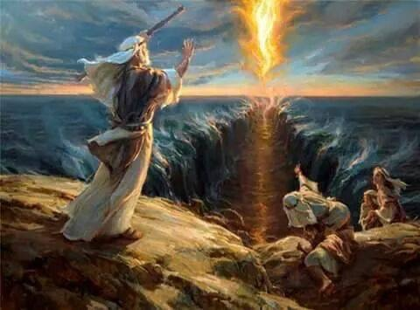
Law & Grace: Lesson 4 Review

Slide 22
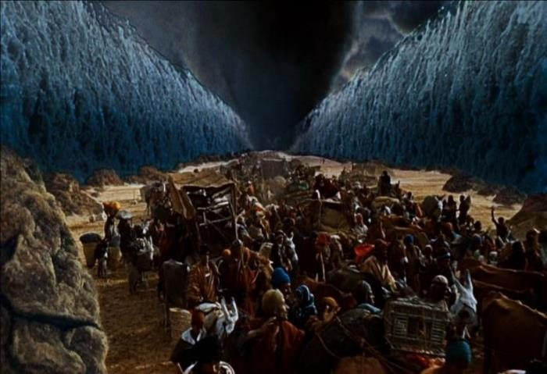
Law & Grace: Lesson 4 Review
Nighttime Crossing of the Red Sea (Exo. 14:19–25)

Slide 23
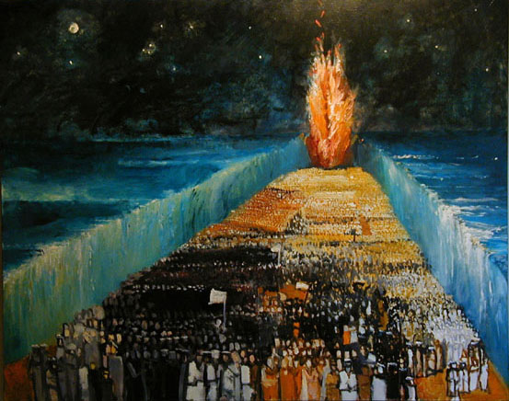
Law & Grace: Lesson 4 Review
Nighttime Crossing of the Red Sea (Exo. 14:19–25)

Slide 24
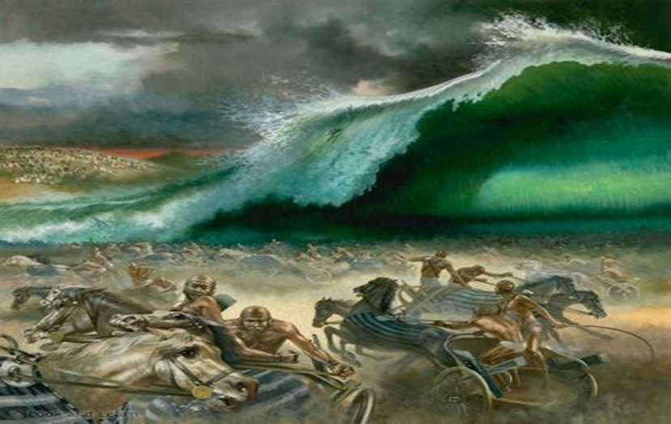
Law & Grace: Lesson 4 Review
SEEN NEVERMORE!

Slide 25
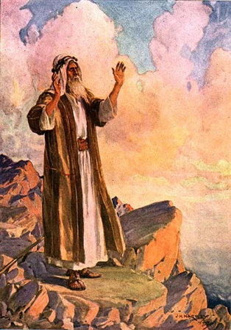
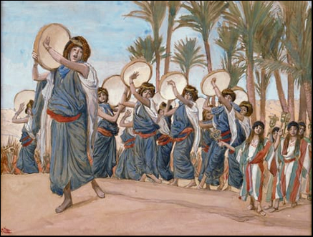
Law & Grace: Lesson 4 Review
EXODUS 15:1-21
THE SONGS OF MOSES AND MIRIAM

Slide 26
ISRAEL or the CHURCH
Law & Grace: Lesson 4 Review
ISRAEL Baptized into Moses | CHURCH Baptized into Christ
1 Cor. 10:2 says that the people of Israel were all baptized into Moses under the cloud and through the sea, a physical presence. this baptism would place them all under the principle of law. | And Rom. 6:3 and also Gal. 3:27 say that we in the Church were all baptized into Christ Jesus, which is a spiritual presence. this baptism would place all of us under the principle of grace.

Slide 27
Law & Grace: Lesson 4 Review
GOD ACTED FOR ISRAEL | GOD ACTED FOR US
God sent Moses to bring the Israelites out of Egypt; but not to die in Egypt (Exodus 3:10). He acted by sending ten plagues to bring Pharaoh to the point of letting “His” people go. God, acting through Moses, Aaron, and the ten plagues, brought “His” people to the sea. Although “His” people thought they were as good as dead, God acted to save them. | God sent Christ to save us from years of bondage to the dread of sin and the tyranny of death in all their forms. Christ died for our sins to end that bondage and bring us out - forever. And in the process, God has us die with Christ, and even though that accomplished wonderful things, it was really death. Though we died with Christ, God had an eternally very good purpose in all of it.

Slide 28
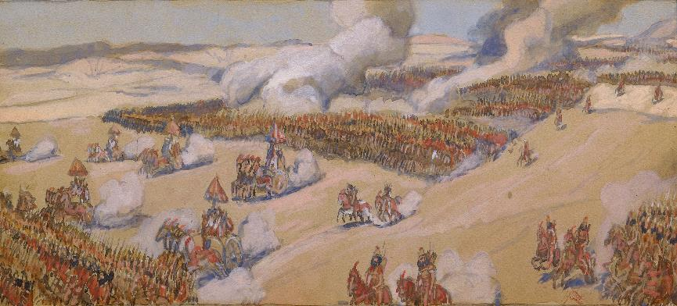
Law & Grace: Lesson 4 Review
Death to life for Israel
The principle of death to life was lived out PHYSICALLY for Israel as God brought them from certain death to miraculously preserved life.

Slide 29
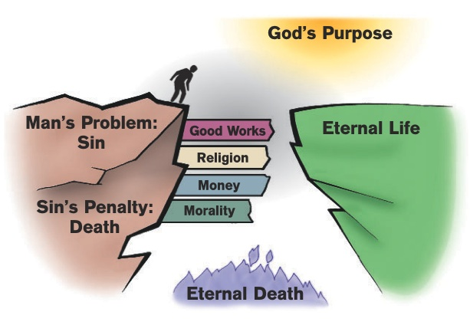
Law & Grace: Lesson 4 Review
Death to life for Us

Slide 30
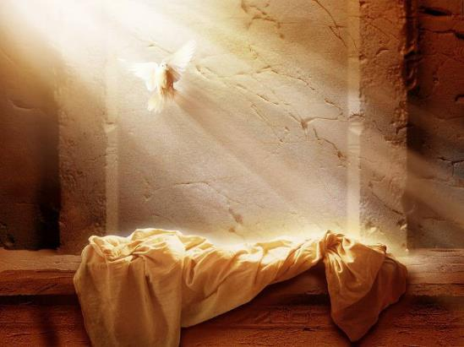
Law & Grace: Lesson 4 Review
Death to life for Us
The principle of death to life was carried out SPIRITUALLY for us as God brought us from spiritual death to Christ’s resurrection life.
Notes:
The moment we believed we were identified with (joined to) Christ in His Death, Burial, Resurrection, Ascension, and Seating in Heaven.
Christ is righteous. The moment we believed we were given Christ’s righteousness which is unchangeable and eternal. Righteousness is right standing with God.
The moment we believed we were positionally “in Christ”, a New Man with a New Nature.
The principle of death to life was carried out SPIRITUALLY for us as God brought us from spiritual death to Christ’s very own resurrection life.

Slide 31
Law & Grace: Lesson 4 Review
Death was SEPARATION for Israel
So by the death of the Egyptians God made a physical separation between Egypt and Israel.

Slide 32
Law & Grace: Lesson 4 Review
Death is SEPARATION for Us
So being “dead unto” and similar terms means for us to be “dead in relationship to” the sin nature, the Law and the world.

Slide 33
Law & Grace: Lesson 4 Review
Death = separation; Being Alive = union
Rom. 6:1-11 | dead to sin, alive to Christ
Rom. 7:1-6 | death releases one from marriage; died to the Law, joined to Christ
2 Cor. 5:14-15 | dead to ourselves, alive to Christ
Gal. 2:19-20 | died to the Law, to live to God
Col. 2:20 | died with Christ to the elementary principles of the world
Col. 3:5, 20 | dead to sin, died with Christ to the world

Slide 34
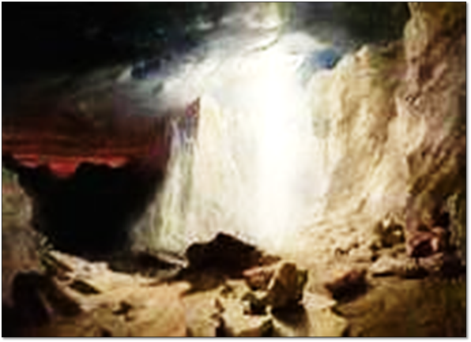
God’s External & Visible Presence with Israel
Law & Grace: Lesson 4 Review
So the Israelites always had a visible reminder of God’s presence in the wilderness.

Slide 35
God’s Internal & Invisible Presence with Us
Law & Grace: Lesson 4 Review
1 Corinthians 3:16
Do you not know that you are a temple of God and that the Spirit of God dwells in you?
So we have an Internal and Invisible reminder of God’s constant presence, wherever we go.

Slide 36
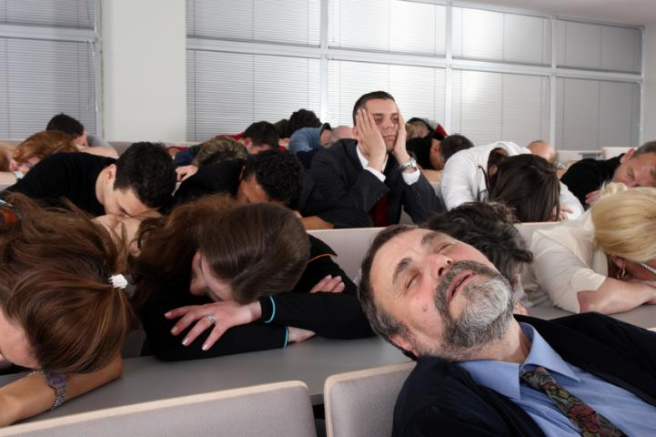
END OF REVIEW
FINALLY

Slide 37
Session 5 Outline
Review
Purpose, Aim, and Objective
Session 4
A Mountaintop Experience – Part 1 (Exo. 19:10-25)
General Information
Contrast & Comparison of Law & Grace
Conclusion

Slide 38
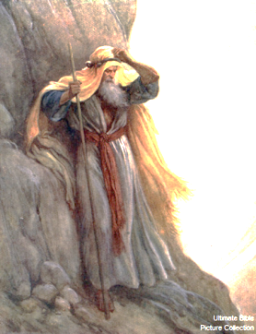
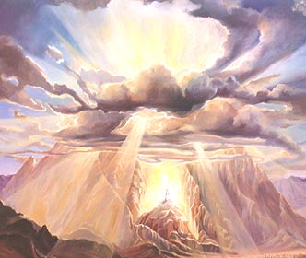
Law & Grace: Lesson 4 Review
A Mountaintop Experience – Part 1
Exodus 19:10-25

Slide 39
Exodus 19:10–14a
¹⁰ The Lord also said to Moses, “Go to the people and consecrate them today and tomorrow, and let them wash their garments; ¹¹ and let them be ready for the third day, for on the third day the Lord will come down on Mount Sinai in the sight of all the people. ¹² “You shall set bounds for the people all around, saying, ‘Beware that you do not go up on the mountain or touch the border of it; whoever touches the mountain shall surely be put to death. ¹³ ‘No hand shall touch him, but he shall surely be stoned or shot through; whether beast or man, he shall not live.’ When the ram’s horn sounds a long blast, they shall come up to the mountain.” ¹⁴ So Moses went down from the mountain to…

Slide 40
Exodus 19:14b–19a
…the people and consecrated the people, and they washed their garments. ¹⁵ He said to the people, “Be ready for the third day; do not go near a woman.” ¹⁶ So it came about on the third day, when it was morning, that there were thunder and lightning flashes and a thick cloud upon the mountain and a very loud trumpet sound, so that all the people who were in the camp trembled. ¹⁷ And Moses brought the people out of the camp to meet God, and they stood at the foot of the mountain. ¹⁸ Now Mount Sinai was all in smoke because the Lord descended upon it in fire; and its smoke ascended like the smoke of a furnace, and the whole mountain quaked violently. ¹⁹ When the . . .

Slide 41
Exodus 19:19b–24a
…sound of the trumpet grew louder and louder, Moses spoke and God answered him with thunder. ²⁰ The Lord came down on Mount Sinai, to the top of the mountain; and the Lord called Moses to the top of the mountain, and Moses went up… ²¹ Then the Lord spoke to Moses, “Go down, warn the people, so that they do not break through to the Lord to gaze, and many of them perish. ²² “Also let the priests who come near to the Lord consecrate themselves, or else the Lord will break out against them.” ²³ Moses said to the Lord, “The people cannot come up to Mount Sinai, for You warned us, saying, ‘Set bounds about the mountain and consecrate it.’ ” ²⁴ Then the Lord said to…

Slide 42
Exodus 19:24b–25
…him, “Go down and come up again, you and Aaron with you; but do not let the priests and the people break through to come up to the Lord, or He will break forth upon them.” ²⁵ So Moses went down to the people and told them.

Slide 43
Session 5 Outline
Review
Purpose, Aim, and Objective
Session 4
A Mountaintop Experience – Part 1 (Exo. 19:10-25)
General Information
Contrast & Comparison of Law & Grace
Conclusion

Slide 44
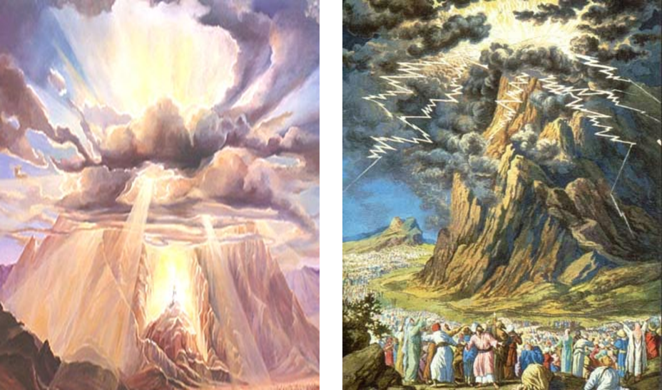
Law & Grace: Lesson 4 Review
Mt. Sinai

Slide 45
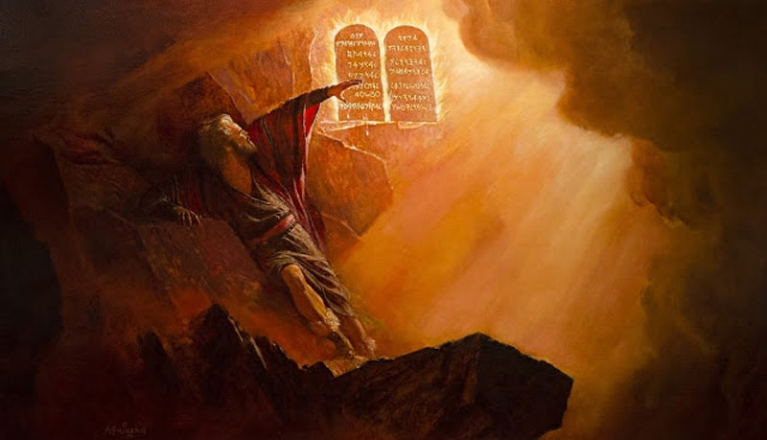
Moses on the Mountain
Law & Grace: Lesson 5 A Mountaintop Experience – Part 1

Slide 46
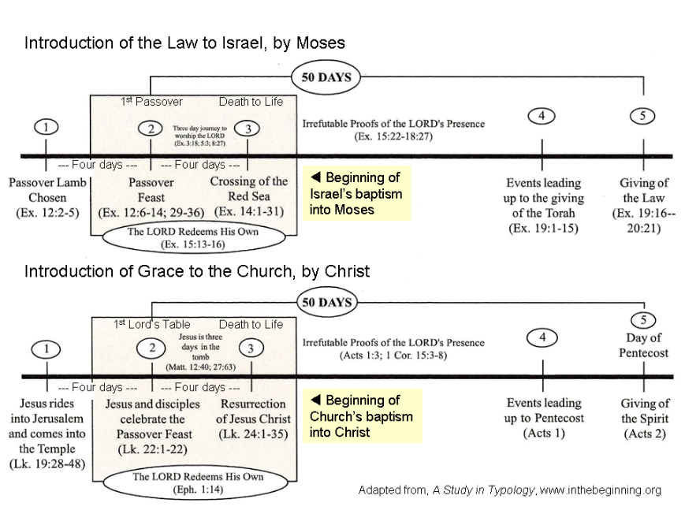
Law & Grace: Lesson 5 A Mountaintop Experience – Part 1

Slide 47
Law & Grace: Lesson 4 Review
Mt. Sinai

Slide 50
Session 5 Outline
Review
Purpose, Aim, and Objective
Session 4
A Mountaintop Experience – Part 1 (Exo. 19:10-25)
General Information
Contrast & Comparison of Law & Grace
Conclusion

Slide 51
Consecration – who does it?
Law & Grace: Lesson 5 A Mountaintop Experience – Part 1
To consecrate is to set apart & dedicate for a holy purpose…
Under the Law… | Under Grace…
…it was the entire responsibility of the people to set themselves apart (Exodus 19:10, 14, 22). | …it is God who has sanctified and set us apart in our eternal position in Christ (1 Cor. 1:2, 6:11; Heb. 2:11), and He also continues to sanctify each of us (Heb. 10:14).

Slide 52
Under the Law: Your Responsibility!
Law & Grace: Lesson 5 A Mountaintop Experience – Part 1
Exodus 19:10, 14, 22
¹⁰ The LORD also said to Moses, “Go to the people and consecrate them today and tomorrow, and let them wash their garments;…¹⁴ So Moses went down from the mountain to the people and consecrated the people, and they washed their garments…²² “Also let the [chief rulers] who come near to the LORD consecrate themselves, or else the LORD will break out against them.”

Slide 53
Consecration – who does it?
Law & Grace: Lesson 5 A Mountaintop Experience – Part 1
To consecrate is to set apart & dedicate for a holy purpose…
Under the Law… | Under Grace…
…it was the entire responsibility of the people to set themselves apart (Exodus 19:10, 14, 22). | …it is God who has sanctified and set us apart in our eternal position in Christ (1 Cor. 1:2, 6:11; Heb. 2:11), and He also continues to sanctify each of us (Heb. 10:14).

Slide 54
Under Grace: God Acts on our behalf!
Law & Grace: Lesson 5 A Mountaintop Experience – Part 1
1 Corinthians 1:2
To the church of God which is at Corinth, to those who have been sanctified in Christ Jesus, saints by calling, with all who in every place call on the name of our Lord Jesus Christ, their Lord and ours: …
1 Corinthians 1:30
“But by His doing you are in Christ Jesus…”

Slide 55
Under Grace: God Acts on our behalf!
Law & Grace: Lesson 5 A Mountaintop Experience – Part 1
1 Corinthians 6:11
Such were some of you; but you were washed, but you were sanctified, but you were justified in the name of the Lord Jesus Christ and in the Spirit of our God.

Slide 56
Under Grace: God Acts on our behalf!
Law & Grace: Lesson 5 A Mountaintop Experience – Part 1
Hebrews 2:11
For both He who sanctifies and those who are sanctified are all from one Father; for which reason He is not ashamed to call them brethren.
Hebrews 10:14
For by one offering He has perfected for all time those who are sanctified.

Slide 57
Stay away… or draw near?
Law & Grace: Lesson 5 A Mountaintop Experience – Part 1
Under the Law… | Under Grace…
…all of the people were to keep away, under penalty of death, from the mountain where God was to give a portion of the Law to Moses. | …we are called to draw near to God & are given access to God by His own accomplishment - all we did was to believe Him.

Slide 58
Under the Law: Distance or Death
Law & Grace: Lesson 5 A Mountaintop Experience – Part 1
Exodus 19:12-13
¹² "You shall set bounds for the people all around, saying, 'Beware that you do not go up on the mountain or touch the border of it; whoever touches the mountain shall surely be put to death. ¹³ 'No hand shall touch him, but he shall surely be stoned or shot through; whether beast or man, he shall not live…"

Slide 59
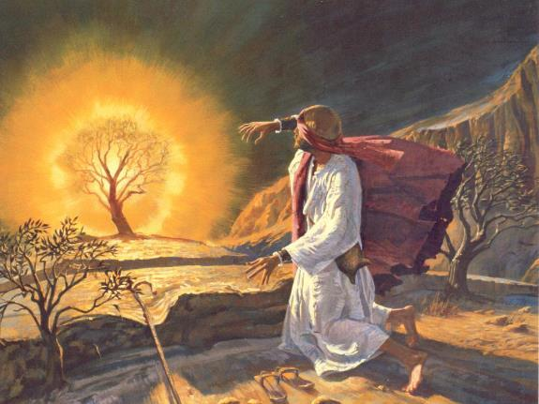
Law & Grace: Lesson 5 A Mountaintop Experience – Part 1
Exodus 3:6
Moses, hid his face, for he was afraid to look at God.
Notes:
Exodus 3:6
Moses, soon to be the Lawgiver, then HID HIS FACE, for he was afraid to look at God.

Slide 60
Stay away… or draw near?
Law & Grace: Lesson 5 A Mountaintop Experience – Part 1
Under the Law… | Under Grace…
…all of the people were to keep away, under penalty of death, from the mountain where God was to give a portion of the Law to Moses. | …we are called to draw near to God and are given access to God by His own accomplishment - all we did was to believe Him.

Slide 61
Under Grace: Access
Law & Grace: Lesson 5 A Mountaintop Experience – Part 1
Ephesians 2:18
¹⁸…for through Him [Christ] we both have our access in one Spirit to the Father.
Ephesians 3:11-12
¹¹ …Christ Jesus our Lord, ¹² in whom we have boldness and confident access through faith in Him.

Slide 62
Death Threatened vs. Death Accomplished
Law & Grace: Lesson 5 A Mountaintop Experience – Part 1
Under the Law… | Under Grace…
…the Israelites were to remain holy and sanctified entirely through their own efforts. The penalty for failure was death to be carried out by the community. | …believers are made holy & sanctified in Christ, since they have already died with Christ -an accomplishment of God Himself and in which the we had no part.

Slide 63
Death Threatened vs. Death Accomplished
Law & Grace: Lesson 5 A Mountaintop Experience – Part 1
Under the Law… | Under Grace…
…the Israelites were to remain holy & sanctified entirely through their own efforts. The penalty for failure was death to be carried out by the community. | …believers are made holy and sanctified in Christ, since they have already died with Christ - an accomplishment of God Himself and in which we had no part.

Slide 64
Death: A Bad Thing or Death: A Good Thing?
Law & Grace: Lesson 5 A Mountaintop Experience – Part 1
Under the Law… | Under Grace…
…from the very giving of it, the Israelites were threatened with the death if they came too close to the mountain. | …as a result of having died with Christ, believers have also died in relationship to Law.
Under the Law, dying was not good or desirable.

Slide 65
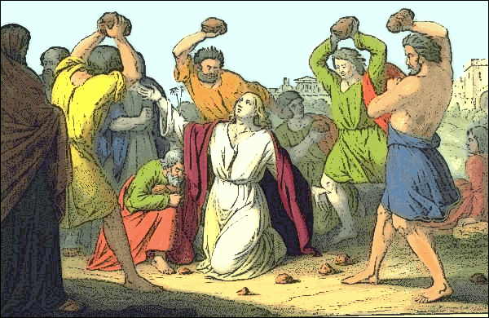
Death: A Bad Thing or Death: A Good Thing?
Law & Grace: Lesson 5 A Mountaintop Experience – Part 1
Under the Law, dying was not good or desirable.

Slide 66
Death: A Bad Thing or Death: A Good Thing?
Law & Grace: Lesson 5 A Mountaintop Experience – Part 1
Under the Law… | Under Grace…
…from the very giving of it, the Israelites were threatened with the death if they came too close to the mountain. | …as a result of having died with Christ, believers have also died in relationship to Law.
…but under Grace our death with Christ is phenomenally good!

Slide 67
Death under the Law…or from it?
Law & Grace: Lesson 5 A Mountaintop Experience – Part 1
Galatians 2:19-21
¹⁹ "For through the Law I died to the Law, so that I might live to God. ²⁰ I have been crucified with Christ; and it is no longer I who live, but Christ lives in me; and the life which I now live in the flesh I live by faith in the Son of God, who loved me and gave Himself up for me. ²¹ I do not nullify the grace of God, for if righteousness comes through the Law, then Christ died needlessly."

Slide 68
Dr. Thomas L. Constable
Expository Notes on the Bible
http://www.soniclight.com/constable/notes.htm
“By virtue of his incorporation into Christ (cf. v. 17) and participation in Christ’s death Paul has undergone a death whereby his relation to the law has been decisively severed and the law has ceased to have any claim on him (cf. Rom. 7:4, 6).…This death to the law’ means not only that the law as a false way of righteousness has been set aside but also that the believer is set free from the dominion of the law…for a life of consecration to God…”

Slide 69
Death under the Law…or from it?
Law & Grace: Lesson 5 A Mountaintop Experience – Part 1
Galatians 2:19-21
¹⁹ "For through the Law I died to the Law, so that I might live to God. ²⁰ I have been crucified with Christ; and it is no longer I who live, but Christ lives in me; and the life which I now live in the flesh I live by faith in the Son of God, who loved me and gave Himself up for me. ²¹ I do not nullify the grace of God, for if righteousness comes through the Law, then Christ died needlessly."

Slide 70
Session 5 Outline
Review
Purpose, Aim, and Objective
Session 4
A Mountaintop Experience – Part 1 (Exo. 19:10-25)
General Information
Contrast & Comparison of Law & Grace
Conclusion

Slide 71
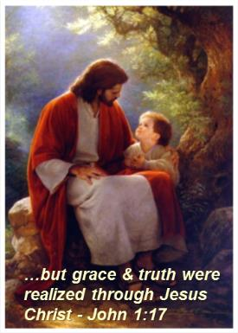
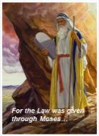
Law & Grace: Lesson 5 A Mountaintop Experience – Part 1
CONCLUSION

Slide 72
C. I. SCOFIELD, D. D.
The Grace of God, The Fundamentals Vol. 3, Chapter VII, p. 98
We have, most of us, been reared and now live under the influence of Galatianism. Protestant theology, alas, is for the most part, thoroughly Galatianized, in that neither law nor grace are given their distinct and separated places, as in the counsels of God, but are mingled together in one incoherent system. The law is no longer, as in the Divine intent, a ministration of death (2 Cor. 3:7), of cursing (Gal. 3:10), of conviction (Rom. 3:19), because we are taught that we must try to keep it, and that by Divine help we may. Nor, on the other hand, does grace bring us blessed deliverance from the dominion of sin, for we are kept under the law as a rule of life despite the plain declaration, “Sin shall not have dominion over you: for ye are not under the law, but under grace” (Rom. 6:14).

Slide 73
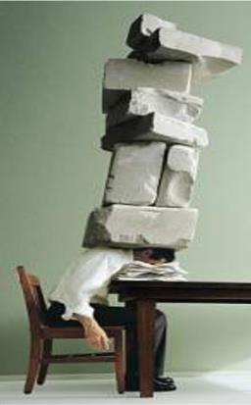
LIVING UNDER LAW OR UNDER GRACE?
Law & Grace: Lesson 5 A Mountaintop Experience – Part 1
What’s your pleasure?

