Slide 1

THE BOOK OF DANIEL
Dr. Andy Woods

Slide 2
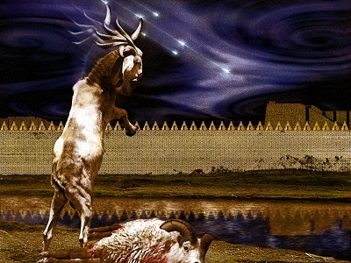
DANIEL 10-12
THE FINAL VISION

Slide 3

Chapter 10–12 Outline
The Setting (10:1-3)
Arrival of the Heavenly Messenger (10:4-9)
Explanation of the Heavenly Messenger (10:10–11:1)
The Prophecy of the Heavenly Messenger (11:2–12:13)

Slide 4
Chapter 10–12 Outline
The Setting (10:1-3)
Arrival of the Heavenly Messenger (10:4-9)
Explanation of the Heavenly Messenger (10:10–11:1)
The Prophecy of the Heavenly Messenger (11:2–12:13)

Slide 5


I. The Setting (10:1-3)
Historically (v. 1)
  Cyrus of Persia
  Third year of Cyrus
Personally (v. 2-3)

Slide 6
Succession of Gentile Rulers
1-4: Nebuchadnezzar of Babylon
5: Belshazzar of Babylon
6: Darius of Media – Persia
7-8: Belshazzar of Babylon
9: Darius of Media – Persia
10-12: Cyrus of Media – Persia

Slide 7
CHAPTER AND VERSE IN DANIEL | CHRONOLOGICAL DATE | BIBLICAL DATE
1:1 | 605 | 3rd year of Jehoiakim
2:1 | 603 | 2nd year of Nebuchadnezzar
5 | Sat. night 10/12/539 (Hoehner)
7:1 | 553 | 1st year of Belshazzar
8:1 | 551 | 3rd year of Belshazzar
9:1 | 538 | 1st year of Darius
10:1 | 536 | 3rd year of Cyrus

Slide 8
Daniel’s Age
CHAPTER | EVENTS | AGE
1 | Taken to Babylonian captivity | 15
2 | Interpreting Nebuchadnezzar’s 1st dream (huge image) | 17
3 | Daniel’s 3 friends cast into the fiery furnace | 19 or 20
4 | Interpreting Nebuchadnezzar’s 2nd dream (huge tree) | 45-50
5 | Interpreting handwriting of the wall at Belshazzar’s feast | Early 80’s
6 | Delivered from the den of lions | c.83
7-8 | Daniel’s visions and dreams | Mid-60’s
9 | Daniel’s seventy “sevens” prophecy | Early-80’s
10-12 | Final dreams and visions | Mid-80’s

Slide 9
Three Returns
 | Date | Duration | Persian king | Jewish leader | Scripture | Purpose | Number of returnees
1st return | 538–515 B.C. | 23 years | Cyrus (Isa 44:28‒45:1) | Zerubbabel | Ezra 1–6; Isaiah 44:28 | Rebuilding the temple | 50,000
2nd return | 458–457 B.C. | 2 years | Artaxerxes | Ezra | Ezra 7–10 | Adorning of the temple and reforming the people | 2,000
3rd return | 444–432 B.C. | 8 years | Artaxerxes | Nehemiah | Nehemiah | Rebuilding the wall

Slide 10
Chapter 10–12 Outline
The Setting (10:1-3)
Arrival of the Heavenly Messenger (10:4-9)
Explanation of the Heavenly Messenger (10:10–11:1)
The Prophecy of the Heavenly Messenger (11:2–12:13)

Slide 11
Chapter 10–12 Outline
The Setting (10:1-3)
Arrival of the Heavenly Messenger (10:4-9)
Explanation of the Heavenly Messenger (10:10–11:1)
The Prophecy of the Heavenly Messenger (11:2–12:13)

Slide 12

III. Explanation of the Heavenly Messenger (10:10–11:1)
Explanation of His Delay (10:10-13)
Explanation of His Visit (10:14–11:1)
  Purpose of his visit (10:14)
  Daniel's reaction (10:15-19)
  Continuing spiritual warfare (10:20–11:1)

Slide 13
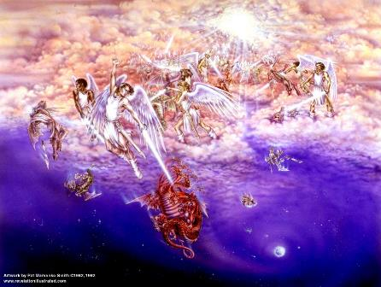
Biblical Reality of the Angelic World
Job 1:12
2 Kings 6:15-17
1 Chron. 21:1
Dan 10:12-13, 20
Matt. 16:21-23
Eph. 6:12
Rev. 12

Slide 14
Chapter 10–12 Outline
The Setting (10:1-3)
Arrival of the Heavenly Messenger (10:4-9)
Explanation of the Heavenly Messenger (10:10–11:1)
The Prophecy of the Heavenly Messenger (11:2–12:13)

Slide 15

IV. The Prophecy of the Heavenly Messenger (11:2–12:13)
Persia (11:2)
Greece (11:3-4)
Ptolemies & Seleucids (11:5-20)
Antiochus (11:21-35)
Antichrist (11:36-45)
Tribulation & Millennium (12:1-13)

Slide 16
IV. The Prophecy of the Heavenly Messenger (11:2–12:13)
Persia (11:2)
Greece (11:3-4)
Ptolemies & Seleucids (11:5-20)
Antiochus (11:21-35)
Antichrist (11:36-45)
Tribulation & Millennium (12:1-13)

Slide 17

Daniel Interprets the Handwriting on the Wall
(Daniel 5)

Slide 18
6 Empires
Babylon (2:36-38; 7:4) 605-539 BC
Media-Persia (2:39a; 7:5) 539-331 BC
Greece (2:39b; 7:6) 331-63 BC
Rome I (2:40; 7:7a) 63 BC – 70 AD
Rome II (2:41-43; 7:7b-8) Tribulation
Kingdom (2:44-45; 7:9-14) After 2nd Coming

Slide 19


Statue
&
Stone

Slide 20

Description of 4 Beasts
2nd Beast (V.5)
  Bear
  Media-Persia
  Chest & Arms of Silver
  5:28; 8:20
  539-331 BC
  Raised on One Side
  Three Ribs
  Arise and Devour

Slide 21

CHART1

Slide 22
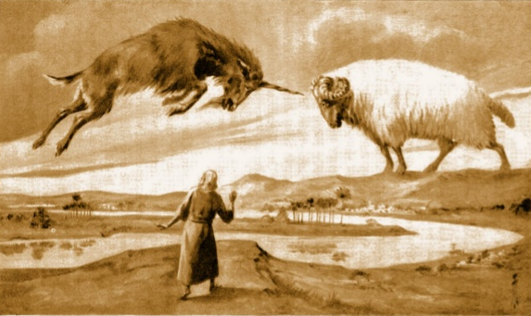
CHAPTER 8

Slide 23

Daniel 8:20-21 (NASB)
“The ram which you saw with the two horns represents the kings of Media and Persia. ²¹ The shaggy goat represents the kingdom of Greece, and the large horn that is between his eyes is the first king.”

Slide 24
PERSIA 11:2
Cambyses 530-523 BC
Pseudo-Smerdis 522 BC
Darius I Hystaspes 521-486 BC
Xerxes 485-465 BC
  Aka. “Ahasuerus” in Esther

Slide 25
Xerxes Against Greece
“In his great campaign against Greece from 481 to 479 BC, with an army of probably 200,000 men and a navy of many hundreds of ships gathered from all over his vast empire, Xerxes desperately sought to avenge the humiliating defeat suffered by his father, Darius I, at the battle of Marathon (490 BC). But his army was defeated north of Athens at Plataea (479 BC) just after his Navy was smashed at Salamis, to the west of Athens.”
John C. Whitcomb, Daniel, Everyman's Bible Commentary (Chicago, IL: Moody, 1985), 146.

Slide 26
IV. The Prophecy of the Heavenly Messenger (11:2–12:13)
Persia (11:2)
Greece (11:3-4)
Ptolemies & Seleucids (11:5-20)
Antiochus (11:21-35)
Antichrist (11:36-45)
Tribulation & Millennium (12:1-13)

Slide 27
6 Empires
Babylon (2:36-38; 7:4) 605-539 BC
Media-Persia (2:39a; 7:5) 539-331 BC
Greece (2:39b; 7:6) 331-63 BC
Rome I (2:40; 7:7a) 63 BC – 70 AD
Rome II (2:41-43; 7:7b-8) Tribulation
Kingdom (2:44-45; 7:9-14) After 2nd Coming

Slide 28
Statue
&
Stone

Slide 29

Description of 4 Beasts
3rd Beast (V. 6)
  Leopard
  Greece
  Belly & Thighs of Bronze
  8:21
  331-63 BC
  Rapid Conquest (Wings & Leopard)
  Four Generals (Wings & Heads)

Slide 30
CHART1

Slide 31
CHAPTER 8

Slide 32
Daniel 8:20-21 (NASB)
“The ram which you saw with the two horns represents the kings of Media and Persia. ²¹ The shaggy goat represents the kingdom of Greece, and the large horn that is between his eyes is the first king.”

Slide 33
Biblical Reality of the Angelic World
Job 1:12
2 Kings 6:15-17
1 Chron. 21:1
Dan 10:12-13, 20
Matt. 16:21-23
Eph. 6:12
Rev. 12

Slide 34
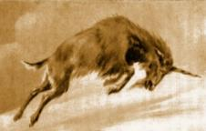
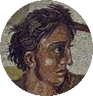

GREECE 11:3-4
Alexander the Great
  Died at age 33 in 323 BC
  No heirs
  Kingdom divided among his 4 generals
Daniel 7:6, 8:5-8

Slide 35
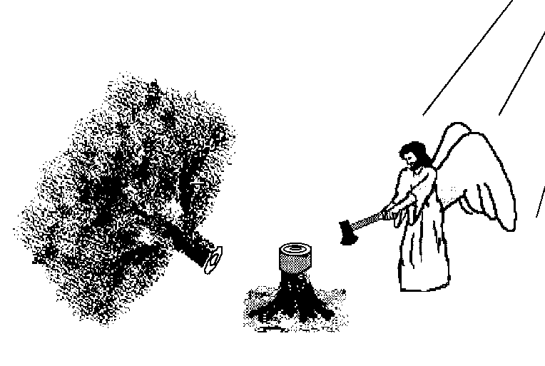
Hall of the Humbled
(Prov. 16:18; 1 Peter 5:5)
Satan (Isa. 14:12-15; Ezek. 28:12-17; 1 Tim. 3:6)
Uzziah (2 Chron 26:16)
Herod (Acts 12:20-23)
Paul (2 Cor 12:1-10)

Slide 36
GREECE 11:3-4
Alexander the Great
  Died at age 33 in 323 BC
  No heirs
  Kingdom divided among his 4 generals
Daniel 7:6, 8:5-8

Slide 37
Four Generals
Daniel 7:6; 8:8, 22
Cassander Macedonia | Ptolemy Egypt
Lysimachus Thrace & Asia Minor | Seleucus Syria (including Israel)

Slide 38
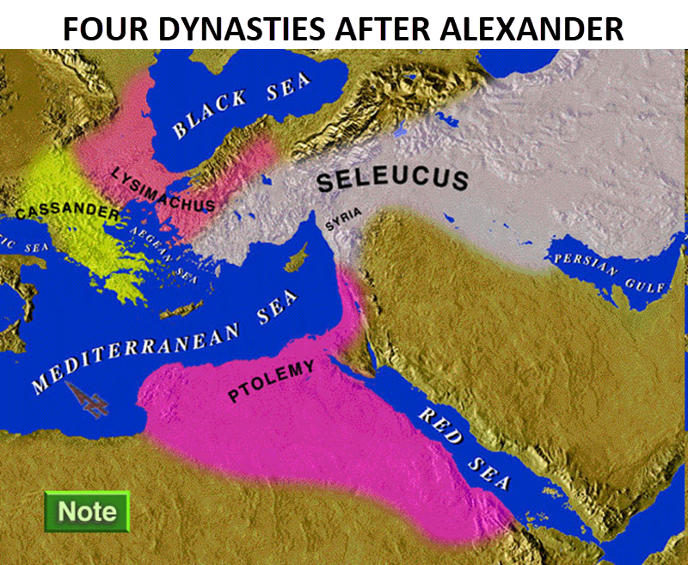

Slide 39
Four Generals
Daniel 7:6; 8:8, 22
Cassander Macedonia | Ptolemy Egypt
Lysimachus Thrace & Asia Minor | Seleucus Syria (including Israel)

Slide 40
IV. The Prophecy of the Heavenly Messenger (11:2–12:13)
Persia (11:2)
Greece (11:3-4)
Ptolemies & Seleucids (11:5-20)
Antiochus (11:21-35)
Antichrist (11:36-45)
Tribulation & Millennium (12:1-13)

Slide 41
PTOLEMIES AND SELEUCIDS 11:5-20
History of warfare between the 2 dynasties
Ptolemies of Egypt vs. Seleucids of Syria
King of the South vs. King of the North
From 323 BC – 175 BC
The beautiful land = Israel
Cassander and Lysimachus not in view
Key transition in 198 B.C.
Selective and non-comprehensive history
What is at stake?

Slide 42
PTOLEMIES AND SELEUCIDS 11:5-20
History of warfare between the 2 dynasties
Ptolemies of Egypt vs. Seleucids of Syria
King of the South vs. King of the North
From 323 BC – 175 BC
The beautiful land = Israel
Cassander and Lysimachus not in view
Key transition in 198 B.C.
Selective and non-comprehensive history
What is at stake?

Slide 43
PTOLEMIES AND SELEUCIDS 11:5-20
History of warfare between the 2 dynasties
Ptolemies of Egypt vs. Seleucids of Syria
King of the South vs. King of the North
From 323 BC – 175 BC
The beautiful land = Israel
Cassander and Lysimachus not in view
Key transition in 198 B.C.
Selective and non-comprehensive history
What is at stake?

Slide 44
PTOLEMIES AND SELEUCIDS 11:5-20
History of warfare between the 2 dynasties
Ptolemies of Egypt vs. Seleucids of Syria
King of the South vs. King of the North
From 323 BC – 175 BC
The beautiful land = Israel
Cassander and Lysimachus not in view
Key transition in 198 B.C.
Selective and non-comprehensive history
What is at stake?

Slide 46
PTOLEMIES AND SELEUCIDS 11:5-20
History of warfare between the 2 dynasties
Ptolemies of Egypt vs. Seleucids of Syria
King of the South vs. King of the North
From 323 BC – 175 BC
The beautiful land = Israel
Cassander and Lysimachus not in view
Key transition in 198 B.C.
Selective and non-comprehensive history
What is at stake?

Slide 47
KINGS OF THE SOUTH (EGYPT) | KINGS OF THE NORTH (SYRIA)
Ptolemy I (Soter) 323–285 | Seleucus I (Nicator) 312–281
Ptolemy II (Philadelphus) 285–247 | Antiochus I (Soter) 281–261
Ptolemy III (Euregetus) 247–221 | Antiochus Theos 261–246
Ptolemy IV (Philopater) 221–220 | Seleucus Callinicus 246–226
Ptolemy V (Epiphanes) 203–182 | Seleucus III 226–223
 | Antiochus III (Great) 223–187
 | Seleucus IV (Philopater) 186–175
 | Antiochus IV (Epiphanes) 175–164
Paul N. Benware, Commentary on the Book of Daniel: The Coming Judgment of the Nations; Daniel's Prophecy of Things to Come (Clifton, TX: Scofield Ministries, 2007), 233.

Slide 48
PTOLEMIES AND SELEUCIDS 11:5-20
History of warfare between the 2 dynasties
Ptolemies of Egypt vs. Seleucids of Syria
King of the South vs. King of the North
From 323 BC – 175 BC
The beautiful land = Israel
Cassander and Lysimachus not in view
Key transition in 198 B.C.
Selective and non-comprehensive history
What is at stake?

Slide 50

Ezekiel 5:5
“Thus says the Lord God, ‘This is Jerusalem; I have set her at the center of the nations, with lands around her.’”

Slide 51
Ezekiel 38:12
“to capture spoil and to seize plunder, to turn your hand against the waste places which are now inhabited, and against the people who are gathered from the nations, who have acquired cattle and goods, who live at the center of the world.”

Slide 52
PTOLEMIES AND SELEUCIDS 11:5-20
History of warfare between the 2 dynasties
Ptolemies of Egypt vs. Seleucids of Syria
King of the South vs. King of the North
From 323 BC – 175 BC
The beautiful land = Israel
Cassander and Lysimachus not in view
Key transition in 198 B.C.
Selective and non-comprehensive history
What is at stake?

Slide 54
Four Generals
Daniel 7:6; 8:8, 22
Cassander Macedonia | Ptolemy Egypt
Lysimachus Thrace & Asia Minor | Seleucus Syria (including Israel)

Slide 55
PTOLEMIES AND SELEUCIDS 11:5-20
History of warfare between the 2 dynasties
Ptolemies of Egypt vs. Seleucids of Syria
King of the South vs. King of the North
From 323 BC – 175 BC
The beautiful land = Israel
Cassander and Lysimachus not in view
Key transition in 198 B.C.
Selective and non-comprehensive history
What is at stake?

Slide 56
Four Generals
Daniel 7:6; 8:8, 22
Cassander Macedonia | Ptolemy Egypt
Lysimachus Thrace & Asia Minor | Seleucus Syria (including Israel)

Slide 57
Intertestamental Chronology (Dates BC)
SELEUCIDS
Seleucus I 312-281
Antiochus I 281-261
Antiochus II 261-246
Seleucus II 246-226
Seleucus III 226-223
Antiochus III 223-187
Seleucus IV Philapator 187-175
Antiochus IV Epiphanes 175-163

Slide 58


Slide 59
PTOLEMIES AND SELEUCIDS 11:5-20
History of warfare between the 2 dynasties
Ptolemies of Egypt vs. Seleucids of Syria
King of the South vs. King of the North
From 323 BC – 175 BC
The beautiful land = Israel
Cassander and Lysimachus not in view
Key transition in 198 B.C.
Selective and non-comprehensive history
What is at stake?

Slide 60
PTOLEMIES AND SELEUCIDS 11:5-20
History of warfare between the 2 dynasties
Ptolemies of Egypt vs. Seleucids of Syria
King of the South vs. King of the North
From 323 BC – 175 BC
The beautiful land = Israel
Cassander and Lysimachus not in view
Key transition in 198 B.C.
Selective and non-comprehensive history
What is at stake?

Slide 61
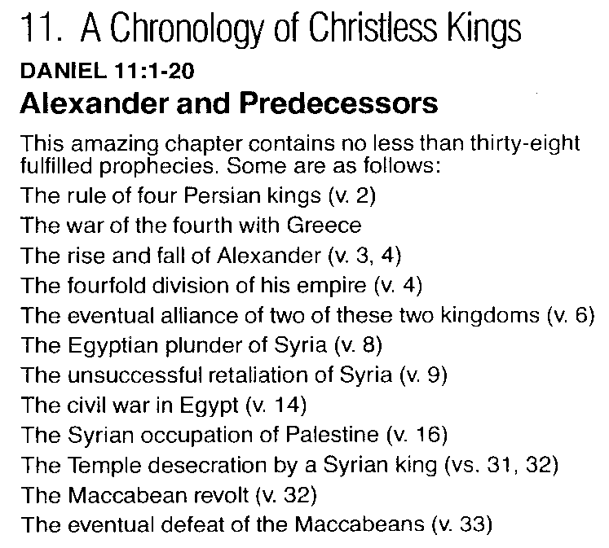
CHART 1

Slide 62

H.C. Leupold’s Homiletical (Preaching) Suggestions on Daniel 11
“This chapter might be treated in Bible classes. We do not see how it could be used for a sermon or for sermons.”
Leupold, H. C. (1949). Exposition of Daniel (p. 525). Grand Rapids, MI: Baker Book House.

Slide 63
IV. The Prophecy of the Heavenly Messenger (11:2–12:13)
Persia (11:2)
Greece (11:3-4)
Ptolemies & Seleucids (11:5-20)
Antiochus (11:21-35)
Antichrist (11:36-45)
Tribulation & Millennium (12:1-13)

Slide 64
IV. The Prophecy of the Heavenly Messenger (11:2–12:13)
Persia (11:2)
Greece (11:3-4)
Ptolemies & Seleucids (11:5-20)
Antiochus (11:21-35)
Antichrist (11:36-45)
Tribulation & Millennium (12:1-13)

Slide 65
IV. The Prophecy of the Heavenly Messenger (11:2–12:13)
Persia (11:2)
Greece (11:3-4)
Ptolemies & Seleucids (11:5-20)
Antiochus (11:21-35)
Antichrist (11:36-45)
Tribulation & Millennium (12:1-13)

Slide 66
Conclusion

Slide 67
Chapter 10–12 Outline
The Setting (10:1-3)
Arrival of the Heavenly Messenger (10:4-9)
Explanation of the Heavenly Messenger (10:1–11:1)
The Prophecy of the Heavenly Messenger (11:2–12:13)

Slide 68
Purpose
To encourage Judah by emphasizing the sovereignty of God during the Babylonian captivity and to teach Judah how to live while outside the land

Slide 69

“The Lord bless you and keep you; the Lord make his face shine on you and be gracious to you; the Lord turn his face toward you and give you peace.” (NIV)

