Slide 1


Slide 2

The Coming Kingdom
Chapter 11
Dr. Andy Woods
Senior Pastor – Sugar Land Bible Church
President – Chafer Theological Seminary

Slide 3
IS THE CHURCH, ISRAEL?
Galatians 6:16

Slide 4
INTRODUCTION
Covenant Theology vs. Dispensational Theology
One group or two? Galatians 6:16
  NIV: “peace and mercy to all who follow this rule, even to the Israel of God.”

Slide 5
Church = Israel

Slide 6

“That is, we believe in the unfolding plan of God in history, the Christian Church is the very fruition of the redemptive purpose of God. As such, the multi-racial, international Church of Jesus Christ supersedes racial, national Israel as the focus of the kingdom of God. Indeed, we believe that the church becomes ‘the Israel of God’ (Gal. 6:16)…”
Kenneth L. Gentry Jr.
“The Iceman Cometh! Mormonism Reigneth!,” Dispensationalism in Transition, Vol 6, No.1; Jan. 1993 p. 1. Italics mine

Slide 7

Hans K. LaRondelle
The Israel of God in Prophecy: Principles of Prophetic Interpretation (Berrien Springs, Mich.: Andrews University U., 1983), pp. 110-11. Italics mine
“Paul’s benediction in Galatians 6:16 becomes, then, the chief witness in the New Testament declaring that the universal church is the Israel of God, the seed of Abraham, the heir to Israel’s covenant promise (c.f. Gal. 3:29; 6:16).”

Slide 8
INTRODUCTION
Covenant Theology vs. Dispensational Theology
One group or two?
  NIV: “peace and mercy to all who follow this rule, even to the Israel of God.”
  NASB: “And to those who will walk by this rule, peace and mercy be upon them, and upon the Israel of God.”

Slide 9

Church
Hebrew Christians

Slide 10
The Galatians 6:16 Controversy
Translation of kai | “even” | “and”
Use of kai | appositional | continuative
Bible version | NIV | NASB
“Israel of God” | Church | Hebrew-Christians within the Church
Israel and Church | Equated | “Israel of God” is a subset within the church
Theology | Replacement Theology | Dispensational Theology

Slide 11
10 Facts Favoring the Dispensational Interpretation of Galatians 6:16
Continuative kai is the most common in NT
Appositional kai is the rarest in the NT
Point easier made by eliminating kai
“Israel” always = national, ethnic Israel
Israel not equated with the church until A.D. 160
Why introduce theological point in conclusion?
Two-fold repetition of upon?
Paul designates two groups elsewhere (Gal. 6:15; 2:7-8)
Paul singles out believing Jews elsewhere
Paul is not anti-Semitic

Slide 12
10 Facts Favoring the Dispensational Interpretation of Galatians 6:16
Continuative kai is the most common in NT
Appositional kai is the rarest in the NT
Point easier made by eliminating kai
“Israel” always = national, ethnic Israel
Israel not equated with the church until A.D. 160
Why introduce theological point in conclusion?
Two-fold repetition of upon?
Paul designates two groups elsewhere (Gal. 6:15; 2:7-8)
Paul singles out believing Jews elsewhere
Paul is not anti-Semitic

Slide 13
10 Facts Favoring the Dispensational Interpretation of Galatians 6:16
Continuative kai is the most common in NT
Appositional kai is the rarest in the NT
Point easier made by eliminating kai
“Israel” always = national, ethnic Israel
Israel not equated with the church until A.D. 160
Why introduce theological point in conclusion?
Two-fold repetition of upon?
Paul designates two groups elsewhere (Gal. 6:15; 2:7-8)
Paul singles out believing Jews elsewhere
Paul is not anti-Semitic

Slide 14

S. Lewis Johnson
“Paul and the 'Israel of God': An Exegetical and Eschatological Case-Study,” in Essays in Honor of J. Dwight Pentecost, ed. Stanley D. Toussaint and Charles H. Dyer (Chicago: Moody, 1986), 187.
“It is necessary to begin this part of the discussion with a basic but often neglected hermeneutical principle. It is this: in the absence of compelling exegetical and theological considerations, we should avoid the rare grammatical usages when the common ones make good sense.”

Slide 15
S. Lewis Johnson
“Paul and the 'Israel of God': An Exegetical and Eschatological Case-Study,” in Essays in Honor of J. Dwight Pentecost, ed. Stanley D. Toussaint and Charles H. Dyer (Chicago: Moody, 1986), 187.
“An extremely rare use has been made to replace the common usage, even in spite of the fact that the common and frequent usage makes perfectly good sense in Galatians 6:16.”

Slide 16
10 Facts Favoring the Dispensational Interpretation of Galatians 6:16
Continuative kai is the most common in NT
Appositional kai is the rarest in the NT
Point easier made by eliminating kai
“Israel” always = national, ethnic Israel
Israel not equated with the church until A.D. 160
Why introduce theological point in conclusion?
Two-fold repetition of upon?
Paul designates two groups elsewhere (Gal. 6:15; 2:7-8)
Paul singles out believing Jews elsewhere
Paul is not anti-Semitic

Slide 17


Galatians 6:16 (NIV)
“And to those who will walk by this rule, peace and mercy to all who follow this rule, even to the Israel of God.”

Slide 18
Galatians 6:16 (NASB)
“And to those who will walk by this rule, peace and mercy be upon them, and upon the Israel of God.”

Slide 19
Galatians 6:16
“And as many as shall walk by this rule, peace be upon them and mercy, upon the Israel of God.”

Slide 20
Matthew 4:4
“But He answered and said, “It is written, ‘Man shall not live on bread alone, but on every word that proceeds out of the mouth of God.’”

Slide 21
Matthew 5:18
“For truly I say to you, until heaven and earth pass away, not the smallest letter or stroke shall pass from the Law until all is accomplished.”

Slide 22
10 Facts Favoring the Dispensational Interpretation of Galatians 6:16
Continuative kai is the most common in NT
Appositional kai is the rarest in the NT
Point easier made by eliminating kai
“Israel” always = national, ethnic Israel
Israel not equated with the church until A.D. 160
Why introduce theological point in conclusion?
Two-fold repetition of upon?
Paul designates two groups elsewhere (Gal. 6:15; 2:7-8)
Paul singles out believing Jews elsewhere
Paul is not anti-Semitic

Slide 23

Israel Means Israel
15x elsewhere in Paul’s writings
72x elsewhere in the New Testament
1800x in the Old Testament
“Israel” or “Israelite” used 2500x in the OT

Slide 24
10 Facts Favoring the Dispensational Interpretation of Galatians 6:16
Continuative kai is the most common in NT
Appositional kai is the rarest in the NT
Point easier made by eliminating kai
“Israel” always = national, ethnic Israel
Israel not equated with the church until A.D. 160
Why introduce theological point in conclusion?
Two-fold repetition of upon?
Paul designates two groups elsewhere (Gal. 6:15; 2:7-8)
Paul singles out believing Jews elsewhere
Paul is not anti-Semitic

Slide 25

Justin Martyr
“Dialogue with Trypho” 123, 135
“As therefore from the one man Jacob, who was surnamed Israel, all your nation has been called Jacob and Israel; so we from Christ, who begat us unto God, (like Jacob, and Israel, and Judah, and Joseph, and David,) are called and are the true sons of God, and keep the commandments of Christ"… "As, therefore, Christ is the Israel and the Jacob, even so we, who have been quarried out from the bowels of Christ, are the true Israelitic race.”

Slide 26
Order of Paul’s Letters
Galatians (A.D. 49)
1‒2 Thessalonians (A.D. 51)
1‒2 Corinthians (A.D. 56)
Romans (A.D. 57)
Ephesians, Colossians, Philemon, Philippians (A.D. 60‒62)
1 Timothy, Titus (A.D. 62‒66)
2 Timothy (A.D. 67)

Slide 27
Order of Paul’s Letters
Galatians (A.D. 49)
1‒2 Thessalonians (A.D. 51)
1‒2 Corinthians (A.D. 56)
Romans (A.D. 57)
Ephesians, Colossians, Philemon, Philippians (A.D. 60‒62)
1 Timothy, Titus (A.D. 62‒66)
2 Timothy (A.D. 67)

Slide 28
10 Facts Favoring the Dispensational Interpretation of Galatians 6:16
Continuative kai is the most common in NT
Appositional kai is the rarest in the NT
Point easier made by eliminating kai
“Israel” always = national, ethnic Israel
Israel not equated with the church until A.D. 160
Why introduce theological point in conclusion?
Two-fold repetition of upon?
Paul designates two groups elsewhere (Gal. 6:15; 2:7-8)
Paul singles out believing Jews elsewhere
Paul is not anti-Semitic

Slide 29
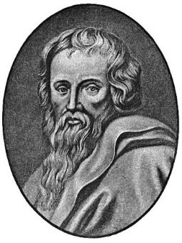
What is Inside? Galatians Structure
Chaps. 1–2: Autobiographical section
Chaps. 3–4: Doctrinal section
Chaps. 5–6: Practical section

Slide 30
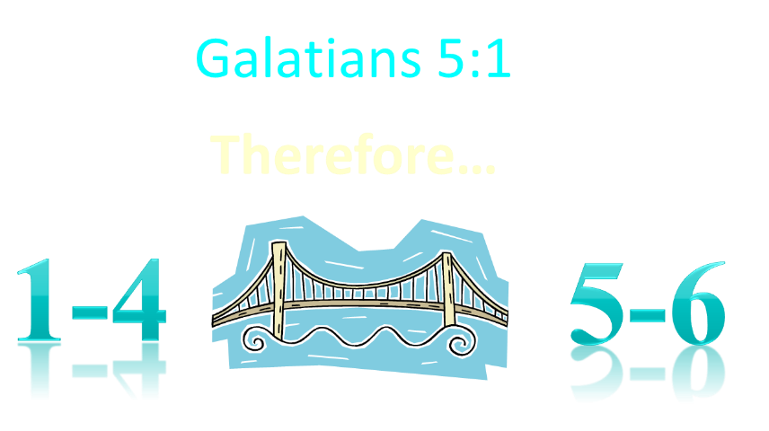

Slide 31
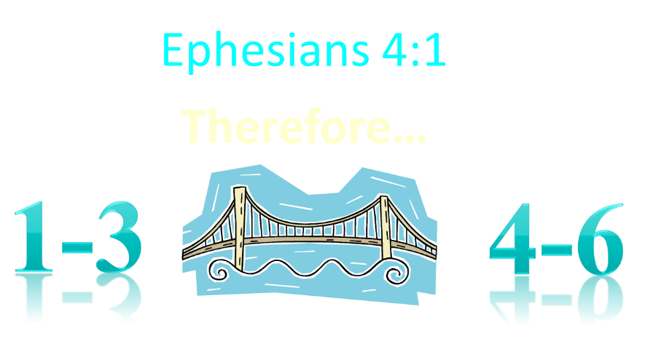

Slide 32
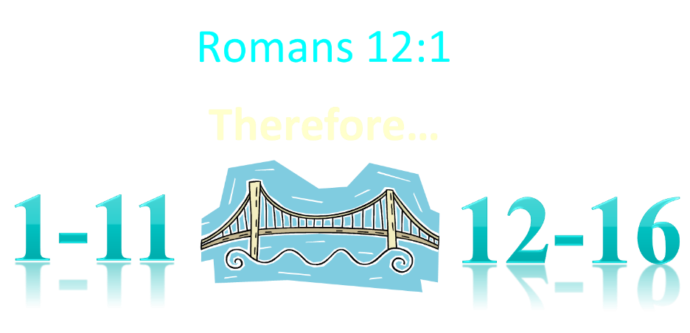

Slide 33
10 Facts Favoring the Dispensational Interpretation of Galatians 6:16
Continuative kai is the most common in NT
Appositional kai is the rarest in the NT
Point easier made by eliminating kai
“Israel” always = national, ethnic Israel
Israel not equated with the church until A.D. 160
Why introduce theological point in conclusion?
Two-fold repetition of upon?
Paul designates two groups elsewhere (Gal. 6:15; 2:7-8)
Paul singles out believing Jews elsewhere
Paul is not anti-Semitic

Slide 34
Galatians 6:16 (NASB)
“And to those who will walk by this rule, peace and mercy be upon (epi) them, and upon (epi) the Israel of God.”

Slide 35
10 Facts Favoring the Dispensational Interpretation of Galatians 6:16
Continuative kai is the most common in NT
Appositional kai is the rarest in the NT
Point easier made by eliminating kai
“Israel” always = national, ethnic Israel
Israel not equated with the church until A.D. 160
Why introduce theological point in conclusion?
Two-fold repetition of upon?
Paul designates two groups elsewhere (Gal. 6:15; 2:7-8)
Paul singles out believing Jews elsewhere
Paul is not anti-Semitic

Slide 36

Galatians 6:15 (NASB)
“For neither is circumcision anything, nor uncircumcision, but a new creation.”

Slide 37
Galatians 2:7-8 (NASB)
⁷ But on the contrary, seeing that I had been entrusted with the gospel to the uncircumcised, just as Peter had been to the circumcised ⁸ (for He who effectually worked for Peter in his apostleship to the circumcised effectually worked for me also to the Gentiles)…

Slide 38
Galatians 6:16 (NASB)
“And to those who will walk by this rule, peace and mercy be upon them, and upon the Israel of God.”

Slide 39
10 Facts Favoring the Dispensational Interpretation of Galatians 6:16
Continuative kai is the most common in NT
Appositional kai is the rarest in the NT
Point easier made by eliminating kai
“Israel” always = national, ethnic Israel
Israel not equated with the church until A.D. 160
Why introduce theological point in conclusion?
Two-fold repetition of upon?
Paul designates two groups elsewhere (Gal. 6:15; 2:7-8)
Paul singles out believing Jews elsewhere
Paul is not anti-Semitic

Slide 40
Galatians 6:16 (NASB)
“And to those who will walk by this rule, peace and mercy be upon them, and upon the Israel of God.”

Slide 41

Romans 2:28-29
“²⁸ For he is not a Jew who is one outwardly, nor is circumcision that which is outward in the flesh. ²⁹ But he is a Jew who is one inwardly; and circumcision is that which is of the heart, by the Spirit, not by the letter; and his praise is not from men, but from God.”

Slide 42
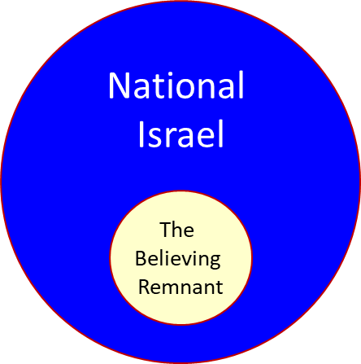
Romans 9:6
“But it is not as though the word of God has failed. For they are not all Israel who are descended from Israel.”

Slide 43
10 Facts Favoring the Dispensational Interpretation of Galatians 6:16
Continuative kai is the most common in NT
Appositional kai is the rarest in the NT
Point easier made by eliminating kai
“Israel” always = national, ethnic Israel
Israel not equated with the church until A.D. 160
Why introduce theological point in conclusion?
Two-fold repetition of upon?
Paul designates two groups elsewhere (Gal. 6:15; 2:7-8)
Paul singles out believing Jews elsewhere
Paul is not anti-Semitic

Slide 44

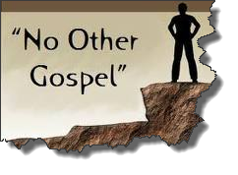
Galatians 1:8–9 (NASB)
⁸ But even if we, or an angel from heaven, should preach to you a gospel contrary to what we have preached to you, he is to be accursed! ⁹ As we have said before, so I say again now, if any man is preaching to you a gospel contrary to what you received, he is to be accursed!

Slide 45

“In view of the apostle's previous strong anti-Judaistic expressions, he feels impelled by the insertion of ‘and’, to emphasize this expression of his true attitude towards his people” (emphasis mine).
Burton
Galatians, p.358

Slide 46
Conclusion

Slide 47
10 Facts Favoring the Dispensational Interpretation of Galatians 6:16
Continuative kai is the most common in NT
Appositional kai is the rarest in the NT
Point easier made by eliminating kai
“Israel” always = national, ethnic Israel
Israel not equated with the church until A.D. 160
Why introduce theological point in conclusion?
Two-fold repetition of upon?
Paul designates two groups elsewhere (Gal. 6:15; 2:7-8)
Paul singles out believing Jews elsewhere
Paul is not anti-Semitic

Slide 48

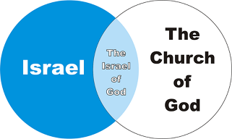
D.W.B Robinson
“The Distinction Between Jewish and Gentile Believers in Galatians,” Australian Biblical Review 13 (1965): 29-48
“The glib citing of Gal. vi: 16 to support the view that ‘the church is the new Israel’ should be vigorously challenged. There is weighty support for a limited interpretation.”

Slide 49
Church = Israel

Slide 50
Church
Hebrew Christians

Slide 51
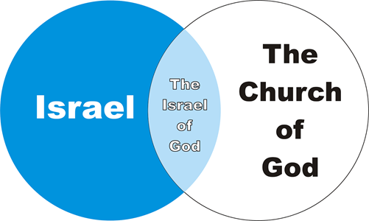

Slide 52
Conclusion
Who’s Who?
  Chrysostom
  Calvin
  Lightfoot
  Stott
  Guthrie
  Luther
  Lenski
  Hendricksen
Amillennial exegetical bias

Slide 53

C.E.B. Cranfield
A Critical and Exegetical Commentary on the Epistle to the Romans p.448
“These 3 chapters (Rom 9-11) emphatically forbid us to speak of the church as having once and for all taken the place of the Jewish people…But the assumption that the church has simply replaced Israel as the people of God is extremely common…And I confess with shame to having also myself used in print on more than one occasion this language of the replacement of Israel by the Church.”

