Slide 1
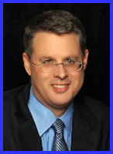
Ecclesiology Session 7
Dr. Andy Woods
Senior Pastor – Sugar Land Bible Church
President – Chafer Theological Seminary

Slide 2
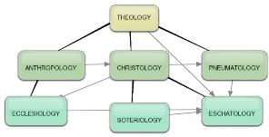
Areas of Systematic Theology
Prolegomena – Introduction
Theology – Study of God
Christology – Study of Christ
Pneumatology – Study of the Holy Spirit
Anthropology – Study of Man
Hamartiology – Study of sin
Soteriology – Study of salvation
Angelology – Study of angels
Ecclesiology – Study of the Church
Eschatology – Study of the end

Slide 3
Ecclesiology Overview
Definition
Universal vs. local
Word pictures
Origin
Israel – Church differences
Intercalation
Purposes
Activities
Government
Officers
Ordinances
Purity

Slide 4
Ecclesiology Overview
Definition
Universal vs. local
Word pictures
Origin
Israel – Church differences
Intercalation
Purposes
Activities
Government
Officers
Ordinances
Purity

Slide 5
Definition of Ecclesiology
Ekklēsía (ἐκκλησία)
ĕk (ἐκ) / kaleo (καλέω)
Acts 15:14
Logos
1 Cor 10:32

Slide 6
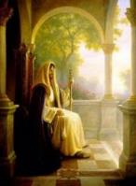
The Definition of the Church
All (both Jew & Gentile) who have trusted in the very Messiah rejected by first-century national Israel (Gal. 3:28; Rom. 10:19; Eph. 2:14)
Intercalation
Does not fulfill Israel’s purposes

Slide 7
Ecclesiology Overview
Definition
Universal vs. local
Word pictures
Origin
Israel – Church differences
Intercalation
Purposes
Activities
Government
Officers
Ordinances
Purity

Slide 8
The Universal vs. Local Church
 | Universal | Local
Number | One | Many
Members | All believers from Pentecost to the Rapture | Local gathering
Spiritual status | Believers only | Believers and unbelievers
Living or dead | Living and dead | Living only
Assembly | Cannot assemble at one place and time | Can assemble at one place and time
Visibility | Invisible | Visible
NT Material | Minority | Majority
Joining | Faith alone | Unique requirements
Denomination | All believers | Specific denomination

Slide 9
Ecclesiology Overview
Definition
Universal vs. local
Word pictures
Origin
Israel – Church differences
Intercalation
Purposes
Activities
Government
Officers
Ordinances
Purity

Slide 10
Universal Church Word Pictures
Shepherd/sheep – John 10:16; Acts 20:28; Heb 13:20; 1 Pet 5:2-4
Head/body – Rom 12:5; 1 Cor 12:12-13; Eph 1:22-23
Bride/groom – Eph 5:22-33; 2 Cor 11:2-3
Temple – 1 Cor 3:16-17; Eph 2:19-22; Gal 6:10
High priest/priesthood – Heb 4:14-15; 1 Pet 2:5-9; Rev 1:6
Pillar of truth – 1 Tim 3:15
Vine and branches – John 15:1-8

Slide 11
Universal Church Word Pictures
Shepherd/sheep – John 10:16; Acts 20:28; Heb 13:20; 1 Pet 5:2-4
Head/body – Rom 12:5; 1 Cor 12:12-13; Eph 1:22-23
Bride/groom – Eph 5:22-33; 2 Cor 11:2-3
Temple – 1 Cor 3:16-17; Eph 2:19-22; Gal 6:10
High priest/priesthood – Heb 4:14-15; 1 Pet 2:5-9; Rev 1:6
Pillar of truth – 1 Tim 3:15
Vine and branches – John 15:1-8

Slide 12
Universal Church Word Pictures
Shepherd/sheep – John 10:16; Acts 20:28; Heb 13:20; 1 Pet 5:2-4
Head/body – Rom 12:5; 1 Cor 12:12-13; Eph 1:22-23
Bride/groom – Eph 5:22-33; 2 Cor 11:2-3
Temple – 1 Cor 3:16-17; Eph 2:19-22; Gal 6:10
High priest/priesthood – Heb 4:14-15; 1 Pet 2:5-9; Rev 1:6
Pillar of truth – 1 Tim 3:15
Vine and branches – John 15:1-8

Slide 13
Universal Church Word Pictures
Shepherd/sheep – John 10:16; Acts 20:28; Heb 13:20; 1 Pet 5:2-4
Head/body – Rom 12:5; 1 Cor 12:12-13; Eph 1:22-23
Bride/groom – Eph 5:22-33; 2 Cor 11:2-3
Temple – 1 Cor 3:16-17; Eph 2:19-22; Gal 6:10
High priest/priesthood – Heb 4:14-15; 1 Pet 2:5-9; Rev 1:6
Pillar of truth – 1 Tim 3:15
Vine and branches – John 15:1-8

Slide 14
Universal Church Word Pictures
Shepherd/sheep – John 10:16; Acts 20:28; Heb 13:20; 1 Pet 5:2-4
Head/body – Rom 12:5; 1 Cor 12:12-13; Eph 1:22-23
Bride/groom – Eph 5:22-33; 2 Cor 11:2-3
Temple – 1 Cor 3:16-17; Eph 2:19-22; Gal 6:10
High priest/priesthood – Heb 4:14-15; 1 Pet 2:5-9; Rev 1:6
Pillar of truth – 1 Tim 3:15
Vine and branches – John 15:1-8

Slide 15
Universal Church Word Pictures
Shepherd/sheep – John 10:16; Acts 20:28; Heb 13:20; 1 Pet 5:2-4
Head/body – Rom 12:5; 1 Cor 12:12-13; Eph 1:22-23
Bride/groom – Eph 5:22-33; 2 Cor 11:2-3
Temple – 1 Cor 3:16-17; Eph 2:19-22; Gal 6:10
High priest/priesthood – Heb 4:14-15; 1 Pet 2:5-9; Rev 1:6
Pillar of truth – 1 Tim 3:15
Vine and branches – John 15:1-8

Slide 16
Universal Church Word Pictures
Shepherd/sheep – John 10:16; Acts 20:28; Heb 13:20; 1 Pet 5:2-4
Head/body – Rom 12:5; 1 Cor 12:12-13; Eph 1:22-23
Bride/groom – Eph 5:22-33; 2 Cor 11:2-3
Temple – 1 Cor 3:16-17; Eph 2:19-22; Gal 6:10
High priest/priesthood – Heb 4:14-15; 1 Pet 2:5-9; Rev 1:6
Pillar of truth – 1 Tim 3:15
Vine and branches – John 15:1-8

Slide 17
Universal Church Word Pictures
Shepherd/sheep – John 10:16; Acts 20:28; Heb 13:20; 1 Pet 5:2-4
Head/body – Rom 12:5; 1 Cor 12:12-13; Eph 1:22-23
Bride/groom – Eph 5:22-33; 2 Cor 11:2-3
Temple – 1 Cor 3:16-17; Eph 2:19-22; Gal 6:10
High priest/priesthood – Heb 4:14-15; 1 Pet 2:5-9; Rev 1:6
Pillar of truth – 1 Tim 3:15
Vine and branches – John 15:1-8

Slide 18
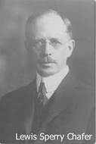
Chafer Systematic Theology, 1:111.
"The Upper Room Discourse, in which the above passage is found, is the seed-plot of that form of doctrine which is later developed in the Epistles. It is not strange, therefore, that the Apostle Paul takes up this great theme for further elucidation."

Slide 19
Seed Truths (John 13─17)
believers' oneness in Christ (John 17:20-23; Eph 2:11-22)
Spirit's permanent residence in the believer (John 14:16; Eph 4:30)
believer's union with Christ (John 14:20; Gal 2:20; Rom 6:1-14)
believer's opposition to the world (John 15:18-19; Jas 4:4; 1 John 2:15-17)
necessity of believer to stay in fellowship with Christ (John 13:10; 15:1-17; 1 John 1:5-7, 9)

Slide 20
Seed Truths (John 13─17)
abiding in Christ as a prerequisite for fruit bearing (John 15:1-7; Philip 4:13)
believer's election (John 15:16; Eph 1:4)
Christ as the ultimate model of sacrificial living and service (John 13:1-20; Philip 2:5-11)
necessity of divine discipline in the believer's life (John 15:2; Heb 12:5-11)
Satan as the god of this age (John 12:31; 14:30; 16:11; 2 Cor 4:4; Eph 2:2)

Slide 21
Seed Truths (John 13─17)
defeat of Satan at the cross (John 12:31; 16:11; Col 2:15; Heb 2:14)
Spirit as the inspirer of all Scripture (John 14:26; 16:13; 2 Tim 3:16; 2 Pet 1:20-21)
the Spirit as the illuminator of all Scripture (John 14:26; 16:13; 1 Cor 2:14; 1 John 2:20, 27)
Christ's provision of peace in the midst of adversity (John 14:27; Philip 4:7)
necessity of the Sprit's convicting ministry as a prerequisite for salvation (John 16:7-11; 1 Cor 2:14; 2 Cor 4:4)

Slide 22
Seed Truths (John 13─17)
normalcy of tribulations in the present age (John 16:33; Jas 1:2-4)
believer as the ultimate over comer (John 16:33; 1 John 4:4; 5:4-5)
Christ's present session at the Father's right hand (John 14:12-14; 17:5; Heb 7:3b, 25)
power of prayer (John 14:12-14; Eph 6:18-20; Jas 5:16)
inerrancy of Scripture (John 17:20; 2 Tim 3:16)
disclosure of Eschatology (John 16:13; 2 Thess 2:1-12)

Slide 23
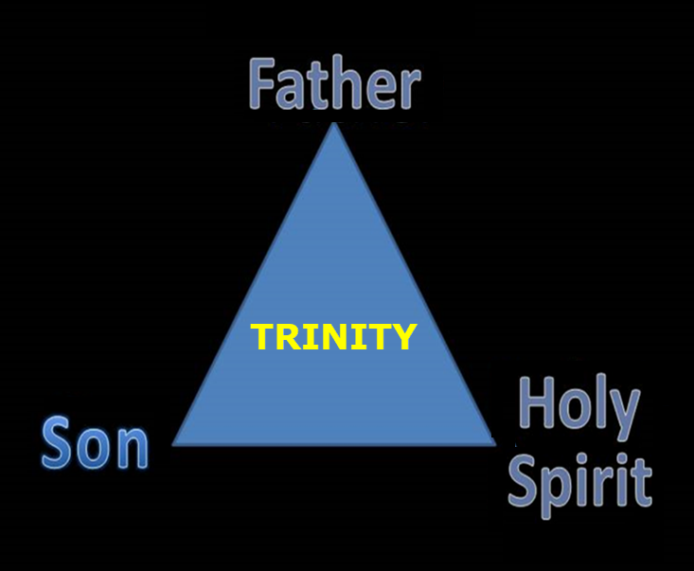

Slide 24
Believers
Disciples

Slide 25
CONCLUSION

Slide 26
Universal Church Word Pictures
Shepherd/sheep – John 10:16; Acts 20:28; Heb 13:20; 1 Pet 5:2-4
Head/body – Rom 12:5; 1 Cor 12:12-13; Eph 1:22-23
Bride/groom – Eph 5:22-33; 2 Cor 11:2-3
Temple – 1 Cor 3:16-17; Eph 2:19-22; Gal 6:10
High priest/priesthood – Heb 4:14-15; 1 Pet 2:5-9; Rev 1:6
Pillar of truth – 1 Tim 3:15
Vine and branches – John 15:1-8

Slide 27
Ecclesiology Overview
Definition
Universal vs. local
Word pictures
Origin
Israel – Church differences
Intercalation
Purposes
Activities
Government
Officers
Ordinances
Purity

