Slide 1
THE BOOK OF DANIEL
Dr. Andy Woods

Slide 2
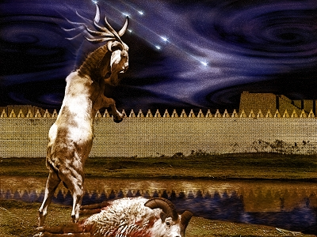
DANIEL 10-12 THE FINAL VISION

Slide 3
Chapter 10–12 Outline
The Setting (10:1-3)
Arrival of the Heavenly Messenger (10:4-9)
Explanation of the Heavenly Messenger (10:10–11:1)
The Prophecy of the Heavenly Messenger (11:2–12:13)

Slide 4
Chapter 10–12 Outline
The Setting (10:1-3)
Arrival of the Heavenly Messenger (10:4-9)
Explanation of the Heavenly Messenger (10:10–11:1)
The Prophecy of the Heavenly Messenger (11:2–12:13)

Slide 5
I. The Setting (10:1-3)
Historically (v. 1)
Cyrus of Persia
Third year of Cyrus
Personally (v. 2-3)

Slide 6
CHAPTER AND VERSE IN DANIEL | CHRONOLOGICAL DATE | BIBLICAL DATE
1:1 | 605 | 3rd year of Jehoiakim
2:1 | 603 | 2nd year of Nebuchadnezzar
5 | Sat. night 10/12/539 (Hoehner)
7:1 | 553 | 1st year of Belshazzar
8:1 | 551 | 3rd year of Belshazzar
9:1 | 538 | 1st year of Darius
10:1 | 536 | 3rd year of Cyrus

Slide 7
Chapter 10–12 Outline
The Setting (10:1-3)
Arrival of the Heavenly Messenger (10:4-9)
Explanation of the Heavenly Messenger (10:10–11:1)
The Prophecy of the Heavenly Messenger (11:2–12:13)

Slide 8
Chapter 10–12 Outline
The Setting (10:1-3)
Arrival of the Heavenly Messenger (10:4-9)
Explanation of the Heavenly Messenger (10:10–11:1)
The Prophecy of the Heavenly Messenger (11:2–12:13)

Slide 9
Chapter 10–12 Outline
The Setting (10:1-3)
Arrival of the Heavenly Messenger (10:4-9)
Explanation of the Heavenly Messenger (10:10–11:1)
The Prophecy of the Heavenly Messenger (11:2–12:13)

Slide 10
IV. The Prophecy of the Heavenly Messenger (11:2–12:13)
Persia (11:2)
Greece (11:3-4)
Ptolemies & Seleucids (11:5-20)
Antiochus IV (11:21-35)
Antichrist (11:36-45)
Tribulation & Millennium (12:1-13)

Slide 11
IV. The Prophecy of the Heavenly Messenger (11:2–12:13)
Persia (11:2)
Greece (11:3-4)
Ptolemies & Seleucids (11:5-20)
Antiochus IV (11:21-35)
Antichrist (11:36-45)
Tribulation & Millennium (12:1-13)

Slide 12
PERSIA 11:2
Cambyses 530-523 BC
Pseudo-Smerdis 522 BC
Darius I Hystaspes 521-486 BC
Xerxes 485-465 BC
Aka. “Ahasuerus” in Esther

Slide 13
IV. The Prophecy of the Heavenly Messenger (11:2–12:13)
Persia (11:2)
Greece (11:3-4)
Ptolemies & Seleucids (11:5-20)
Antiochus (11:21-35)
Antichrist (11:36-45)
Tribulation & Millennium (12:1-13)

Slide 14
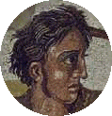
GREECE 11:3-4
Alexander the Great
Died at age 33 in 323 BC
No heirs
Kingdom divided among his 4 generals
Daniel 7:6, 8:5-8

Slide 15
Four Generals Daniel 7:6; 8:8, 22
Cassander Macedonia | Ptolemy Egypt
Lysimachus Thrace & Asia Minor | Seleucus Syria (including Israel)

Slide 16
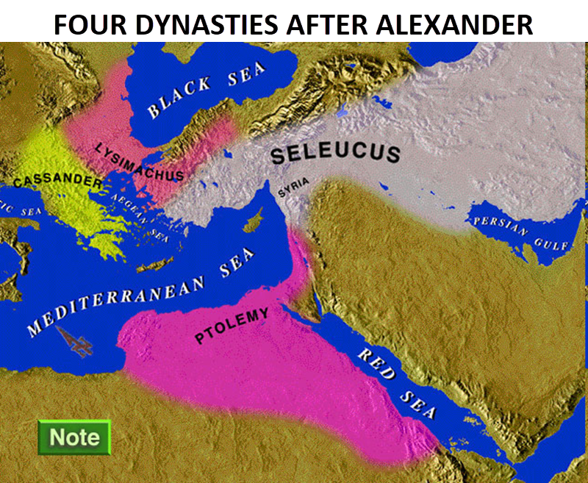

Slide 17
Four Generals Daniel 7:6; 8:8, 22
Cassander Macedonia | Ptolemy Egypt
Lysimachus Thrace & Asia Minor | Seleucus Syria (including Israel)

Slide 18
IV. The Prophecy of the Heavenly Messenger (11:2–12:13)
Persia (11:2)
Greece (11:3-4)
Ptolemies & Seleucids (11:5-20)
Antiochus (11:21-35)
Antichrist (11:36-45)
Tribulation & Millennium (12:1-13)

Slide 19
PTOLEMIES AND SELEUCIDS 11:5-20
History of warfare between the 2 dynasties
Ptolemies of Egypt vs. Seleucids of Syria
King of the South vs. King of the North
From 323 BC – 175 BC
The beautiful land = Israel
Cassander and Lysimachus not in view
Key transition in 198 B.C.
Selective and non-comprehensive history
What is at stake?

Slide 20
PTOLEMIES AND SELEUCIDS 11:5-20
History of warfare between the 2 dynasties
Ptolemies of Egypt vs. Seleucids of Syria
King of the South vs. King of the North
From 323 BC – 175 BC
The beautiful land = Israel
Cassander and Lysimachus not in view
Key transition in 198 B.C.
Selective and non-comprehensive history
What is at stake?

Slide 21
PTOLEMIES AND SELEUCIDS 11:5-20
History of warfare between the 2 dynasties
Ptolemies of Egypt vs. Seleucids of Syria
King of the South vs. King of the North
From 323 BC – 175 BC
The beautiful land = Israel
Cassander and Lysimachus not in view
Key transition in 198 B.C.
Selective and non-comprehensive history
What is at stake?

Slide 22
PTOLEMIES AND SELEUCIDS 11:5-20
History of warfare between the 2 dynasties
Ptolemies of Egypt vs. Seleucids of Syria
King of the South vs. King of the North
From 323 BC – 175 BC
The beautiful land = Israel
Cassander and Lysimachus not in view
Key transition in 198 B.C.
Selective and non-comprehensive history
What is at stake?

Slide 24
PTOLEMIES AND SELEUCIDS 11:5-20
History of warfare between the 2 dynasties
Ptolemies of Egypt vs. Seleucids of Syria
King of the South vs. King of the North
From 323 BC – 175 BC
The beautiful land = Israel
Cassander and Lysimachus not in view
Key transition in 198 B.C.
Selective and non-comprehensive history
What is at stake?

Slide 25
KINGS OF THE SOUTH (EGYPT) | KINGS OF THE NORTH (SYRIA)
Ptolemy I (Soter) 323–285 | Seleucus I (Nicator) 312–281
Ptolemy II (Philadelphus) 285–247 | Antiochus I (Soter) 281–261
Ptolemy III (Euregetus) 247–221 | Antiochus Theos 261–246
Ptolemy IV (Philopater) 221–220 | Seleucus Callinicus 246–226
Ptolemy V (Epiphanes) 203–182 | Seleucus III 226–223
 | Antiochus III (Great) 223–187
 | Seleucus IV (Philopater) 186–175
 | Antiochus IV (Epiphanes) 175–164
Paul N. Benware, Commentary on the Book of Daniel: The Coming Judgment of the Nations; Daniel's Prophecy of Things to Come (Clifton, TX: Scofield Ministries, 2007), 233.

Slide 26
PTOLEMIES AND SELEUCIDS 11:5-20
History of warfare between the 2 dynasties
Ptolemies of Egypt vs. Seleucids of Syria
King of the South vs. King of the North
From 323 BC – 175 BC
The beautiful land = Israel
Cassander and Lysimachus not in view
Key transition in 198 B.C.
Selective and non-comprehensive history
What is at stake?

Slide 28
Ezekiel 5:5
“Thus says the Lord God, ‘This is Jerusalem; I have set her at the center of the nations, with lands around her.’”

Slide 29
Ezekiel 38:12
“to capture spoil and to seize plunder, to turn your hand against the waste places which are now inhabited, and against the people who are gathered from the nations, who have acquired cattle and goods, who live at the center of the world.”

Slide 30
PTOLEMIES AND SELEUCIDS 11:5-20
History of warfare between the 2 dynasties
Ptolemies of Egypt vs. Seleucids of Syria
King of the South vs. King of the North
From 323 BC – 175 BC
The beautiful land = Israel
Cassander and Lysimachus not in view
Key transition in 198 B.C.
Selective and non-comprehensive history
What is at stake?

Slide 32
Four Generals Daniel 7:6; 8:8, 22
Cassander Macedonia | Ptolemy Egypt
Lysimachus Thrace & Asia Minor | Seleucus Syria (including Israel)

Slide 33
PTOLEMIES AND SELEUCIDS 11:5-20
History of warfare between the 2 dynasties
Ptolemies of Egypt vs. Seleucids of Syria
King of the South vs. King of the North
From 323 BC – 175 BC
The beautiful land = Israel
Cassander and Lysimachus not in view
Key transition in 198 B.C.
Selective and non-comprehensive history
What is at stake?

Slide 34
KINGS OF THE SOUTH (EGYPT) | KINGS OF THE NORTH (SYRIA)
Ptolemy I (Soter) 323–285 | Seleucus I (Nicator) 312–281
Ptolemy II (Philadelphus) 285–247 | Antiochus I (Soter) 281–261
Ptolemy III (Euregetus) 247–221 | Antiochus Theos 261–246
Ptolemy IV (Philopater) 221–220 | Seleucus Callinicus 246–226
Ptolemy V (Epiphanes) 203–182 | Seleucus III 226–223
 | Antiochus III (Great) 223–187
 | Seleucus IV (Philopater) 186–175
 | Antiochus IV (Epiphanes) 175–164
Paul N. Benware, Commentary on the Book of Daniel: The Coming Judgment of the Nations; Daniel's Prophecy of Things to Come (Clifton, TX: Scofield Ministries, 2007), 233.

Slide 35
Four Generals Daniel 7:6; 8:8, 22
Cassander Macedonia | Ptolemy Egypt
Lysimachus Thrace & Asia Minor | Seleucus Syria (including Israel)

Slide 36
Intertestamental Chronology (Dates BC)
SELEUCIDS
Seleucus I 312-281
Antiochus I 281-261
Antiochus II 261-246
Seleucus II 246-226
Seleucus III 226-223
Antiochus III 223-187
Seleucus IV Philapator 187-175
Antiochus IV Epiphanes 175-163

Slide 38
PTOLEMIES AND SELEUCIDS 11:5-20
History of warfare between the 2 dynasties
Ptolemies of Egypt vs. Seleucids of Syria
King of the South vs. King of the North
From 323 BC – 175 BC
The beautiful land = Israel
Cassander and Lysimachus not in view
Key transition in 198 B.C.
Selective and non-comprehensive history
What is at stake?

Slide 39
PTOLEMIES AND SELEUCIDS 11:5-20
History of warfare between the 2 dynasties
Ptolemies of Egypt vs. Seleucids of Syria
King of the South vs. King of the North
From 323 BC – 175 BC
The beautiful land = Israel
Cassander and Lysimachus not in view
Key transition in 198 B.C.
Selective and non-comprehensive history
What is at stake?

Slide 40
CHART 1

Slide 41
H.C. Leupold’s Homiletical (Preaching) Suggestions on Daniel 11
“This chapter might be treated in Bible classes. We do not see how it could be used for a sermon or for sermons.”
Leupold, H. C. (1949). Exposition of Daniel (p. 525). Grand Rapids, MI: Baker Book House.

Slide 42
Matthew 4:4
“But He answered and said, “It is written, ‘Man shall not live on bread alone, but on every word that proceeds out of the mouth of God.’”

Slide 43
Matthew 5:18
“For truly I say to you, until heaven and earth pass away, not the smallest letter or stroke shall pass from the Law until all is accomplished.”

Slide 44
KINGS OF THE SOUTH (EGYPT) | KINGS OF THE NORTH (SYRIA)
Ptolemy I (Soter) 323–285 | Seleucus I (Nicator) 312–281
Ptolemy II (Philadelphus) 285–247 | Antiochus I (Soter) 281–261
Ptolemy III (Euregetus) 247–221 | Antiochus Theos 261–246
Ptolemy IV (Philopater) 221–220 | Seleucus Callinicus 246–226
Ptolemy V (Epiphanes) 203–182 | Seleucus III 226–223
 | Antiochus III (Great) 223–187
 | Seleucus IV (Philopater) 186–175
 | Antiochus IV (Epiphanes) 175–164
Paul N. Benware, Commentary on the Book of Daniel: The Coming Judgment of the Nations; Daniel's Prophecy of Things to Come (Clifton, TX: Scofield Ministries, 2007), 233.

Slide 45
Daniel 11:5
King of the S. = Ptolemy I
Ptolemy I initially joined with Seleucus I
Ptolemy I broke with Seleucus I
Ptolemy I made Israel part of his empire
Paul N. Benware, Commentary on the Book of Daniel: The Coming Judgment of the Nations; Daniel's Prophecy of Things to Come (Clifton, TX: Scofield Ministries, 2007), 232-36.

Slide 46
KINGS OF THE SOUTH (EGYPT) | KINGS OF THE NORTH (SYRIA)
Ptolemy I (Soter) 323–285 | Seleucus I (Nicator) 312–281
Ptolemy II (Philadelphus) 285–247 | Antiochus I (Soter) 281–261
Ptolemy III (Euregetus) 247–221 | Antiochus Theos 261–246
Ptolemy IV (Philopater) 221–220 | Seleucus Callinicus 246–226
Ptolemy V (Epiphanes) 203–182 | Seleucus III 226–223
 | Antiochus III (Great) 223–187
 | Seleucus IV (Philopater) 186–175
 | Antiochus IV (Epiphanes) 175–164
Paul N. Benware, Commentary on the Book of Daniel: The Coming Judgment of the Nations; Daniel's Prophecy of Things to Come (Clifton, TX: Scofield Ministries, 2007), 233.

Slide 47
Daniel 11:6
Bernice (daughter of Ptolemy II) marries Antiochus Theos
Antiochus Theos brings back former wife Laodice when Ptolemy II dies
Laodice poisons Antiochus Theos, Bernice, and Bernice’s children
Those Bernice brought from Egypt also destroyed
Laodice’s son (Seluecus Calliniucus) becomes ruler of the N.
Paul N. Benware, Commentary on the Book of Daniel: The Coming Judgment of the Nations; Daniel's Prophecy of Things to Come (Clifton, TX: Scofield Ministries, 2007), 232-36.

Slide 48
KINGS OF THE SOUTH (EGYPT) | KINGS OF THE NORTH (SYRIA)
Ptolemy I (Soter) 323–285 | Seleucus I (Nicator) 312–281
Ptolemy II (Philadelphus) 285–247 | Antiochus I (Soter) 281–261
Ptolemy III (Euregetus) 247–221 | Antiochus Theos 261–246
Ptolemy IV (Philopater) 221–220 | Seleucus Callinicus 246–226
Ptolemy V (Epiphanes) 203–182 | Seleucus III 226–223
 | Antiochus III (Great) 223–187
 | Seleucus IV (Philopater) 186–175
 | Antiochus IV (Epiphanes) 175–164
Paul N. Benware, Commentary on the Book of Daniel: The Coming Judgment of the Nations; Daniel's Prophecy of Things to Come (Clifton, TX: Scofield Ministries, 2007), 233.

Slide 49
Daniel 11:7-9
Ptolemy III = brother of the poisoned Bernice
Ptolemy III conquers King of the N. (Seleucus Callinicus)
Ptolemy III takes strongholds and wealth
Counter attack by Seleucus Callinicus was fruitless
Paul N. Benware, Commentary on the Book of Daniel: The Coming Judgment of the Nations; Daniel's Prophecy of Things to Come (Clifton, TX: Scofield Ministries, 2007), 232-36.

Slide 50
KINGS OF THE SOUTH (EGYPT) | KINGS OF THE NORTH (SYRIA)
Ptolemy I (Soter) 323–285 | Seleucus I (Nicator) 312–281
Ptolemy II (Philadelphus) 285–247 | Antiochus I (Soter) 281–261
Ptolemy III (Euregetus) 247–221 | Antiochus Theos 261–246
Ptolemy IV (Philopater) 221–220 | Seleucus Callinicus 246–226
Ptolemy V (Epiphanes) 203–182 | Seleucus III 226–223
 | Antiochus III (Great) 223–187
 | Seleucus IV (Philopater) 186–175
 | Antiochus IV (Epiphanes) 175–164
Paul N. Benware, Commentary on the Book of Daniel: The Coming Judgment of the Nations; Daniel's Prophecy of Things to Come (Clifton, TX: Scofield Ministries, 2007), 233.

Slide 51
Daniel 11:10
Seleucus Callinicus has two sons: Selecus III & Antiochus III
Seleucus III dies in battle
Throne taken by Antiochus III
Antiochus III becomes a powerful King of the N.
Antiochus III took sever cities in Israel from Ptolemy Philopater
Antiochus III brought the Kingdom of the N. to the very border of the Kingdom of the S.
Paul N. Benware, Commentary on the Book of Daniel: The Coming Judgment of the Nations; Daniel's Prophecy of Things to Come (Clifton, TX: Scofield Ministries, 2007), 232-36.

Slide 52
KINGS OF THE SOUTH (EGYPT) | KINGS OF THE NORTH (SYRIA)
Ptolemy I (Soter) 323–285 | Seleucus I (Nicator) 312–281
Ptolemy II (Philadelphus) 285–247 | Antiochus I (Soter) 281–261
Ptolemy III (Euregetus) 247–221 | Antiochus Theos 261–246
Ptolemy IV (Philopater) 221–220 | Seleucus Callinicus 246–226
Ptolemy V (Epiphanes) 203–182 | Seleucus III 226–223
 | Antiochus III (Great) 223–187
 | Seleucus IV (Philopater) 186–175
 | Antiochus IV (Epiphanes) 175–164
Paul N. Benware, Commentary on the Book of Daniel: The Coming Judgment of the Nations; Daniel's Prophecy of Things to Come (Clifton, TX: Scofield Ministries, 2007), 233.

Slide 53
Daniel 11:11-12
Victories of Antiochus III aroused Ptolemy IV
Ptolemy IV vs. Antiochus III
Antiochus III favored
Ptolemy IV prevails
Antiochus III escapes with his life and is granted peace by Ptolemy IV
Ptolemy IV does not crush the N. in preference for living a life of ease
Paul N. Benware, Commentary on the Book of Daniel: The Coming Judgment of the Nations; Daniel's Prophecy of Things to Come (Clifton, TX: Scofield Ministries, 2007), 232-36.

Slide 54
KINGS OF THE SOUTH (EGYPT) | KINGS OF THE NORTH (SYRIA)
Ptolemy I (Soter) 323–285 | Seleucus I (Nicator) 312–281
Ptolemy II (Philadelphus) 285–247 | Antiochus I (Soter) 281–261
Ptolemy III (Euregetus) 247–221 | Antiochus Theos 261–246
Ptolemy IV (Philopater) 221–220 | Seleucus Callinicus 246–226
Ptolemy V (Epiphanes) 203–182 | Seleucus III 226–223
 | Antiochus III (Great) 223–187
 | Seleucus IV (Philopater) 186–175
 | Antiochus IV (Epiphanes) 175–164
Paul N. Benware, Commentary on the Book of Daniel: The Coming Judgment of the Nations; Daniel's Prophecy of Things to Come (Clifton, TX: Scofield Ministries, 2007), 233.

Slide 55
Daniel 11:13-16
Antiochus III recovers from defeat
Ptolemy IV dies suddenly thereby vacating Egypt’s throne
Ptolemy V occupies the throne at age 6
Antiochus III saw this as an opportunity to invade Egypt
Antiochus III and Philip of Macedon invade Egypt
Many Egyptians sided with the invaders
Antiochus III did as he pleased, took Israel, and placed it under sovereignty of the N.
Paul N. Benware, Commentary on the Book of Daniel: The Coming Judgment of the Nations; Daniel's Prophecy of Things to Come (Clifton, TX: Scofield Ministries, 2007), 232-36.

Slide 56
KINGS OF THE SOUTH (EGYPT) | KINGS OF THE NORTH (SYRIA)
Ptolemy I (Soter) 323–285 | Seleucus I (Nicator) 312–281
Ptolemy II (Philadelphus) 285–247 | Antiochus I (Soter) 281–261
Ptolemy III (Euregetus) 247–221 | Antiochus Theos 261–246
Ptolemy IV (Philopater) 221–220 | Seleucus Callinicus 246–226
Ptolemy V (Epiphanes) 203–182 | Seleucus III 226–223
 | Antiochus III (Great) 223–187
 | Seleucus IV (Philopater) 186–175
 | Antiochus IV (Epiphanes) 175–164
Paul N. Benware, Commentary on the Book of Daniel: The Coming Judgment of the Nations; Daniel's Prophecy of Things to Come (Clifton, TX: Scofield Ministries, 2007), 233.

Slide 57
Daniel 11:17
Antiochus III tries to regain control over Egypt by marrying his daughter Cleopatra over to Ptolemy V
Cleopatra remains loyal to her husband (Ptolemy V) and not her father (Antiochus III)
Paul N. Benware, Commentary on the Book of Daniel: The Coming Judgment of the Nations; Daniel's Prophecy of Things to Come (Clifton, TX: Scofield Ministries, 2007), 232-36.

Slide 58
KINGS OF THE SOUTH (EGYPT) | KINGS OF THE NORTH (SYRIA)
Ptolemy I (Soter) 323–285 | Seleucus I (Nicator) 312–281
Ptolemy II (Philadelphus) 285–247 | Antiochus I (Soter) 281–261
Ptolemy III (Euregetus) 247–221 | Antiochus Theos 261–246
Ptolemy IV (Philopater) 221–220 | Seleucus Callinicus 246–226
Ptolemy V (Epiphanes) 203–182 | Seleucus III 226–223
 | Antiochus III (Great) 223–187
 | Seleucus IV (Philopater) 186–175
 | Antiochus IV (Epiphanes) 175–164
Paul N. Benware, Commentary on the Book of Daniel: The Coming Judgment of the Nations; Daniel's Prophecy of Things to Come (Clifton, TX: Scofield Ministries, 2007), 233.

Slide 59
Daniel 11:18-19
Antiochus III (discontent over prior victories) invades Greece
Rome tells Antiochus III to leave Greece alone
Antiochus III refuses to listen to Rome
Roman general Cornelius Scipio defeats Antiochus III
Antiochus III returns home and robs the Temple of Jupiter in order to compensate for depleted funds
Caused rebellion
Death of Antiochus III
Paul N. Benware, Commentary on the Book of Daniel: The Coming Judgment of the Nations; Daniel's Prophecy of Things to Come (Clifton, TX: Scofield Ministries, 2007), 232-36.

Slide 60
KINGS OF THE SOUTH (EGYPT) | KINGS OF THE NORTH (SYRIA)
Ptolemy I (Soter) 323–285 | Seleucus I (Nicator) 312–281
Ptolemy II (Philadelphus) 285–247 | Antiochus I (Soter) 281–261
Ptolemy III (Euregetus) 247–221 | Antiochus Theos 261–246
Ptolemy IV (Philopater) 221–220 | Seleucus Callinicus 246–226
Ptolemy V (Epiphanes) 203–182 | Seleucus III 226–223
 | Antiochus III (Great) 223–187
 | Seleucus IV (Philopater) 186–175
 | Antiochus IV (Epiphanes) 175–164
Paul N. Benware, Commentary on the Book of Daniel: The Coming Judgment of the Nations; Daniel's Prophecy of Things to Come (Clifton, TX: Scofield Ministries, 2007), 233.

Slide 61
Daniel 11:20
Antiochus III replaced by his son Seleucus IV
Seleucus IV is forced to pay tribute to Rome
Consequently Seleucus IV heavily taxes his own people
Consequently Seleucus IV becomes unpopular with his own people
Consequently Seleucus IV sent tax collector Heliodorus to Jerusalem to plunder treasure from the Temple
Seleucus IV was poisoned by Heliodorus resulting in a sort reign of a few days
Lead up to Antiochus IV
Paul N. Benware, Commentary on the Book of Daniel: The Coming Judgment of the Nations; Daniel's Prophecy of Things to Come (Clifton, TX: Scofield Ministries, 2007), 232-36.

Slide 62
Daniel 11:5-20 Applications
The real cause of war (Dan. 9:26; Mark 7:20-23; James 4:1-2; Prov. 4:23)
Earthly riches can be lost (Dan. 11:8; Matt. 6:19-20; 1 Tim. 6:7, 17)
Political leaders come and go (Dan. 2:44; Heb. 12:28)
God is faithful to His people (2 Tim. 2:13)

Slide 63
Daniel 11:5-20 Applications
The real cause of war (Dan. 9:26; Mark 7:20-23; James 4:1-2; Prov. 4:23)
Earthly riches can be lost (Dan. 11:8; Matt. 6:19-20; 1 Tim. 6:7, 17)
Political leaders come and go (Dan. 2:44; Heb. 12:28)
God is faithful to His people (2 Tim. 2:13)

Slide 64
Daniel 11:5-20 Applications
The real cause of war (Dan. 9:26; Mark 7:20-23; James 4:1-2; Prov. 4:23)
Earthly riches can be lost (Dan. 11:8; Matt. 6:19-20; 1 Tim. 6:7, 17)
Political leaders come and go (Dan. 2:44; Heb. 12:28)
God is faithful to His people (2 Tim. 2:13)

Slide 65
Daniel 11:5-20 Applications
The real cause of war (Dan. 9:26; Mark 7:20-23; James 4:1-2; Prov. 4:23)
Earthly riches can be lost (Dan. 11:8; Matt. 6:19-20; 1 Tim. 6:7, 17)
Political leaders come and go (Dan. 2:44; Heb. 12:28)
God is faithful to His people (2 Tim. 2:13)

Slide 66
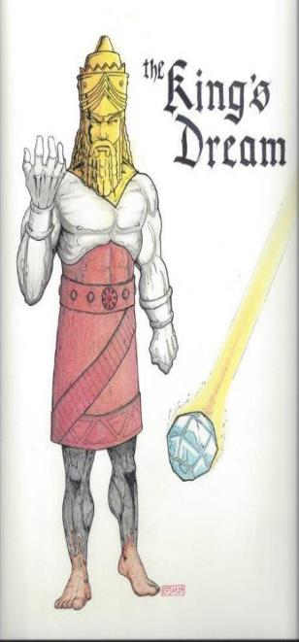
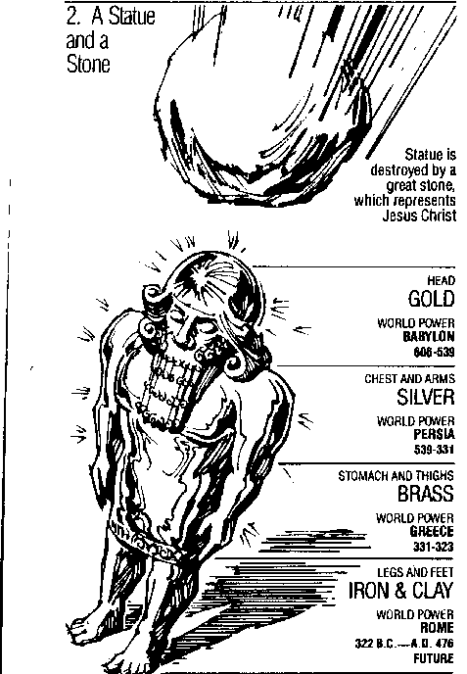
Statue
&
Stone

Slide 67
Daniel 11:5-20 Applications
The real cause of war (Dan. 9:26; Mark 7:20-23; James 4:1-2; Prov. 4:23)
Earthly riches can be lost (Dan. 11:8; Matt. 6:19-20; 1 Tim. 6:7, 17)
Political leaders come and go (Dan. 2:44; Heb. 12:28)
God is faithful to His people (2 Tim. 2:13)

Slide 68
IV. The Prophecy of the Heavenly Messenger (11:2–12:13)
Persia (11:2)
Greece (11:3-4)
Ptolemies & Seleucids (11:5-20)
Antiochus (11:21-35)
Antichrist (11:36-45)
Tribulation & Millennium (12:1-13)

Slide 69
IV. The Prophecy of the Heavenly Messenger (11:2–12:13)
Persia (11:2)
Greece (11:3-4)
Ptolemies & Seleucids (11:5-20)
Antiochus (11:21-35)
Antichrist (11:36-45)
Tribulation & Millennium (12:1-13)

Slide 70
IV. The Prophecy of the Heavenly Messenger (11:2–12:13)
Persia (11:2)
Greece (11:3-4)
Ptolemies & Seleucids (11:5-20)
Antiochus (11:21-35)
Antichrist (11:36-45)
Tribulation & Millennium (12:1-13)

Slide 71
Conclusion

Slide 72
Chapter 10–12 Outline
The Setting (10:1-3)
Arrival of the Heavenly Messenger (10:4-9)
Explanation of the Heavenly Messenger (10:10–11:1)
The Prophecy of the Heavenly Messenger (11:2–12:13)

Slide 73
Purpose
To encourage Judah by emphasizing the sovereignty of God during the Babylonian captivity and to teach Judah how to live while outside the land

Slide 74
“The Lord bless you and keep you; the Lord make his face shine on you and be gracious to you; the Lord turn his face toward you and give you peace.” (NIV)

