Slide 1
THE BOOK OF DANIEL
Dr. Andy Woods

Slide 2
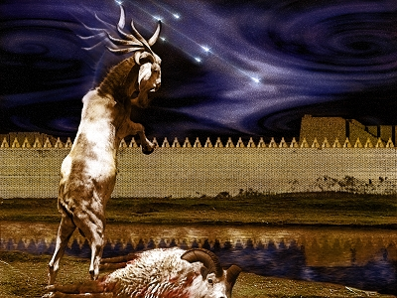
DANIEL 10-12 THE FINAL VISION

Slide 3
Chapter 10–12 Outline
The Setting (10:1-3)
Arrival of the Heavenly Messenger (10:4-9)
Explanation of the Heavenly Messenger (10:10–11:1)
The Prophecy of the Heavenly Messenger (11:2–12:13)

Slide 4
Chapter 10–12 Outline
The Setting (10:1-3)
Arrival of the Heavenly Messenger (10:4-9)
Explanation of the Heavenly Messenger (10:10–11:1)
The Prophecy of the Heavenly Messenger (11:2–12:13)

Slide 5
I. The Setting (10:1-3)
Historically (v. 1)
Cyrus of Persia
Third year of Cyrus
Personally (v. 2-3)

Slide 6
CHAPTER AND VERSE IN DANIEL | CHRONOLOGICAL DATE | BIBLICAL DATE
1:1 | 605 | 3rd year of Jehoiakim
2:1 | 603 | 2nd year of Nebuchadnezzar
5 | Sat. night 10/12/539 (Hoehner)
7:1 | 553 | 1st year of Belshazzar
8:1 | 551 | 3rd year of Belshazzar
9:1 | 538 | 1st year of Darius
10:1 | 536 | 3rd year of Cyrus

Slide 7
Chapter 10–12 Outline
The Setting (10:1-3)
Arrival of the Heavenly Messenger (10:4-9)
Explanation of the Heavenly Messenger (10:10–11:1)
The Prophecy of the Heavenly Messenger (11:2–12:13)

Slide 8
Chapter 10–12 Outline
The Setting (10:1-3)
Arrival of the Heavenly Messenger (10:4-9)
Explanation of the Heavenly Messenger (10:10–11:1)
The Prophecy of the Heavenly Messenger (11:2–12:13)

Slide 9
Chapter 10–12 Outline
The Setting (10:1-3)
Arrival of the Heavenly Messenger (10:4-9)
Explanation of the Heavenly Messenger (10:10–11:1)
The Prophecy of the Heavenly Messenger (11:2–12:13)

Slide 10
IV. The Prophecy of the Heavenly Messenger (11:2–12:13)
Persia (11:2)
Greece (11:3-4)
Ptolemies & Seleucids (11:5-20)
Antiochus IV (11:21-35)
Antichrist (11:36-45)
Tribulation & Millennium (12:1-13)

Slide 11
IV. The Prophecy of the Heavenly Messenger (11:2–12:13)
Persia (11:2)
Greece (11:3-4)
Ptolemies & Seleucids (11:5-20)
Antiochus IV (11:21-35)
Antichrist (11:36-45)
Tribulation & Millennium (12:1-13)

Slide 12
PERSIA 11:2
Cambyses 530-523 BC
Pseudo-Smerdis 522 BC
Darius I Hystaspes 521-486 BC
Xerxes 485-465 BC
Aka. “Ahasuerus” in Esther

Slide 13
IV. The Prophecy of the Heavenly Messenger (11:2–12:13)
Persia (11:2)
Greece (11:3-4)
Ptolemies & Seleucids (11:5-20)
Antiochus (11:21-35)
Antichrist (11:36-45)
Tribulation & Millennium (12:1-13)

Slide 14
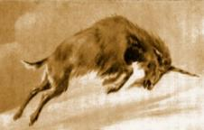
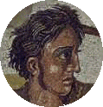
GREECE 11:3-4
Alexander the Great
Died at age 33 in 323 BC
No heirs
Kingdom divided among his 4 generals
Daniel 7:6, 8:5-8

Slide 15
Four Generals Daniel 7:6; 8:8, 22
Cassander Macedonia | Ptolemy Egypt
Lysimachus Thrace & Asia Minor | Seleucus Syria (including Israel)

Slide 16
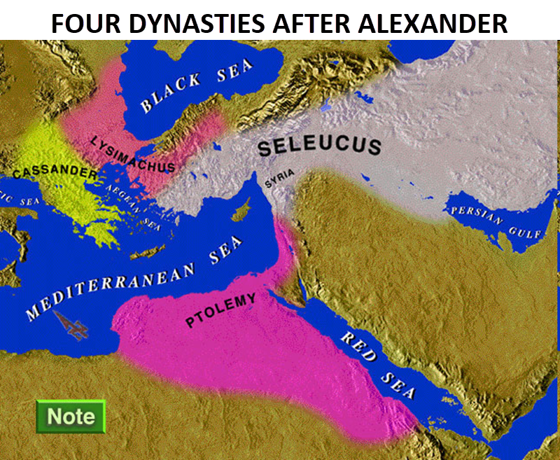

Slide 17
Four Generals Daniel 7:6; 8:8, 22
Cassander Macedonia | Ptolemy Egypt
Lysimachus Thrace & Asia Minor | Seleucus Syria (including Israel)

Slide 18
IV. The Prophecy of the Heavenly Messenger (11:2–12:13)
Persia (11:2)
Greece (11:3-4)
Ptolemies & Seleucids (11:5-20)
Antiochus (11:21-35)
Antichrist (11:36-45)
Tribulation & Millennium (12:1-13)

Slide 19
PTOLEMIES AND SELEUCIDS 11:5-20
History of warfare between the 2 dynasties
Ptolemies of Egypt vs. Seleucids of Syria
King of the South vs. King of the North
From 323 BC – 175 BC
The beautiful land = Israel
Cassander and Lysimachus not in view
Key transition in 198 B.C.
Selective and non-comprehensive history
What is at stake?

Slide 20
KINGS OF THE SOUTH (EGYPT) | KINGS OF THE NORTH (SYRIA)
Ptolemy I (Soter) 323–285 | Seleucus I (Nicator) 312–281
Ptolemy II (Philadelphus) 285–247 | Antiochus I (Soter) 281–261
Ptolemy III (Euregetus) 247–221 | Antiochus Theos 261–246
Ptolemy IV (Philopater) 221–220 | Seleucus Callinicus 246–226
Ptolemy V (Epiphanes) 203–182 | Seleucus III 226–223
 | Antiochus III (Great) 223–187
 | Seleucus IV (Philopater) 186–175
 | Antiochus IV (Epiphanes) 175–164
Paul N. Benware, Commentary on the Book of Daniel: The Coming Judgment of the Nations; Daniel's Prophecy of Things to Come (Clifton, TX: Scofield Ministries, 2007), 233.

Slide 21
Four Generals Daniel 7:6; 8:8, 22
Cassander Macedonia | Ptolemy Egypt
Lysimachus Thrace & Asia Minor | Seleucus Syria (including Israel)

Slide 22
Intertestamental Chronology (Dates BC)
SELEUCIDS
Seleucus I 312-281
Antiochus I 281-261
Antiochus II 261-246
Seleucus II 246-226
Seleucus III 226-223
Antiochus III 223-187
Seleucus IV Philapator 187-175
Antiochus IV Epiphanes 175-163

Slide 24
KINGS OF THE SOUTH (EGYPT) | KINGS OF THE NORTH (SYRIA)
Ptolemy I (Soter) 323–285 | Seleucus I (Nicator) 312–281
Ptolemy II (Philadelphus) 285–247 | Antiochus I (Soter) 281–261
Ptolemy III (Euregetus) 247–221 | Antiochus Theos 261–246
Ptolemy IV (Philopater) 221–220 | Seleucus Callinicus 246–226
Ptolemy V (Epiphanes) 203–182 | Seleucus III 226–223
 | Antiochus III (Great) 223–187
 | Seleucus IV (Philopater) 186–175
 | Antiochus IV (Epiphanes) 175–164
Paul N. Benware, Commentary on the Book of Daniel: The Coming Judgment of the Nations; Daniel's Prophecy of Things to Come (Clifton, TX: Scofield Ministries, 2007), 233.

Slide 25
Daniel 11:13-16
Antiochus III recovers from defeat
Ptolemy IV dies suddenly thereby vacating Egypt’s throne
Ptolemy V occupies the throne at age 6
Antiochus III saw this as an opportunity to invade Egypt
Antiochus III and Philip of Macedon invade Egypt
Many Egyptians sided with the invaders
Antiochus III did as he pleased, took Israel, and placed it under sovereignty of the North.
Paul N. Benware, Commentary on the Book of Daniel: The Coming Judgment of the Nations; Daniel's Prophecy of Things to Come (Clifton, TX: Scofield Ministries, 2007), 232-36.

Slide 26
KINGS OF THE SOUTH (EGYPT) | KINGS OF THE NORTH (SYRIA)
Ptolemy I (Soter) 323–285 | Seleucus I (Nicator) 312–281
Ptolemy II (Philadelphus) 285–247 | Antiochus I (Soter) 281–261
Ptolemy III (Euregetus) 247–221 | Antiochus Theos 261–246
Ptolemy IV (Philopater) 221–220 | Seleucus Callinicus 246–226
Ptolemy V (Epiphanes) 203–182 | Seleucus III 226–223
 | Antiochus III (Great) 223–187
 | Seleucus IV (Philopater) 186–175
 | Antiochus IV (Epiphanes) 175–164
Paul N. Benware, Commentary on the Book of Daniel: The Coming Judgment of the Nations; Daniel's Prophecy of Things to Come (Clifton, TX: Scofield Ministries, 2007), 233.

Slide 27
Daniel 11:17
Antiochus III tries to regain control over Egypt by marrying his daughter Cleopatra over to Ptolemy V
Cleopatra remains loyal to her husband (Ptolemy V) and not her father (Antiochus III)
Paul N. Benware, Commentary on the Book of Daniel: The Coming Judgment of the Nations; Daniel's Prophecy of Things to Come (Clifton, TX: Scofield Ministries, 2007), 232-36.

Slide 28
KINGS OF THE SOUTH (EGYPT) | KINGS OF THE NORTH (SYRIA)
Ptolemy I (Soter) 323–285 | Seleucus I (Nicator) 312–281
Ptolemy II (Philadelphus) 285–247 | Antiochus I (Soter) 281–261
Ptolemy III (Euregetus) 247–221 | Antiochus Theos 261–246
Ptolemy IV (Philopater) 221–220 | Seleucus Callinicus 246–226
Ptolemy V (Epiphanes) 203–182 | Seleucus III 226–223
 | Antiochus III (Great) 223–187
 | Seleucus IV (Philopater) 186–175
 | Antiochus IV (Epiphanes) 175–164
Paul N. Benware, Commentary on the Book of Daniel: The Coming Judgment of the Nations; Daniel's Prophecy of Things to Come (Clifton, TX: Scofield Ministries, 2007), 233.

Slide 29
Daniel 11:18-19
Antiochus III (discontent over prior victories) invades Greece
Rome tells Antiochus III to leave Greece alone
Antiochus III refuses to listen to Rome
Roman general Cornelius Scipio defeats Antiochus III
Antiochus III returns home and robs the Temple of Jupiter in order to compensate for depleted funds
Caused rebellion
Death of Antiochus III
Paul N. Benware, Commentary on the Book of Daniel: The Coming Judgment of the Nations; Daniel's Prophecy of Things to Come (Clifton, TX: Scofield Ministries, 2007), 232-36.

Slide 30
KINGS OF THE SOUTH (EGYPT) | KINGS OF THE NORTH (SYRIA)
Ptolemy I (Soter) 323–285 | Seleucus I (Nicator) 312–281
Ptolemy II (Philadelphus) 285–247 | Antiochus I (Soter) 281–261
Ptolemy III (Euregetus) 247–221 | Antiochus Theos 261–246
Ptolemy IV (Philopater) 221–220 | Seleucus Callinicus 246–226
Ptolemy V (Epiphanes) 203–182 | Seleucus III 226–223
 | Antiochus III (Great) 223–187
 | Seleucus IV (Philopater) 186–175
 | Antiochus IV (Epiphanes) 175–164
Paul N. Benware, Commentary on the Book of Daniel: The Coming Judgment of the Nations; Daniel's Prophecy of Things to Come (Clifton, TX: Scofield Ministries, 2007), 233.

Slide 31
Daniel 11:20
Antiochus III replaced by his son Seleucus IV
Seleucus IV is forced to pay tribute to Rome
Consequently Seleucus IV heavily taxes his own people
Consequently Seleucus IV becomes unpopular with his own people
Consequently Seleucus IV sent tax collector Heliodorus to Jerusalem to plunder treasure from the Temple
Seleucus IV was poisoned by Heliodorus resulting in a sort reign of a few days
Lead up to Antiochus IV
Paul N. Benware, Commentary on the Book of Daniel: The Coming Judgment of the Nations; Daniel's Prophecy of Things to Come (Clifton, TX: Scofield Ministries, 2007), 232-36.

Slide 32
Daniel 11:5-20 Applications
Prophecy is proof of divine inspiration (Isa. 48:3, 5; John 13:19; 14:29)
The real cause of war (Dan. 9:26; Mark 7:20-23; James 4:1-2; Prov. 4:23)
Earthly riches can be lost (Dan. 11:8; Matt. 6:19-20; 1 Tim. 6:7, 17)
Political leaders come and go (Dan. 2:44; Heb. 12:28)
God is faithful to His people (2 Tim. 2:13)

Slide 33
Daniel 11:5-20 Applications
Prophecy is proof of divine inspiration (Isa. 48:3, 5; John 13:19; 14:29)
The real cause of war (Dan. 9:26; Mark 7:20-23; James 4:1-2; Prov. 4:23)
Earthly riches can be lost (Dan. 11:8; Matt. 6:19-20; 1 Tim. 6:7, 17)
Political leaders come and go (Dan. 2:44; Heb. 12:28)
God is faithful to His people (2 Tim. 2:13)

Slide 34
Daniel 11:5-20 Applications
Prophecy is proof of divine inspiration (Isa. 48:3, 5; John 13:19; 14:29)
The real cause of war (Dan. 9:26; Mark 7:20-23; James 4:1-2; Prov. 4:23)
Earthly riches can be lost (Dan. 11:8; Matt. 6:19-20; 1 Tim. 6:7, 17)
Political leaders come and go (Dan. 2:44; Heb. 12:28)
God is faithful to His people (2 Tim. 2:13)

Slide 35
Daniel 11:5-20 Applications
Prophecy is proof of divine inspiration (Isa. 48:3, 5; John 13:19; 14:29)
The real cause of war (Dan. 9:26; Mark 7:20-23; James 4:1-2; Prov. 4:23)
Earthly riches can be lost (Dan. 11:8; Matt. 6:19-20; 1 Tim. 6:7, 17)
Political leaders come and go (Dan. 2:44; Heb. 12:28)
God is faithful to His people (2 Tim. 2:13)

Slide 36
Daniel 11:5-20 Applications
Prophecy is proof of divine inspiration (Isa. 48:3, 5; John 13:19; 14:29)
The real cause of war (Dan. 9:26; Mark 7:20-23; James 4:1-2; Prov. 4:23)
Earthly riches can be lost (Dan. 11:8; Matt. 6:19-20; 1 Tim. 6:7, 17)
Political leaders come and go (Dan. 2:44; Heb. 12:28)
God is faithful to His people (2 Tim. 2:13)

Slide 37
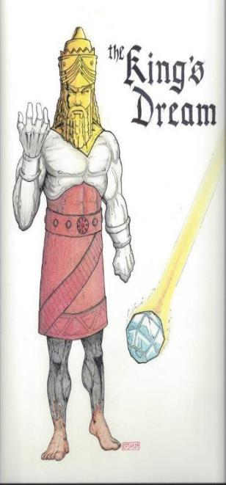
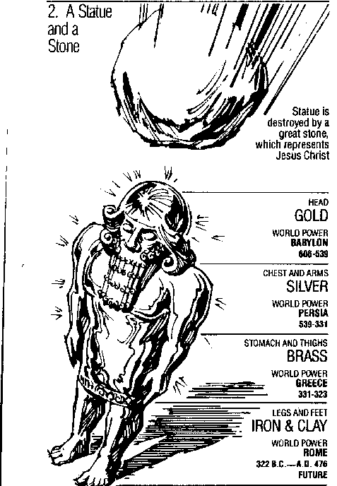
Statue
&
Stone

Slide 38
Daniel 11:5-20 Applications
Prophecy is proof of divine inspiration (Isa. 48:3, 5; John 13:19; 14:29)
The real cause of war (Dan. 9:26; Mark 7:20-23; James 4:1-2; Prov. 4:23)
Earthly riches can be lost (Dan. 11:8; Matt. 6:19-20; 1 Tim. 6:7, 17)
Political leaders come and go (Dan. 2:44; Heb. 12:28)
God is faithful to His people (2 Tim. 2:13)

Slide 39
2 Timothy 2:13
“If we are faithless, He remains faithful, for He cannot deny Himself.”

Slide 40
IV. The Prophecy of the Heavenly Messenger (11:2–12:13)
Persia (11:2)
Greece (11:3-4)
Ptolemies & Seleucids (11:5-20)
Antiochus (11:21-35)
Antichrist (11:36-45)
Tribulation & Millennium (12:1-13)

Slide 41
IV. The Prophecy of the Heavenly Messenger (11:2–12:13)
Persia (11:2)
Greece (11:3-4)
Ptolemies & Seleucids (11:5-20)
Antiochus (11:21-35)
Antichrist (11:36-45)
Tribulation & Millennium (12:1-13)

Slide 42
IV. The Prophecy of the Heavenly Messenger (11:2–12:13)
Persia (11:2)
Greece (11:3-4)
Ptolemies & Seleucids (11:5-20)
Antiochus (11:21-35)
Antichrist (11:36-45)
Tribulation & Millennium (12:1-13)

Slide 43
Conclusion

Slide 44
Chapter 10–12 Outline
The Setting (10:1-3)
Arrival of the Heavenly Messenger (10:4-9)
Explanation of the Heavenly Messenger (10:10–11:1)
The Prophecy of the Heavenly Messenger (11:2–12:13)

Slide 45
Purpose
To encourage Judah by emphasizing the sovereignty of God during the Babylonian captivity and to teach Judah how to live while outside the land

Slide 46
“The Lord bless you and keep you; the Lord make his face shine on you and be gracious to you; the Lord turn his face toward you and give you peace.” (NIV)

