Slide 1
THE BOOK OF DANIEL
Dr. Andy Woods

Slide 2
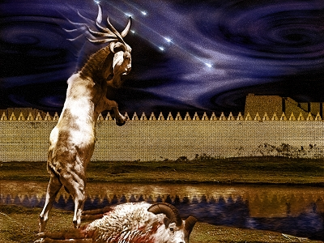
DANIEL 10-12 THE FINAL VISION

Slide 3
Chapter 10–12 Outline
The Setting (10:1-3)
Arrival of the Heavenly Messenger (10:4-9)
Explanation of the Heavenly Messenger (10:10–11:1)
The Prophecy of the Heavenly Messenger (11:2–12:13)

Slide 4
Chapter 10–12 Outline
The Setting (10:1-3)
Arrival of the Heavenly Messenger (10:4-9)
Explanation of the Heavenly Messenger (10:10–11:1)
The Prophecy of the Heavenly Messenger (11:2–12:13)

Slide 5
CHAPTER AND VERSE IN DANIEL | CHRONOLOGICAL DATE | BIBLICAL DATE
1:1 | 605 | 3rd year of Jehoiakim
2:1 | 603 | 2nd year of Nebuchadnezzar
5 | Sat. night 10/12/539 (Hoehner)
7:1 | 553 | 1st year of Belshazzar
8:1 | 551 | 3rd year of Belshazzar
9:1 | 538 | 1st year of Darius
10:1 | 536 | 3rd year of Cyrus

Slide 6
Chapter 10–12 Outline
The Setting (10:1-3)
Arrival of the Heavenly Messenger (10:4-9)
Explanation of the Heavenly Messenger (10:10–11:1)
The Prophecy of the Heavenly Messenger (11:2–12:13)

Slide 7
Chapter 10–12 Outline
The Setting (10:1-3)
Arrival of the Heavenly Messenger (10:4-9)
Explanation of the Heavenly Messenger (10:10–11:1)
The Prophecy of the Heavenly Messenger (11:2–12:13)

Slide 8
Chapter 10–12 Outline
The Setting (10:1-3)
Arrival of the Heavenly Messenger (10:4-9)
Explanation of the Heavenly Messenger (10:10–11:1)
The Prophecy of the Heavenly Messenger (11:2–12:13)

Slide 9
IV. The Prophecy of the Heavenly Messenger (11:2–12:13)
Persia (11:2)
Greece (11:3-4)
Ptolemies & Seleucids (11:5-20)
Antiochus IV (11:21-35)
Antichrist (11:36-45)
Tribulation & Millennium (12:1-13)

Slide 10
IV. The Prophecy of the Heavenly Messenger (11:2–12:13)
Persia (11:2)
Greece (11:3-4)
Ptolemies & Seleucids (11:5-20)
Antiochus IV (11:21-35)
Antichrist (11:36-45)
Tribulation & Millennium (12:1-13)

Slide 11
PERSIA 11:2
Cambyses 530-523 BC
Pseudo-Smerdis 522 BC
Darius I Hystaspes 521-486 BC
Xerxes 485-465 BC
Aka. “Ahasuerus” in Esther

Slide 12
IV. The Prophecy of the Heavenly Messenger (11:2–12:13)
Persia (11:2)
Greece (11:3-4)
Ptolemies & Seleucids (11:5-20)
Antiochus (11:21-35)
Antichrist (11:36-45)
Tribulation & Millennium (12:1-13)

Slide 13
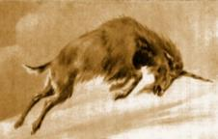
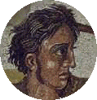
GREECE 11:3-4
Alexander the Great
Died at age 33 in 323 BC
No heirs
Kingdom divided among his 4 generals
Daniel 7:6, 8:5-8

Slide 14
Four Generals Daniel 7:6; 8:8, 22
Cassander Macedonia | Ptolemy Egypt
Lysimachus Thrace & Asia Minor | Seleucus Syria (including Israel)

Slide 15
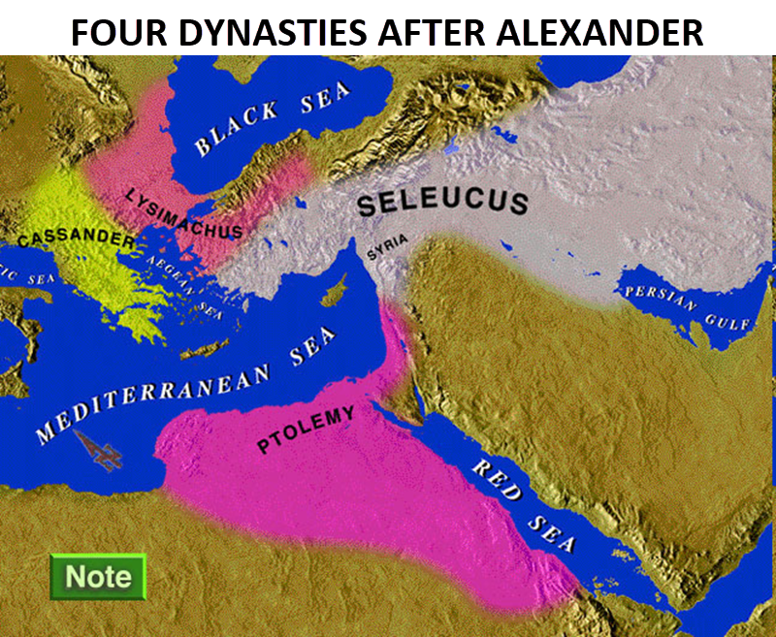

Slide 16
Four Generals Daniel 7:6; 8:8, 22
Cassander Macedonia | Ptolemy Egypt
Lysimachus Thrace & Asia Minor | Seleucus Syria (including Israel)

Slide 17
IV. The Prophecy of the Heavenly Messenger (11:2–12:13)
Persia (11:2)
Greece (11:3-4)
Ptolemies & Seleucids (11:5-20)
Antiochus (11:21-35)
Antichrist (11:36-45)
Tribulation & Millennium (12:1-13)

Slide 18
PTOLEMIES AND SELEUCIDS 11:5-20
History of warfare between the 2 dynasties
Ptolemies of Egypt vs. Seleucids of Syria
King of the South vs. King of the North
From 323 BC – 175 BC
The beautiful land = Israel
Cassander and Lysimachus not in view
Key transition in 198 B.C.
Selective and non-comprehensive history
What is at stake?

Slide 19
KINGS OF THE SOUTH (EGYPT) | KINGS OF THE NORTH (SYRIA)
Ptolemy I (Soter) 323–285 | Seleucus I (Nicator) 312–281
Ptolemy II (Philadelphus) 285–247 | Antiochus I (Soter) 281–261
Ptolemy III (Euregetus) 247–221 | Antiochus Theos 261–246
Ptolemy IV (Philopater) 221–220 | Seleucus Callinicus 246–226
Ptolemy V (Epiphanes) 203–182 | Seleucus III 226–223
 | Antiochus III (Great) 223–187
 | Seleucus IV (Philopater) 186–175
 | Antiochus IV (Epiphanes) 175–164
Paul N. Benware, Commentary on the Book of Daniel: The Coming Judgment of the Nations; Daniel's Prophecy of Things to Come (Clifton, TX: Scofield Ministries, 2007), 233.

Slide 20
Four Generals Daniel 7:6; 8:8, 22
Cassander Macedonia | Ptolemy Egypt
Lysimachus Thrace & Asia Minor | Seleucus Syria (including Israel)

Slide 21
Intertestamental Chronology (Dates BC)
SELEUCIDS
Seleucus I 312-281
Antiochus I 281-261
Antiochus II 261-246
Seleucus II 246-226
Seleucus III 226-223
Antiochus III 223-187
Seleucus IV Philapator 187-175
Antiochus IV Epiphanes 175-163

Slide 23
IV. The Prophecy of the Heavenly Messenger (11:2–12:13)
Persia (11:2)
Greece (11:3-4)
Ptolemies & Seleucids (11:5-20)
Antiochus IV (11:21-35)
Antichrist (11:36-45)
Tribulation & Millennium (12:1-13)

Slide 24
Daniel 11:21-35 Overview
Antiochus IV Epiphanes moves into center stage
He reigned for 10 years 175 – 164 B.C.
Daniel predictions 536 B.C. (Dan. 10:1)
Antiochus IV = “little horn” (Dan. 8:9-14, 23-25)
Goal of Hellenization & persecution of the Jews
Antiochus IV known for his hatred of the Jews
Antiochus IV will desecrate the Jewish Temple
Fulfilment recorded in 1 – 2 Maccabees
Antiochus IV = Antichrist’s prefigurement (Dan. 9:27; 11:36-45)

Slide 25
The Career of Antiochus IV Epiphanes Daniel 11:21-35
His rise to power (21)
His initial and general military successes (22-24)
His 1st military activities concerning Egypt & Israel (25-28)
His desecration of the Jewish Temple (29-31)
The reaction of Israel to the Temple’s desecration (32-25)

Slide 26
The Career of Antiochus IV Epiphanes Daniel 11:21-35
His rise to power (21)
His initial and general military successes (22-24)
His 1st military activities concerning Egypt & Israel (25-28)
His desecration of the Jewish Temple (29-31)
The reaction of Israel to the Temple’s desecration (32-25)

Slide 27
KINGS OF THE SOUTH (EGYPT) | KINGS OF THE NORTH (SYRIA)
Ptolemy I (Soter) 323–285 | Seleucus I (Nicator) 312–281
Ptolemy II (Philadelphus) 285–247 | Antiochus I (Soter) 281–261
Ptolemy III (Euregetus) 247–221 | Antiochus Theos 261–246
Ptolemy IV (Philopater) 221–220 | Seleucus Callinicus 246–226
Ptolemy V (Epiphanes) 203–182 | Seleucus III 226–223
 | Antiochus III (Great) 223–187
 | Seleucus IV (Philopater) 186–175
 | Antiochus IV (Epiphanes) 175–164
Paul N. Benware, Commentary on the Book of Daniel: The Coming Judgment of the Nations; Daniel's Prophecy of Things to Come (Clifton, TX: Scofield Ministries, 2007), 233.

Slide 28
Daniel 11:21
Death of Seleucus IV Philopater
Heir apparent Demetrius (son of Seleucus IV) sent to Rome
Antiochus IV Epiphanes rises to Syria’s throne
Not a “god-like” person but rather a “despicable person”
“Intrigue” and a lack of “honor” brought Antiochus IV to the throne
Paul N. Benware, Commentary on the Book of Daniel: The Coming Judgment of the Nations; Daniel's Prophecy of Things to Come (Clifton, TX: Scofield Ministries, 2007), 236-46.

Slide 29
The Career of Antiochus IV Epiphanes Daniel 11:21-35
His rise to power (21)
His initial and general military successes (22-24)
His 1st military activities concerning Egypt & Israel (25-28)
His desecration of the Jewish Temple (29-31)
The reaction of Israel to the Temple’s desecration (32-25)

Slide 30
Daniel 11:22
Initial military activities of Antiochus IV with his forces “overflowing” his opponents
Syrians already enjoyed control of the land of Israel
High Priest Onias III (“Prince of the Covenant”) disliked by Antiochus IV
Antiochus IV favored Jason (Onias III’s brother)
Antiochus IV pressures Israel to replace (“shatter”) Jason with Onias III
Paul N. Benware, Commentary on the Book of Daniel: The Coming Judgment of the Nations; Daniel's Prophecy of Things to Come (Clifton, TX: Scofield Ministries, 2007), 236-46.

Slide 33
KINGS OF THE SOUTH (EGYPT) | KINGS OF THE NORTH (SYRIA)
Ptolemy I (Soter) 323–285 | Seleucus I (Nicator) 312–281
Ptolemy II (Philadelphus) 285–247 | Antiochus I (Soter) 281–261
Ptolemy III (Euregetus) 247–221 | Antiochus Theos 261–246
Ptolemy IV (Philopater) 221–220 | Seleucus Callinicus 246–226
Ptolemy V (Epiphanes) 203–182 | Seleucus III 226–223
 | Antiochus III (Great) 223–187
 | Seleucus IV (Philopater) 186–175
 | Antiochus IV (Epiphanes) 175–164
Paul N. Benware, Commentary on the Book of Daniel: The Coming Judgment of the Nations; Daniel's Prophecy of Things to Come (Clifton, TX: Scofield Ministries, 2007), 233.

Slide 34
Daniel 11:22
Initial military activities of Antiochus IV with his forces “overflowing” his opponents
Syrians already enjoyed control of the land of Israel
High Priest Onias III (“Prince of the Covenant”) disliked by Antiochus IV
Antiochus IV favored Jason (Onias III’s brother)
Antiochus IV pressures Israel to replace (“shatter”) Jason with Onias III
Paul N. Benware, Commentary on the Book of Daniel: The Coming Judgment of the Nations; Daniel's Prophecy of Things to Come (Clifton, TX: Scofield Ministries, 2007), 236-46.

Slide 35
Daniel 11:23
“Alliance” between Antiochus IV & the new puppet High Priest Jason
Antiochus IV “practiced deception”
Antiochus IV gained power with a “small” group “of people”
Paul N. Benware, Commentary on the Book of Daniel: The Coming Judgment of the Nations; Daniel's Prophecy of Things to Come (Clifton, TX: Scofield Ministries, 2007), 236-46.

Slide 36
Daniel 11:24
Antiochus IV achieved power by any means possible including attacking others “in a time of tranquility”
Antiochus IV implemented a wealth redistribution strategy in order to win the favor of the under classes
His evil would be limited “only for a time”
Paul N. Benware, Commentary on the Book of Daniel: The Coming Judgment of the Nations; Daniel's Prophecy of Things to Come (Clifton, TX: Scofield Ministries, 2007), 236-46.

Slide 39
Daniel 11:24
Antiochus IV achieved power by any means possible including attacking others “in a time of tranquility”
Antiochus IV implemented a wealth redistribution strategy in order to win the favor of the under classes
His evil would be limited “only for a time”
Paul N. Benware, Commentary on the Book of Daniel: The Coming Judgment of the Nations; Daniel's Prophecy of Things to Come (Clifton, TX: Scofield Ministries, 2007), 236-46.

Slide 40
Conclusion

Slide 41
Chapter 10–12 Outline
The Setting (10:1-3)
Arrival of the Heavenly Messenger (10:4-9)
Explanation of the Heavenly Messenger (10:10–11:1)
The Prophecy of the Heavenly Messenger (11:2–12:13)

Slide 42
Purpose
To encourage Judah by emphasizing the sovereignty of God during the Babylonian captivity and to teach Judah how to live while outside the land

Slide 43
“The Lord bless you and keep you; the Lord make his face shine on you and be gracious to you; the Lord turn his face toward you and give you peace.” (NIV)

