Slide 1


Slide 2

The Coming Kingdom
Chapter 11
Dr. Andy Woods
Senior Pastor – Sugar Land Bible Church
President – Chafer Theological Seminary

Slide 3

Kingdom Study Outline
What does the Bible Say About the Kingdom?
The Main Problem with Kingdom Now NT interpretations
Why do some believe that we are in the kingdom now?
Why does it matter?

Slide 4
Kingdom Study Outline
What does the Bible Say About the Kingdom?
The Main Problem with Kingdom Now NT interpretations
Why do some believe that we are in the kingdom now?
Why does it matter?

Slide 5
1. Kingdom Throughout the Bible
Eden Abrahamic Covenant Mosaic Covenant Divided Kingdom Times of the Gentiles | Old Testament Prophets Post exile Offer of the King / Kingdom Rejection of the Offer Interim Age

Slide 6
1. Kingdom Throughout the Bible
Eden Abrahamic Covenant Mosaic Covenant Divided Kingdom Times of the Gentiles | Old Testament Prophets Post exile Offer of the King / Kingdom Rejection of the Offer Interim Age

Slide 7

THE INTERIM AGE
The Inter-advent Age (Matt. 13)
The Church Age (Matt. 16:18)

Slide 8
THE INTERIM AGE
The Inter-advent Age (Matt. 13)
The Church Age (Matt. 16:18)

Slide 9
Matthew 13 Parables
Public parables (13:1-2)
  Sower (13:1-9, 18-23)
  Wheat and tares (13:24-30, 36-43)
  Mustard seed (13:31-32)
  Leaven (13:33)
Private parables (13:36)
  Earthen treasure (13:44)
  Pearl of great price (13:45-46)
  Dragnet (13:47-50)
  Householder (13:51-52)

Slide 10
THE INTERIM AGE
The Inter-advent Age (Matt. 13)
The Church Age (Matt. 16:18)

Slide 11

The Church Age
The definition of the Church
The beginning of the Church
The purposes of the Church
The Church is not the Kingdom
The Church is not Israel

Slide 12
The Church Age
The definition of the Church
The beginning of the Church
The purposes of the Church
The Church is not the Kingdom
The Church is not Israel

Slide 13
1. The Definition of the Church
All (both Jew & Gentile) who have trusted in the very Messiah rejected by first-century national Israel (Gal. 3:28; Rom. 10:19; Eph. 2:14)
Intercalation
Does not fulfill Israel’s purposes

Slide 14
The Church Age
The definition of the Church
The beginning of the Church
The purposes of the Church
The Church is not the Kingdom
The Church is not Israel

Slide 15

2. When Did the Church Begin?
Christ referred to the Church in the future tense (Matt. 16:18)
Paul referred to the Church as a “mystery” (Eph. 3:4-5, 9)
The Church did not exist prior to Acts 1 since Christ became the head of the Church (Eph. 5:23) after His Ascension (Eph. 1:20-22)
The Church did not exist prior to Acts 1 since spiritual gifts (1 Cor. 12:7; 14:26) only came into existence after His Ascension (Eph. 4:7-11)

Slide 16
2. When Did the Church Begin?
The Church existed before Paul’s conversion in Acts 9 (Acts 5:11; 8:1,3; Rom. 16:7)
The Baptizing (joining, uniting, identifying) ministry of the Holy Spirit began in Acts 2
  1 Cor. 12:13
  Acts 1:5
  Acts 11:15-16
  Acts 2:1-4, 37-41

Slide 17
The Church Age
The definition of the Church
The beginning of the Church
The purposes of the Church
The Church is not the Kingdom
The Church is not Israel

Slide 18

3. Purposes of the Local Church
Glorify God (Eph 3:21)
Edify the saints (Eph 4:11-16)
Fulfill the Great Commission (Matt 28:18-20)

Slide 19
The Church Age
The definition of the Church
The beginning of the Church
The purposes of the Church
The Church is not the Kingdom
The Church is not Israel

Slide 20
4. Church ≠ Kingdom
Jesus Christ is never called the King of the Church
Jesus Christ’s relationship to His Church is never depicted through the King-Kingdom metaphor
Prolonged Church Age carnality
Church Age Gospel = believe (Acts 16:30-31)
Kingdom’s arrival is instantaneous (Dan. 2:44) while the Church's construction is gradual (Eph. 2:22)
Church = heir of the Kingdom (James 2:5)

Slide 21
4. Church ≠ Kingdom
Church suffers today (John 16:33)
Satanic influence on the Church (Ephes. 4:26-27)
The Times of the Gentiles continue
NT kingdom references predominantly future
Jesus Christ is never said to be ruling from David’s Throne now
Kingdom miracles (Isa. 35:5-6) are absent today (2 Tim. 4:20)
Kingdom prosperity (Amos 9:11-15) is absent today (Acts 11:28)

Slide 22
The Church Age
The definition of the Church
The beginning of the Church
The purposes of the Church
The Church is not the Kingdom
The Church is not Israel

Slide 23


Exodus 19:5-6
“Now then, if you will indeed obey My voice and keep My covenant, then you shall be My own possession among all the peoples, for all the earth is Mine; and you shall be to Me a kingdom of priests and a holy nation.’ These are the words that you shall speak to the sons of Israel.”

Slide 24
Deuteronomy 17:15
“you shall surely set a king over you whom the Lord your God chooses, one from among your countrymen you shall set as king over yourselves; you may not put a foreigner over yourselves who is not your countryman.”

Slide 25
Matthew 23:37-39 (NASB)
“Jerusalem, Jerusalem, who kills the prophets and stones those who are sent to her! How often I wanted to gather your children together, the way a hen gathers her chicks under her wings, and you were unwilling. ³⁸ Behold, your house is being left to you desolate! ³⁹ For I say to you, from now on you will not see Me until you say, ‘Blessed is He who comes in the name of the Lord!”

Slide 26
5. Discontinuity Between Israel & the Church
 | ISRAEL | CHURCH
Marriage | Wife | Bride
Christ | Birthed Christ | Birthed by Christ
Return | 2nd advent | Rapture
Leader | King | Head, Groom
Beginning | Gen 12 | Acts 2
Scripture | 4/5 | 1/5
Covenants | Parties | Beneficiaries
Nation | Political | Spiritual

Slide 27
5. Discontinuity Between Israel & the Church
 | ISRAEL | CHURCH
Marriage | Wife | Bride
Christ | Birthed Christ | Birthed by Christ
Return | 2nd advent | Rapture
Leader | King | Head, Groom
Beginning | Gen 12 | Acts 2
Scripture | 4/5 | 1/5
Covenants | Parties | Beneficiaries
Nation | Political | Spiritual

Slide 28


2 Cor. 11:2-3
Betrothal Period
“ For I am jealous for you with a godly jealousy; for I betrothed you to one husband, so that to Christ I might present you as a pure virgin. But I fear, lest somehow, as the serpent deceived Eve by his craftiness, so your minds may be corrupted by from the simplicity that is in Christ.”

Slide 29
5. Discontinuity Between Israel & the Church
 | ISRAEL | CHURCH
Marriage | Wife | Bride
Christ | Birthed Christ | Birthed by Christ
Return | 2nd advent | Rapture
Leader | King | Head, Groom
Beginning | Gen 12 | Acts 2
Scripture | 4/5 | 1/5
Covenants | Parties | Beneficiaries
Nation | Political | Spiritual

Slide 30

Matthew 16:18 (NASB)
I also say to you that you are Peter, and upon this rock I will build [oikodomeō] My church; and the gates of Hades will not overpower it.

Slide 31
5. Discontinuity Between Israel & the Church
 | ISRAEL | CHURCH
Marriage | Wife | Bride
Christ | Birthed Christ | Birthed by Christ
Return | 2nd advent | Rapture
Leader | King | Head, Groom
Beginning | Gen 12 | Acts 2
Scripture | 4/5 | 1/5
Covenants | Parties | Beneficiaries
Nation | Political | Spiritual

Slide 32
Matthew 23:37-39 (NASB)
“Jerusalem, Jerusalem, who kills the prophets and stones those who are sent to her! How often I wanted to gather your children together, the way a hen gathers her chicks under her wings, and you were unwilling. ³⁸ Behold, your house is being left to you desolate! ³⁹ For I say to you, from now on you will not see Me until you say, ‘Blessed is He who comes in the name of the Lord!”

Slide 33
5. Discontinuity Between Israel & the Church
 | ISRAEL | CHURCH
Marriage | Wife | Bride
Christ | Birthed Christ | Birthed by Christ
Return | 2nd advent | Rapture
Leader | King | Head, Groom
Beginning | Gen 12 | Acts 2
Scripture | 4/5 | 1/5
Covenants | Parties | Beneficiaries
Nation | Political | Spiritual

Slide 34
5. Discontinuity Between Israel & the Church
 | ISRAEL | CHURCH
Marriage | Wife | Bride
Christ | Birthed Christ | Birthed by Christ
Return | 2nd advent | Rapture
Leader | King | Head, Groom
Beginning | Gen 12 | Acts 2
Scripture | 4/5 | 1/5
Covenants | Parties | Beneficiaries
Nation | Political | Spiritual

Slide 35

Joshua 24:2-3

Slide 36
5. Discontinuity Between Israel & the Church
 | ISRAEL | CHURCH
Marriage | Wife | Bride
Christ | Birthed Christ | Birthed by Christ
Return | 2nd advent | Rapture
Leader | King | Head, Groom
Beginning | Gen 12 | Acts 2
Scripture | 4/5 | 1/5
Covenants | Parties | Beneficiaries
Nation | Political | Spiritual

Slide 37
5. Discontinuity Between Israel & the Church
 | ISRAEL | CHURCH
Marriage | Wife | Bride
Christ | Birthed Christ | Birthed by Christ
Return | 2nd advent | Rapture
Leader | King | Head, Groom
Beginning | Gen 12 | Acts 2
Scripture | 4/5 | 1/5
Covenants | Parties | Beneficiaries
Nation | Political | Spiritual

Slide 38


Slide 39
5. Discontinuity Between Israel & the Church
 | ISRAEL | CHURCH
Marriage | Wife | Bride
Christ | Birthed Christ | Birthed by Christ
Return | 2nd advent | Rapture
Leader | King | Head, Groom
Beginning | Gen 12 | Acts 2
Scripture | 4/5 | 1/5
Covenants | Parties | Beneficiaries
Nation | Political | Spiritual

Slide 40


Slide 41
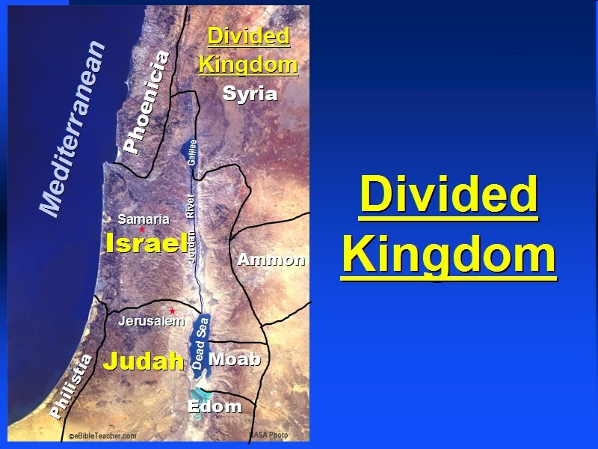

Slide 42

Romans 10:19 (NASB)
But I say, surely Israel did not know, did they? First Moses says, “I will make you jealous by that which is not a nation, By a nation without understanding will I anger you.”

Slide 43
Galatians 3:28 (NASB)
There is neither Jew nor Greek, there is neither slave nor free man, there is neither male nor female; for you are all one in Christ Jesus.

Slide 44
Ephesians 2:14 (NASB)
For He Himself is our peace, who made both groups into one and broke down the barrier of the dividing wall.

Slide 45
5. Discontinuity Between Israel & the Church
 | ISRAEL | CHURCH
Wars | Political | Spiritual
Timing | A quo / ad quem | No time indicators
Priesthood | Have a priesthood | Are a priesthood
Temple | Physical | Body
Resurrection | 1st resurrection | Rapture
Judgment | Earthly (Ezek. 20:33-44) | Heavenly (Bema)
New Jerusalem | Gates | Foundations
Entrance | Physical birth | Spiritual birth

Slide 46
5. Discontinuity Between Israel & the Church
 | ISRAEL | CHURCH
Wars | Political | Spiritual
Timing | A quo / ad quem | No time indicators
Priesthood | Have a priesthood | Are a priesthood
Temple | Physical | Body
Resurrection | 1st resurrection | Rapture
Judgment | Earthly (Ezek. 20:33-44) | Heavenly (Bema)
New Jerusalem | Gates | Foundations
Entrance | Physical birth | Spiritual birth

Slide 47


Slide 48
Levitical Feasts (23)
Feast | Season | Purpose | Type
Passover | Spring | Redemption | 1 Cor 5:7
Unleavened Bread | Spring | Separation | John 6:35
1st fruits | Spring | Praise | 1 Cor 15:20
Pentecost | Spring | Praise | Acts 2:1-4
Trumpets | Fall | New Year | Matt 24:31
Atonement | Fall | Lev 16 | Zech 12:10
Booths | Fall | Wilderness provision | Zech 14:16-18

Slide 49


Slide 50
5. Discontinuity Between Israel & the Church
 | ISRAEL | CHURCH
Wars | Political | Spiritual
Timing | A quo / ad quem | No time indicators
Priesthood | Have a priesthood | Are a priesthood
Temple | Physical | Body
Resurrection | 1st resurrection | Rapture
Judgment | Earthly (Ezek. 20:33-44) | Heavenly (Bema)
New Jerusalem | Gates | Foundations
Entrance | Physical birth | Spiritual birth

Slide 51
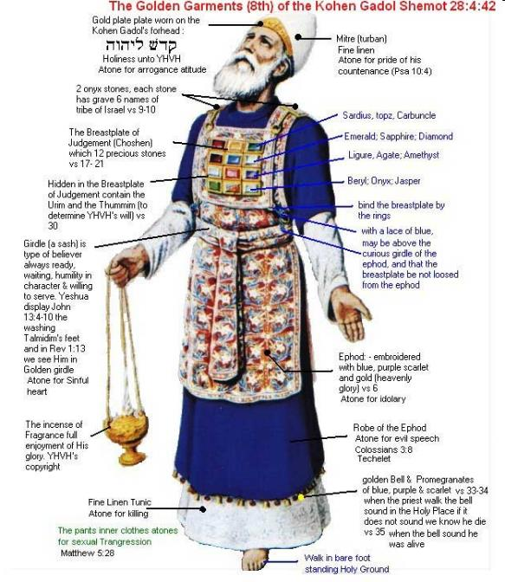

Slide 52
5. Discontinuity Between Israel & the Church
 | ISRAEL | CHURCH
Wars | Political | Spiritual
Timing | A quo / ad quem | No time indicators
Priesthood | Have a priesthood | Are a priesthood
Temple | Physical | Body
Resurrection | 1st resurrection | Rapture
Judgment | Earthly (Ezek. 20:33-44) | Heavenly (Bema)
New Jerusalem | Gates | Foundations
Entrance | Physical birth | Spiritual birth

Slide 53
ISRAEL’S FOUR TEMPLES
Solomon’s pre exilic temple (Kings and Chronicles)
Zerubbabel’s post exilic temple (Ezra 1-6; John 2:20)
Antichrist's temple (Dan 9:27; Matt 24:15; 2 Thess 2:4; Rev 11:1-2)
Millennial temple (Ezek 40-48)

Slide 54
5. Discontinuity Between Israel & the Church
 | ISRAEL | CHURCH
Wars | Political | Spiritual
Timing | A quo / ad quem | No time indicators
Priesthood | Have a priesthood | Are a priesthood
Temple | Physical | Body
Resurrection | 1st resurrection | Rapture
Judgment | Earthly (Ezek. 20:33-44) | Heavenly (Bema)
New Jerusalem | Gates | Foundations
Entrance | Physical birth | Spiritual birth

Slide 55
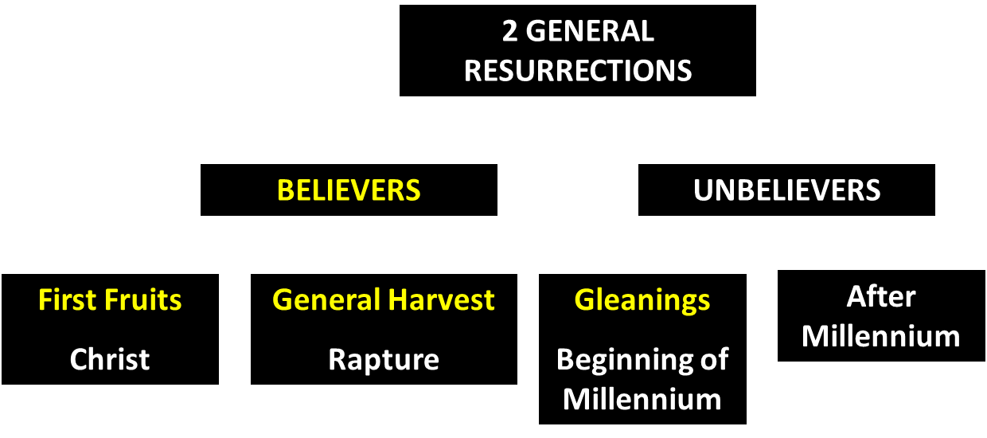
God’s Resurrection Program

Slide 56
5. Discontinuity Between Israel & the Church
 | ISRAEL | CHURCH
Wars | Political | Spiritual
Timing | A quo / ad quem | No time indicators
Priesthood | Have a priesthood | Are a priesthood
Temple | Physical | Body
Resurrection | 1st resurrection | Rapture
Judgment | Earthly (Ezek. 20:33-44) | Heavenly (Bema)
New Jerusalem | Gates | Foundations
Entrance | Physical birth | Spiritual birth

Slide 57
1 Corinthians 4:5 (NASB)
“ Therefore do not go on passing judgment before the time, but wait until the Lord comes who will both bring to light the things hidden in the darkness and disclose the motives of men’s hearts; and then each man’s praise will come to him from God.”

Slide 58
1 Thessalonians 4:17 (NASB)
“Then we who are alive and remain will be caught up together with them in the clouds to meet the Lord in the air, and so we shall always be with the Lord.”

Slide 59


Slide 60
5. Discontinuity Between Israel & the Church
 | ISRAEL | CHURCH
Wars | Political | Spiritual
Timing | A quo / ad quem | No time indicators
Priesthood | Have a priesthood | Are a priesthood
Temple | Physical | Body
Resurrection | 1st resurrection | Rapture
Judgment | Earthly (Ezek. 20:33-44) | Heavenly (Bema)
New Jerusalem | Gates | Foundations
Entrance | Physical birth | Spiritual birth

Slide 61
Jerusalem Descending
Notes:
The descending city is described as being like a stone called Jasper, only unlike the earthly stone, this one is clear as crystal. The ultimate state of heaven sounds more like a diamond, doesn’t it?

Slide 62
Revelation 21:16-17
¹⁶ The city was laid out like a square, as long as it was wide. He measured the city with the rod and found it to be [1500 miles] in length, and as wide and high as it is long. ¹⁷ He measured its wall and it was 144 cubits thick, by man's measurement, which the angel was using.
Notes:
READ…

Slide 63
The New Jerusalem

Slide 64
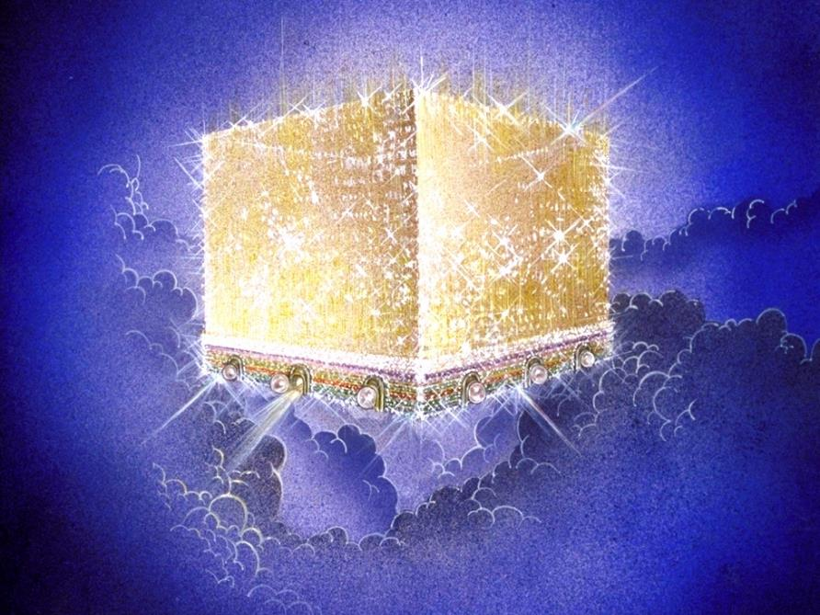
Notes:
Every city needs light. God, the ultimate source of power, illumines the city from his glory. Have you ever taken time to look at a sunset just after it has rained? As the sun sets, there is a kind of a glow cast on everything. It captures the spirit. This is just a little foretaste of the glory and splendor of heaven.

Slide 65
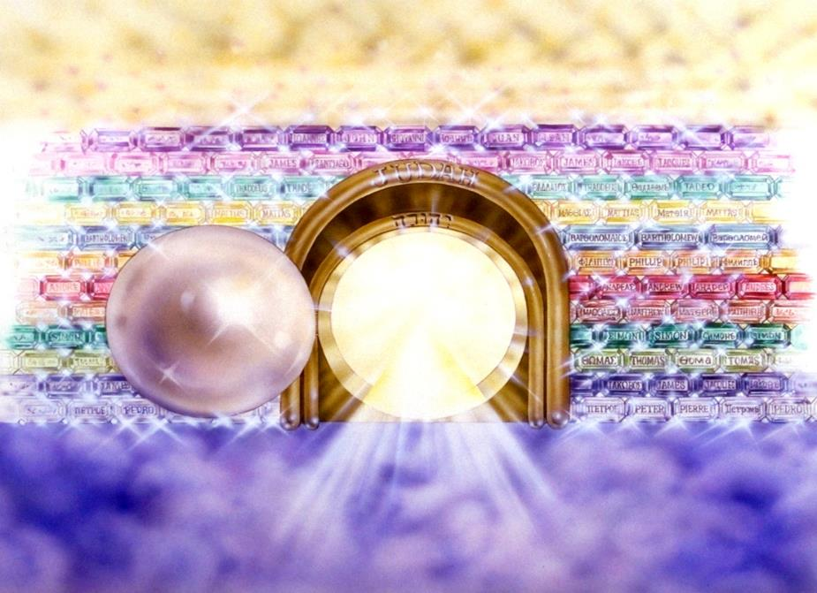
Notes:
Here you see an artist’s ideas of…
12 Gates = 12 Tribes of Israel
12 Foundation Stones = 12 Apostles of the Church

Slide 66
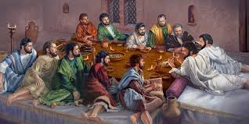
Ephesians 2:20 (NASB)
“having been built on the foundation of the apostles and prophets, Christ Jesus Himself being the corner stone.”

Slide 67
5. Discontinuity Between Israel & the Church
 | ISRAEL | CHURCH
Wars | Political | Spiritual
Timing | A quo / ad quem | No time indicators
Priesthood | Have a priesthood | Are a priesthood
Temple | Physical | Body
Resurrection | 1st resurrection | Rapture
Judgment | Earthly (Ezek. 20:33-44) | Heavenly (Bema)
New Jerusalem | Gates | Foundations
Entrance | Physical birth | Spiritual birth

Slide 68
5. Discontinuity Between Israel & the Church
 | ISRAEL | CHURCH
Governing principle | Law | NT
Relation to HS | Selective, temporary, subsequent | Universal, permanent, at moment of salvation
Farewell address | Olivet Discourse | Upper Room Discourse
Designation | First Born Son | Bride of Christ
Revealed in OT | Yes | No
Evangelism | Come & See | Go & Proclaim
Blessings | Earthly | Heavenly
Composition | Believers & Unbelievers | Believers Only

Slide 69
5. Discontinuity Between Israel & the Church
 | ISRAEL | CHURCH
Governing principle | Law | NT
Relation to HS | Selective, temporary, subsequent | Universal, permanent, at moment of salvation
Farewell address | Olivet Discourse | Upper Room Discourse
Designation | First Born Son | Bride of Christ
Revealed in OT | Yes | No
Evangelism | Come & See | Go & Proclaim
Blessings | Earthly | Heavenly
Composition | Believers & Unbelievers | Believers Only

Slide 70
Psalm 147:19-20
“He declares His words to Jacob, His statutes and His ordinances to Israel. He has not dealt thus with any nation; And as for His ordinances, they have not known them. Praise the Lord!”

Slide 71
Six Parts of a Suzerain-Vassal Treaty in Deuteronomy
Preamble (1:1-5)
Prologue (1:6–4:40)
Covenant obligations (5–26)
Storage and reading instructions (27:2-3; 31:9, 24, 26)
Witnesses (32:1)
Blessings and curses (28)

Slide 72
Six Parts of a Suzerain-Vassal Treaty in Deuteronomy
Preamble (1:1-5)
Prologue (1:6–4:40)
Covenant obligations (5–26)
Storage and reading instructions (27:2-3; 31:9, 24, 26)
Witnesses (32:1)
Blessings and curses (28)

Slide 73
5. Discontinuity Between Israel & the Church
 | ISRAEL | CHURCH
Governing principle | Law | NT
Relation to HS | Selective, temporary, subsequent | Universal, permanent, at moment of salvation
Farewell address | Olivet Discourse | Upper Room Discourse
Designation | First Born Son | Bride of Christ
Revealed in OT | Yes | No
Evangelism | Come & See | Go & Proclaim
Blessings | Earthly | Heavenly
Composition | Believers & Unbelievers | Believers Only

Slide 74
Work of the Spirit in the OT vs. Church Age
 | OT/Gospels | Today
Reception of all of the Spirit at the moment of salvation? | Subsequent to salvation (Exod 31:3) | At moment of salvation (Rom 8:9)
How long is the indwelling? | Temporary indwelling (1 Sam 16:14; Ps 51:11) | Permanent indwelling (John 14:16)
Who is indwelt? | Selective indwelling (Joel 2:28) | Universal indwelling (1 Cor 12:13)

Slide 75
Work of the Spirit in the OT & Gospels
Pattern of Holy Spirit’s present work is not found in the OT or Gospels
  John 7:37-39
  John 14:16-17
  Acts 1:5

Slide 76
5. Discontinuity Between Israel & the Church
 | ISRAEL | CHURCH
Governing principle | Law | NT
Relation to HS | Selective, temporary, subsequent | Universal, permanent, at moment of salvation
Farewell address | Olivet Discourse | Upper Room Discourse
Designation | First Born Son | Bride of Christ
Revealed in OT | Yes | No
Evangelism | Come & See | Go & Proclaim
Blessings | Earthly | Heavenly
Composition | Believers & Unbelievers | Believers Only

Slide 77
Discourse
 | OLIVET | UPPER ROOM
SCRIPTURE | Matt 24─25 | John 13─17
LOCATION | Mount of Olives | Upper Room
PASSION WEEK | Third day | Sixth day
GENERAL FOCUS | Farewell: Israel | Hello: Church
SPECIFIC FOCUS | Israel’s future | Divine provisions
PROMPTING | Temple's destruction | Christ's imminent departure
EXPLANATIONS | Written OT | Unwritten NT

Slide 78
5. Discontinuity Between Israel & the Church
 | ISRAEL | CHURCH
Governing principle | Law | NT
Relation to HS | Selective, temporary, subsequent | Universal, permanent, at moment of salvation
Farewell address | Olivet Discourse | Upper Room Discourse
Designation | First Born Son | Bride of Christ
Revealed in OT | Yes | No
Evangelism | Come & See | Go & Proclaim
Blessings | Earthly | Heavenly
Composition | Believers & Unbelievers | Believers Only

Slide 79
5. Discontinuity Between Israel & the Church
 | ISRAEL | CHURCH
Governing principle | Law | NT
Relation to HS | Selective, temporary, subsequent | Universal, permanent, at moment of salvation
Farewell address | Olivet Discourse | Upper Room Discourse
Designation | First Born Son | Bride of Christ
Revealed in OT | Yes | No
Evangelism | Come & See | Go & Proclaim
Blessings | Earthly | Heavenly
Composition | Believers & Unbelievers | Believers Only

Slide 80
Matthew 16:18 (NASB)
I also say to you that you are Peter, and upon this rock I will build [oikodomeō] My church; and the gates of Hades will not overpower it.

Slide 81

Ephesians 3:3-6 (NASB)
“that by revelation there was made known to me the mystery, as I wrote before in brief. ⁴ By referring to this, when you read you can understand my insight into the mystery of Christ, ⁵ which in other generations was not made known to the sons of men, as it has now been revealed to His holy apostles and prophets in the Spirit; ⁶ to be specific, that the Gentiles are fellow heirs and fellow members of the body, and fellow partakers of the promise in Christ Jesus through the gospel”.

Slide 82
Ephesians 3:9 (NASB)
“and to bring to light what is the administration of the mystery which for ages has been hidden in God who created all things.”

Slide 83
“Mystery” Defined
“In the N.T, it [mystērion] denotes, not the mysterious (as with the Eng. word), but that which, being outside the range of unassisted natural apprehension, can be made known only by Divine revelation, and is made known in a manner and at a time appointed by God, and to those who are illumined by His Spirit.”
W. E. Vine, Merrill F. Unger, and William White, Vine's Complete Expository Dictionary of the Old and New Testament Words (Nashville: Nelson, 1996), 424.

Slide 84
Colossians 1:26 (NASB)
“that is, the mystery which has been hidden from the past ages and generations, but has now been manifested to His.”

Slide 85
5. Discontinuity Between Israel & the Church
 | ISRAEL | CHURCH
Governing principle | Law | NT
Relation to HS | Selective, temporary, subsequent | Universal, permanent, at moment of salvation
Farewell address | Olivet Discourse | Upper Room Discourse
Designation | First Born Son | Bride of Christ
Revealed in OT | Yes | No
Evangelism | Come & See | Go & Proclaim
Blessings | Earthly | Heavenly
Composition | Believers & Unbelievers | Believers Only

Slide 86
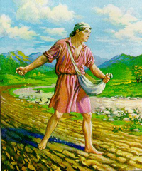
Matthew 13:3 (NASB)
“And He spoke many things to them in parables, saying, “Behold, the sower went out to sow.”

Slide 87
The Prophetic Parables of
Matthew Thirteen - A. W. Pink
“The words ‘went forth to sow,’ or as Mark’s Gospel puts it ‘went out’ were indicative of the great dispensational change which was soon to be introduced. There was no longer to be a planting of vines or fig-trees in Israel, but a going out of the mercy of God unto the Gentiles; therefore what we have here is the broadcast sowing of the Seed in the field at large, for as verse 38 tells us ‘the field is the world.’”
A. W. Pink (2005). The Prophetic Parables of Matthew Thirteen. Bellingham, WA: Logos Bible Software.

Slide 88
5. Discontinuity Between Israel & the Church
 | ISRAEL | CHURCH
Governing principle | Law | NT
Relation to HS | Selective, temporary, subsequent | Universal, permanent, at moment of salvation
Farewell address | Olivet Discourse | Upper Room Discourse
Designation | First Born Son | Bride of Christ
Revealed in OT | Yes | No
Evangelism | Come & See | Go & Proclaim
Blessings | Earthly | Heavenly
Composition | Believers & Unbelievers | Believers Only

Slide 89
Ephesians 1:3 (NASB)
“Blessed be the God and Father of our Lord Jesus Christ, who has blessed us with every spiritual blessing in the heavenly places in Christ.”

Slide 90
Revelation 2:9 (NASB)
“I know your tribulation and your poverty (but you are rich), and the blasphemy by those who say they are Jews and are not, but are a synagogue of Satan.”

Slide 91
5. Discontinuity Between Israel & the Church
 | ISRAEL | CHURCH
Governing principle | Law | NT
Relation to HS | Selective, temporary, subsequent | Universal, permanent, at moment of salvation
Farewell address | Olivet Discourse | Upper Room Discourse
Designation | First Born Son | Bride of Christ
Revealed in OT | Yes | No
Evangelism | Come & See | Go & Proclaim
Blessings | Earthly | Heavenly
Composition | Believers & Unbelievers | Believers Only

Slide 92
1 Corinthians 3:1-3 (NKJV)
¹ And I, brethren, could not speak to you as to spiritual people but as to carnal, as to babes in Christ. ² I fed you with milk and not with solid food; for until now you were not able to receive it, and even now you are still not able; ³ for you are still carnal. For where there are envy, strife, and divisions among you, are you not carnal and behaving like mere men?

Slide 93

Notes:
Ray Steadman – “1st Californians”
Unbelievers vs Categories of Believers
Unbelievers – ψυχικός psuchikós; Natural, pertaining to the natural as distinguished from the spiritual
Spiritual Believers – πνευματικός pneumatikós; of persons who are spiritual, enlightened by the Holy Spirit
Infant Believers – σάρκινος sárkinos; with propensities of the flesh unto sin; νήπιος nḗpios; an infant, child, baby without any definite limitation of age. (This relates to immaturity and lack of instruction)
Carnal Believers – σαρκικός sarkikós; tendency to satisfy the flesh, implying sinfulness, sinful propensity, carnal (This relates to disobedience and open rebellion)

Slide 94
Conclusion

Slide 95
5. Discontinuity Between Israel & the Church
 | ISRAEL | CHURCH
Marriage | Wife | Bride
Christ | Birthed Christ | Birthed by Christ
Return | 2nd advent | Rapture
Leader | King | Head, Groom
Beginning | Gen 12 | Acts 2
Scripture | 4/5 | 1/5
Covenants | Parties | Beneficiaries
Nation | Political | Spiritual

Slide 96
5. Discontinuity Between Israel & the Church
 | ISRAEL | CHURCH
Wars | Political | Spiritual
Timing | A quo / ad quem | No time indicators
Priesthood | Have a priesthood | Are a priesthood
Temple | Physical | Body
Resurrection | 1st resurrection | Rapture
Judgment | Earthly (Ezek. 20:33-44) | Heavenly (Bema)
New Jerusalem | Gates | Foundations
Entrance | Physical birth | Spiritual birth

Slide 97
5. Discontinuity Between Israel & the Church
 | ISRAEL | CHURCH
Governing principle | Law | NT
Relation to HS | Selective, temporary, subsequent | Universal, permanent, at moment of salvation
Farewell address | Olivet Discourse | Upper Room Discourse
Designation | First Born Son | Bride of Christ
Revealed in OT | Yes | No
Evangelism | Come & See | Go & Proclaim
Blessings | Earthly | Heavenly
Composition | Believers & Unbelievers | Believers Only

Slide 98
Ephesians 3:10 (NASB)
“so that the manifold wisdom of God might now be made known through the church to the rulers and the authorities in the heavenly places.”

Slide 99
THE INTERIM AGE
The Inter-advent Age (Matt. 13)
The Church Age (Matt. 16:18)

Slide 100
The Church Age
The definition of the Church
The beginning of the Church
The purposes of the Church
The Church is not the Kingdom
The Church is not Israel

