Slide 1

THE BOOK OF DANIEL
Dr. Andy Woods

Slide 2

Message
Times of the Gentiles are revealed prophetically (2, 7, 8-12) and ethically (1, 3-6)

Slide 3

Purpose
To encourage Judah by emphasizing the sovereignty of God during the Babylonian captivity and to teach Judah how to live while outside the land

Slide 4
Synthetic Outline
Historical (1-7):
  Daniel interprets, 3rd person, gentile nations
  Intro “Hebrew” (1)
  Aramaic chiasm (2-7)

Slide 5
Synthetic Outline
Historical (1-7):
  Daniel interprets, 3rd person, gentile nations
  Intro “Hebrew” (1)
  Aramaic chiasm (2-7)

Slide 6
Synthetic Outline
Historical (1-7):
  Daniel interprets, 3rd person, gentile nations
  Intro “Hebrew” (1)
  Aramaic chiasm (2-7)

Slide 7

Synthetic Outline
  Chiasm “Aramaic” ( 2-7)
1. Gentile History (2)
  2. Protection (3)
    3. Revelation to a gentile king (4)
    3. Revelation to a gentile king (5)
  2. Protection (6)
1. Gentile history (7)

Slide 8
Synthetic Outline
Prophetic (8-12):
  Angel interprets, 1st person, Jewish nation, Hebrew
  Ram & Goat (8)
  70 weeks (9)
  Final vision (10-12)

Slide 9
Synthetic Outline
Prophetic (8-12):
  Angel interprets, 1st person, Jewish nation, Hebrew
  Ram & Goat (8)
  70 weeks (9)
  Final vision (10-12)

Slide 10
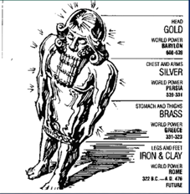
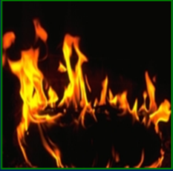
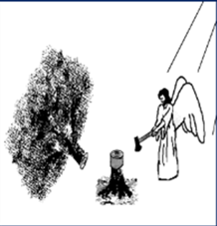

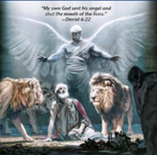
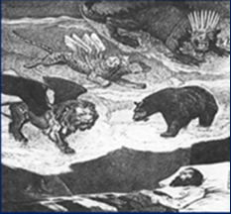
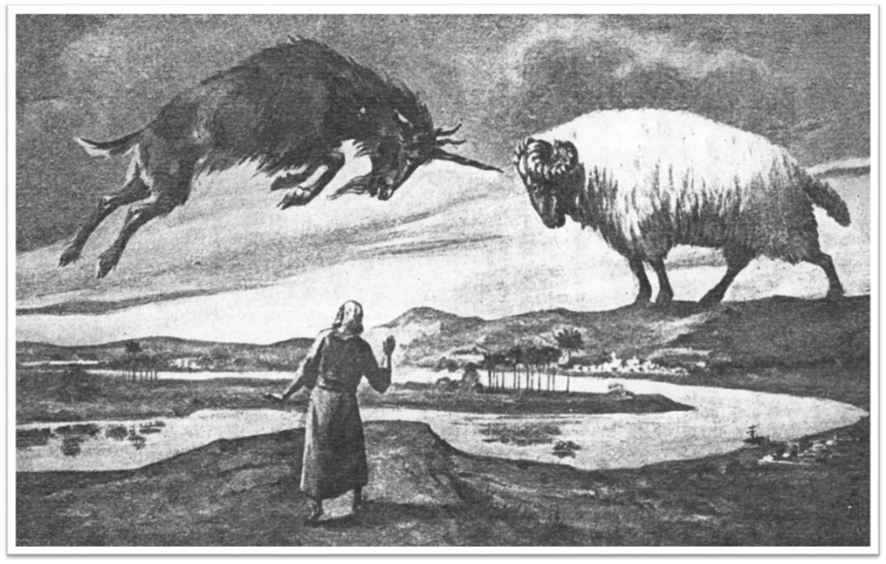
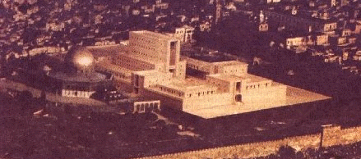
CHAPTER REVIEW
Chapter 2 | Chapter 3 | Chapter 4 | Chapter 5
Chapter 6 | Chapter 7 | Chapter 8 | Chapter 9

Slide 11
Chapter 10–12 Outline
The Setting (10:1-3)
Arrival of the Heavenly Messenger (10:4-9)
Explanation of the Heavenly Messenger (10:1–11:1)
The Prophecy of the Heavenly Messenger (11:2–12:13)

Slide 12
Chapter 10–12 Outline
The Setting (10:1-3)
Arrival of the Heavenly Messenger (10:4-9)
Explanation of the Heavenly Messenger (10:1–11:1)
The Prophecy of the Heavenly Messenger (11:2–12:13)

Slide 13

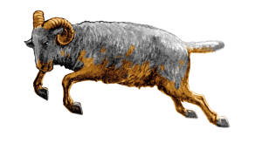
I. The Setting (10:1-3)
Historically (v. 1)
  Cyrus of Persia
  Third year of Cyrus
Personally (v. 2-3)

Slide 14
I. The Setting (10:1-3)
Historically (v. 1)
  Cyrus of Persia
  Third year of Cyrus
Personally (v. 2-3)

Slide 15
I. The Setting (10:1-3)
Historically (v. 1)
  Cyrus of Persia
  Third year of Cyrus
Personally (v. 2-3)

Slide 16
Succession of Gentile Rulers
1-4: Nebuchadnezzar of Babylon
5: Belshazzar of Babylon
6: Darius of Media – Persia
7-8: Belshazzar of Babylon
9: Darius of Media – Persia
10-12: Cyrus of Media – Persia

Slide 17
Succession of Gentile Rulers
1-4: Nebuchadnezzar of Babylon
5: Belshazzar of Babylon
6: Darius of Media – Persia
7-8: Belshazzar of Babylon
9: Darius of Media – Persia
10-12: Cyrus of Media – Persia

Slide 18

I. The Setting (10:1-3)
Historically (v. 1)
  Cyrus of Persia
  Third year of Cyrus
Personally (v. 2-3)

Slide 19
CHAPTER AND VERSE IN DANIEL | CHRONOLOGICAL DATE | BIBLICAL DATE
1:1 | 605 | 3rd year of Jehoiakim
2:1 | 603 | 2nd year of Nebuchadnezzar
5 | Sat. night 10/12/539 (Hoehner)
7:1 | 553 | 1st year of Belshazzar
8:1 | 551 | 3rd year of Belshazzar
9:1 | 538 | 1st year of Darius
10:1 | 536 | 3rd year of Cyrus

Slide 20
CHAPTER AND VERSE IN DANIEL | CHRONOLOGICAL DATE | BIBLICAL DATE
1:1 | 605 | 3rd year of Jehoiakim
2:1 | 603 | 2nd year of Nebuchadnezzar
5 | Sat. night 10/12/539 (Hoehner)
7:1 | 553 | 1st year of Belshazzar
8:1 | 551 | 3rd year of Belshazzar
9:1 | 538 | 1st year of Darius
10:1 | 536 | 3rd year of Cyrus

Slide 21
Daniel’s Age
CHAPTER | EVENTS | AGE
1 | Taken to Babylonian captivity | 15
2 | Interpreting Nebuchadnezzar’s 1st dream (huge image) | 17
3 | Daniel’s 3 friends cast into the fiery furnace | 19 or 20
4 | Interpreting Nebuchadnezzar’s 2nd dream (huge tree) | 45-50
5 | Interpreting handwriting of the wall at Belshazzar’s feast | Early 80’s
6 | Delivered from the den of lions | c.83
7-8 | Daniel’s visions and dreams | Mid-60’s
9 | Daniel’s seventy “sevens” prophecy | Early-80’s
10-12 | Final dreams and visions | Mid-80’s

Slide 22
Daniel’s Age
CHAPTER | EVENTS | AGE
1 | Taken to Babylonian captivity | 15
2 | Interpreting Nebuchadnezzar’s 1st dream (huge image) | 17
3 | Daniel’s 3 friends cast into the fiery furnace | 19 or 20
4 | Interpreting Nebuchadnezzar’s 2nd dream (huge tree) | 45-50
5 | Interpreting handwriting of the wall at Belshazzar’s feast | Early 80’s
6 | Delivered from the den of lions | c.83
7-8 | Daniel’s visions and dreams | Mid-60’s
9 | Daniel’s seventy “sevens” prophecy | Early-80’s
10-12 | Final dreams and visions | Mid-80’s

Slide 23
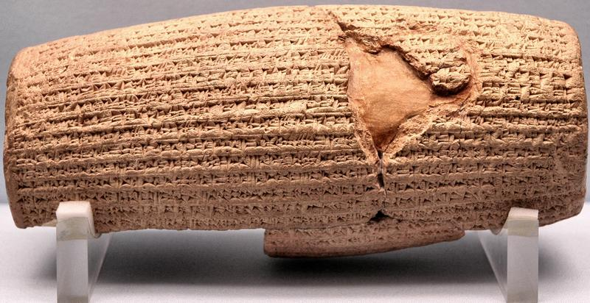
Cyrus Cylinder

Slide 24
Three Returns
 | Date | Duration | Persian king | Jewish leader | Scripture | Purpose | Number of returnees
1st return | 538–515 B.C. | 23 years | Cyrus (Isa 44:28‒45:1) | Zerubbabel | Ezra 1–6; Isaiah 44:28 | Rebuilding the temple | 50,000
2nd return | 458–457 B.C. | 2 years | Artaxerxes | Ezra | Ezra 7–10 | Adorning of the temple and reforming the people | 2,000
3rd return | 444–432 B.C. | 8 years | Artaxerxes | Nehemiah | Nehemiah | Rebuilding the wall

Slide 25
NEBUCHADNEZZAR’S 3 SIEGES OF JUDAH
 | 1 | 2 | 3
Year | 605 | 597 | 586
Scripture | 2 Kings 24:1; Dan.1:1 | 2 Kings 24:10-16; Ezek. 1:1-2 | 2 Kings 25:1-2, Ezek 33:21
Judah’s king | Jehoiakim | Jehoiachin | Zedekiah
Those taken | Daniel & some princes | Ezekiel & majority 10k | Remnant captured, Jerusalem & Temple destroyed

Slide 26

Matthew 24:15
“Therefore when you see the abomination of desolation which was spoken of through Daniel the prophet, standing in the holy place (let the reader understand).”

Slide 27
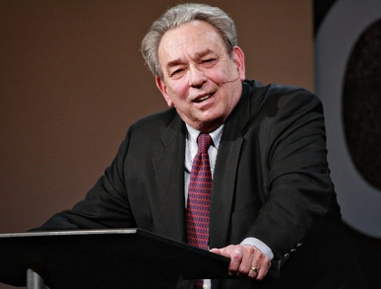
R.C. Sproul
Knowing Scripture (Downers Grove, IL: InterVarsity Press, 1977), 15-17.
The reformers had “total confidence in what is called the perspicuity of Scripture...the clarity of Scripture. They maintained that the Bible is basically clear and lucid. It is simple enough for any literate person to understand its basic message…What kind of God would reveal his love and redemption in terms so technical and concepts so profound that only an elite corps of professional scholars could understand them?…”

Slide 28
R.C. Sproul
Knowing Scripture (Downers Grove, IL: InterVarsity Press, 1977), 15-17.
“Biblical Christianity is not so esoteric a religion. Its content is not concealed in vague symbols that require some sort of special ‘insight’ to grasp. There is no special prowess or pneumatic gift that is necessary to understand the basic message of Scripture…The Bible speaks of God in meaningful patterns of speech. Some of those patterns my be more difficult than others, but they are not meant to be nonsense statements that only a guru can fathom.”

Slide 29
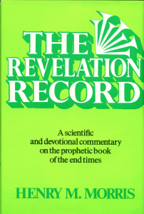
Morris
The Revelation Record, 323
“At the very least, it would be confusing to John’s first century readers, as well as to later generations, for him to write so much about Babylon when he really meant Rome (Paul was not afraid to speak directly against Rome in his writings, so why should John be?) or ‘the false church’ (all the apostles , including John, wrote plainly and scathingly about false teachers and false doctrines in the church and would not hide their teachings by symbols). It must be stressed that Revelation means “unveiling,” not “veiling.” In the absence of any statement in the text to the contrary, therefore, we must assume that the term Babylon applies to the real city of Babylon…”

Slide 30
Matthew 24:15
“Therefore when you see the abomination of desolation which was spoken of through Daniel the prophet, standing in the holy place (let the reader understand).”

Slide 31
I. The Setting (10:1-3)
Historically (v. 1)
  Cyrus of Persia
  Third year of Cyrus
Personally (v. 2-3)

Slide 32
Chapter 10–12 Outline
The Setting (10:1-3)
Arrival of the Heavenly Messenger (10:4-9)
Explanation of the Heavenly Messenger (10:1–11:1)
The Prophecy of the Heavenly Messenger (11:2–12:13)

Slide 33
II. Arrival of the Heavenly Messenger (10:4-9)
His description (v. 4-6)
Response (v. 7-9)
  Daniel’s friends (7)
  Daniel (8-9)

Slide 34
II. Arrival of the Heavenly Messenger (10:4-9)
His description (v. 4-6)
Response (v. 7-9)
  Daniel’s friends (7)
  Daniel (8-9)

Slide 35


Slide 36
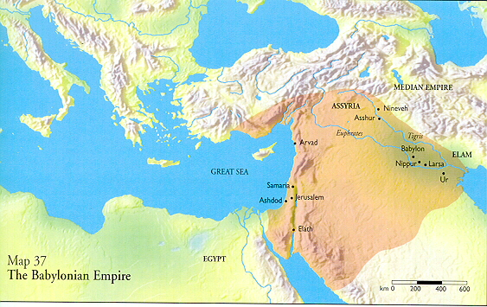

Slide 37
II. Arrival of the Heavenly Messenger (10:4-9)
His description (v. 4-6)
Response (v. 7-9)
  Daniel’s friends (7)
  Daniel (8-9)

Slide 38
II. Arrival of the Heavenly Messenger (10:4-9)
His description (v. 4-6)
Response (v. 7-9)
  Daniel’s friends (7)
  Daniel (8-9)

Slide 39
II. Arrival of the Heavenly Messenger (10:4-9)
His description (v. 4-6)
Response (v. 7-9)
  Daniel’s friends (7)
  Daniel (8-9)

Slide 40
Chapter 10–12 Outline
The Setting (10:1-3)
Arrival of the Heavenly Messenger (10:4-9)
Explanation of the Heavenly Messenger (10:1–11:1)
The Prophecy of the Heavenly Messenger (11:2–12:13)

Slide 41
III. Explanation of the Heavenly Messenger (10:10–11:1)
Explanation of His Delay (10:10-13)
Explanation of His Visit (10:14–11:1)
  Purpose of his visit (10:14)
  Daniel's reaction (10:15-19)
  Continuing spiritual warfare (10:20–11:1)

Slide 42
III. Explanation of the Heavenly Messenger (10:10–11:1)
Explanation of His Delay (10:10-13)
Explanation of His Visit (10:14–11:1)
  Purpose of his visit (10:14)
  Daniel's reaction (10:15-19)
  Continuing spiritual warfare (10:20–11:1)

Slide 43


Genesis 12:3
“And I will bless those who bless you, And the one who curses you I will curse. And in you all the families of the earth will be blessed.”

Slide 44
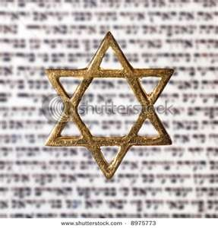
Israel’s Three Blessings to the World
(Gen 12:3b)
Scripture (Rom 3:2)
Savior (John 4:22)
Kingdom (Isa 2:2-3)

Slide 45
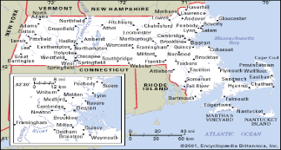
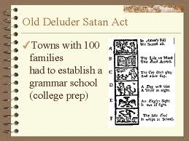
Old Satan Deluder Law: 1642 Massachusetts
Church of the Holy Trinity v. U.S., 143 U.S. 457, 467 (1892)
“It being one chief project of that old deluder, Satan, to keep men from the knowledge of the Scriptures, as in former time…It is therefore ordered…that after the Lord hath increased the settlement…they shall…appoint one within their town, to teach all such children to read…they shall set up a grammar school to instruct youths…”

Slide 46
III. Explanation of the Heavenly Messenger (10:10–11:1)
Explanation of His Delay (10:10-13)
Explanation of His Visit (10:14–11:1)
  Purpose of his visit (10:14)
  Daniel's reaction (10:15-19)
  Continuing spiritual warfare (10:20–11:1)

Slide 47
III. Explanation of the Heavenly Messenger (10:10–11:1)
Explanation of His Delay (10:10-13)
Explanation of His Visit (10:14–11:1)
  Purpose of his visit (10:14)
  Daniel's reaction (10:15-19)
  Continuing spiritual warfare (10:20–11:1)

Slide 48
III. Explanation of the Heavenly Messenger (10:10–11:1)
Explanation of His Delay (10:10-13)
Explanation of His Visit (10:14–11:1)
  Purpose of his visit (10:14)
  Daniel's reaction (10:15-19)
  Continuing spiritual warfare (10:20–11:1)

Slide 49
2. Daniel’s Reaction (15-19)
Problem (v.15-17)
Solution (v.18-19)

Slide 50
2. Daniel’s Reaction (15-19)
Problem (v.15-17)
Solution (v.18-19)

Slide 51
2. Daniel’s Reaction (15-19)
Problem (v.15-17)
Solution (v.18-19)

Slide 52
III. Explanation of the Heavenly Messenger (10:10–11:1)
Explanation of His Delay (10:10-13)
Explanation of His Visit (10:14–11:1)
  Purpose of his visit (10:14)
  Daniel's reaction (10:15-19)
  Continuing spiritual warfare (10:20–11:1)

Slide 53

CHART1

Slide 54
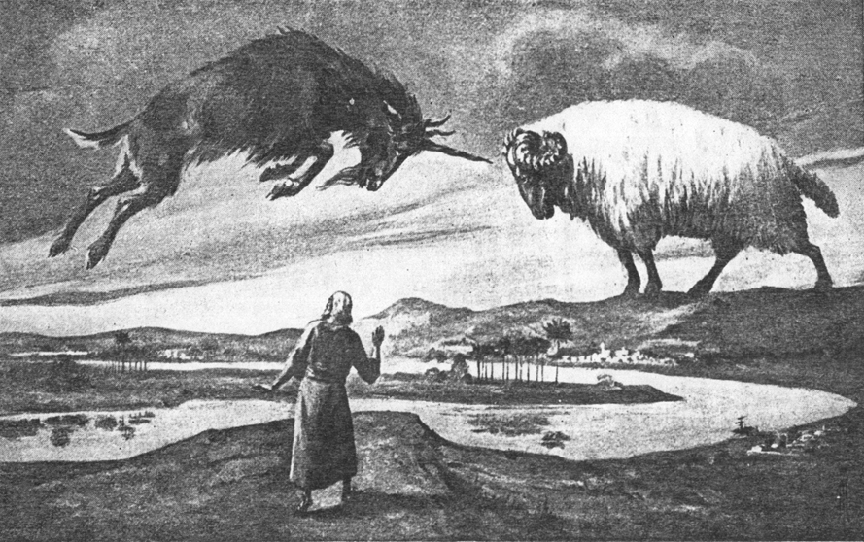
CHAPTER 8

Slide 55
Daniel 8:20-21 (NASB)
“The ram which you saw with the two horns represents the kings of Media and Persia. ²¹ The shaggy goat represents the kingdom of Greece, and the large horn that is between his eyes is the first king.”

Slide 56
Chapter 10–12 Outline
The Setting (10:1-3)
Arrival of the Heavenly Messenger (10:4-9)
Explanation of the Heavenly Messenger (10:1–11:1)
The Prophecy of the Heavenly Messenger (11:2–12:13)

Slide 57
IV. The Prophecy of the Heavenly Messenger (11:2–12:13)
Persia (11:2)
Greece (11:3-4)
Ptolemies & Seleucids (11:5-20)
Antiochus (11:21-35)
Antichrist (11:36-45)
Tribulation & Millennium (12:1-13)

Slide 58
IV. The Prophecy of the Heavenly Messenger (11:2–12:13)
Persia (11:2)
Greece (11:3-4)
Ptolemies & Seleucids (11:5-20)
Antiochus (11:21-35)
Antichrist (11:36-45)
Tribulation & Millennium (12:1-13)

Slide 59
IV. The Prophecy of the Heavenly Messenger (11:2–12:13)
Persia (11:2)
Greece (11:3-4)
Ptolemies & Seleucids (11:5-20)
Antiochus (11:21-35)
Antichrist (11:36-45)
Tribulation & Millennium (12:1-13)

Slide 60
IV. The Prophecy of the Heavenly Messenger (11:2–12:13)
Persia (11:2)
Greece (11:3-4)
Ptolemies & Seleucids (11:5-20)
Antiochus (11:21-35)
Antichrist (11:36-45)
Tribulation & Millennium (12:1-13)

Slide 61
IV. The Prophecy of the Heavenly Messenger (11:2–12:13)
Persia (11:2)
Greece (11:3-4)
Ptolemies & Seleucids (11:5-20)
Antiochus (11:21-35)
Antichrist (11:36-45)
Tribulation & Millennium (12:1-13)

Slide 62
IV. The Prophecy of the Heavenly Messenger (11:2–12:13)
Persia (11:2)
Greece (11:3-4)
Ptolemies & Seleucids (11:5-20)
Antiochus (11:21-35)
Antichrist (11:36-45)
Tribulation & Millennium (12:1-13)

Slide 63
IV. The Prophecy of the Heavenly Messenger (11:2–12:13)
Persia (11:2)
Greece (11:3-4)
Ptolemies & Seleucids (11:5-20)
Antiochus (11:21-35)
Antichrist (11:36-45)
Tribulation & Millennium (12:1-13)

Slide 64
Conclusion

Slide 65
Chapter 10–12 Outline
The Setting (10:1-3)
Arrival of the Heavenly Messenger (10:4-9)
Explanation of the Heavenly Messenger (10:1–11:1)
The Prophecy of the Heavenly Messenger (11:2–12:13)

Slide 66


Statue
&
Stone

Slide 67
Purpose
To encourage Judah by emphasizing the sovereignty of God during the Babylonian captivity and to teach Judah how to live while outside the land

Slide 68
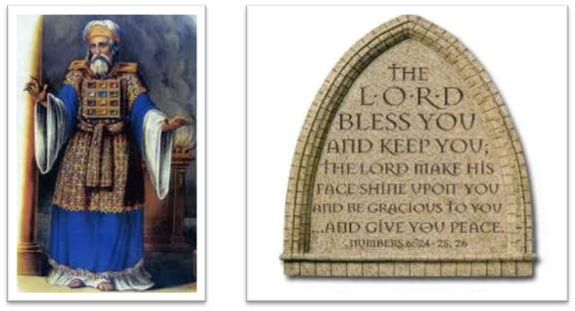
“The Lord bless you and keep you; the Lord make his face shine on you and be gracious to you; the Lord turn his face toward you and give you peace.” (NIV)

