Slide 1

THE BOOK OF DANIEL
Dr. Andy Woods

Slide 2

Chapter 10–12 Outline
The Setting (10:1-3)
Arrival of the Heavenly Messenger (10:4-9)
Explanation of the Heavenly Messenger (10:1–11:1)
The Prophecy of the Heavenly Messenger (11:2–12:13)

Slide 3
Chapter 10–12 Outline
The Setting (10:1-3)
Arrival of the Heavenly Messenger (10:4-9)
Explanation of the Heavenly Messenger (10:1–11:1)
The Prophecy of the Heavenly Messenger (11:2–12:13)

Slide 4

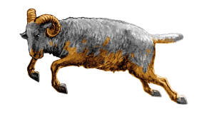
I. The Setting (10:1-3)
Historically (v. 1)
  Cyrus of Persia
  Third year of Cyrus
Personally (v. 2-3)

Slide 5
I. The Setting (10:1-3)
Historically (v. 1)
  Cyrus of Persia
  Third year of Cyrus
Personally (v. 2-3)

Slide 6

I. The Setting (10:1-3)
Historically (v. 1)
  Cyrus of Persia
  Third year of Cyrus
Personally (v. 2-3)

Slide 7
Succession of Gentile Rulers
1-4: Nebuchadnezzar of Babylon
5: Belshazzar of Babylon
6: Darius of Media – Persia
7-8: Belshazzar of Babylon
9: Darius of Media – Persia
10-12: Cyrus of Media – Persia

Slide 8
I. The Setting (10:1-3)
Historically (v. 1)
  Cyrus of Persia
  Third year of Cyrus
Personally (v. 2-3)

Slide 9
CHAPTER AND VERSE IN DANIEL | CHRONOLOGICAL DATE | BIBLICAL DATE
1:1 | 605 | 3rd year of Jehoiakim
2:1 | 603 | 2nd year of Nebuchadnezzar
5 | Sat. night 10/12/539 (Hoehner)
7:1 | 553 | 1st year of Belshazzar
8:1 | 551 | 3rd year of Belshazzar
9:1 | 538 | 1st year of Darius
10:1 | 536 | 3rd year of Cyrus

Slide 10
Daniel’s Age
CHAPTER | EVENTS | AGE
1 | Taken to Babylonian captivity | 15
2 | Interpreting Nebuchadnezzar’s 1st dream (huge image) | 17
3 | Daniel’s 3 friends cast into the fiery furnace | 19 or 20
4 | Interpreting Nebuchadnezzar’s 2nd dream (huge tree) | 45-50
5 | Interpreting handwriting of the wall at Belshazzar’s feast | Early 80’s
6 | Delivered from the den of lions | c.83
7-8 | Daniel’s visions and dreams | Mid-60’s
9 | Daniel’s seventy “sevens” prophecy | Early-80’s
10-12 | Final dreams and visions | Mid-80’s

Slide 11
Three Returns
 | Date | Duration | Persian king | Jewish leader | Scripture | Purpose | Number of returnees
1st return | 538–515 B.C. | 23 years | Cyrus (Isa 44:28‒45:1) | Zerubbabel | Ezra 1–6; Isaiah 44:28 | Rebuilding the temple | 50,000
2nd return | 458–457 B.C. | 2 years | Artaxerxes | Ezra | Ezra 7–10 | Adorning of the temple and reforming the people | 2,000
3rd return | 444–432 B.C. | 8 years | Artaxerxes | Nehemiah | Nehemiah | Rebuilding the wall

Slide 12
I. The Setting (10:1-3)
Historically (v. 1)
  Cyrus of Persia
  Third year of Cyrus
Personally (v. 2-3)

Slide 13
Chapter 10–12 Outline
The Setting (10:1-3)
Arrival of the Heavenly Messenger (10:4-9)
Explanation of the Heavenly Messenger (10:1–11:1)
The Prophecy of the Heavenly Messenger (11:2–12:13)

Slide 14
II. Arrival of the Heavenly Messenger (10:4-9)
His description (v. 4-6)
Response (v. 7-9)
  Daniel’s friends (7)
  Daniel (8-9)

Slide 15
II. Arrival of the Heavenly Messenger (10:4-9)
His description (v. 4-6)
Response (v. 7-9)
  Daniel’s friends (7)
  Daniel (8-9)

Slide 16


Slide 17
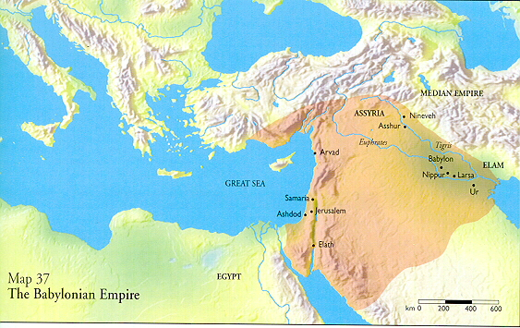

Slide 18
II. Arrival of the Heavenly Messenger (10:4-9)
His description (v. 4-6)
Response (v. 7-9)
  Daniel’s friends (7)
  Daniel (8-9)

Slide 19
II. Arrival of the Heavenly Messenger (10:4-9)
His description (v. 4-6)
Response (v. 7-9)
  Daniel’s friends (7)
  Daniel (8-9)

Slide 20
II. Arrival of the Heavenly Messenger (10:4-9)
His description (v. 4-6)
Response (v. 7-9)
  Daniel’s friends (7)
  Daniel (8-9)

Slide 21
Chapter 10–12 Outline
The Setting (10:1-3)
Arrival of the Heavenly Messenger (10:4-9)
Explanation of the Heavenly Messenger (10:1–11:1)
The Prophecy of the Heavenly Messenger (11:2–12:13)

Slide 22
III. Explanation of the Heavenly Messenger (10:10–11:1)
Explanation of His Delay (10:10-13)
Explanation of His Visit (10:14–11:1)
  Purpose of his visit (10:14)
  Daniel's reaction (10:15-19)
  Continuing spiritual warfare (10:20–11:1)

Slide 23
III. Explanation of the Heavenly Messenger (10:10–11:1)
Explanation of His Delay (10:10-13)
Explanation of His Visit (10:14–11:1)
  Purpose of his visit (10:14)
  Daniel's reaction (10:15-19)
  Continuing spiritual warfare (10:20–11:1)

Slide 24


Genesis 12:3
“And I will bless those who bless you, And the one who curses you I will curse. And in you all the families of the earth will be blessed.”

Slide 25
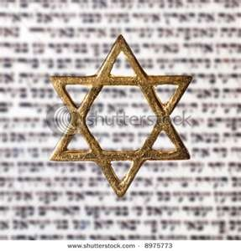
Israel’s Three Blessings to the World
(Gen 12:3b)
Scripture (Rom 3:2)
Savior (John 4:22)
Kingdom (Isa 2:2-3)

Slide 26
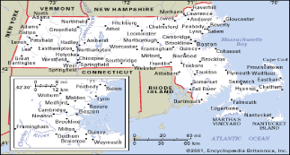
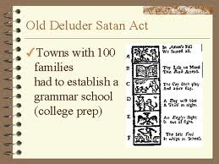
Old Satan Deluder Law: 1642 Massachusetts
Church of the Holy Trinity v. U.S., 143 U.S. 457, 467 (1892)
“It being one chief project of that old deluder, Satan, to keep men from the knowledge of the Scriptures, as in former time…It is therefore ordered…that after the Lord hath increased the settlement…they shall…appoint one within their town, to teach all such children to read…they shall set up a grammar school to instruct youths…”

Slide 27
III. Explanation of the Heavenly Messenger (10:10–11:1)
Explanation of His Delay (10:10-13)
Explanation of His Visit (10:14–11:1)
  Purpose of his visit (10:14)
  Daniel's reaction (10:15-19)
  Continuing spiritual warfare (10:20–11:1)

Slide 28
III. Explanation of the Heavenly Messenger (10:10–11:1)
Explanation of His Delay (10:10-13)
Explanation of His Visit (10:14–11:1)
  Purpose of his visit (10:14)
  Daniel's reaction (10:15-19)
  Continuing spiritual warfare (10:20–11:1)

Slide 29
III. Explanation of the Heavenly Messenger (10:10–11:1)
Explanation of His Delay (10:10-13)
Explanation of His Visit (10:14–11:1)
  Purpose of his visit (10:14)
  Daniel's reaction (10:15-19)
  Continuing spiritual warfare (10:20–11:1)

Slide 30
2. Daniel’s Reaction (15-19)
Problem (v.15-17)
Solution (v.18-19)

Slide 31
2. Daniel’s Reaction (15-19)
Problem (v.15-17)
Solution (v.18-19)

Slide 32
2. Daniel’s Reaction (15-19)
Problem (v.15-17)
Solution (v.18-19)

Slide 33
III. Explanation of the Heavenly Messenger (10:10–11:1)
Explanation of His Delay (10:10-13)
Explanation of His Visit (10:14–11:1)
  Purpose of his visit (10:14)
  Daniel's reaction (10:15-19)
  Continuing spiritual warfare (10:20–11:1)

Slide 34

CHART1

Slide 35
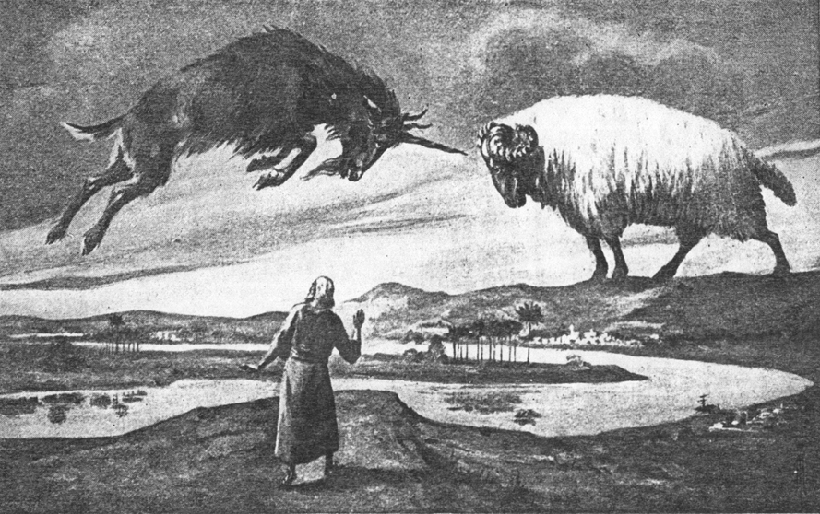
CHAPTER 8

Slide 36
Daniel 8:20-21 (NASB)
“The ram which you saw with the two horns represents the kings of Media and Persia. ²¹ The shaggy goat represents the kingdom of Greece, and the large horn that is between his eyes is the first king.”

Slide 37
Chapter 10–12 Outline
The Setting (10:1-3)
Arrival of the Heavenly Messenger (10:4-9)
Explanation of the Heavenly Messenger (10:1–11:1)
The Prophecy of the Heavenly Messenger (11:2–12:13)

Slide 38
IV. The Prophecy of the Heavenly Messenger (11:2–12:13)
Persia (11:2)
Greece (11:3-4)
Ptolemies & Seleucids (11:5-20)
Antiochus (11:21-35)
Antichrist (11:36-45)
Tribulation & Millennium (12:1-13)

Slide 39
IV. The Prophecy of the Heavenly Messenger (11:2–12:13)
Persia (11:2)
Greece (11:3-4)
Ptolemies & Seleucids (11:5-20)
Antiochus (11:21-35)
Antichrist (11:36-45)
Tribulation & Millennium (12:1-13)

Slide 40
IV. The Prophecy of the Heavenly Messenger (11:2–12:13)
Persia (11:2)
Greece (11:3-4)
Ptolemies & Seleucids (11:5-20)
Antiochus (11:21-35)
Antichrist (11:36-45)
Tribulation & Millennium (12:1-13)

Slide 41
IV. The Prophecy of the Heavenly Messenger (11:2–12:13)
Persia (11:2)
Greece (11:3-4)
Ptolemies & Seleucids (11:5-20)
Antiochus (11:21-35)
Antichrist (11:36-45)
Tribulation & Millennium (12:1-13)

Slide 42
IV. The Prophecy of the Heavenly Messenger (11:2–12:13)
Persia (11:2)
Greece (11:3-4)
Ptolemies & Seleucids (11:5-20)
Antiochus (11:21-35)
Antichrist (11:36-45)
Tribulation & Millennium (12:1-13)

Slide 43
IV. The Prophecy of the Heavenly Messenger (11:2–12:13)
Persia (11:2)
Greece (11:3-4)
Ptolemies & Seleucids (11:5-20)
Antiochus (11:21-35)
Antichrist (11:36-45)
Tribulation & Millennium (12:1-13)

Slide 44
IV. The Prophecy of the Heavenly Messenger (11:2–12:13)
Persia (11:2)
Greece (11:3-4)
Ptolemies & Seleucids (11:5-20)
Antiochus (11:21-35)
Antichrist (11:36-45)
Tribulation & Millennium (12:1-13)

Slide 45
Conclusion

Slide 46
Chapter 10–12 Outline
The Setting (10:1-3)
Arrival of the Heavenly Messenger (10:4-9)
Explanation of the Heavenly Messenger (10:1–11:1)
The Prophecy of the Heavenly Messenger (11:2–12:13)

Slide 47


Statue
&
Stone

Slide 48
Purpose
To encourage Judah by emphasizing the sovereignty of God during the Babylonian captivity and to teach Judah how to live while outside the land

Slide 49
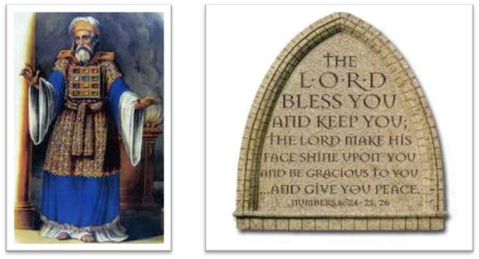
“The Lord bless you and keep you; the Lord make his face shine on you and be gracious to you; the Lord turn his face toward you and give you peace.” (NIV)

