Slide 1

THE BOOK OF DANIEL
Dr. Andy Woods

Slide 2

Chapter 10–12 Outline
The Setting (10:1-3)
Arrival of the Heavenly Messenger (10:4-9)
Explanation of the Heavenly Messenger (10:10–11:1)
The Prophecy of the Heavenly Messenger (11:2–12:13)

Slide 3
Chapter 10–12 Outline
The Setting (10:1-3)
Arrival of the Heavenly Messenger (10:4-9)
Explanation of the Heavenly Messenger (10:10–11:1)
The Prophecy of the Heavenly Messenger (11:2–12:13)

Slide 4

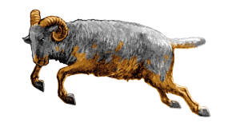
I. The Setting (10:1-3)
Historically (v. 1)
  Cyrus of Persia
  Third year of Cyrus
Personally (v. 2-3)

Slide 5
Succession of Gentile Rulers
1-4: Nebuchadnezzar of Babylon
5: Belshazzar of Babylon
6: Darius of Media – Persia
7-8: Belshazzar of Babylon
9: Darius of Media – Persia
10-12: Cyrus of Media – Persia

Slide 6
CHAPTER AND VERSE IN DANIEL | CHRONOLOGICAL DATE | BIBLICAL DATE
1:1 | 605 | 3rd year of Jehoiakim
2:1 | 603 | 2nd year of Nebuchadnezzar
5 | Sat. night 10/12/539 (Hoehner)
7:1 | 553 | 1st year of Belshazzar
8:1 | 551 | 3rd year of Belshazzar
9:1 | 538 | 1st year of Darius
10:1 | 536 | 3rd year of Cyrus

Slide 7
Daniel’s Age
CHAPTER | EVENTS | AGE
1 | Taken to Babylonian captivity | 15
2 | Interpreting Nebuchadnezzar’s 1st dream (huge image) | 17
3 | Daniel’s 3 friends cast into the fiery furnace | 19 or 20
4 | Interpreting Nebuchadnezzar’s 2nd dream (huge tree) | 45-50
5 | Interpreting handwriting of the wall at Belshazzar’s feast | Early 80’s
6 | Delivered from the den of lions | c.83
7-8 | Daniel’s visions and dreams | Mid-60’s
9 | Daniel’s seventy “sevens” prophecy | Early-80’s
10-12 | Final dreams and visions | Mid-80’s

Slide 8
Three Returns
 | Date | Duration | Persian king | Jewish leader | Scripture | Purpose | Number of returnees
1st return | 538–515 B.C. | 23 years | Cyrus (Isa 44:28‒45:1) | Zerubbabel | Ezra 1–6; Isaiah 44:28 | Rebuilding the temple | 50,000
2nd return | 458–457 B.C. | 2 years | Artaxerxes | Ezra | Ezra 7–10 | Adorning of the temple and reforming the people | 2,000
3rd return | 444–432 B.C. | 8 years | Artaxerxes | Nehemiah | Nehemiah | Rebuilding the wall

Slide 9
Chapter 10–12 Outline
The Setting (10:1-3)
Arrival of the Heavenly Messenger (10:4-9)
Explanation of the Heavenly Messenger (10:10–11:1)
The Prophecy of the Heavenly Messenger (11:2–12:13)

Slide 10
Chapter 10–12 Outline
The Setting (10:1-3)
Arrival of the Heavenly Messenger (10:4-9)
Explanation of the Heavenly Messenger (10:10–11:1)
The Prophecy of the Heavenly Messenger (11:2–12:13)

Slide 11

III. Explanation of the Heavenly Messenger (10:10–11:1)
Explanation of His Delay (10:10-13)
Explanation of His Visit (10:14–11:1)
  Purpose of his visit (10:14)
  Daniel's reaction (10:15-19)
  Continuing spiritual warfare (10:20–11:1)

Slide 12
III. Explanation of the Heavenly Messenger (10:10–11:1)
Explanation of His Delay (10:10-13)
Explanation of His Visit (10:14–11:1)
  Purpose of his visit (10:14)
  Daniel's reaction (10:15-19)
  Continuing spiritual warfare (10:20–11:1)

Slide 13


Genesis 12:3
“And I will bless those who bless you, And the one who curses you I will curse. And in you all the families of the earth will be blessed.”

Slide 14
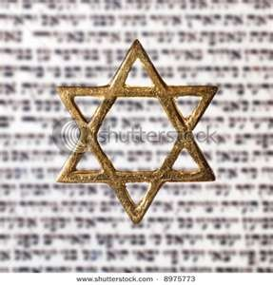
Israel’s Three Blessings to the World
(Gen 12:3b)
Scripture (Rom 3:2)
Savior (John 4:22)
Kingdom (Isa 2:2-3)

Slide 15
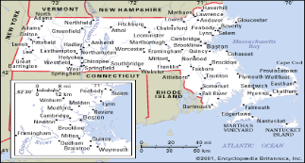
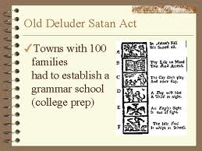
Old Satan Deluder Law: 1642 Massachusetts
Church of the Holy Trinity v. U.S., 143 U.S. 457, 467 (1892)
“It being one chief project of that old deluder, Satan, to keep men from the knowledge of the Scriptures, as in former time…It is therefore ordered…that after the Lord hath increased the settlement…they shall…appoint one within their town, to teach all such children to read…they shall set up a grammar school to instruct youths…”

Slide 16
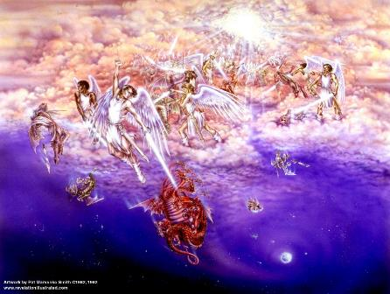
Biblical Reality of the Angelic World
Job 1:12
2 Kings 6:15-17
1 Chron 21:1
Dan 10:12-13, 20
Matt 16:21-23
Eph 6:12
Rev 12

Slide 17
III. Explanation of the Heavenly Messenger (10:10–11:1)
Explanation of His Delay (10:10-13)
Explanation of His Visit (10:14–11:1)
  Purpose of his visit (10:14)
  Daniel's reaction (10:15-19)
  Continuing spiritual warfare (10:20–11:1)

Slide 18
III. Explanation of the Heavenly Messenger (10:10–11:1)
Explanation of His Delay (10:10-13)
Explanation of His Visit (10:14–11:1)
  Purpose of his visit (10:14)
  Daniel's reaction (10:15-19)
  Continuing spiritual warfare (10:20–11:1)

Slide 19
III. Explanation of the Heavenly Messenger (10:10–11:1)
Explanation of His Delay (10:10-13)
Explanation of His Visit (10:14–11:1)
  Purpose of his visit (10:14)
  Daniel's reaction (10:15-19)
  Continuing spiritual warfare (10:20–11:1)

Slide 20
2. Daniel’s Reaction (15-19)
Problem (v.15-17)
Solution (v.18-19)

Slide 21
2. Daniel’s Reaction (15-19)
Problem (v.15-17)
Solution (v.18-19)

Slide 22
2. Daniel’s Reaction (15-19)
Problem (v.15-17)
Solution (v.18-19)

Slide 23
III. Explanation of the Heavenly Messenger (10:10–11:1)
Explanation of His Delay (10:10-13)
Explanation of His Visit (10:14–11:1)
  Purpose of his visit (10:14)
  Daniel's reaction (10:15-19)
  Continuing spiritual warfare (10:20–11:1)

Slide 24

CHART1

Slide 25
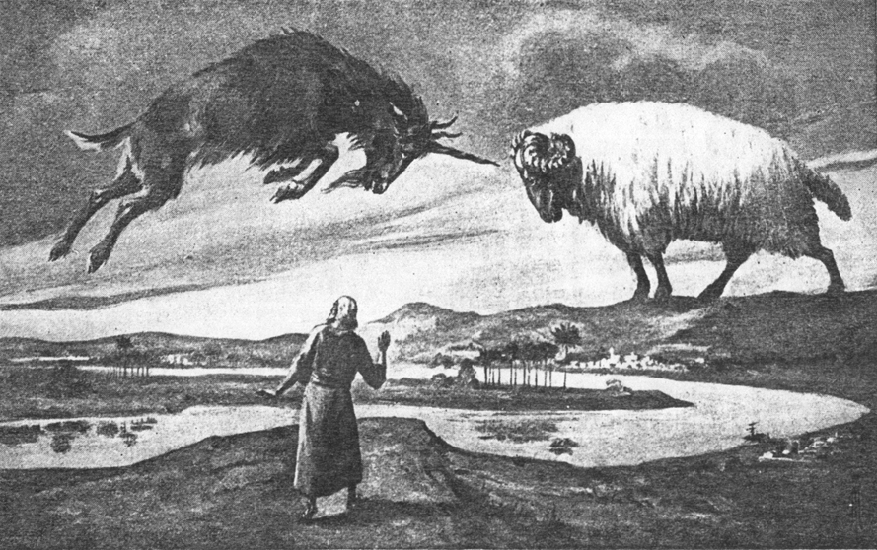
CHAPTER 8

Slide 26
Daniel 8:20-21 (NASB)
“The ram which you saw with the two horns represents the kings of Media and Persia. ²¹ The shaggy goat represents the kingdom of Greece, and the large horn that is between his eyes is the first king.”

Slide 27
Conclusion

Slide 28
Chapter 10–12 Outline
The Setting (10:1-3)
Arrival of the Heavenly Messenger (10:4-9)
Explanation of the Heavenly Messenger (10:1–11:1)
The Prophecy of the Heavenly Messenger (11:2–12:13)

Slide 29


Statue
&
Stone

Slide 30
Purpose
To encourage Judah by emphasizing the sovereignty of God during the Babylonian captivity and to teach Judah how to live while outside the land

Slide 31
Chapter 10–12 Outline
The Setting (10:1-3)
Arrival of the Heavenly Messenger (10:4-9)
Explanation of the Heavenly Messenger (10:10–11:1)
The Prophecy of the Heavenly Messenger (11:2–12:13)

Slide 32
IV. The Prophecy of the Heavenly Messenger (11:2–12:13)
Persia (11:2)
Greece (11:3-4)
Ptolemies & Seleucids (11:5-20)
Antiochus (11:21-35)
Antichrist (11:36-45)
Tribulation & Millennium (12:1-13)

Slide 33
IV. The Prophecy of the Heavenly Messenger (11:2–12:13)
Persia (11:2)
Greece (11:3-4)
Ptolemies & Seleucids (11:5-20)
Antiochus (11:21-35)
Antichrist (11:36-45)
Tribulation & Millennium (12:1-13)

Slide 34
IV. The Prophecy of the Heavenly Messenger (11:2–12:13)
Persia (11:2)
Greece (11:3-4)
Ptolemies & Seleucids (11:5-20)
Antiochus (11:21-35)
Antichrist (11:36-45)
Tribulation & Millennium (12:1-13)

Slide 35
IV. The Prophecy of the Heavenly Messenger (11:2–12:13)
Persia (11:2)
Greece (11:3-4)
Ptolemies & Seleucids (11:5-20)
Antiochus (11:21-35)
Antichrist (11:36-45)
Tribulation & Millennium (12:1-13)

Slide 36
IV. The Prophecy of the Heavenly Messenger (11:2–12:13)
Persia (11:2)
Greece (11:3-4)
Ptolemies & Seleucids (11:5-20)
Antiochus (11:21-35)
Antichrist (11:36-45)
Tribulation & Millennium (12:1-13)

Slide 37
IV. The Prophecy of the Heavenly Messenger (11:2–12:13)
Persia (11:2)
Greece (11:3-4)
Ptolemies & Seleucids (11:5-20)
Antiochus (11:21-35)
Antichrist (11:36-45)
Tribulation & Millennium (12:1-13)

Slide 38
IV. The Prophecy of the Heavenly Messenger (11:2–12:13)
Persia (11:2)
Greece (11:3-4)
Ptolemies & Seleucids (11:5-20)
Antiochus (11:21-35)
Antichrist (11:36-45)
Tribulation & Millennium (12:1-13)

Slide 39
Conclusion

Slide 40
Chapter 10–12 Outline
The Setting (10:1-3)
Arrival of the Heavenly Messenger (10:4-9)
Explanation of the Heavenly Messenger (10:1–11:1)
The Prophecy of the Heavenly Messenger (11:2–12:13)

Slide 41
Statue
&
Stone

Slide 42
Purpose
To encourage Judah by emphasizing the sovereignty of God during the Babylonian captivity and to teach Judah how to live while outside the land

Slide 43
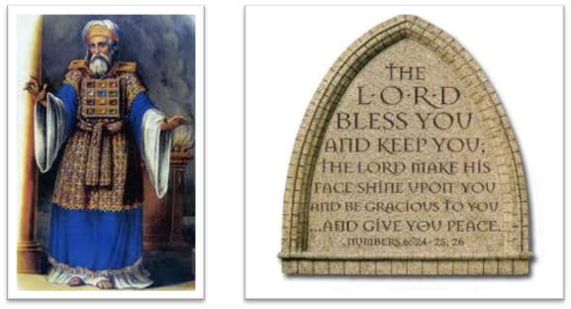
“The Lord bless you and keep you; the Lord make his face shine on you and be gracious to you; the Lord turn his face toward you and give you peace.” (NIV)

