Slide 1
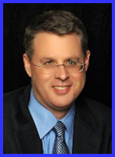
Ecclesiology Session 4
Dr. Andy Woods
Senior Pastor – Sugar Land Bible Church
President – Chafer Theological Seminary

Slide 2
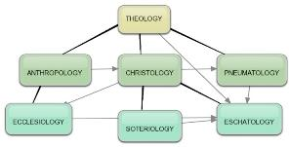
Areas of Systematic Theology
Prolegomena – Introduction
Theology – Study of God
Christology – Study of Christ
Pneumatology – Study of the Holy Spirit
Anthropology – Study of Man
Hamartiology – Study of sin
Soteriology – Study of salvation
Angelology – Study of angels
Ecclesiology – Study of the Church
Eschatology – Study of the end

Slide 3
Ecclesiology Overview
Definition
Universal vs. local
Word pictures
Origin
Israel – Church differences
Intercalation
Purposes
Activities
Government
Officers
Ordinances
Purity

Slide 4
Ecclesiology Overview
Definition
Universal vs. local
Word pictures
Origin
Israel – Church differences
Intercalation
Purposes
Activities
Government
Officers
Ordinances
Purity

Slide 5
Definition of Ecclesiology
Ekklēsía (ἐκκλησία)
ĕk (ἐκ) / kaleo (καλέω)
Acts 15:14
Logos
1 Cor 10:32

Slide 6
1 Corinthians 10:32
“Give no offense either to Jews or to Greeks or to the church of God.”

Slide 7
The Definition of the Church
All (both Jew & Gentile) who have trusted in the very Messiah rejected by first-century national Israel (Gal. 3:28; Rom. 10:19; Eph. 2:14)
Intercalation
Does not fulfill Israel’s purposes

Slide 8
Ecclesiology Overview
Definition
Universal vs. local
Word pictures
Origin
Israel – Church differences
Intercalation
Purposes
Activities
Government
Officers
Ordinances
Purity

Slide 9
The Universal vs. Local Church
 | Universal | Local
Number | One | Many
Members | All believers from Pentecost to the Rapture | Local gathering
Spiritual status | Believers only | Believers and unbelievers
Living or dead | Living and dead | Living only
Assembly | Cannot assemble at one place and time | Can assemble at one place and time
Visibility | Invisible | Visible
NT Material | Minority | Majority
Joining | Faith alone | Unique requirements
Denomination | All believers | Specific denomination

Slide 10
Ecclesiology Overview
Definition
Universal vs. local
Word pictures
Origin
Israel – Church differences
Intercalation
Purposes
Activities
Government
Officers
Ordinances
Purity

Slide 11
Universal Church Word Pictures
Shepherd/sheep – John 10:16; Acts 20:28; Heb 13:20; 1 Pet 5:2-4
Head/body – Rom 12:5; 1 Cor 12:12-13; Eph 1:22-23
Bride/groom – Eph 5:22-33; 2 Cor 11:2-3
Temple – 1 Cor 3:16-17; Eph 2:19-22; Gal 6:10
High priest/priesthood – Heb 4:14-15; 1 Pet 2:5-9; Rev 1:6
Pillar of truth – 1 Tim 3:15
Vine and branches – John 15:1-8

Slide 12
Universal Church Word Pictures
Shepherd/sheep – John 10:16; Acts 20:28; Heb 13:20; 1 Pet 5:2-4
Head/body – Rom 12:5; 1 Cor 12:12-13; Eph 1:22-23
Bride/groom – Eph 5:22-33; 2 Cor 11:2-3
Temple – 1 Cor 3:16-17; Eph 2:19-22; Gal 6:10
High priest/priesthood – Heb 4:14-15; 1 Pet 2:5-9; Rev 1:6
Pillar of truth – 1 Tim 3:15
Vine and branches – John 15:1-8

Slide 13
Universal Church Word Pictures
Shepherd/sheep – John 10:16; Acts 20:28; Heb 13:20; 1 Pet 5:2-4
Head/body – Rom 12:5; 1 Cor 12:12-13; Eph 1:22-23
Bride/groom – Eph 5:22-33; 2 Cor 11:2-3
Temple – 1 Cor 3:16-17; Eph 2:19-22; Gal 6:10
High priest/priesthood – Heb 4:14-15; 1 Pet 2:5-9; Rev 1:6
Pillar of truth – 1 Tim 3:15
Vine and branches – John 15:1-8

Slide 14
Universal Church Word Pictures
Shepherd/sheep – John 10:16; Acts 20:28; Heb 13:20; 1 Pet 5:2-4
Head/body – Rom 12:5; 1 Cor 12:12-13; Eph 1:22-23
Bride/groom – Eph 5:22-33; 2 Cor 11:2-3
Temple – 1 Cor 3:16-17; Eph 2:19-22; Gal 6:10
High priest/priesthood – Heb 4:14-15; 1 Pet 2:5-9; Rev 1:6
Pillar of truth – 1 Tim 3:15
Vine and branches – John 15:1-8

Slide 15
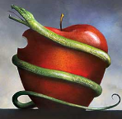
2 Cor. 11:2-3 (NKJV)
Betrothal Period
“ For I am jealous for you with a godly jealousy; for I betrothed you to one husband, so that to Christ I might present you as a pure virgin. But I fear, lest somehow, as the serpent deceived Eve by his craftiness, so your minds may be corrupted by from the simplicity that is in Christ.”

Slide 16
Jewish Marriage Analogy
Marriage covenant | Groom initiated; Covenant established upon payment for bride; drank same cup | Christ initiated; Christ’s sacrificial death (1 Cor. 6:19-20; 11:25)
Bride set apart | Bride set apart exclusively for groom | Church’s positionally sanctified (1 Cor. 1:2; 6:9-11)
Bridal chamber prepared | Groom separates from bride and returns to his father’s house to prepare bridal chamber | Christ’s 2000 year separation from church; Ascension; return to heaven to prepare dwellings (John 14:2; Acts 1:9-11)
Betrothal period | Loyalty test | Reward determined by orthodoxy and orthopraxy (Jas. 4:4)
Bride retrieved | Groom returns at unknown time preceded by a shout with escorts to retrieve bride | Rapture at unknown time (John 14:3; 1 Thess. 4:16-17)
Showers, Maranatha Our Lord, Come!, 164-69.

Slide 17
Jewish Marriage Analogy
Bride and groom hidden in Father’s house for seven days | Hidden in the Father’s house for seven days: three events transpire | Church hidden from world during Daniel’s 70th Week
Bride cleansed | Bride undergoes ritual cleansing prior to wedding ceremony | Bema Seat Judgment 1 Cor 3:10-15; 2 Cor 5:10)
Wedding ceremony | Meeting with the Father’s assembled wedding guests; Private wedding ceremony | Meeting with OT saints; Rev 19:7
Consummation | Bride and groom consummate the marriage | Eph 5:27
Marriage feast | Public presentation; Bride unveiled; marriage feast | Col 3:3-4; Rev 19:9
Showers, Maranatha Our Lord, Come!, 164-69.

Slide 18
Jewish Marriage Analogy
Bride and groom hidden in Father’s house for seven days | Hidden in the Father’s house for seven days: three events transpire | Church hidden from world during Daniel’s 70th Week
Bride cleansed | Bride undergoes ritual cleansing prior to wedding ceremony | Bema Seat Judgment 1 Cor 3:10-15; 2 Cor 5:10)
Wedding ceremony | Meeting with the Father’s assembled wedding guests; Private wedding ceremony | Meeting with OT saints; Rev 19:7
Consummation | Bride and groom consummate the marriage | Eph 5:27
Marriage feast | Public presentation; Bride unveiled; marriage feast | Col 3:3-4; Rev 19:9
Showers, Maranatha Our Lord, Come!, 164-69.

Slide 19
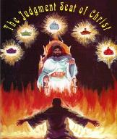
2 Corinthians 5:10
“For we must all appear before the judgment seat of Christ, so that each one may be recompensed for his deeds in the body, according to what he has done, whether good or bad.”

Slide 20
Jewish Marriage Analogy
Bride and groom hidden in Father’s house for seven days | Hidden in the Father’s house for seven days: three events transpire | Church hidden from world during Daniel’s 70th Week
Bride cleansed | Bride undergoes ritual cleansing prior to wedding ceremony | Bema Seat Judgment 1 Cor 3:10-15; 2 Cor 5:10)
Wedding ceremony | Meeting with the Father’s assembled wedding guests; Private wedding ceremony | Meeting with OT saints; Rev 19:7
Consummation | Bride and groom consummate the marriage | Eph 5:27
Marriage feast | Public presentation; Bride unveiled; marriage feast | Col 3:3-4; Rev 19:9
Showers, Maranatha Our Lord, Come!, 164-69.

Slide 21
Universal Church Word Pictures
Shepherd/sheep – John 10:16; Acts 20:28; Heb 13:20; 1 Pet 5:2-4
Head/body – Rom 12:5; 1 Cor 12:12-13; Eph 1:22-23
Bride/groom – Eph 5:22-33; 2 Cor 11:2-3
Temple – 1 Cor 3:16-17; Eph 2:19-22; Gal 6:10
High priest/priesthood – Heb 4:14-15; 1 Pet 2:5-9; Rev 1:6
Pillar of truth – 1 Tim 3:15
Vine and branches – John 15:1-8

Slide 22
ISRAEL’S FOUR TEMPLES
Solomon’s pre exilic temple (966 bc, Kings and Chronicles)
Zerubbabel’s post exilic temple (Ezra 1-6; John 2:20)
Antichrist's temple (Dan 9:27; Matt 24:15; 2 Thess 2:4; Rev 11:1-2)
Millennial temple (Ezek 40-48)
Notes:
Herod proposed to renovate Zerubbabel’s Temple in 20-19 BC. Finishing touches continued until AD 63.

Slide 23
Universal Church Word Pictures
Shepherd/sheep – John 10:16; Acts 20:28; Heb 13:20; 1 Pet 5:2-4
Head/body – Rom 12:5; 1 Cor 12:12-13; Eph 1:22-23
Bride/groom – Eph 5:22-33; 2 Cor 11:2-3
Temple – 1 Cor 3:16-17; Eph 2:19-22; Gal 6:10
High priest/priesthood – Heb 4:14-15; 1 Pet 2:5-9; Rev 1:6
Pillar of truth – 1 Tim 3:15
Vine and branches – John 15:1-8

Slide 24
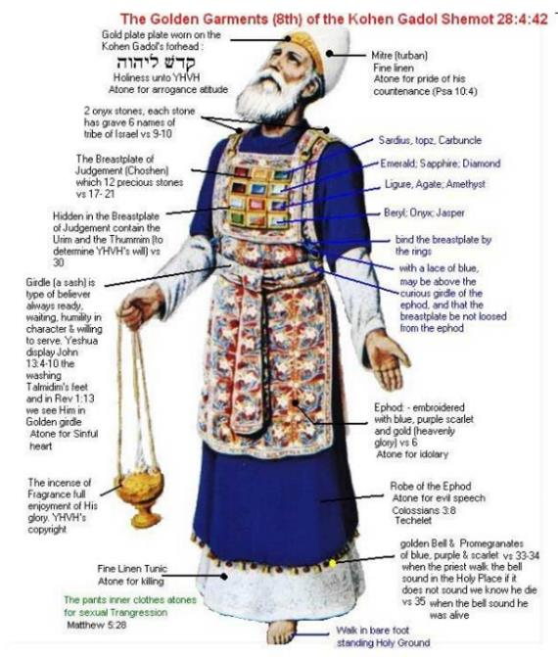

Slide 25
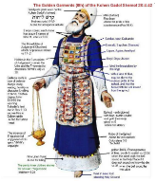
Revelation 1:6
“and He [God] has made us [Church] to be a kingdom, priests to His God and Father—to Him be the glory and the dominion forever and ever. Amen.”

Slide 26
Spiritual Sacrifices
Body – Rom 12:1
Praise – Heb 13:15
Good works – Philip 2:17
Financial giving – Heb 13:16

Slide 27
Universal Church Word Pictures
Shepherd/sheep – John 10:16; Acts 20:28; Heb 13:20; 1 Pet 5:2-4
Head/body – Rom 12:5; 1 Cor 12:12-13; Eph 1:22-23
Bride/groom – Eph 5:22-33; 2 Cor 11:2-3
Temple – 1 Cor 3:16-17; Eph 2:19-22; Gal 6:10
High priest/priesthood – Heb 4:14-15; 1 Pet 2:5-9; Rev 1:6
Pillar of truth – 1 Tim 3:15
Vine and branches – John 15:1-8

Slide 28
Universal Church Word Pictures
Shepherd/sheep – John 10:16; Acts 20:28; Heb 13:20; 1 Pet 5:2-4
Head/body – Rom 12:5; 1 Cor 12:12-13; Eph 1:22-23
Bride/groom – Eph 5:22-33; 2 Cor 11:2-3
Temple – 1 Cor 3:16-17; Eph 2:19-22; Gal 6:10
High priest/priesthood – Heb 4:14-15; 1 Pet 2:5-9; Rev 1:6
Pillar of truth – 1 Tim 3:15
Vine and branches – John 15:1-8

Slide 29
CONCLUSION

Slide 30
Universal Church Word Pictures
Shepherd/sheep – John 10:16; Acts 20:28; Heb 13:20; 1 Pet 5:2-4
Head/body – Rom 12:5; 1 Cor 12:12-13; Eph 1:22-23
Bride/groom – Eph 5:22-33; 2 Cor 11:2-3
Temple – 1 Cor 3:16-17; Eph 2:19-22; Gal 6:10
High priest/priesthood – Heb 4:14-15; 1 Pet 2:5-9; Rev 1:6
Pillar of truth – 1 Tim 3:15
Vine and branches – John 15:1-8

Slide 31
Ecclesiology Overview
Definition
Universal vs. local
Word pictures
Origin
Israel – Church differences
Intercalation
Purposes
Activities
Government
Officers
Ordinances
Purity

