Slide 1

THE BOOK OF DANIEL
Dr. Andy Woods

Slide 2

Chapter 10–12 Outline
The Setting (10:1-3)
Arrival of the Heavenly Messenger (10:4-9)
Explanation of the Heavenly Messenger (10:10–11:1)
The Prophecy of the Heavenly Messenger (11:2–12:13)

Slide 3
Chapter 10–12 Outline
The Setting (10:1-3)
Arrival of the Heavenly Messenger (10:4-9)
Explanation of the Heavenly Messenger (10:10–11:1)
The Prophecy of the Heavenly Messenger (11:2–12:13)

Slide 4

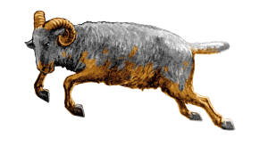
I. The Setting (10:1-3)
Historically (v. 1)
  Cyrus of Persia
  Third year of Cyrus
Personally (v. 2-3)

Slide 5
Succession of Gentile Rulers
1-4: Nebuchadnezzar of Babylon
5: Belshazzar of Babylon
6: Darius of Media – Persia
7-8: Belshazzar of Babylon
9: Darius of Media – Persia
10-12: Cyrus of Media – Persia

Slide 6
CHAPTER AND VERSE IN DANIEL | CHRONOLOGICAL DATE | BIBLICAL DATE
1:1 | 605 | 3rd year of Jehoiakim
2:1 | 603 | 2nd year of Nebuchadnezzar
5 | Sat. night 10/12/539 (Hoehner)
7:1 | 553 | 1st year of Belshazzar
8:1 | 551 | 3rd year of Belshazzar
9:1 | 538 | 1st year of Darius
10:1 | 536 | 3rd year of Cyrus

Slide 7
Daniel’s Age
CHAPTER | EVENTS | AGE
1 | Taken to Babylonian captivity | 15
2 | Interpreting Nebuchadnezzar’s 1st dream (huge image) | 17
3 | Daniel’s 3 friends cast into the fiery furnace | 19 or 20
4 | Interpreting Nebuchadnezzar’s 2nd dream (huge tree) | 45-50
5 | Interpreting handwriting of the wall at Belshazzar’s feast | Early 80’s
6 | Delivered from the den of lions | c.83
7-8 | Daniel’s visions and dreams | Mid-60’s
9 | Daniel’s seventy “sevens” prophecy | Early-80’s
10-12 | Final dreams and visions | Mid-80’s

Slide 8
Three Returns
 | Date | Duration | Persian king | Jewish leader | Scripture | Purpose | Number of returnees
1st return | 538–515 B.C. | 23 years | Cyrus (Isa 44:28‒45:1) | Zerubbabel | Ezra 1–6; Isaiah 44:28 | Rebuilding the temple | 50,000
2nd return | 458–457 B.C. | 2 years | Artaxerxes | Ezra | Ezra 7–10 | Adorning of the temple and reforming the people | 2,000
3rd return | 444–432 B.C. | 8 years | Artaxerxes | Nehemiah | Nehemiah | Rebuilding the wall

Slide 9
Chapter 10–12 Outline
The Setting (10:1-3)
Arrival of the Heavenly Messenger (10:4-9)
Explanation of the Heavenly Messenger (10:10–11:1)
The Prophecy of the Heavenly Messenger (11:2–12:13)

Slide 10
Chapter 10–12 Outline
The Setting (10:1-3)
Arrival of the Heavenly Messenger (10:4-9)
Explanation of the Heavenly Messenger (10:10–11:1)
The Prophecy of the Heavenly Messenger (11:2–12:13)

Slide 11

III. Explanation of the Heavenly Messenger (10:10–11:1)
Explanation of His Delay (10:10-13)
Explanation of His Visit (10:14–11:1)
  Purpose of his visit (10:14)
  Daniel's reaction (10:15-19)
  Continuing spiritual warfare (10:20–11:1)

Slide 12
III. Explanation of the Heavenly Messenger (10:10–11:1)
Explanation of His Delay (10:10-13)
Explanation of His Visit (10:14–11:1)
  Purpose of his visit (10:14)
  Daniel's reaction (10:15-19)
  Continuing spiritual warfare (10:20–11:1)

Slide 13
III. Explanation of the Heavenly Messenger (10:10–11:1)
Explanation of His Delay (10:10-13)
Explanation of His Visit (10:14–11:1)
  Purpose of his visit (10:14)
  Daniel's reaction (10:15-19)
  Continuing spiritual warfare (10:20–11:1)

Slide 14
III. Explanation of the Heavenly Messenger (10:10–11:1)
Explanation of His Delay (10:10-13)
Explanation of His Visit (10:14–11:1)
  Purpose of his visit (10:14)
  Daniel's reaction (10:15-19)
  Continuing spiritual warfare (10:20–11:1)

Slide 15
III. Explanation of the Heavenly Messenger (10:10–11:1)
Explanation of His Delay (10:10-13)
Explanation of His Visit (10:14–11:1)
  Purpose of his visit (10:14)
  Daniel's reaction (10:15-19)
  Continuing spiritual warfare (10:20–11:1)

Slide 16
2. Daniel’s Reaction (15-19)
Problem (v.15-17)
Solution (v.18-19)

Slide 17
2. Daniel’s Reaction (15-19)
Problem (v.15-17)
Solution (v.18-19)

Slide 18
2. Daniel’s Reaction (15-19)
Problem (v.15-17)
Solution (v.18-19)

Slide 19
III. Explanation of the Heavenly Messenger (10:10–11:1)
Explanation of His Delay (10:10-13)
Explanation of His Visit (10:14–11:1)
  Purpose of his visit (10:14)
  Daniel's reaction (10:15-19)
  Continuing spiritual warfare (10:20–11:1)

Slide 20
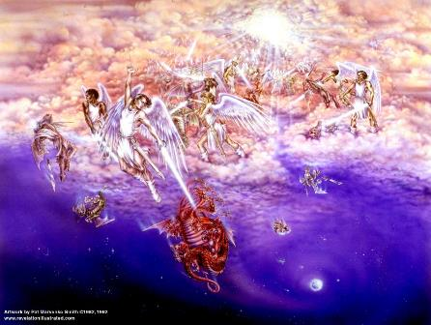
Biblical Reality of the Angelic World
Job 1:12
2 Kings 6:15-17
1 Chron. 21:1
Dan 10:12-13, 20
Matt. 16:21-23
Eph. 6:12
Rev. 12

Slide 21

CHART1

Slide 22
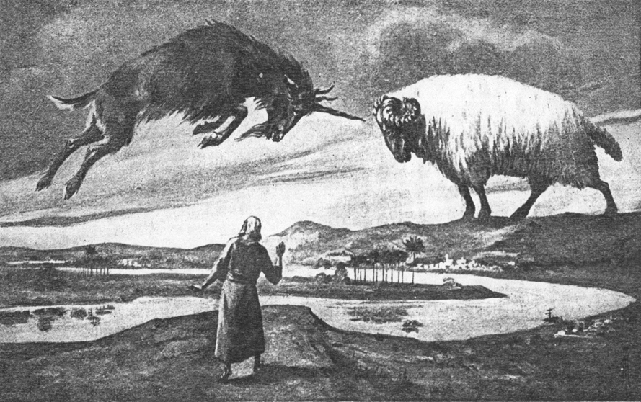
CHAPTER 8

Slide 23

Daniel 8:20-21 (NASB)
“The ram which you saw with the two horns represents the kings of Media and Persia. ²¹ The shaggy goat represents the kingdom of Greece, and the large horn that is between his eyes is the first king.”

Slide 24
Conclusion

Slide 25
Chapter 10–12 Outline
The Setting (10:1-3)
Arrival of the Heavenly Messenger (10:4-9)
Explanation of the Heavenly Messenger (10:1–11:1)
The Prophecy of the Heavenly Messenger (11:2–12:13)

Slide 26


Statue
&
Stone

Slide 27
Purpose
To encourage Judah by emphasizing the sovereignty of God during the Babylonian captivity and to teach Judah how to live while outside the land

Slide 28
Chapter 10–12 Outline
The Setting (10:1-3)
Arrival of the Heavenly Messenger (10:4-9)
Explanation of the Heavenly Messenger (10:10–11:1)
The Prophecy of the Heavenly Messenger (11:2–12:13)

Slide 29
IV. The Prophecy of the Heavenly Messenger (11:2–12:13)
Persia (11:2)
Greece (11:3-4)
Ptolemies & Seleucids (11:5-20)
Antiochus (11:21-35)
Antichrist (11:36-45)
Tribulation & Millennium (12:1-13)

Slide 30
IV. The Prophecy of the Heavenly Messenger (11:2–12:13)
Persia (11:2)
Greece (11:3-4)
Ptolemies & Seleucids (11:5-20)
Antiochus (11:21-35)
Antichrist (11:36-45)
Tribulation & Millennium (12:1-13)

Slide 31
IV. The Prophecy of the Heavenly Messenger (11:2–12:13)
Persia (11:2)
Greece (11:3-4)
Ptolemies & Seleucids (11:5-20)
Antiochus (11:21-35)
Antichrist (11:36-45)
Tribulation & Millennium (12:1-13)

Slide 32
IV. The Prophecy of the Heavenly Messenger (11:2–12:13)
Persia (11:2)
Greece (11:3-4)
Ptolemies & Seleucids (11:5-20)
Antiochus (11:21-35)
Antichrist (11:36-45)
Tribulation & Millennium (12:1-13)

Slide 33
IV. The Prophecy of the Heavenly Messenger (11:2–12:13)
Persia (11:2)
Greece (11:3-4)
Ptolemies & Seleucids (11:5-20)
Antiochus (11:21-35)
Antichrist (11:36-45)
Tribulation & Millennium (12:1-13)

Slide 34
IV. The Prophecy of the Heavenly Messenger (11:2–12:13)
Persia (11:2)
Greece (11:3-4)
Ptolemies & Seleucids (11:5-20)
Antiochus (11:21-35)
Antichrist (11:36-45)
Tribulation & Millennium (12:1-13)

Slide 35
IV. The Prophecy of the Heavenly Messenger (11:2–12:13)
Persia (11:2)
Greece (11:3-4)
Ptolemies & Seleucids (11:5-20)
Antiochus (11:21-35)
Antichrist (11:36-45)
Tribulation & Millennium (12:1-13)

Slide 36
Conclusion

Slide 37
Chapter 10–12 Outline
The Setting (10:1-3)
Arrival of the Heavenly Messenger (10:4-9)
Explanation of the Heavenly Messenger (10:1–11:1)
The Prophecy of the Heavenly Messenger (11:2–12:13)

Slide 38
Statue
&
Stone

Slide 39
Purpose
To encourage Judah by emphasizing the sovereignty of God during the Babylonian captivity and to teach Judah how to live while outside the land

Slide 40
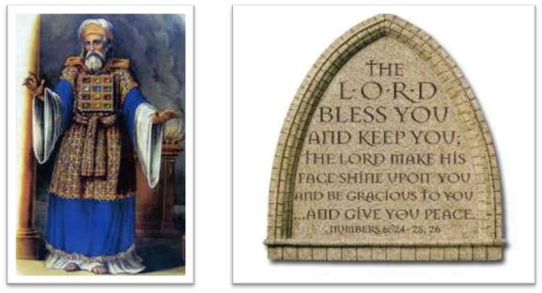
“The Lord bless you and keep you; the Lord make his face shine on you and be gracious to you; the Lord turn his face toward you and give you peace.” (NIV)

