Slide 1
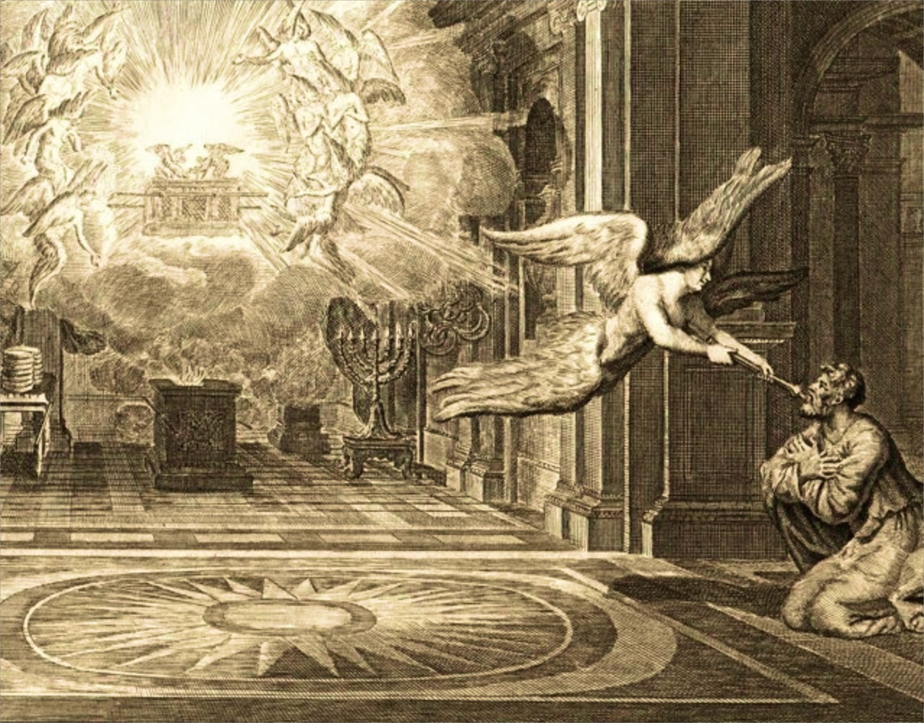
Isaiah 6

Slide 2
Isaiah 6:1
1 In the year of King Uzziah’s death I saw the Lord sitting on a throne, lofty and exalted, with the train of His robe filling the temple.

Slide 3
Isaiah 6:2
2 Seraphim stood above Him, each having six wings: with two he covered his face, and with two he covered his feet, and with two he flew.

Slide 4
Isaiah 6:3
3 And one called out to another and said, “Holy, Holy, Holy, is the LORD of hosts, The whole earth is full of His glory.”

Slide 5
Isaiah 6:4
4 And the foundations of the thresholds trembled at the voice of him who called out, while the temple was filling with smoke.

Slide 6
Isaiah 6:5
5 Then I said, “Woe is me, for I am ruined! Because I am a man of unclean lips, and I live among a people of unclean lips; For my eyes have seen the King, the LORD of hosts.”

Slide 7
Isaiah 6:6-7
6 Then one of the seraphim flew to me with a burning coal in his hand, which he had taken from the altar with tongs. 7 He touched my mouth with it and said, “Behold, this has touched your lips; and your iniquity is taken away and your sin is forgiven.”

Slide 8
Isaiah 6:8
Then I heard the voice of the Lord, saying, “Whom shall I send, and who will go for Us?” Then I said, “Here am I. Send me!”

Slide 9
Isaiah 6

Slide 10
Isaiah 40:12-13
12 Who has measured the waters in the hollow of His hand, and marked off the heavens by the span, and calculated the dust of the earth by the measure, and weighed the mountains in a balance and the hills in a pair of scales? 13 Who has directed the Spirit of the Lord, or as His counselor has informed Him?

Slide 11
Isaiah 40:14
14 With whom did He consult and who gave Him understanding? And who taught Him in the path of justice and taught Him knowledge and informed Him of the way of understanding?

Slide 12
Islam: Koran
“They do blaspheme who say Allah is one of three in a trinity; for there is no god except One Allah.” (Surah 5:73)

Slide 13
Jehovah’s Witnesses
“Jesus lived as a spirit person in heaven before he was born in Bethlehem. He was God’s first creation and the only one created directly by God.” www.jw.org.

Slide 14
Jehovah’s Witnesses
“The holy spirit is God’s power in action, his active force. . . . By referring to God’s spirit as his ‘hands,’ ‘fingers,’ or ‘breath,’ the Bible shows that the holy spirit is not a person.” www.jw.org.

Slide 15
Matthew 5:16
Let your light shine before men in such a way that they may see your good works, and glorify your Father who is in heaven.

Slide 16
Philippians 4:20
Now to our God and Father be the glory forever and ever. Amen.

Slide 17
John 1:1
In the beginning was the Word, and the Word was with God, and the Word was God.

Slide 18
Colossians 2:9
For in Him all the fullness of Deity dwells in bodily form.

Slide 19
Hebrews 9:14
how much more will the blood of Christ, who through the eternal Spirit offered Himself without blemish to God, cleanse your conscience from dead works to serve the living God?

Slide 20
1 Corinthians 2:11
Even so the thoughts of God no one knows except the Spirit of God.

Slide 21
Ephesians 2:17-18
17 and He came and preached peace to you who were far away, and peace to those who were near; 18 for through Him we both have our access in one Spirit to the Father.

Slide 22
Isaiah 6:9-10
9 He said, “Go, and tell this people: ‘Keep on listening, but do not perceive; keep on looking, but do not understand.’ 10 Render the hearts of this people insensitive, their ears dull, and their eyes dim, otherwise they might see with their eyes, hear with their ears, understand with their hearts, and return and be healed.”

Slide 23
Isaiah 1:2
2 Listen, O heavens, and hear, O earth; For the Lord speaks, “Sons I have reared and brought up, but they have revolted against Me.”

Slide 24
Isaiah 1:2-4
Listen, O heavens, and hear, O earth; For the Lord speaks, “Sons I have reared and brought up, but they have revolted against Me. 3 An ox knows its owner, and a donkey its master’s manger, but Israel does not know, My people do not understand.” 4 Alas, sinful nation, people weighed down with iniquity, offspring of evildoers, sons who act corruptly! They have abandoned the Lord, they have despised the Holy One of Israel, they have turned away from Him.

Slide 25
Isaiah 1:2-4
Listen, O heavens, and hear, O earth; For the Lord speaks, “Sons I have reared and brought up, but they have revolted against Me. 3 An ox knows its owner, and a donkey its master’s manger, but Israel does not know, My people do not understand.” 4 Alas, sinful nation, people weighed down with iniquity, offspring of evildoers, sons who act corruptly! They have abandoned the Lord, they have despised the Holy One of Israel, they have turned away from Him.

Slide 26
Isaiah 6

Slide 27
Isaiah 6:9-10
9 He said, “Go, and tell this people: ‘Keep on listening, but do not perceive; keep on looking, but do not understand.’ 10 Render the hearts of this people insensitive, their ears dull, and their eyes dim, otherwise they might see with their eyes, hear with their ears, understand with their hearts, and return and be healed.”

Slide 28
Isaiah 6

