Slide 1
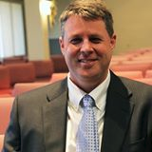
The Protestant Reformation: The Good, The Bad, and The Ugly Session 14
Andy Woods, Th.M.., JD., PhD.
Sr. Pastor, Sugar Land Bible Church
President Chafer Theological Seminary

Slide 2
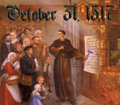
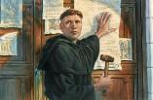
Introduction
Oct 31, 1517
500 years
Far reaching impact
Partial restoration
Restoration of a hermeneutic
Selectively applied
Subsequent generations applied consistently
Preview

Slide 3
Overview
The early church
The Alexandrian eclipse
The Dark Ages
The contribution of the Protestant Reformers
The Reformers’ incomplete revolution
Reformed Theology today
Dispensationalism & the completed revolution
Looking back 500 years later
Notes:
Outline

Slide 4
Overview
THE EARLY CHURCH
The Alexandrian eclipse
The Dark Ages
The contribution of the Protestant Reformers
The Reformers’ incomplete revolution
Reformed Theology today
Dispensationalism & the completed revolution
Looking back 500 years later
Notes:
Outline

Slide 5
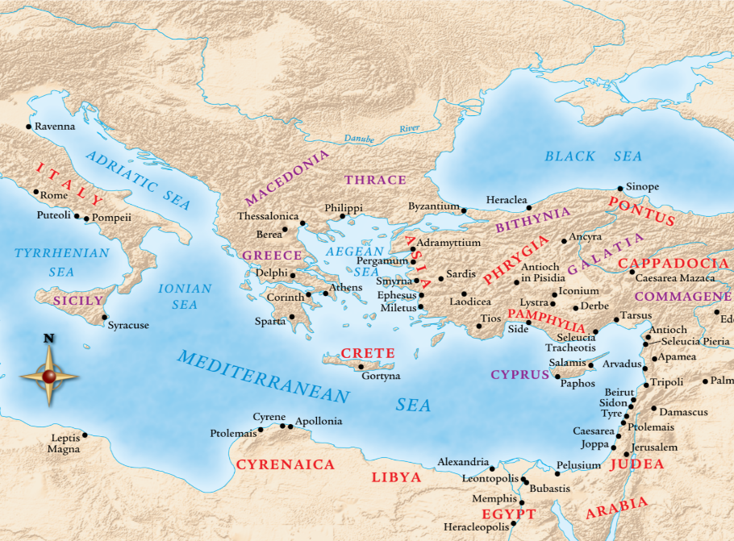

Slide 6
Overview
The early church
THE ALEXANDRIAN ECLIPSE
The Dark Ages
The contribution of the Protestant Reformers
The Reformers’ incomplete revolution
Reformed Theology today
Dispensationalism & the completed revolution
Looking back 500 years later
Notes:
Outline

Slide 8
Overview
The early church
The Alexandrian eclipse
THE DARK AGES
The contribution of the Protestant Reformers
The Reformers’ incomplete revolution
Reformed Theology today
Dispensationalism & the completed revolution
Looking back 500 years later
Notes:
Outline

Slide 9
Overview
The early church
The Alexandrian eclipse
The Dark Ages
THE CONTRIBUTION OF THE PROTESTANT REFORMERS
The Reformers’ incomplete revolution
Reformed Theology today
Dispensationalism & the completed revolution
Looking back 500 years later
Notes:
Outline

Slide 10
Overview
The early church
The Alexandrian eclipse
The Dark Ages
The Contribution of the Protestant Reformers
THE REFORMERS’ INCOMPLETE REVOLUTION
Reformed Theology today
Dispensationalism & the completed revolution
Looking back 500 years later
Notes:
Outline

Slide 11
Overview
The early church
The Alexandrian eclipse
The Dark Ages
The contribution of the Protestant Reformers
The Reformers’ incomplete revolution
REFORMED THEOLOGY TODAY
Dispensationalism & the completed revolution
Looking back 500 years later
Notes:
Outline

Slide 12
Overview
The early church
The Alexandrian eclipse
The Dark Ages
The Contribution of the Protestant Reformers
The Reformers’ Incomplete Revolution
Reformed Theology Today
DISPENSATIONALISM & THE COMPLETED REVOLUTION
Looking back 500 years later
Notes:
Outline

Slide 13
VII. Dispensationalism & the Completed Revolution
Dispensational movement
19th century
Reformers’ hermeneutic
Applied to the whole bible
Retrieved key doctrines: Chiliasm, Israel-church distinction, Pretribulationalism
Curb on anti-Semitism and Geneva social experiments
Key dispensational leaders
Notes:
Outline

Slide 14
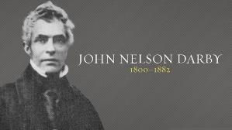
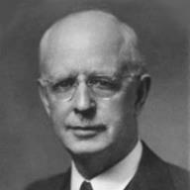
Dispensationalism Advocates
Key Dispensational Commentators
John Nelson Darby (1800–1882)
Sir Robert Anderson (1841–1918)
Cyrus Ingerson Scofield (1843–1921)
William Eugene Blackstone (1841–1935)
Henry Allen Ironside (1876–1951)
Lewis Sperry Chafer (1871–1952)

Slide 15
Dispensationalism Advocates
Key Dispensational Commentators
John Nelson Darby (1800–1882)
Sir Robert Anderson (1841–1918)
Cyrus Ingerson Scofield (1843–1921)
William Eugene Blackstone (1841–1935)
Henry Allen Ironside (1876–1951)
Lewis Sperry Chafer (1871–1952)

Slide 16
If the first 69 weeks were fulfilled literally then the remaining week will be fulfilled literally.

Slide 17
Sir Robert Anderson The Coming Prince, p.147-148
“There is not a single prophecy, of which the fulfillment is recorded in Scripture, that was not realized with absolute accuracy, and in every detail; and it is wholly unjustifiable to assume that a new system of fulfillment was inaugurated after the sacred canon closed…Literalness of fulfillment may therefore be accepted as an axiom to guide us in the study of prophecy.”

Slide 18
Dispensationalism Advocates
Key Dispensational Commentators
John Nelson Darby (1800–1882)
Sir Robert Anderson (1841–1918)
Cyrus Ingerson Scofield (1843–1921)
William Eugene Blackstone (1841–1935)
Henry Allen Ironside (1876–1951)
Lewis Sperry Chafer (1871–1952)

Slide 19
NEXT WEEK
The early church
The Alexandrian eclipse
The Dark Ages
The Contribution of the Protestant Reformers
The Reformers’ Incomplete Revolution
Reformed Theology Today
Dispensationalism & The Completed Revolution
LOOKING BACK 500 YEARS LATER
Notes:
Outline

Slide 20
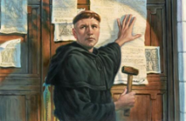
Conclusion
Oct 31, 1517
500 years
Rejoice over the Reformers
Not idolize the Reformers
Partial restoration
Restoration of a hermeneutic
Selectively applied
Seed-right method
Subsequent generations applied consistently
Review

Slide 21
Conclusion

Slide 22
Review
The early church
The Alexandrian eclipse
The Dark Ages
The contribution of the Protestant Reformers
The Reformers’ incomplete revolution
Reformed Theology today
Dispensationalism & the completed revolution
Looking back 500 years later
Notes:
Outline

