Slide 1
THE BOOK OF DANIEL
Andy Woods, Th.M.., JD., PhD.
Sr. Pastor, Sugar Land Bible Church
President Chafer Theological Seminary

Slide 2
Chapter 9 Outline
The Setting (1-2)
Daniel’s prayer (3-19)
Gabriel’s arrival (20-23)
The Seventy Weeks Prophecy (24-27)

Slide 3
The Seventy Weeks Prophecy 10 FACTS
Focus = Jews & Jerusalem (v.24b)
490 year period of time (v.24a)
360-day years
6 prophecies WILL BE fulfilled (v.24c)
March 5, 444 BC prophecy begins (25a)
483 years elapse between beginning of prophecy & Palm Sunday (25b)
Gap between 483rd & 484th year (26)
Final 7 years = future Tribulation period (27)
Dan. 9:27 Overview of Tribulation
Daniel 9:27 = Revelation 6-19

Slide 4
The Seventy Weeks Prophecy 10 FACTS
Focus = Jews & Jerusalem (v.24b)
490 year period of time (v.24a)
360-day years
6 prophecies WILL BE fulfilled (v.24c)
March 5, 444 BC prophecy begins (25a)
483 years elapse between beginning of prophecy & Palm Sunday (25b)
Gap between 483rd & 484th year (26)
Final 7 years = future Tribulation period (27)
Dan. 9:27 Overview of Tribulation
Daniel 9:27 = Revelation 6-19

Slide 5
Daniel 9:24 (NASB)
Seventy weeks have been decreed for your people and your holy city, to finish the transgression, to make an end of sin, to make atonement for iniquity, to bring in everlasting righteousness, to seal up vision and prophecy and to anoint the most holy place.

Slide 6
The Seventy Weeks Prophecy 10 FACTS
Focus = Jews & Jerusalem (v.24b)
490 year period of time (v.24a)
360-day years
6 prophecies WILL BE fulfilled (v.24c)
March 5, 444 BC prophecy begins (25a)
483 years elapse between beginning of prophecy & Palm Sunday (25b)
Gap between 483rd & 484th year (26)
Final 7 years = future Tribulation period (27)
Dan. 9:27 Overview of Tribulation
Daniel 9:27 = Revelation 6-19

Slide 7
Daniel 9:24 (NASB)
Seventy weeks have been decreed for your people and your holy city, to finish the transgression, to make an end of sin, to make atonement for iniquity, to bring in everlasting righteousness, to seal up vision and prophecy and to anoint the most holy place.

Slide 9
The Seventy Weeks Prophecy 10 FACTS
Focus = Jews & Jerusalem (v.24b)
490 year period of time (v.24a)
360-day years
6 prophecies WILL BE fulfilled (v.24c)
March 5, 444 BC prophecy begins (25a)
483 years elapse between beginning of prophecy & Palm Sunday (25b)
Gap between 483rd & 484th year (26)
Final 7 years = future Tribulation period (27)
Dan. 9:27 Overview of Tribulation
Daniel 9:27 = Revelation 6-19

Slide 10
360-day YEARS
TRIBULATION
Rev. 11:3 (1260 days)
Rev. 11:2 (42 months)
1260 days / 42 months = 30 days per month
30 days x 12 months = 360 days per year
THE FLOOD
Gen. 7:24 (150 days)
Gen. 7:11; 8:4 (5 months)
150 days / 5 months = 30 days per month
30 days x 12 months = 360 days per year

Slide 11
The Seventy Weeks Prophecy 10 FACTS
Focus = Jews & Jerusalem (v.24b)
490 year period of time (v.24a)
360-day years
6 prophecies WILL BE fulfilled (v.24c)
March 5, 444 BC prophecy begins (25a)
483 years elapse between beginning of prophecy & Palm Sunday (25b)
Gap between 483rd & 484th year (26)
Final 7 years = future Tribulation period (27)
Dan. 9:27 Overview of Tribulation
Daniel 9:27 = Revelation 6-19

Slide 12
Daniel 9:24 (NASB)
Seventy weeks have been decreed for your people and your holy city, to finish the transgression, to make an end of sin, to make atonement for iniquity, to bring in everlasting righteousness, to seal up vision and prophecy and to anoint the most holy place.

Slide 13
6 Prophecies WILL BE fulfilled V.24c
“to finish transgression”
“to make an end of sin”
“to make atonement for iniquity”
“to bring in everlasting righteousness”
“to seal up vision and prophecy”
“to anoint the most holy place”
Arnold Fructenbaum, Footsteps of the Messiah, p.191-4

Slide 14
The Seventy Weeks Prophecy 10 FACTS
Focus = Jews & Jerusalem (v.24b)
490 year period of time (v.24a)
360-day years
6 prophecies WILL BE fulfilled (v.24c)
March 5, 444 BC prophecy begins (25a)
483 years elapse between beginning of prophecy & Palm Sunday (25b)
Gap between 483rd & 484th year (26)
Final 7 years = future Tribulation period (27)
Dan. 9:27 Overview of Tribulation
Daniel 9:27 = Revelation 6-19

Slide 16
Daniel 9:25 (NASB)
So you are to know and discern that from the issuing of a decree to restore and rebuild Jerusalem until Messiah the Prince there will be seven weeks and sixty-two weeks; it will be built again, with plaza and moat, even in times of distress.

Slide 17
Nehemiah 2:1 (NASB)
And it came about in the month Nisan, in the twentieth year of King Artaxerxes, that wine was before him, and I took up the wine and gave it to the king. Now I had not been sad in his presence.

Slide 18
The Seventy Weeks Prophecy 10 FACTS
Focus = Jews & Jerusalem (v.24b)
490 year period of time (v.24a)
360-day years
6 prophecies WILL BE fulfilled (v.24c)
March 5, 444 BC prophecy begins (25a)
483 years elapse between beginning of prophecy & Palm Sunday (25b)
Gap between 483rd & 484th year (26)
Final 7 years = future Tribulation period (27)
Dan. 9:27 Overview of Tribulation
Daniel 9:27 = Revelation 6-19

Slide 19
Daniel 9:25 (NASB)
So you are to know and discern that from the issuing of a decree to restore and rebuild Jerusalem until Messiah the Prince there will be seven weeks and sixty-two weeks; it will be built again, with plaza and moat, even in times of distress.

Slide 20
Messiah must present Himself to Israel on March 30, A.D. 33 (Daniel 9:25)

Slide 21
The Seventy Weeks Prophecy 10 FACTS
Focus = Jews & Jerusalem (v.24b)
490 year period of time (v.24a)
360-day years
6 prophecies WILL BE fulfilled (v.24c)
March 5, 444 BC prophecy begins (25a)
483 years elapse between beginning of prophecy & Palm Sunday (25b)
Gap between 483rd & 484th year (26)
Final 7 years = future Tribulation period (27)
Dan. 9:27 Overview of Tribulation
Daniel 9:27 = Revelation 6-19

Slide 23
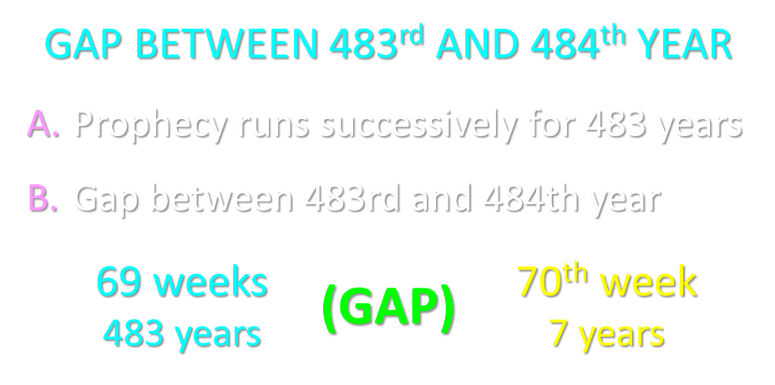

Slide 25
6 Reasons for Gap
Events prophesied v.26
Messiah crucified v.26a
70 AD holocaust v.26b
Prophecies in Dan. 9:24 would have been fulfilled 7 years after Palm Sunday
Jesus indicated a gap - (Matt. 24:15, 21-22, 29-30)
Daniel 9:27 was never fulfilled historically
Gap occurs elsewhere - (Is. 61:1-2; Luke 4:16-21; Isaiah 9:6)
Early church fathers indicated a gap

Slide 26
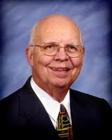
Purposes of the Local Church
Glorify God (Eph 3:21)
Edify the saints (Eph 4:11-16)
Fulfill the Great Commission (Matt 28:18-20)

Slide 27
The Seventy Weeks Prophecy 10 FACTS
Focus = Jews & Jerusalem (v.24b)
490 year period of time (v.24a)
360-day years
6 prophecies WILL BE fulfilled (v.24c)
March 5, 444 BC prophecy begins (25a)
483 years elapse between beginning of prophecy & Palm Sunday (25b)
Gap between 483rd & 484th year (26)
Final 7 years = future Tribulation period (27)
Dan. 9:27 Overview of Tribulation
Daniel 9:27 = Revelation 6-19

Slide 28
FINAL 7 YEARS = FUTURE TRIBULATION v.27
490 years total
483 years have transpired
7 years remain
Gap exists between 483rd & 484th year
Final 7 years are future
Final 7 years are the Tribulation period

Slide 29
The Seventy Weeks Prophecy 10 FACTS
Focus = Jews & Jerusalem (v.24b)
490 year period of time (v.24a)
360-day years
6 prophecies WILL BE fulfilled (v.24c)
March 5, 444 BC prophecy begins (25a)
483 years elapse between beginning of prophecy & Palm Sunday (25b)
Gap between 483rd & 484th year (26)
Final 7 years = future Tribulation period (27)
Dan. 9:27 Overview of Tribulation
Daniel 9:27 = Revelation 6-19

Slide 30
Daniel 9:27 (NASB)
And he will make a firm covenant with the many for one week, but in the middle of the week he will put a stop to sacrifice and grain offering; and on the wing of abominations will come one who makes desolate, even until a complete destruction, one that is decreed, is poured out on the one who makes desolate.

Slide 31
Daniel 9:27 = Tribulation Overview
Duration = 7 years
Starts = Peace Treaty
Mid-point = Temple Desecration
Conclude = Second Advent

Slide 34
THE STAGE IS BEING SET
Rebirth of Israel in 1948
Israel’s desire for peace
Desire among some Jews to Rebuild 3rd Jewish temple
Desire among some Jews to Restore the sacrificial system

Slide 35
THE STAGE IS BEING SET
Rebirth of Israel in 1948
Israel’s desire for peace
Desire among some Jews to Rebuild 3rd Jewish temple
Desire among some Jews to Restore the sacrificial system

Slide 36
Daniel 9:27 (NASB)
And he will make a firm covenant with the many for one week, but in the middle of the week he will put a stop to sacrifice and grain offering; and on the wing of abominations will come one who makes desolate, even until a complete destruction, one that is decreed, is poured out on the one who makes desolate.

Slide 37
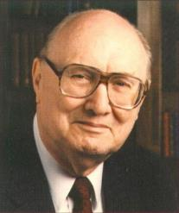
John Walvoord Israel in Prophecy, Page 26
“Of the many peculiar phenomena which characterize the present generation, few events can claim equal significance as far as Biblical prophecy is concerned with that of the return of Israel to their land. It constitutes a preparation for the end of the age, the setting for the coming of the Lord for His church, and the fulfillment of Israel’s prophetic destiny.”

Slide 38
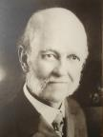
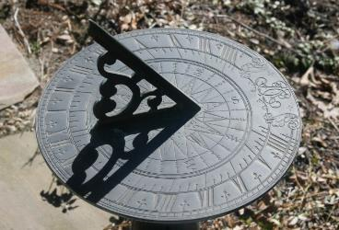
William E. Blackstone
Jesus Is Coming: God's Hope for a Restless World (New York: F.H. Revell, 1908; reprint, Grand Rapids: Kregel, 1989), 238.
“Israel is God's sun dial. If anyone desires to know our place in God’s chronology, our position in the great march of events, look at Israel.”

Slide 40
THE STAGE IS BEING SET
Rebirth of Israel in 1948
Israel’s desire for peace
Desire among some Jews to Rebuild 3rd Jewish temple
Desire among some Jews to Restore the sacrificial system

Slide 41
Daniel 9:27 (NASB)
And he will make a firm covenant with the many for one week, but in the middle of the week he will put a stop to sacrifice and grain offering; and on the wing of abominations will come one who makes desolate, even until a complete destruction, one that is decreed, is poured out on the one who makes desolate.

Slide 42
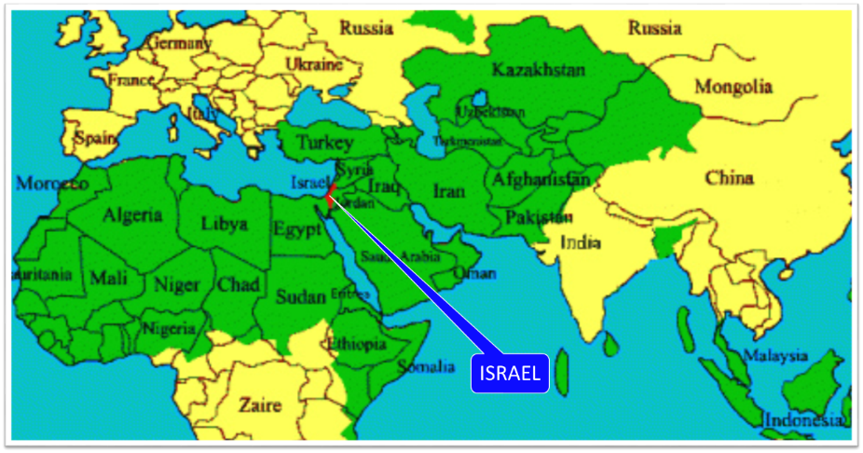

Slide 43
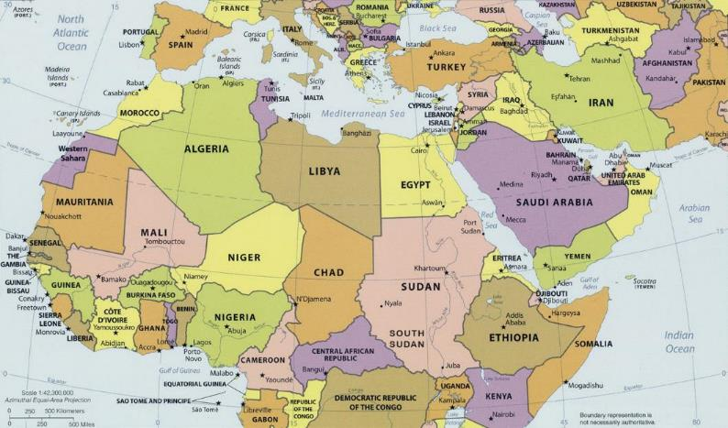
ISRAEL

Slide 44
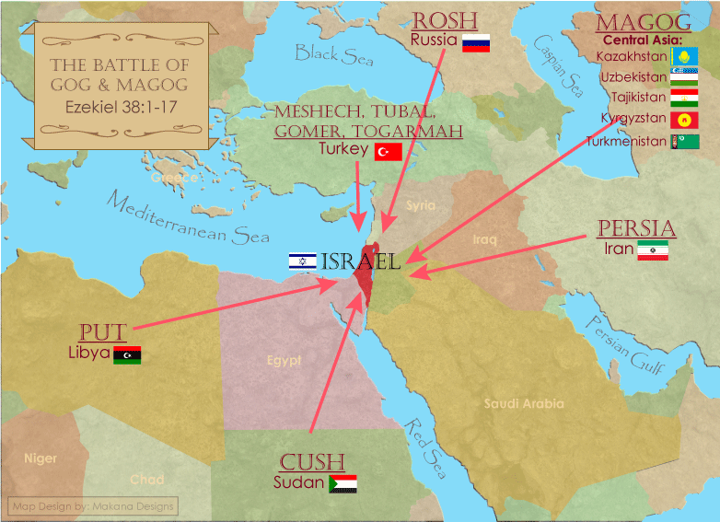

Slide 45
Transforming David Into Goliath?
 | NEIGHBORS | ISRAEL
Number of nations | 21 | 1
Size | 640 Times Israel’s Size | 1/19th Size of California
Population | 250 million (1.4 billion Muslims worldwide) | 6 million
Type of government | Dictatorships | Democratic-Republic
Wealth | Most of the world’s oil | Some potential oil discoveries
Peaceful co-existence? | Limited desire for peace (except for Egypt and Jordan) | Desire for peace
Holy book | Koran commands worldwide submission | Torah promises small allotment of land
http://www.mefacts.com/cached.asp?x_id=10190

Slide 46
THE STAGE IS BEING SET
Rebirth of Israel in 1948
Israel’s desire for peace
Desire among some Jews to Rebuild 3rd Jewish temple
Desire among some Jews to Restore the sacrificial system

Slide 47
Daniel 9:27 (NASB)
And he will make a firm covenant with the many for one week, but in the middle of the week he will put a stop to sacrifice and grain offering; and on the wing of abominations will come one who makes desolate, even until a complete destruction, one that is decreed, is poured out on the one who makes desolate.

Slide 48
ISRAEL’S FOUR TEMPLES
Solomon’s pre exilic temple (Kings and Chronicles)
Zerubbabel’s post exilic temple (Ezra 1-6; John 2:20)
Antichrist's temple (Dan 9:27; Matt 24:15; 2 Thess 2:4; Rev 11:1-2)
Millennial temple (Ezek 40-48)

Slide 49
ISRAEL’S FOUR TEMPLES
Solomon’s pre exilic temple (Kings and Chronicles)
Zerubbabel’s post exilic temple (Ezra 1-6; John 2:20)
Antichrist's temple (Dan 9:27; Matt 24:15; 2 Thess 2:4; Rev 11:1-2)
Millennial temple (Ezek 40-48)

Slide 52
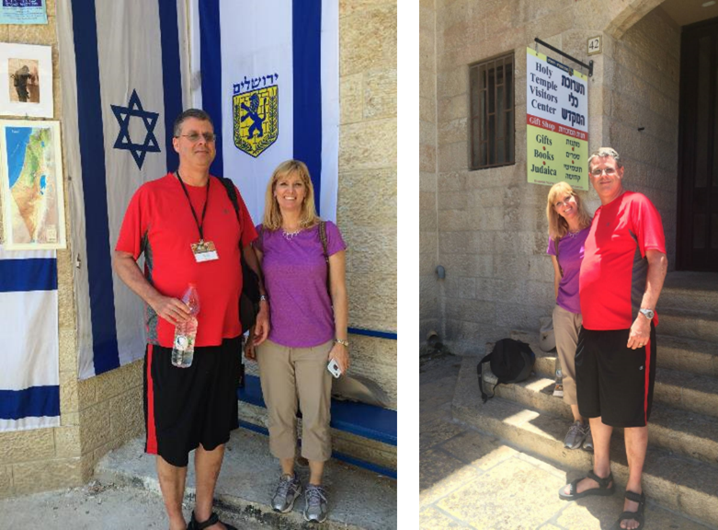

Slide 53
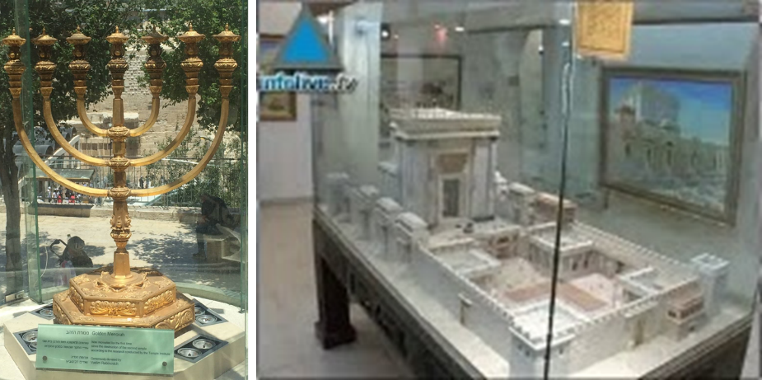

Slide 55
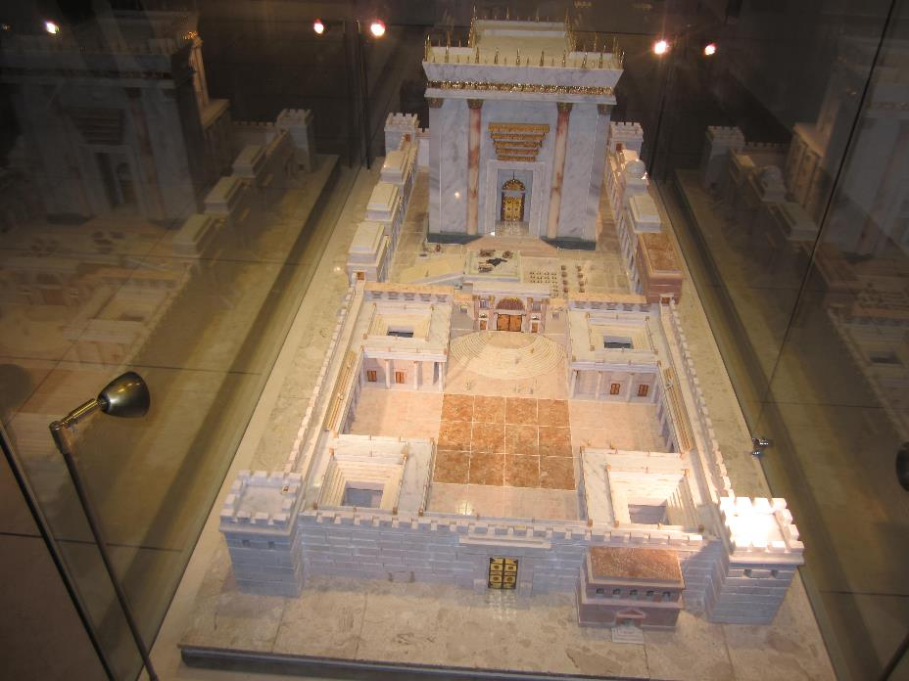

Slide 56
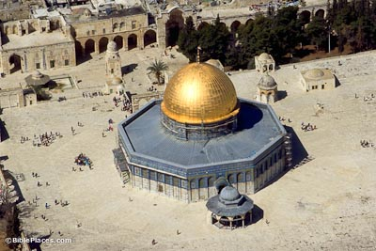

Slide 57
THE STAGE IS BEING SET
Rebirth of Israel in 1948
Israel’s desire for peace
Desire among some Jews to Rebuild 3rd Jewish temple
Desire among some Jews to Restore the sacrificial system

Slide 58
Daniel 9:27 (NASB)
And he will make a firm covenant with the many for one week, but in the middle of the week he will put a stop to sacrifice and grain offering; and on the wing of abominations will come one who makes desolate, even until a complete destruction, one that is decreed, is poured out on the one who makes desolate.

Slide 59
The Times of Israel April 6, 2017 In first, sheep slaughtered in Jerusalem Old City in reenactment of Passover sacrifice
“With priests blowing silver trumpets, a group of religious Jews slaughtered a sheep on Thursday in Jerusalem’s Old City to demonstrate the traditional paschal sacrifice, the first time such a reenactment has been held inside the city walls in 2,000 years.”
http://www.timesofisrael.com/in-a-first-sheep-slaughtered-in-jerusalem-old-city-in-reenactment-of-passover-sacrifice/#comments

Slide 60
THE STAGE IS BEING SET
Rebirth of Israel in 1948
Israel’s desire for peace
Desire among some Jews to Rebuild 3rd Jewish temple
Desire among some Jews to Restore the sacrificial system

Slide 61
The Seventy Weeks Prophecy 10 FACTS
Focus = Jews & Jerusalem (v.24b)
490 year period of time (v.24a)
360-day years
6 prophecies WILL BE fulfilled (v.24c)
March 5, 444 BC prophecy begins (25a)
483 years elapse between beginning of prophecy & Palm Sunday (25b)
Gap between 483rd & 484th year (26)
Final 7 years = future Tribulation period (27)
Dan. 9:27 Overview of Tribulation
Daniel 9:27 = Revelation 6-19

Slide 62
Daniel 9:27 (NASB)
And he will make a firm covenant with the many for one week, but in the middle of the week he will put a stop to sacrifice and grain offering; and on the wing of abominations will come one who makes desolate, even until a complete destruction, one that is decreed, is poured out on the one who makes desolate.

Slide 63
DANIEL 9:27 = REVELATION 6-19
Rebuilt temple (Rev. 11:1-2)
Division of the Tribulation into two 3½ year periods (Rev. 11:2. 13:5, 11:3, 12:6, 14)
Antichrist (Rev. 13:1-10)
Destruction of Antichrist (Rev. 19:20)
2nd Coming (Rev. 19:11-21)

Slide 64
DANIEL 9:27 = REVELATION 6-19
Rebuilt temple (Rev. 11:1-2)
Division of the Tribulation into two 3½ year periods (Rev. 11:2. 13:5, 11:3, 12:6, 14)
Antichrist (Rev. 13:1-10)
Destruction of Antichrist (Rev. 19:20)
2nd Coming (Rev. 19:11-21)

Slide 65
Daniel 9:27 (NASB)
And he will make a firm covenant with the many for one week, but in the middle of the week he will put a stop to sacrifice and grain offering; and on the wing of abominations will come one who makes desolate, even until a complete destruction, one that is decreed, is poured out on the one who makes desolate.

Slide 66
DANIEL 9:27 = REVELATION 6-19
Rebuilt temple (Rev. 11:1-2)
Division of the Tribulation into two 3½ year periods (Rev. 11:2. 13:5, 11:3, 12:6, 14)
Antichrist (Rev. 13:1-10)
Destruction of Antichrist (Rev. 19:20)
2nd Coming (Rev. 19:11-21)

Slide 67
Daniel 9:27 (NASB)
And he will make a firm covenant with the many for one week, but in the middle of the week he will put a stop to sacrifice and grain offering; and on the wing of abominations will come one who makes desolate, even until a complete destruction, one that is decreed, is poured out on the one who makes desolate.

Slide 68
DANIEL 9:27 = REVELATION 6-19
Rebuilt temple (Rev. 11:1-2)
Division of the Tribulation into two 3½ year periods (Rev. 11:2. 13:5, 11:3, 12:6, 14)
Antichrist (Rev. 13:1-10)
Destruction of Antichrist (Rev. 19:20)
2nd Coming (Rev. 19:11-21)

Slide 69
Daniel 9:27 (NASB)
And he will make a firm covenant with the many for one week, but in the middle of the week he will put a stop to sacrifice and grain offering; and on the wing of abominations will come one who makes desolate, even until a complete destruction, one that is decreed, is poured out on the one who makes desolate.

Slide 70
DANIEL 9:27 = REVELATION 6-19
Rebuilt temple (Rev. 11:1-2)
Division of the Tribulation into two 3½ year periods (Rev. 11:2. 13:5, 11:3, 12:6, 14)
Antichrist (Rev. 13:1-10)
Destruction of Antichrist (Rev. 19:20)
2nd Coming (Rev. 19:11-21)

Slide 71
Daniel 9:27 (NASB)
And he will make a firm covenant with the many for one week, but in the middle of the week he will put a stop to sacrifice and grain offering; and on the wing of abominations will come one who makes desolate, even until a complete destruction, one that is decreed, is poured out on the one who makes desolate.

Slide 72
Revelation 19:20 (NASB)
And the beast was seized, and with him the false prophet who performed the signs in his presence, by which he deceived those who had received the mark of the beast and those who worshiped his image; these two were thrown alive into the lake of fire which burns with brimstone.

Slide 73
DANIEL 9:27 = REVELATION 6-19
Rebuilt temple (Rev. 11:1-2)
Division of the Tribulation into two 3½ year periods (Rev. 11:2. 13:5, 11:3, 12:6, 14)
Antichrist (Rev. 13:1-10)
Destruction of Antichrist (Rev. 19:20)
2nd Coming (Rev. 19:11-21)

Slide 74
Daniel 9:27 (NASB)
And he will make a firm covenant with the many for one week, but in the middle of the week he will put a stop to sacrifice and grain offering; and on the wing of abominations will come one who makes desolate, even until a complete destruction, one that is decreed, is poured out on the one who makes desolate.

Slide 75
Revelation 19:20 (NASB)
And the beast was seized, and with him the false prophet who performed the signs in his presence, by which he deceived those who had received the mark of the beast and those who worshiped his image; these two were thrown alive into the lake of fire which burns with brimstone.

Slide 78
Revelation 1:19 (NASB)
Therefore write the things which you have seen, and the things which are, and the things which will take place after these things.

Slide 79
Rev 1:19
Seen (1)
Are (2–3)
After these things (4–22)

Slide 80
Revelation 4:1 (NASB)
After these things I looked, and behold, a door standing open in heaven, and the first voice which I had heard, like the sound of a trumpet speaking with me, said, “Come up here, and I will show you what must take place after these things.”

Slide 81
The Missing Church
Rev 4-19
Rev 13:9
Revelation’s Jewish nature

Slide 82
The Seventy Weeks Prophecy 10 FACTS
Focus = Jews & Jerusalem (v.24b)
490 year period of time (v.24a)
360-day years
6 prophecies WILL BE fulfilled (v.24c)
March 5, 444 BC prophecy begins (25a)
483 years elapse between beginning of prophecy & Palm Sunday (25b)
Gap between 483rd & 484th year (26)
Final 7 years = future Tribulation period (27)
Dan. 9:27 Overview of Tribulation
Daniel 9:27 = Revelation 6-19

Slide 83
Daniel 9:24 (NASB)
Seventy weeks have been decreed for your people and your holy city, to finish the transgression, to make an end of sin, to make atonement for iniquity, to bring in everlasting righteousness, to seal up vision and prophecy and to anoint the most holy place.

Slide 85
The Seventy Weeks Prophecy 10 FACTS
Focus = Jews & Jerusalem (v.24b)
490 year period of time (v.24a)
360-day years
6 prophecies WILL BE fulfilled (v.24c)
March 5, 444 BC prophecy begins (25a)
483 years elapse between beginning of prophecy & Palm Sunday (25b)
Gap between 483rd & 484th year (26)
Final 7 years = future Tribulation period (27)
Dan. 9:27 Overview of Tribulation
Daniel 9:27 = Revelation 6-19

Slide 86
Daniel 9:24 (NASB)
Seventy weeks have been decreed for your people and your holy city, to finish the transgression, to make an end of sin, to make atonement for iniquity, to bring in everlasting righteousness, to seal up vision and prophecy and to anoint the most holy place.

Slide 87
6 Prophecies WILL BE fulfilled V.24c
“to finish transgression”
“to make an end of sin”
“to make atonement for iniquity”
“to bring in everlasting righteousness”
“to seal up vision and prophecy”
“to anoint the most holy place”
Arnold Fructenbaum, Footsteps of the Messiah, p.191-4

Slide 89
Conclusion

Slide 90
The Seventy Weeks Prophecy 10 FACTS
Focus = Jews & Jerusalem (v.24b)
490 year period of time (v.24a)
360-day years
6 prophecies WILL BE fulfilled (v.24c)
March 5, 444 BC prophecy begins (25a)
483 years elapse between beginning of prophecy & Palm Sunday (25b)
Gap between 483rd & 484th year (26)
Final 7 years = future Tribulation period (27)
Dan. 9:27 Overview of Tribulation
Daniel 9:27 = Revelation 6-19

Slide 91
Chapter 9 Outline
The Setting (1-2)
Daniel’s prayer (3-19)
Gabriel’s arrival (20-23)
The Seventy Weeks Prophecy (24-27)

