Slide 1


Slide 2

The Coming Kingdom
Chapter 11
Dr. Andy Woods
Senior Pastor – Sugar Land Bible Church
President – Chafer Theological Seminary

Slide 3

Kingdom Study Outline
What does the Bible Say About the Kingdom?
The Main Problem with Kingdom Now NT interpretations
Why do some believe that we are in the kingdom now?
Why does it matter?

Slide 4
Kingdom Study Outline
What does the Bible Say About the Kingdom?
The Main Problem with Kingdom Now NT interpretations
Why do some believe that we are in the kingdom now?
Why does it matter?

Slide 5
1. Kingdom Throughout the Bible
Eden Abrahamic Covenant Mosaic Covenant Divided Kingdom Times of the Gentiles | Old Testament Prophets Post exile Offer of the King / Kingdom Rejection of the Offer Interim Age

Slide 6
1. Kingdom Throughout the Bible
Eden Abrahamic Covenant Mosaic Covenant Divided Kingdom Times of the Gentiles | Old Testament Prophets Post exile Offer of the King / Kingdom Rejection of the Offer Interim Age

Slide 7
1. Kingdom Throughout the Bible
Eden Abrahamic Covenant Mosaic Covenant Divided Kingdom Times of the Gentiles | Old Testament Prophets Post exile Offer of the King / Kingdom Rejection of the Offer Interim Age

Slide 8
1. Kingdom Throughout the Bible
Eden Abrahamic Covenant Mosaic Covenant Divided Kingdom Times of the Gentiles | Old Testament Prophets Post exile Offer of the King / Kingdom Rejection of the Offer Interim Age

Slide 9
1. Kingdom Throughout the Bible
Eden Abrahamic Covenant Mosaic Covenant Divided Kingdom Times of the Gentiles | Old Testament Prophets Post exile Offer of the King / Kingdom Rejection of the Offer Interim Age

Slide 10
1. Kingdom Throughout the Bible
Eden Abrahamic Covenant Mosaic Covenant Divided Kingdom Times of the Gentiles | Old Testament Prophets Post exile Offer of the King / Kingdom Rejection of the Offer Interim Age

Slide 11
1. Kingdom Throughout the Bible
Eden Abrahamic Covenant Mosaic Covenant Divided Kingdom Times of the Gentiles | Old Testament Prophets Post exile Offer of the King / Kingdom Rejection of the Offer Interim Age

Slide 12
1. Kingdom Throughout the Bible
Eden Abrahamic Covenant Mosaic Covenant Divided Kingdom Times of the Gentiles | Old Testament Prophets Post exile Offer of the King / Kingdom Rejection of the Offer Interim Age

Slide 13
1. Kingdom Throughout the Bible
Eden Abrahamic Covenant Mosaic Covenant Divided Kingdom Times of the Gentiles | Old Testament Prophets Post exile Offer of the King / Kingdom Rejection of the Offer Interim Age

Slide 14
1. Kingdom Throughout the Bible
Eden Abrahamic Covenant Mosaic Covenant Divided Kingdom Times of the Gentiles | Old Testament Prophets Post exile Offer of the King / Kingdom Rejection of the Offer Interim Age

Slide 15
1. Kingdom Throughout the Bible
Eden Abrahamic Covenant Mosaic Covenant Divided Kingdom Times of the Gentiles | Old Testament Prophets Post exile Offer of the King / Kingdom Rejection of the Offer Interim Age

Slide 16

THE INTERIM AGE
The Inter-advent Age (Matt. 13)
The Church Age (Matt. 16:18)

Slide 17
THE INTERIM AGE
The Inter-advent Age (Matt. 13)
The Church Age (Matt. 16:18)

Slide 18
Matthew 13 Parables
Public parables (13:1-2)
  Sower (13:1-9, 18-23)
  Wheat and tares (13:24-30, 36-43)
  Mustard seed (13:31-32)
  Leaven (13:33)
Private parables (13:36)
  Earthen treasure (13:44)
  Pearl of great price (13:45-46)
  Dragnet (13:47-50)
  Householder (13:51-52)

Slide 19
THE INTERIM AGE
The Inter-advent Age (Matt. 13)
The Church Age (Matt. 16:18)

Slide 20

The Church Age
The definition of the Church
The beginning of the Church
The purposes of the Church
The Church is not the Kingdom
The Church is not Israel

Slide 21
The Church Age
The definition of the Church
The beginning of the Church
The purposes of the Church
The Church is not the Kingdom
The Church is not Israel

Slide 22
1. The Definition of the Church
All (both Jew & Gentile) who have trusted in the very Messiah rejected by first-century national Israel (Gal. 3:28; Rom. 10:19; Eph. 2:14)
Intercalation
Does not fulfill Israel’s purposes

Slide 23
1. The Definition of the Church
All (both Jew & Gentile) who have trusted in the very Messiah rejected by first-century national Israel (Gal. 3:28; Rom. 10:19; Eph. 2:14)
Intercalation
Does not fulfill Israel’s purposes

Slide 24
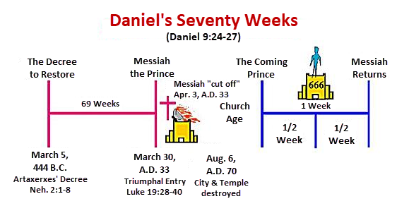

Slide 25
1. The Definition of the Church
All (both Jew & Gentile) who have trusted in the very Messiah rejected by first-century national Israel (Gal. 3:28; Rom. 10:19; Eph. 2:14)
Intercalation
Does not fulfill Israel’s purposes

Slide 26
The Church Age
The definition of the Church
The beginning of the Church
The purposes of the Church
The Church is not the Kingdom
The Church is not Israel

Slide 27

2. When Did the Church Begin?
Christ referred to the Church in the future tense (Matt. 16:18)
Paul referred to the Church as a “mystery” (Eph. 3:4-5, 9)
The Church did not exist prior to Acts 1 since Christ became the head of the Church (Eph. 5:23) after His Ascension (Eph. 1:20-22)
The Church did not exist prior to Acts 1 since spiritual gifts (1 Cor. 12:7; 14:26) only came into existence after His Ascension (Eph. 4:7-11)

Slide 28
2. When Did the Church Begin?
Christ referred to the Church in the future tense (Matt. 16:18)
Paul referred to the Church as a “mystery” (Eph. 3:4-5, 9)
The Church did not exist prior to Acts 1 since Christ became the head of the Church (Eph. 5:23) after His Ascension (Eph. 1:20-22)
The Church did not exist prior to Acts 1 since spiritual gifts (1 Cor. 12:7; 14:26) only came into existence after His Ascension (Eph. 4:7-11)

Slide 29

Matthew 16:18 (NASB)
I also say to you that you are Peter, and upon this rock I will build [oikodomeō] My church; and the gates of Hades will not overpower it.

Slide 30
Acts 7:38 (NASB)
This is the one who was in the congregation [ekklēsia] in the wilderness together with the angel who was speaking to him on Mount Sinai, and who was with our fathers; and he received living oracles to pass on to you.

Slide 31
2. When Did the Church Begin?
Christ referred to the Church in the future tense (Matt. 16:18)
Paul referred to the Church as a “mystery” (Eph. 3:4-5, 9)
The Church did not exist prior to Acts 1 since Christ became the head of the Church (Eph. 5:23) after His Ascension (Eph. 1:20-22)
The Church did not exist prior to Acts 1 since spiritual gifts (1 Cor. 12:7; 14:26) only came into existence after His Ascension (Eph. 4:7-11)

Slide 32
Romans 16:25-26 (NASB)
²⁵ “Now to Him who is able to establish you according to my gospel and the preaching of Jesus Christ, according to the revelation of the mystery which has been kept secret for long ages past, ²⁶ but now is manifested, and by the Scriptures of the prophets, according to the commandment of the eternal God, has been made known to all the nations, leading to obedience of faith.”

Slide 33
“Mystery” Defined
“In the N.T, it [mystērion] denotes, not the mysterious (as with the Eng. word), but that which, being outside the range of unassisted natural apprehension, can be made known only by Divine revelation, and is made known in a manner and at a time appointed by God, and to those who are illumined by His Spirit.”
W. E. Vine, Merrill F. Unger, and William White, Vine's Complete Expository Dictionary of the Old and New Testament Words (Nashville: Nelson, 1996), 424.

Slide 34
2. When Did the Church Begin?
Christ referred to the Church in the future tense (Matt. 16:18)
Paul referred to the Church as a “mystery” (Eph. 3:4-5, 9)
The Church did not exist prior to Acts 1 since Christ became the head of the Church (Eph. 5:23) after His Ascension (Eph. 1:20-22)
The Church did not exist prior to Acts 1 since spiritual gifts (1 Cor. 12:7; 14:26) only came into existence after His Ascension (Eph. 4:7-11)

Slide 35
2. When Did the Church Begin?
The Church existed before Paul’s conversion in Acts 9 (Acts 5:11; 8:1,3; Rom. 16:7)
The Baptizing ministry of the Holy Spirit began in Acts 2
  1 Cor. 12:13
  Acts 1:5
  Acts 11:15-16
  Acts 2:1-4, 37-41

Slide 36
The Church Age
The definition of the Church
The beginning of the Church
The purposes of the Church
The Church is not the Kingdom
The Church is not Israel

Slide 37

3. Purposes of the Local Church
Glorify God (Eph 3:21)
Edify the saints (Eph 4:11-16)
Fulfill the Great Commission (Matt 28:18-20)

Slide 38
Acts 15:14 (NASB)
Simeon has related how God first concerned Himself about taking from among the Gentiles a people for His name.

Slide 39
The Church Age
The definition of the Church
The beginning of the Church
The purposes of the Church
The Church is not the Kingdom
The Church is not Israel

Slide 40
4. Church ≠ Kingdom
Jesus Christ is never called the King of the Church
Jesus Christ’s relationship to His Church is never depicted through the King-Kingdom metaphor
Prolonged Church Age carnality
Church Age Gospel = believe (Acts 16:30-31)
Kingdom’s arrival is instantaneous (Dan. 2:44) while the Church's construction is gradual (Eph. 2:22)
Church = heir of the Kingdom (James 2:5)

Slide 41
4. Church ≠ Kingdom
Jesus Christ is never called the King of the Church
Jesus Christ’s relationship to His Church is never depicted through the King-Kingdom metaphor
Prolonged Church Age carnality
Church Age Gospel = believe (Acts 16:30-31)
Kingdom’s arrival is instantaneous (Dan. 2:44) while the Church's construction is gradual (Eph. 2:22)
Church = heir of the Kingdom (James 2:5)

Slide 42
Universal Church Word Pictures
Shepherd/sheep-John 10:16; Acts 20:28; Heb 13:20; 1 Pet 5:2-4
Head/body-Rom 12:5; 1 Cor 12:12-13; Eph 1:22-23
Bride/groom-Eph 5:22-31; 2 Cor 11:2
Temple-1 Cor 3:16-17; Eph 2:19-22; Gal 6:10
High priest/priesthood-Heb 4:14-15; 1 Pet 2:5-9; Rev 1:6
Pillar of truth-1 Tim 3:15
Vine and branches-John 15:1-8

Slide 43
4. Church ≠ Kingdom
Jesus Christ is never called the King of the Church
Jesus Christ’s relationship to His Church is never depicted through the King-Kingdom metaphor
Prolonged Church Age carnality
Church Age Gospel = believe (Acts 16:30-31)
Kingdom’s arrival is instantaneous (Dan. 2:44) while the Church's construction is gradual (Eph. 2:22)
Church = heir of the Kingdom (James 2:5)

Slide 44
1 Corinthians 3:1-3 (NKJV)
¹ And I, brethren, could not speak to you as to spiritual people but as to carnal, as to babes in Christ. ² I fed you with milk and not with solid food; for until now you were not able to receive it, and even now you are still not able; ³ for you are still carnal. For where there are envy, strife, and divisions among you, are you not carnal and behaving like mere men?

Slide 45

Notes:
Ray Steadman – “1st Californians”
Unbelievers vs Categories of Believers
Unbelievers – ψυχικός psuchikós; Natural, pertaining to the natural as distinguished from the spiritual
Spiritual Believers – πνευματικός pneumatikós; of persons who are spiritual, enlightened by the Holy Spirit
Infant Believers – σάρκινος sárkinos; with propensities of the flesh unto sin; νήπιος nḗpios; an infant, child, baby without any definite limitation of age. (This relates to immaturity and lack of instruction)
Carnal Believers – σαρκικός sarkikós; tendency to satisfy the flesh, implying sinfulness, sinful propensity, carnal (This relates to disobedience and open rebellion)

Slide 46
4. Church ≠ Kingdom
Jesus Christ is never called the King of the Church
Jesus Christ’s relationship to His Church is never depicted through the King-Kingdom metaphor
Prolonged Church Age carnality
Church Age Gospel = believe (Acts 16:30-31)
Kingdom’s arrival is instantaneous (Dan. 2:44) while the Church's construction is gradual (Eph. 2:22)
Church = heir of the Kingdom (James 2:5)

Slide 47
Messengers of the Kingdom In Matthew
John the Baptist – 3:2
Jesus Christ – 4:17
12 Apostles – 10:5-7
Seventy – Luke 10:1, 9
Toussaint, Behold the King, 18-20

Slide 48
Matthew 4:17 (NASB)
“From that time Jesus began to preach and say, ‘Repent, for the kingdom of heaven is at hand.’”

Slide 49
Acts 16:30-31 (NASB)
³⁰ and after he brought them out, he said, “Sirs, what must I do to be saved?” ³¹ They said, “Believe in the Lord Jesus, and you will be saved, you and your household.”

Slide 50
4. Church ≠ Kingdom
Jesus Christ is never called the King of the Church
Jesus Christ’s relationship to His Church is never depicted through the King-Kingdom metaphor
Prolonged Church Age carnality
Church Age Gospel = believe (Acts 16:30-31)
Kingdom’s arrival is instantaneous (Dan. 2:44) while the Church's construction is gradual (Eph. 2:22)
Church = heir of the Kingdom (James 2:5)

Slide 51
Progress Reports in Acts
Clearest: Acts 2:47; 6:7; 9:31; 12:24; 16:5; 19:20; 28:30-31
Less clear: Acts 1:15; 2:41; 4:4, 31; 5:14, 42; 8:25, 40; 11:21; 13:49; 17:6

Slide 52
4. Church ≠ Kingdom
Jesus Christ is never called the King of the Church
Jesus Christ’s relationship to His Church is never depicted through the King-Kingdom metaphor
Prolonged Church Age carnality
Church Age Gospel = believe (Acts 16:30-31)
Kingdom’s arrival is instantaneous (Dan. 2:44) while the Church's construction is gradual (Eph. 2:22)
Church = heir of the Kingdom (James 2:5)

Slide 53
4. Church ≠ Kingdom
Church suffers today (John 16:33)
Satanic influence on the Church (Ephes. 4:26-27)
The Times of the Gentiles continue
NT kingdom references predominantly future
Jesus Christ is never said to be ruling from David’s Throne now
Kingdom miracles (Isa. 35:5-6) are absent today (2 Tim. 4:20)
Kingdom prosperity (Amos 9:11-15) is absent today (Acts 11:28)

Slide 54
4. Church ≠ Kingdom
Church suffers today (John 16:33)
Satanic influence on the Church (Ephes. 4:26-27)
The Times of the Gentiles continue
NT kingdom references predominantly future
Jesus Christ is never said to be ruling from David’s Throne now
Kingdom miracles (Isa. 35:5-6) are absent today (2 Tim. 4:20)
Kingdom prosperity (Amos 9:11-15) is absent today (Acts 11:28)

Slide 55
Revelation 20:1-3 (NASB)
“Then I saw an angel coming down from heaven, holding the key of the abyss and a great chain in his hand. ² And he laid hold of the dragon, the serpent of old, who is the devil and Satan, and bound him for a thousand years; ³ and he threw him into the abyss, and shut it and sealed it over him, so that he would not deceive the nations any longer, until the thousand years were completed; after these things he must be released for a short time.”

Slide 56
4. Church ≠ Kingdom
Church suffers today (John 16:33)
Satanic influence on the Church (Ephes. 4:26-27)
The Times of the Gentiles continue
NT kingdom references predominantly future
Jesus Christ is never said to be ruling from David’s Throne now
Kingdom miracles (Isa. 35:5-6) are absent today (2 Tim. 4:20)
Kingdom prosperity (Amos 9:11-15) is absent today (Acts 11:28)

Slide 57


Statue
&
Stone

Slide 58
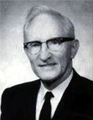
Merill F. Unger
Unger's Commentary on the Old Testament (Chicago: Moody, 1981; reprint, Chatanooga, TN: AMG, 2002), 1643.
“Hence, the iron kingdom with its feet of iron and clay (cf. Dan. 3:33-35, 40, 44) and the nondescript beast of 7:7-8 envision…the form in which it will exist after the church period, when God will resume His dealing with the nation Israel. How futile for conservative scholars to ignore that fact and to seek to find literal fulfillment of those prophecies in history or in the church, when those predictions refer to events yet future and have no application whatever to the church.”

Slide 59
4. Church ≠ Kingdom
Church suffers today (John 16:33)
Satanic influence on the Church (Ephes. 4:26-27)
The Times of the Gentiles continue
NT kingdom references predominantly future
Jesus Christ is never said to be ruling from David’s Throne now
Kingdom miracles (Isa. 35:5-6) are absent today (2 Tim. 4:20)
Kingdom prosperity (Amos 9:11-15) is absent today (Acts 11:28)

Slide 60
The Church Age
The definition of the Church
The beginning of the Church
The purposes of the Church
The Church is not the Kingdom
The Church is not Israel

Slide 61


Exodus 19:5-6
“Now then, if you will indeed obey My voice and keep My covenant, then you shall be My own possession among all the peoples, for all the earth is Mine; and you shall be to Me a kingdom of priests and a holy nation.’ These are the words that you shall speak to the sons of Israel.”

Slide 62
Deuteronomy 17:15
“you shall surely set a king over you whom the Lord your God chooses, one from among your countrymen you shall set as king over yourselves; you may not put a foreigner over yourselves who is not your countryman.”

Slide 63
Matthew 23:37-39 (NASB)
“Jerusalem, Jerusalem, who kills the prophets and stones those who are sent to her! How often I wanted to gather your children together, the way a hen gathers her chicks under her wings, and you were unwilling. ³⁸ Behold, your house is being left to you desolate! ³⁹ For I say to you, from now on you will not see Me until you say, ‘Blessed is He who comes in the name of the Lord!”

Slide 64
5. Discontinuity Between Israel & the Church
 | ISRAEL | CHURCH
Marriage | Wife | Bride
Christ | Birthed Christ | Birthed by Christ
Return | 2nd advent | Rapture
Leader | King | Head, Groom
Beginning | Gen 12 | Acts 2
Scripture | 4/5 | 1/5
Covenants | Parties | Beneficiaries
Nation | Political | Spiritual

Slide 65
5. Discontinuity Between Israel & the Church
 | ISRAEL | CHURCH
Marriage | Wife | Bride
Christ | Birthed Christ | Birthed by Christ
Return | 2nd advent | Rapture
Leader | King | Head, Groom
Beginning | Gen 12 | Acts 2
Scripture | 4/5 | 1/5
Covenants | Parties | Beneficiaries
Nation | Political | Spiritual

Slide 66

Joshua 24:2-3

Slide 67
5. Discontinuity Between Israel & the Church
 | ISRAEL | CHURCH
Marriage | Wife | Bride
Christ | Birthed Christ | Birthed by Christ
Return | 2nd advent | Rapture
Leader | King | Head, Groom
Beginning | Gen 12 | Acts 2
Scripture | 4/5 | 1/5
Covenants | Parties | Beneficiaries
Nation | Political | Spiritual

Slide 68
5. Discontinuity Between Israel & the Church
 | ISRAEL | CHURCH
Marriage | Wife | Bride
Christ | Birthed Christ | Birthed by Christ
Return | 2nd advent | Rapture
Leader | King | Head, Groom
Beginning | Gen 12 | Acts 2
Scripture | 4/5 | 1/5
Covenants | Parties | Beneficiaries
Nation | Political | Spiritual

Slide 69


Slide 70
5. Discontinuity Between Israel & the Church
 | ISRAEL | CHURCH
Marriage | Wife | Bride
Christ | Birthed Christ | Birthed by Christ
Return | 2nd advent | Rapture
Leader | King | Head, Groom
Beginning | Gen 12 | Acts 2
Scripture | 4/5 | 1/5
Covenants | Parties | Beneficiaries
Nation | Political | Spiritual

Slide 71


Slide 72
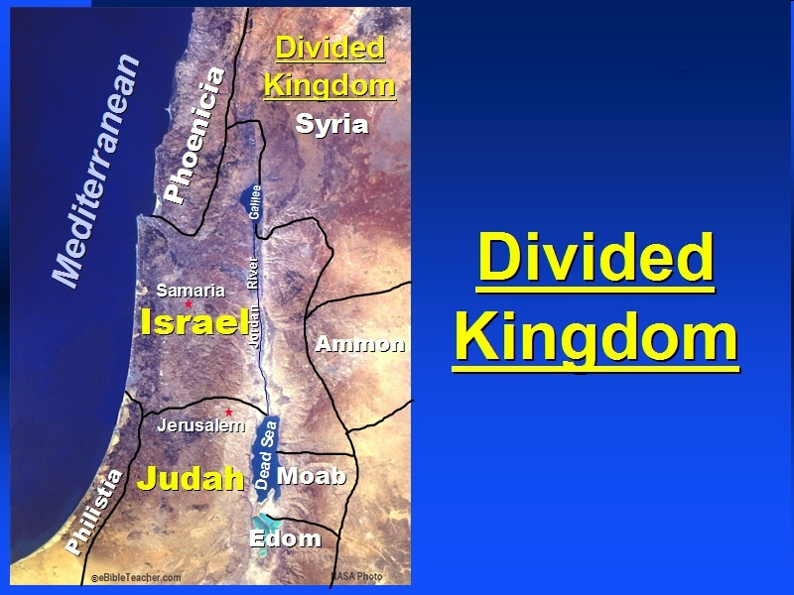

Slide 73
5. Discontinuity Between Israel & the Church
 | Israel | Church
Wars | Political | Spiritual
Timing | A quo / ad quem | No time indicators
Priesthood | Have a priesthood | Are a priesthood
Temple | Physical | Body
Resurrection | 1st resurrection | Rapture
Judgment | Earthly (Ezek. 20:33-44) | Heavenly (Bema)
New Jerusalem | Gates | Foundations
Entrance | Physical birth | Spiritual birth

Slide 74
5. Discontinuity Between Israel & the Church
 | Israel | Church
Wars | Political | Spiritual
Timing | A quo / ad quem | No time indicators
Priesthood | Have a priesthood | Are a priesthood
Temple | Physical | Body
Resurrection | 1st resurrection | Rapture
Judgment | Earthly (Ezek. 20:33-44) | Heavenly (Bema)
New Jerusalem | Gates | Foundations
Entrance | Physical birth | Spiritual birth

Slide 75


Slide 76
Levitical Feasts (23)
Feast | Season | Purpose | Type
Passover | Spring | Redemption | 1 Cor 5:7
Unleavened Bread | Spring | Separation | John 6:35
1st fruits | Spring | Praise | 1 Cor 15:20
Pentecost | Spring | Praise | Acts 2:1-4
Trumpets | Fall | New Year | Matt 24:31
Atonement | Fall | Lev 16 | Zech 12:10
Booths | Fall | Wilderness provision | Zech 14:16-18

Slide 77


Slide 78
5. Discontinuity Between Israel & the Church
 | Israel | Church
Wars | Political | Spiritual
Timing | A quo / ad quem | No time indicators
Priesthood | Have a priesthood | Are a priesthood
Temple | Physical | Body
Resurrection | 1st resurrection | Rapture
Judgment | Earthly (Ezek. 20:33-44) | Heavenly (Bema)
New Jerusalem | Gates | Foundations
Entrance | Physical birth | Spiritual birth

Slide 79
5. Discontinuity Between Israel & the Church
 | Israel | Church
Wars | Political | Spiritual
Timing | A quo / ad quem | No time indicators
Priesthood | Have a priesthood | Are a priesthood
Temple | Physical | Body
Resurrection | 1st resurrection | Rapture
Judgment | Earthly (Ezek. 20:33-44) | Heavenly (Bema)
New Jerusalem | Gates | Foundations
Entrance | Physical birth | Spiritual birth

Slide 80
ISRAEL’S FOUR TEMPLES
Solomon’s pre exilic temple (Kings and Chronicles)
Zerubbabel’s post exilic temple (Ezra 1-6; John 2:20)
Antichrist's temple (Dan 9:27; Matt 24:15; 2 Thess 2:4; Rev 11:1-2)
Millennial temple (Ezek 40-48)

Slide 81
5. Discontinuity Between Israel & the Church
 | Israel | Church
Wars | Political | Spiritual
Timing | A quo / ad quem | No time indicators
Priesthood | Have a priesthood | Are a priesthood
Temple | Physical | Body
Resurrection | 1st resurrection | Rapture
Judgment | Earthly (Ezek. 20:33-44) | Heavenly (Bema)
New Jerusalem | Gates | Foundations
Entrance | Physical birth | Spiritual birth

Slide 82
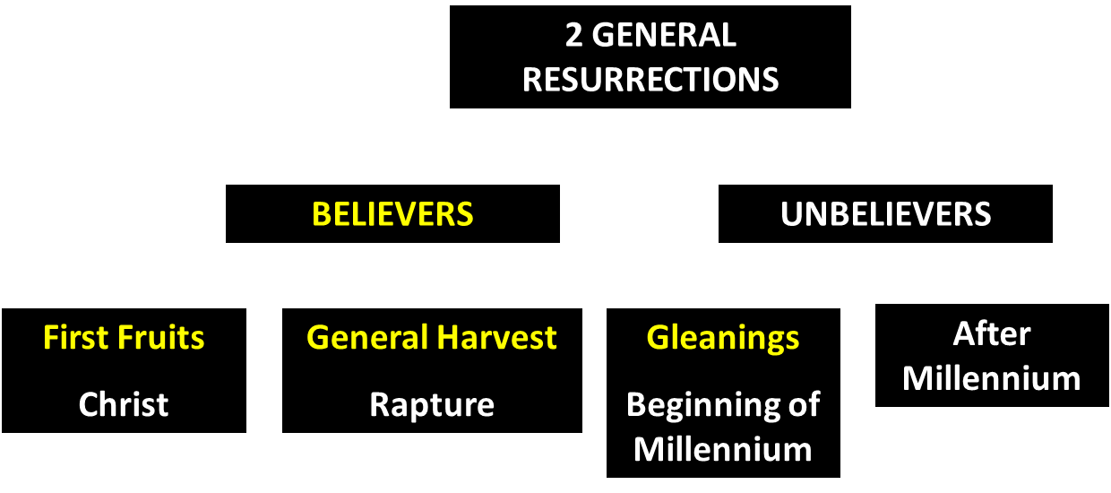
God’s Resurrection Program

Slide 83
5. Discontinuity Between Israel & the Church
 | Israel | Church
Wars | Political | Spiritual
Timing | A quo / ad quem | No time indicators
Priesthood | Have a priesthood | Are a priesthood
Temple | Physical | Body
Resurrection | 1st resurrection | Rapture
Judgment | Earthly (Ezek. 20:33-44) | Heavenly (Bema)
New Jerusalem | Gates | Foundations
Entrance | Physical birth | Spiritual birth

Slide 84
5. Discontinuity Between Israel & the Church
 | Israel | Church
Wars | Political | Spiritual
Timing | A quo / ad quem | No time indicators
Priesthood | Have a priesthood | Are a priesthood
Temple | Physical | Body
Resurrection | 1st resurrection | Rapture
Judgment | Earthly (Ezek. 20:33-44) | Heavenly (Bema)
New Jerusalem | Gates | Foundations
Entrance | Physical birth | Spiritual birth

Slide 85
Ephesians 2:20 (NASB)
“having been built on the foundation of the apostles and prophets, Christ Jesus Himself being the corner stone.”

Slide 86
5. Discontinuity Between Israel & the Church
 | Israel | Church
Wars | Political | Spiritual
Timing | A quo / ad quem | No time indicators
Priesthood | Have a priesthood | Are a priesthood
Temple | Physical | Body
Resurrection | 1st resurrection | Rapture
Judgment | Earthly (Ezek. 20:33-44) | Heavenly (Bema)
New Jerusalem | Gates | Foundations
Entrance | Physical birth | Spiritual birth

Slide 87
5. Discontinuity Between Israel & the Church
 | Israel | Church
Governing principle | Law | NT
Relation to HS | Selective, temporary, subsequent | Universal, permanent, at moment of salvation
Farewell address | Olivet Discourse | Upper Room Discourse
Designation | First Born Son | Bride of Christ
Revealed in OT | Yes | No
Evangelism | Come & See | Go & Proclaim
Blessings | Earthly | Heavenly
Composition | Believers & Unbelievers | Believers Only

Slide 88
5. Discontinuity Between Israel & the Church
 | Israel | Church
Governing principle | Law | NT
Relation to HS | Selective, temporary, subsequent | Universal, permanent, at moment of salvation
Farewell address | Olivet Discourse | Upper Room Discourse
Designation | First Born Son | Bride of Christ
Revealed in OT | Yes | No
Evangelism | Come & See | Go & Proclaim
Blessings | Earthly | Heavenly
Composition | Believers & Unbelievers | Believers Only

Slide 89
Work of the Spirit in the OT & Gospels
Pattern of Holy Spirit’s present work is not found in the OT or Gospels
  John 7:37-39
  John 14:16-17
  Acts 1:5

Slide 90
Work of the Spirit in the OT vs. Church Age
 | OT/Gospels | Today
Reception of all of the Spirit at the moment of salvation? | Subsequent to salvation (Exod 31:3) | At moment of salvation (Rom 8:9)
How long is the indwelling? | Temporary indwelling (1 Sam 16:14; Ps 51:11) | Permanent indwelling (John 14:16)
Who is indwelt? | Selective indwelling (Joel 2:28) | Universal indwelling (1 Cor 12:13)

Slide 91
5. Discontinuity Between Israel & the Church
 | Israel | Church
Governing principle | Law | NT
Relation to HS | Selective, temporary, subsequent | Universal, permanent, at moment of salvation
Farewell address | Olivet Discourse | Upper Room Discourse
Designation | First Born Son | Bride of Christ
Revealed in OT | Yes | No
Evangelism | Come & See | Go & Proclaim
Blessings | Earthly | Heavenly
Composition | Believers & Unbelievers | Believers Only

Slide 92
Discourse
 | OLIVET | UPPER ROOM
SCRIPTURE | Matt 24─25 | John 13─17
LOCATION | Mount of Olives | Upper Room
PASSION WEEK | Third day | Sixth day
GENERAL FOCUS | Farewell: Israel | Hello: Church
SPECIFIC FOCUS | Israel’s future | Divine provisions
PROMPTING | Temple's destruction | Christ's imminent departure
EXPLANATIONS | Written OT | Unwritten NT

Slide 93
5. Discontinuity Between Israel & the Church
 | Israel | Church
Governing principle | Law | NT
Relation to HS | Selective, temporary, subsequent | Universal, permanent, at moment of salvation
Farewell address | Olivet Discourse | Upper Room Discourse
Designation | First Born Son | Bride of Christ
Revealed in OT | Yes | No
Evangelism | Come & See | Go & Proclaim
Blessings | Earthly | Heavenly
Composition | Believers & Unbelievers | Believers Only

Slide 94
5. Discontinuity Between Israel & the Church
 | Israel | Church
Governing principle | Law | NT
Relation to HS | Selective, temporary, subsequent | Universal, permanent, at moment of salvation
Farewell address | Olivet Discourse | Upper Room Discourse
Designation | First Born Son | Bride of Christ
Revealed in OT | Yes | No
Evangelism | Come & See | Go & Proclaim
Blessings | Earthly | Heavenly
Composition | Believers & Unbelievers | Believers Only

Slide 95
1 Corinthians 3:1-3 (NKJV)
¹ And I, brethren, could not speak to you as to spiritual people but as to carnal, as to babes in Christ. ² I fed you with milk and not with solid food; for until now you were not able to receive it, and even now you are still not able; ³ for you are still carnal. For where there are envy, strife, and divisions among you, are you not carnal and behaving like mere men?

Slide 96
Notes:
Ray Steadman – “1st Californians”
Unbelievers vs Categories of Believers
Unbelievers – ψυχικός psuchikós; Natural, pertaining to the natural as distinguished from the spiritual
Spiritual Believers – πνευματικός pneumatikós; of persons who are spiritual, enlightened by the Holy Spirit
Infant Believers – σάρκινος sárkinos; with propensities of the flesh unto sin; νήπιος nḗpios; an infant, child, baby without any definite limitation of age. (This relates to immaturity and lack of instruction)
Carnal Believers – σαρκικός sarkikós; tendency to satisfy the flesh, implying sinfulness, sinful propensity, carnal (This relates to disobedience and open rebellion)

Slide 97
Conclusion

Slide 98
THE INTERIM AGE
The Inter-advent Age (Matt. 13)
The Church Age (Matt. 16:18)

Slide 99
The Church Age
The definition of the Church
The beginning of the Church
The purposes of the Church
The Church is not the Kingdom
The Church is not Israel

