Slide 1
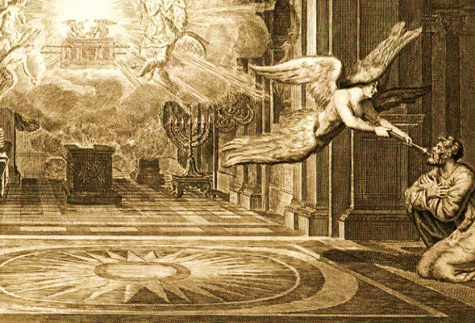
Isaiah 6

Slide 2
Isaiah 6 Outline
God’s holiness demands that we submit to Him. (Isaiah 6:1-7)
Rebellion against God is self-destructive (Isaiah 6:8-10)

Slide 3
Isaiah 6 Outline
God’s holiness demands that we submit to Him. (Isaiah 6:1-7)
Rebellion against God is self-destructive (Isaiah 6:8-10)

Slide 4
Isaiah 6:8
Then I heard the voice of the Lord, saying, “Whom shall I send, and who will go for Us?” Then I said, “Here am I. Send me!”

Slide 5
Isaiah 6:9-10
9 He said, “Go, and tell this people: ‘Keep on listening, but do not perceive; keep on looking, but do not understand.’ 10 Render the hearts of this people insensitive, their ears dull, and their eyes dim, otherwise they might see with their eyes, hear with their ears, understand with their hearts, and return and be healed.”

Slide 6
Isaiah 1:4
Alas, sinful nation, people weighed down with iniquity, offspring of evildoers, sons who act corruptly! They have abandoned the Lord, they have despised the Holy One of Israel, they have turned away from Him.

Slide 7
Matthew 23:37
“O Jerusalem, Jerusalem, you who kill the prophets and stone those who are sent to you! How often I have longed to gather your children together as a hen gathers her chicks under her wings, but you would have none of it!”

Slide 8
Isaiah 6

Slide 9
Genesis 12:1-3
1 Now the LORD said to Abram, “Go forth from your country, and from your relatives and from your father’s house, to the land which I will show you; 2 and I will make you a great nation and I will bless you, and make your name great; and so you shall be a blessing; 3 and I will bless those who bless you, and the one who curses you I will curse. And in you all the families of the earth will be blessed.”

Slide 10
Isaiah 6

Slide 11
Genesis 15:18-21
18 On that day the LORD made a covenant with Abram, saying, “To your descendants I have given this land, from the river of Egypt as far as the great river, the river Euphrates: 19 the Kenite and the Kenizzite and the Kadmonite 20 and the Hittite and the Perizzite and the Rephaim 21 and the Amorite and the Canaanite and the Girgashite and the Jebusite.”

Slide 12
Romans 11:28
From the standpoint of the gospel they are enemies for your sake, but from the standpoint of God’s choice they are beloved for the sake of the fathers;

Slide 13
Isaiah 6 Outline
God’s holiness demands that we submit to Him. (Isaiah 6:1-7)
Rebellion against God is self-destructive (Isaiah 6:8-10)
God’s plan marches on despite rebellion against Him. (Isaiah 6:8-13)

Slide 14
Isaiah 6:9-10
9 He said, “Go, and tell this people: ‘Keep on listening, but do not perceive; keep on looking, but do not understand.’ 10 Render the hearts of this people insensitive, their ears dull, and their eyes dim, otherwise they might see with their eyes, hear with their ears, understand with their hearts, and return and be healed.”

Slide 15
Isaiah 6:11-13
11 Then I said, “Lord, how long?” And He answered, “Until cities are devastated and without inhabitant, houses are without people and the land is utterly desolate, 12 The Lord has removed men far away, and the forsaken places are many in the midst of the land. 13 Yet there will be a tenth portion in it, and it will again be subject to burning, like a terebinth or an oak whose stump remains when it is felled. The holy seed is its stump.”

Slide 16
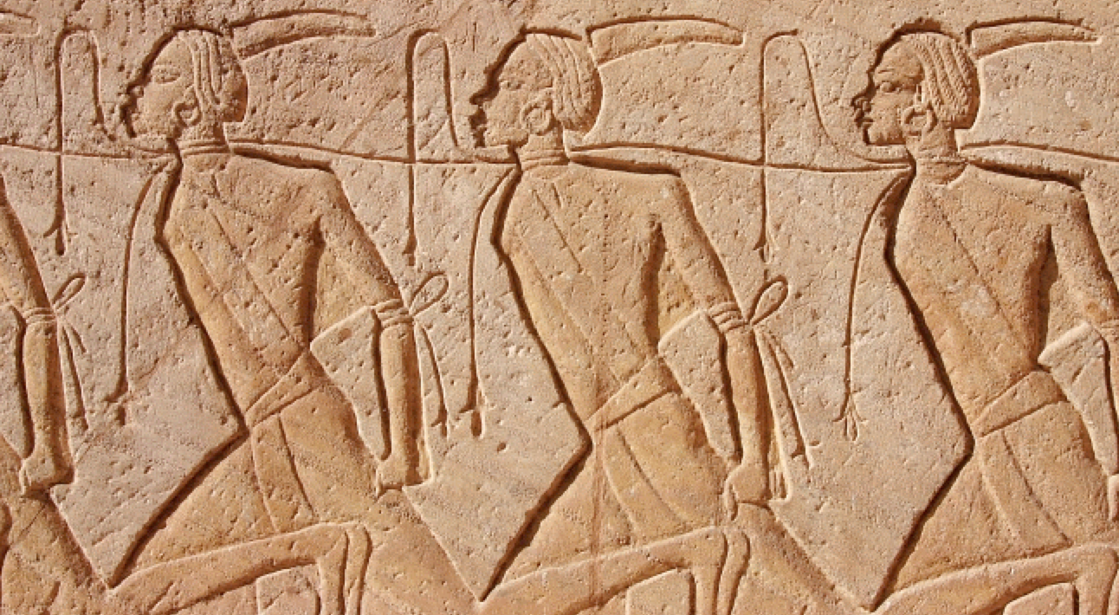
Enslaved Exiles

Slide 17
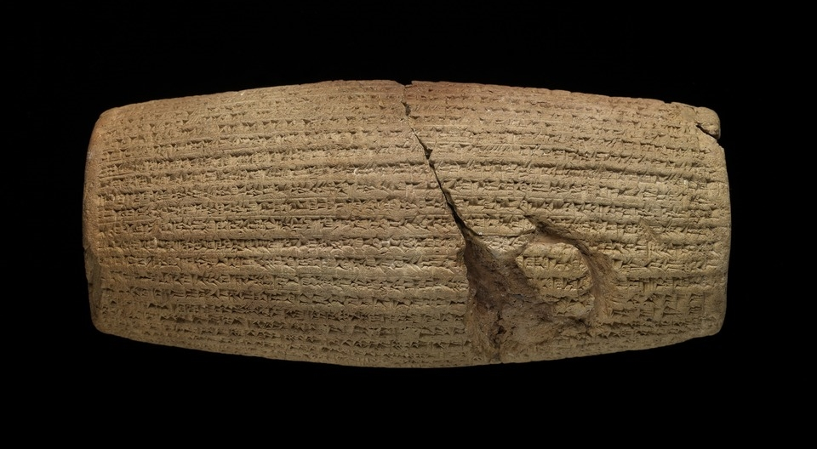
Cyrus Cylinder

Slide 18
Isaiah 6

Slide 19
John 12:36-38
36 . . . These things Jesus spoke, and He went away and hid Himself from them. 37 But though He had performed so many signs before them, yet they were not believing in Him. 38 This was to fulfill the word of Isaiah the prophet which he spoke: “Lord, who has believed our report? And to whom has the arm of the Lord been revealed?”

Slide 20
John 12:39-41
39 For this reason they could not believe, for Isaiah said again, 40 “He has blinded their eyes and He hardened their heart, so that they would not see with their eyes and perceive with their heart, and be converted and I heal them.” 41 These things Isaiah said because he saw His glory, and he spoke of Him.

Slide 21
John 12:39-41
39 For this reason they could not believe, for Isaiah said again, 40 “He has blinded their eyes and He hardened their heart, so that they would not see with their eyes and perceive with their heart, and be converted and I heal them.” 41 These things Isaiah said because he [Isaiah] saw His glory [Jesus’ glory], and he [Isaiah] spoke of Him [Jesus].

Slide 22
Isaiah 6 Outline
God’s holiness demands that we submit to Him. (Isaiah 6:1-7)
Rebellion against God is self-destructive (Isaiah 6:8-10)
God’s plan marches on despite rebellion against Him. (Isaiah 6:8-13)

Slide 23
Isaiah 6

