Slide 1


Slide 2

The Coming Kingdom
Chapter 11
Dr. Andy Woods
Senior Pastor – Sugar Land Bible Church
President – Chafer Theological Seminary

Slide 3

Kingdom Study Outline
What does the Bible Say About the Kingdom?
The Main Problem with Kingdom Now NT interpretations
Why do some believe that we are in the kingdom now?
Why does it matter?

Slide 4
Kingdom Study Outline
What does the Bible Say About the Kingdom?
The Main Problem with Kingdom Now NT interpretations
Why do some believe that we are in the kingdom now?
Why does it matter?

Slide 5
1. Kingdom Throughout the Bible
Eden Abrahamic Covenant Mosaic Covenant Divided Kingdom Times of the Gentiles | Old Testament Prophets Post exile Offer of the King / Kingdom Rejection of the Offer Interim Age

Slide 6
1. Kingdom Throughout the Bible
Eden Abrahamic Covenant Mosaic Covenant Divided Kingdom Times of the Gentiles | Old Testament Prophets Post exile Offer of the King / Kingdom Rejection of the Offer Interim Age

Slide 7

THE INTERIM AGE
The Inter-advent Age (Matt. 13)
The Church Age (Matt. 16:18)

Slide 8
THE INTERIM AGE
The Inter-advent Age (Matt. 13)
The Church Age (Matt. 16:18)

Slide 9
Matthew 13 Parables
Public parables (13:1-2)
  Sower (13:1-9, 18-23)
  Wheat and tares (13:24-30, 36-43)
  Mustard seed (13:31-32)
  Leaven (13:33)
Private parables (13:36)
  Earthen treasure (13:44)
  Pearl of great price (13:45-46)
  Dragnet (13:47-50)
  Householder (13:51-52)

Slide 10
THE INTERIM AGE
The Inter-advent Age (Matt. 13)
The Church Age (Matt. 16:18)

Slide 11

The Church Age
The definition of the Church
The beginning of the Church
The purposes of the Church
The Church is not the Kingdom
The Church is not Israel

Slide 12
The Church Age
The definition of the Church
The beginning of the Church
The purposes of the Church
The Church is not the Kingdom
The Church is not Israel

Slide 13
1. The Definition of the Church
All (both Jew & Gentile) who have trusted in the very Messiah rejected by first-century national Israel (Gal. 3:28; Rom. 10:19; Eph. 2:14)
Intercalation
Does not fulfill Israel’s purposes

Slide 14
The Church Age
The definition of the Church
The beginning of the Church
The purposes of the Church
The Church is not the Kingdom
The Church is not Israel

Slide 15

2. When Did the Church Begin?
Christ referred to the Church in the future tense (Matt. 16:18)
Paul referred to the Church as a “mystery” (Eph. 3:4-5, 9)
The Church did not exist prior to Acts 1 since Christ became the head of the Church (Eph. 5:23) after His Ascension (Eph. 1:20-22)
The Church did not exist prior to Acts 1 since spiritual gifts (1 Cor. 12:7; 14:26) only came into existence after His Ascension (Eph. 4:7-11)

Slide 16
2. When Did the Church Begin?
The Church existed before Paul’s conversion in Acts 9 (Acts 5:11; 8:1,3; Rom. 16:7)
The Baptizing (joining, uniting, identifying) ministry of the Holy Spirit began in Acts 2
  1 Cor. 12:13
  Acts 1:5
  Acts 11:15-16
  Acts 2:1-4, 37-41

Slide 17
The Church Age
The definition of the Church
The beginning of the Church
The purposes of the Church
The Church is not the Kingdom
The Church is not Israel

Slide 18

3. Purposes of the Local Church
Glorify God (Eph 3:21)
Edify the saints (Eph 4:11-16)
Fulfill the Great Commission (Matt 28:18-20)

Slide 19

Acts 15:14 (NASB)
Simeon has related how God first concerned Himself about taking from among the Gentiles a people for His name.

Slide 20
The Church Age
The definition of the Church
The beginning of the Church
The purposes of the Church
The Church is not the Kingdom
The Church is not Israel

Slide 21
4. Church ≠ Kingdom
Jesus Christ is never called the King of the Church
Jesus Christ’s relationship to His Church is never depicted through the King-Kingdom metaphor
Prolonged Church Age carnality
Church Age Gospel = believe (Acts 16:30-31)
Kingdom’s arrival is instantaneous (Dan. 2:44) while the Church's construction is gradual (Eph. 2:22)
Church = heir of the Kingdom (James 2:5)

Slide 22
4. Church ≠ Kingdom
Jesus Christ is never called the King of the Church
Jesus Christ’s relationship to His Church is never depicted through the King-Kingdom metaphor
Prolonged Church Age carnality
Church Age Gospel = believe (Acts 16:30-31)
Kingdom’s arrival is instantaneous (Dan. 2:44) while the Church's construction is gradual (Eph. 2:22)
Church = heir of the Kingdom (James 2:5)

Slide 23
Universal Church Word Pictures
Shepherd/sheep-John 10:16; Acts 20:28; Heb 13:20; 1 Pet 5:2-4
Head/body-Rom 12:5; 1 Cor 12:12-13; Eph 1:22-23
Bride/groom-Eph 5:22-31; 2 Cor 11:2
Temple-1 Cor 3:16-17; Eph 2:19-22; Gal 6:10
High priest/priesthood-Heb 4:14-15; 1 Pet 2:5-9; Rev 1:6
Pillar of truth-1 Tim 3:15
Vine and branches-John 15:1-8

Slide 24
4. Church ≠ Kingdom
Jesus Christ is never called the King of the Church
Jesus Christ’s relationship to His Church is never depicted through the King-Kingdom metaphor
Prolonged Church Age carnality
Church Age Gospel = believe (Acts 16:30-31)
Kingdom’s arrival is instantaneous (Dan. 2:44) while the Church's construction is gradual (Eph. 2:22)
Church = heir of the Kingdom (James 2:5)

Slide 25
1 Corinthians 3:1-3 (NKJV)
¹ And I, brethren, could not speak to you as to spiritual people but as to carnal, as to babes in Christ. ² I fed you with milk and not with solid food; for until now you were not able to receive it, and even now you are still not able; ³ for you are still carnal. For where there are envy, strife, and divisions among you, are you not carnal and behaving like mere men?

Slide 26

Notes:
Ray Steadman – “1st Californians”
Unbelievers vs Categories of Believers
Unbelievers – ψυχικός psuchikós; Natural, pertaining to the natural as distinguished from the spiritual
Spiritual Believers – πνευματικός pneumatikós; of persons who are spiritual, enlightened by the Holy Spirit
Infant Believers – σάρκινος sárkinos; with propensities of the flesh unto sin; νήπιος nḗpios; an infant, child, baby without any definite limitation of age. (This relates to immaturity and lack of instruction)
Carnal Believers – σαρκικός sarkikós; tendency to satisfy the flesh, implying sinfulness, sinful propensity, carnal (This relates to disobedience and open rebellion)

Slide 27


Slide 28
4. Church ≠ Kingdom
Jesus Christ is never called the King of the Church
Jesus Christ’s relationship to His Church is never depicted through the King-Kingdom metaphor
Prolonged Church Age carnality
Church Age Gospel = believe (Acts 16:30-31)
Kingdom’s arrival is instantaneous (Dan. 2:44) while the Church's construction is gradual (Eph. 2:22)
Church = heir of the Kingdom (James 2:5)

Slide 29
Messengers of the Kingdom In Matthew
John the Baptist – 3:2
Jesus Christ – 4:17
12 Apostles – 10:5-7
Seventy – Luke 10:1, 9
Toussaint, Behold the King, 18-20

Slide 30
Matthew 4:17 (NASB)
“From that time Jesus began to preach and say, ‘Repent, for the kingdom of heaven is at hand.’”

Slide 31
Matthew 10:5-7 (NASB)
“These twelve Jesus sent out after instructing them: “Do not go in the way of the Gentiles, and do not enter any city of the Samaritans; ⁶ but rather go to the lost sheep of the house of Israel. ⁷ And as you go, preach, saying, ‘The kingdom of heaven is at hand.’”

Slide 32
Acts 16:30-31 (NASB)
³⁰ and after he brought them out, he said, “Sirs, what must I do to be saved?” ³¹ They said, “Believe in the Lord Jesus, and you will be saved, you and your household.”

Slide 33
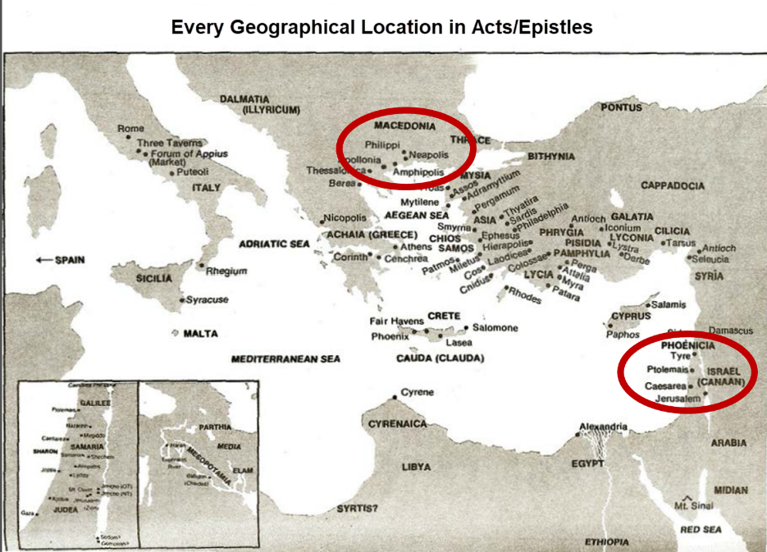

Slide 34
4. Church ≠ Kingdom
Jesus Christ is never called the King of the Church
Jesus Christ’s relationship to His Church is never depicted through the King-Kingdom metaphor
Prolonged Church Age carnality
Church Age Gospel = believe (Acts 16:30-31)
Kingdom’s arrival is instantaneous (Dan. 2:44) while the Church's construction is gradual (Eph. 2:22)
Church = heir of the Kingdom (James 2:5)

Slide 35


Statue
&
Stone

Slide 36
Progress Reports in Acts
Clearest: Acts 2:47; 6:7; 9:31; 12:24; 16:5; 19:20; 28:30-31
Less clear: Acts 1:15; 2:41; 4:4, 31; 5:14, 42; 8:25, 40; 11:21; 13:49; 17:6

Slide 37
4. Church ≠ Kingdom
Jesus Christ is never called the King of the Church
Jesus Christ’s relationship to His Church is never depicted through the King-Kingdom metaphor
Prolonged Church Age carnality
Church Age Gospel = believe (Acts 16:30-31)
Kingdom’s arrival is instantaneous (Dan. 2:44) while the Church's construction is gradual (Eph. 2:22)
Church = heir of the Kingdom (James 2:5)

Slide 38
4. Church ≠ Kingdom
Church suffers today (John 16:33)
Satanic influence on the Church (Ephes. 4:26-27)
The Times of the Gentiles continue
NT kingdom references predominantly future
Jesus Christ is never said to be ruling from David’s Throne now
Kingdom miracles (Isa. 35:5-6) are absent today (2 Tim. 4:20)
Kingdom prosperity (Amos 9:11-15) is absent today (Acts 11:28)

Slide 39
4. Church ≠ Kingdom
Church suffers today (John 16:33)
Satanic influence on the Church (Ephes. 4:26-27)
The Times of the Gentiles continue
NT kingdom references predominantly future
Jesus Christ is never said to be ruling from David’s Throne now
Kingdom miracles (Isa. 35:5-6) are absent today (2 Tim. 4:20)
Kingdom prosperity (Amos 9:11-15) is absent today (Acts 11:28)

Slide 40
Revelation 20:1-3 (NASB)
“Then I saw an angel coming down from heaven, holding the key of the abyss and a great chain in his hand. ² And he laid hold of the dragon, the serpent of old, who is the devil and Satan, and bound him for a thousand years; ³ and he threw him into the abyss, and shut it and sealed it over him, so that he would not deceive the nations any longer, until the thousand years were completed; after these things he must be released for a short time.”

Slide 41
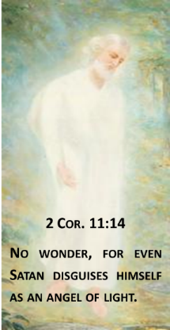

Satan Uses Believers
Peter – Matt. 16:21-23
Ananias & Sapphira – Acts 5:3-4, 11
Ephesians – Ephes. 4:26-27

Slide 42
4. Church ≠ Kingdom
Church suffers today (John 16:33)
Satanic influence on the Church (Ephes. 4:26-27)
The Times of the Gentiles continue
NT kingdom references predominantly future
Jesus Christ is never said to be ruling from David’s Throne now
Kingdom miracles (Isa. 35:5-6) are absent today (2 Tim. 4:20)
Kingdom prosperity (Amos 9:11-15) is absent today (Acts 11:28)

Slide 43
Statue
&
Stone

Slide 44
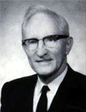
Merill F. Unger
Unger's Commentary on the Old Testament (Chicago: Moody, 1981; reprint, Chatanooga, TN: AMG, 2002), 1643.
“Hence, the iron kingdom with its feet of iron and clay (cf. Dan. 3:33-35, 40, 44) and the nondescript beast of 7:7-8 envision…the form in which it will exist after the church period, when God will resume His dealing with the nation Israel. How futile for conservative scholars to ignore that fact and to seek to find literal fulfillment of those prophecies in history or in the church, when those predictions refer to events yet future and have no application whatever to the church.”

Slide 45
4. Church ≠ Kingdom
Church suffers today (John 16:33)
Satanic influence on the Church (Ephes. 4:26-27)
The Times of the Gentiles continue
NT kingdom references predominantly future
Jesus Christ is never said to be ruling from David’s Throne now
Kingdom miracles (Isa. 35:5-6) are absent today (2 Tim. 4:20)
Kingdom prosperity (Amos 9:11-15) is absent today (Acts 11:28)

Slide 46
4. Church ≠ Kingdom
Church suffers today (John 16:33)
Satanic influence on the Church (Ephes. 4:26-27)
The Times of the Gentiles continue
NT kingdom references predominantly future
Jesus Christ is never said to be ruling from David’s Throne now
Kingdom miracles (Isa. 35:5-6) are absent today (2 Tim. 4:20)
Kingdom prosperity (Amos 9:11-15) is absent today (Acts 11:28)

Slide 47
Christ’s Three Offices
Prophet – 1st Coming (Matt. 4:17)
Priest – Present Session (Heb. 4:15)
King – 2nd Coming (Isa. 9:6-7; Matt. 25:31)

Slide 48
4. Church ≠ Kingdom
Church suffers today (John 16:33)
Satanic influence on the Church (Ephes. 4:26-27)
The Times of the Gentiles continue
NT kingdom references predominantly future
Jesus Christ is never said to be ruling from David’s Throne now
Kingdom miracles (Isa. 35:5-6) are absent today (2 Tim. 4:20)
Kingdom prosperity (Amos 9:11-15) is absent today (Acts 11:28)

Slide 49
Order of Paul’s Letters
Galatians (A.D. 49)
1‒2 Thessalonians (A.D. 51)
1‒2 Corinthians (A.D. 56)
Romans (A.D. 57)
Ephesians, Colossians, Philemon, Philippians (A.D. 60‒62)
1 Timothy, Titus (A.D. 62‒66)
2 Timothy (A.D. 67)

Slide 50
Order of Paul’s Letters
Galatians (A.D. 49)
1‒2 Thessalonians (A.D. 51)
1‒2 Corinthians (A.D. 56)
Romans (A.D. 57)
Ephesians, Colossians, Philemon, Philippians (A.D. 60‒62)
1 Timothy, Titus (A.D. 62‒66)
2 Timothy (A.D. 67)

Slide 51
4. Church ≠ Kingdom
Church suffers today (John 16:33)
Satanic influence on the Church (Ephes. 4:26-27)
The Times of the Gentiles continue
NT kingdom references predominantly future
Jesus Christ is never said to be ruling from David’s Throne now
Kingdom miracles (Isa. 35:5-6) are absent today (2 Tim. 4:20)
Kingdom prosperity (Amos 9:11-15) is absent today (Acts 11:28)

Slide 52
Conclusion

Slide 53
THE INTERIM AGE
The Inter-advent Age (Matt. 13)
The Church Age (Matt. 16:18)

Slide 54
The Church Age
The definition of the Church
The beginning of the Church
The purposes of the Church
The Church is not the Kingdom
The Church is not Israel

