Slide 1

THE BOOK OF DANIEL
Andy Woods, Th.M.., JD., PhD.
Sr. Pastor, Sugar Land Bible Church
President Chafer Theological Seminary

Slide 2

Chapter 9 Outline
The Setting (1-2)
Daniel’s prayer (3-19)
Gabriel’s arrival (20-23)
The Seventy Weeks Prophecy (24-27)

Slide 3
The Seventy Weeks Prophecy 10 FACTS
Focus = Jews & Jerusalem (v.24b)
490 year period of time (v.24a)
360-day years
6 prophecies WILL BE fulfilled (v.24c)
March 5, 444 BC prophecy begins (25a)
483 years elapse between beginning of prophecy & Palm Sunday (25b)
Gap between 483rd & 484th year (26)
Final 7 years = future Tribulation period (27)
Dan. 9:27 Overview of Tribulation
Daniel 9:27 = Revelation 6-19

Slide 4
The Seventy Weeks Prophecy 10 FACTS
Focus = Jews & Jerusalem (v.24b)
490 year period of time (v.24a)
360-day years
6 prophecies WILL BE fulfilled (v.24c)
March 5, 444 BC prophecy begins (25a)
483 years elapse between beginning of prophecy & Palm Sunday (25b)
Gap between 483rd & 484th year (26)
Final 7 years = future Tribulation period (27)
Dan. 9:27 Overview of Tribulation
Daniel 9:27 = Revelation 6-19

Slide 5

Daniel 9:24 (NASB)
Seventy weeks have been decreed for your people and your holy city, to finish the transgression, to make an end of sin, to make atonement for iniquity, to bring in everlasting righteousness, to seal up vision and prophecy and to anoint the most holy place.

Slide 6
The Seventy Weeks Prophecy 10 FACTS
Focus = Jews & Jerusalem (v.24b)
490 year period of time (v.24a)
360-day years
6 prophecies WILL BE fulfilled (v.24c)
March 5, 444 BC prophecy begins (25a)
483 years elapse between beginning of prophecy & Palm Sunday (25b)
Gap between 483rd & 484th year (26)
Final 7 years = future Tribulation period (27)
Dan. 9:27 Overview of Tribulation
Daniel 9:27 = Revelation 6-19

Slide 7
Daniel 9:24 (NASB)
Seventy weeks have been decreed for your people and your holy city, to finish the transgression, to make an end of sin, to make atonement for iniquity, to bring in everlasting righteousness, to seal up vision and prophecy and to anoint the most holy place.

Slide 8


Slide 9
The Seventy Weeks Prophecy 10 FACTS
Focus = Jews & Jerusalem (v.24b)
490 year period of time (v.24a)
360-day years
6 prophecies WILL BE fulfilled (v.24c)
March 5, 444 BC prophecy begins (25a)
483 years elapse between beginning of prophecy & Palm Sunday (25b)
Gap between 483rd & 484th year (26)
Final 7 years = future Tribulation period (27)
Dan. 9:27 Overview of Tribulation
Daniel 9:27 = Revelation 6-19

Slide 10
360-day YEARS
TRIBULATION
  Rev. 11:3 (1260 days)
  Rev. 11:2 (42 months)
  1260 days / 42 months = 30 days per month
  30 days x 12 months = 360 days per year
THE FLOOD
  Gen. 7:24 (150 days)
  Gen. 7:11; 8:4 (5 months)
  150 days / 5 months = 30 days per month
  30 days x 12 months = 360 days per year

Slide 11
The Seventy Weeks Prophecy 10 FACTS
Focus = Jews & Jerusalem (v.24b)
490 year period of time (v.24a)
360-day years
6 prophecies WILL BE fulfilled (v.24c)
March 5, 444 BC prophecy begins (25a)
483 years elapse between beginning of prophecy & Palm Sunday (25b)
Gap between 483rd & 484th year (26)
Final 7 years = future Tribulation period (27)
Dan. 9:27 Overview of Tribulation
Daniel 9:27 = Revelation 6-19

Slide 12
Daniel 9:24 (NASB)
Seventy weeks have been decreed for your people and your holy city, to finish the transgression, to make an end of sin, to make atonement for iniquity, to bring in everlasting righteousness, to seal up vision and prophecy and to anoint the most holy place.

Slide 13

6 Prophecies WILL BE fulfilled V.24c
  “to finish transgression”
  “to make an end of sin”
  “to make atonement for iniquity”
  “to bring in everlasting righteousness”
  “to seal up vision and prophecy”
  “to anoint the most holy place”
Arnold Fructenbaum, Footsteps of the Messiah, p.191-4

Slide 14
The Seventy Weeks Prophecy 10 FACTS
Focus = Jews & Jerusalem (v.24b)
490 year period of time (v.24a)
360-day years
6 prophecies WILL BE fulfilled (v.24c)
March 5, 444 BC prophecy begins (25a)
483 years elapse between beginning of prophecy & Palm Sunday (25b)
Gap between 483rd & 484th year (26)
Final 7 years = future Tribulation period (27)
Dan. 9:27 Overview of Tribulation
Daniel 9:27 = Revelation 6-19

Slide 16
Daniel 9:25 (NASB)
So you are to know and discern that from the issuing of a decree to restore and rebuild Jerusalem until Messiah the Prince there will be seven weeks and sixty-two weeks; it will be built again, with plaza and moat, even in times of distress.

Slide 17
Nehemiah 2:1 (NASB)
And it came about in the month Nisan, in the twentieth year of King Artaxerxes, that wine was before him, and I took up the wine and gave it to the king. Now I had not been sad in his presence.

Slide 18
The Seventy Weeks Prophecy 10 FACTS
Focus = Jews & Jerusalem (v.24b)
490 year period of time (v.24a)
360-day years
6 prophecies WILL BE fulfilled (v.24c)
March 5, 444 BC prophecy begins (25a)
483 years elapse between beginning of prophecy & Palm Sunday (25b)
Gap between 483rd & 484th year (26)
Final 7 years = future Tribulation period (27)
Dan. 9:27 Overview of Tribulation
Daniel 9:27 = Revelation 6-19

Slide 19
Daniel 9:25 (NASB)
So you are to know and discern that from the issuing of a decree to restore and rebuild Jerusalem until Messiah the Prince there will be seven weeks and sixty-two weeks; it will be built again, with plaza and moat, even in times of distress.

Slide 20

Messiah must present Himself to Israel on March 30, A.D. 33 (Daniel 9:25)

Slide 21
The Seventy Weeks Prophecy 10 FACTS
Focus = Jews & Jerusalem (v.24b)
490 year period of time (v.24a)
360-day years
6 prophecies WILL BE fulfilled (v.24c)
March 5, 444 BC prophecy begins (25a)
483 years elapse between beginning of prophecy & Palm Sunday (25b)
Gap between 483rd & 484th year (26)
Final 7 years = future Tribulation period (27)
Dan. 9:27 Overview of Tribulation
Daniel 9:27 = Revelation 6-19

Slide 23
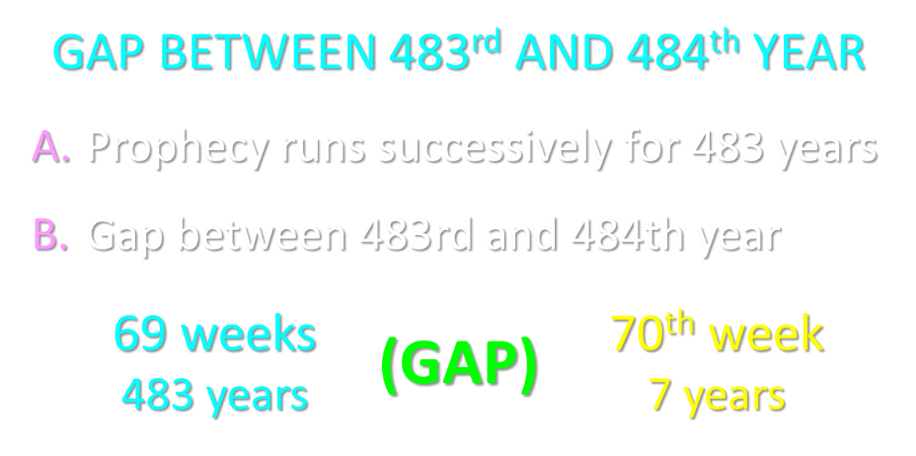

Slide 24
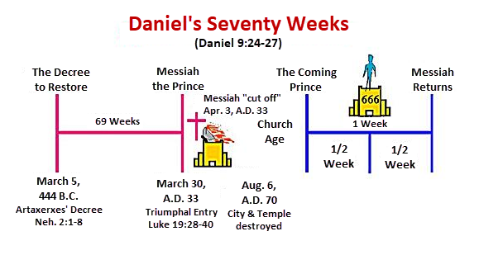

Slide 25
6 Reasons for Gap
  Events prophesied v.26
    Messiah crucified v.26a
    70 AD holocaust v.26b
  Prophecies in Dan. 9:24 would have been fulfilled 7 years after Palm Sunday
  Jesus indicated a gap - (Matt. 24:15, 21-22, 29-30)
  Daniel 9:27 was never fulfilled historically
  Gap occurs elsewhere - (Is. 61:1-2; Luke 4:16-21; Isaiah 9:6)
  Early church fathers indicated a gap

Slide 26

Purposes of the Local Church
Glorify God (Eph 3:21)
Edify the saints (Eph 4:11-16)
Fulfill the Great Commission (Matt 28:18-20)

Slide 27
The Seventy Weeks Prophecy 10 FACTS
Focus = Jews & Jerusalem (v.24b)
490 year period of time (v.24a)
360-day years
6 prophecies WILL BE fulfilled (v.24c)
March 5, 444 BC prophecy begins (25a)
483 years elapse between beginning of prophecy & Palm Sunday (25b)
Gap between 483rd & 484th year (26)
Final 7 years = future Tribulation period (27)
Dan. 9:27 Overview of Tribulation
Daniel 9:27 = Revelation 6-19

Slide 28
FINAL 7 YEARS = FUTURE TRIBULATION v.27
490 years total
483 years have transpired
7 years remain
Gap exists between 483rd & 484th year
Final 7 years are future
Final 7 years are the Tribulation period

Slide 29
The Seventy Weeks Prophecy 10 FACTS
Focus = Jews & Jerusalem (v.24b)
490 year period of time (v.24a)
360-day years
6 prophecies WILL BE fulfilled (v.24c)
March 5, 444 BC prophecy begins (25a)
483 years elapse between beginning of prophecy & Palm Sunday (25b)
Gap between 483rd & 484th year (26)
Final 7 years = future Tribulation period (27)
Dan. 9:27 Overview of Tribulation
Daniel 9:27 = Revelation 6-19

Slide 30
Daniel 9:27 (NASB)
And he will make a firm covenant with the many for one week, but in the middle of the week he will put a stop to sacrifice and grain offering; and on the wing of abominations will come one who makes desolate, even until a complete destruction, one that is decreed, is poured out on the one who makes desolate.

Slide 31

Daniel 9:27 = Tribulation Overview
Duration = 7 years
Starts = Peace Treaty
Mid-point = Temple Desecration
Conclude = Second Advent

Slide 32


Slide 33


Slide 34
THE STAGE IS BEING SET
Rebirth of Israel in 1948
Israel’s desire for peace
Desire among some Jews to Rebuild 3rd Jewish temple
Desire among some Jews to Restore the sacrificial system

Slide 35
The Seventy Weeks Prophecy 10 FACTS
Focus = Jews & Jerusalem (v.24b)
490 year period of time (v.24a)
360-day years
6 prophecies WILL BE fulfilled (v.24c)
March 5, 444 BC prophecy begins (25a)
483 years elapse between beginning of prophecy & Palm Sunday (25b)
Gap between 483rd & 484th year (26)
Final 7 years = future Tribulation period (27)
Dan. 9:27 Overview of Tribulation
Daniel 9:27 = Revelation 6-19

Slide 36
Daniel 9:27 (NASB)
And he will make a firm covenant with the many for one week, but in the middle of the week he will put a stop to sacrifice and grain offering; and on the wing of abominations will come one who makes desolate, even until a complete destruction, one that is decreed, is poured out on the one who makes desolate.

Slide 37
DANIEL 9:27 = REVELATION 6-19
Rebuilt temple (Rev. 11:1-2)
Division of the Tribulation into two 3½ year periods (Rev. 11:2. 13:5, 11:3, 12:6, 14)
Antichrist (Rev. 13:1-10)
Destruction of Antichrist (Rev. 19:20)
2nd Coming (Rev. 19:11-21)

Slide 38
DANIEL 9:27 = REVELATION 6-19
Rebuilt temple (Rev. 11:1-2)
Division of the Tribulation into two 3½ year periods (Rev. 11:2. 13:5, 11:3, 12:6, 14)
Antichrist (Rev. 13:1-10)
Destruction of Antichrist (Rev. 19:20)
2nd Coming (Rev. 19:11-21)

Slide 39
Daniel 9:27 (NASB)
And he will make a firm covenant with the many for one week, but in the middle of the week he will put a stop to sacrifice and grain offering; and on the wing of abominations will come one who makes desolate, even until a complete destruction, one that is decreed, is poured out on the one who makes desolate.

Slide 41
DANIEL 9:27 = REVELATION 6-19
Rebuilt temple (Rev. 11:1-2)
Division of the Tribulation into two 3½ year periods (Rev. 11:2. 13:5, 11:3, 12:6, 14)
Antichrist (Rev. 13:1-10)
Destruction of Antichrist (Rev. 19:20)
2nd Coming (Rev. 19:11-21)

Slide 42
Daniel 9:27 (NASB)
And he will make a firm covenant with the many for one week, but in the middle of the week he will put a stop to sacrifice and grain offering; and on the wing of abominations will come one who makes desolate, even until a complete destruction, one that is decreed, is poured out on the one who makes desolate.

Slide 44
DANIEL 9:27 = REVELATION 6-19
Rebuilt temple (Rev. 11:1-2)
Division of the Tribulation into two 3½ year periods (Rev. 11:2. 13:5, 11:3, 12:6, 14)
Antichrist (Rev. 13:1-10)
Destruction of Antichrist (Rev. 19:20)
2nd Coming (Rev. 19:11-21)

Slide 45
Daniel 9:27 (NASB)
And he will make a firm covenant with the many for one week, but in the middle of the week he will put a stop to sacrifice and grain offering; and on the wing of abominations will come one who makes desolate, even until a complete destruction, one that is decreed, is poured out on the one who makes desolate.

Slide 46
DANIEL 9:27 = REVELATION 6-19
Rebuilt temple (Rev. 11:1-2)
Division of the Tribulation into two 3½ year periods (Rev. 11:2. 13:5, 11:3, 12:6, 14)
Antichrist (Rev. 13:1-10)
Destruction of Antichrist (Rev. 19:20)
2nd Coming (Rev. 19:11-21)

Slide 47
Daniel 9:27 (NASB)
And he will make a firm covenant with the many for one week, but in the middle of the week he will put a stop to sacrifice and grain offering; and on the wing of abominations will come one who makes desolate, even until a complete destruction, one that is decreed, is poured out on the one who makes desolate.

Slide 48
Revelation 19:20 (NASB)
And the beast was seized, and with him the false prophet who performed the signs in his presence, by which he deceived those who had received the mark of the beast and those who worshiped his image; these two were thrown alive into the lake of fire which burns with brimstone.

Slide 49
DANIEL 9:27 = REVELATION 6-19
Rebuilt temple (Rev. 11:1-2)
Division of the Tribulation into two 3½ year periods (Rev. 11:2. 13:5, 11:3, 12:6, 14)
Antichrist (Rev. 13:1-10)
Destruction of Antichrist (Rev. 19:20)
2nd Coming (Rev. 19:11-21)

Slide 50
Daniel 9:27 (NASB)
And he will make a firm covenant with the many for one week, but in the middle of the week he will put a stop to sacrifice and grain offering; and on the wing of abominations will come one who makes desolate, even until a complete destruction, one that is decreed, is poured out on the one who makes desolate.

Slide 52
Revelation 19:20 (NASB)
And the beast was seized, and with him the false prophet who performed the signs in his presence, by which he deceived those who had received the mark of the beast and those who worshiped his image; these two were thrown alive into the lake of fire which burns with brimstone.

Slide 54


Slide 55
When Will the Rapture Take Place Relative to the Tribulation Period?
Pre-tribulation rapture theory
Mid-tribulation rapture theory
Post-tribulation rapture theory
Pre-wrath rapture theory
Partial rapture theory

Slide 56
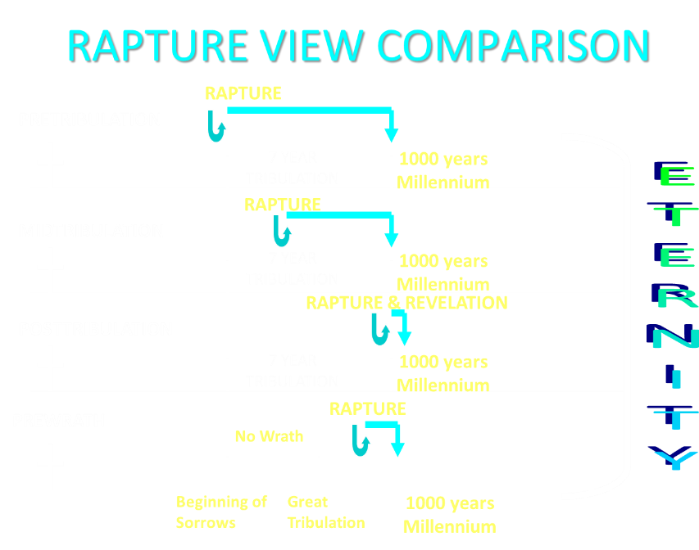

Slide 57
Revelation 1:19 (NASB)
Therefore write the things which you have seen, and the things which are, and the things which will take place after these things.

Slide 58
Revelation 1:19
Seen (1)
Are (2–3)
After these things (4–22)

Slide 59
Revelation 4:1 (NASB)
After these things I looked, and behold, a door standing open in heaven, and the first voice which I had heard, like the sound of a trumpet speaking with me, said, “Come up here, and I will show you what must take place after these things.”

Slide 60
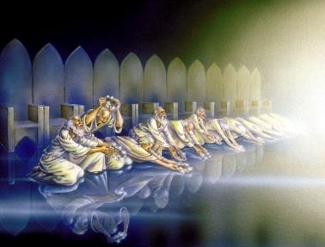
The Missing Church
Rev 4-19
Rev 13:9
Revelation’s Jewish nature

Slide 61
The Missing Church
Rev 4-19
Rev 13:9
Revelation’s Jewish nature

Slide 62
God’s Work Through Israel in Revelation
Rev 7-144,000 Jews
Rev 11-Two Jewish witnesses
Rev 12-Israel flees

Slide 63
God’s Work Through Israel in Revelation
Rev 7-144,000 Jews
Rev 11-Two Jewish witnesses
Rev 12-Israel flees

Slide 64
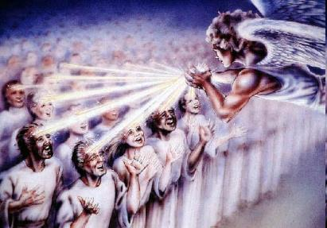
Revelation 7
7:1-8-144,000 Jews
7:9-17-Gentiles reached by the 144,000

Slide 65
Distinctions Between 144,000 & Multitude
REVELATION 7:1-8 | REVELATION 7:9-17
Numbered | Innumerable
Jews | All nations
Sealed | Slain
Sealed before the Tribulation | Converted out of the Tribulation
Hitchcock and Ice, The Truth Behind Left Behind, 77

Slide 66
God’s Work Through Israel in Revelation
Rev 7-144,000 Jews
Rev 11-Two Jewish witnesses
Rev 12-Israel flees

Slide 67
God’s Work Through Israel in Revelation
Rev 7-144,000 Jews
Rev 11-Two Jewish witnesses
Rev 12-Israel flees

Slide 68

Revelation 12:1-5
¹And a great sign appeared in heaven: a woman clothed in the sun, and the moon under her feet, and upon her head a crown of twelve stars; ²and she was with child; and she cried out, being in labor pain to give birth. ³And another sign was seen in heaven: and behold, a great red dragon, having seven heads and ten horns, and upon his heads seven diadems.

Slide 69
Revelation 12:1-5 (cont’d)
⁴And his tail swept a third part of the stars of heaven, and did cast them to the earth: and the dragon stood before the woman that is about to give birth, so that when she gave birth he may devour her child. ⁵And she gave birth to a son, a man child, who is to rule all the nations with a rod of iron: and her child was caught up unto God, and to his throne.

Slide 70
Revelation: 12 Symbols
Son = Messiah (Rev 12:5; Ps. 2:9; Acts 1:9)
Dragon = Satan (Rev 12:3, 9)
Woman = Israel (Rev 12:1; Gen 37:9-10)

Slide 71
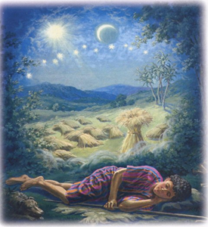
Genesis 37:9
Now he had still another dream, and related it to his brothers, and said, “Lo, I have had still another dream; and behold, the sun and the moon and eleven stars were bowing down to me.

Slide 72
Genesis 37:10
He related it to his father and to his brothers; and his father rebuked him and said to him, “What is this dream that you have had? Shall I and your mother and your brothers actually come to bow ourselves down before you to the ground?”

Slide 73
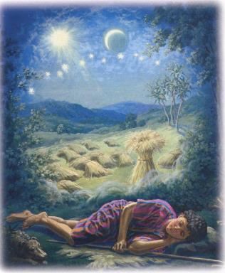
Genesis 37:9-10
Sun = Jacob
Moon = Leah
11 Stars=Joseph’s brothers
12th Star = Joseph
12 Stars=Israel’s twelve tribes

Slide 74
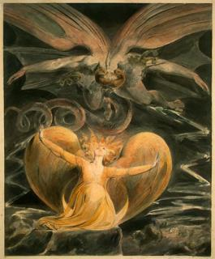
2 CYCLES OF SATANIC PERSECUTION
(Revelation 12:13-16)
“Pursues the woman” = persecution of Israel 12:13-14
“Flood from his mouth” = tries to destroy Israel 12:15-16

Slide 75
Descriptions of Satanic Hatred
(Revelation 12:12-17)
Wrath 12:12
Persecution 12:13
Sweep away 12:15
Enraged 12:17
War 12:17

Slide 76
The Seventy Weeks Prophecy 10 FACTS
Focus = Jews & Jerusalem (v.24b)
490 year period of time (v.24a)
360-day years
6 prophecies WILL BE fulfilled (v.24c)
March 5, 444 BC prophecy begins (25a)
483 years elapse between beginning of prophecy & Palm Sunday (25b)
Gap between 483rd & 484th year (26)
Final 7 years = future Tribulation period (27)
Dan. 9:27 Overview of Tribulation
Daniel 9:27 = Revelation 6-19

Slide 77
Daniel 9:24 (NASB)
Seventy weeks have been decreed for your people and your holy city, to finish the transgression, to make an end of sin, to make atonement for iniquity, to bring in everlasting righteousness, to seal up vision and prophecy and to anoint the most holy place.

Slide 78
Galatians 3:28 (NASB)
There is neither Jew nor Greek, there is neither slave nor free man, there is neither male nor female; for you are all one in Christ Jesus.

Slide 79
Ephesians 2:14 (NASB)
For He Himself is our peace, who made both groups into one and broke down the barrier of the dividing wall.

Slide 80
Romans 10:19 (NASB)
But I say, surely Israel did not know, did they? First Moses says, “I will make you jealous by that which is not a nation, By a nation without understanding will I anger you.”

Slide 81
Ephesians 3:3-6 (NASB)
“that by revelation there was made known to me the mystery, as I wrote before in brief. ⁴ By referring to this, when you read you can understand my insight into the mystery of Christ, ⁵ which in other generations was not made known to the sons of men, as it has now been revealed to His holy apostles and prophets in the Spirit; ⁶ to be specific, that the Gentiles are fellow heirs and fellow members of the body, and fellow partakers of the promise in Christ Jesus through the gospel”.

Slide 82
Ephesians 3:9 (NASB)
“and to bring to light what is the administration of the mystery which for ages has been hidden in God who created all things.”

Slide 83
“Mystery” Defined
“In the N.T, it [mystērion] denotes, not the mysterious (as with the Eng. word), but that which, being outside the range of unassisted natural apprehension, can be made known only by Divine revelation, and is made known in a manner and at a time appointed by God, and to those who are illumined by His Spirit.”
W. E. Vine, Merrill F. Unger, and William White, Vine's Complete Expository Dictionary of the Old and New Testament Words (Nashville: Nelson, 1996), 424.

Slide 84
Colossians 1:26 (NASB)
“that is, the mystery which has been hidden from the past ages and generations, but has now been manifested to His.”

Slide 85


Slide 86
The Seventy Weeks Prophecy 10 FACTS
Focus = Jews & Jerusalem (v.24b)
490 year period of time (v.24a)
360-day years
6 prophecies WILL BE fulfilled (v.24c)
March 5, 444 BC prophecy begins (25a)
483 years elapse between beginning of prophecy & Palm Sunday (25b)
Gap between 483rd & 484th year (26)
Final 7 years = future Tribulation period (27)
Dan. 9:27 Overview of Tribulation
Daniel 9:27 = Revelation 6-19

Slide 87
Daniel 9:24 (NASB)
Seventy weeks have been decreed for your people and your holy city, to finish the transgression, to make an end of sin, to make atonement for iniquity, to bring in everlasting righteousness, to seal up vision and prophecy and to anoint the most holy place.

Slide 88
6 Prophecies WILL BE fulfilled V.24c
  “to finish transgression”
  “to make an end of sin”
  “to make atonement for iniquity”
  “to bring in everlasting righteousness”
  “to seal up vision and prophecy”
  “to anoint the most holy place”
Arnold Fructenbaum, Footsteps of the Messiah, p.191-4

Slide 90
Conclusion

Slide 91
The Seventy Weeks Prophecy 10 FACTS
Focus = Jews & Jerusalem (v.24b)
490 year period of time (v.24a)
360-day years
6 prophecies WILL BE fulfilled (v.24c)
March 5, 444 BC prophecy begins (25a)
483 years elapse between beginning of prophecy & Palm Sunday (25b)
Gap between 483rd & 484th year (26)
Final 7 years = future Tribulation period (27)
Dan. 9:27 Overview of Tribulation
Daniel 9:27 = Revelation 6-19

Slide 92
Chapter 9 Outline
The Setting (1-2)
Daniel’s prayer (3-19)
Gabriel’s arrival (20-23)
The Seventy Weeks Prophecy (24-27)

