Slide 1
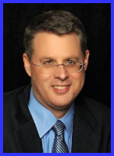
Ecclesiology Session 1
Dr. Andy Woods
Senior Pastor – Sugar Land Bible Church
President – Chafer Theological Seminary

Slide 2
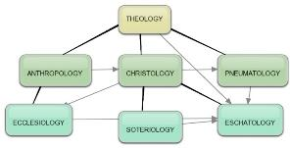
Areas of Systematic Theology
Prolegomena – Introduction
Theology – Study of God
Christology – Study of Christ
Pneumatology – Study of the Holy Spirit
Anthropology – Study of Man
Hamartiology – Study of sin
Soteriology – Study of salvation
Angelology – Study of angels
Ecclesiology – Study of the Church
Eschatology – Study of the end

Slide 3
Areas of Systematic Theology
Prolegomena – Introduction
Theology – Study of God
Christology – Study of Christ
Pneumatology – Study of the Holy Spirit
Anthropology – Study of Man
Hamartiology – Study of sin
Soteriology – Study of salvation
Angelology – Study of angels
Ecclesiology – Study of the Church
Eschatology – Study of the end

Slide 4
Areas of Systematic Theology
Prolegomena – Introduction
Theology – Study of God
Christology – Study of Christ
Pneumatology – Study of the Holy Spirit
Anthropology – Study of Man
Hamartiology – Study of sin
Soteriology – Study of salvation
Angelology – Study of angels
Ecclesiology – Study of the Church
Eschatology – Study of the end

Slide 5
Ecclesiology Overview
Definition
Universal vs. local
Word pictures
Origin
Israel – Church differences
Intercalation
Purposes
Activities
Government
Officers
Ordinances
Purity

Slide 6
Ecclesiology Overview
Definition
Universal vs. local
Word pictures
Origin
Israel – Church differences
Intercalation
Purposes
Activities
Government
Officers
Ordinances
Purity

Slide 7
Definition of Ecclesiology
Ekklēsía (ἐκκλησία)
ĕk (ἐκ) / kaleo (καλέω)
Acts 15:14
Logos
1 Cor 10:32

Slide 8
Acts 15:14 (NASB)
“Simeon has related how God first concerned Himself about taking from among the Gentiles a people for His name.”

Slide 9
Definition of Ecclesiology
Ekklēsía (ἐκκλησία)
ĕk (ἐκ) / kaleo (καλέω)
Acts 15:14
Logos
1 Cor 10:32

Slide 10
1 Corinthians 10:32 (NASB)
“Give no offense either to Jews or to Greeks or to the church of God.”

Slide 11
1 Corinthians 10:32 (NASB)
“Give no offense either to Jews or to Greeks or to the church of God.”

Slide 12
Genesis 3:15 (NASB)
“And I will put enmity Between you and the woman, And between your seed and her seed; He shall bruise you on the head, And you shall bruise him on the heel.”

Slide 13
Spread of the Mother-Child Cult
 | Mother | Child
Assyria | Ishtar | Tammuz
Phoenicia | Astarte | Baal
Egypt | Isis | Osirus/Horus
Greece | Aphrodite | Eros
Rome | Venus | Cupid
Asia | Cybele | Desius
India | Isi | Aswara
Roman Catholicism | Mary | Jesus
Israel | Queen of Heaven (Jer. 7:18; 44:17) | Tammuz (Ezek. 8:14-15)
Alexander Hislop, Two Babylons

Slide 14
Spread of the Mother-Child Cult
 | Mother | Child
Assyria | Ishtar | Tammuz
Phoenicia | Astarte | Baal
Egypt | Isis | Osirus/Horus
Greece | Aphrodite | Eros
Rome | Venus | Cupid
Asia | Cybele | Desius
India | Isi | Aswara
Roman Catholicism | Mary | Jesus
Israel | Queen of Heaven (Jer. 7:18; 44:17) | Tammuz (Ezek. 8:14-15)
Alexander Hislop, Two Babylons

Slide 15
1 Timothy 2:5 (NASB)
“For there is one God, and one mediator also between God and men, the man Christ Jesus.”

Slide 16
Matthew 13:55 (NASB)
“Is not this the carpenter’s son? Is not His mother called Mary, and His brothers, James and Joseph and Simon and Judas?”

Slide 17
Luke 1:46-47 (NASB)
“And Mary said: “My soul exalts the Lord, And my spirit has rejoiced in God my Savior.”

Slide 18
Romans 3:23 (NASB)
“for all have sinned and fall short of the glory of God.”

Slide 19
1 Corinthians 10:32 (NASB)
“Give no offense either to Jews or to Greeks or to the church of God.”

Slide 20
Joshua 24:2-3 (NASB)
“² Joshua said to all the people, “Thus says the Lord, the God of Israel, ‘From ancient times your fathers lived beyond the River, namely, Terah, the father of Abraham and the father of Nahor, and they served other gods. ³ Then I took your father Abraham from beyond the River, and led him through all the land of Canaan, and multiplied his descendants and gave him Isaac.”

Slide 21
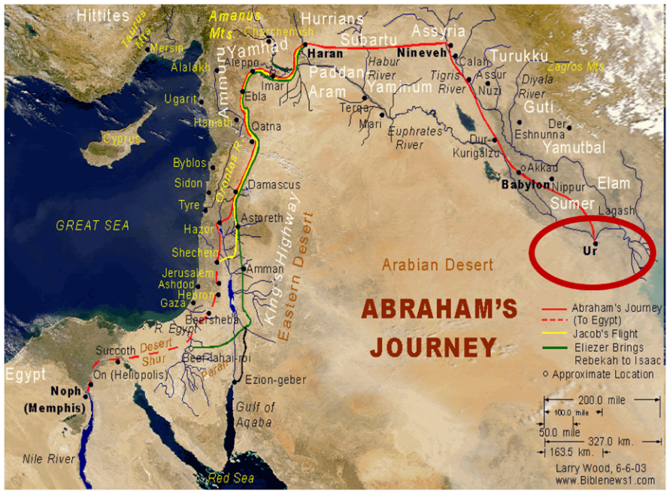
Joshua 24:2-3

Slide 22
1 Samuel 8:5 (NASB)
“and they said to him, ‘Behold, you have grown old, and your sons do not walk in your ways. Now appoint a king for us to judge us like all the nations.’”

Slide 23
Spread of the Mother-Child Cult
 | Mother | Child
Assyria | Ishtar | Tammuz
Phoenicia | Astarte | Baal
Egypt | Isis | Osirus/Horus
Greece | Aphrodite | Eros
Rome | Venus | Cupid
Asia | Cybele | Desius
India | Isi | Aswara
Roman Catholicism | Mary | Jesus
Israel | Queen of Heaven (Jer. 7:18; 44:17) | Tammuz (Ezek. 8:14-15)
Alexander Hislop, Two Babylons

Slide 24
Jeremiah 7:18 (NASB)
“The children gather wood, and the fathers kindle the fire, and the women knead dough to make cakes for the queen of heaven; and they pour out drink offerings to other gods in order to spite Me.”

Slide 25
Jeremiah 44:17 (NASB)
“But rather we will certainly carry out every word that has proceeded from our mouths, by burning sacrifices to the queen of heaven and pouring out drink offerings to her, just as we ourselves, our forefathers, our kings and our princes did in the cities of Judah and in the streets of Jerusalem; for then we had plenty of food and were well off and saw no misfortune.”

Slide 26
Ezekiel 8:14-15 (NASB)
“Then He brought me to the entrance of the gate of the Lord’s house which was toward the north; and behold, women were sitting there weeping for Tammuz. ¹⁵ He said to me, “Do you see this, son of man? Yet you will see still greater abominations than these.”

Slide 27
1 Corinthians 10:32 (NASB)
“Give no offense either to Jews or to Greeks or to the church of God.”

Slide 28
Ephesians 3:11 (NASB)
“This was in accordance with the eternal purpose which He carried out in Christ Jesus our Lord.”

Slide 29
The Definition of the Church
All (both Jew & Gentile) who have trusted in the very Messiah rejected by first-century national Israel (Gal. 3:28; Rom. 10:19; Eph. 2:14)
Intercalation
Does not fulfill Israel’s purposes

Slide 30
Ecclesiology Overview
Definition
Universal vs. local
Word pictures
Origin
Israel – Church differences
Intercalation
Purposes
Activities
Government
Officers
Ordinances
Purity

Slide 31
The Universal vs. Local Church
 | Universal | Local
Number | One | Many
Members | All believers from Pentecost to the Rapture | Local gathering
Spiritual status | Believers only | Believers and unbelievers
Living or dead | Living and dead | Living only
Assembly | Cannot assemble at one place and time | Can assemble at one place and time
Visibility | Invisible | Visible
NT Material | Minority | Majority
Joining | Faith alone | Unique requirements
Denomination | All believers | Specific denomination

Slide 32
Ecclesiology Overview
Definition
Universal vs. local
Word pictures
Origin
Israel – Church differences
Intercalation
Purposes
Activities
Government
Officers
Ordinances
Purity

