Slide 1


Slide 2

The Coming Kingdom
Chapter 11
Dr. Andy Woods
Senior Pastor – Sugar Land Bible Church
President – Chafer Theological Seminary

Slide 3

Kingdom Study Outline
What does the Bible Say About the Kingdom?
The Main Problem with Kingdom Now NT interpretations
Why do some believe that we are in the kingdom now?
Why does it matter?

Slide 4
Kingdom Study Outline
What does the Bible Say About the Kingdom?
The Main Problem with Kingdom Now NT interpretations
Why do some believe that we are in the kingdom now?
Why does it matter?

Slide 5
1. Kingdom Throughout the Bible
Eden Abrahamic Covenant Mosaic Covenant Divided Kingdom Times of the Gentiles | Old Testament Prophets Post exile Offer of the King / Kingdom Rejection of the Offer Interim Age

Slide 6
1. Kingdom Throughout the Bible
Eden Abrahamic Covenant Mosaic Covenant Divided Kingdom Times of the Gentiles | Old Testament Prophets Post exile Offer of the King / Kingdom Rejection of the Offer Interim Age

Slide 7

THE INTERIM AGE
The Inter-advent Age (Matt. 13)
The Church Age (Matt. 16:18)

Slide 8
THE INTERIM AGE
The Inter-advent Age (Matt. 13)
The Church Age (Matt. 16:18)

Slide 9
Matthew 13 Parables
Public parables (13:1-2)
  Sower (13:1-9, 18-23)
  Wheat and tares (13:24-30, 36-43)
  Mustard seed (13:31-32)
  Leaven (13:33)
Private parables (13:36)
  Earthen treasure (13:44)
  Pearl of great price (13:45-46)
  Dragnet (13:47-50)
  Householder (13:51-52)

Slide 10
THE INTERIM AGE
The Inter-advent Age (Matt. 13)
The Church Age (Matt. 16:18)

Slide 11

The Church Age
The definition of the Church
The beginning of the Church
The purposes of the Church
The Church is not the Kingdom
The Church is not Israel

Slide 12
The Church Age
The definition of the Church
The beginning of the Church
The purposes of the Church
The Church is not the Kingdom
The Church is not Israel

Slide 13
1. The Definition of the Church
All (both Jew & Gentile) who have trusted in the very Messiah rejected by first-century national Israel (Gal. 3:28; Rom. 10:19; Eph. 2:14)
Intercalation
Does not fulfill Israel’s purposes

Slide 14
The Church Age
The definition of the Church
The beginning of the Church
The purposes of the Church
The Church is not the Kingdom
The Church is not Israel

Slide 15

2. When Did the Church Begin?
Christ referred to the Church in the future tense (Matt. 16:18)
Paul referred to the Church as a “mystery” (Eph. 3:4-5, 9)
The Church did not exist prior to Acts 1 since Christ became the head of the Church (Eph. 5:23) after His Ascension (Eph. 1:20-22)
The Church did not exist prior to Acts 1 since spiritual gifts (1 Cor. 12:7; 14:26) only came into existence after His Ascension (Eph. 4:7-11)

Slide 16
2. When Did the Church Begin?
The Church existed before Paul’s conversion in Acts 9 (Acts 5:11; 8:1,3; Rom. 16:7)
The Baptizing (joining, uniting, identifying) ministry of the Holy Spirit began in Acts 2
  1 Cor. 12:13
  Acts 1:5
  Acts 11:15-16
  Acts 2:1-4, 37-41

Slide 17
The Church Age
The definition of the Church
The beginning of the Church
The purposes of the Church
The Church is not the Kingdom
The Church is not Israel

Slide 18

3. Purposes of the Local Church
Glorify God (Eph 3:21)
Edify the saints (Eph 4:11-16)
Fulfill the Great Commission (Matt 28:18-20)

Slide 19
The Church Age
The definition of the Church
The beginning of the Church
The purposes of the Church
The Church is not the Kingdom
The Church is not Israel

Slide 20
4. Church ≠ Kingdom
Jesus Christ is never called the King of the Church
Jesus Christ’s relationship to His Church is never depicted through the King-Kingdom metaphor
Prolonged Church Age carnality
Church Age Gospel = believe (Acts 16:30-31)
Kingdom’s arrival is instantaneous (Dan. 2:44) while the Church's construction is gradual (Eph. 2:22)
Church = heir of the Kingdom (James 2:5)

Slide 21
4. Church ≠ Kingdom
Church suffers today (John 16:33)
Satanic influence on the Church (Ephes. 4:26-27)
The Times of the Gentiles continue
NT kingdom references predominantly future
Jesus Christ is never said to be ruling from David’s Throne now
Kingdom miracles (Isa. 35:5-6) are absent today (2 Tim. 4:20)
Kingdom prosperity (Amos 9:11-15) is absent today (Acts 11:28)

Slide 22
4. Church ≠ Kingdom
Jesus Christ is never called the King of the Church
Jesus Christ’s relationship to His Church is never depicted through the King-Kingdom metaphor
Prolonged Church Age carnality
Church Age Gospel = believe (Acts 16:30-31)
Kingdom’s arrival is instantaneous (Dan. 2:44) while the Church's construction is gradual (Eph. 2:22)
Church = heir of the Kingdom (James 2:5)

Slide 23
4. Church ≠ Kingdom
Jesus Christ is never called the King of the Church
Jesus Christ’s relationship to His Church is never depicted through the King-Kingdom metaphor
Prolonged Church Age carnality
Church Age Gospel = believe (Acts 16:30-31)
Kingdom’s arrival is instantaneous (Dan. 2:44) while the Church's construction is gradual (Eph. 2:22)
Church = heir of the Kingdom (James 2:5)

Slide 24
Universal Church Word Pictures
Shepherd/sheep – John 10:16; Acts 20:28; Heb 13:20; 1 Pet 5:2-4
Head/body – Rom 12:5; 1 Cor 12:12-13; Eph 1:22-23
Bride/groom – Eph 5:22-31; 2 Cor 11:2
Temple – 1 Cor 3:16-17; Eph 2:19-22; Gal 6:10
High priest/priesthood – Heb 4:14-15; 1 Pet 2:5-9; Rev 1:6
Pillar of truth – 1 Tim 3:15
Vine and branches – John 15:1-8

Slide 25
4. Church ≠ Kingdom
Jesus Christ is never called the King of the Church
Jesus Christ’s relationship to His Church is never depicted through the King-Kingdom metaphor
Prolonged Church Age carnality
Church Age Gospel = believe (Acts 16:30-31)
Kingdom’s arrival is instantaneous (Dan. 2:44) while the Church's construction is gradual (Eph. 2:22)
Church = heir of the Kingdom (James 2:5)

Slide 26

Zechariah 14:16-18 (NASB)
“Then it will come about that any who are left of all the nations that went against Jerusalem will go up from year to year to worship the King, the Lord of hosts, and to celebrate the Feast of Booths. ¹⁷ And it will be that whichever of the families of the earth does not go up to Jerusalem to worship the King, the Lord of hosts, there will be no rain on them. ¹⁸ If the family of Egypt does not go up or enter, then no rain will fall on them; it will be the plague with which the Lord smites the nations who do not go up to celebrate the Feast of Booths.”

Slide 27
1 Corinthians 3:1-3 (NKJV)
¹ And I, brethren, could not speak to you as to spiritual people but as to carnal, as to babes in Christ. ² I fed you with milk and not with solid food; for until now you were not able to receive it, and even now you are still not able; ³ for you are still carnal. For where there are envy, strife, and divisions among you, are you not carnal and behaving like mere men?

Slide 28

Notes:
Ray Steadman – “1st Californians”
Unbelievers vs Categories of Believers
Unbelievers – ψυχικός psuchikós; Natural, pertaining to the natural as distinguished from the spiritual
Spiritual Believers – πνευματικός pneumatikós; of persons who are spiritual, enlightened by the Holy Spirit
Infant Believers – σάρκινος sárkinos; with propensities of the flesh unto sin; νήπιος nḗpios; an infant, child, baby without any definite limitation of age. (This relates to immaturity and lack of instruction)
Carnal Believers – σαρκικός sarkikós; tendency to satisfy the flesh, implying sinfulness, sinful propensity, carnal (This relates to disobedience and open rebellion)

Slide 29


Slide 30
4. Church ≠ Kingdom
Jesus Christ is never called the King of the Church
Jesus Christ’s relationship to His Church is never depicted through the King-Kingdom metaphor
Prolonged Church Age carnality
Church Age Gospel = believe (Acts 16:30-31)
Kingdom’s arrival is instantaneous (Dan. 2:44) while the Church's construction is gradual (Eph. 2:22)
Church = heir of the Kingdom (James 2:5)

Slide 31
Messengers of the Kingdom In Matthew
John the Baptist – 3:2
Jesus Christ – 4:17
12 Apostles – 10:5-7
Seventy – Luke 10:1, 9
Toussaint, Behold the King, 18-20

Slide 32
Matthew 4:17 (NASB)
“From that time Jesus began to preach and say, ‘Repent, for the kingdom of heaven is at hand.’”

Slide 33
Matthew 10:5-7 (NASB)
“These twelve Jesus sent out after instructing them: “Do not go in the way of the Gentiles, and do not enter any city of the Samaritans; ⁶ but rather go to the lost sheep of the house of Israel. ⁷ And as you go, preach, saying, ‘The kingdom of heaven is at hand.’”

Slide 34
Acts 16:30-31 (NASB)
³⁰ and after he brought them out, he said, “Sirs, what must I do to be saved?” ³¹ They said, “Believe in the Lord Jesus, and you will be saved, you and your household.”

Slide 35
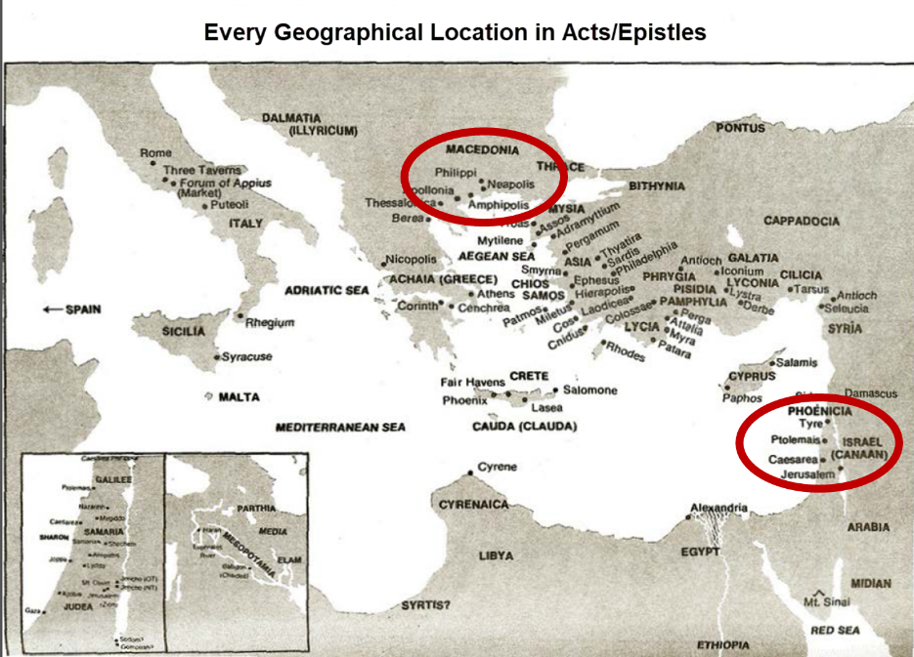

Slide 36
4. Church ≠ Kingdom
Jesus Christ is never called the King of the Church
Jesus Christ’s relationship to His Church is never depicted through the King-Kingdom metaphor
Prolonged Church Age carnality
Church Age Gospel = believe (Acts 16:30-31)
Kingdom’s arrival is instantaneous (Dan. 2:44) while the Church's construction is gradual (Eph. 2:22)
Church = heir of the Kingdom (James 2:5)

Slide 37


Statue
&
Stone

Slide 38
Acts 15:14 (NASB)
Simeon has related how God first concerned Himself about taking from among the Gentiles a people for His name.

Slide 39
Progress Reports in Acts
Clearest: Acts 2:47; 6:7; 9:31; 12:24; 16:5; 19:20; 28:30-31
Less clear: Acts 1:15; 2:41; 4:4, 31; 5:14, 42; 8:25, 40; 11:21; 13:49; 17:6

Slide 40
4. Church ≠ Kingdom
Jesus Christ is never called the King of the Church
Jesus Christ’s relationship to His Church is never depicted through the King-Kingdom metaphor
Prolonged Church Age carnality
Church Age Gospel = believe (Acts 16:30-31)
Kingdom’s arrival is instantaneous (Dan. 2:44) while the Church's construction is gradual (Eph. 2:22)
Church = heir of the Kingdom (James 2:5)

Slide 41
4. Church ≠ Kingdom
Church suffers today (John 16:33)
Satanic influence on the Church (Ephes. 4:26-27)
The Times of the Gentiles continue
NT kingdom references predominantly future
Jesus Christ is never said to be ruling from David’s Throne now
Kingdom miracles (Isa. 35:5-6) are absent today (2 Tim. 4:20)
Kingdom prosperity (Amos 9:11-15) is absent today (Acts 11:28)

Slide 42
Revelation 20:4-5 (NASB)
“⁴ Then I saw thrones, and they sat on them, and judgment was given to them. And I saw the souls of those who had been beheaded because of their testimony of Jesus and because of the word of God, and those who had not worshiped the beast or his image, and had not received the mark on their forehead and on their hand; and they came to life and reigned with Christ for a thousand years. ⁵ The rest of the dead did not come to life until the thousand years were completed. This is the first resurrection.”

Slide 43
4. Church ≠ Kingdom
Church suffers today (John 16:33)
Satanic influence on the Church (Ephes. 4:26-27)
The Times of the Gentiles continue
NT kingdom references predominantly future
Jesus Christ is never said to be ruling from David’s Throne now
Kingdom miracles (Isa. 35:5-6) are absent today (2 Tim. 4:20)
Kingdom prosperity (Amos 9:11-15) is absent today (Acts 11:28)

Slide 44
Revelation 20:1-3 (NASB)
“Then I saw an angel coming down from heaven, holding the key of the abyss and a great chain in his hand. ² And he laid hold of the dragon, the serpent of old, who is the devil and Satan, and bound him for a thousand years; ³ and he threw him into the abyss, and shut it and sealed it over him, so that he would not deceive the nations any longer, until the thousand years were completed; after these things he must be released for a short time.”

Slide 45
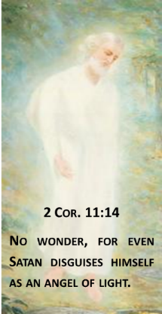

Satan Uses Believers
Peter – Matt. 16:21-23
Ananias & Sapphira – Acts 5:3-4, 11
Ephesians – Ephes. 4:26-27

Slide 46
4. Church ≠ Kingdom
Church suffers today (John 16:33)
Satanic influence on the Church (Ephes. 4:26-27)
The Times of the Gentiles continue
NT kingdom references predominantly future
Jesus Christ is never said to be ruling from David’s Throne now
Kingdom miracles (Isa. 35:5-6) are absent today (2 Tim. 4:20)
Kingdom prosperity (Amos 9:11-15) is absent today (Acts 11:28)

Slide 47
Statue
&
Stone

Slide 48
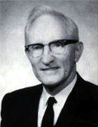
Merill F. Unger
Unger's Commentary on the Old Testament (Chicago: Moody, 1981; reprint, Chatanooga, TN: AMG, 2002), 1643.
“Hence, the iron kingdom with its feet of iron and clay (cf. Dan. 3:33-35, 40, 44) and the nondescript beast of 7:7-8 envision…the form in which it will exist after the church period, when God will resume His dealing with the nation Israel. How futile for conservative scholars to ignore that fact and to seek to find literal fulfillment of those prophecies in history or in the church, when those predictions refer to events yet future and have no application whatever to the church.”

Slide 49
4. Church ≠ Kingdom
Church suffers today (John 16:33)
Satanic influence on the Church (Ephes. 4:26-27)
The Times of the Gentiles continue
NT kingdom references predominantly future
Jesus Christ is never said to be ruling from David’s Throne now
Kingdom miracles (Isa. 35:5-6) are absent today (2 Tim. 4:20)
Kingdom prosperity (Amos 9:11-15) is absent today (Acts 11:28)

Slide 50
4. Church ≠ Kingdom
Church suffers today (John 16:33)
Satanic influence on the Church (Ephes. 4:26-27)
The Times of the Gentiles continue
NT kingdom references predominantly future
Jesus Christ is never said to be ruling from David’s Throne now
Kingdom miracles (Isa. 35:5-6) are absent today (2 Tim. 4:20)
Kingdom prosperity (Amos 9:11-15) is absent today (Acts 11:28)

Slide 51
Christ’s Three Offices
Prophet – 1st Coming (Matt. 4:17)
Priest – Present Session (Heb. 4:15)
King – 2nd Coming (Isa. 9:6-7; Matt. 25:31)

Slide 52
4. Church ≠ Kingdom
Church suffers today (John 16:33)
Satanic influence on the Church (Ephes. 4:26-27)
The Times of the Gentiles continue
NT kingdom references predominantly future
Jesus Christ is never said to be ruling from David’s Throne now
Kingdom miracles (Isa. 35:5-6) are absent today (2 Tim. 4:20)
Kingdom prosperity (Amos 9:11-15) is absent today (Acts 11:28)

Slide 53
Order of Paul’s Letters
Galatians (A.D. 49)
1‒2 Thessalonians (A.D. 51)
1‒2 Corinthians (A.D. 56)
Romans (A.D. 57)
Ephesians, Colossians, Philemon, Philippians (A.D. 60‒62)
1 Timothy, Titus (A.D. 62‒66)
2 Timothy (A.D. 67)

Slide 54
Order of Paul’s Letters
Galatians (A.D. 49)
1‒2 Thessalonians (A.D. 51)
1‒2 Corinthians (A.D. 56)
Romans (A.D. 57)
Ephesians, Colossians, Philemon, Philippians (A.D. 60‒62)
1 Timothy, Titus (A.D. 62‒66)
2 Timothy (A.D. 67)

Slide 55
4. Church ≠ Kingdom
Church suffers today (John 16:33)
Satanic influence on the Church (Ephes. 4:26-27)
The Times of the Gentiles continue
NT kingdom references predominantly future
Jesus Christ is never said to be ruling from David’s Throne now
Kingdom miracles (Isa. 35:5-6) are absent today (2 Tim. 4:20)
Kingdom prosperity (Amos 9:11-15) is absent today (Acts 11:28)

Slide 56
The Church Age
The definition of the Church
The beginning of the Church
The purposes of the Church
The Church is not the Kingdom
The Church is not Israel

Slide 57
Conclusion

Slide 58
THE INTERIM AGE
The Inter-advent Age (Matt. 13)
The Church Age (Matt. 16:18)

Slide 59
The Church Age
The definition of the Church
The beginning of the Church
The purposes of the Church
The Church is not the Kingdom
The Church is not Israel

Slide 60
PLAN IS TO STOP HERE

Slide 61
The Church Age
The definition of the Church
The beginning of the Church
The purposes of the Church
The Church is not the Kingdom
The Church is not Israel

Slide 62


Exodus 19:5-6
“Now then, if you will indeed obey My voice and keep My covenant, then you shall be My own possession among all the peoples, for all the earth is Mine; and you shall be to Me a kingdom of priests and a holy nation.’ These are the words that you shall speak to the sons of Israel.”

Slide 63
Deuteronomy 17:15
“you shall surely set a king over you whom the Lord your God chooses, one from among your countrymen you shall set as king over yourselves; you may not put a foreigner over yourselves who is not your countryman.”

Slide 64
Matthew 23:37-39 (NASB)
“Jerusalem, Jerusalem, who kills the prophets and stones those who are sent to her! How often I wanted to gather your children together, the way a hen gathers her chicks under her wings, and you were unwilling. ³⁸ Behold, your house is being left to you desolate! ³⁹ For I say to you, from now on you will not see Me until you say, ‘Blessed is He who comes in the name of the Lord!”

Slide 65
5. Discontinuity Between Israel & the Church
 | ISRAEL | CHURCH
Marriage | Wife | Bride
Christ | Birthed Christ | Birthed by Christ
Return | 2nd advent | Rapture
Leader | King | Head, Groom
Beginning | Gen 12 | Acts 2
Scripture | 4/5 | 1/5
Covenants | Parties | Beneficiaries
Nation | Political | Spiritual

Slide 66
5. Discontinuity Between Israel & the Church
 | ISRAEL | CHURCH
Marriage | Wife | Bride
Christ | Birthed Christ | Birthed by Christ
Return | 2nd advent | Rapture
Leader | King | Head, Groom
Beginning | Gen 12 | Acts 2
Scripture | 4/5 | 1/5
Covenants | Parties | Beneficiaries
Nation | Political | Spiritual

Slide 67

Joshua 24:2-3

Slide 68
5. Discontinuity Between Israel & the Church
 | ISRAEL | CHURCH
Marriage | Wife | Bride
Christ | Birthed Christ | Birthed by Christ
Return | 2nd advent | Rapture
Leader | King | Head, Groom
Beginning | Gen 12 | Acts 2
Scripture | 4/5 | 1/5
Covenants | Parties | Beneficiaries
Nation | Political | Spiritual

Slide 69
5. Discontinuity Between Israel & the Church
 | ISRAEL | CHURCH
Marriage | Wife | Bride
Christ | Birthed Christ | Birthed by Christ
Return | 2nd advent | Rapture
Leader | King | Head, Groom
Beginning | Gen 12 | Acts 2
Scripture | 4/5 | 1/5
Covenants | Parties | Beneficiaries
Nation | Political | Spiritual

Slide 70


Slide 71
5. Discontinuity Between Israel & the Church
 | ISRAEL | CHURCH
Marriage | Wife | Bride
Christ | Birthed Christ | Birthed by Christ
Return | 2nd advent | Rapture
Leader | King | Head, Groom
Beginning | Gen 12 | Acts 2
Scripture | 4/5 | 1/5
Covenants | Parties | Beneficiaries
Nation | Political | Spiritual

Slide 72


Slide 73
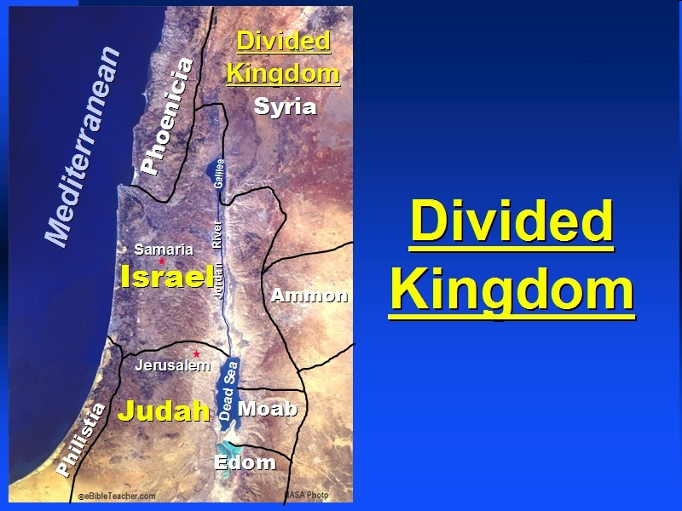

Slide 74
5. Discontinuity Between Israel & the Church
 | Israel | Church
Wars | Political | Spiritual
Timing | A quo / ad quem | No time indicators
Priesthood | Have a priesthood | Are a priesthood
Temple | Physical | Body
Resurrection | 1st resurrection | Rapture
Judgment | Earthly (Ezek. 20:33-44) | Heavenly (Bema)
New Jerusalem | Gates | Foundations
Entrance | Physical birth | Spiritual birth

Slide 75
5. Discontinuity Between Israel & the Church
 | Israel | Church
Wars | Political | Spiritual
Timing | A quo / ad quem | No time indicators
Priesthood | Have a priesthood | Are a priesthood
Temple | Physical | Body
Resurrection | 1st resurrection | Rapture
Judgment | Earthly (Ezek. 20:33-44) | Heavenly (Bema)
New Jerusalem | Gates | Foundations
Entrance | Physical birth | Spiritual birth

Slide 76


Slide 77
Levitical Feasts (23)
Feast | Season | Purpose | Type
Passover | Spring | Redemption | 1 Cor 5:7
Unleavened Bread | Spring | Separation | John 6:35
1st fruits | Spring | Praise | 1 Cor 15:20
Pentecost | Spring | Praise | Acts 2:1-4
Trumpets | Fall | New Year | Matt 24:31
Atonement | Fall | Lev 16 | Zech 12:10
Booths | Fall | Wilderness provision | Zech 14:16-18

Slide 78


Slide 79
5. Discontinuity Between Israel & the Church
 | Israel | Church
Wars | Political | Spiritual
Timing | A quo / ad quem | No time indicators
Priesthood | Have a priesthood | Are a priesthood
Temple | Physical | Body
Resurrection | 1st resurrection | Rapture
Judgment | Earthly (Ezek. 20:33-44) | Heavenly (Bema)
New Jerusalem | Gates | Foundations
Entrance | Physical birth | Spiritual birth

Slide 80
5. Discontinuity Between Israel & the Church
 | Israel | Church
Wars | Political | Spiritual
Timing | A quo / ad quem | No time indicators
Priesthood | Have a priesthood | Are a priesthood
Temple | Physical | Body
Resurrection | 1st resurrection | Rapture
Judgment | Earthly (Ezek. 20:33-44) | Heavenly (Bema)
New Jerusalem | Gates | Foundations
Entrance | Physical birth | Spiritual birth

Slide 81
ISRAEL’S FOUR TEMPLES
Solomon’s pre exilic temple (Kings and Chronicles)
Zerubbabel’s post exilic temple (Ezra 1-6; John 2:20)
Antichrist's temple (Dan 9:27; Matt 24:15; 2 Thess 2:4; Rev 11:1-2)
Millennial temple (Ezek 40-48)

Slide 82
5. Discontinuity Between Israel & the Church
 | Israel | Church
Wars | Political | Spiritual
Timing | A quo / ad quem | No time indicators
Priesthood | Have a priesthood | Are a priesthood
Temple | Physical | Body
Resurrection | 1st resurrection | Rapture
Judgment | Earthly (Ezek. 20:33-44) | Heavenly (Bema)
New Jerusalem | Gates | Foundations
Entrance | Physical birth | Spiritual birth

Slide 83
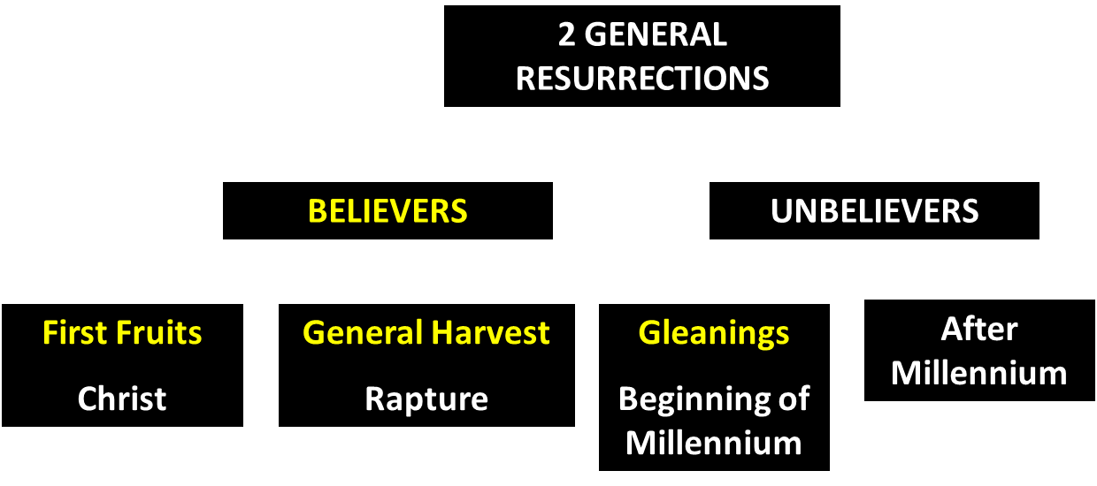
God’s Resurrection Program

Slide 84
5. Discontinuity Between Israel & the Church
 | Israel | Church
Wars | Political | Spiritual
Timing | A quo / ad quem | No time indicators
Priesthood | Have a priesthood | Are a priesthood
Temple | Physical | Body
Resurrection | 1st resurrection | Rapture
Judgment | Earthly (Ezek. 20:33-44) | Heavenly (Bema)
New Jerusalem | Gates | Foundations
Entrance | Physical birth | Spiritual birth

Slide 85
5. Discontinuity Between Israel & the Church
 | Israel | Church
Wars | Political | Spiritual
Timing | A quo / ad quem | No time indicators
Priesthood | Have a priesthood | Are a priesthood
Temple | Physical | Body
Resurrection | 1st resurrection | Rapture
Judgment | Earthly (Ezek. 20:33-44) | Heavenly (Bema)
New Jerusalem | Gates | Foundations
Entrance | Physical birth | Spiritual birth

Slide 86
Ephesians 2:20 (NASB)
“having been built on the foundation of the apostles and prophets, Christ Jesus Himself being the corner stone.”

Slide 87
5. Discontinuity Between Israel & the Church
 | Israel | Church
Wars | Political | Spiritual
Timing | A quo / ad quem | No time indicators
Priesthood | Have a priesthood | Are a priesthood
Temple | Physical | Body
Resurrection | 1st resurrection | Rapture
Judgment | Earthly (Ezek. 20:33-44) | Heavenly (Bema)
New Jerusalem | Gates | Foundations
Entrance | Physical birth | Spiritual birth

Slide 88
5. Discontinuity Between Israel & the Church
 | Israel | Church
Governing principle | Law | NT
Relation to HS | Selective, temporary, subsequent | Universal, permanent, at moment of salvation
Farewell address | Olivet Discourse | Upper Room Discourse
Designation | First Born Son | Bride of Christ
Revealed in OT | Yes | No
Evangelism | Come & See | Go & Proclaim
Blessings | Earthly | Heavenly
Composition | Believers & Unbelievers | Believers Only

Slide 89
5. Discontinuity Between Israel & the Church
 | Israel | Church
Governing principle | Law | NT
Relation to HS | Selective, temporary, subsequent | Universal, permanent, at moment of salvation
Farewell address | Olivet Discourse | Upper Room Discourse
Designation | First Born Son | Bride of Christ
Revealed in OT | Yes | No
Evangelism | Come & See | Go & Proclaim
Blessings | Earthly | Heavenly
Composition | Believers & Unbelievers | Believers Only

Slide 90
Work of the Spirit in the OT & Gospels
Pattern of Holy Spirit’s present work is not found in the OT or Gospels
  John 7:37-39
  John 14:16-17
  Acts 1:5

Slide 91
Work of the Spirit in the OT vs. Church Age
 | OT/Gospels | Today
Reception of all of the Spirit at the moment of salvation? | Subsequent to salvation (Exod 31:3) | At moment of salvation (Rom 8:9)
How long is the indwelling? | Temporary indwelling (1 Sam 16:14; Ps 51:11) | Permanent indwelling (John 14:16)
Who is indwelt? | Selective indwelling (Joel 2:28) | Universal indwelling (1 Cor 12:13)

Slide 92
5. Discontinuity Between Israel & the Church
 | Israel | Church
Governing principle | Law | NT
Relation to HS | Selective, temporary, subsequent | Universal, permanent, at moment of salvation
Farewell address | Olivet Discourse | Upper Room Discourse
Designation | First Born Son | Bride of Christ
Revealed in OT | Yes | No
Evangelism | Come & See | Go & Proclaim
Blessings | Earthly | Heavenly
Composition | Believers & Unbelievers | Believers Only

Slide 93
Discourse
 | OLIVET | UPPER ROOM
SCRIPTURE | Matt 24─25 | John 13─17
LOCATION | Mount of Olives | Upper Room
PASSION WEEK | Third day | Sixth day
GENERAL FOCUS | Farewell: Israel | Hello: Church
SPECIFIC FOCUS | Israel’s future | Divine provisions
PROMPTING | Temple's destruction | Christ's imminent departure
EXPLANATIONS | Written OT | Unwritten NT

Slide 94
5. Discontinuity Between Israel & the Church
 | Israel | Church
Governing principle | Law | NT
Relation to HS | Selective, temporary, subsequent | Universal, permanent, at moment of salvation
Farewell address | Olivet Discourse | Upper Room Discourse
Designation | First Born Son | Bride of Christ
Revealed in OT | Yes | No
Evangelism | Come & See | Go & Proclaim
Blessings | Earthly | Heavenly
Composition | Believers & Unbelievers | Believers Only

Slide 95
5. Discontinuity Between Israel & the Church
 | Israel | Church
Governing principle | Law | NT
Relation to HS | Selective, temporary, subsequent | Universal, permanent, at moment of salvation
Farewell address | Olivet Discourse | Upper Room Discourse
Designation | First Born Son | Bride of Christ
Revealed in OT | Yes | No
Evangelism | Come & See | Go & Proclaim
Blessings | Earthly | Heavenly
Composition | Believers & Unbelievers | Believers Only

Slide 96
1 Corinthians 3:1-3 (NKJV)
¹ And I, brethren, could not speak to you as to spiritual people but as to carnal, as to babes in Christ. ² I fed you with milk and not with solid food; for until now you were not able to receive it, and even now you are still not able; ³ for you are still carnal. For where there are envy, strife, and divisions among you, are you not carnal and behaving like mere men?

Slide 97
Notes:
Ray Steadman – “1st Californians”
Unbelievers vs Categories of Believers
Unbelievers – ψυχικός psuchikós; Natural, pertaining to the natural as distinguished from the spiritual
Spiritual Believers – πνευματικός pneumatikós; of persons who are spiritual, enlightened by the Holy Spirit
Infant Believers – σάρκινος sárkinos; with propensities of the flesh unto sin; νήπιος nḗpios; an infant, child, baby without any definite limitation of age. (This relates to immaturity and lack of instruction)
Carnal Believers – σαρκικός sarkikós; tendency to satisfy the flesh, implying sinfulness, sinful propensity, carnal (This relates to disobedience and open rebellion)

Slide 98
Conclusion

Slide 99
THE INTERIM AGE
The Inter-advent Age (Matt. 13)
The Church Age (Matt. 16:18)

Slide 100
The Church Age
The definition of the Church
The beginning of the Church
The purposes of the Church
The Church is not the Kingdom
The Church is not Israel

