Slide 1
Law vs. Grace: An Overview Jim McGowan, Th.D. Sugar Land Bible Church 10-29-2017
For the Law was given through Moses…
…but grace & truth were realized through Jesus Christ - John 1:17
Special thanks to Dr. Vern Peterman for access to his insights and resources.

Slide 2
Session 4 Outline
Review
Purpose, Aim, and Objective
Session 3
Through the Sea w/o Getting Wet – Exo. 13-14
General Information
Contrast & Comparison of Law & Grace
Conclusion

Slide 3
Session 4 Outline
Review
Purpose, Aim, and Objective
Session 3
Through the Sea w/o Getting Wet – Exo. 13-14
General Information
Contrast & Comparison of Law & Grace
Conclusion

Slide 4
OUR PURPOSE, AIM AND OBJECTIVE
Law & Grace
…is to Compare and Contrast Law and Grace so as to properly understand these two important themes and how they are related to the life of the New Testament Believer.

Slide 5
2 Corinthians 3:7–9
⁷ But if the ministry of death, in letters engraved on stones, came with glory, so that the sons of Israel could not look intently at the face of Moses because of the glory of his face, fading as it was, ⁸ how will the ministry of the Spirit fail to be even more with glory? ⁹ For if the ministry of condemnation has glory, much more does the ministry of righteousness abound in glory. (NASB95)
Notes:
2 Corinthians 3:7–9
⁷ But if the ministry of death, in letters engraved on stones, came with glory, so that the sons of Israel could not look intently at the face of Moses because of the glory of his face, fading as it was, ⁸ how will the ministry of the Spirit fail to be even more with glory? ⁹ For if the ministry of condemnation has glory, much more does the ministry of righteousness abound in glory. (NASB95)
NEXT SLIDE

Slide 6
TEACHINGS OF LAW | TEACHINGS OF GRACE
Written with ink. | Written with the Spirit of the living God.
In tables of stone. | In fleshy tables of the heart.
The letter killeth. | The Spirit giveth life.
The ministration of death. | The ministration of the Spirit.
Was glorious. | Is rather glorious.
Done away. | Remaineth.
Abolished. | We have such hope.
L. S. CHAFER, Systematic theology (Vol. 4, p. 242). (1993). Grand Rapids, MI: Kregel Publications.

Slide 7
C. I. SCOFIELD, D. D.
The Grace of God, The Fundamentals Vol. 3, Chapter VII, p. 98
We have, most of us, been reared and now live under the influence of Galatianism. Protestant theology, alas, is for the most part, thoroughly Galatianized, in that neither law nor grace are given their distinct and separated places, as in the counsels of God, but are mingled together in one incoherent system. The law is no longer, as in the Divine intent, a ministration of death (2 Cor. 3:7), of cursing (Gal. 3:10), of conviction (Rom. 3:19), because we are taught that we must try to keep it, and that by Divine help we may. Nor, on the other hand, does grace bring us blessed deliverance from the dominion of sin, for we are kept under the law as a rule of life despite the plain declaration, “Sin shall not have dominion over you: for ye are not under the law, but under grace” (Rom. 6:14).

Slide 8
Session 4 Outline
Review
Purpose, Aim, and Objective
Session 3
Through the Sea w/o Getting Wet – Exo. 13-14
General Information
Contrast & Comparison of Law & Grace
Conclusion

Slide 9
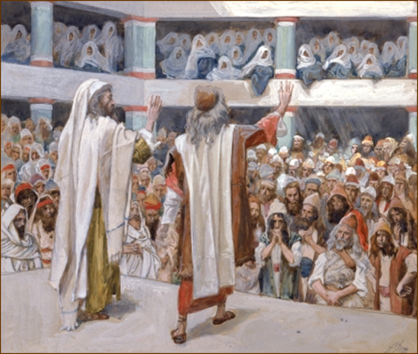
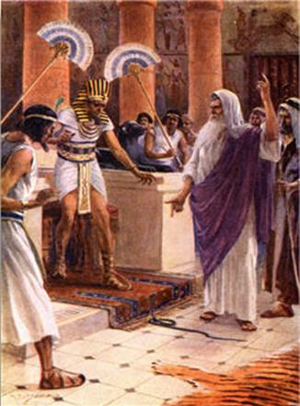
Law & Grace: Sesson 3 Review
Moses and his brother Aaron would appear before their own people, and before Pharaoh’s court

Slide 10
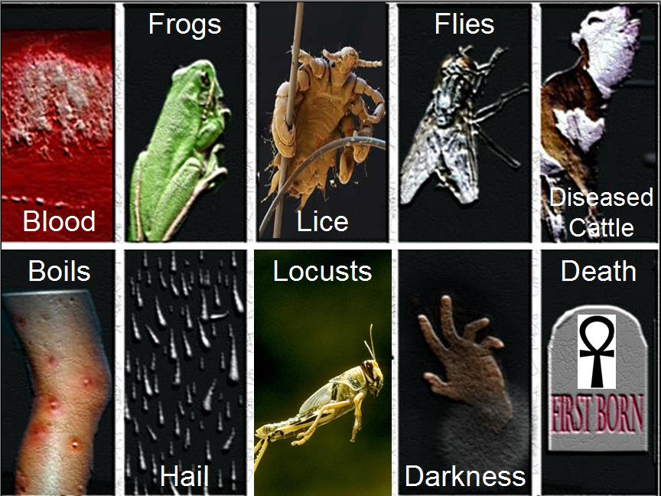
Law & Grace: Sesson 3 Review

Slide 11
Law & Grace: Sesson 3 Review
10 plagues (strikes) of Egypt: Exo. 12:12; Num. 33:4
Plague | Egyptian god defeated | Exodus
1. Water into blood | Osiris | 7:20
2. Frogs infestation | Hekt | 8:6
3. Lice (Gnats) infestation | Seb | 8:17
4. Fly infestation | Hatkok | 8:24
5. Cattle diseased | Apis | 9:6
6. Boil epidemic | Typhon | 9:10
7. Fiery Hail | Shu | 9:24
8. Locust infestation | Serapai | 10:13
9. 3 Days of darkness | Ra | 10:22
10. Death of firstborn | All the gods | 12:29
http://www.raidersnewsupdate.com

Slide 12
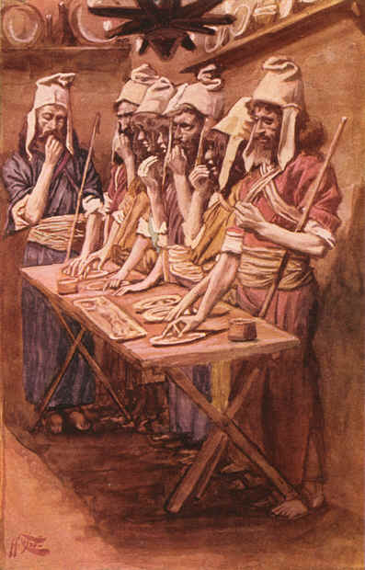
PASSOVER
Law & Grace: Sesson 3 Review

Slide 13
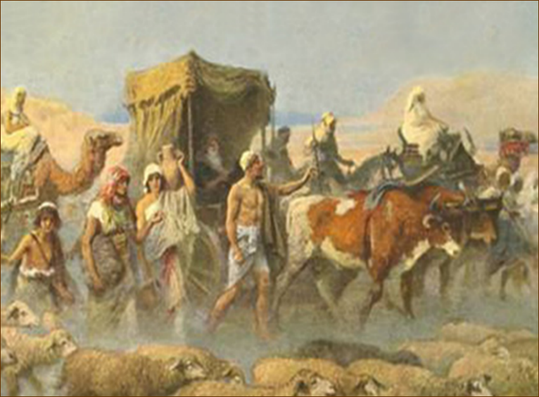
GET OUT OF DODGE!
Law & Grace: Sesson 3 Review

Slide 14
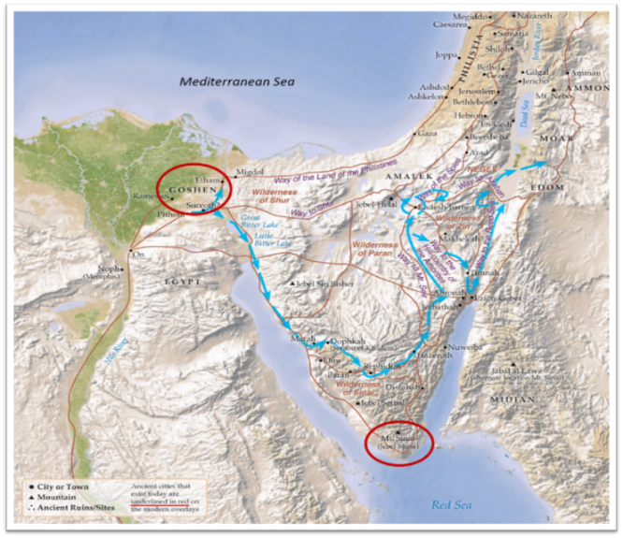
THE NILE DELTA AND LAND OF GOSHEN
Law & Grace: Sesson 3 Review
Notes:
God Separates Israel from Egypt

Slide 15
Session 4 Outline
Review
Purpose, Aim, and Objective
Session 3
Through the Sea w/o Getting Wet – Exo. 13-14
General Information
Contrast & Comparison of Law & Grace
Conclusion

Slide 16
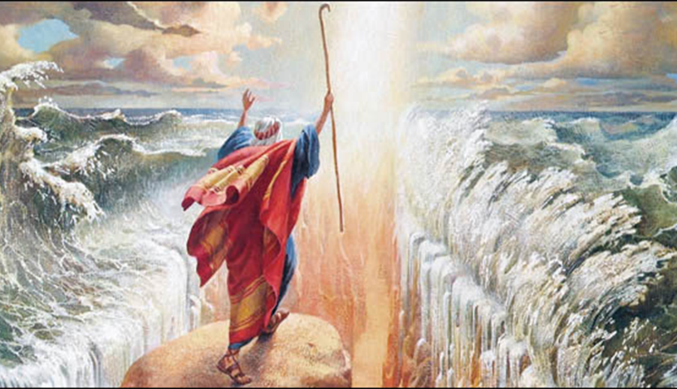
Law & Grace: Sesson 3 Review
A CLOSER LOOK AT THE CROSSING
Notes:
God Separates Israel from Egypt

Slide 17
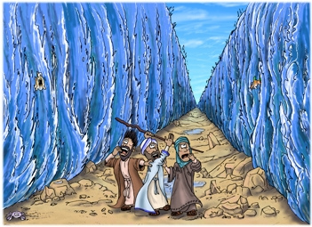
Law & Grace: Through The Sea Without Getting Wet!
THROUGH THE SEA WITHOUT GETTING WET!

Slide 18
Session 4 Outline
Review
Purpose, Aim, and Objective
Session 3
Through the Sea w/o Getting Wet – Exo. 13-14
General Information
Contrast & Comparison of Law & Grace
Conclusion

Slide 19
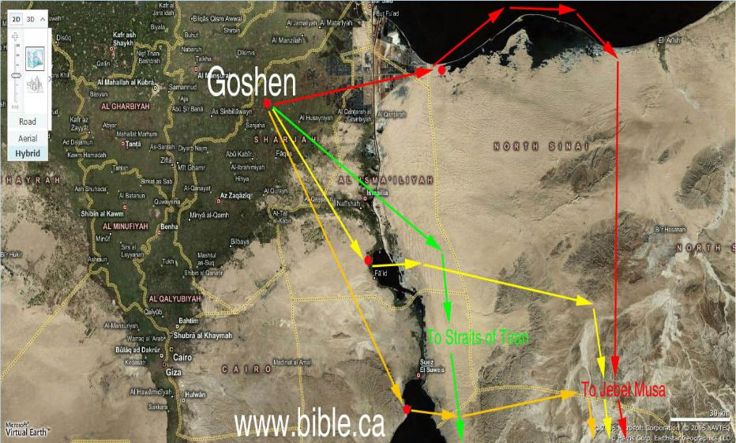
POSSIBLE EXODUS ROUTES- SERIES OF LAKES
Law & Grace: Through The Sea Without Getting Wet!

Slide 20
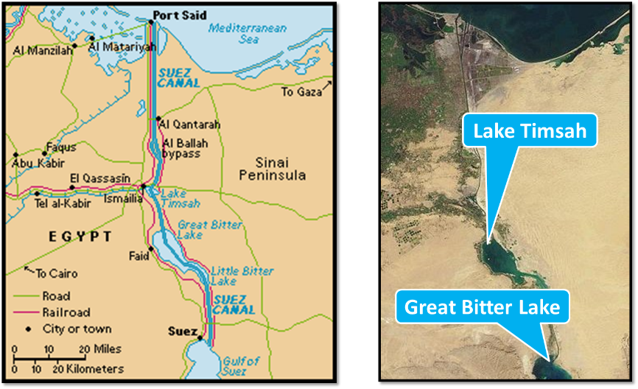
POSSIBLE EXODUS ROUTES LAKE TIMSAH / THE GREAT BITTER LAKE
Law & Grace: Through The Sea Without Getting Wet!

Slide 21
POSSIBLE EXODUS ROUTES THE GREAT BITTER LAKE
Law & Grace: Through The Sea Without Getting Wet!

Slide 22
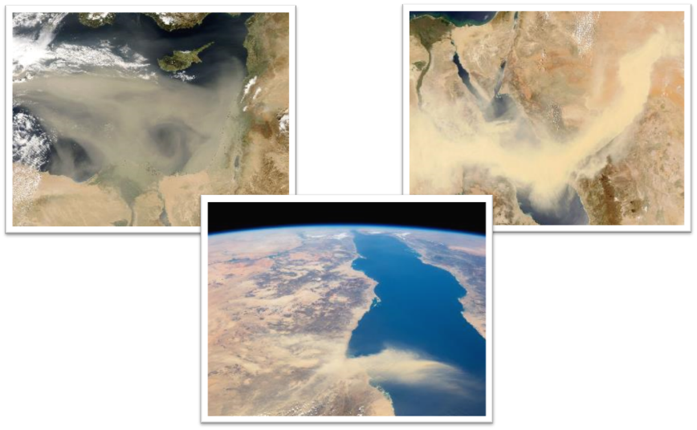
POSSIBLE EXODUS ROUTES EGYPTIAN SAND STORMS
Law & Grace: Through The Sea Without Getting Wet!

Slide 23
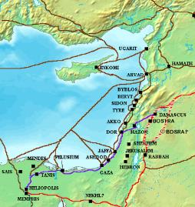
Law & Grace: Through The Sea Without Getting Wet!
POSSIBLE EXODUS ROUTES THE WAY OF THE SEA

Slide 24
Law & Grace: Through The Sea Without Getting Wet!
POSSIBLE EXODUS ROUTES THE WAY OF THE SEA

Slide 25
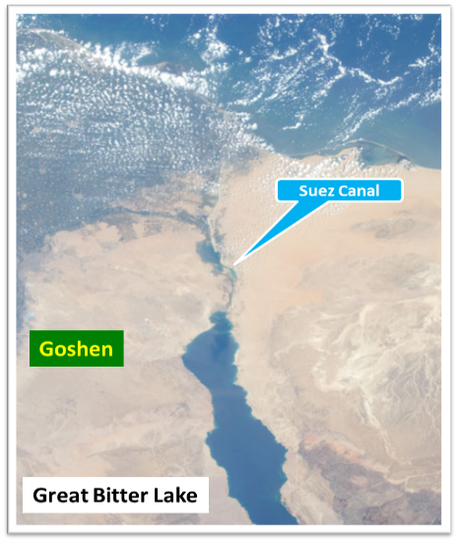
POSSIBLE EXODUS ROUTES THE GREAT BITTER LAKES REGION
Law & Grace: Through The Sea Without Getting Wet!

Slide 26
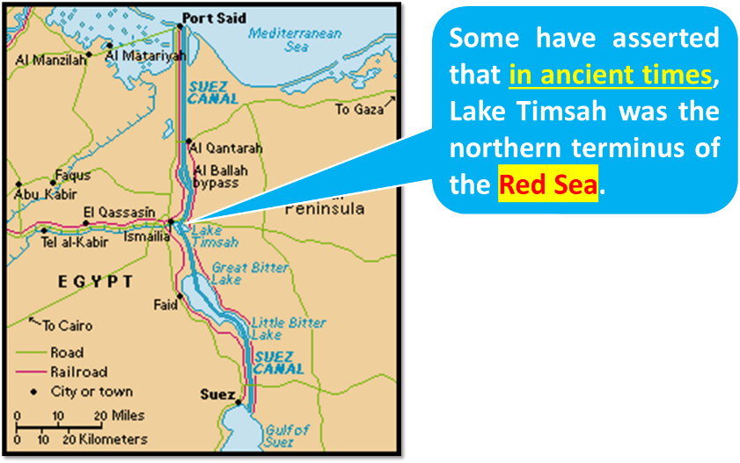
POSSIBLE EXODUS ROUTES LAKE TIMSAH
Law & Grace: Through The Sea Without Getting Wet!

Slide 27
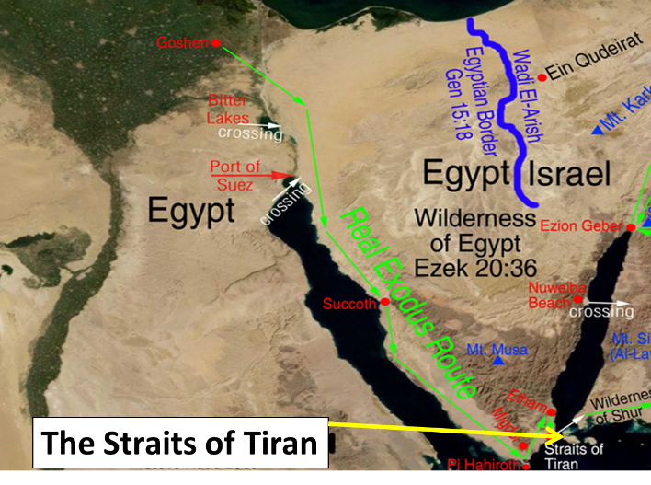
Law & Grace: Through The Sea Without Getting Wet!
POSSIBLE EXODUS ROUTES
THE STRAITS OF TIRAN

Slide 28
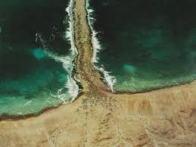
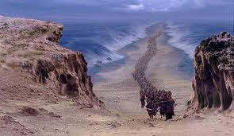
Law & Grace: Through The Sea Without Getting Wet!
POSSIBLE EXODUS ROUTES
“And [you] shall go on dry ground through the midst of the sea.” Ex. 14:16

Slide 29
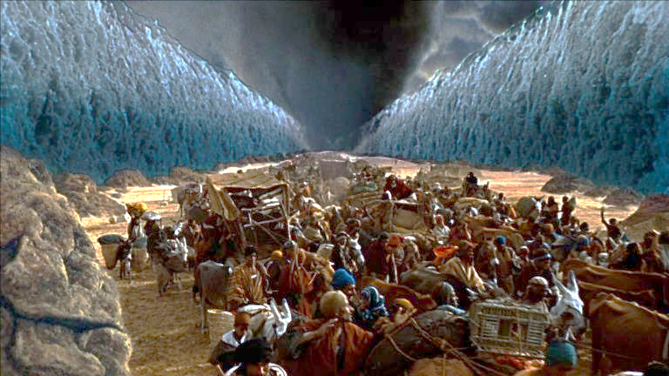
Law & Grace: Through The Sea Without Getting Wet!
POSSIBLE EXODUS ROUTES
A NIGHTTIME CROSSING!
See Exo. 14:19–25

Slide 30
Exodus 14:21–24 (NASB95)
²¹ Then Moses stretched out his hand over the sea; and the LORD swept the sea back by a strong east wind all night and turned the sea into dry land, so the waters were divided. ²² The sons of Israel went through the midst of the sea…²³ Then the Egyptians took up the pursuit,…into the midst of the sea. ²⁴ At the morning watch, the LORD looked down on the army of the Egyptians through the pillar of fire and cloud and brought the army of the Egyptians into confusion.

Slide 31
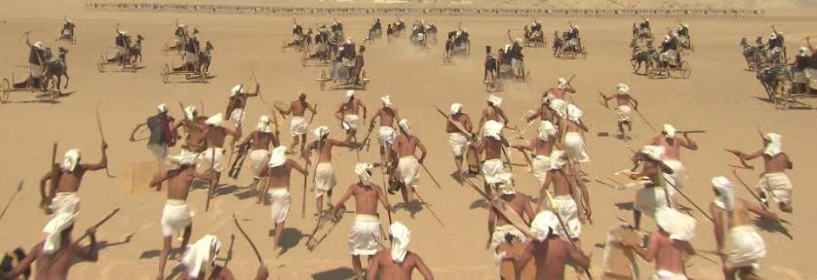
Law & Grace: Through The Sea Without Getting Wet!
WHAT WERE WE THINKING?
‘Then the Egyptians took up the pursuit…’ Exo. 14:23

Slide 32
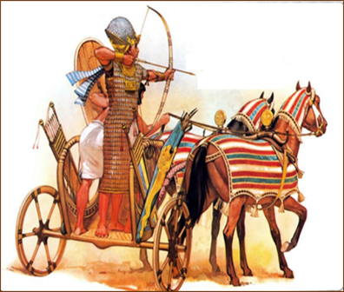
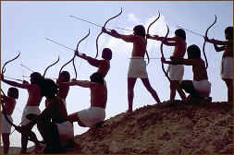
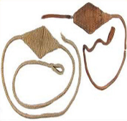
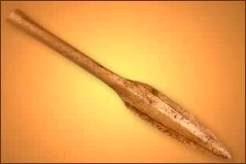
Law & Grace: Through The Sea Without Getting Wet!
WHAT WERE WE THINKING?
‘Then the Egyptians took up the pursuit…’ Exo. 14:23

Slide 33
Law & Grace: Through The Sea Without Getting Wet!
POSSIBLE EXODUS ROUTES
A NIGHTTIME CROSSING!

Slide 34
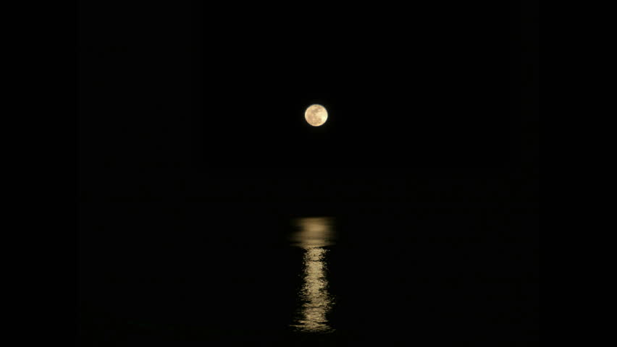
Law & Grace: Through The Sea Without Getting Wet!
POSSIBLE EXODUS ROUTES
A MOONLIT NIGHTTIME CROSSING?

Slide 35
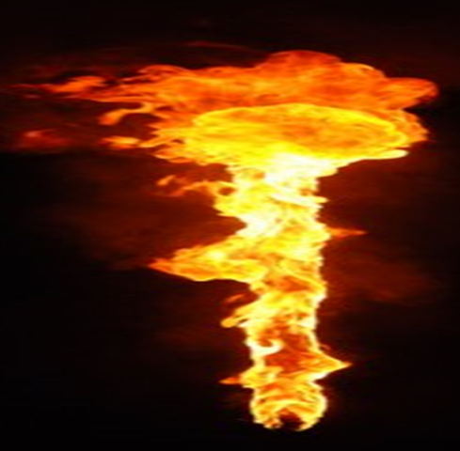
Law & Grace: Through The Sea Without Getting Wet!
POSSIBLE EXODUS ROUTES
PILLAR OF FIRE

Slide 36
Law & Grace: Through The Sea Without Getting Wet!
POSSIBLE EXODUS ROUTES
A NIGHTTIME CROSSING!

Slide 37
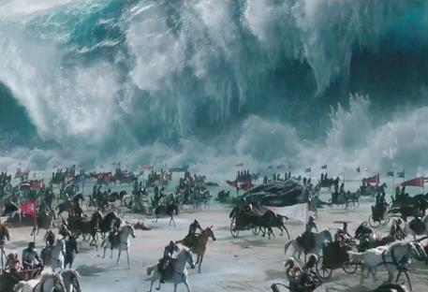
Exodus 14:23 (NASB95)
Then the Egyptians took up the pursuit, and all Pharaoh’s horses, his chariots and his horsemen went in after them into the midst of the sea.

Slide 38
Exodus 14:24, 26–28 (NASB95)
²⁴ At the morning watch, the Lord looked down on the army of the Egyptians through the pillar of fire and cloud… ²⁶ Then the Lord said to Moses, “Stretch out your hand…²⁷ So Moses stretched out his hand over the sea, and the sea returned to its normal state at daybreak,…²⁸ The waters returned and covered…Pharaoh’s entire army …not even one of them remained.

Slide 39
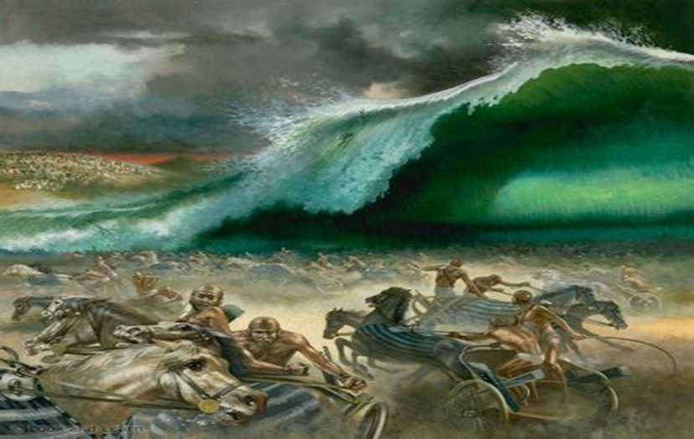
Law & Grace: Through The Sea Without Getting Wet!
POSSIBLE EXODUS ROUTES
SEEN NEVERMORE!

Slide 40
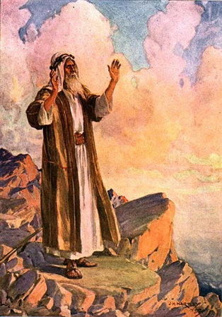
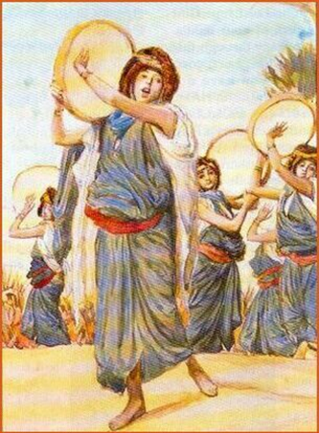
Law & Grace: Through The Sea Without Getting Wet!
EXODUS 15:1-21
THE SONGS OF MOSES AND MIRIAM

Slide 41
Session 4 Outline
Review
Purpose, Aim, and Objective
Session 3
Through the Sea w/o Getting Wet – Exo. 13-14
General Information
Contrast & Comparison of Law & Grace
Conclusion

Slide 42
WITH WHOM ARE YOU IDENTIFIED?
Law & Grace: Through The Sea Without Getting Wet!
ISRAEL Baptized into Moses | CHURCH Baptized into Christ
1 Cor. 10:2 says that the people of Israel were all “baptized into Moses in the cloud and in the sea”, a physical presence. this baptism would place them all under the principle of law. | And Rom. 6:3 and also Gal. 3:27 say that we in the Church were all “baptized into Christ Jesus”, which is a spiritual presence. this baptism would place all of us under the principle of grace.

Slide 43
Romans 6:3
Or do you not know that all of us who have been baptized into Christ Jesus have been baptized into His death?

Slide 44
Romans 6:3
Or do you not know that all of us who have been baptized (Aorist Passive) into Christ Jesus have been baptized into His death?
Galatians 3:27
For all of you who were baptized (Aorist Passive) into Christ have clothed yourselves with Christ.

Slide 45
1 Corinthians 1:30a
But by His [God’s] doing you are in Christ Jesus…

Slide 46
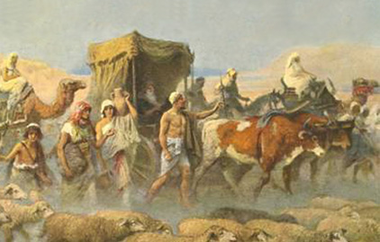
GOD ACTED FOR ISRAEL!
Law & Grace: Through The Sea Without Getting Wet!
God sent Moses to bring the Israelites out of Egypt – not to die in Egypt (Exodus 3:10).

Slide 47
Exodus 3:10
“Therefore, come now, and I will send you to Pharaoh, so that you may bring My people, the sons of Israel, out of Egypt.”

Slide 48
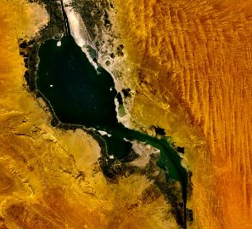
GOD ACTED FOR ISRAEL!
Law & Grace: Through The Sea Without Getting Wet!
God, acting through Moses and Aaron, and also through the 10 plagues, brought His people to the sea.
His people thought they were as good as dead but, God acted to save them.

Slide 49
Exodus 14:10–12
¹⁰ As Pharaoh drew near, the sons of Israel looked, and behold, the Egyptians were marching after them, and they became very frightened; so the sons of Israel cried out to the Lord. ¹¹ Then they said to Moses, “Is it because there were no graves in Egypt that you have taken us away to die in the wilderness? Why have you dealt with us in this way, bringing us out of Egypt? ¹² “Is this not the word that we spoke to you in Egypt, saying, ‘Leave us alone that we may serve the Egyptians’? For it would have been better for us to serve the Egyptians than to die in the wilderness.”

Slide 50
GOD ACTED FOR US!
Law & Grace: Through The Sea Without Getting Wet!
God sent Christ to deliver us from the bondage and tyranny of the sin nature and spiritual death.
Christ’s death provides us each our own personal exodus from bondage - forever.

Slide 51
GOD ACTED FOR US!
Law & Grace: Through The Sea Without Getting Wet!
Unlike the Israelites who were only threatened with death, God, in His infinite wisdom had us die with Christ, in His death on the Cross.
Our death with Christ, through our baptism into Christ (identification with Him), has an eternally good purpose to it.

Slide 52
Romans 8:28-30
²⁸ And we know that God causes all things to work together for good to those who love God, to those who are called according to His purpose. ²⁹ For those whom He foreknew, He also predestined to become conformed to the image of His Son, so that He would be the firstborn among many brethren; ³⁰ and these whom He predestined, He also called; and these whom He called, He also justified; and these whom He justified, He also glorified.

Slide 53
Law & Grace: Through The Sea Without Getting Wet!
DEATH TO LIFE FOR ISRAEL!
The Israelites thought that they were as good as dead with the Egyptians racing toward them on one side and the sea on the other.

Slide 54
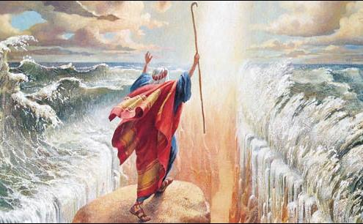
Law & Grace: Through The Sea Without Getting Wet!
DEATH TO LIFE FOR ISRAEL!
But God miraculously saved them from what would have been certain death, by parting the sea for the Israelites, NOT for any of the Egyptians.

Slide 55
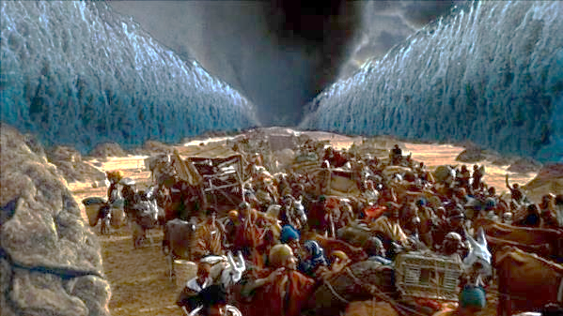
Law & Grace: Through The Sea Without Getting Wet!
DEATH TO LIFE FOR ISRAEL!
The principle of death to life was lived out physically for Israel as God brought them from certain death to miraculously preserved life.

Slide 56
Law & Grace: Through The Sea Without Getting Wet!
DEATH TO LIFE FOR US!
Before we believed, we were dead in our trespasses and sins, even as we walked the planet and were interacting with each other.

Slide 57
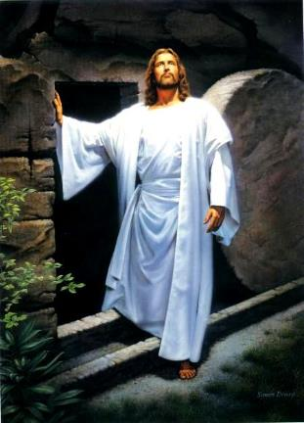
Law & Grace: Through The Sea Without Getting Wet!
DEATH TO LIFE FOR US!
But we who believe in Christ, have been raised with Him, so as to have new life – Christ’s very own resurrection life!

Slide 58
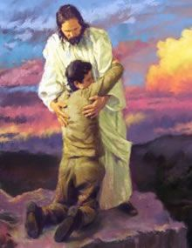
Law & Grace: Through The Sea Without Getting Wet!
DEATH TO LIFE FOR US!
The principle of death to life was carried out spiritually for us as God brought us from spiritual death to Christ’s resurrection life.

Slide 59
Law & Grace: Through The Sea Without Getting Wet!
DEATH WAS SEPARATION FOR ISRAEL!
The people of Israel crossed the sea that God had parted for them, but He closed those same waters over the Egyptians who were in pursuit.

Slide 60
Law & Grace: Through The Sea Without Getting Wet!
DEATH WAS SEPARATION FOR ISRAEL!
The ‘death’ of the Egyptian military in the waters of the sea literally, physically, and permanently, ‘separated’ the Israelites from the pursuing Egyptians…forever!

Slide 61
Law & Grace: Through The Sea Without Getting Wet!
DEATH IS SEPARATION FOR US!
According to the New Testament, for those of us who make up the Body of Christ, ‘spiritual death’ means ‘separation’.

Slide 62
Law & Grace: Through The Sea Without Getting Wet!
DEATH IS SEPARATION FOR US!
That is why the New Testament letters use terms like “dead unto” or “dead to” or “died to”.
So being “dead unto” and similar terms means for us to be “dead in relationship to” the sin nature, the Law and the world.

Slide 63
Law & Grace: Through The Sea Without Getting Wet!
DEATH = SEPARATION; BEING ALIVE = UNION
Rom. 6:1-11 | dead to sin, alive to Christ
Rom. 7:1-6 | death releases one from marriage; died to the Law, joined to Christ
2 Cor. 5:14-15 | dead to ourselves, alive to Christ
Gal. 2:19-20 | died to the Law, to live to God
Col. 2:20 | died with Christ to the elementary principles of the world
Col. 3:5, 20 | dead to sin, died with Christ to the world

Slide 64
Law & Grace: Through The Sea Without Getting Wet!
DEATH = SEPARATION; BEING ALIVE = UNION
Frequently some will say that the Apostle Paul is the one who explained these truths, (death is separation, and being alive is union), and that's true, however, the Apostle Peter also clearly understood these truths (death is separation, and being alive is union), that is, ‘dead in relationship to, and alive in relationship to’. Consider 1 Peter 2:24:

Slide 65
Law & Grace: Through The Sea Without Getting Wet!
DEATH = SEPARATION; BEING ALIVE = UNION

Slide 66
Law & Grace: Through The Sea Without Getting Wet!
DEATH = SEPARATION; BEING ALIVE = UNION

Slide 67
Law & Grace: Through The Sea Without Getting Wet!
DEATH = SEPARATION; BEING ALIVE = UNION

Slide 68
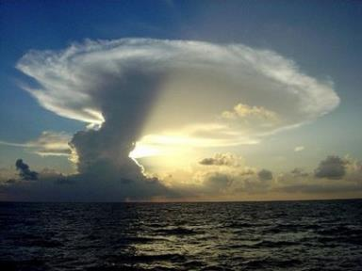
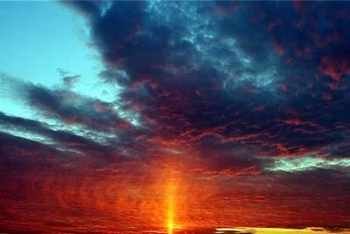
ISRAEL HAD GOD’S EXTERNAL AND VISIBLE PRESENCE
Law & Grace: Through The Sea Without Getting Wet!
Consider that from the time that Israel began to come out of Egypt they had a visible presence of God, as a pillar of cloud by day, and a pillar of fire by night.

Slide 69
ISRAEL HAD GOD’S EXTERNAL AND VISIBLE PRESENCE
Law & Grace: Through The Sea Without Getting Wet!
Most of the time this cloud led them as they traveled by day, remaining there visibly as a pillar of fire as they camped each night.

Slide 70
WE HAVE GOD’S INTERNAL AND INVISIBLE PRESENCE
Law & Grace: Through The Sea Without Getting Wet!
We have God’s presence as well, but not just when we wander the wilderness – but all the time, and within every single one of us who believes.
We are both individually and corporately, as the body of Christ, the temple of God – God dwells in us (1 Cor. 3:16; 6:19).

Slide 71
1 Cor. 3:16; 6:19
^{3:16} Do you not know that you are a temple of God and that the Spirit of God dwells in you?...^{6:19} Or do you not know that your body is a temple of the Holy Spirit who is in you, whom you have from God, and that you are not your own?

Slide 72
Session 4 Outline
Review
Purpose, Aim, and Objective
Session 3
Through the Sea w/o Getting Wet – Exo. 13-14
General Information
Contrast & Comparison of Law & Grace
Conclusion

Slide 73
C. I. SCOFIELD, D. D.
The Grace of God, The Fundamentals Vol. 3, Chapter VII, p. 98
We have, most of us, been reared and now live under the influence of Galatianism. Protestant theology, alas, is for the most part, thoroughly Galatianized, in that neither law nor grace are given their distinct and separated places, as in the counsels of God, but are mingled together in one incoherent system. The law is no longer, as in the Divine intent, a ministration of death (2 Cor. 3:7), of cursing (Gal. 3:10), of conviction (Rom. 3:19), because we are taught that we must try to keep it, and that by Divine help we may. Nor, on the other hand, does grace bring us blessed deliverance from the dominion of sin, for we are kept under the law as a rule of life despite the plain declaration, “Sin shall not have dominion over you: for ye are not under the law, but under grace” (Rom. 6:14).

Slide 74
Law & Grace: Through The Sea Without Getting Wet!
LAW | GRACE
Israel was baptized into Moses which place them all under the principle of law and obligated them to it (1 Cor. 10:2). | Believers are baptized into Christ Jesus , which places us all under the principle of grace and obligates us to it (Rom. 6:3; Gal. 3:27).

Slide 75
Law & Grace: Through The Sea Without Getting Wet!
WITH WHOM ARE YOU IDENTIFIED?

