Slide 1
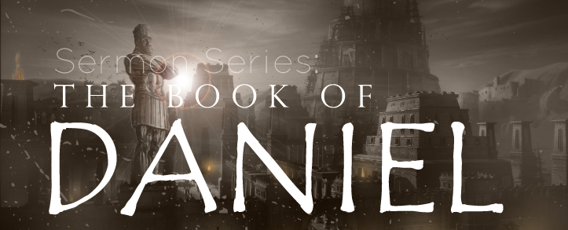
THE BOOK OF DANIEL
Andy Woods, Th.M.., JD., PhD.
Sr. Pastor, Sugar Land Bible Church
President Chafer Theological Seminary

Slide 2

Message
Times of the Gentiles are revealed prophetically (2, 7, 8-12) and ethically (1, 3-6)

Slide 3

Synthetic Outline
Historical (1-7):
  Daniel interprets, 3rd person, gentile nations
  Intro “Hebrew” (1)
  Aramaic chiasm (2-7)

Slide 4
Synthetic Outline
Historical (1-7):
  Daniel interprets, 3rd person, gentile nations
  Intro “Hebrew” (1)
  Aramaic chiasm (2-7)

Slide 5
Synthetic Outline
Historical (1-7):
  Daniel interprets, 3rd person, gentile nations
  Intro “Hebrew” (1)
  Aramaic chiasm (2-7)

Slide 6

Synthetic Outline
  Chiasm “Aramaic” ( 2-7)
1. Gentile History (2)
  2. Protection (3)
    3. Revelation to a gentile king (4)
    3. Revelation to a gentile king (5)
  2. Protection (6)
1. Gentile history (7)

Slide 7
Synthetic Outline
Prophetic (8-12):
  Angel interprets, 1st person, Jewish nation, Hebrew
  Ram & Goat (8)
  70 weeks (9)
  Final vision (10-12)

Slide 8
Synthetic Outline
Prophetic (8-12):
  Angel interprets, 1st person, Jewish nation, Hebrew
  Ram & Goat (8)
  70 weeks (9)
  Final vision (10-12)

Slide 9

Chapter 9 Outline
The Setting (1-2)
Daniel’s prayer (3-19)
Gabriel’s arrival (20-23)
The Seventy Weeks Prophecy (24-27)

Slide 10
Chapter 9 Outline
The Setting (1-2)
Daniel’s prayer (3-19)
Gabriel’s arrival (20-23)
The Seventy Weeks Prophecy (24-27)

Slide 11
I. The Setting (1-2)
Historical setting (v.1)
Prophetic setting (v.2)

Slide 12
CHAPTER AND VERSE IN DANIEL | CHRONOLOGICAL DATE | BIBLICAL DATE
1:1 | 605 | 3rd year of Jehoiakim
2:1 | 603 | 2nd year of Nebuchadnezzar
5 | Sat. night 10/12/539 (Hoehner)
7:1 | 553 | 1st year of Belshazzar
8:1 | 551 | 3rd year of Belshazzar
9:1 | 538 | 1st year of Darius
10:1 | 536 | 3rd year of Cyrus

Slide 13
Daniel’s Age
CHAPTER | EVENTS | AGE
1 | Taken to Babylonian captivity | 15
2 | Interpreting Nebuchadnezzar’s 1st dream (huge image) | 17
3 | Daniel’s 3 friends cast into the fiery furnace | 19 or 20
4 | Interpreting Nebuchadnezzar’s 2nd dream (huge tree) | 45-50
5 | Interpreting handwriting of the wall at Belshazzar’s feast | Early 80’s
6 | Delivered from the den of lions | c.83
7-8 | Daniel’s visions and dreams | Mid-60’s
9 | Daniel’s seventy “sevens” prophecy | Early-80’s
10-12 | Final dreams and visions | Mid-80’s

Slide 14
I. The Setting (1-2)
Historical setting (v.1)
Prophetic setting (v.2)

Slide 15
SETTING : PROPHETIC
V.2
70 YEAR CAPTIVITY ABOUT TO END
  Jeremiah 25:11; 29:10
  Prophecy provides important information
  Prophecy gives insight into current events
  Why 70 years?
    Lev. 25:1-5; 26:33-35; 2 Chron. 36:21

Slide 16


Statue
&
Stone

Slide 17
Chapter 9 Outline
The Setting (1-2)
Daniel’s prayer (3-19)
Gabriel’s arrival (20-23)
The Seventy Weeks Prophecy (24-27)

Slide 18
Chapter 9 Outline
The Setting (1-2)
Daniel’s prayer (3-19)
Gabriel’s arrival (20-23)
The Seventy Weeks Prophecy (24-27)

Slide 19
Chapter 9 Outline
The Setting (1-2)
Daniel’s prayer (3-19)
Gabriel’s arrival (20-23)
The Seventy Weeks Prophecy (24-27)

Slide 20
The Seventy Weeks Prophecy 10 FACTS
Focus = Jews & Jerusalem (v.24b)
490 year period of time (v.24a)
360-day years
6 prophecies WILL BE fulfilled (v.24c)
March 5, 444 BC prophecy begins (25a)
483 years elapse between beginning of prophecy & Palm Sunday (25b)
Gap between 483rd & 484th year (26)
Final 7 years = future Tribulation period (27)
Dan. 9:27 Overview of Tribulation
Daniel 9:27 = Revelation 6-19

Slide 21
The Seventy Weeks Prophecy 10 FACTS
Focus = Jews & Jerusalem (v.24b)
490 year period of time (v.24a)
360-day years
6 prophecies WILL BE fulfilled (v.24c)
March 5, 444 BC prophecy begins (25a)
483 years elapse between beginning of prophecy & Palm Sunday (25b)
Gap between 483rd & 484th year (26)
Final 7 years = future Tribulation period (27)
Dan. 9:27 Overview of Tribulation
Daniel 9:27 = Revelation 6-19

Slide 22

Daniel 9:24 (NASB)
Seventy weeks have been decreed for your people and your holy city, to finish the transgression, to make an end of sin, to make atonement for iniquity, to bring in everlasting righteousness, to seal up vision and prophecy and to anoint the most holy place.

Slide 23
FOCUS : JEWS & JERUSALEM
“your people and your city”
Prophecy directed toward Daniel
Daniel was a Jew
Jewish people & Jerusalem
Not the church or world history

Slide 24
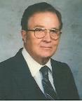

Robert Culver
Daniel and the Latter Days
(Chicago, IL: Moody Press, 1977), p. 149
“Let the postmillennial and amillennial commentators look long and steadily at this fact. This prophecy is a prophecy for Daniel’s people and Daniel’s city. No alchemy of Origenistic spiritualizing interpretation can change that.”

Slide 25
The Seventy Weeks Prophecy 10 FACTS
Focus = Jews & Jerusalem (v.24b)
490 year period of time (v.24a)
360-day years
6 prophecies WILL BE fulfilled (v.24c)
March 5, 444 BC prophecy begins (25a)
483 years elapse between beginning of prophecy & Palm Sunday (25b)
Gap between 483rd & 484th year (26)
Final 7 years = future Tribulation period (27)
Dan. 9:27 Overview of Tribulation
Daniel 9:27 = Revelation 6-19

Slide 26
Daniel 9:24 (NASB)
Seventy weeks have been decreed for your people and your holy city, to finish the transgression, to make an end of sin, to make atonement for iniquity, to bring in everlasting righteousness, to seal up vision and prophecy and to anoint the most holy place.

Slide 27
490 YEAR PERIOD OF TIME v.24a
“A Week of Years”
Daniel 9:1-2
Genesis 29:27
70 x 7 = 490

Slide 28
Daniel 9:24 (NASB)
Seventy weeks have been decreed for your people and your holy city, to finish the transgression, to make an end of sin, to make atonement for iniquity, to bring in everlasting righteousness, to seal up vision and prophecy and to anoint the most holy place.

Slide 29


Slide 30
The Seventy Weeks Prophecy 10 FACTS
Focus = Jews & Jerusalem (v.24b)
490 year period of time (v.24a)
360-day years
6 prophecies WILL BE fulfilled (v.24c)
March 5, 444 BC prophecy begins (25a)
483 years elapse between beginning of prophecy & Palm Sunday (25b)
Gap between 483rd & 484th year (26)
Final 7 years = future Tribulation period (27)
Dan. 9:27 Overview of Tribulation
Daniel 9:27 = Revelation 6-19

Slide 31
360-day YEARS
TRIBULATION
  Rev. 11:3 (1260 days)
  Rev. 11:2 (42 months)
  1260 days / 42 months = 30 days per month
  30 days x 12 months = 360 days per year
THE FLOOD
  Gen. 7:24 (150 days)
  Gen. 7:11; 8:4 (5 months)
  150 days / 5 months = 30 days per month
  30 days x 12 months = 360 days per year

Slide 32
The Seventy Weeks Prophecy 10 FACTS
Focus = Jews & Jerusalem (v.24b)
490 year period of time (v.24a)
360-day years
6 prophecies WILL BE fulfilled (v.24c)
March 5, 444 BC prophecy begins (25a)
483 years elapse between beginning of prophecy & Palm Sunday (25b)
Gap between 483rd & 484th year (26)
Final 7 years = future Tribulation period (27)
Dan. 9:27 Overview of Tribulation
Daniel 9:27 = Revelation 6-19

Slide 33
Daniel 9:24 (NASB)
Seventy weeks have been decreed for your people and your holy city, to finish the transgression, to make an end of sin, to make atonement for iniquity, to bring in everlasting righteousness, to seal up vision and prophecy and to anoint the most holy place.

Slide 34

6 Prophecies WILL BE fulfilled V.24c
  “to finish transgression”
  “to make an end of sin”
  “to make atonement for iniquity”
  “to bring in everlasting righteousness”
  “to seal up vision and prophecy”
  “to anoint the most holy place”
Arnold Fructenbaum, Footsteps of the Messiah, p.191-4

Slide 35
6 Prophecies WILL BE fulfilled V.24c
  “to finish transgression”
  “to make an end of sin”
  “to make atonement for iniquity”
  “to bring in everlasting righteousness”
  “to seal up vision and prophecy”
  “to anoint the most holy place”
Arnold Fructenbaum, Footsteps of the Messiah, p.191-4

Slide 36
6 Prophecies WILL BE fulfilled V.24c
  “to finish transgression”
  “to make an end of sin”
  “to make atonement for iniquity”
  “to bring in everlasting righteousness”
  “to seal up vision and prophecy”
  “to anoint the most holy place”
Arnold Fructenbaum, Footsteps of the Messiah, p.191-4

Slide 37


Slide 38
Jeremiah 31:31-34
“Behold, days are coming,” declares the Lord, “when I will make a new covenant with the house of Israel and with the house of Judah, ³² not like the covenant which I made with their fathers in the day I took them by the hand to bring them out of the land of Egypt, My covenant which they broke, although I was a husband to them,” declares the Lord. ³³ “But this is the covenant which I will make with the house of Israel after those days,” declares the Lord, “I will put My law within them and on their heart I will write it; and I will be their God, and they shall be My people. ³⁴ They will not teach again, each man his neighbor and each man his brother, saying, ‘Know the Lord,’ for they will all know Me, from the least of them to the greatest of them,” declares the Lord, “for I will forgive their iniquity, and their sin I will remember no more.”

Slide 39
6 Prophecies WILL BE fulfilled V.24c
  “to finish transgression”
  “to make an end of sin”
  “to make atonement for iniquity”
  “to bring in everlasting righteousness”
  “to seal up vision and prophecy”
  “to anoint the most holy place”
Arnold Fructenbaum, Footsteps of the Messiah, p.191-4

Slide 40
6 Prophecies WILL BE fulfilled V.24c
  “to finish transgression”
  “to make an end of sin”
  “to make atonement for iniquity”
  “to bring in everlasting righteousness”
  “to seal up vision and prophecy”
  “to anoint the most holy place”
Arnold Fructenbaum, Footsteps of the Messiah, p.191-4

Slide 41
Isaiah 9:6-7 (NASB)
⁶ For a child will be born to us, a son will be given to us; And the government will rest on His shoulders; And His name will be called Wonderful Counselor, Mighty God, Eternal Father, Prince of Peace.⁷ There will be no end to the increase of His government or of peace, On the throne of David and over his kingdom, To establish it and to uphold it with justice and righteousness From then on and forevermore. The zeal of the Lord of hosts will accomplish this.

Slide 42
6 Prophecies WILL BE fulfilled V.24c
  “to finish transgression”
  “to make an end of sin”
  “to make atonement for iniquity”
  “to bring in everlasting righteousness”
  “to seal up vision and prophecy”
  “to anoint the most holy place”
Arnold Fructenbaum, Footsteps of the Messiah, p.191-4

Slide 44
6 Prophecies WILL BE fulfilled V.24c
  “to finish transgression”
  “to make an end of sin”
  “to make atonement for iniquity”
  “to bring in everlasting righteousness”
  “to seal up vision and prophecy”
  “to anoint the most holy place”
Arnold Fructenbaum, Footsteps of the Messiah, p.191-4

Slide 45
ISRAEL’S FOUR TEMPLES
Solomon’s pre exilic temple (Kings and Chronicles)
Zerubbabel’s post exilic temple (Ezra 1-6; John 2:20)
Antichrist's temple (Dan 9:27; Matt 24:15; 2 Thess 2:4; Rev 11:1-2)
Millennial temple (Ezek 40-48)

Slide 46
ISRAEL’S FOUR TEMPLES
Solomon’s pre exilic temple (Kings and Chronicles)
Zerubbabel’s post exilic temple (Ezra 1-6; John 2:20)
Antichrist's temple (Dan 9:27; Matt 24:15; 2 Thess 2:4; Rev 11:1-2)
Millennial temple (Ezek 40-48)

Slide 47
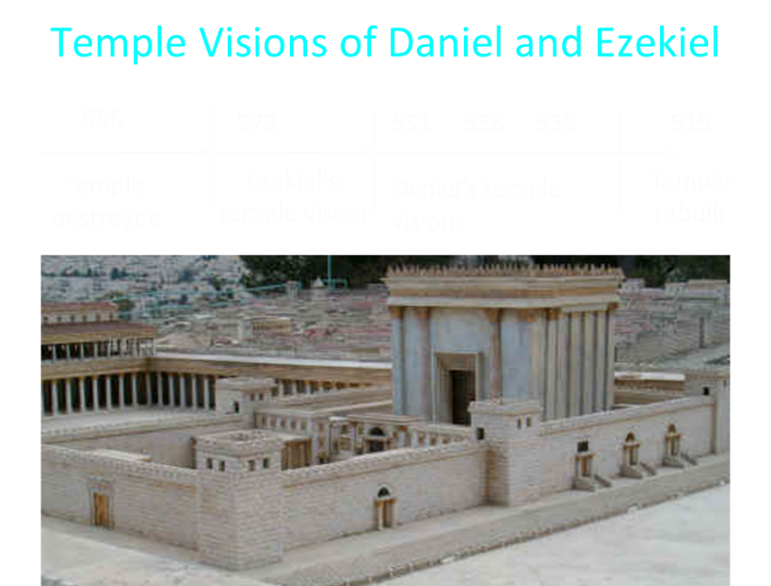

Slide 48
6 Prophecies WILL BE fulfilled V.24c
  “to finish transgression”
  “to make an end of sin”
  “to make atonement for iniquity”
  “to bring in everlasting righteousness”
  “to seal up vision and prophecy”
  “to anoint the most holy place”
Arnold Fructenbaum, Footsteps of the Messiah, p.191-4

Slide 49
The Seventy Weeks Prophecy 10 FACTS
Focus = Jews & Jerusalem (v.24b)
490 year period of time (v.24a)
360-day years
6 prophecies WILL BE fulfilled (v.24c)
March 5, 444 BC prophecy begins (25a)
483 years elapse between beginning of prophecy & Palm Sunday (25b)
Gap between 483rd & 484th year (26)
Final 7 years = future Tribulation period (27)
Dan. 9:27 Overview of Tribulation
Daniel 9:27 = Revelation 6-19

Slide 50
Daniel 9:25 (NASB)
So you are to know and discern that from the issuing of a decree to restore and rebuild Jerusalem until Messiah the Prince there will be seven weeks and sixty-two weeks; it will be built again, with plaza and moat, even in times of distress.

Slide 52
PROPHECY BEGINS WITH DECREE
Decree to rebuild Jerusalem
Not the decrees involving the temple
  Cyrus 538 BC (Ezra 1:1-4; 6:1-5)
  Darius 520 BC (Ezra 6:6-12)
  Artaxerxes 458 BC (Ezra 7:11-16)
Decree of Artaxerxes (Neh. 1-2)
  Nehemiah 2: 3, 5, 8
  Distress (Daniel 9:25)
  March 5, 444 B.C. (Neh.2:1)

Slide 53
Daniel 9:25 (NASB)
So you are to know and discern that from the issuing of a decree to restore and rebuild Jerusalem until Messiah the Prince there will be seven weeks and sixty-two weeks; it will be built again, with plaza and moat, even in times of distress.

Slide 54
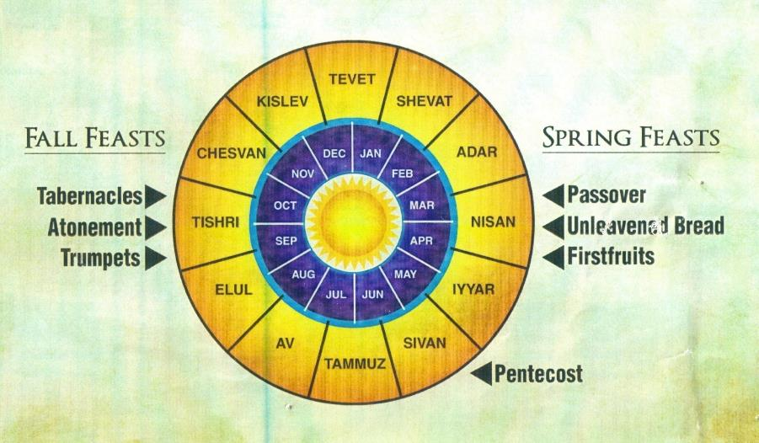

Slide 55


Slide 56
The Seventy Weeks Prophecy 10 FACTS
Focus = Jews & Jerusalem (v.24b)
490 year period of time (v.24a)
360-day years
6 prophecies WILL BE fulfilled (v.24c)
March 5, 444 BC prophecy begins (25a)
483 years elapse between beginning of prophecy & Palm Sunday (25b)
Gap between 483rd & 484th year (26)
Final 7 years = future Tribulation period (27)
Dan. 9:27 Overview of Tribulation
Daniel 9:27 = Revelation 6-19

Slide 57
Daniel 9:25 (NASB)
So you are to know and discern that from the issuing of a decree to restore and rebuild Jerusalem until Messiah the Prince there will be seven weeks and sixty-two weeks; it will be built again, with plaza and moat, even in times of distress.

Slide 58
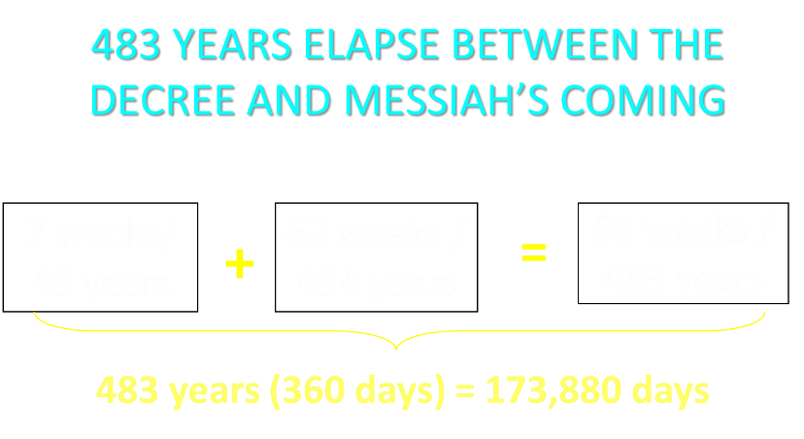

Slide 59
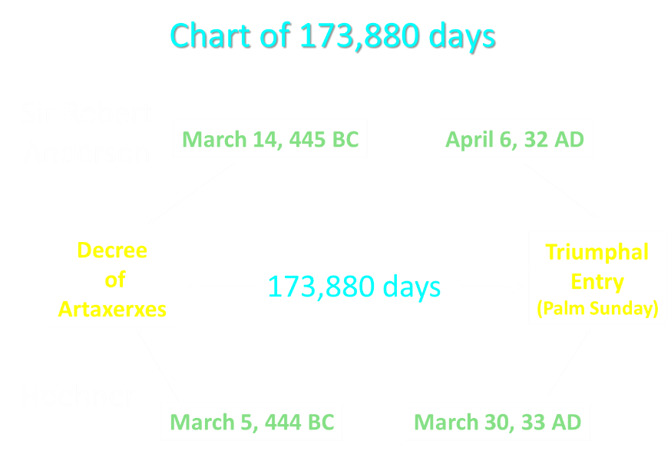

Slide 60

If the first 69 weeks were fulfilled literally then the remaining week will be fulfilled literally.

Slide 61

Sir Robert Anderson
The Coming Prince, p.147-148
“There is not a single prophecy, of which the fulfillment is recorded in Scripture, that was not realized with absolute accuracy, and in every detail; and it is wholly unjustifiable to assume that a new system of fulfillment was inaugurated after the sacred canon closed…
Literalness of fulfillment may therefore be accepted as an axiom to guide us in the study of prophecy.”

Slide 62
The Seventy Weeks Prophecy 10 FACTS
Focus = Jews & Jerusalem (v.24b)
490 year period of time (v.24a)
360-day years
6 prophecies WILL BE fulfilled (v.24c)
March 5, 444 BC prophecy begins (25a)
483 years elapse between beginning of prophecy & Palm Sunday (25b)
Gap between 483rd & 484th year (26)
Final 7 years = future Tribulation period (27)
Dan. 9:27 Overview of Tribulation
Daniel 9:27 = Revelation 6-19

Slide 64
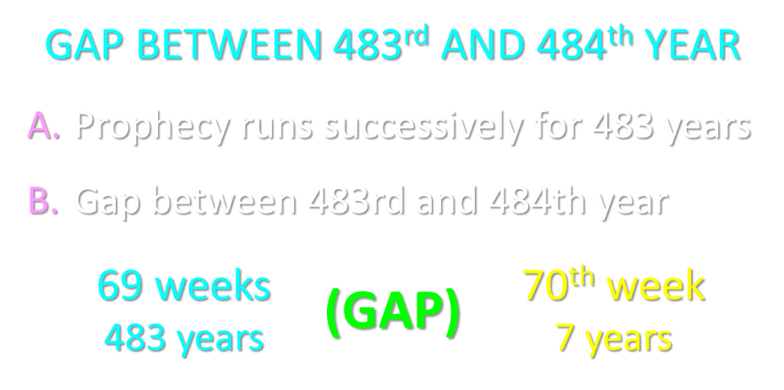

Slide 65
6 Reasons for Gap
  Events prophesied v.26
    Messiah crucified v.26a
    70 AD holocaust v.26b
  Prophecies in Dan. 9:24 would have been fulfilled 7 years after Palm Sunday
  Jesus indicated a gap - (Matt. 24:15, 21-22, 29-30)
  Daniel 9:27 was never fulfilled historically
  Gap occurs elsewhere - (Is. 61:1-2; Luke 4:16-21; Isaiah 9:6)
  Early church fathers indicated a gap

Slide 66
6 Reasons for Gap
  Events prophesied v.26
    Messiah crucified v.26a
    70 AD holocaust v.26b
  Prophecies in Dan. 9:24 would have been fulfilled 7 years after Palm Sunday
  Jesus indicated a gap - (Matt. 24:15, 21-22, 29-30)
  Daniel 9:27 was never fulfilled historically
  Gap occurs elsewhere - (Is. 61:1-2; Luke 4:16-21; Isaiah 9:6)
  Early church fathers indicated a gap

Slide 67
Daniel 9:26 (NASB)
Then after the sixty-two weeks the Messiah will be cut off and have nothing, and the people of the prince who is to come will destroy the city and the sanctuary. And its end will come with a flood; even to the end there will be war; desolations are determined.

Slide 68
Daniel 9:26 (NASB)
Then after the sixty-two weeks the Messiah will be cut off and have nothing, and the people of the prince who is to come will destroy the city and the sanctuary. And its end will come with a flood; even to the end there will be war; desolations are determined.

Slide 69
ISRAEL’S FOUR TEMPLES
Solomon’s pre exilic temple (Kings and Chronicles)
Zerubbabel’s post exilic temple (Ezra 1-6; John 2:20)
Antichrist's temple (Dan 9:27; Matt 24:15; 2 Thess 2:4; Rev 11:1-2)
Millennial temple (Ezek 40-48)

Slide 70
ISRAEL’S FOUR TEMPLES
Solomon’s pre exilic temple (Kings and Chronicles)
Zerubbabel’s post exilic temple (Ezra 1-6; John 2:20)
Antichrist's temple (Dan 9:27; Matt 24:15; 2 Thess 2:4; Rev 11:1-2)
Millennial temple (Ezek 40-48)

Slide 72
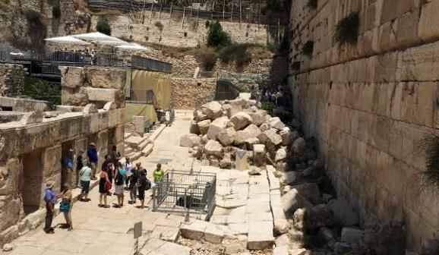
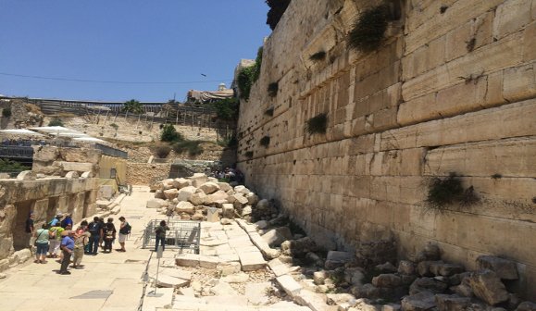

Slide 73
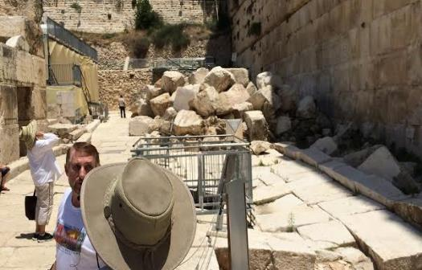
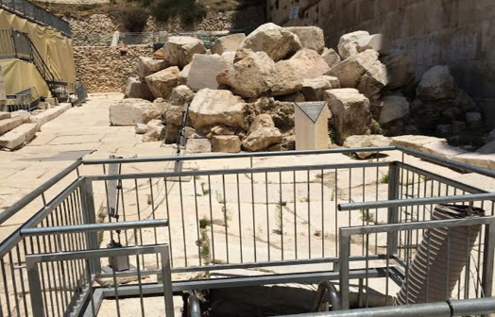

Slide 74
6 Reasons for Gap
  Events prophesied v.26
    Messiah crucified v.26a
    70 AD holocaust v.26b
  Prophecies in Dan. 9:24 would have been fulfilled 7 years after Palm Sunday
  Jesus indicated a gap - (Matt. 24:15, 21-22, 29-30)
  Daniel 9:27 was never fulfilled historically
  Gap occurs elsewhere - (Is. 61:1-2; Luke 4:16-21; Isaiah 9:6)
  Early church fathers indicated a gap

Slide 75
6 Reasons for Gap
  Events prophesied v.26
    Messiah crucified v.26a
    70 AD holocaust v.26b
  Prophecies in Dan. 9:24 would have been fulfilled 7 years after Palm Sunday
  Jesus indicated a gap - (Matt. 24:15, 21-22, 29-30)
  Daniel 9:27 was never fulfilled historically
  Gap occurs elsewhere - (Is. 61:1-2; Luke 4:16-21; Isaiah 9:6)
  Early church fathers indicated a gap

Slide 76
6 Reasons for Gap
  Events prophesied v.26
    Messiah crucified v.26a
    70 AD holocaust v.26b
  Prophecies in Dan. 9:24 would have been fulfilled 7 years after Palm Sunday
  Jesus indicated a gap - (Matt. 24:15, 21-22, 29-30)
  Daniel 9:27 was never fulfilled historically
  Gap occurs elsewhere - (Is. 61:1-2; Luke 4:16-21; Isaiah 9:6)
  Early church fathers indicated a gap

Slide 77
6 Reasons for Gap
  Events prophesied v.26
    Messiah crucified v.26a
    70 AD holocaust v.26b
  Prophecies in Dan. 9:24 would have been fulfilled 7 years after Palm Sunday
  Jesus indicated a gap - (Matt. 24:15, 21-22, 29-30)
  Daniel 9:27 was never fulfilled historically
  Gap occurs elsewhere - (Is. 61:1-2; Luke 4:16-21; Isaiah 9:6)
  Early church fathers indicated a gap

Slide 78
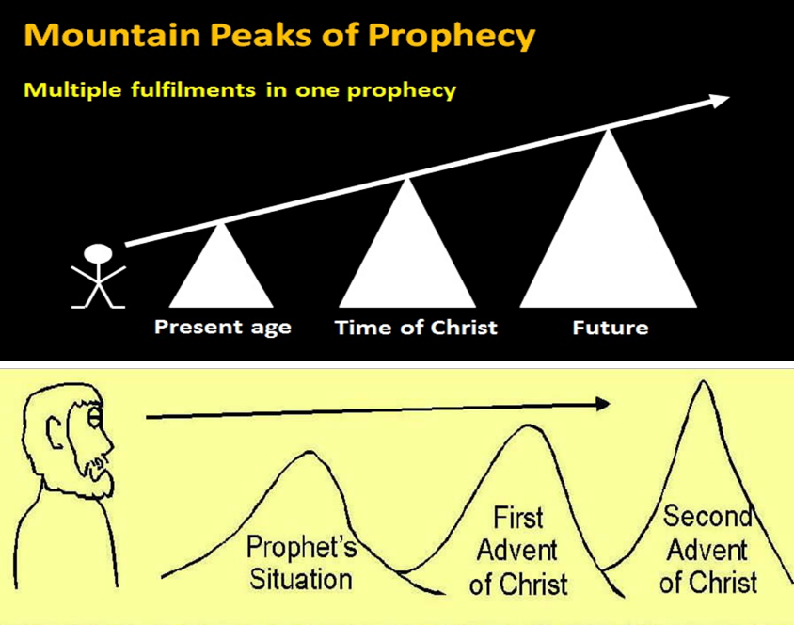

Slide 79












Understanding Daniel’s
Prophetic Perspective
Antichrist
Antiochus IV
(Daniel 11:36-45)
(Daniel 11:21-35)
Far
Fulfillment
Near
Fulfillment
Daniel

Slide 80
Isaiah 9:6-7 (NASB)
⁶ For a child will be born to us, a son will be given to us; And the government will rest on His shoulders; And His name will be called Wonderful Counselor, Mighty God, Eternal Father, Prince of Peace.⁷ There will be no end to the increase of His government or of peace, On the throne of David and over his kingdom, To establish it and to uphold it with justice and righteousness From then on and forevermore. The zeal of the Lord of hosts will accomplish this.

Slide 81
6 Reasons for Gap
  Events prophesied v.26
    Messiah crucified v.26a
    70 AD holocaust v.26b
  Prophecies in Dan. 9:24 would have been fulfilled 7 years after Palm Sunday
  Jesus indicated a gap - (Matt. 24:15, 21-22, 29-30)
  Daniel 9:27 was never fulfilled historically
  Gap occurs elsewhere - (Is. 61:1-2; Luke 4:16-21; Isaiah 9:6)
  Early church fathers indicated a gap

Slide 82

Hippolytus
Fragments From Commentaries, Daniel, paragraph 22 Cited by Hitchcock and Ice in The Truth Behind the Left behind Series p.98.
“For when the three score and two weeks are fulfilled, and Christ is come, and the Gospel is preached in every place, the times being then accomplished, there will remain only one week, the last, in which Elijah will appear, and Enoch, and in the midst of it the abomination of desolation will be manifest, viz., Antichrist, announcing desolation to the world.”

Slide 83
The Seventy Weeks Prophecy 10 FACTS
Focus = Jews & Jerusalem (v.24b)
490 year period of time (v.24a)
360-day years
6 prophecies WILL BE fulfilled (v.24c)
March 5, 444 BC prophecy begins (25a)
483 years elapse between beginning of prophecy & Palm Sunday (25b)
Gap between 483rd & 484th year (26)
Final 7 years = future Tribulation period (27)
Dan. 9:27 Overview of Tribulation
Daniel 9:27 = Revelation 6-19

Slide 84
FINAL 7 YEARS = FUTURE TRIBULATION v.27
490 years total
483 years have transpired
Gap exists between 483rd & 484th year
Final 7 years are future
Final 7 years are the Tribulation period

Slide 85
The Seventy Weeks Prophecy 10 FACTS
Focus = Jews & Jerusalem (v.24b)
490 year period of time (v.24a)
360-day years
6 prophecies WILL BE fulfilled (v.24c)
March 5, 444 BC prophecy begins (25a)
483 years elapse between beginning of prophecy & Palm Sunday (25b)
Gap between 483rd & 484th year (26)
Final 7 years = future Tribulation period (27)
Dan. 9:27 Overview of Tribulation
Daniel 9:27 = Revelation 6-19

Slide 86
Daniel 9:27 (NASB)
And he will make a firm covenant with the many for one week, but in the middle of the week he will put a stop to sacrifice and grain offering; and on the wing of abominations will come one who makes desolate, even until a complete destruction, one that is decreed, is poured out on the one who makes desolate.

Slide 87


Slide 89
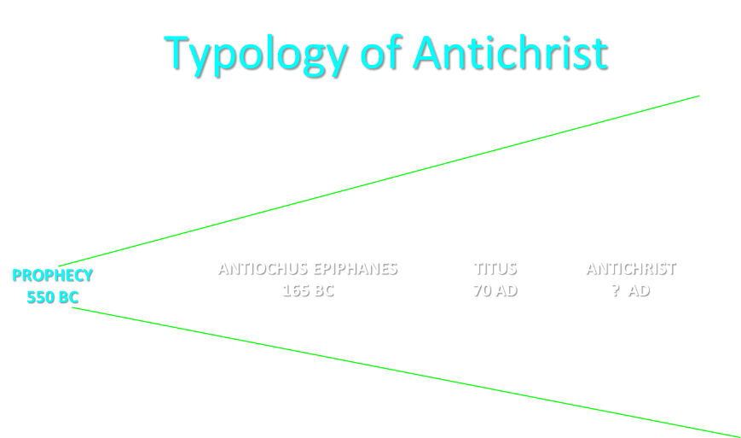

Slide 91


Slide 92
THE STAGE IS BEING SET
Rebirth of Israel in 1948
Israel’s desire for peace
Desire among some Jews to Rebuild 3rd Jewish temple
Desire among some Jews to Restore the sacrificial system
  Source: Randall Price “Ready to Rebuild”

Slide 93
THE STAGE IS BEING SET
Rebirth of Israel in 1948
Israel’s desire for peace
Desire among some Jews to Rebuild 3rd Jewish temple
Desire among some Jews to Restore the sacrificial system
  Source: Randall Price “Ready to Rebuild”

Slide 94
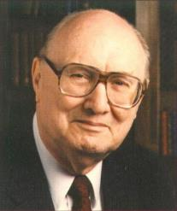
John Walvoord
Israel in Prophecy, Page 26
“Of the many peculiar phenomena which characterize the present generation, few events can claim equal significance as far as Biblical prophecy is concerned with that of the return of Israel to their land. It constitutes a preparation for the end of the age, the setting for the coming of the Lord for His church, and the fulfillment of Israel’s prophetic destiny.”

Slide 95
THE STAGE IS BEING SET
Rebirth of Israel in 1948
Israel’s desire for peace
Desire among some Jews to Rebuild 3rd Jewish temple
Desire among some Jews to Restore the sacrificial system
  Source: Randall Price “Ready to Rebuild”

Slide 96
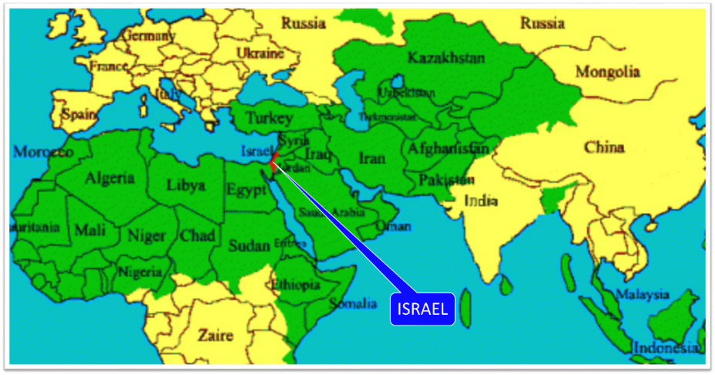

Slide 97
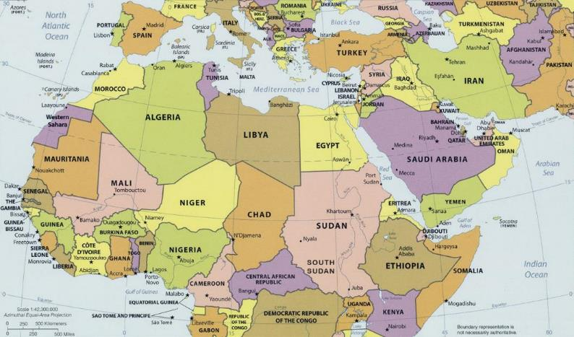
ISRAEL

Slide 98


Slide 99
THE STAGE IS BEING SET
Rebirth of Israel in 1948
Israel’s desire for peace
Desire among some Jews to Rebuild 3rd Jewish temple
Desire among some Jews to Restore the sacrificial system
  Source: Randall Price “Ready to Rebuild”

Slide 100
ISRAEL’S FOUR TEMPLES
Solomon’s pre exilic temple (Kings and Chronicles)
Zerubbabel’s post exilic temple (Ezra 1-6; John 2:20)
Antichrist's temple (Dan 9:27; Matt 24:15; 2 Thess 2:4; Rev 11:1-2)
Millennial temple (Ezek 40-48)

Slide 101
ISRAEL’S FOUR TEMPLES
Solomon’s pre exilic temple (Kings and Chronicles)
Zerubbabel’s post exilic temple (Ezra 1-6; John 2:20)
Antichrist's temple (Dan 9:27; Matt 24:15; 2 Thess 2:4; Rev 11:1-2)
Millennial temple (Ezek 40-48)

Slide 103


Slide 104
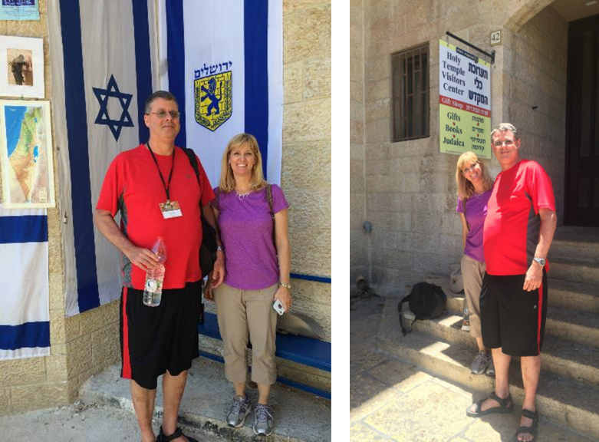

Slide 105
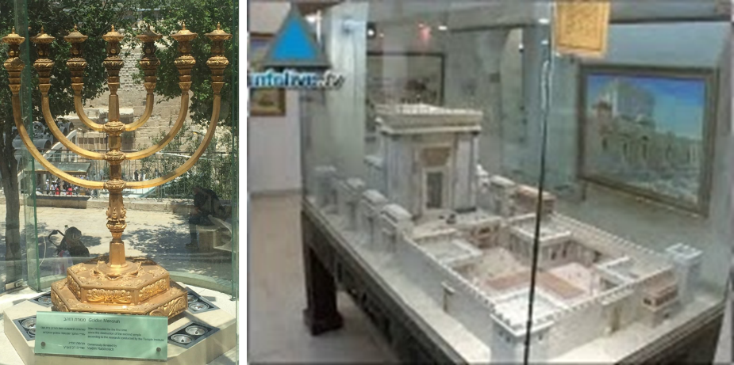

Slide 106
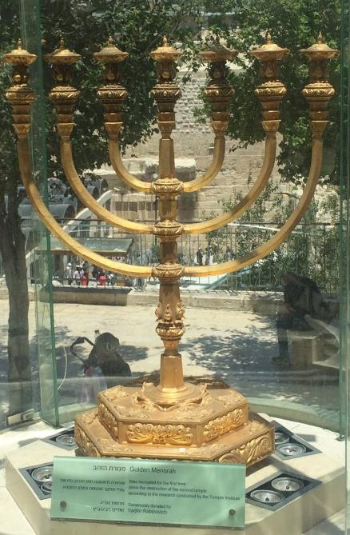

Slide 107
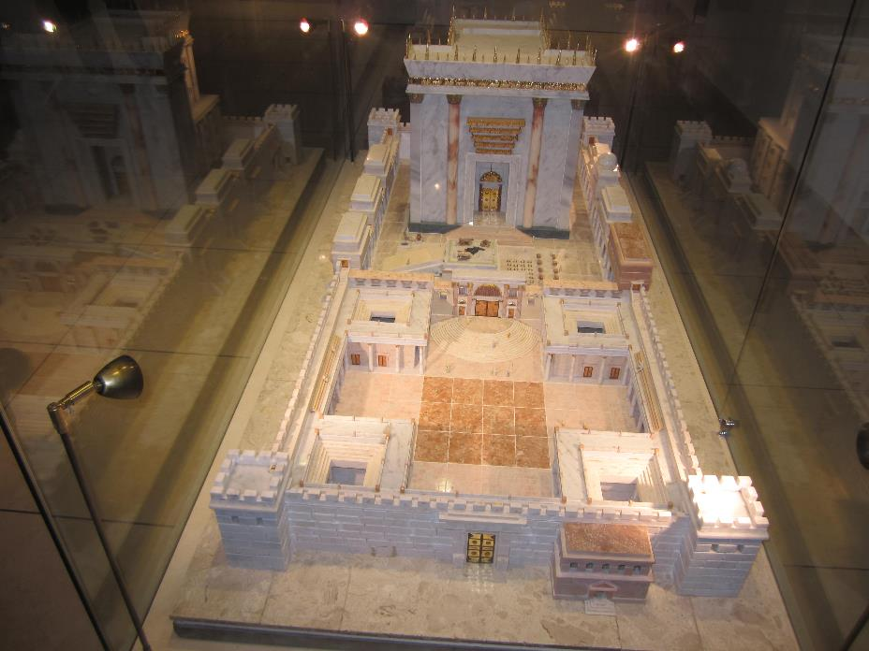

Slide 108
THE STAGE IS BEING SET
Rebirth of Israel in 1948
Israel’s desire for peace
Desire among some Jews to Rebuild 3rd Jewish temple
Desire among some Jews to Restore the sacrificial system
  Source: Randall Price “Ready to Rebuild”

Slide 109
The Times of Israel
April 6, 2017
In first, sheep slaughtered in Jerusalem Old City in reenactment of Passover sacrifice
“With priests blowing silver trumpets, a group of religious Jews slaughtered a sheep on Thursday in Jerusalem’s Old City to demonstrate the traditional paschal sacrifice, the first time such a reenactment has been held inside the city walls in 2,000 years.”
http://www.timesofisrael.com/in-a-first-sheep-slaughtered-in-jerusalem-old-city-in-reenactment-of-passover-sacrifice/#comments

Slide 110
The Seventy Weeks Prophecy 10 FACTS
Focus = Jews & Jerusalem (v.24b)
490 year period of time (v.24a)
360-day years
6 prophecies WILL BE fulfilled (v.24c)
March 5, 444 BC prophecy begins (25a)
483 years elapse between beginning of prophecy & Palm Sunday (25b)
Gap between 483rd & 484th year (26)
Final 7 years = future Tribulation period (27)
Dan. 9:27 Overview of Tribulation
Daniel 9:27 = Revelation 6-19

Slide 111
Daniel 9:27 (NASB)
And he will make a firm covenant with the many for one week, but in the middle of the week he will put a stop to sacrifice and grain offering; and on the wing of abominations will come one who makes desolate, even until a complete destruction, one that is decreed, is poured out on the one who makes desolate.

Slide 112
DANIEL 9:27 = REVELATION 6-19
Rebuilt temple (Rev. 11:1-2)
Division of the Tribulation into two 3½ year periods (Rev. 11:2. 13:5, 11:3, 12:6, 14)
Antichrist (Rev. 13:1-10)
Destruction of Antichrist (Rev. 19:20)
2nd Coming (Rev. 19:11-21)

Slide 114


Slide 115


Slide 116
Conclusion

Slide 117
The Seventy Weeks Prophecy 10 FACTS
Focus = Jews & Jerusalem (v.24b)
490 year period of time (v.24a)
360-day years
6 prophecies WILL BE fulfilled (v.24c)
March 5, 444 BC prophecy begins (25a)
483 years elapse between beginning of prophecy & Palm Sunday (25b)
Gap between 483rd & 484th year (26)
Final 7 years = future Tribulation period (27)
Dan. 9:27 Overview of Tribulation
Daniel 9:27 = Revelation 6-19

Slide 118
Chapter 9 Outline
The Setting (1-2)
Daniel’s prayer (3-19)
Gabriel’s arrival (20-23)
The Seventy Weeks Prophecy (24-27)

