Slide 1
The Protestant Reformation: The Good, The Bad, and The Ugly Session 12
Andy Woods, Th.M.., JD., PhD.
Sr. Pastor, Sugar Land Bible Church
President Chafer Theological Seminary

Slide 2
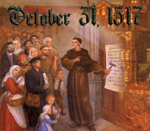
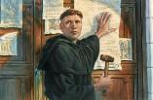
Introduction
Oct 31, 1517
500 years
Far reaching impact
Partial restoration
Restoration of a hermeneutic
Selectively applied
Subsequent generations applied consistently
Preview

Slide 3
Overview
The early church
The Alexandrian eclipse
The Dark Ages
The contribution of the Protestant Reformers
The Reformers’ incomplete revolution
Reformed Theology today
Dispensationalism & the completed revolution
Looking back 500 years later
Notes:
Outline

Slide 4
Overview
THE EARLY CHURCH
The Alexandrian eclipse
The Dark Ages
The contribution of the Protestant Reformers
The Reformers’ incomplete revolution
Reformed Theology today
Dispensationalism & the completed revolution
Looking back 500 years later
Notes:
Outline

Slide 5
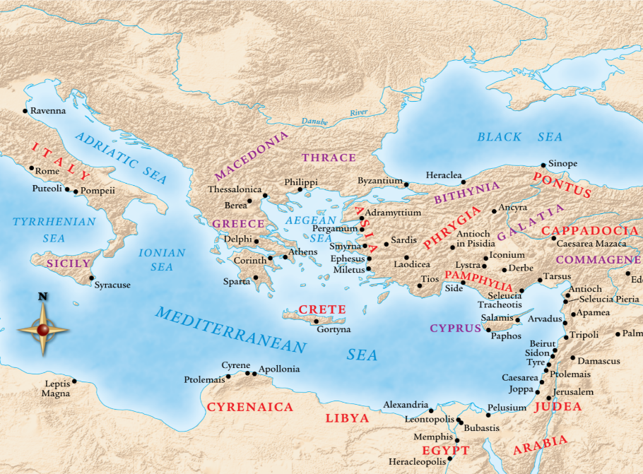

Slide 6
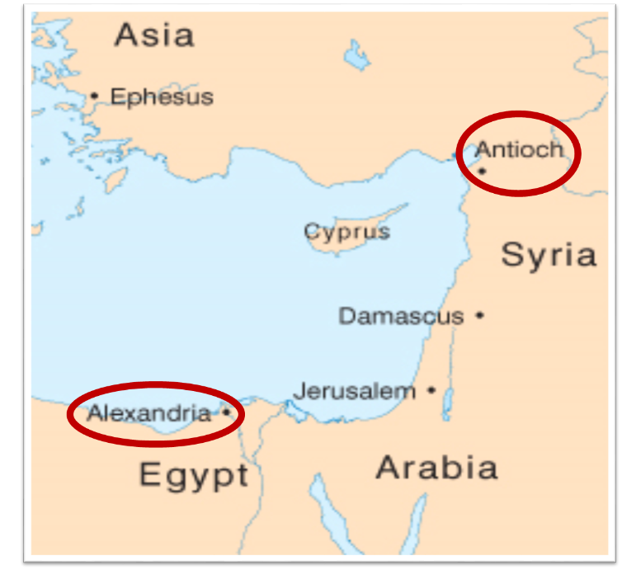

Slide 7
Overview
The early church
THE ALEXANDRIAN ECLIPSE
The Dark Ages
The contribution of the Protestant Reformers
The Reformers’ incomplete revolution
Reformed Theology today
Dispensationalism & the completed revolution
Looking back 500 years later
Notes:
Outline

Slide 10
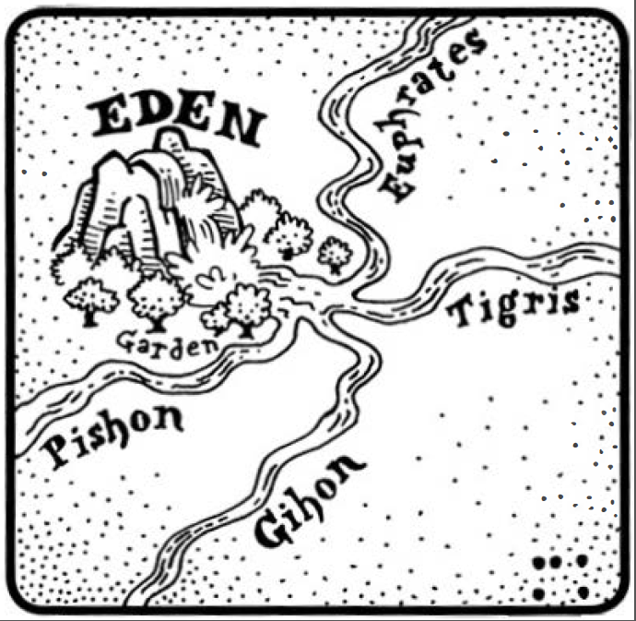
Dangers of Allegorization – Philo

Slide 11
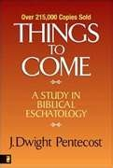
Dangers of Allegorization
Text is not being interpreted
Authority is transferred from text to interpreter
There is no way to test the interpreter
No mechanism for controlling the interpreter’s imagination
Pentecost, Things to Come, pps. 4-5

Slide 12
What Caused the Shift Into Allegorism?
Need for immediate relevance
Incorporation of human philosophy into interpretation
Gnostic dualism (Gen. 1:31; 1 John 2:22; 4:2-3; Acts 17:32; 1 Cor. 15:12)
Decline of the church's Jewish population
Constantine’s Edict of Milan (A.D. 313)
AD 70 and Hadrian’s (A.D. 117–138)“Palestine”
Notes:
Outline

Slide 13
Overview
The early church
The Alexandrian eclipse
THE DARK AGES
The contribution of the Protestant Reformers
The Reformers’ incomplete revolution
Reformed Theology today
Dispensationalism & the completed revolution
Looking back 500 years later
Notes:
Outline

Slide 14
III. The Dark Ages (or the Middle Ages)
Lasted from the 4th to the 16th centuries
Obsolescence of prophetic studies
Domination of Augustinian Amillennialism
Only one church: Roman Catholicism
The Bible is removed from the people
Allegorization
Illiteracy
Mass read in Latin
Sale of indulgences
Anti-Semitism
Church in need of rescue
Notes:
Outline

Slide 15
Overview
The early church
The Alexandrian eclipse
The Dark Ages
THE CONTRIBUTION OF THE PROTESTANT REFORMERS
The Reformers’ incomplete revolution
Reformed Theology today
Dispensationalism & the completed revolution
Looking back 500 years later
Notes:
Outline

Slide 16
IV. Contribution of the Protestant Reformers
Preparation of the Reformers
Emphasis on literal interpretation
Denunciation of allegorization
Rejection of church tradition as a guide
Priesthood of all believers
Bible translations
Literacy
Basis for the American system of governance
Five solas
Rejection of celibacy of the priesthood
The ultimate sacrifice
Rejoice
Notes:
Outline

Slide 17
Overview
The early church
The Alexandrian eclipse
The Dark Ages
The Contribution of the Protestant Reformers
THE REFORMERS’ INCOMPLETE REVOLUTION
Reformed Theology today
Dispensationalism & the completed revolution
Looking back 500 years later
Notes:
Outline

Slide 18
V. The Reformers’ Incomplete Revolution
Protology
Selective literalism
Did not deal with eschatology in depth
Retention of Augustinian Amillennialism
Antichrist & Babylon = Pope and Papacy
Dragged vestiges of Roman Catholicism with them
Initially desired to remain Catholics
Infant baptism
Consubstantiation
Church = the earthly kingdom
Anti-Semitism
Reasons for their inconsistency
Laid the groundwork for future generations
Notes:
Outline

Slide 19
Overview
The early church
The Alexandrian eclipse
The Dark Ages
The contribution of the Protestant Reformers
The Reformers’ incomplete revolution
REFORMED THEOLOGY TODAY
Dispensationalism & the completed revolution
Looking back 500 years later
Notes:
Outline

Slide 20
VI. Reformed Theology Today
Erroneously assumed no further progress to be made
Froze progress into creeds & confessions
Creeds & confessions = authority rather than Scripture
Augustinian Amillennialism fossilized into RT
Allegorizing of biblical Eschatological texts is common
Zech. 14:4
Preterism
Rev. 20-22
Ezek. 40-48
Not applying a literal hermeneutic to the whole Bible
Notes:
Outline

Slide 21
VI. Reformed Theology Today
Erroneously assumed no further progress to be made
Froze progress into creeds & confessions
Creeds & confessions = authority rather than Scripture
Augustinian Amillennialism fossilized into RT
Allegorizing of biblical Eschatological texts is common
Zech. 14:4
Preterism
Rev. 20-22
Ezek. 40-48
Not applying a literal hermeneutic to the whole Bible
Notes:
Outline

Slide 22
Daniel 12:4, 9 (NASB)
“But as for you, Daniel, conceal these words and seal up the book until the end of time; many will go back and forth, and knowledge will increase…He said, ‘Go your way, Daniel, for these words are concealed and sealed up until the end time.’”

Slide 23
Amos 8:12 (NASB)
“People will stagger from sea to sea And from the north even to the east; They will go to and fro to seek the word of the Lord, But they will not find it.”

Slide 24
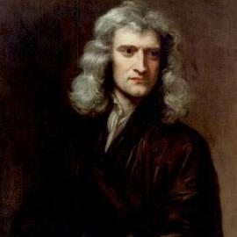
Sir Isaac Newton (1642–1727)
"About the time of the end, a body of men will be raised up who will turn their attention to the Prophecies, and insist upon their literal interpretation, in the midst of much clamor and opposition."
Isaac Newton cited in Nathaniel West, The Thousand Years in Both Testaments, 462.

Slide 25
VI. Reformed Theology Today
Erroneously assumed no further progress to be made
Froze progress into creeds & confessions
Creeds & confessions = authority rather than Scripture
Augustinian Amillennialism fossilized into RT
Allegorizing of biblical Eschatological texts is common
Zech. 14:4
Preterism
Rev. 20-22
Ezek. 40-48
Not applying a literal hermeneutic to the whole Bible
Notes:
Outline

Slide 26
Westminster Confession
Westminster Confession. Chaps. 32and 33; Larger Cat. , Ques. 87–89.–These teach—1. At the last day shall be a general resurrection of the dead both of the just and of the unjust. 2. All found alive shall be immediately changed. 3. Immediately after the resurrection shall follow the general and final judgment of all angels and men, good and bad. 4. That the date of this day and hour is purposely kept secret by God.

Slide 28
VI. Reformed Theology Today
Erroneously assumed no further progress to be made
Froze progress into creeds & confessions
Creeds & confessions = authority rather than Scripture
Augustinian Amillennialism fossilized into RT
Allegorizing of biblical Eschatological texts is common
Zech. 14:4
Preterism
Rev. 20-22
Ezek. 40-48
Not applying a literal hermeneutic to the whole Bible
Notes:
Outline

Slide 29
Jeremy Edmondson
“The goal of the Reformation was to point Christianity back to the Scriptures. The noble intentions of the Reformers called for the Bible as the supreme authority for believers everywhere. For this we rejoice! But if the Reformation and its resulting creeds are exalted to the standard of measuring orthodoxy, does it not defeat the very purpose for which it was intended?”
Jeremy Edmondson, "Returning to Scripture as Our Sole Authority," in Free Grace Theology: 5 Ways It Magnifies the Gospel, ed. et al. Charlie C. Bing (Allen, TX: Bold Grace, 2016), 3.

Slide 30
VI. Reformed Theology Today
Erroneously assumed no further progress to be made
Froze progress into creeds & confessions
Creeds & confessions = authority rather than Scripture
Augustinian Amillennialism fossilized into RT
Allegorizing of biblical Eschatological texts is common
Zech. 14:4
Preterism
Rev. 20-22
Ezek. 40-48
Not applying a literal hermeneutic to the whole Bible
Notes:
Outline

Slide 31
Renald Showers
John Ankerberg and Renald Showers, The Most Asked Prophecy Questions (Chattanooga, TN: ATRI, 2000), 328.
Showers explains, “The Lutheran, Reformed, and Anglican Reformers rejected Premillennialism as being ‘Jewish opinions.’ They maintained the Amillennial view which the Roman Catholic Church had adopted from Augustine.”

Slide 32
Barry Horner
Barry E. Horner, Future Israel: Why Christian Anti-Judaism Must Be Challenged, ed. E. Ray Clendenen, NAC Stuides in Bible & Theology (Nashville, TN: Baker, 2007), 155-60.
“The inheritance from the Augustinian tradition that modern Europe received, notwithstanding the opposition of Melanchthon and others to Luther's excesses, resulted in a continuance of an eschatology that upheld the essentially anti-Judiac thesis, namely, the transference of blessings, formerly promised to Israel, to the Christian church for it's fulfillment...On a much larger scale the reformed movement maintained its allegiance to Augustinian eschatology, which essentially found authoritative expression in the writings of Francis Turretin (1623–1687) who studied at Calvin's academy in Geneva and later taught there for 30 years. His monumental Institutes of Elenctic Theology became the epitome of reformed doctrine. Not surprisingly, his quotations of Augustine are . . .

Slide 33
Barry Horner
Barry E. Horner, Future Israel: Why Christian Anti-Judaism Must Be Challenged, ed. E. Ray Clendenen, NAC Stuides in Bible & Theology (Nashville, TN: Baker, 2007), 155-60.
...copious, even far exceeding references to Calvin. Consequently, Turretin's eschatology is almost predictable...Of course such a mass incorporation into the church is to the exclusion of any perpetuation of Jewish identity. In classic Augustinian fashion, there is token recognition of Jewish individuality for a time, though any form of Jewish restoration was considered to be a gross form of chiliasm. Turretin's Institutes became the central textbook for systematic theology in American Ivy League colleges during the later half of the 18th century. It is not surprising that the early theologians of Princeton Theological Seminary highly esteemed this most influential legacy, and of course it's eschatology.”

Slide 34
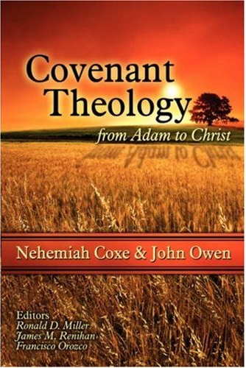
Distinctives of Covenantism
A system of interpreting the Scriptures on the basis of two covenants: the covenant of works and the covenant of grace. Some add the covenant of redemption.
Importance of grace – In every age, believers are always saved by grace.
God’s primary purpose on earth is redemptive.
Partial allegorical system of hermeneutics

Slide 35
Distinctives of Covenantism
Covenant of Works – God entered into a covenant with Adam as the federal head of the human race in which He promised eternal life for obedience and eternal death for disobedience.
Covenant of Redemption – A covenant made between God the Father and God the Son in eternity past in which they covenanted together for the redemption of the human race.
Covenant of Grace – A covenant made by God with the elect in which He provides salvation to the elect sinner.

Slide 36
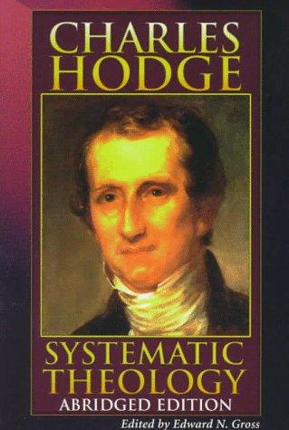
Implied vs. Exegetical Covenants
“this statement does not rest upon any express declaration of the Scriptures…And although the word covenant [as in works] is not used in Genesis, and does not elsewhere, in any clear passage occur in reference to the transaction there recorded,…it is plain that the Bible does represent the arrangement made with Adam as a truly federal transaction.”
Hodge, Systematic Theology, 2:117

Slide 37
VI. Reformed Theology Today
Erroneously assumed no further progress to be made
Froze progress into creeds & confessions
Creeds & confessions = authority rather than Scripture
Augustinian Amillennialism fossilized into RT
Allegorizing of biblical Eschatological texts is common
Zech. 14:4
Preterism
Rev. 20-22
Ezek. 40-48
Not applying a literal hermeneutic to the whole Bible
Notes:
Outline

Slide 38
VI. Reformed Theology Today
Erroneously assumed no further progress to be made
Froze progress into creeds & confessions
Creeds & confessions = authority rather than Scripture
Augustinian Amillennialism fossilized into RT
Allegorizing of biblical Eschatological texts is common
Zech. 14:4
Preterism
Rev. 20-22
Ezek. 40-48
Not applying a literal hermeneutic to the whole Bible
Notes:
Outline

Slide 39
Zechariah 14:4 (NASB)
“In that day His feet will stand on the Mount of Olives, which is in front of Jerusalem on the east; and the Mount of Olives will be split in its middle from east to west by a very large valley, so that half of the mountain will move toward the north and the other half toward the south.”

Slide 40
David Reagan
“The Beginning and the Ending,” online: http://christinprophecy.org/articles/the-beginning-and-the-ending/, accessed 19 April 2017, 1.
“Let me give you a classic example of spiritualization taken from the writings of a theologian by the name of Loraine Boettner. It has to do with his interpretation of Zechariah 14:1-9. That passage says that in the end times Jerusalem will be surrounded by enemy forces and will be ready to fall to them when the Lord will suddenly return to the Mount of Olives. When His feet touch the Mount, it will split down the middle. The Lord will then speak a supernatural word that will instantly destroy all the enemy forces. And on that day, the Lord will become King over all the earth. In his commentary on this passage, Boettner completely spiritualized it. He argued that the Mount of Olives stands for the human heart. The enemy forces symbolize the evil in this world that surrounds and attacks the heart. The Lord’s return represents what happens when a person accepts Jesus as Lord and Savior. Thus, when Jesus comes into a person’s heart, their heart (the Mount of Olives) splits in contrition, and all the evil influences in the person’s life are defeated, and Jesus becomes king of that person’s heart. That’s what I call an exercise in imagination!”

Slide 41
VI. Reformed Theology Today
Erroneously assumed no further progress to be made
Froze progress into creeds & confessions
Creeds & confessions = authority rather than Scripture
Augustinian Amillennialism fossilized into RT
Allegorizing of biblical Eschatological texts is common
Zech. 14:4
Preterism
Rev. 20-22
Ezek. 40-48
Not applying a literal hermeneutic to the whole Bible
Notes:
Outline

Slide 42
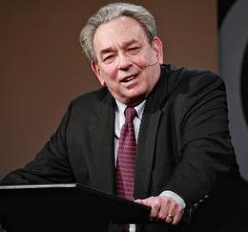
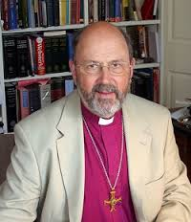
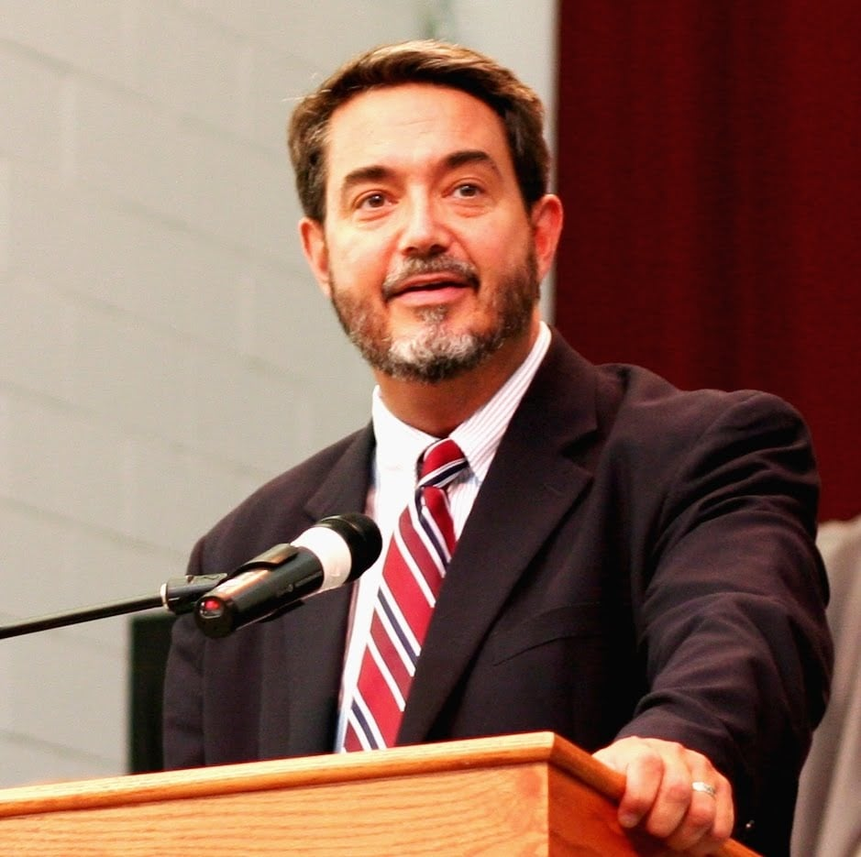
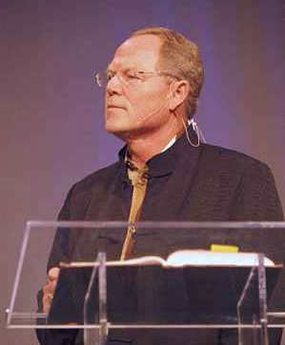
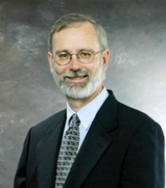
Preterism Advocates
Recent Preterist Commentators
R.C. Sproul
N.T. Wright
Scott Hahn
J. Massyngbaerde Ford
David Chilton
Hank Hanegraaff
Kenneth Gentry

Slide 44
GLOBAL EVENTS YET TO OCCUR
World population destroyed (Rev. 6:8; 9:15)
Sea turns to blood (Rev. 16:3)
Greatest Earthquake in history (Rev. 16:18)
The great city that reigns over the entire earth (Rev. 17:18)

Slide 45
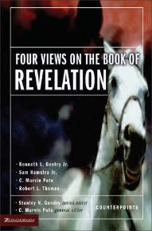
Kenneth Gentry
Four Views of Revelation, p. 38.
“…the preterist view does understand Revelation’s prophecies as strongly reflecting actual historical events in John’s near future, though they are set in apocalyptic drama and clothed in poetic hyperbole.”

Slide 46
Sproul
The Last Days According to Jesus, 45.
“Russell and Calvin agree that the language employed in biblical prophecy is not always cold and logical as is common in the western world, but adopts a kind of fervor common to the East.”

Slide 47
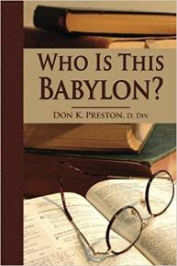
Don Preston
Who Is This Babylon? (Don K. Preston, 1999), 56.
Preterist Don Preston also relies upon Revelation to belonging to the apocalyptic category in order to find support for his view that Revelation's global language was fulfilled in the local events of A.D. 70. He observes that apocalyptic literature hyperbolizes the destruction of Jerusalem. According to Sibylline Oracle 5:153, “the whole creation was shaken” when war began on Jerusalem. If Revelation is also apocalyptic literature, then Revelation must be similarly using hyperbolic language.

Slide 48
Kenneth Gentry
Four Views of Revelation, p. 38.
“Before beginning my survey, I must note what most Christians suspect and what virtually all evangelical scholars (excluding classic dispensationalists) recognize regarding the book: Revelation is a highly figurative book that we cannot approach with a simple straightforward literalism.”

Slide 49
Robert Thomas
“A Classical Dispensationalist View of Revelation,” in Four Views of the Book of Revelation, p.181.
“A Preterist approach must assume an apocalyptic genre in which the language only faintly and indirectly reflects the actual events. This extreme allegorical interpretation allows for finding fulfillments in the first-century Roman Empire prior to the destruction of Jerusalem in A.D. 70.”

Slide 50
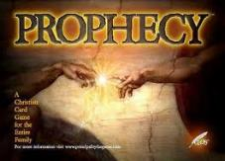
Emergent Eschatology and Genre
“The book of Revelation is an example of popular literary genre of ancient Judaism, known today as Jewish apocalyptic. Trying to read it without understanding its genre would be like watching Star Trek or some other science fiction show thinking it was a historical documentary…instead of being a book about the distant future, it becomes a way of talking about the challenges of the immediate present.”
Brian McLaren, The Secret Message of Jesus, 175-76

Slide 51
VI. Reformed Theology Today
Erroneously assumed no further progress to be made
Froze progress into creeds & confessions
Creeds & confessions = authority rather than Scripture
Augustinian Amillennialism fossilized into RT
Allegorizing of biblical Eschatological texts is common
Zech. 14:4
Preterism
Rev. 20-22
Ezek. 40-48
Not applying a literal hermeneutic to the whole Bible
Notes:
Outline

Slide 52
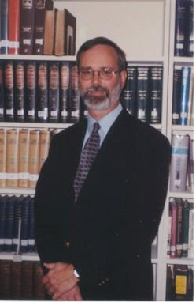
Kenneth L. Gentry He Shall Have Dominion: A Post Millennial Eschatology (Tyler, Texas: Institute for Christian economics, 1992), page 335.
“The proper understanding of the thousand-year time frame in Revelation 20 is that it is representative of a long and glorious era and is not limited to a literal 365,000 days. The figure represents a perfect cube of 10, which is the number of quantitative perfection.”

Slide 53
Reasons for Understanding 1000 Literally
John’s use of indefinite concepts elsewhere (Rev. 20:8, 20:3)
Exception to the “# of years” examples?
Other numbers are taken literally
Two witnesses (11:3)
7000 people (11:13)
4 Angels (7:1)
7 Angels (8:6)
144,000 Jews (7:4)
42 months (11:2)
1260 days (11:3)
Not always a symbolic interpretation (Rev. 17:18)

Slide 54
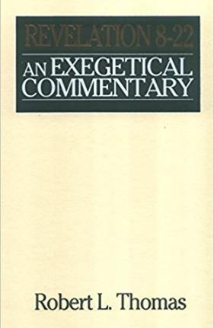
Robert Thomas
Revelation 8 to 22: An Exegetical Commentary (Chicago: Moody Press, 1992), 408.
Robert Thomas observes that, "no number in Revelation is verifiably a symbolic number.”

Slide 55
Revelation 21:16-17
¹⁶ The city was laid out like a square, as long as it was wide. He measured the city with the rod and found it to be [1500 miles] in length, and as wide and high as it is long. ¹⁷ He measured its wall and it was 144 cubits thick, by man's measurement, which the angel was using.
Notes:
READ…

Slide 56
Jerusalem Descending
Notes:
The descending city is described as being like a stone called Jasper, only unlike the earthly stone, this one is clear as crystal. The ultimate state of heaven sounds more like a diamond, doesn’t it?

Slide 57
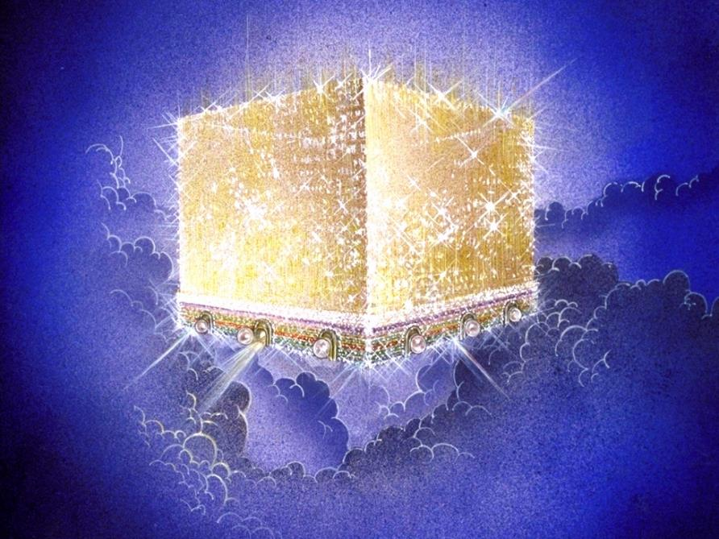
Notes:
Every city needs light. God, the ultimate source of power, illumines the city from his glory. Have you ever taken time to look at a sunset just after it has rained? As the sun sets, there is a kind of a glow cast on everything. It captures the spirit. This is just a little foretaste of the glory and splendor of heaven.

Slide 58
The New Jerusalem

Slide 59
Paul Lee Tan
Cited in, The Interpretation of Prophecy (Winona Lake, IN: BMH, 1974), 285-86.
Swete: “Such dimensions defy imagination and are permissible only in the language of symbolism.”
Barnes: “Of course, this must preclude all idea of there being such a city literally in Palestine…this cannot be understood literally; and the very idea of a literal fulfillment of this shows the absurdity of that method of interpretation…this cannot be taken literally; and an attempt to explain all of this literally would show that that method of interpreting the Apocalypse is impracticable.”

Slide 60
Paul Lee Tan
Cited in, The Interpretation of Prophecy (Winona Lake, IN: BMH, 1974), 285-86.
Grant: “no clearer proof…that all is figurative. Such a height is simply out of harmony with the constitution of our world.”
Boettner: “Neither the shape nor the dimensions of the city can be taken with mathematical exactness, as if it were a gigantic apartment house.”

Slide 61
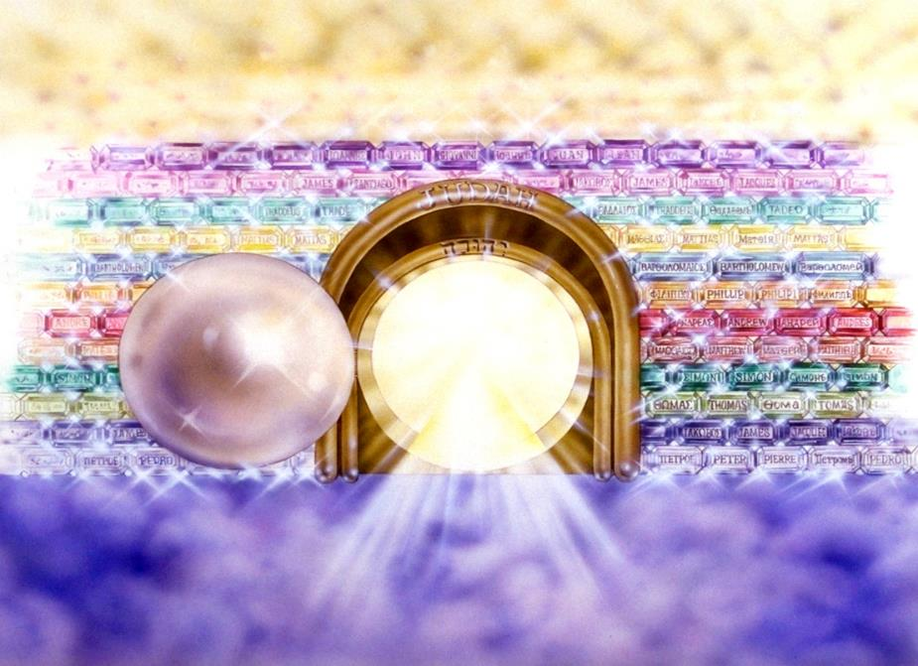
Notes:
Here you see an artist’s ideas of…
12 Gates = 12 Tribes of Israel
12 Foundation Stones = 12 Apostles of the Church

Slide 62
Notes:
And the streets are made of what? Gold. When a man heard he was about to die, he desperately gathered up his life’s greatest accumulation—gold bars. When he did finally enter heaven, toting the heaven load, one angel poked another angel in the ribs. He said, “Hey, look, that guy brought pavement!”

Slide 63
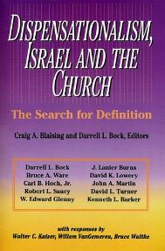
David L. Turner
“The New Jerusalem in Revelation 21:1-22:5; Consummation of a Biblical Continuum,” Dispensationalism, Israel, and the Church, ed., Craig A. Blaising and Darrell L. Bock (Grand Rapids: Zondervan, 1992), 277.
“Perhaps the absence of oysters large enough to produce such pearls and the absence of sufficient gold to pave such a city (viewed literally 1380 miles squared and high) is viewed as sufficient reason not to take these images as fully literal!…the preceding discussion serves to warn against a ‘hyper-literal’ approach to apocalyptic imagery….”

Slide 64
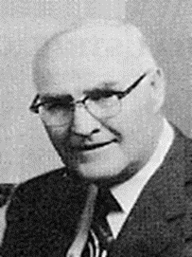
“When the plain sense of Scripture makes common sense, seek no other sense; therefore, take every word at its primary, ordinary, usual, literal meaning unless the facts of the immediate context, studied in light of related passages and axiomatic and fundamental truths, indicate clearly otherwise.”
David L. Cooper
The World’s Greatest Library Graphically Illustrated (Los Angeles: Biblical Research Society, 1970), 11.

Slide 65
VI. Reformed Theology Today
Erroneously assumed no further progress to be made
Froze progress into creeds & confessions
Creeds & confessions = authority rather than Scripture
Augustinian Amillennialism fossilized into RT
Allegorizing of biblical Eschatological texts is common
Zech. 14:4
Preterism
Rev. 20-22
Ezek. 40-48
Not applying a literal hermeneutic to the whole Bible
Notes:
Outline

Slide 66
Gary DeMar
Last Days Madness, 4th rev. ed. (Powder Springs, GA: American, 1999), 97-98.
“The Book of Hebrews was written to show beyond a shadow of a doubt that the entire Old Covenant system–with its priest, sacrifices, ceremonies, and temple–has been done away with in Christ…The prophecy of Ezekiel’s temple is a picture of the restored covenant community that returned to the land after the exile. The vision should not be projected 2500 years into the future into some earthly millennial kingdom where sacrifices will be offered for atonement in the presence of the crucified Christ.”

Slide 68
VI. Reformed Theology Today
Erroneously assumed no further progress to be made
Froze progress into creeds & confessions
Creeds & confessions = authority rather than Scripture
Augustinian Amillennialism fossilized into RT
Allegorizing of biblical Eschatological texts is common
Zech. 14:4
Preterism
Rev. 20-22
Ezek. 40-48
Not applying a literal hermeneutic to the whole Bible
Notes:
Outline

Slide 69
Albertus Pieters
“The leader,” September 5, 1931; as cited in John F. Walvoord, The Millennial Kingdom: A Basic Text in Premillennial Theology (Findlay, OH: Dunham, 1959), 128.
“The question whether the Old Testament prophecies concerning the people of God must be interpreted in their ordinary sense, as other Scriptures are interpreted, or can properly be applied to the Christian church, is called the question of spiritualization of prophecy. This is one of the major problems in biblical interpretation, and confronts everyone who makes a serious study of the Word of God. It is one of the chief keys to the difference of opinion between Premillenarians and the mass of Christian scholars. The former reject spiritualization, the latter employ it; and as long as there is no agreement on this point the debate is interminable and fruitless.”

Slide 70
CONCLUSION

Slide 71
VI. Reformed Theology Today
Erroneously assumed no further progress to be made
Froze progress into creeds & confessions
Creeds & confessions = authority rather than Scripture
Augustinian Amillennialism fossilized into RT
Allegorizing of biblical Eschatological texts is common
Zech. 14:4
Preterism
Rev. 20-22
Ezek. 40-48
Not applying a literal hermeneutic to the whole Bible
Notes:
Outline

Slide 72
NEXT WEEK
The early church
The Alexandrian eclipse
The Dark Ages
The Contribution of the Protestant Reformers
The Reformers’ Incomplete Revolution
Reformed Theology Today
DISPENSATIONALISM & THE COMPLETED REVOLUTION
Looking back 500 years later
Notes:
Outline

