Slide 1

THE BOOK OF DANIEL
Andy Woods, Th.M.., JD., PhD.
Sr. Pastor, Sugar Land Bible Church
President Chafer Theological Seminary

Slide 2

Message
Times of the Gentiles are revealed prophetically (2, 7, 8-12) and ethically (1, 3-6)

Slide 3

Synthetic Outline
Historical (1-7):
  Daniel interprets, 3rd person, gentile nations
  Intro “Hebrew” (1)
  Aramaic chiasm (2-7)

Slide 4
Synthetic Outline
Historical (1-7):
  Daniel interprets, 3rd person, gentile nations
  Intro “Hebrew” (1)
  Aramaic chiasm (2-7)

Slide 5
Synthetic Outline
Historical (1-7):
  Daniel interprets, 3rd person, gentile nations
  Intro “Hebrew” (1)
  Aramaic chiasm (2-7)

Slide 6

Synthetic Outline
  Chiasm “Aramaic” ( 2-7)
1. Gentile History (2)
  2. Protection (3)
    3. Revelation to a gentile king (4)
    3. Revelation to a gentile king (5)
  2. Protection (6)
1. Gentile history (7)

Slide 7
Synthetic Outline
Prophetic (8-12):
  Angel interprets, 1st person, Jewish nation, Hebrew
  Ram & Goat (8)
  70 weeks (9)
  Final vision (10-12)

Slide 8
Synthetic Outline
Prophetic (8-12):
  Angel interprets, 1st person, Jewish nation, Hebrew
  Ram & Goat (8)
  70 weeks (9)
  Final vision (10-12)

Slide 9

Chapter 9 Outline
The Setting (1-2)
Daniel’s prayer (3-19)
Gabriel’s arrival (20-23)
The Seventy Weeks Prophecy (24-27)

Slide 10
Chapter 9 Outline
The Setting (1-2)
Daniel’s prayer (3-19)
Gabriel’s arrival (20-23)
The Seventy Weeks Prophecy (24-27)

Slide 11
I. The Setting (1-2)
Historical setting (v.1)
Prophetic setting (v.2)

Slide 12
CHAPTER AND VERSE IN DANIEL | CHRONOLOGICAL DATE | BIBLICAL DATE
1:1 | 605 | 3rd year of Jehoiakim
2:1 | 603 | 2nd year of Nebuchadnezzar
5 | Sat. night 10/12/539 (Hoehner)
7:1 | 553 | 1st year of Belshazzar
8:1 | 551 | 3rd year of Belshazzar
9:1 | 538 | 1st year of Darius
10:1 | 536 | 3rd year of Cyrus

Slide 13
Daniel’s Age
CHAPTER | EVENTS | AGE
1 | Taken to Babylonian captivity | 15
2 | Interpreting Nebuchadnezzar’s 1st dream (huge image) | 17
3 | Daniel’s 3 friends cast into the fiery furnace | 19 or 20
4 | Interpreting Nebuchadnezzar’s 2nd dream (huge tree) | 45-50
5 | Interpreting handwriting of the wall at Belshazzar’s feast | Early 80’s
6 | Delivered from the den of lions | c.83
7-8 | Daniel’s visions and dreams | Mid-60’s
9 | Daniel’s seventy “sevens” prophecy | Early-80’s
10-12 | Final dreams and visions | Mid-80’s

Slide 14
I. The Setting (1-2)
Historical setting (v.1)
Prophetic setting (v.2)

Slide 15
SETTING : PROPHETIC
V.2
70 YEAR CAPTIVITY ABOUT TO END
  Jeremiah 25:11; 29:10
  Prophecy provides important information
  Prophecy gives insight into current events
  Why 70 years?
    Lev. 25:1-5; 26:33-35; 2 Chron. 36:21

Slide 16


Statue
&
Stone

Slide 17
Chapter 9 Outline
The Setting (1-2)
Daniel’s prayer (3-19)
Gabriel’s arrival (20-23)
The Seventy Weeks Prophecy (24-27)

Slide 18
Chapter 9 Outline
The Setting (1-2)
Daniel’s prayer (3-19)
Gabriel’s arrival (20-23)
The Seventy Weeks Prophecy (24-27)

Slide 19
Chapter 9 Outline
The Setting (1-2)
Daniel’s prayer (3-19)
Gabriel’s arrival (20-23)
The Seventy Weeks Prophecy (24-27)

Slide 20
The Seventy Weeks Prophecy 10 FACTS
Focus = Jews & Jerusalem (v.24b)
490 year period of time (v.24a)
360-day years
6 prophecies WILL BE fulfilled (v.24c)
March 5, 444 BC prophecy begins (25a)
483 years elapse between beginning of prophecy & Palm Sunday (25b)
Gap between 483rd & 484th year (26)
Final 7 years = future Tribulation period (27)
Dan. 9:27 Overview of Tribulation
Daniel 9:27 = Revelation 6-19

Slide 21
The Seventy Weeks Prophecy 10 FACTS
Focus = Jews & Jerusalem (v.24b)
490 year period of time (v.24a)
360-day years
6 prophecies WILL BE fulfilled (v.24c)
March 5, 444 BC prophecy begins (25a)
483 years elapse between beginning of prophecy & Palm Sunday (25b)
Gap between 483rd & 484th year (26)
Final 7 years = future Tribulation period (27)
Dan. 9:27 Overview of Tribulation
Daniel 9:27 = Revelation 6-19

Slide 22

Daniel 9:24 (NASB)
Seventy weeks have been decreed for your people and your holy city, to finish the transgression, to make an end of sin, to make atonement for iniquity, to bring in everlasting righteousness, to seal up vision and prophecy and to anoint the most holy place.

Slide 23
The Seventy Weeks Prophecy 10 FACTS
Focus = Jews & Jerusalem (v.24b)
490 year period of time (v.24a)
360-day years
6 prophecies WILL BE fulfilled (v.24c)
March 5, 444 BC prophecy begins (25a)
483 years elapse between beginning of prophecy & Palm Sunday (25b)
Gap between 483rd & 484th year (26)
Final 7 years = future Tribulation period (27)
Dan. 9:27 Overview of Tribulation
Daniel 9:27 = Revelation 6-19

Slide 24
Daniel 9:24 (NASB)
Seventy weeks have been decreed for your people and your holy city, to finish the transgression, to make an end of sin, to make atonement for iniquity, to bring in everlasting righteousness, to seal up vision and prophecy and to anoint the most holy place.

Slide 25


Slide 26
The Seventy Weeks Prophecy 10 FACTS
Focus = Jews & Jerusalem (v.24b)
490 year period of time (v.24a)
360-day years
6 prophecies WILL BE fulfilled (v.24c)
March 5, 444 BC prophecy begins (25a)
483 years elapse between beginning of prophecy & Palm Sunday (25b)
Gap between 483rd & 484th year (26)
Final 7 years = future Tribulation period (27)
Dan. 9:27 Overview of Tribulation
Daniel 9:27 = Revelation 6-19

Slide 27
360-day YEARS
TRIBULATION
  Rev. 11:3 (1260 days)
  Rev. 11:2 (42 months)
  1260 days / 42 months = 30 days per month
  30 days x 12 months = 360 days per year
THE FLOOD
  Gen. 7:24 (150 days)
  Gen. 7:11; 8:4 (5 months)
  150 days / 5 months = 30 days per month
  30 days x 12 months = 360 days per year

Slide 28
The Seventy Weeks Prophecy 10 FACTS
Focus = Jews & Jerusalem (v.24b)
490 year period of time (v.24a)
360-day years
6 prophecies WILL BE fulfilled (v.24c)
March 5, 444 BC prophecy begins (25a)
483 years elapse between beginning of prophecy & Palm Sunday (25b)
Gap between 483rd & 484th year (26)
Final 7 years = future Tribulation period (27)
Dan. 9:27 Overview of Tribulation
Daniel 9:27 = Revelation 6-19

Slide 29
Daniel 9:24 (NASB)
Seventy weeks have been decreed for your people and your holy city, to finish the transgression, to make an end of sin, to make atonement for iniquity, to bring in everlasting righteousness, to seal up vision and prophecy and to anoint the most holy place.

Slide 30

6 Prophecies WILL BE fulfilled V.24c
  “to finish transgression”
  “to make an end of sin”
  “to make atonement for iniquity”
  “to bring in everlasting righteousness”
  “to seal up vision and prophecy”
  “to anoint the most holy place”
Arnold Fructenbaum, Footsteps of the Messiah, p.191-4

Slide 31
The Seventy Weeks Prophecy 10 FACTS
Focus = Jews & Jerusalem (v.24b)
490 year period of time (v.24a)
360-day years
6 prophecies WILL BE fulfilled (v.24c)
March 5, 444 BC prophecy begins (25a)
483 years elapse between beginning of prophecy & Palm Sunday (25b)
Gap between 483rd & 484th year (26)
Final 7 years = future Tribulation period (27)
Dan. 9:27 Overview of Tribulation
Daniel 9:27 = Revelation 6-19

Slide 32
Daniel 9:25 (NASB)
So you are to know and discern that from the issuing of a decree to restore and rebuild Jerusalem until Messiah the Prince there will be seven weeks and sixty-two weeks; it will be built again, with plaza and moat, even in times of distress.

Slide 34
PROPHECY BEGINS WITH DECREE
Decree to rebuild Jerusalem
Not the decrees involving the temple
  Cyrus 538 BC (Ezra 1:1-4; 6:1-5)
  Darius 520 BC (Ezra 6:6-12)
  Artaxerxes 458 BC (Ezra 7:11-16)
Decree of Artaxerxes (Neh. 1-2)
  Nehemiah 2: 3, 5, 8
  Distress (Daniel 9:25)
  March 5, 444 B.C. (Neh.2:1)

Slide 35
Nehemiah 2:1-11 (NASB)
³ I said to the king, “Let the king live forever. Why should my face not be sad when the city, the place of my fathers’ tombs, lies desolate and its gates have been consumed by fire?” …⁵ I said to the king, “If it please the king, and if your servant has found favor before you, send me to Judah, to the city of my fathers’ tombs, that I may rebuild it.”…⁸ and a letter to Asaph the keeper of the king’s forest, that he may give me timber to make beams for the gates of the fortress which is by the temple, for the wall of the city and for the house to which I will go.” And the king granted them to me because the good hand of my God was on me…¹¹ So I came to Jerusalem and was there three days.

Slide 36
Daniel 9:25 (NASB)
So you are to know and discern that from the issuing of a decree to restore and rebuild Jerusalem until Messiah the Prince there will be seven weeks and sixty-two weeks; it will be built again, with plaza and moat, even in times of distress.

Slide 37
Nehemiah 2:1 (NASB)
And it came about in the month Nisan, in the twentieth year of King Artaxerxes, that wine was before him, and I took up the wine and gave it to the king. Now I had not been sad in his presence.

Slide 38
Nehemiah 2:1 (NASB)
And it came about in the month Nisan, in the twentieth year of King Artaxerxes, that wine was before him, and I took up the wine and gave it to the king. Now I had not been sad in his presence.

Slide 39
Nehemiah 2:1 (NASB)
And it came about in the month Nisan, in the twentieth year of King Artaxerxes, that wine was before him, and I took up the wine and gave it to the king. Now I had not been sad in his presence.

Slide 40
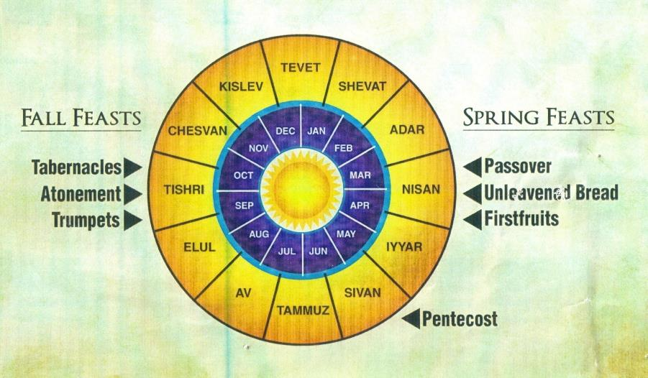

Slide 41


Slide 42
CHAPTER AND VERSE IN DANIEL | CHRONOLOGICAL DATE | BIBLICAL DATE
1:1 | 605 | 3rd year of Jehoiakim
2:1 | 603 | 2nd year of Nebuchadnezzar
5 | Sat. night 10/12/539 (Hoehner)
7:1 | 553 | 1st year of Belshazzar
8:1 | 551 | 3rd year of Belshazzar
9:1 | 538 | 1st year of Darius
10:1 | 536 | 3rd year of Cyrus

Slide 43

Daniel 12:4, 9 (NASB)
“But as for you, Daniel, conceal these words and seal up the book until the end of time; many will go back and forth, and knowledge will increase…He said, ‘Go your way, Daniel, for these words are concealed and sealed up until the end time.’”

Slide 44
The Seventy Weeks Prophecy 10 FACTS
Focus = Jews & Jerusalem (v.24b)
490 year period of time (v.24a)
360-day years
6 prophecies WILL BE fulfilled (v.24c)
March 5, 444 BC prophecy begins (25a)
483 years elapse between beginning of prophecy & Palm Sunday (25b)
Gap between 483rd & 484th year (26)
Final 7 years = future Tribulation period (27)
Dan. 9:27 Overview of Tribulation
Daniel 9:27 = Revelation 6-19

Slide 45
Daniel 9:25 (NASB)
So you are to know and discern that from the issuing of a decree to restore and rebuild Jerusalem until Messiah the Prince there will be seven weeks and sixty-two weeks; it will be built again, with plaza and moat, even in times of distress.

Slide 46
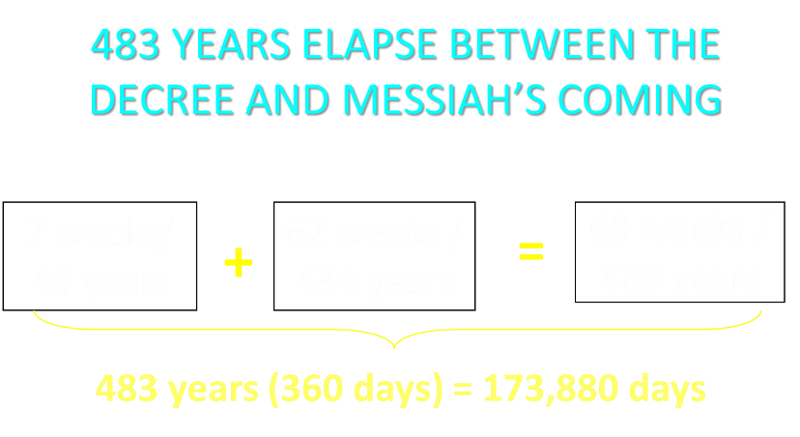

Slide 47
BIBLICAL MATHEMATICS
444 B.C. – (Artaxerxes decree of Nehemiah 2)
+33 A.D. – (Triumphal entry of Luke 19:28-44)
= 477 years
-1 – (1 B.C. to A.D. 1 = 1 year, not 2 years)
= 476 years
x 365 days
= 173, 740 days
+ 25 days – (March 5 to March 30)
= 173, 765 days
+115 days – (leap years)
= 173, 880 days

Slide 48
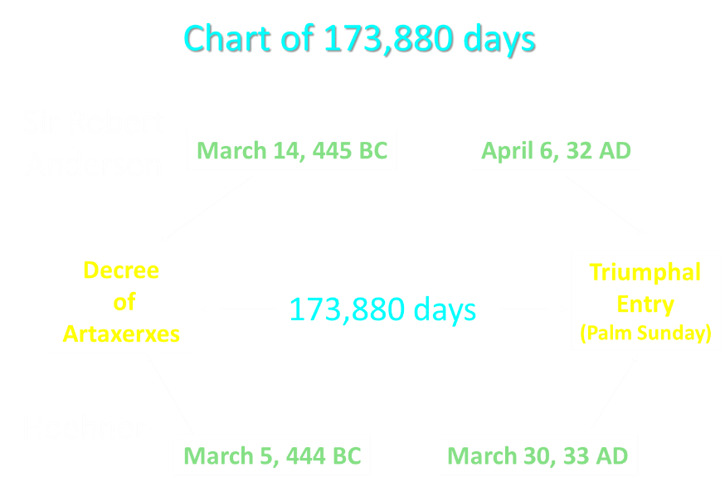

Slide 49

Messiah must present Himself to Israel on March 30, A.D. 33 (Daniel 9:25)

Slide 50
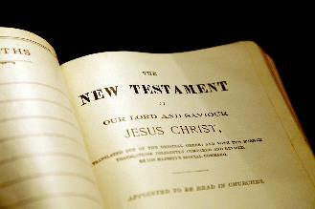
New Testament Perspective
  Palm Sunday statements
    Luke 19:37-38
    Luke 19:39-40
    Luke 19:42
    Luke 19:44
  Israel held accountable for knowing the time (Matt. 16:1-3)
  The time of Christ’s birth
    Galatians 4:4
    Watchfulness of Simeon & Anna (Luke 2:25-26, 36-38)
    The visit of the Magi (Dan. 2:48; Num. 24:17; Deut. 23:4)
  The Messianic Secret (Mark 8:29-30)

Slide 51
New Testament Perspective
  Palm Sunday statements
    Luke 19:37-38
    Luke 19:39-40
    Luke 19:42
    Luke 19:44
  Israel held accountable for knowing the time (Matt. 16:1-3)
  The time of Christ’s birth
    Galatians 4:4
    Watchfulness of Simeon & Anna (Luke 2:25-26, 36-38)
    The visit of the Magi (Dan. 2:48; Num. 24:17; Deut. 23:4)
  The Messianic Secret (Mark 8:29-30)

Slide 52
Luke 19:37-38 (NASB)
As soon as He was approaching, near the descent of the Mount of Olives, the whole crowd of the disciples began to praise God joyfully with a loud voice for all the miracles which they had seen, shouting: “Blessed is the King who comes in the name of the Lord; Peace in heaven and glory in the highest!”

Slide 53
Luke 19:39-40 (NASB)
Some of the Pharisees in the crowd said to Him, “Teacher, rebuke Your disciples.” But Jesus answered, “I tell you, if these become silent, the stones will cry out!”

Slide 54
Luke 19:42, 44 (NASB)
saying, “If you had known in this day, even you, the things which make for peace! But now they have been hidden from your eyes…and they will level you to the ground and your children within you, and they will not leave in you one stone upon another, because you did not recognize the time of your visitation.”

Slide 55
New Testament Perspective
  Palm Sunday statements
    Luke 19:37-38
    Luke 19:39-40
    Luke 19:42
    Luke 19:44
  Israel held accountable for knowing the time (Matt. 16:1-3)
  The time of Christ’s birth
    Galatians 4:4
    Watchfulness of Simeon & Anna (Luke 2:25-26, 36-38)
    The visit of the Magi (Dan. 2:48; Num. 24:17; Deut. 23:4)
  The Messianic Secret (Mark 8:29-30)

Slide 56
Matthew 16:1-3 (NASB)
The Pharisees and Sadducees came up, and testing Jesus, they asked Him to show them a sign from heaven. But He replied to them, “When it is evening, you say, ‘It will be fair weather, for the sky is red.’ And in the morning, ‘There will be a storm today, for the sky is red and threatening.’ Do you know how to discern the appearance of the sky, but cannot discern the signs of the times?”

Slide 57
New Testament Perspective
  Palm Sunday statements
    Luke 19:37-38
    Luke 19:39-40
    Luke 19:42
    Luke 19:44
  Israel held accountable for knowing the time (Matt. 16:1-3)
  The time of Christ’s birth
    Galatians 4:4
    Watchfulness of Simeon & Anna (Luke 2:25-26, 36-38)
    The visit of the Magi (Dan. 2:48; Num. 24:17; Deut. 23:4)
  The Messianic Secret (Mark 8:29-30)

Slide 58
New Testament Perspective
  Palm Sunday statements
    Luke 19:37-38
    Luke 19:39-40
    Luke 19:42
    Luke 19:44
  Israel held accountable for knowing the time (Matt. 16:1-3)
  The time of Christ’s birth
    Galatians 4:4
    Watchfulness of Simeon & Anna (Luke 2:25-26, 36-38)
    The visit of the Magi (Dan. 2:48; Num. 24:17; Deut. 23:4)
  The Messianic Secret (Mark 8:29-30)

Slide 59

Galatians 4:4 (NASB)
“But when the fullness of the time came, God sent forth His Son, born of a woman, born under the Law.”

Slide 60
New Testament Perspective
  Palm Sunday statements
    Luke 19:37-38
    Luke 19:39-40
    Luke 19:42
    Luke 19:44
  Israel held accountable for knowing the time (Matt. 16:1-3)
  The time of Christ’s birth
    Galatians 4:4
    Watchfulness of Simeon & Anna (Luke 2:25-26, 36-38)
    The visit of the Magi (Dan. 2:48; Num. 24:17; Deut. 23:4)
  The Messianic Secret (Mark 8:29-30)

Slide 61
New Testament Perspective
  Palm Sunday statements
    Luke 19:37-38
    Luke 19:39-40
    Luke 19:42
    Luke 19:44
  Israel held accountable for knowing the time (Matt. 16:1-3)
  The time of Christ’s birth
    Galatians 4:4
    Watchfulness of Simeon & Anna (Luke 2:25-26, 36-38)
    The visit of the Magi (Dan. 2:48; Num. 24:17; Deut. 23:4)
  The Messianic Secret (Mark 8:29-30)

Slide 62
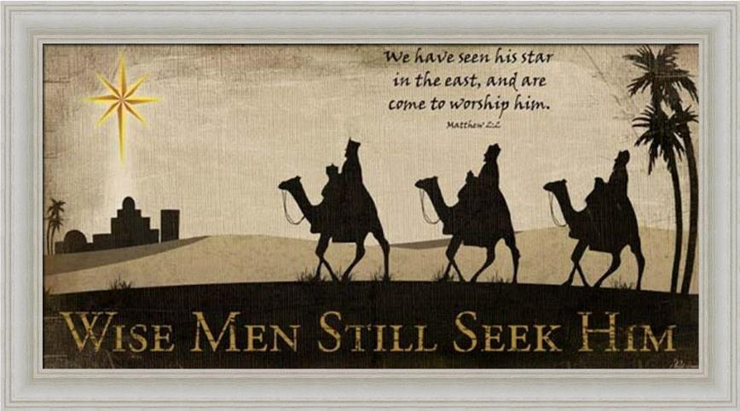

Slide 63
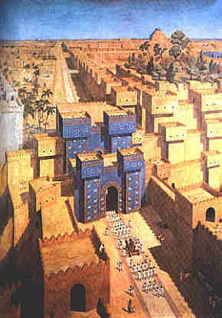
East = Babylon
Genesis 2:8
Genesis 11:2
Matthew 2:2

Slide 64
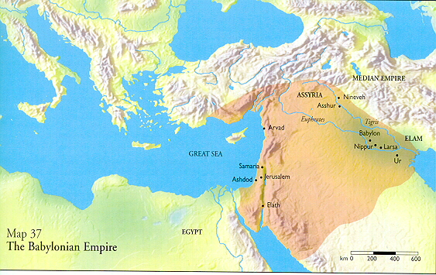

Slide 65
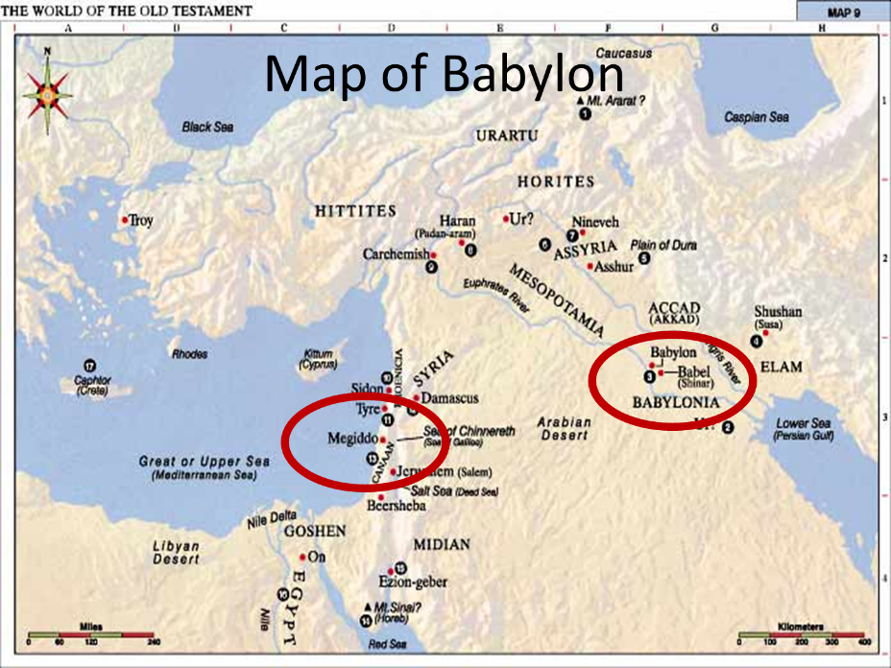

Slide 66
Daniel 2:48 (NASB)
“Then the king promoted Daniel and gave him many great gifts, and he made him ruler over the whole province of Babylon and chief prefect over all the wise men of Babylon.”

Slide 67
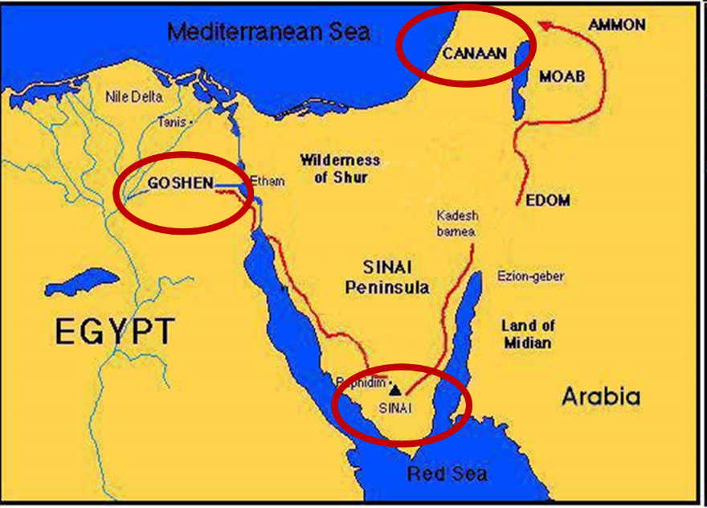

Slide 68
Balaam's 7 Oracles Blessing Israel (23-24)
  First oracle (23:1-12), Balaam explained that God’s blessings upon Israel were irrevocable.
  Second oracle (23:13-26), Balaam explained that the source of Israel’s blessing was her unique relationship to Yahweh
  Third oracle (23:27–24:14), Balaam extolled Israel’s beauty.
  Fourth oracle (24:15-19), Balaam explained that a future messianic deliverer (Gen 49:10) would spring forth and exercise dominion from Israel.

Slide 69
Balaam's 7 Oracles Blessing Israel (23-24)
  Fifth oracle (Num. 24:20) predicts Amalek’s destruction. Amalek was the first foe that Israel had to fight against after leaving Egypt (Exod 17).
  Sixth oracle (24:21-22) predicts the destruction of the Midianite group known as the Kenites as well as Assyria.
  The nations of the seventh oracle are difficult to identify (24:23-24).

Slide 70
Messiah must be Jewish or from the line of Jacob (Numbers 24:17)

Slide 71
Numbers 24:17 (NASB)
“I see him, but not now; I behold him, but not near; A star shall come forth from Jacob, A scepter shall rise from Israel, And shall crush through the forehead of Moab, And tear down all the sons of Sheth.”

Slide 72
Deuteronomy 23:4 (NASB)
“because they did not meet you with food and water on the way when you came out of Egypt, and because they hired against you Balaam the son of Beor from Pethor of Mesopotamia, to curse you.”

Slide 74
New Testament Perspective
  Palm Sunday statements
    Luke 19:37-38
    Luke 19:39-40
    Luke 19:42
    Luke 19:44
  Israel held accountable for knowing the time (Matt. 16:1-3)
  The time of Christ’s birth
    Galatians 4:4
    Watchfulness of Simeon & Anna (Luke 2:25-26, 36-38)
    The visit of the Magi (Dan. 2:48; Num. 24:17; Deut. 23:4)
  The Messianic Secret (Mark 8:29-30)

Slide 75
Mark 8:29-30 (NASB)
“And He continued by questioning them, “But who do you say that I am?” Peter answered and said to Him, “You are the Christ.” ³⁰ And He warned them to tell no one about Him.”

Slide 76

If the first 69 weeks were fulfilled literally then the remaining week will be fulfilled literally.

Slide 77

Sir Robert Anderson
The Coming Prince, p.147-148
“There is not a single prophecy, of which the fulfillment is recorded in Scripture, that was not realized with absolute accuracy, and in every detail; and it is wholly unjustifiable to assume that a new system of fulfillment was inaugurated after the sacred canon closed…
Literalness of fulfillment may therefore be accepted as an axiom to guide us in the study of prophecy.”

Slide 78
The Seventy Weeks Prophecy 10 FACTS
Focus = Jews & Jerusalem (v.24b)
490 year period of time (v.24a)
360-day years
6 prophecies WILL BE fulfilled (v.24c)
March 5, 444 BC prophecy begins (25a)
483 years elapse between beginning of prophecy & Palm Sunday (25b)
Gap between 483rd & 484th year (26)
Final 7 years = future Tribulation period (27)
Dan. 9:27 Overview of Tribulation
Daniel 9:27 = Revelation 6-19

Slide 80
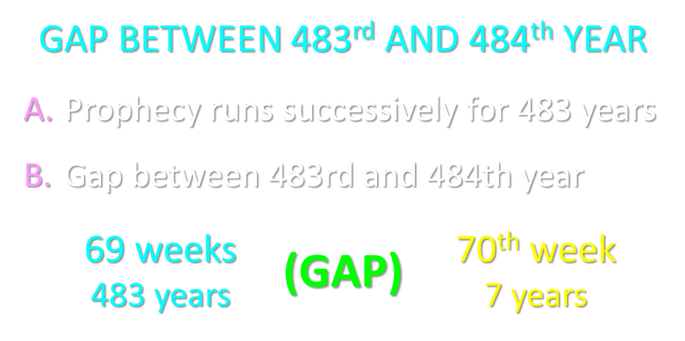

Slide 81
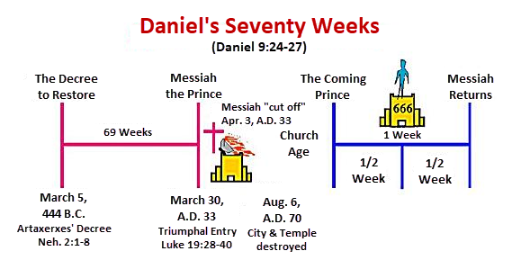

Slide 82
6 Reasons for Gap
  Events prophesied v.26
    Messiah crucified v.26a
    70 AD holocaust v.26b
  Prophecies in Dan. 9:24 would have been fulfilled 7 years after Palm Sunday
  Jesus indicated a gap - (Matt. 24:15, 21-22, 29-30)
  Daniel 9:27 was never fulfilled historically
  Gap occurs elsewhere - (Is. 61:1-2; Luke 4:16-21; Isaiah 9:6)
  Early church fathers indicated a gap

Slide 83
6 Reasons for Gap
  Events prophesied v.26
    Messiah crucified v.26a
    70 AD holocaust v.26b
  Prophecies in Dan. 9:24 would have been fulfilled 7 years after Palm Sunday
  Jesus indicated a gap - (Matt. 24:15, 21-22, 29-30)
  Daniel 9:27 was never fulfilled historically
  Gap occurs elsewhere - (Is. 61:1-2; Luke 4:16-21; Isaiah 9:6)
  Early church fathers indicated a gap

Slide 84
Daniel 9:26 (NASB)
Then after the sixty-two weeks the Messiah will be cut off and have nothing, and the people of the prince who is to come will destroy the city and the sanctuary. And its end will come with a flood; even to the end there will be war; desolations are determined.

Slide 85
Daniel 9:26 (NASB)
Then after the sixty-two weeks the Messiah will be cut off and have nothing, and the people of the prince who is to come will destroy the city and the sanctuary. And its end will come with a flood; even to the end there will be war; desolations are determined.

Slide 86
ISRAEL’S FOUR TEMPLES
Solomon’s pre exilic temple (Kings and Chronicles)
Zerubbabel’s post exilic temple (Ezra 1-6; John 2:20)
Antichrist's temple (Dan 9:27; Matt 24:15; 2 Thess 2:4; Rev 11:1-2)
Millennial temple (Ezek 40-48)

Slide 87
ISRAEL’S FOUR TEMPLES
Solomon’s pre exilic temple (Kings and Chronicles)
Zerubbabel’s post exilic temple (Ezra 1-6; John 2:20)
Antichrist's temple (Dan 9:27; Matt 24:15; 2 Thess 2:4; Rev 11:1-2)
Millennial temple (Ezek 40-48)

Slide 88
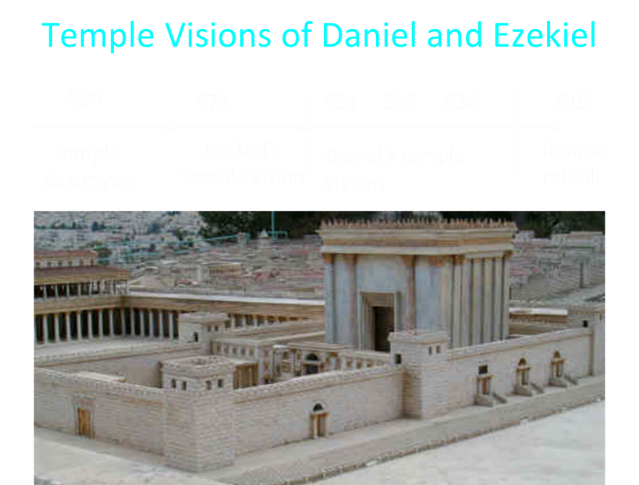

Slide 89
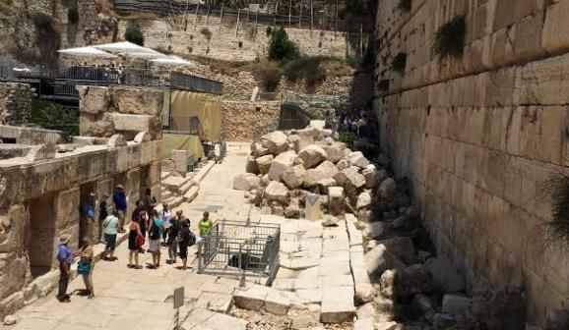
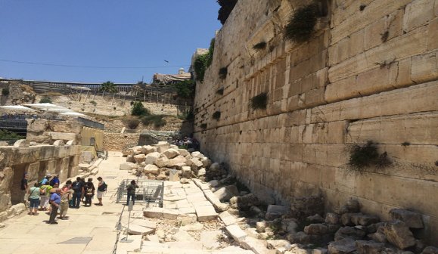

Slide 90
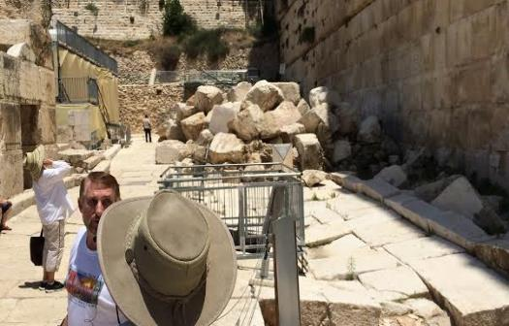
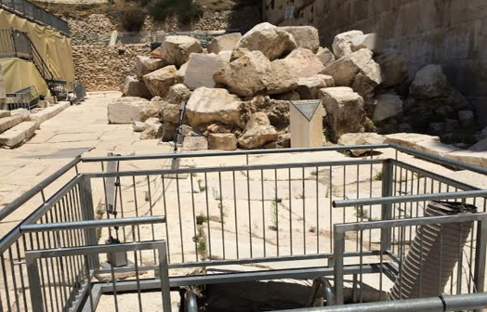

Slide 91
6 Reasons for Gap
  Events prophesied v.26
    Messiah crucified v.26a
    70 AD holocaust v.26b
  Prophecies in Dan. 9:24 would have been fulfilled 7 years after Palm Sunday
  Jesus indicated a gap - (Matt. 24:15, 21-22, 29-30)
  Daniel 9:27 was never fulfilled historically
  Gap occurs elsewhere - (Is. 61:1-2; Luke 4:16-21; Isaiah 9:6)
  Early church fathers indicated a gap

Slide 92
6 Reasons for Gap
  Events prophesied v.26
    Messiah crucified v.26a
    70 AD holocaust v.26b
  Prophecies in Dan. 9:24 would have been fulfilled 7 years after Palm Sunday
  Jesus indicated a gap - (Matt. 24:15, 21-22, 29-30)
  Daniel 9:27 was never fulfilled historically
  Gap occurs elsewhere - (Is. 61:1-2; Luke 4:16-21; Isaiah 9:6)
  Early church fathers indicated a gap

Slide 93
6 Reasons for Gap
  Events prophesied v.26
    Messiah crucified v.26a
    70 AD holocaust v.26b
  Prophecies in Dan. 9:24 would have been fulfilled 7 years after Palm Sunday
  Jesus indicated a gap - (Matt. 24:15, 21-22, 29-30)
  Daniel 9:27 was never fulfilled historically
  Gap occurs elsewhere - (Is. 61:1-2; Luke 4:16-21; Isaiah 9:6)
  Early church fathers indicated a gap

Slide 94
6 Reasons for Gap
  Events prophesied v.26
    Messiah crucified v.26a
    70 AD holocaust v.26b
  Prophecies in Dan. 9:24 would have been fulfilled 7 years after Palm Sunday
  Jesus indicated a gap - (Matt. 24:15, 21-22, 29-30)
  Daniel 9:27 was never fulfilled historically
  Gap occurs elsewhere - (Is. 61:1-2; Luke 4:16-21; Isaiah 9:6)
  Early church fathers indicated a gap

Slide 95
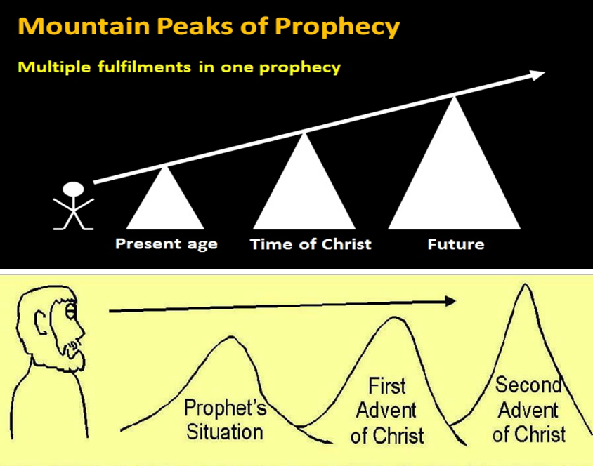

Slide 96












Understanding Daniel’s
Prophetic Perspective
Antichrist
Antiochus IV
(Daniel 11:36-45)
(Daniel 11:21-35)
Far
Fulfillment
Near
Fulfillment
Daniel

Slide 97
Isaiah 9:6-7 (NASB)
⁶ For a child will be born to us, a son will be given to us; And the government will rest on His shoulders; And His name will be called Wonderful Counselor, Mighty God, Eternal Father, Prince of Peace.⁷ There will be no end to the increase of His government or of peace, On the throne of David and over his kingdom, To establish it and to uphold it with justice and righteousness From then on and forevermore. The zeal of the Lord of hosts will accomplish this.

Slide 98
6 Reasons for Gap
  Events prophesied v.26
    Messiah crucified v.26a
    70 AD holocaust v.26b
  Prophecies in Dan. 9:24 would have been fulfilled 7 years after Palm Sunday
  Jesus indicated a gap - (Matt. 24:15, 21-22, 29-30)
  Daniel 9:27 was never fulfilled historically
  Gap occurs elsewhere - (Is. 61:1-2; Luke 4:16-21; Isaiah 9:6)
  Early church fathers indicated a gap

Slide 99

Hippolytus
Fragments From Commentaries, Daniel, paragraph 22 Cited by Hitchcock and Ice in The Truth Behind the Left behind Series p.98.
“For when the three score and two weeks are fulfilled, and Christ is come, and the Gospel is preached in every place, the times being then accomplished, there will remain only one week, the last, in which Elijah will appear, and Enoch, and in the midst of it the abomination of desolation will be manifest, viz., Antichrist, announcing desolation to the world.”

Slide 102
The Seventy Weeks Prophecy 10 FACTS
Focus = Jews & Jerusalem (v.24b)
490 year period of time (v.24a)
360-day years
6 prophecies WILL BE fulfilled (v.24c)
March 5, 444 BC prophecy begins (25a)
483 years elapse between beginning of prophecy & Palm Sunday (25b)
Gap between 483rd & 484th year (26)
Final 7 years = future Tribulation period (27)
Dan. 9:27 Overview of Tribulation
Daniel 9:27 = Revelation 6-19

Slide 103
FINAL 7 YEARS = FUTURE TRIBULATION v.27
490 years total
483 years have transpired
Gap exists between 483rd & 484th year
Final 7 years are future
Final 7 years are the Tribulation period

Slide 104
The Seventy Weeks Prophecy 10 FACTS
Focus = Jews & Jerusalem (v.24b)
490 year period of time (v.24a)
360-day years
6 prophecies WILL BE fulfilled (v.24c)
March 5, 444 BC prophecy begins (25a)
483 years elapse between beginning of prophecy & Palm Sunday (25b)
Gap between 483rd & 484th year (26)
Final 7 years = future Tribulation period (27)
Dan. 9:27 Overview of Tribulation
Daniel 9:27 = Revelation 6-19

Slide 105
Daniel 9:27 (NASB)
And he will make a firm covenant with the many for one week, but in the middle of the week he will put a stop to sacrifice and grain offering; and on the wing of abominations will come one who makes desolate, even until a complete destruction, one that is decreed, is poured out on the one who makes desolate.

Slide 106


Slide 108
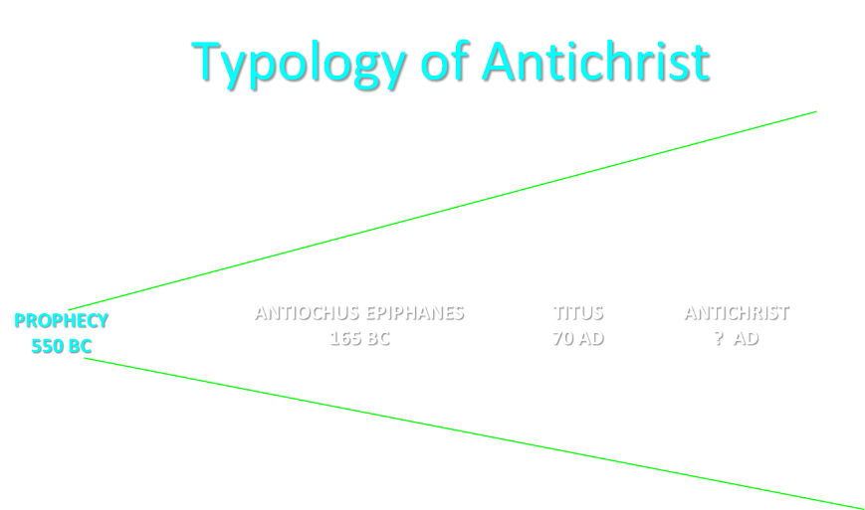

Slide 110


Slide 111
THE STAGE IS BEING SET
Rebirth of Israel in 1948
Israel’s desire for peace
Desire among some Jews to Rebuild 3rd Jewish temple
Desire among some Jews to Restore the sacrificial system
  Source: Randall Price “Ready to Rebuild”

Slide 112
THE STAGE IS BEING SET
Rebirth of Israel in 1948
Israel’s desire for peace
Desire among some Jews to Rebuild 3rd Jewish temple
Desire among some Jews to Restore the sacrificial system
  Source: Randall Price “Ready to Rebuild”

Slide 113
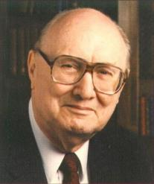
John Walvoord
Israel in Prophecy, Page 26
“Of the many peculiar phenomena which characterize the present generation, few events can claim equal significance as far as Biblical prophecy is concerned with that of the return of Israel to their land. It constitutes a preparation for the end of the age, the setting for the coming of the Lord for His church, and the fulfillment of Israel’s prophetic destiny.”

Slide 114
THE STAGE IS BEING SET
Rebirth of Israel in 1948
Israel’s desire for peace
Desire among some Jews to Rebuild 3rd Jewish temple
Desire among some Jews to Restore the sacrificial system
  Source: Randall Price “Ready to Rebuild”

Slide 115
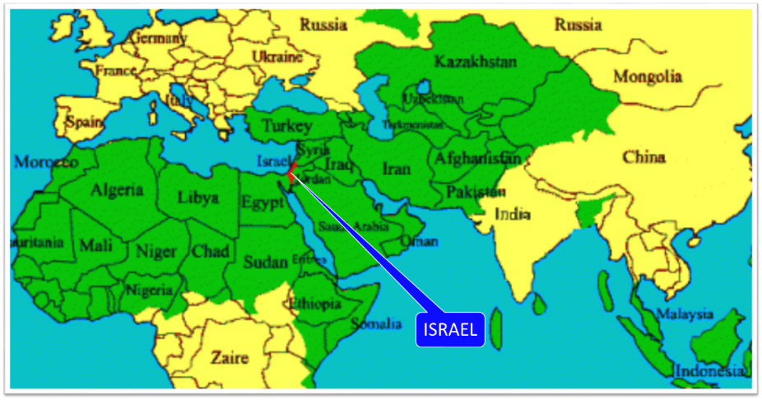

Slide 116
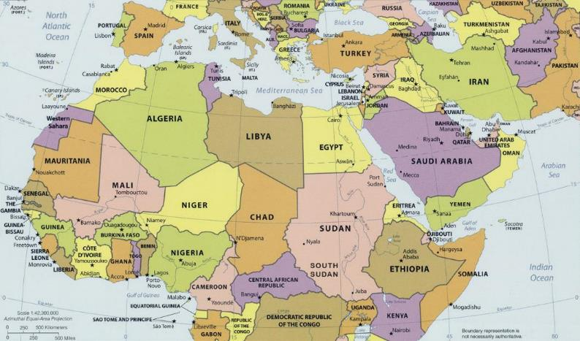
ISRAEL

Slide 117


Slide 118
THE STAGE IS BEING SET
Rebirth of Israel in 1948
Israel’s desire for peace
Desire among some Jews to Rebuild 3rd Jewish temple
Desire among some Jews to Restore the sacrificial system
  Source: Randall Price “Ready to Rebuild”

Slide 119
ISRAEL’S FOUR TEMPLES
Solomon’s pre exilic temple (Kings and Chronicles)
Zerubbabel’s post exilic temple (Ezra 1-6; John 2:20)
Antichrist's temple (Dan 9:27; Matt 24:15; 2 Thess 2:4; Rev 11:1-2)
Millennial temple (Ezek 40-48)

Slide 120
ISRAEL’S FOUR TEMPLES
Solomon’s pre exilic temple (Kings and Chronicles)
Zerubbabel’s post exilic temple (Ezra 1-6; John 2:20)
Antichrist's temple (Dan 9:27; Matt 24:15; 2 Thess 2:4; Rev 11:1-2)
Millennial temple (Ezek 40-48)

Slide 122


Slide 123
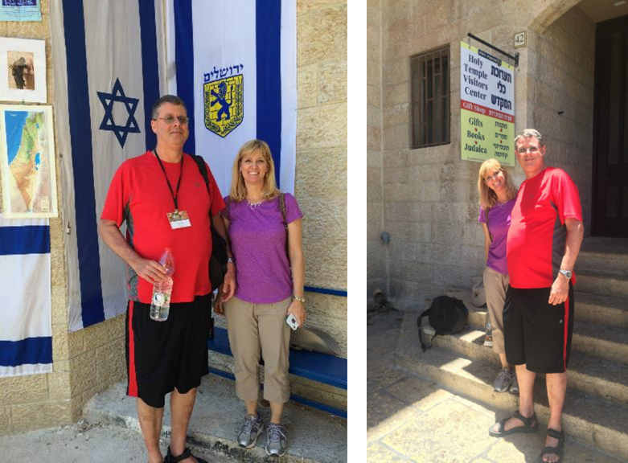

Slide 124
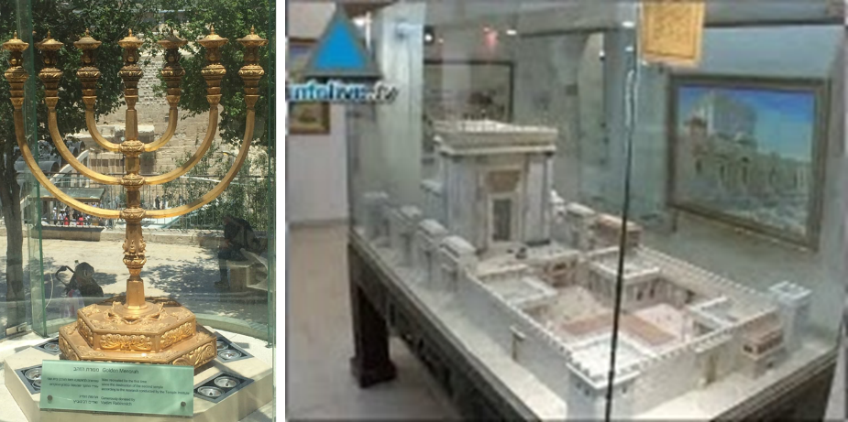

Slide 125
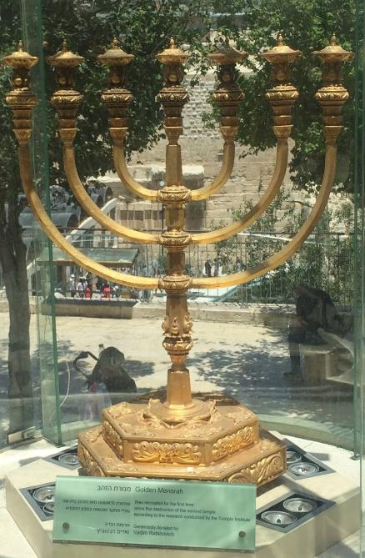

Slide 126
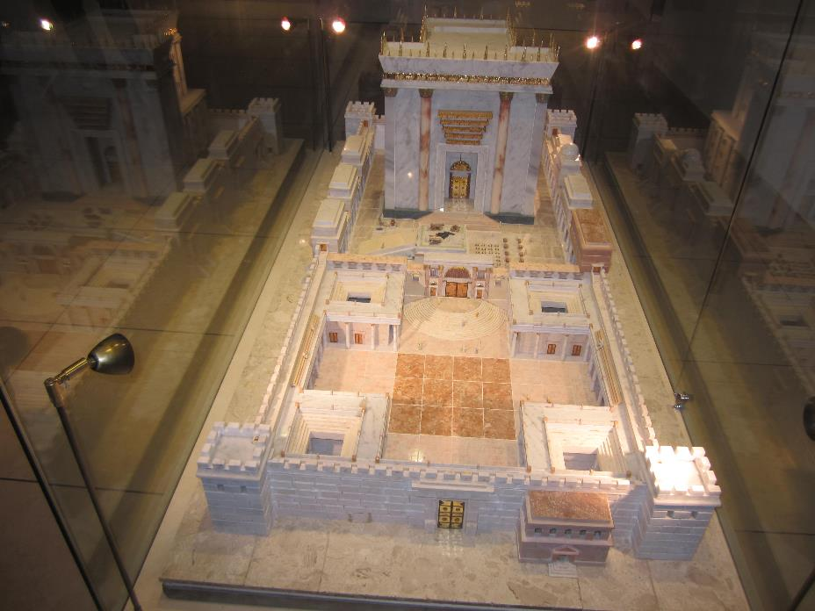

Slide 127
THE STAGE IS BEING SET
Rebirth of Israel in 1948
Israel’s desire for peace
Desire among some Jews to Rebuild 3rd Jewish temple
Desire among some Jews to Restore the sacrificial system
  Source: Randall Price “Ready to Rebuild”

Slide 128
The Times of Israel
April 6, 2017
In first, sheep slaughtered in Jerusalem Old City in reenactment of Passover sacrifice
“With priests blowing silver trumpets, a group of religious Jews slaughtered a sheep on Thursday in Jerusalem’s Old City to demonstrate the traditional paschal sacrifice, the first time such a reenactment has been held inside the city walls in 2,000 years.”
http://www.timesofisrael.com/in-a-first-sheep-slaughtered-in-jerusalem-old-city-in-reenactment-of-passover-sacrifice/#comments

Slide 129
The Seventy Weeks Prophecy 10 FACTS
Focus = Jews & Jerusalem (v.24b)
490 year period of time (v.24a)
360-day years
6 prophecies WILL BE fulfilled (v.24c)
March 5, 444 BC prophecy begins (25a)
483 years elapse between beginning of prophecy & Palm Sunday (25b)
Gap between 483rd & 484th year (26)
Final 7 years = future Tribulation period (27)
Dan. 9:27 Overview of Tribulation
Daniel 9:27 = Revelation 6-19

Slide 130
Daniel 9:27 (NASB)
And he will make a firm covenant with the many for one week, but in the middle of the week he will put a stop to sacrifice and grain offering; and on the wing of abominations will come one who makes desolate, even until a complete destruction, one that is decreed, is poured out on the one who makes desolate.

Slide 131
DANIEL 9:27 = REVELATION 6-19
Rebuilt temple (Rev. 11:1-2)
Division of the Tribulation into two 3½ year periods (Rev. 11:2. 13:5, 11:3, 12:6, 14)
Antichrist (Rev. 13:1-10)
Destruction of Antichrist (Rev. 19:20)
2nd Coming (Rev. 19:11-21)

Slide 133


Slide 134


Slide 135
Conclusion

Slide 136
The Seventy Weeks Prophecy 10 FACTS
Focus = Jews & Jerusalem (v.24b)
490 year period of time (v.24a)
360-day years
6 prophecies WILL BE fulfilled (v.24c)
March 5, 444 BC prophecy begins (25a)
483 years elapse between beginning of prophecy & Palm Sunday (25b)
Gap between 483rd & 484th year (26)
Final 7 years = future Tribulation period (27)
Dan. 9:27 Overview of Tribulation
Daniel 9:27 = Revelation 6-19

Slide 137
Chapter 9 Outline
The Setting (1-2)
Daniel’s prayer (3-19)
Gabriel’s arrival (20-23)
The Seventy Weeks Prophecy (24-27)

