Slide 1
Isaiah 6

Slide 2
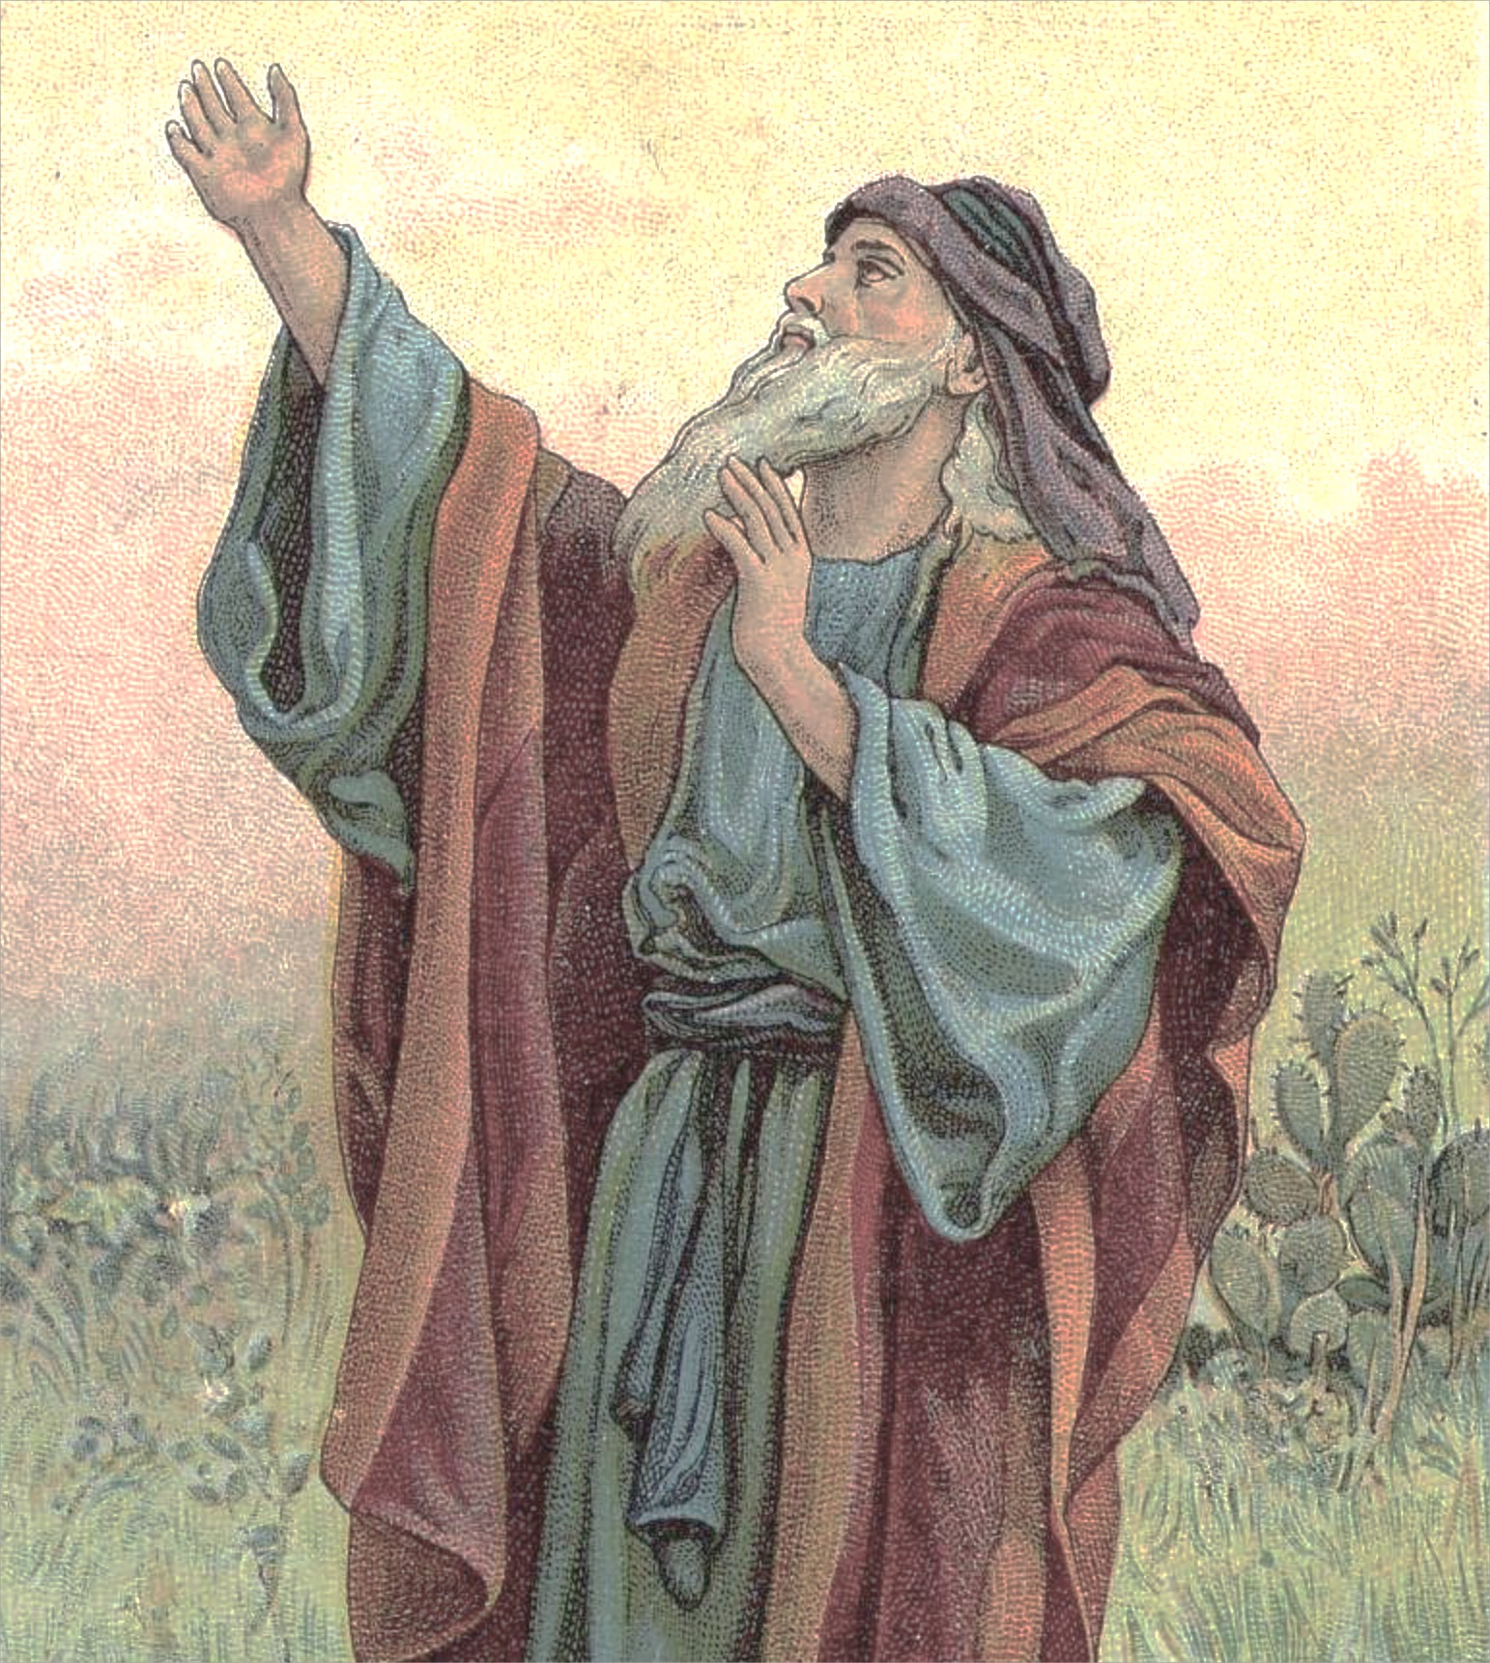
Isaiah 6 Outline
God’s holiness demands that we submit to Him. (Isaiah 6:1-7)
A. Isaiah’s Background
1. Ministry: mid 700’s to 680’s
2. Lived in Jerusalem (Southern Kingdom)
3. Access to kings; possibly royal family
4. Sophisticated & eloquent writer
5. Often called the 5th Gospel

Slide 3
Isaiah 6 Outline
God’s holiness demands that we submit to Him. (Isaiah 6:1-7)
A. Isaiah’s Background
1. Ministry: mid 700’s to 680’s
2. Lived in Jerusalem (Southern Kingdom)
3. Access to kings; possibly royal family
4. Sophisticated & eloquent writer
5. Often called the 5th Gospel

Slide 4
Isaiah 6 Outline
God’s holiness demands that we submit to Him. (Isaiah 6:1-7)
A. Isaiah’s Background
B. Isaiah divides book into three parts (one author)
1. Ch. 1-39 (audience alive): judgment coming
2. Ch. 40-55 (audience exiled): comfort and hope
3. Ch. 56-66 (audience returned): urge obedience

Slide 5
Isaiah 6 Outline
God’s holiness demands that we submit to Him. (Isaiah 6:1-7)
A. Isaiah’s Background
B. Isaiah divides book into three parts (one author)
C. Isaiah’s vision of heaven (6:1-7)
1. Political and spiritual power united (6:1)
2. Earthly words describing heavenly scene (6:2)
3. “Holy, Holy, Holy . . . earth full of His glory” (6:3)
4. Lord overwhelming: Smoke and quaking (6:4)
5. Slightest sin magnified (6:5)
6. Represents forgiveness of sin (6:6-7)

Slide 6
Isaiah 6:1
“In the year of King Uzziah’s death I saw the Lord sitting on a throne, lofty and exalted, with the train of His robe filling the temple.”

Slide 7
Isaiah 6 Outline
God’s holiness demands that we submit to Him. (Isaiah 6:1-7)
A. Isaiah’s Background
B. Isaiah divides book into three parts (one author)
C. Isaiah’s vision of heaven (6:1-7)
1. Political and spiritual power united (6:1)
2. Earthly words describing heavenly scene (6:2)
3. “Holy, Holy, Holy. . .earth full of His glory” (6:3)
4. Lord overwhelming: Smoke and quaking (6:4)
5. Slightest sin magnified (6:5)
6. Represents forgiveness of sin (6:6-7)

Slide 8
Isaiah 6:2
“Seraphim stood above Him, each having six wings: with two he covered his face, and with two he covered his feet, and with two he flew.”

Slide 9
Isaiah 6 Outline
God’s holiness demands that we submit to Him. (Isaiah 6:1-7)
A. Isaiah’s Background
B. Isaiah divides book into three parts (one author)
C. Isaiah’s vision of heaven (6:1-7)
1. Political and spiritual power united (6:1)
2. Earthly words describing heavenly scene (6:2)
3. “Holy, Holy, Holy. . .earth full of His glory” (6:3)
4. Lord overwhelming: Smoke and quaking (6:4)
5. Slightest sin magnified (6:5)
6. Represents forgiveness of sin (6:6-7)

Slide 11
Hebrews 1:14
“Are they not all ministering spirits, sent out to render service for the sake of those who will inherit salvation?”

Slide 12
Isaiah 6:3
“And one called out to another and said, ‘Holy, Holy, Holy, is the Lord of hosts, The whole earth is full of His glory.’”

Slide 13
Isaiah 6 Outline
God’s holiness demands that we submit to Him. (Isaiah 6:1-7)
A. Isaiah’s Background
B. Isaiah divides book into three parts (one author)
C. Isaiah’s vision of heaven (6:1-7)
1. Political and spiritual power united (6:1)
2. Earthly words describing heavenly scene (6:2)
3. “Holy, Holy, Holy. . .earth full of His glory” (6:3)
4. Lord overwhelming: Smoke and quaking (6:4)
5. Slightest sin magnified (6:5)
6. Represents forgiveness of sin (6:6-7)

Slide 14
Isaiah 55:8-9
“My thoughts are not your thoughts, and my ways are not your ways. For as the heavens are higher than the earth, so are My ways higher than your ways And My thoughts than your thoughts.”

Slide 15
Revelation 4:8
“Holy, holy, holy is the Lord God, the Almighty, who was and who is and who is to come.”

Slide 16
Isaiah 6:3
“And one called out to another and said, ‘Holy, Holy, Holy, is the Lord of hosts, The whole earth is full of His glory.’”

Slide 17
Isaiah 6:4
“And the foundations of the thresholds trembled at the voice of him who called out, while the temple was filling with smoke.”

Slide 18
Isaiah 6 Outline
God’s holiness demands that we submit to Him. (Isaiah 6:1-7)
A. Isaiah’s Background
B. Isaiah divides book into three parts (one author)
C. Isaiah’s vision of heaven (6:1-7)
1. Political and spiritual power united (6:1)
2. Earthly words describing heavenly scene (6:2)
3. “Holy, Holy, Holy. . .earth full of His glory” (6:3)
4. Lord overwhelming: Smoke and quaking (6:4)
5. Slightest sin magnified (6:5)
6. Represents forgiveness of sin (6:6-7)

Slide 19
Isaiah 6:5
“Then I said, ‘Woe is me, for I am ruined! Because I am a man of unclean lips, And I live among a people of unclean lips; For my eyes have seen the King, the Lord of hosts.’”

Slide 20
Isaiah 6 Outline
God’s holiness demands that we submit to Him. (Isaiah 6:1-7)
A. Isaiah’s Background
B. Isaiah divides book into three parts (one author)
C. Isaiah’s vision of heaven (6:1-7)
1. Political and spiritual power united (6:1)
2. Earthly words describing heavenly scene (6:2)
3. “Holy, Holy, Holy. . .earth full of His glory” (6:3)
4. Lord overwhelming: Smoke and quaking (6:4)
5. Slightest sin magnified (6:5)
6. Represents forgiveness of sin (6:6-7)

Slide 21
Isaiah 6:6-7
“Then one of the seraphim flew to me with a burning coal in his hand, which he had taken from the altar with tongs. He touched my mouth with it and said, ‘Behold, this has touched your lips; and your iniquity is taken away and your sin is forgiven.’”

Slide 22
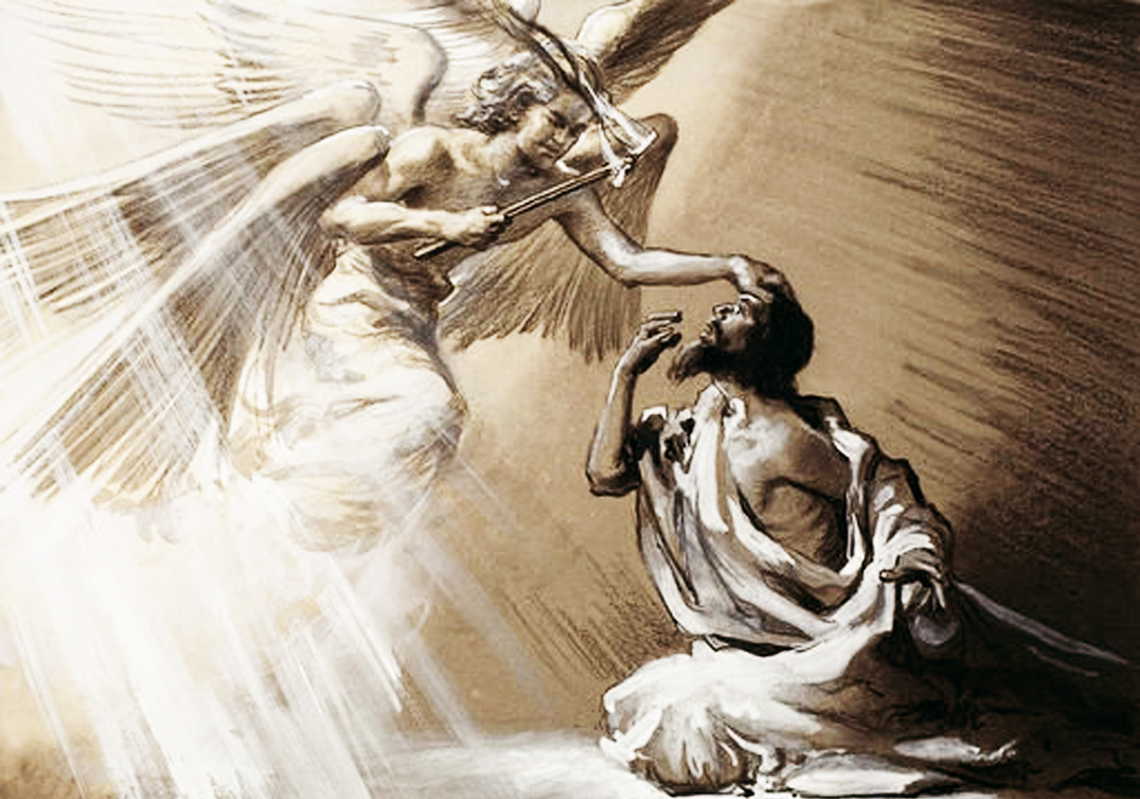

Slide 23
Isaiah 6 Outline
God’s holiness demands that we submit to Him. (Isaiah 6:1-7)
A. Isaiah’s Background
B. Isaiah divides book into three parts (one author)
C. Isaiah’s vision of heaven (6:1-7)
1. Political and spiritual power united (6:1)
2. Earthly words describing heavenly scene (6:2)
3. “Holy, Holy, Holy. . .earth full of His glory” (6:3)
4. Lord overwhelming: Smoke and quaking (6:4)
5. Slightest sin magnified (6:5)
6. Represents forgiveness of sin (6:6-7)

