Slide 1

THE BOOK OF DANIEL
Andy Woods, Th.M.., JD., PhD.
Sr. Pastor, Sugar Land Bible Church
President Chafer Theological Seminary

Slide 2

Message
Times of the Gentiles are revealed prophetically (2, 7, 8-12) and ethically (1, 3-6)

Slide 3

Synthetic Outline
Historical (1-7):
  Daniel interprets, 3rd person, gentile nations
  Intro “Hebrew” (1)
  Aramaic chiasm (2-7)

Slide 4
Synthetic Outline
Historical (1-7):
  Daniel interprets, 3rd person, gentile nations
  Intro “Hebrew” (1)
  Aramaic chiasm (2-7)

Slide 5
Synthetic Outline
Historical (1-7):
  Daniel interprets, 3rd person, gentile nations
  Intro “Hebrew” (1)
  Aramaic chiasm (2-7)

Slide 6

Synthetic Outline
  Chiasm “Aramaic” ( 2-7)
1. Gentile History (2)
  2. Protection (3)
    3. Revelation to a gentile king (4)
    3. Revelation to a gentile king (5)
  2. Protection (6)
1. Gentile history (7)

Slide 7
Synthetic Outline
Prophetic (8-12):
  Angel interprets, 1st person, Jewish nation, Hebrew
  Ram & Goat (8)
  70 weeks (9)
  Final vision (10-12)

Slide 8
Synthetic Outline
Prophetic (8-12):
  Angel interprets, 1st person, Jewish nation, Hebrew
  Ram & Goat (8)
  70 weeks (9)
  Final vision (10-12)

Slide 9

Chapter 9 Outline
The Setting (1-2)
Daniel’s prayer (3-19)
Gabriel’s arrival (20-23)
The Seventy Weeks Prophecy (24-27)

Slide 10
Chapter 9 Outline
The Setting (1-2)
Daniel’s prayer (3-19)
Gabriel’s arrival (20-23)
The Seventy Weeks Prophecy (24-27)

Slide 11
I. The Setting (1-2)
Historical setting (v.1)
Prophetic setting (v.2)

Slide 12
CHAPTER AND VERSE IN DANIEL | CHRONOLOGICAL DATE | BIBLICAL DATE
1:1 | 605 | 3rd year of Jehoiakim
2:1 | 603 | 2nd year of Nebuchadnezzar
5 | Sat. night 10/12/539 (Hoehner)
7:1 | 553 | 1st year of Belshazzar
8:1 | 551 | 3rd year of Belshazzar
9:1 | 538 | 1st year of Darius
10:1 | 536 | 3rd year of Cyrus

Slide 13
I. The Setting (1-2)
Historical setting (v.1)
Prophetic setting (v.2)

Slide 14
Chapter 9 Outline
The Setting (1-2)
Daniel’s prayer (3-19)
Gabriel’s arrival (20-23)
The Seventy Weeks Prophecy (24-27)

Slide 15
Chapter 9 Outline
The Setting (1-2)
Daniel’s prayer (3-19)
Gabriel’s arrival (20-23)
The Seventy Weeks Prophecy (24-27)

Slide 16
Chapter 9 Outline
The Setting (1-2)
Daniel’s prayer (3-19)
Gabriel’s arrival (20-23)
The Seventy Weeks Prophecy (24-27)

Slide 17
The Seventy Weeks Prophecy 10 FACTS
Focus = Jews & Jerusalem (v.24b)
490 year period of time (v.24a)
360-day years
6 prophecies WILL BE fulfilled (v.24c)
March 5, 444 BC prophecy begins (25a)
483 years elapse between beginning of prophecy & Palm Sunday (25b)
Gap between 483rd & 484th year (26)
Final 7 years = future Tribulation period (27)
Dan. 9:27 Overview of Tribulation
Daniel 9:27 = Revelation 6-19

Slide 18
The Seventy Weeks Prophecy 10 FACTS
Focus = Jews & Jerusalem (v.24b)
490 year period of time (v.24a)
360-day years
6 prophecies WILL BE fulfilled (v.24c)
March 5, 444 BC prophecy begins (25a)
483 years elapse between beginning of prophecy & Palm Sunday (25b)
Gap between 483rd & 484th year (26)
Final 7 years = future Tribulation period (27)
Dan. 9:27 Overview of Tribulation
Daniel 9:27 = Revelation 6-19

Slide 19

Daniel 9:24 (NASB)
Seventy weeks have been decreed for your people and your holy city, to finish the transgression, to make an end of sin, to make atonement for iniquity, to bring in everlasting righteousness, to seal up vision and prophecy and to anoint the most holy place.

Slide 20
The Seventy Weeks Prophecy 10 FACTS
Focus = Jews & Jerusalem (v.24b)
490 year period of time (v.24a)
360-day years
6 prophecies WILL BE fulfilled (v.24c)
March 5, 444 BC prophecy begins (25a)
483 years elapse between beginning of prophecy & Palm Sunday (25b)
Gap between 483rd & 484th year (26)
Final 7 years = future Tribulation period (27)
Dan. 9:27 Overview of Tribulation
Daniel 9:27 = Revelation 6-19

Slide 21
Daniel 9:24 (NASB)
Seventy weeks have been decreed for your people and your holy city, to finish the transgression, to make an end of sin, to make atonement for iniquity, to bring in everlasting righteousness, to seal up vision and prophecy and to anoint the most holy place.

Slide 22


Slide 23
The Seventy Weeks Prophecy 10 FACTS
Focus = Jews & Jerusalem (v.24b)
490 year period of time (v.24a)
360-day years
6 prophecies WILL BE fulfilled (v.24c)
March 5, 444 BC prophecy begins (25a)
483 years elapse between beginning of prophecy & Palm Sunday (25b)
Gap between 483rd & 484th year (26)
Final 7 years = future Tribulation period (27)
Dan. 9:27 Overview of Tribulation
Daniel 9:27 = Revelation 6-19

Slide 24
360-day YEARS
TRIBULATION
  Rev. 11:3 (1260 days)
  Rev. 11:2 (42 months)
  1260 days / 42 months = 30 days per month
  30 days x 12 months = 360 days per year
THE FLOOD
  Gen. 7:24 (150 days)
  Gen. 7:11; 8:4 (5 months)
  150 days / 5 months = 30 days per month
  30 days x 12 months = 360 days per year

Slide 25
The Seventy Weeks Prophecy 10 FACTS
Focus = Jews & Jerusalem (v.24b)
490 year period of time (v.24a)
360-day years
6 prophecies WILL BE fulfilled (v.24c)
March 5, 444 BC prophecy begins (25a)
483 years elapse between beginning of prophecy & Palm Sunday (25b)
Gap between 483rd & 484th year (26)
Final 7 years = future Tribulation period (27)
Dan. 9:27 Overview of Tribulation
Daniel 9:27 = Revelation 6-19

Slide 26
Daniel 9:24 (NASB)
Seventy weeks have been decreed for your people and your holy city, to finish the transgression, to make an end of sin, to make atonement for iniquity, to bring in everlasting righteousness, to seal up vision and prophecy and to anoint the most holy place.

Slide 27

6 Prophecies WILL BE fulfilled V.24c
  “to finish transgression”
  “to make an end of sin”
  “to make atonement for iniquity”
  “to bring in everlasting righteousness”
  “to seal up vision and prophecy”
  “to anoint the most holy place”
Arnold Fructenbaum, Footsteps of the Messiah, p.191-4

Slide 28
The Seventy Weeks Prophecy 10 FACTS
Focus = Jews & Jerusalem (v.24b)
490 year period of time (v.24a)
360-day years
6 prophecies WILL BE fulfilled (v.24c)
March 5, 444 BC prophecy begins (25a)
483 years elapse between beginning of prophecy & Palm Sunday (25b)
Gap between 483rd & 484th year (26)
Final 7 years = future Tribulation period (27)
Dan. 9:27 Overview of Tribulation
Daniel 9:27 = Revelation 6-19

Slide 29
Daniel 9:25 (NASB)
So you are to know and discern that from the issuing of a decree to restore and rebuild Jerusalem until Messiah the Prince there will be seven weeks and sixty-two weeks; it will be built again, with plaza and moat, even in times of distress.

Slide 31
PROPHECY BEGINS WITH DECREE
Decree to rebuild Jerusalem
Not the decrees involving the temple
  Cyrus 538 BC (Ezra 1:1-4; 6:1-5)
  Darius 520 BC (Ezra 6:6-12)
  Artaxerxes 458 BC (Ezra 7:11-16)
Decree of Artaxerxes (Neh. 1-2)
  Nehemiah 2: 3, 5, 8
  Distress (Daniel 9:25)
  March 5, 444 B.C. (Neh.2:1)

Slide 32
Nehemiah 2:1 (NASB)
And it came about in the month Nisan, in the twentieth year of King Artaxerxes, that wine was before him, and I took up the wine and gave it to the king. Now I had not been sad in his presence.

Slide 33
The Seventy Weeks Prophecy 10 FACTS
Focus = Jews & Jerusalem (v.24b)
490 year period of time (v.24a)
360-day years
6 prophecies WILL BE fulfilled (v.24c)
March 5, 444 BC prophecy begins (25a)
483 years elapse between beginning of prophecy & Palm Sunday (25b)
Gap between 483rd & 484th year (26)
Final 7 years = future Tribulation period (27)
Dan. 9:27 Overview of Tribulation
Daniel 9:27 = Revelation 6-19

Slide 34
Daniel 9:25 (NASB)
So you are to know and discern that from the issuing of a decree to restore and rebuild Jerusalem until Messiah the Prince there will be seven weeks and sixty-two weeks; it will be built again, with plaza and moat, even in times of distress.

Slide 35
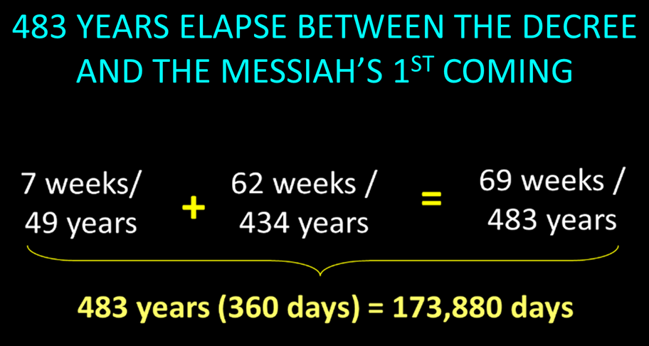

Slide 36

BIBLICAL MATHEMATICS
444 B.C. – (Artaxerxes decree of Nehemiah 2)
+33 A.D. – (Triumphal entry of Luke 19:28-44)
= 477 years
-1 – (1 B.C. to A.D. 1 = 1 year, not 2 years)
= 476 years
x 365 days
= 173, 740 days
+ 25 days – (March 5 to March 30)
= 173, 765 days
+115 days – (leap years)
= 173, 880 days

Slide 37
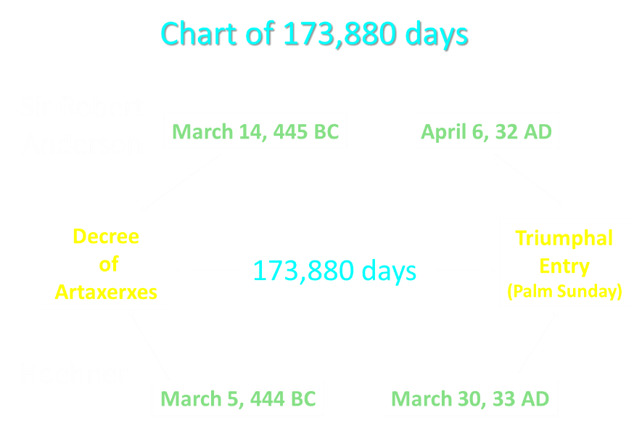

Slide 38

Messiah must present Himself to Israel on March 30, A.D. 33 (Daniel 9:25)

Slide 39
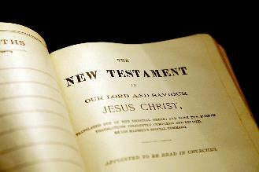
New Testament Perspective
  Palm Sunday statements
    Luke 19:37-38
    Luke 19:39-40
    Luke 19:42
    Luke 19:44
  Israel held accountable for knowing the time (Matt. 16:1-3)
  The time of Christ’s birth
    Galatians 4:4
    Watchfulness of Simeon & Anna (Luke 2:25-26, 36-38)
    The visit of the Magi (Dan. 2:48; Num. 24:17; Deut. 23:4)
  The Messianic Secret (Mark 8:29-30)

Slide 40

If the first 69 weeks were fulfilled literally then the remaining week will be fulfilled literally.

Slide 41
The Seventy Weeks Prophecy 10 FACTS
Focus = Jews & Jerusalem (v.24b)
490 year period of time (v.24a)
360-day years
6 prophecies WILL BE fulfilled (v.24c)
March 5, 444 BC prophecy begins (25a)
483 years elapse between beginning of prophecy & Palm Sunday (25b)
Gap between 483rd & 484th year (26)
Final 7 years = future Tribulation period (27)
Dan. 9:27 Overview of Tribulation
Daniel 9:27 = Revelation 6-19

Slide 43
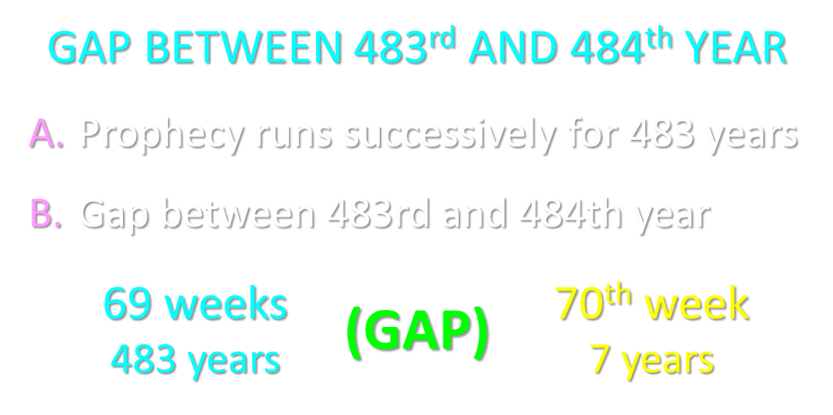

Slide 44
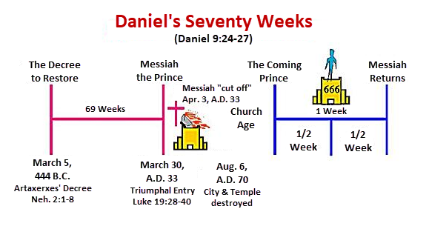

Slide 45
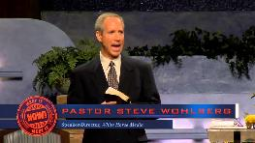
Steve Wohlberg
Steve Wohlberg, Exploding the Israel Deception: A Jewish Believer Exposes False Prophecies About Israel, the Temple, and Armageddon (Roseville, CA: Amazing Facts, 1998), 43.
"Much of the Christian world is now locked in a fierce debate about whether Jesus will return for His church before the seven years (the pre-tribulation view), in the midst of the seven years (the mid-tribulation view), or at the end of the seven years (the post-tribulation view). Yet by far the most explosive question, which few seem to be asking, should be ‘is an in time 'seven-year period of great tribulation' really the correct interpretation of Daniel 9:27 in the first place?’ Historically, protestant scholars have not applied Daniel 9:27 to a future period of tribulation at all! Neither have they applied the ‘he’ to the antichrist! Rather, they applied it to Jesus Christ.”

Slide 46
6 Reasons for Gap
  Events prophesied v.26
    Messiah crucified v.26a
    70 AD holocaust v.26b
  Prophecies in Dan. 9:24 would have been fulfilled 7 years after Palm Sunday
  Jesus indicated a gap - (Matt. 24:15, 21-22, 29-30)
  Daniel 9:27 was never fulfilled historically
  Gap occurs elsewhere - (Is. 61:1-2; Luke 4:16-21; Isaiah 9:6)
  Early church fathers indicated a gap

Slide 47
6 Reasons for Gap
  Events prophesied v.26
    Messiah crucified v.26a
    70 AD holocaust v.26b
  Prophecies in Dan. 9:24 would have been fulfilled 7 years after Palm Sunday
  Jesus indicated a gap - (Matt. 24:15, 21-22, 29-30)
  Daniel 9:27 was never fulfilled historically
  Gap occurs elsewhere - (Is. 61:1-2; Luke 4:16-21; Isaiah 9:6)
  Early church fathers indicated a gap

Slide 48
6 Reasons for Gap
  Events prophesied v.26
    Messiah crucified v.26a
    70 AD holocaust v.26b
  Prophecies in Dan. 9:24 would have been fulfilled 7 years after Palm Sunday
  Jesus indicated a gap - (Matt. 24:15, 21-22, 29-30)
  Daniel 9:27 was never fulfilled historically
  Gap occurs elsewhere - (Is. 61:1-2; Luke 4:16-21; Isaiah 9:6)
  Early church fathers indicated a gap

Slide 49
Daniel 9:26 (NASB)
Then after the sixty-two weeks the Messiah will be cut off and have nothing, and the people of the prince who is to come will destroy the city and the sanctuary. And its end will come with a flood; even to the end there will be war; desolations are determined.

Slide 50
Daniel 9:25 (NASB)
So you are to know and discern that from the issuing of a decree to restore and rebuild Jerusalem until Messiah the Prince there will be seven weeks and sixty-two weeks; it will be built again, with plaza and moat, even in times of distress.

Slide 51
6 Reasons for Gap
  Events prophesied v.26
    Messiah crucified v.26a
    70 AD holocaust v.26b
  Prophecies in Dan. 9:24 would have been fulfilled 7 years after Palm Sunday
  Jesus indicated a gap - (Matt. 24:15, 21-22, 29-30)
  Daniel 9:27 was never fulfilled historically
  Gap occurs elsewhere - (Is. 61:1-2; Luke 4:16-21; Isaiah 9:6)
  Early church fathers indicated a gap

Slide 52
Daniel 9:26 (NASB)
Then after the sixty-two weeks the Messiah will be cut off and have nothing, and the people of the prince who is to come will destroy the city and the sanctuary. And its end will come with a flood; even to the end there will be war; desolations are determined.

Slide 53
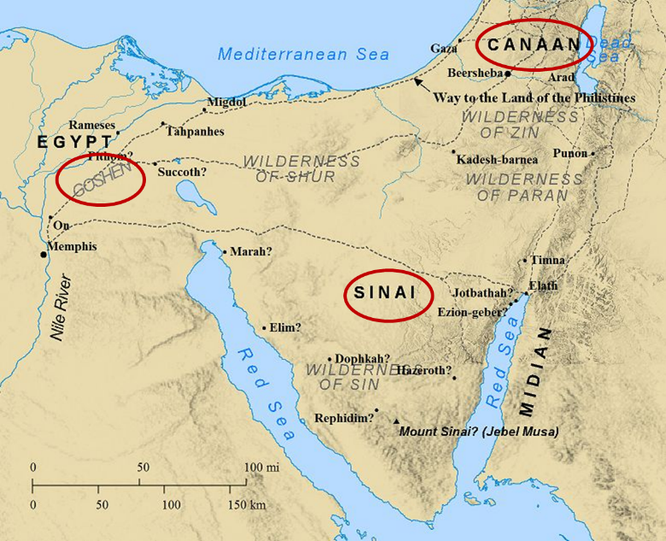

Slide 54
Six Parts of a Suzerain-Vassal Treaty in Deuteronomy
Preamble (1:1-5)
Prologue (1:6–4:40)
Covenant obligations (5–26)
Storage and reading instructions (27:2-3; 31:9, 24, 26)
Witnesses (32:1)
Blessings and curses (28)

Slide 55
Six Parts of a Suzerain-Vassal Treaty in Deuteronomy
Preamble (1:1-5)
Prologue (1:6–4:40)
Covenant obligations (5–26)
Storage and reading instructions (27:2-3; 31:9, 24, 26)
Witnesses (32:1)
Blessings and curses (28)

Slide 56
Luke 19:41-44 (NASB)
⁴¹ When He approached Jerusalem, He saw the city and wept over it, ⁴² saying, “If you had known in this day, even you, the things which make for peace! But now they have been hidden from your eyes. ⁴³ For the days will come upon you when your enemies will throw up a barricade against you, and surround you and hem you in on every side, ⁴⁴ and they will level you to the ground and your children within you, and they will not leave in you one stone upon another, because you did not recognize the time of your visitation.

Slide 57
ISRAEL’S FOUR TEMPLES
Solomon’s pre exilic temple (Kings and Chronicles)
Zerubbabel’s post exilic temple (Ezra 1-6; John 2:20)
Antichrist's temple (Dan 9:27; Matt 24:15; 2 Thess 2:4; Rev 11:1-2)
Millennial temple (Ezek 40-48)

Slide 58
ISRAEL’S FOUR TEMPLES
Solomon’s pre exilic temple (Kings and Chronicles)
Zerubbabel’s post exilic temple (Ezra 1-6; John 2:20)
Antichrist's temple (Dan 9:27; Matt 24:15; 2 Thess 2:4; Rev 11:1-2)
Millennial temple (Ezek 40-48)

Slide 59
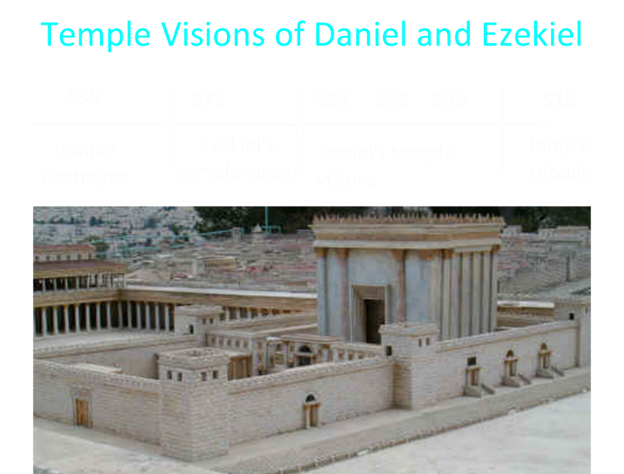

Slide 60
CHAPTER AND VERSE IN DANIEL | CHRONOLOGICAL DATE | BIBLICAL DATE
1:1 | 605 | 3rd year of Jehoiakim
2:1 | 603 | 2nd year of Nebuchadnezzar
5 | Sat. night 10/12/539 (Hoehner)
7:1 | 553 | 1st year of Belshazzar
8:1 | 551 | 3rd year of Belshazzar
9:1 | 538 | 1st year of Darius
10:1 | 536 | 3rd year of Cyrus

Slide 61
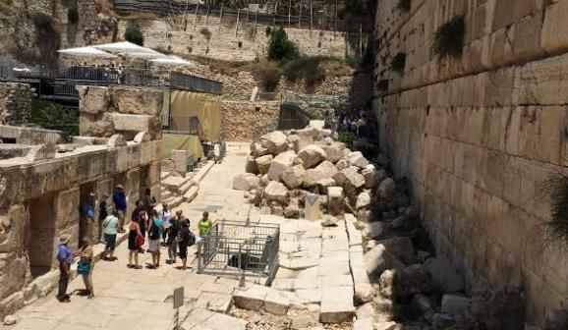
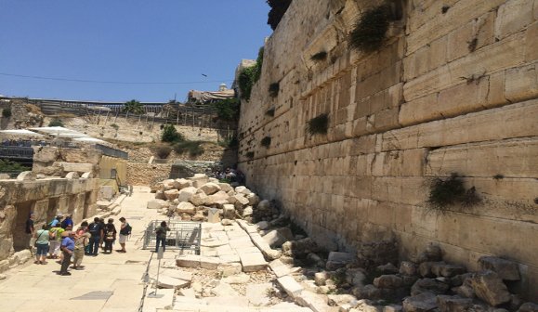

Slide 62
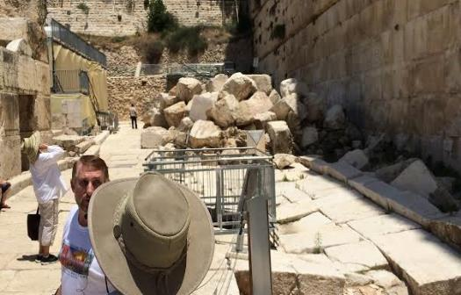
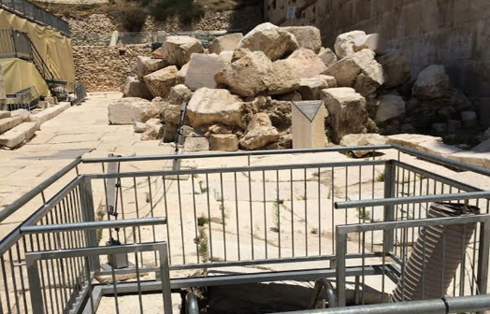

Slide 63
6 Reasons for Gap
  Events prophesied v.26
    Messiah crucified v.26a
    70 AD holocaust v.26b
  Prophecies in Dan. 9:24 would have been fulfilled 7 years after Palm Sunday
  Jesus indicated a gap - (Matt. 24:15, 21-22, 29-30)
  Daniel 9:27 was never fulfilled historically
  Gap occurs elsewhere - (Is. 61:1-2; Luke 4:16-21; Isaiah 9:6)
  Early church fathers indicated a gap

Slide 64
The Seventy Weeks Prophecy 10 FACTS
Focus = Jews & Jerusalem (v.24b)
490 year period of time (v.24a)
360-day years
6 prophecies WILL BE fulfilled (v.24c)
March 5, 444 BC prophecy begins (25a)
483 years elapse between beginning of prophecy & Palm Sunday (25b)
Gap between 483rd & 484th year (26)
Final 7 years = future Tribulation period (27)
Dan. 9:27 Overview of Tribulation
Daniel 9:27 = Revelation 6-19

Slide 65
Daniel 9:24 (NASB)
Seventy weeks have been decreed for your people and your holy city, to finish the transgression, to make an end of sin, to make atonement for iniquity, to bring in everlasting righteousness, to seal up vision and prophecy and to anoint the most holy place.

Slide 66
6 Prophecies WILL BE fulfilled V.24c
  “to finish transgression”
  “to make an end of sin”
  “to make atonement for iniquity”
  “to bring in everlasting righteousness”
  “to seal up vision and prophecy”
  “to anoint the most holy place”
Arnold Fructenbaum, Footsteps of the Messiah, p.191-4

Slide 67
6 Reasons for Gap
  Events prophesied v.26
    Messiah crucified v.26a
    70 AD holocaust v.26b
  Prophecies in Dan. 9:24 would have been fulfilled 7 years after Palm Sunday
  Jesus indicated a gap - (Matt. 24:15, 21-22, 29-30)
  Daniel 9:27 was never fulfilled historically
  Gap occurs elsewhere - (Is. 61:1-2; Luke 4:16-21; Isaiah 9:6)
  Early church fathers indicated a gap

Slide 68

Matthew 24:15
“Therefore when you see the abomination of desolation which was spoken of through Daniel the prophet, standing in the holy place (let the reader understand).”

Slide 69
Matthew 24:15
“Therefore when you see the abomination of desolation which was spoken of through Daniel the prophet, standing in the holy place (let the reader understand).”

Slide 70
6 Reasons for Gap
  Events prophesied v.26
    Messiah crucified v.26a
    70 AD holocaust v.26b
  Prophecies in Dan. 9:24 would have been fulfilled 7 years after Palm Sunday
  Jesus indicated a gap - (Matt. 24:15, 21-22, 29-30)
  Daniel 9:27 was never fulfilled historically
  Gap occurs elsewhere - (Is. 61:1-2; Luke 4:16-21; Isaiah 9:6)
  Early church fathers indicated a gap

Slide 71
Daniel 9:27 (NASB)
And he will make a firm covenant with the many for one week, but in the middle of the week he will put a stop to sacrifice and grain offering; and on the wing of abominations will come one who makes desolate, even until a complete destruction, one that is decreed, is poured out on the one who makes desolate.

Slide 72
Daniel 9:27 (NASB)
And he will make a firm covenant with the many for one week, but in the middle of the week he will put a stop to sacrifice and grain offering; and on the wing of abominations will come one who makes desolate, even until a complete destruction, one that is decreed, is poured out on the one who makes desolate.

Slide 73


Slide 74
Daniel 9:27 (NASB)
And he will make a firm covenant with the many for one week, but in the middle of the week he will put a stop to sacrifice and grain offering; and on the wing of abominations will come one who makes desolate, even until a complete destruction, one that is decreed, is poured out on the one who makes desolate.

Slide 75
Daniel 8:12 (NASB)
And on account of transgression the host will be given over to the horn along with the regular sacrifice; and it will fling truth to the ground and perform its will and prosper.

Slide 76
Daniel 9:27 (NASB)
And he will make a firm covenant with the many for one week, but in the middle of the week he will put a stop to sacrifice and grain offering; and on the wing of abominations will come one who makes desolate, even until a complete destruction, one that is decreed, is poured out on the one who makes desolate.

Slide 77
6 Reasons for Gap
  Events prophesied v.26
    Messiah crucified v.26a
    70 AD holocaust v.26b
  Prophecies in Dan. 9:24 would have been fulfilled 7 years after Palm Sunday
  Jesus indicated a gap - (Matt. 24:15, 21-22, 29-30)
  Daniel 9:27 was never fulfilled historically
  Gap occurs elsewhere - (Is. 61:1-2; Luke 4:16-21; Isaiah 9:6)
  Early church fathers indicated a gap

Slide 78
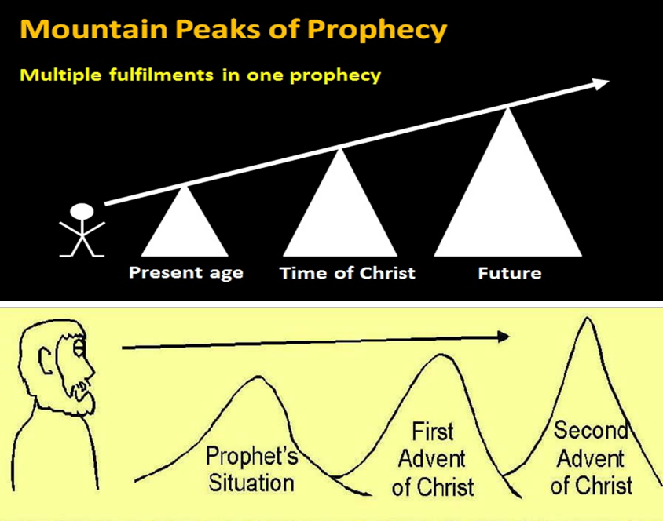

Slide 79
Zechariah 9:9-10 (NASB)
⁹ Rejoice greatly, O daughter of Zion! Shout in triumph, O daughter of Jerusalem! Behold, your king is coming to you; He is just and endowed with salvation, Humble, and mounted on a donkey, Even on a colt, the foal of a donkey.¹⁰ I will cut off the chariot from Ephraim And the horse from Jerusalem; And the bow of war will be cut off. And He will speak peace to the nations; And His dominion will be from sea to sea, And from the River to the ends of the earth.

Slide 80
Isaiah 9:6-7 (NASB)
⁶ For a child will be born to us, a son will be given to us; And the government will rest on His shoulders; And His name will be called Wonderful Counselor, Mighty God, Eternal Father, Prince of Peace.⁷ There will be no end to the increase of His government or of peace, On the throne of David and over his kingdom, To establish it and to uphold it with justice and righteousness From then on and forevermore. The zeal of the Lord of hosts will accomplish this.

Slide 81
Isaiah 61:1-2 (NASB)
¹ The Spirit of the Lord God is upon me, Because the Lord has anointed me To bring good news to the afflicted; He has sent me to bind up the brokenhearted, To proclaim liberty to captives And freedom to prisoners;² To proclaim the favorable year of the Lord And the day of vengeance of our God; To comfort all who mourn.

Slide 82
Luke 4:16-21 (NASB)
¹⁶ And He came to Nazareth, where He had been brought up; and as was His custom, He entered the synagogue on the Sabbath, and stood up to read. ¹⁷ And the book of the prophet Isaiah was handed to Him. And He opened the book and found the place where it was written,¹⁸ “The Spirit of the Lord is upon Me, Because He anointed Me to preach the gospel to the poor. He has sent Me to proclaim release to the captives, And recovery of sight to the blind, To set …

Slide 83
Luke 4:16-21 (NASB)
…free those who are oppressed,¹⁹ To proclaim the favorable year of the Lord.” ²⁰ And He closed the book, gave it back to the attendant and sat down; and the eyes of all in the synagogue were fixed on Him. ²¹ And He began to say to them, “Today this Scripture has been fulfilled in your hearing.”

Slide 84
Isaiah 61:1-2 (NASB)
¹ The Spirit of the Lord God is upon me, Because the Lord has anointed me To bring good news to the afflicted; He has sent me to bind up the brokenhearted, To proclaim liberty to captives And freedom to prisoners;² To proclaim the favorable year of the Lord And the day of vengeance of our God; To comfort all who mourn.

Slide 85


Statue
&
Stone

Slide 86












Understanding Daniel’s
Prophetic Perspective
Antichrist
Antiochus IV
(Daniel 11:36-45)
(Daniel 11:21-35)
Far
Fulfillment
Near
Fulfillment
Daniel

Slide 87
1 Peter 1:10-11 (NASB)
¹⁰ As to this salvation, the prophets who prophesied of the grace that would come to you made careful searches and inquiries, ¹¹ seeking to know what person or time the Spirit of Christ within them was indicating as He predicted the sufferings of Christ and the glories to follow.

Slide 88
6 Reasons for Gap
  Events prophesied v.26
    Messiah crucified v.26a
    70 AD holocaust v.26b
  Prophecies in Dan. 9:24 would have been fulfilled 7 years after Palm Sunday
  Jesus indicated a gap - (Matt. 24:15, 21-22, 29-30)
  Daniel 9:27 was never fulfilled historically
  Gap occurs elsewhere - (Is. 61:1-2; Luke 4:16-21; Isaiah 9:6)
  Early church fathers indicated a gap

Slide 89

Hippolytus (170 – 235 AD)
Fragments From Commentaries, Daniel, paragraph 22 Cited by Hitchcock and Ice in The Truth Behind the Left behind Series p.98.
“For when the three score and two weeks are fulfilled, and Christ is come, and the Gospel is preached in every place, the times being then accomplished, there will remain only one week, the last, in which Elijah will appear, and Enoch, and in the midst of it the abomination of desolation will be manifest, viz., Antichrist, announcing desolation to the world.”
Louis E. Knowles, "The Interpretation of the Seventy Weeks Prophecy in the Early Chruch Fathers," The Westminster Theological Journal 7, (May 1945): 136-60.

Slide 90
6 Reasons for Gap
  Events prophesied v.26
    Messiah crucified v.26a
    70 AD holocaust v.26b
  Prophecies in Dan. 9:24 would have been fulfilled 7 years after Palm Sunday
  Jesus indicated a gap - (Matt. 24:15, 21-22, 29-30)
  Daniel 9:27 was never fulfilled historically
  Gap occurs elsewhere - (Is. 61:1-2; Luke 4:16-21; Isaiah 9:6)
  Early church fathers indicated a gap

Slide 93

Purposes of the Local Church
Glorify God (Eph 3:21)
Edify the saints (Eph 4:11-16)
Fulfill the Great Commission (Matt 28:18-20)

Slide 94
Ephesians 3:11 (NASB)
¹¹ his was in accordance with the eternal purpose which He carried out in Christ Jesus our Lord

Slide 95
The Seventy Weeks Prophecy 10 FACTS
Focus = Jews & Jerusalem (v.24b)
490 year period of time (v.24a)
360-day years
6 prophecies WILL BE fulfilled (v.24c)
March 5, 444 BC prophecy begins (25a)
483 years elapse between beginning of prophecy & Palm Sunday (25b)
Gap between 483rd & 484th year (26)
Final 7 years = future Tribulation period (27)
Dan. 9:27 Overview of Tribulation
Daniel 9:27 = Revelation 6-19

Slide 96
FINAL 7 YEARS = FUTURE TRIBULATION v.27
490 years total
483 years have transpired
7 years remain
Gap exists between 483rd & 484th year
Final 7 years are future
Final 7 years are the Tribulation period

Slide 97
FINAL 7 YEARS = FUTURE TRIBULATION v.27
490 years total
483 years have transpired
7 years remain
Gap exists between 483rd & 484th year
Final 7 years are future
Final 7 years are the Tribulation period

Slide 98
Daniel 9:24 (NASB)
Seventy weeks have been decreed for your people and your holy city, to finish the transgression, to make an end of sin, to make atonement for iniquity, to bring in everlasting righteousness, to seal up vision and prophecy and to anoint the most holy place.

Slide 100
FINAL 7 YEARS = FUTURE TRIBULATION v.27
490 years total
483 years have transpired
7 years remain
Gap exists between 483rd & 484th year
Final 7 years are future
Final 7 years are the Tribulation period

Slide 102
FINAL 7 YEARS = FUTURE TRIBULATION v.27
490 years total
483 years have transpired
7 years remain
Gap exists between 483rd & 484th year
Final 7 years are future
Final 7 years are the Tribulation period

Slide 103
FINAL 7 YEARS = FUTURE TRIBULATION v.27
490 years total
483 years have transpired
7 years remain
Gap exists between 483rd & 484th year
Final 7 years are future
Final 7 years are the Tribulation period

Slide 104
6 Reasons for Gap
  Events prophesied v.26
    Messiah crucified v.26a
    70 AD holocaust v.26b
  Prophecies in Dan. 9:24 would have been fulfilled 7 years after Palm Sunday
  Jesus indicated a gap - (Matt. 24:15, 21-22, 29-30)
  Daniel 9:27 was never fulfilled historically
  Gap occurs elsewhere - (Is. 61:1-2; Luke 4:16-21; Isaiah 9:6)
  Early church fathers indicated a gap

Slide 105
FINAL 7 YEARS = FUTURE TRIBULATION v.27
490 years total
483 years have transpired
7 years remain
Gap exists between 483rd & 484th year
Final 7 years are future
Final 7 years are the Tribulation period

Slide 106
FINAL 7 YEARS = FUTURE TRIBULATION v.27
490 years total
483 years have transpired
7 years remain
Gap exists between 483rd & 484th year
Final 7 years are future
Final 7 years are the Tribulation period

Slide 107
Daniel 9:27 (NASB)
And he will make a firm covenant with the many for one week, but in the middle of the week he will put a stop to sacrifice and grain offering; and on the wing of abominations will come one who makes desolate, even until a complete destruction, one that is decreed, is poured out on the one who makes desolate.

Slide 108
The Seventy Weeks Prophecy 10 FACTS
Focus = Jews & Jerusalem (v.24b)
490 year period of time (v.24a)
360-day years
6 prophecies WILL BE fulfilled (v.24c)
March 5, 444 BC prophecy begins (25a)
483 years elapse between beginning of prophecy & Palm Sunday (25b)
Gap between 483rd & 484th year (26)
Final 7 years = future Tribulation period (27)
Dan. 9:27 Overview of Tribulation
Daniel 9:27 = Revelation 6-19

Slide 109
Daniel 9:27 (NASB)
And he will make a firm covenant with the many for one week, but in the middle of the week he will put a stop to sacrifice and grain offering; and on the wing of abominations will come one who makes desolate, even until a complete destruction, one that is decreed, is poured out on the one who makes desolate.

Slide 110


Slide 112
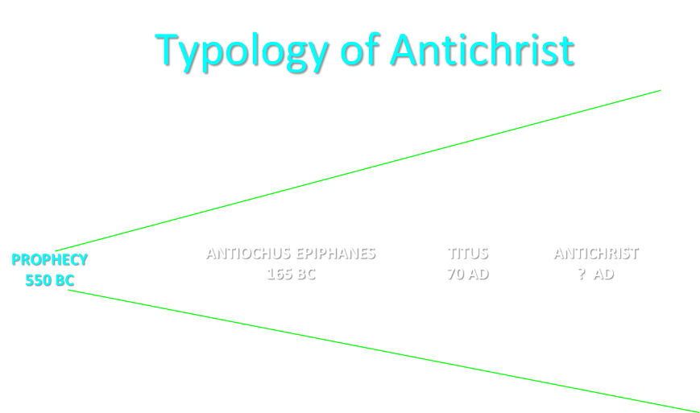

Slide 114


Slide 115
THE STAGE IS BEING SET
Rebirth of Israel in 1948
Israel’s desire for peace
Desire among some Jews to Rebuild 3rd Jewish temple
Desire among some Jews to Restore the sacrificial system
Source: Randall Price “Ready to Rebuild”

Slide 116
THE STAGE IS BEING SET
Rebirth of Israel in 1948
Israel’s desire for peace
Desire among some Jews to Rebuild 3rd Jewish temple
Desire among some Jews to Restore the sacrificial system
Source: Randall Price “Ready to Rebuild”

Slide 117
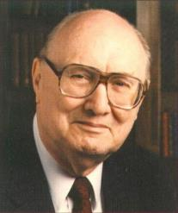
John Walvoord
Israel in Prophecy, Page 26
“Of the many peculiar phenomena which characterize the present generation, few events can claim equal significance as far as Biblical prophecy is concerned with that of the return of Israel to their land. It constitutes a preparation for the end of the age, the setting for the coming of the Lord for His church, and the fulfillment of Israel’s prophetic destiny.”

Slide 118
THE STAGE IS BEING SET
Rebirth of Israel in 1948
Israel’s desire for peace
Desire among some Jews to Rebuild 3rd Jewish temple
Desire among some Jews to Restore the sacrificial system
Source: Randall Price “Ready to Rebuild”

Slide 119
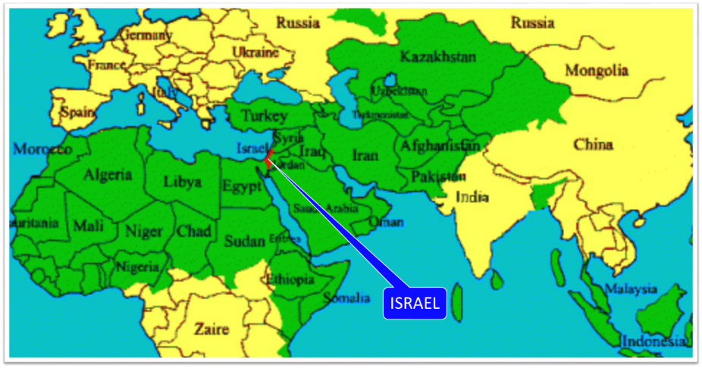

Slide 120
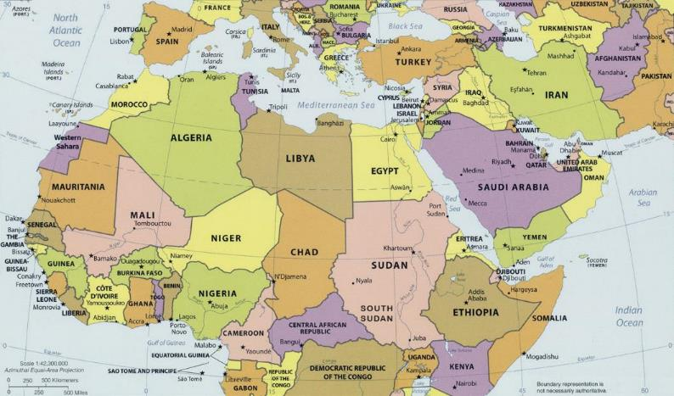
ISRAEL

Slide 121


Slide 122
THE STAGE IS BEING SET
Rebirth of Israel in 1948
Israel’s desire for peace
Desire among some Jews to Rebuild 3rd Jewish temple
Desire among some Jews to Restore the sacrificial system
Source: Randall Price “Ready to Rebuild”

Slide 123
ISRAEL’S FOUR TEMPLES
Solomon’s pre exilic temple (Kings and Chronicles)
Zerubbabel’s post exilic temple (Ezra 1-6; John 2:20)
Antichrist's temple (Dan 9:27; Matt 24:15; 2 Thess 2:4; Rev 11:1-2)
Millennial temple (Ezek 40-48)

Slide 124
ISRAEL’S FOUR TEMPLES
Solomon’s pre exilic temple (Kings and Chronicles)
Zerubbabel’s post exilic temple (Ezra 1-6; John 2:20)
Antichrist's temple (Dan 9:27; Matt 24:15; 2 Thess 2:4; Rev 11:1-2)
Millennial temple (Ezek 40-48)

Slide 126


Slide 127
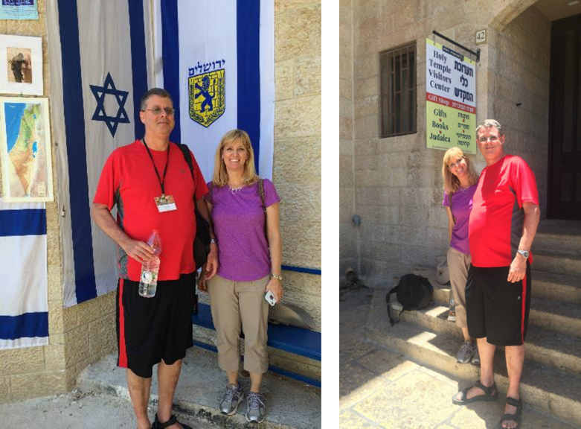

Slide 128
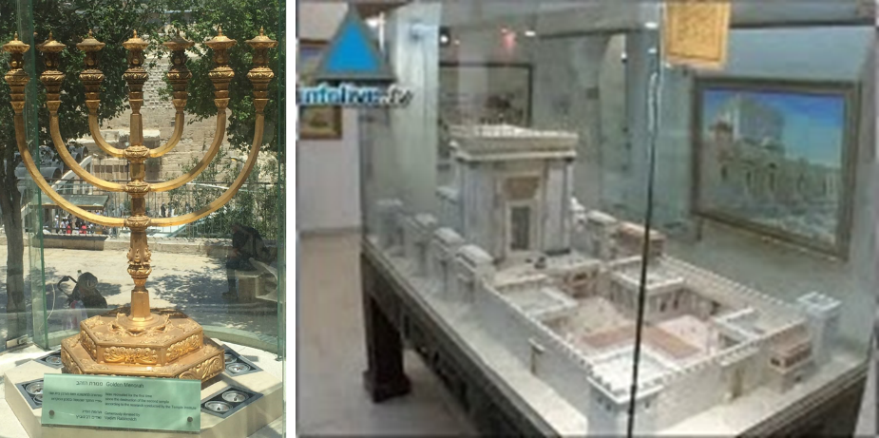

Slide 129
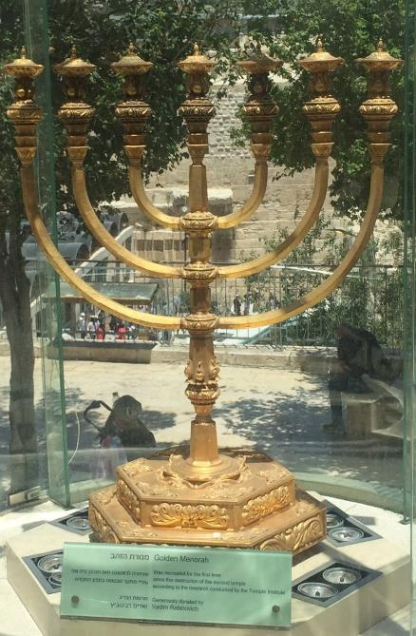

Slide 130
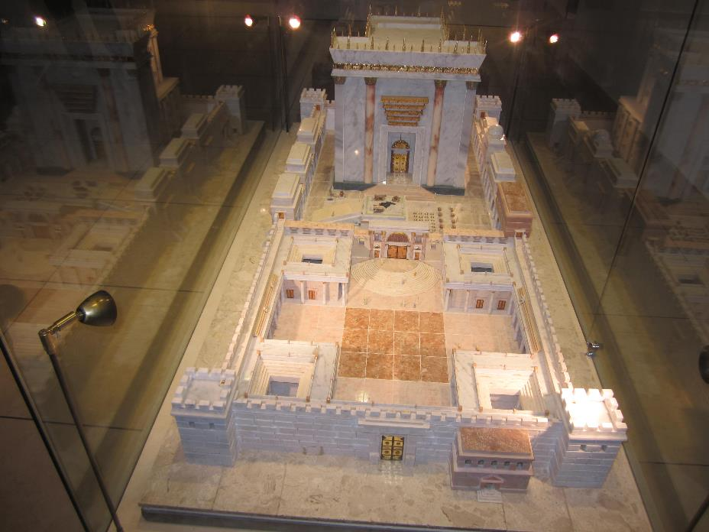

Slide 131
THE STAGE IS BEING SET
Rebirth of Israel in 1948
Israel’s desire for peace
Desire among some Jews to Rebuild 3rd Jewish temple
Desire among some Jews to Restore the sacrificial system
Source: Randall Price “Ready to Rebuild”

Slide 132
The Times of Israel
April 6, 2017
In first, sheep slaughtered in Jerusalem Old City in reenactment of Passover sacrifice
“With priests blowing silver trumpets, a group of religious Jews slaughtered a sheep on Thursday in Jerusalem’s Old City to demonstrate the traditional paschal sacrifice, the first time such a reenactment has been held inside the city walls in 2,000 years.”
http://www.timesofisrael.com/in-a-first-sheep-slaughtered-in-jerusalem-old-city-in-reenactment-of-passover-sacrifice/#comments

Slide 133
The Seventy Weeks Prophecy 10 FACTS
Focus = Jews & Jerusalem (v.24b)
490 year period of time (v.24a)
360-day years
6 prophecies WILL BE fulfilled (v.24c)
March 5, 444 BC prophecy begins (25a)
483 years elapse between beginning of prophecy & Palm Sunday (25b)
Gap between 483rd & 484th year (26)
Final 7 years = future Tribulation period (27)
Dan. 9:27 Overview of Tribulation
Daniel 9:27 = Revelation 6-19

Slide 134
Daniel 9:27 (NASB)
And he will make a firm covenant with the many for one week, but in the middle of the week he will put a stop to sacrifice and grain offering; and on the wing of abominations will come one who makes desolate, even until a complete destruction, one that is decreed, is poured out on the one who makes desolate.

Slide 135
DANIEL 9:27 = REVELATION 6-19
Rebuilt temple (Rev. 11:1-2)
Division of the Tribulation into two 3½ year periods (Rev. 11:2. 13:5, 11:3, 12:6, 14)
Antichrist (Rev. 13:1-10)
Destruction of Antichrist (Rev. 19:20)
2nd Coming (Rev. 19:11-21)

Slide 137


Slide 138


Slide 139
Conclusion

Slide 140
The Seventy Weeks Prophecy 10 FACTS
Focus = Jews & Jerusalem (v.24b)
490 year period of time (v.24a)
360-day years
6 prophecies WILL BE fulfilled (v.24c)
March 5, 444 BC prophecy begins (25a)
483 years elapse between beginning of prophecy & Palm Sunday (25b)
Gap between 483rd & 484th year (26)
Final 7 years = future Tribulation period (27)
Dan. 9:27 Overview of Tribulation
Daniel 9:27 = Revelation 6-19

Slide 141
Chapter 9 Outline
The Setting (1-2)
Daniel’s prayer (3-19)
Gabriel’s arrival (20-23)
The Seventy Weeks Prophecy (24-27)

