Slide 1
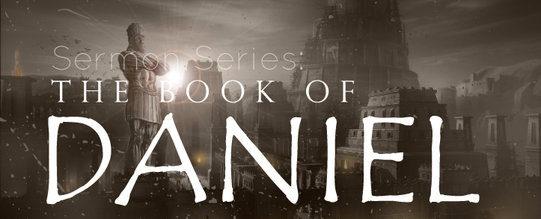
THE BOOK OF DANIEL
Andy Woods, Th.M.., JD., PhD.
Sr. Pastor, Sugar Land Bible Church
President Chafer Theological Seminary

Slide 2
Chapter 9 Outline
The Setting (1-2)
Daniel’s prayer (3-19)
Gabriel’s arrival (20-23)
The Seventy Weeks Prophecy (24-27)

Slide 3
The Seventy Weeks Prophecy 10 FACTS
Focus = Jews & Jerusalem (v.24b)
490 year period of time (v.24a)
360-day years
6 prophecies WILL BE fulfilled (v.24c)
March 5, 444 BC prophecy begins (25a)
483 years elapse between beginning of prophecy & Palm Sunday (25b)
Gap between 483rd & 484th year (26)
Final 7 years = future Tribulation period (27)
Dan. 9:27 Overview of Tribulation
Daniel 9:27 = Revelation 6-19

Slide 4
The Seventy Weeks Prophecy 10 FACTS
Focus = Jews & Jerusalem (v.24b)
490 year period of time (v.24a)
360-day years
6 prophecies WILL BE fulfilled (v.24c)
March 5, 444 BC prophecy begins (25a)
483 years elapse between beginning of prophecy & Palm Sunday (25b)
Gap between 483rd & 484th year (26)
Final 7 years = future Tribulation period (27)
Dan. 9:27 Overview of Tribulation
Daniel 9:27 = Revelation 6-19

Slide 5
Daniel 9:24 (NASB)
Seventy weeks have been decreed for your people and your holy city, to finish the transgression, to make an end of sin, to make atonement for iniquity, to bring in everlasting righteousness, to seal up vision and prophecy and to anoint the most holy place.

Slide 6
The Seventy Weeks Prophecy 10 FACTS
Focus = Jews & Jerusalem (v.24b)
490 year period of time (v.24a)
360-day years
6 prophecies WILL BE fulfilled (v.24c)
March 5, 444 BC prophecy begins (25a)
483 years elapse between beginning of prophecy & Palm Sunday (25b)
Gap between 483rd & 484th year (26)
Final 7 years = future Tribulation period (27)
Dan. 9:27 Overview of Tribulation
Daniel 9:27 = Revelation 6-19

Slide 7
Daniel 9:24 (NASB)
Seventy weeks have been decreed for your people and your holy city, to finish the transgression, to make an end of sin, to make atonement for iniquity, to bring in everlasting righteousness, to seal up vision and prophecy and to anoint the most holy place.

Slide 9
The Seventy Weeks Prophecy 10 FACTS
Focus = Jews & Jerusalem (v.24b)
490 year period of time (v.24a)
360-day years
6 prophecies WILL BE fulfilled (v.24c)
March 5, 444 BC prophecy begins (25a)
483 years elapse between beginning of prophecy & Palm Sunday (25b)
Gap between 483rd & 484th year (26)
Final 7 years = future Tribulation period (27)
Dan. 9:27 Overview of Tribulation
Daniel 9:27 = Revelation 6-19

Slide 10
360-day YEARS
TRIBULATION
Rev. 11:3 (1260 days)
Rev. 11:2 (42 months)
1260 days / 42 months = 30 days per month
30 days x 12 months = 360 days per year
THE FLOOD
Gen. 7:24 (150 days)
Gen. 7:11; 8:4 (5 months)
150 days / 5 months = 30 days per month
30 days x 12 months = 360 days per year

Slide 11
The Seventy Weeks Prophecy 10 FACTS
Focus = Jews & Jerusalem (v.24b)
490 year period of time (v.24a)
360-day years
6 prophecies WILL BE fulfilled (v.24c)
March 5, 444 BC prophecy begins (25a)
483 years elapse between beginning of prophecy & Palm Sunday (25b)
Gap between 483rd & 484th year (26)
Final 7 years = future Tribulation period (27)
Dan. 9:27 Overview of Tribulation
Daniel 9:27 = Revelation 6-19

Slide 12
6 Prophecies WILL BE fulfilled V.24c
“to finish transgression”
“to make an end of sin”
“to make atonement for iniquity”
“to bring in everlasting righteousness”
“to seal up vision and prophecy”
“to anoint the most holy place”
Arnold Fructenbaum, Footsteps of the Messiah, p.191-4

Slide 13
The Seventy Weeks Prophecy 10 FACTS
Focus = Jews & Jerusalem (v.24b)
490 year period of time (v.24a)
360-day years
6 prophecies WILL BE fulfilled (v.24c)
March 5, 444 BC prophecy begins (25a)
483 years elapse between beginning of prophecy & Palm Sunday (25b)
Gap between 483rd & 484th year (26)
Final 7 years = future Tribulation period (27)
Dan. 9:27 Overview of Tribulation
Daniel 9:27 = Revelation 6-19

Slide 14
Daniel 9:25 (NASB)
So you are to know and discern that from the issuing of a decree to restore and rebuild Jerusalem until Messiah the Prince there will be seven weeks and sixty-two weeks; it will be built again, with plaza and moat, even in times of distress.

Slide 15
Nehemiah 2:1 (NASB)
And it came about in the month Nisan, in the twentieth year of King Artaxerxes, that wine was before him, and I took up the wine and gave it to the king. Now I had not been sad in his presence.

Slide 16
The Seventy Weeks Prophecy 10 FACTS
Focus = Jews & Jerusalem (v.24b)
490 year period of time (v.24a)
360-day years
6 prophecies WILL BE fulfilled (v.24c)
March 5, 444 BC prophecy begins (25a)
483 years elapse between beginning of prophecy & Palm Sunday (25b)
Gap between 483rd & 484th year (26)
Final 7 years = future Tribulation period (27)
Dan. 9:27 Overview of Tribulation
Daniel 9:27 = Revelation 6-19

Slide 17
Daniel 9:25 (NASB)
So you are to know and discern that from the issuing of a decree to restore and rebuild Jerusalem until Messiah the Prince there will be seven weeks and sixty-two weeks; it will be built again, with plaza and moat, even in times of distress.

Slide 18
Messiah must present Himself to Israel on March 30, A.D. 33 (Daniel 9:25)

Slide 19
The Seventy Weeks Prophecy 10 FACTS
Focus = Jews & Jerusalem (v.24b)
490 year period of time (v.24a)
360-day years
6 prophecies WILL BE fulfilled (v.24c)
March 5, 444 BC prophecy begins (25a)
483 years elapse between beginning of prophecy & Palm Sunday (25b)
Gap between 483rd & 484th year (26)
Final 7 years = future Tribulation period (27)
Dan. 9:27 Overview of Tribulation
Daniel 9:27 = Revelation 6-19

Slide 21
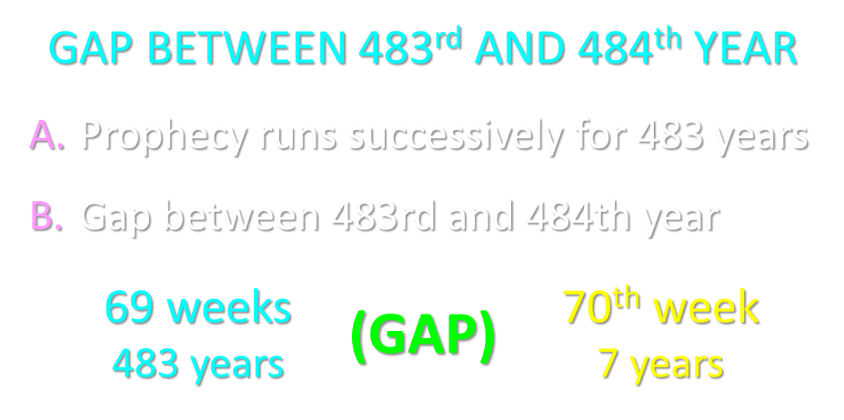

Slide 23
6 Reasons for Gap
Events prophesied v.26
Messiah crucified v.26a
70 AD holocaust v.26b
Prophecies in Dan. 9:24 would have been fulfilled 7 years after Palm Sunday
Jesus indicated a gap - (Matt. 24:15, 21-22, 29-30)
Daniel 9:27 was never fulfilled historically
Gap occurs elsewhere - (Is. 61:1-2; Luke 4:16-21; Isaiah 9:6)
Early church fathers indicated a gap

Slide 24
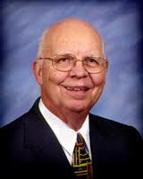
Purposes of the Local Church
Glorify God (Eph 3:21)
Edify the saints (Eph 4:11-16)
Fulfill the Great Commission (Matt 28:18-20)

Slide 25
The Seventy Weeks Prophecy 10 FACTS
Focus = Jews & Jerusalem (v.24b)
490 year period of time (v.24a)
360-day years
6 prophecies WILL BE fulfilled (v.24c)
March 5, 444 BC prophecy begins (25a)
483 years elapse between beginning of prophecy & Palm Sunday (25b)
Gap between 483rd & 484th year (26)
Final 7 years = future Tribulation period (27)
Dan. 9:27 Overview of Tribulation
Daniel 9:27 = Revelation 6-19

Slide 26
FINAL 7 YEARS = FUTURE TRIBULATION v.27
490 years total
483 years have transpired
7 years remain
Gap exists between 483rd & 484th year
Final 7 years are future
Final 7 years are the Tribulation period

Slide 27
FINAL 7 YEARS = FUTURE TRIBULATION v.27
490 years total
483 years have transpired
7 years remain
Gap exists between 483rd & 484th year
Final 7 years are future
Final 7 years are the Tribulation period

Slide 28
FINAL 7 YEARS = FUTURE TRIBULATION v.27
490 years total
483 years have transpired
7 years remain
Gap exists between 483rd & 484th year
Final 7 years are future
Final 7 years are the Tribulation period

Slide 29
FINAL 7 YEARS = FUTURE TRIBULATION v.27
490 years total
483 years have transpired
7 years remain
Gap exists between 483rd & 484th year
Final 7 years are future
Final 7 years are the Tribulation period

Slide 30
FINAL 7 YEARS = FUTURE TRIBULATION v.27
490 years total
483 years have transpired
7 years remain
Gap exists between 483rd & 484th year
Final 7 years are future
Final 7 years are the Tribulation period

Slide 31
FINAL 7 YEARS = FUTURE TRIBULATION v.27
490 years total
483 years have transpired
7 years remain
Gap exists between 483rd & 484th year
Final 7 years are future
Final 7 years are the Tribulation period

Slide 32
FINAL 7 YEARS = FUTURE TRIBULATION v.27
490 years total
483 years have transpired
7 years remain
Gap exists between 483rd & 484th year
Final 7 years are future
Final 7 years are the Tribulation period

Slide 33
The Seventy Weeks Prophecy 10 FACTS
Focus = Jews & Jerusalem (v.24b)
490 year period of time (v.24a)
360-day years
6 prophecies WILL BE fulfilled (v.24c)
March 5, 444 BC prophecy begins (25a)
483 years elapse between beginning of prophecy & Palm Sunday (25b)
Gap between 483rd & 484th year (26)
Final 7 years = future Tribulation period (27)
Dan. 9:27 Overview of Tribulation
Daniel 9:27 = Revelation 6-19

Slide 34
Daniel 9:27 (NASB)
And he will make a firm covenant with the many for one week, but in the middle of the week he will put a stop to sacrifice and grain offering; and on the wing of abominations will come one who makes desolate, even until a complete destruction, one that is decreed, is poured out on the one who makes desolate.

Slide 35
Daniel 9:27 = Tribulation Overview
Duration = 7 years
Starts = Peace Treaty
Mid-point = Temple Desecration
Conclude = Second Advent

Slide 36
Daniel 9:27 = Tribulation Overview
Duration = 7 years
Starts = Peace Treaty
Mid-point = Temple Desecration
Conclude = Second Advent

Slide 37
Daniel 9:27 (NASB)
And he will make a firm covenant with the many for one week, but in the middle of the week he will put a stop to sacrifice and grain offering; and on the wing of abominations will come one who makes desolate, even until a complete destruction, one that is decreed, is poured out on the one who makes desolate.

Slide 38
490 YEAR PERIOD OF TIME v.24a
“A Week of Years”
Daniel 9:1-2
Genesis 29:27
70 x 7 = 490

Slide 40
Daniel 9:27 = Tribulation Overview
Duration = 7 years
Starts = Peace Treaty
Mid-point = Temple Desecration
Conclude = Second Advent

Slide 42
Daniel 9:27 (NASB)
And he will make a firm covenant with the many for one week, but in the middle of the week he will put a stop to sacrifice and grain offering; and on the wing of abominations will come one who makes desolate, even until a complete destruction, one that is decreed, is poured out on the one who makes desolate.

Slide 43
Daniel 9:27 (NASB)
And he will make a firm covenant with the many for one week, but in the middle of the week he will put a stop to sacrifice and grain offering; and on the wing of abominations will come one who makes desolate, even until a complete destruction, one that is decreed, is poured out on the one who makes desolate.

Slide 44
Daniel 9:26 (NASB)
Then after the sixty-two weeks the Messiah will be cut off and have nothing, and the people of the prince who is to come will destroy the city and the sanctuary. And its end will come with a flood; even to the end there will be war; desolations are determined.

Slide 45
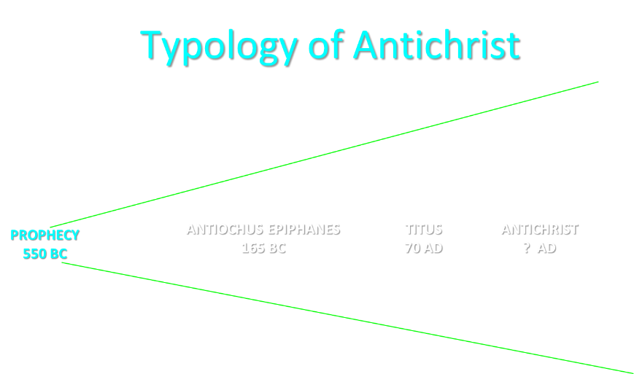

Slide 46
Daniel 9:27 (NASB)
And he will make a firm covenant with the many for one week, but in the middle of the week he will put a stop to sacrifice and grain offering; and on the wing of abominations will come one who makes desolate, even until a complete destruction, one that is decreed, is poured out on the one who makes desolate.

Slide 47
Daniel 7:25 (NASB)
He will speak out against the Most High and wear down the saints of the Highest One, and he will intend to make alterations in times and in law; and they will be given into his hand for a time, times, and half a time.

Slide 48
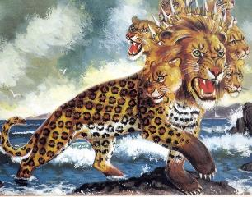
Revelation 13:5 (NASB)
There was given to him a mouth speaking arrogant words and blasphemies, and authority to act for forty-two months was given to him.

Slide 49
Daniel 9:27 (NASB)
And he will make a firm covenant with the many for one week, but in the middle of the week he will put a stop to sacrifice and grain offering; and on the wing of abominations will come one who makes desolate, even until a complete destruction, one that is decreed, is poured out on the one who makes desolate.

Slide 50
2 Thessalonians 2:3-4 (NASB)
Let no one in any way deceive you, for it will not come unless the apostasy comes first, and the man of lawlessness is revealed, the son of destruction, who opposes and exalts himself above every so-called god or object of worship, so that he takes his seat in the temple of God, displaying himself as being God.

Slide 51
Daniel 9:27 (NASB)
And he will make a firm covenant with the many for one week, but in the middle of the week he will put a stop to sacrifice and grain offering; and on the wing of abominations will come one who makes desolate, even until a complete destruction, one that is decreed, is poured out on the one who makes desolate.

Slide 52
2 Thessalonians 2:8 (NASB)
Then that lawless one will be revealed whom the Lord will slay with the breath of His mouth and bring to an end by the appearance of His coming.

Slide 53
Revelation 19:20 (NASB)
And the beast was seized, and with him the false prophet who performed the signs in his presence, by which he deceived those who had received the mark of the beast and those who worshiped his image; these two were thrown alive into the lake of fire which burns with brimstone.

Slide 54
Daniel 9:27 (NASB)
And he will make a firm covenant with the many for one week, but in the middle of the week he will put a stop to sacrifice and grain offering; and on the wing of abominations will come one who makes desolate, even until a complete destruction, one that is decreed, is poured out on the one who makes desolate.

Slide 55
The Seventy Weeks Prophecy 10 FACTS
Focus = Jews & Jerusalem (v.24b)
490 year period of time (v.24a)
360-day years
6 prophecies WILL BE fulfilled (v.24c)
March 5, 444 BC prophecy begins (25a)
483 years elapse between beginning of prophecy & Palm Sunday (25b)
Gap between 483rd & 484th year (26)
Final 7 years = future Tribulation period (27)
Dan. 9:27 Overview of Tribulation
Daniel 9:27 = Revelation 6-19

Slide 56
Daniel 9:24 (NASB)
Seventy weeks have been decreed for your people and your holy city, to finish the transgression, to make an end of sin, to make atonement for iniquity, to bring in everlasting righteousness, to seal up vision and prophecy and to anoint the most holy place.

Slide 57
Daniel 11:33 (NASB)
Those who have insight among the people will give understanding to the many; yet they will fall by sword and by flame, by captivity and by plunder for many days.

Slide 58
Daniel 9:27 (NASB)
And he will make a firm covenant with the many for one week, but in the middle of the week he will put a stop to sacrifice and grain offering; and on the wing of abominations will come one who makes desolate, even until a complete destruction, one that is decreed, is poured out on the one who makes desolate.

Slide 61
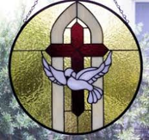
2 Thessalonians 2:6-7 (NASB)
⁶And you know what restrains [katechō; neuter] him now, so that in his time he will be revealed. ⁷For the mystery of lawlessness is already at work; only he who now restrains [katechō; masculine] will do so until he is taken out of the way.

Slide 62
John 14:16-17 (NASB)
¹⁶ I will ask the Father, and He will give you another Helper, that He may be with you forever; ¹⁷ that is the Spirit of truth, whom the world cannot receive, because it does not see Him or know Him, but you know Him because He abides with you and will be in you.

Slide 63
Guessing the Identity of the Antichrist?
“We will not, however, incur the risk of pronouncing positively as to the name of Antichrist. But if it had been necessary to announce his name plainly at the present time, it would have been spoken by him who saw the apocalypse. For it was not seen long ago, but almost in our own time, at the end of the reign of Domitian.”
Irenaeus Against Heresies 5.30.3

Slide 64
Daniel 9:27 = Tribulation Overview
Duration = 7 years
Starts = Peace Treaty
Mid-point = Temple Desecration
Conclude = Second Advent

Slide 65
Daniel 9:27 (NASB)
And he will make a firm covenant with the many for one week, but in the middle of the week he will put a stop to sacrifice and grain offering; and on the wing of abominations will come one who makes desolate, even until a complete destruction, one that is decreed, is poured out on the one who makes desolate.

Slide 66
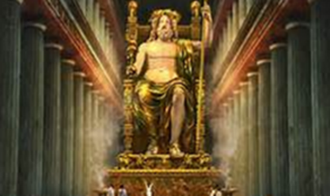
Daniel 11:31 (NASB)
Forces from him will arise, desecrate the sanctuary fortress, and do away with the regular sacrifice. And they will set up the abomination of desolation.

Slide 67
HANUKKAH
The Maccabean revolt
December 25th 165 BC : the temple is liberated and rededicated
1 & 2 Maccabees
The miracle of the lamp oil
Hanukkah “Feast of Dedication” (festival of lights).
Christmas / Jewish Holiday
John 10:22-24

Slide 68
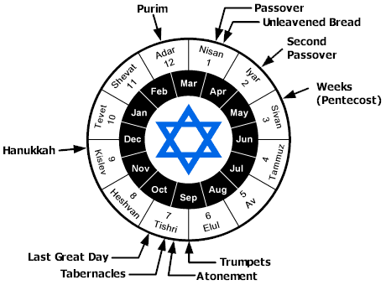

Slide 70
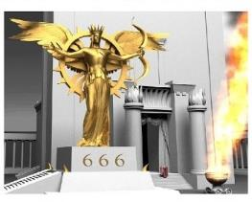
Revelation 13:15 (NASB)
And it was given to him to give breath to the image of the beast, so that the image of the beast would even speak and cause as many as do not worship the image of the beast to be killed.

Slide 71
Daniel 12:7 (NASB)
I heard the man dressed in linen, who was above the waters of the river, as he raised his right hand and his left toward heaven, and swore by Him who lives forever that it would be for a time, times, and half a time; and as soon as they finish shattering the power of the holy people, all these events will be completed.

Slide 72
Daniel 9:27 (NASB)
And he will make a firm covenant with the many for one week, but in the middle of the week he will put a stop to sacrifice and grain offering; and on the wing of abominations will come one who makes desolate, even until a complete destruction, one that is decreed, is poured out on the one who makes desolate.

Slide 74
Daniel 9:27 = Tribulation Overview
Duration = 7 years
Starts = Peace Treaty
Mid-point = Temple Desecration
Conclude = Second Advent

Slide 75
Daniel 9:27 (NASB)
And he will make a firm covenant with the many for one week, but in the middle of the week he will put a stop to sacrifice and grain offering; and on the wing of abominations will come one who makes desolate, even until a complete destruction, one that is decreed, is poured out on the one who makes desolate.

Slide 76
2 Thessalonians 2:8 (NASB)
Then that lawless one will be revealed whom the Lord will slay with the breath of His mouth and bring to an end by the appearance of His coming.

Slide 77
Revelation 19:20 (NASB)
And the beast was seized, and with him the false prophet who performed the signs in his presence, by which he deceived those who had received the mark of the beast and those who worshiped his image; these two were thrown alive into the lake of fire which burns with brimstone.

Slide 78
The Seventy Weeks Prophecy 10 FACTS
Focus = Jews & Jerusalem (v.24b)
490 year period of time (v.24a)
360-day years
6 prophecies WILL BE fulfilled (v.24c)
March 5, 444 BC prophecy begins (25a)
483 years elapse between beginning of prophecy & Palm Sunday (25b)
Gap between 483rd & 484th year (26)
Final 7 years = future Tribulation period (27)
Dan. 9:27 Overview of Tribulation
Daniel 9:27 = Revelation 6-19

Slide 79
Daniel 9:24 (NASB)
Seventy weeks have been decreed for your people and your holy city, to finish the transgression, to make an end of sin, to make atonement for iniquity, to bring in everlasting righteousness, to seal up vision and prophecy and to anoint the most holy place.

Slide 81
Daniel 9:27 = Tribulation Overview
Duration = 7 years
Starts = Peace Treaty
Mid-point = Temple Desecration
Conclude = Second Advent

Slide 83
THE STAGE IS BEING SET
Rebirth of Israel in 1948
Israel’s desire for peace
Desire among some Jews to Rebuild 3rd Jewish temple
Desire among some Jews to Restore the sacrificial system

Slide 84
THE STAGE IS BEING SET
Rebirth of Israel in 1948
Israel’s desire for peace
Desire among some Jews to Rebuild 3rd Jewish temple
Desire among some Jews to Restore the sacrificial system

Slide 85
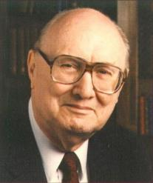
John Walvoord Israel in Prophecy, Page 26
“Of the many peculiar phenomena which characterize the present generation, few events can claim equal significance as far as Biblical prophecy is concerned with that of the return of Israel to their land. It constitutes a preparation for the end of the age, the setting for the coming of the Lord for His church, and the fulfillment of Israel’s prophetic destiny.”

Slide 86
THE STAGE IS BEING SET
Rebirth of Israel in 1948
Israel’s desire for peace
Desire among some Jews to Rebuild 3rd Jewish temple
Desire among some Jews to Restore the sacrificial system

Slide 87
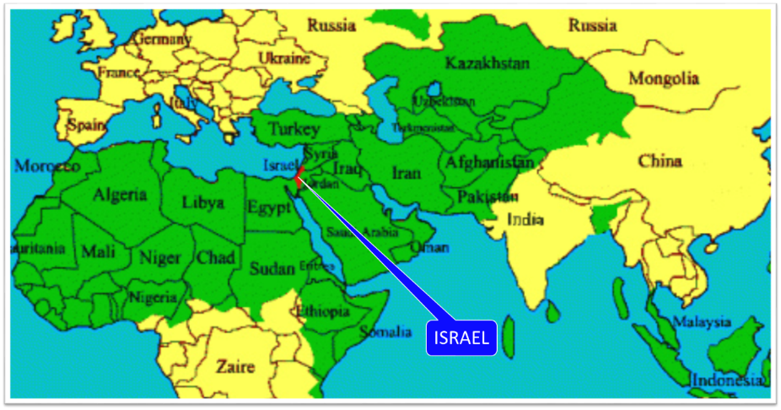

Slide 88
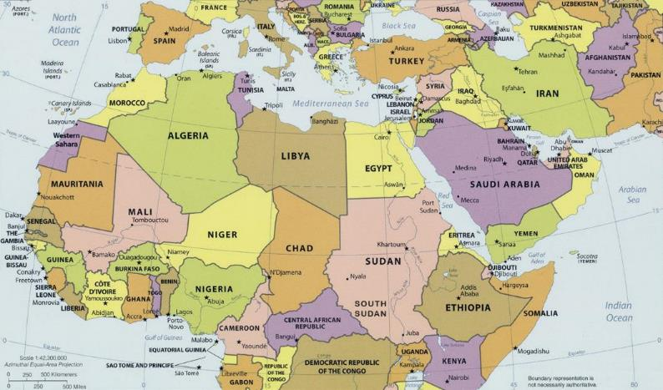
ISRAEL

Slide 89
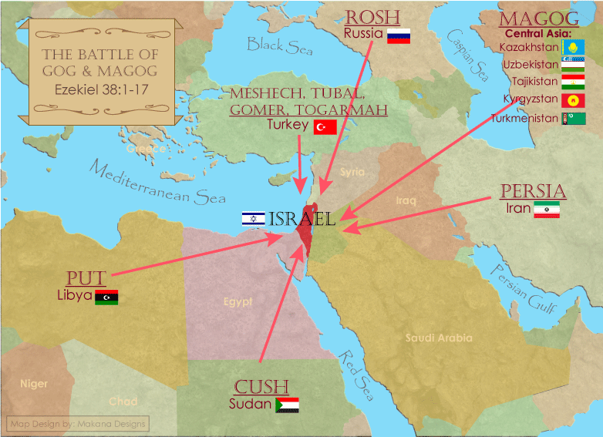

Slide 90
THE STAGE IS BEING SET
Rebirth of Israel in 1948
Israel’s desire for peace
Desire among some Jews to Rebuild 3rd Jewish temple
Desire among some Jews to Restore the sacrificial system

Slide 91
ISRAEL’S FOUR TEMPLES
Solomon’s pre exilic temple (Kings and Chronicles)
Zerubbabel’s post exilic temple (Ezra 1-6; John 2:20)
Antichrist's temple (Dan 9:27; Matt 24:15; 2 Thess 2:4; Rev 11:1-2)
Millennial temple (Ezek 40-48)

Slide 92
ISRAEL’S FOUR TEMPLES
Solomon’s pre exilic temple (Kings and Chronicles)
Zerubbabel’s post exilic temple (Ezra 1-6; John 2:20)
Antichrist's temple (Dan 9:27; Matt 24:15; 2 Thess 2:4; Rev 11:1-2)
Millennial temple (Ezek 40-48)

Slide 95
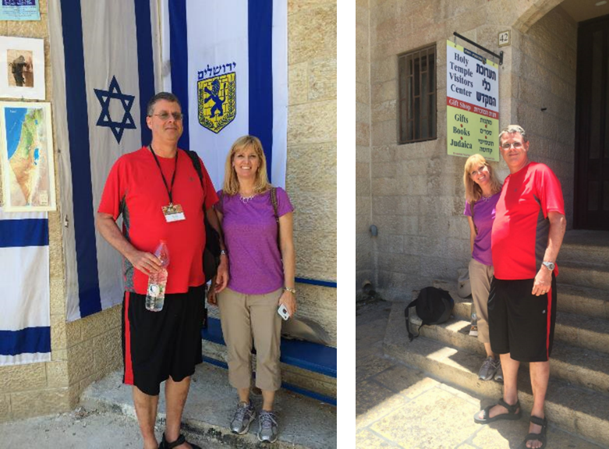

Slide 96
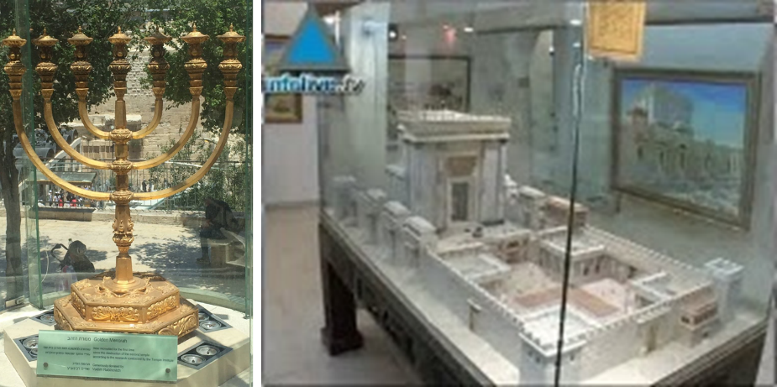

Slide 98
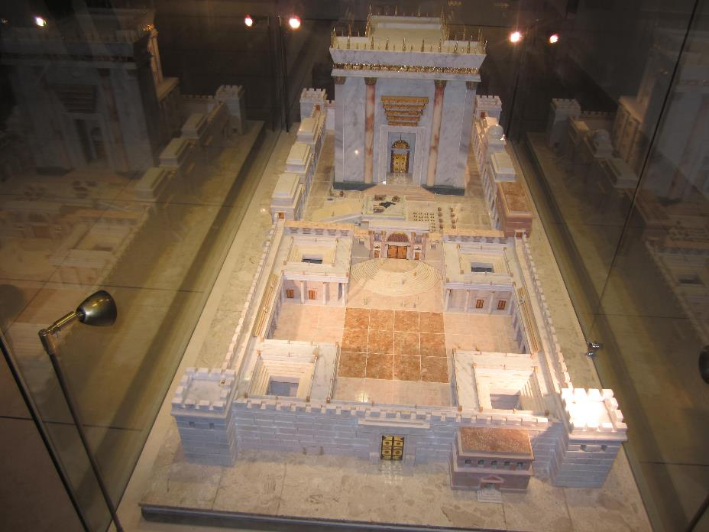

Slide 99
THE STAGE IS BEING SET
Rebirth of Israel in 1948
Israel’s desire for peace
Desire among some Jews to Rebuild 3rd Jewish temple
Desire among some Jews to Restore the sacrificial system

Slide 100
The Times of Israel April 6, 2017 In first, sheep slaughtered in Jerusalem Old City in reenactment of Passover sacrifice
“With priests blowing silver trumpets, a group of religious Jews slaughtered a sheep on Thursday in Jerusalem’s Old City to demonstrate the traditional paschal sacrifice, the first time such a reenactment has been held inside the city walls in 2,000 years.”
http://www.timesofisrael.com/in-a-first-sheep-slaughtered-in-jerusalem-old-city-in-reenactment-of-passover-sacrifice/#comments

Slide 101
THE STAGE IS BEING SET
Rebirth of Israel in 1948
Israel’s desire for peace
Desire among some Jews to Rebuild 3rd Jewish temple
Desire among some Jews to Restore the sacrificial system

Slide 102
The Seventy Weeks Prophecy 10 FACTS
Focus = Jews & Jerusalem (v.24b)
490 year period of time (v.24a)
360-day years
6 prophecies WILL BE fulfilled (v.24c)
March 5, 444 BC prophecy begins (25a)
483 years elapse between beginning of prophecy & Palm Sunday (25b)
Gap between 483rd & 484th year (26)
Final 7 years = future Tribulation period (27)
Dan. 9:27 Overview of Tribulation
Daniel 9:27 = Revelation 6-19

Slide 103
Daniel 9:27 (NASB)
And he will make a firm covenant with the many for one week, but in the middle of the week he will put a stop to sacrifice and grain offering; and on the wing of abominations will come one who makes desolate, even until a complete destruction, one that is decreed, is poured out on the one who makes desolate.

Slide 104
DANIEL 9:27 = REVELATION 6-19
Rebuilt temple (Rev. 11:1-2)
Division of the Tribulation into two 3½ year periods (Rev. 11:2. 13:5, 11:3, 12:6, 14)
Antichrist (Rev. 13:1-10)
Destruction of Antichrist (Rev. 19:20)
2nd Coming (Rev. 19:11-21)

Slide 108
Conclusion

Slide 109
The Seventy Weeks Prophecy 10 FACTS
Focus = Jews & Jerusalem (v.24b)
490 year period of time (v.24a)
360-day years
6 prophecies WILL BE fulfilled (v.24c)
March 5, 444 BC prophecy begins (25a)
483 years elapse between beginning of prophecy & Palm Sunday (25b)
Gap between 483rd & 484th year (26)
Final 7 years = future Tribulation period (27)
Dan. 9:27 Overview of Tribulation
Daniel 9:27 = Revelation 6-19

Slide 110
Chapter 9 Outline
The Setting (1-2)
Daniel’s prayer (3-19)
Gabriel’s arrival (20-23)
The Seventy Weeks Prophecy (24-27)

