Slide 1
The Protestant Reformation: The Good, The Bad, and The Ugly Session 13
Andy Woods, Th.M.., JD., PhD.
Sr. Pastor, Sugar Land Bible Church
President Chafer Theological Seminary

Slide 2
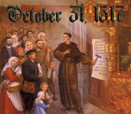
Introduction
Oct 31, 1517
500 years
Far reaching impact
Partial restoration
Restoration of a hermeneutic
Selectively applied
Subsequent generations applied consistently
Preview

Slide 3
Overview
The early church
The Alexandrian eclipse
The Dark Ages
The contribution of the Protestant Reformers
The Reformers’ incomplete revolution
Reformed Theology today
Dispensationalism & the completed revolution
Looking back 500 years later
Notes:
Outline

Slide 4
Overview
THE EARLY CHURCH
The Alexandrian eclipse
The Dark Ages
The contribution of the Protestant Reformers
The Reformers’ incomplete revolution
Reformed Theology today
Dispensationalism & the completed revolution
Looking back 500 years later
Notes:
Outline

Slide 5
Overview
The early church
THE ALEXANDRIAN ECLIPSE
The Dark Ages
The contribution of the Protestant Reformers
The Reformers’ incomplete revolution
Reformed Theology today
Dispensationalism & the completed revolution
Looking back 500 years later
Notes:
Outline

Slide 6
Overview
The early church
The Alexandrian eclipse
THE DARK AGES
The contribution of the Protestant Reformers
The Reformers’ incomplete revolution
Reformed Theology today
Dispensationalism & the completed revolution
Looking back 500 years later
Notes:
Outline

Slide 7
Overview
The early church
The Alexandrian eclipse
The Dark Ages
THE CONTRIBUTION OF THE PROTESTANT REFORMERS
The Reformers’ incomplete revolution
Reformed Theology today
Dispensationalism & the completed revolution
Looking back 500 years later
Notes:
Outline

Slide 8
Overview
The early church
The Alexandrian eclipse
The Dark Ages
The Contribution of the Protestant Reformers
THE REFORMERS’ INCOMPLETE REVOLUTION
Reformed Theology today
Dispensationalism & the completed revolution
Looking back 500 years later
Notes:
Outline

Slide 9
Overview
The early church
The Alexandrian eclipse
The Dark Ages
The contribution of the Protestant Reformers
The Reformers’ incomplete revolution
REFORMED THEOLOGY TODAY
Dispensationalism & the completed revolution
Looking back 500 years later
Notes:
Outline

Slide 10
William Hendriksen
WM. Hendriksen – Baker Book House – 1967 – Chapter 9 - p.174
“The expression ‘a time, and times, and half a time’ occurs first in the book of Daniel 7:25; 12:7. It is the period of the antichrist. Now, John emphasizes the fact that the spirit of the antichrist is in the world already, 1 John 4:3. Hence, in the Apocalypse this period of three years and a half refers to the entire gospel age.”

Slide 11
William Hendriksen
WM. Hendriksen – Baker Book House – 1967 – Chapter 14 - p.226
“Hence, in close harmony with all these Scriptural passages – and our exegesis must always be based upon the authority of Scripture! – we conclude that also here in Rev. 20:1-3 the binding of Satan and the fact that he is hurled into the abyss to remain there for a thousand years indicates that throughout this present Gospel Age, which begins with Christ’s first coming and extends nearly to the second coming, the devil’s influence on earth is curtailed so that he is unable to prevent the extension of the church among the nations by the means of an active missionary program. During this entire period he is prevented from causing the nations – the world in general – to destroy the church as a mighty missionary institution.”

Slide 12
Overview
The early church
The Alexandrian eclipse
The Dark Ages
The Contribution of the Protestant Reformers
The Reformers’ Incomplete Revolution
Reformed Theology Today
DISPENSATIONALISM & THE COMPLETED REVOLUTION
Looking back 500 years later
Notes:
Outline

Slide 13
VII. Dispensationalism & the Completed Revolution
Reformed movement
Dispensational movement
Notes:
Outline

Slide 14
VII. Dispensationalism & the Completed Revolution
Reformed movement
Dispensational movement
Notes:
Outline

Slide 15
VII. Dispensationalism & the Completed Revolution
Reformed movement
16th century
Right hermeneutic
Applied to some of the Bible
Retrieved the solas
Notes:
Outline

Slide 16
VII. Dispensationalism & the Completed Revolution
Reformed movement
16th century
Right hermeneutic
Applied to some of the Bible
Retrieved the solas
Notes:
Outline

Slide 17
VII. Dispensationalism & the Completed Revolution
Reformed movement
16th century
Right hermeneutic
Applied to some of the Bible
Retrieved the solas
Notes:
Outline

Slide 18
VII. Dispensationalism & the Completed Revolution
Reformed movement
16th century
Right hermeneutic
Applied to some of the Bible
Retrieved the solas
Notes:
Outline

Slide 19
VII. Dispensationalism & the Completed Revolution
Reformed movement
16th century
Right hermeneutic
Applied to some of the Bible
Retrieved the solas
Notes:
Outline

Slide 20
Number | Latin | Meaning
1. | Sola Scriptura | Scripture Alone
2. | Solus Christus | Christ Alone
3. | Sola Fide | Faith Alone
4. | Sola Graetia | Grace Alone
5. | Soli Deo Gloria | To the Glory of God Alone

Slide 21
VII. Dispensationalism & the Completed Revolution
Reformed movement
Dispensational movement
Notes:
Outline

Slide 22
VII. Dispensationalism & the Completed Revolution
Dispensational movement
19th century
Reformers’ hermeneutic
Applied to the whole bible
Retrieved key doctrines: Chiliasm, Israel-church distinction, Pretribulationalism
Curb on anti-Semitism and Geneva social experiments
Key dispensational leaders
Notes:
Outline

Slide 23
VII. Dispensationalism & the Completed Revolution
Dispensational movement
19th century
Reformers’ hermeneutic
Applied to the whole bible
Retrieved key doctrines: Chiliasm, Israel-church distinction, Pretribulationalism
Curb on anti-Semitism and Geneva social experiments
Key dispensational leaders
Notes:
Outline

Slide 24
VII. Dispensationalism & the Completed Revolution
Dispensational movement
19th century
Reformers’ hermeneutic
Applied to the whole bible
Retrieved key doctrines: Chiliasm, Israel-church distinction, Pretribulationalism
Curb on anti-Semitism and Geneva social experiments
Key dispensational leaders
Notes:
Outline

Slide 25
VII. Dispensationalism & the Completed Revolution
Dispensational movement
19th century
Reformers’ hermeneutic
Applied to the whole bible
Retrieved key doctrines: Chiliasm, Israel-church distinction, Pretribulationalism
Curb on anti-Semitism and Geneva social experiments
Key dispensational leaders
Notes:
Outline

Slide 26
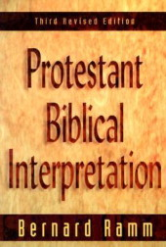
Literal
“A literal hermeneutic attaches to every word the same meaning that it would have in normal usage, whether employed in speaking, writing, or thinking.”
Bernard, Ramm, Protestant Biblical Interpretation (Boston: W.A. Wilde, 1956), 89-92.

Slide 29
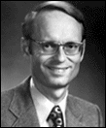
Charles Ryrie Dispensationalism (Chicago: Moody Press, 1965), 86.
Literal interpretation “…might also be called plain interpretation so that no one receives the mistaken notion that the literal principle rules out figures of speech.”

Slide 30
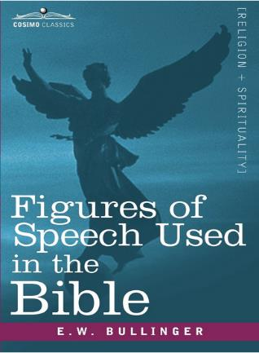
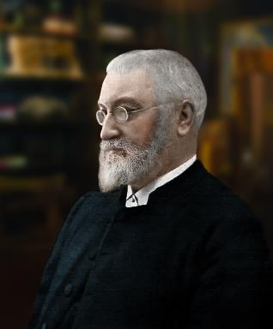
E.W. Bullinger (1837‒1913)

Slide 32
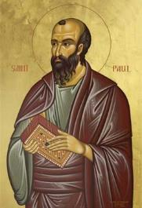
Galatians 4:24
“This is allegorically speaking, for these women are two covenants: one proceeding from Mount Sinai bearing children who are to be slaves; she is Hagar.”

Slide 33
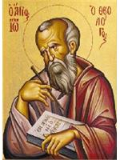
Revelation 11:8
“And their dead bodies will lie in the street of the great city which mystically is called Sodom and Egypt, where also their Lord was crucified.”

Slide 34
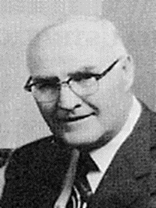
David L. Cooper
The World’s Greatest Library Graphically Illustrated (Los Angeles: Biblical Research Society, 1970), 11.
“When the plain sense of Scripture makes common sense, seek no other sense; therefore, take every word at its primary, ordinary, usual, literal meaning unless the facts of the immediate context, studied in light of related passages and axiomatic and fundamental truths, indicate clearly otherwise.”

Slide 36
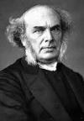
“Probably as valuable a testimony as any that could be offered was given by Dr. Horatius Bonar. When speaking of the results of fifty years of the study of prophecy, he concluded with the statement that first of all, he had gained assurance as to the authority and inspiration of the Scriptures. Secondly, he felt more certain than ever that the literal interpretation of the Word is the best. Said he: ‘literal if possible,' is, I believe the only maxim that will carry you right through the Word of God from Genesis to Revelation.’"
Horatius Bonar (A.D. 1808–1889)
Quoted in Charles L. Feinberg, Millennialism: The Two Major Views (Winona Lake, IN: BMH, 1985), 47-48.

Slide 37
VII. Dispensationalism & the Completed Revolution
Dispensational movement
19th century
Reformers’ hermeneutic
Applied to the whole bible
Retrieved key doctrines: Chiliasm, Israel-church distinction, Pretribulationalism
Curb on anti-Semitism and Geneva social experiments
Key dispensational leaders
Notes:
Outline

Slide 39
Evidence of Abrahamic Covenant’s Unconditional Nature
ANE covenant ratification ceremony (Gen 15)
Lack of stated conditions for Israel’s obedience (Gen 15)
Covenant's eternality (Gen 17:7, 13, 19; Ps. 90:2)
Covenant's immutability (Heb 6:13-18; Mal. 3:6)
Trans-generational reaffirmation despite perpetual national disobedience (Jer 31:35-37)
Walvoord, The Millennial Kingdom, 149-52

Slide 40
Land Promises Fulfilled in the Time of Joshua (Josh. 11:23; 21:43-45) or Solomon (1 Kgs. 4:21)?
Extended context (Josh 13:1-7; Judges 1:19, 21, 27, 29, 30-36)
Land gained in conquest was only a fraction of what was promised (1 Kgs. 4:25)
Jerusalem not conquered in Joshua’s day (Josh 15:63; 2 Sam 5)
Solomon’s reign extended to the border of Egypt (1 Kgs. 4:21) and not the River of Egypt (Gen. 15:18)
Solomon’s reign was tributary only (1 Kgs. 4:21)
Forever? (Gen 17:7-8, 13, 19)
Reaffirmation of land promises long after Joshua and Solomon’s time (Amos 9:11-15)
Fruchtenbaum, Israelology, 521-22, 631-32

Slide 41
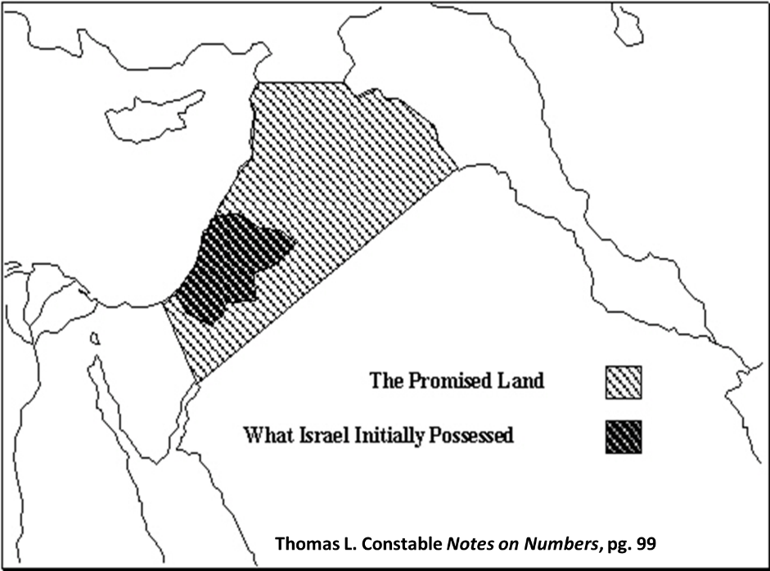

Slide 42
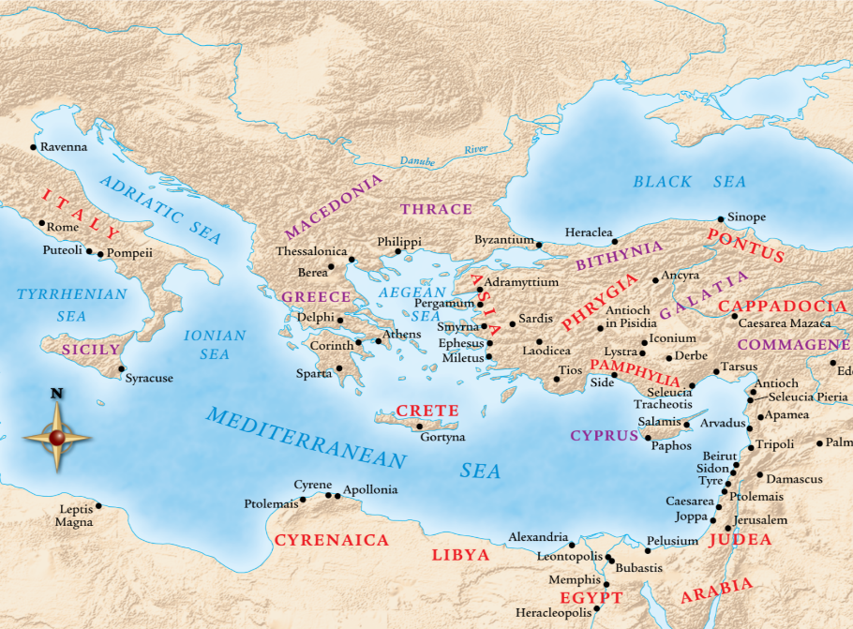

Slide 43
VII. Dispensationalism & the Completed Revolution
Dispensational movement
19th century
Reformers’ hermeneutic
Applied to the whole bible
Retrieved key doctrines: Chiliasm, Israel-church distinction, Pretribulationalism
Curb on anti-Semitism and Geneva social experiments
Key dispensational leaders
Notes:
Outline

Slide 44
Distinctives of Covenantism
A system of interpreting the Scriptures on the basis of two covenants: the covenant of works and the covenant of grace. Some add the covenant of redemption.
Importance of grace – In every age, believers are always saved by grace.
God’s primary purpose on earth is redemptive.
Partial allegorical system of hermeneutics

Slide 45
Distinctives of Covenantism
Covenant of Works – God entered into a covenant with Adam as the federal head of the human race in which He promised eternal life for obedience and eternal death for disobedience.
Covenant of Redemption – A covenant made between God the Father and God the Son in eternity past in which they covenanted together for the redemption of the human race.
Covenant of Grace – A covenant made by God with the elect in which He provides salvation to the elect sinner.

Slide 46
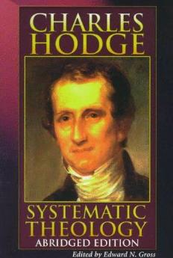
Implied vs. Exegetical Covenants
“this statement [Covenant of Grace] does not rest upon any express declaration of the Scriptures…[and] although the word covenant [as in works] is not used in Genesis, and does not elsewhere, in any clear passage, occur in reference to the transaction there recorded,…it is plain that the Bible does represent the arrangement made with Adam as a truly federal transaction.”
Hodge, Systematic Theology, 2:117

Slide 47
Dispensational Theology is a System of Theology
Traditional-normative dispensational theology is a system that embodies three essential, fundamental concepts called the sine qua non (lit. “without which is not”):
The consistent use of a plain, normal, literal, grammatical-historical method of interpretation;
Which reveals that the Church is distinct from Israel;
God’s overall purpose is to bring glory to Himself (Eph. 1:6, 12, 14).
Dr. Charles Ryrie, Dispensationalism, pp. 38-41

Slide 48
Doxological Purpose
God’s ultimate purpose for the ages is to glorify Himself. Scripture is not human-centered, as though salvation were the principle point, but God-centered, because His glory is at the center.
The glory of God is the primary principle that unifies all dispensations, the program of salvation being just one of the means by which God glorifies Himself. Each successive revelation of God’s plan for the ages, as well as His dealing with the elect, non-elect, angels, and nations all manifest His glory.
Dictionary of Premillennial Theology, Charles Ryrie, p. 94

Slide 50
VII. Dispensationalism & the Completed Revolution
Dispensational movement
19th century
Reformers’ hermeneutic
Applied to the whole bible
Retrieved key doctrines: Chiliasm, Israel-church distinction, Pretribulationalism
Curb on anti-Semitism and Geneva social experiments
Key dispensational leaders
Notes:
Outline

Slide 51
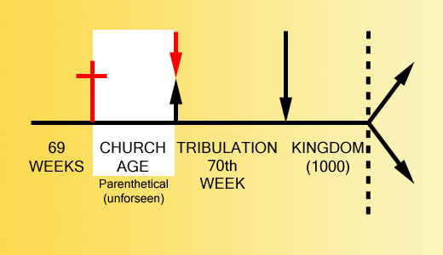

Slide 53
VII. Dispensationalism & the Completed Revolution
Dispensational movement
19th century
Reformers’ hermeneutic
Applied to the whole bible
Retrieved key doctrines: Chiliasm, Israel-church distinction, Pretribulationalism
Curb on anti-Semitism and Geneva social experiments
Key dispensational leaders
Notes:
Outline

Slide 54
VII. Dispensationalism & the Completed Revolution
Dispensational movement
19th century
Reformers’ hermeneutic
Applied to the whole bible
Retrieved key doctrines: Chiliasm, Israel-church distinction, Pretribulationalism
Curb on anti-Semitism and Geneva social experiments
Key dispensational leaders
Notes:
Outline

Slide 55
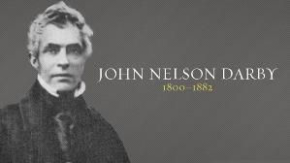
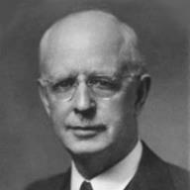
Dispensationalism Advocates
Key Dispensational Commentators
John Nelson Darby (1800–1882)
Sir Robert Anderson (1841–1918)
Cyrus Ingerson Scofield (1843–1921)
William Eugene Blackstone (1841–1935)
Henry Allen Ironside (1876–1951)
Lewis Sperry Chafer (1871–1952)

Slide 56
Dispensationalism Advocates
Key Dispensational Commentators
John Nelson Darby (1800–1882)
Sir Robert Anderson (1841–1918)
Cyrus Ingerson Scofield (1843–1921)
William Eugene Blackstone (1841–1935)
Henry Allen Ironside (1876–1951)
Lewis Sperry Chafer (1871–1952)

Slide 57
If the first 69 weeks were fulfilled literally then the remaining week will be fulfilled literally.

Slide 58
Sir Robert Anderson The Coming Prince, p.147-148
“There is not a single prophecy, of which the fulfillment is recorded in Scripture, that was not realized with absolute accuracy, and in every detail; and it is wholly unjustifiable to assume that a new system of fulfillment was inaugurated after the sacred canon closed…
Literalness of fulfillment may therefore be accepted as an axiom to guide us in the study of prophecy.”

Slide 59
Dispensationalism Advocates
Key Dispensational Commentators
John Nelson Darby (1800–1882)
Sir Robert Anderson (1841–1918)
Cyrus Ingerson Scofield (1843–1921)
William Eugene Blackstone (1841–1935)
Henry Allen Ironside (1876–1951)
Lewis Sperry Chafer (1871–1952)

Slide 60
CONCLUSION

Slide 61
NEXT WEEK
The early church
The Alexandrian eclipse
The Dark Ages
The Contribution of the Protestant Reformers
The Reformers’ Incomplete Revolution
Reformed Theology Today
Dispensationalism & The Completed Revolution
LOOKING BACK 500 YEARS LATER
Notes:
Outline

