Slide 1
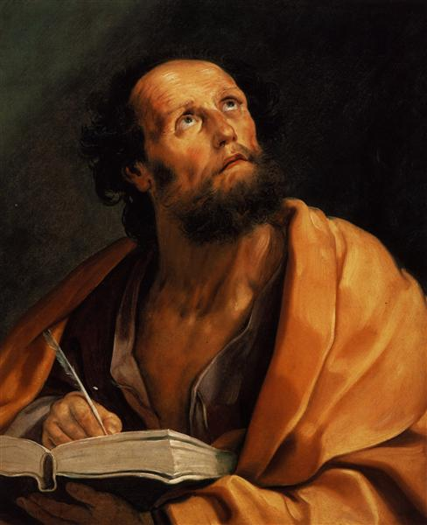
Lessons in Luke
The life and works of Luke

Slide 2
Luke
The Book of Luke is unique
Synoptics
Unique Qualities
Longest book of NT
Most Literary
Exclusive material/events/quotes

Slide 3
Luke
2. The Author
External Evidence
Internal Evidence
Characteristics of Luke
Gentile believer
Humble
Faithful
Beloved Physician

Slide 4
Humility
“…humility is considered the proper attitude of human beings toward their Creator. Humility is a grateful and spontaneous awareness that life is a gift, and it is manifested as an ungrudging and unhypocritical acknowledgment of absolute dependence upon God”
Walter A. Elwell and Philip Wesley Comfort, Tyndale Bible Dictionary, Tyndale Reference Library (Wheaton, IL: Tyndale House Publishers, 2001), 618.

Slide 5
Ephesians 2:13
“…remember that you were at that time separate from Christ, excluded from the commonwealth of Israel, and strangers to the covenants of promise, having no hope and without God in the world. But now in Christ Jesus you who formerly were far off have been brought near by the blood of Christ.”

Slide 6
Luke
2. The Author
External Evidence
Internal Evidence
Characteristics of Luke
Gentile believer
Humble
Faithful
Beloved Physician

Slide 7
Luke
2. The Author (Cont.)
C. Characteristics of Luke
Not an eye witness

Slide 8
Luke
2. The Author (Cont.)
C. Characteristics of Luke
Not an eye witness
Faithful Historian

Slide 9
“Property-especially wealth creating property-can be seen as giving its owner political power and the liberty to do whatever he or she wants. At the same time, the ownership of property immediately creates inequality in society.”
Schmidt, Shelby, Bardes & Ford, American Government & Politics Today, (Boston, MA: Wadsworth Publishing, 2014), 10.

Slide 10
“…early colonists were intolerant of religious beliefs that did not quite conform to those held by the majority of citizens in their own community.”
Schmidt, Shelby, Bardes & Ford, American Government & Politics Today, (Boston, MA: Wadsworth Publishing, 2014), 98.

Slide 11
“African Americans continue to feel a sense of injustice of race, and this feeling is often not apparent to, or appreciated by the majority of white America.”
Schmidt, Shelby, Bardes & Ford, American Government & Politics Today, (Boston, MA: Wadsworth Publishing, 2014), 152.

Slide 12
“The statue of liberty is an enduring symbol of American Democracy.”
William A. McClenaghan, Magruder’s American Government, (Upper Saddle River, NJ: Prentice Hall, 2013), 3.

Slide 13
“But what is justice? The term is difficult to define, for justice is a concept – an idea, an invention of the human mind. Like other concepts, such as truth, liberty, and fairness, justice means whatever the people want it to mean.”
William A. McClenaghan, Magruder’s American Government, (Upper Saddle River, NJ: Prentice Hall, 2013), 10.

Slide 14
Luke
2. The Author (Cont.)
C. Characteristics of Luke
Not an eye witness
Faithful Historian

Slide 15
Luke
2. The Author (Cont.)
C. Characteristics of Luke
Not an eye witness
Faithful Historian
Faithful Theologian
Faithful Preacher

Slide 16
Luke 19:10
“For the Son of Man has come to seek and to save that which was lost.”

Slide 17
Outline of Luke
The introduction of the Son of Man (1:1- 4:13)
The ministry of the Son of Man (4:14-9:50)
The rejection of the Son of Man (9:51-19:27)
The Crucifixion of the Son of Man (19:28-24:53)
Bruce Wilkinson and Kenneth Boa, Talk Thru the Bible (Nashville, TN: Thomas Nelson Publishers, 1980),329-330.

Slide 18
Luke 19:10
“For the Son of Man has come to seek and to save that which was lost.”

Slide 19
Source: https://www.youtube.com/watch?v=uMs2ulEcOhg

Slide 20
Luke 19:10
“For the Son of Man has come to seek and to save that which was lost.”

Slide 21
Luke 19:10
“For the Son of Man has come to seek and to save that which was lost.”

Slide 22
Luke’s Purpose
“…to write it out for you in consecutive order…so that you may know the exact truth about the things you have been taught.”
Luke 1:3 – 4

Slide 23
Lessons in Luke
The life and works of Luke

