Slide 1
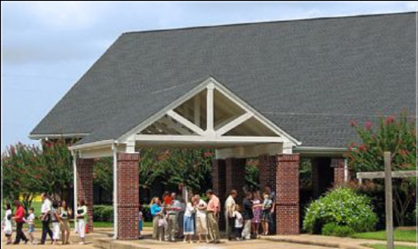
Beholding the Lord through His Word – Part 4
Jim McGowan, Th.D. Sugar Land Bible Church 08-06-2017.
This presentation was compiled using resources obtained from Dr. Vern Peterman, Holly Hills Bible Church – Used with permission.

Slide 2
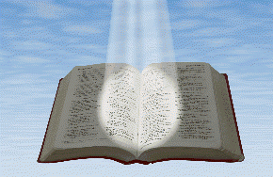
Beholding the Lord through His word
Seeing
the Living Word of God
in the written word of God

Slide 3
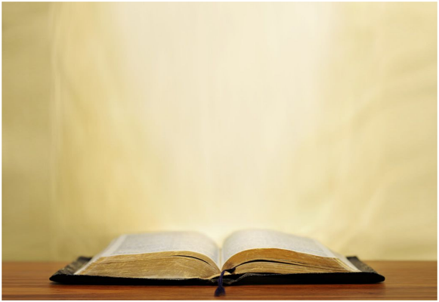
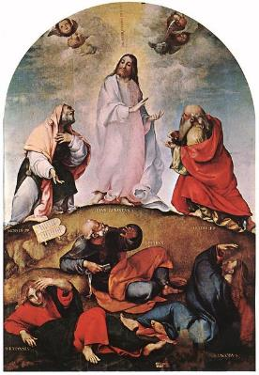
Beholding the Lord through His word
2 Corinthians 3:18 (NASB95)
“But we all… beholding… the glory of the Lord”
John 1:14 (NASB95)
“we saw His glory…full of grace and truth” (cf. 1:1-18)
Seeing
the Living Word of God
in the written word of God

Slide 4
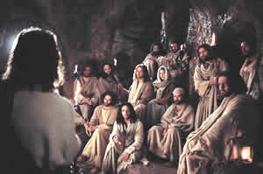
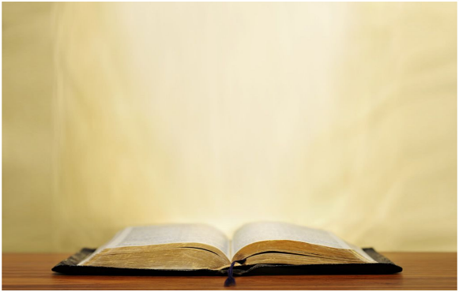
Beholding the Lord through His word
1 John 1:1-4 (NASB95)
“we have seen with our eyes…the Word of Life”
Hebrews 12:2 (NASB95)
“fixing our eyes on Jesus” (cf. 12:1-2)
Seeing
the Living Word of God
in the written word of God

Slide 5
Hebrews 12:1–2 (NASB95)
¹ Therefore, since we have so great a cloud of witnesses surrounding us, let us also lay aside every encumbrance and the sin which so easily entangles us, and let us run with endurance the race that is set before us, ² fixing our eyes on Jesus, the author and perfecter of faith, who for the joy set before Him endured the cross, despising the shame, and has sat down at the right hand of the throne of God.

Slide 6
Outline
Preliminary Comments
The Book of Hebrews is Special
Historical Background Information
Functioning Temple in Jerusalem
Backdrop of Athletic Competition
Chiasitic Pattern
Exposition
Conclusion

Slide 7
Outline
Preliminary Comments
The Book of Hebrews is Special
Historical Background Information
Functioning Temple in Jerusalem
Backdrop of Athletic Competition
Chiasitic Pattern
Exposition
Conclusion

Slide 8
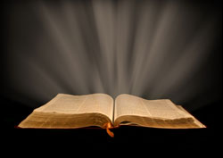
Hebrews is a very special book!

Slide 9
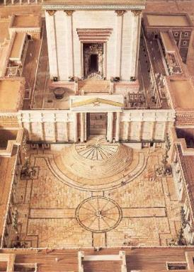
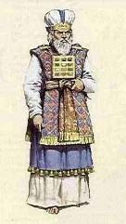
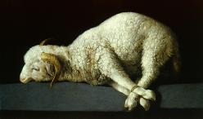
Hebrews is a very special book!
Hebrews was written to Jews, at a time when the sacrificial system in Jerusalem was still ongoing.

Slide 10
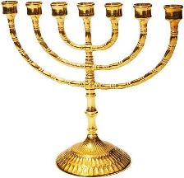
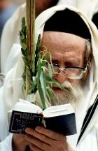
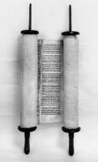
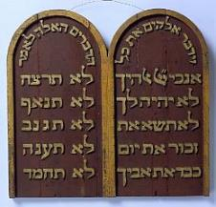
Hebrews is a very special book!
Many Jews who had become believers in Christ were being tempted to drift back under Judaism.

Slide 11
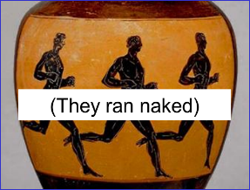
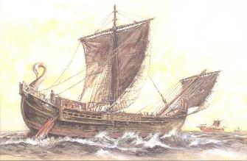
Hebrews is a very special book!
Hebrews has a ‘full cargo’ of nautical terms, and also makes active use of athletic terms, including the ones used in today’s passage: ‘and let us run with endurance the race that is set before us…’.

Slide 12
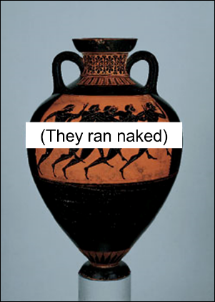
Keep your eyes on the goal
Hebrews 12:1-2 was written against a background of athletic competition, specifically running.

Slide 13
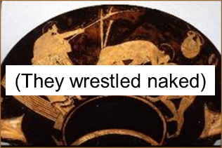
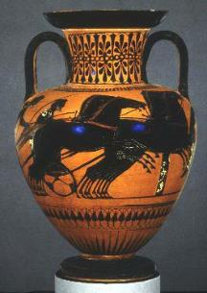
Keep your eyes on the goal
The Olympics began in 776 BC, & later on even involved a number of Jews, in varying degrees.

Slide 14
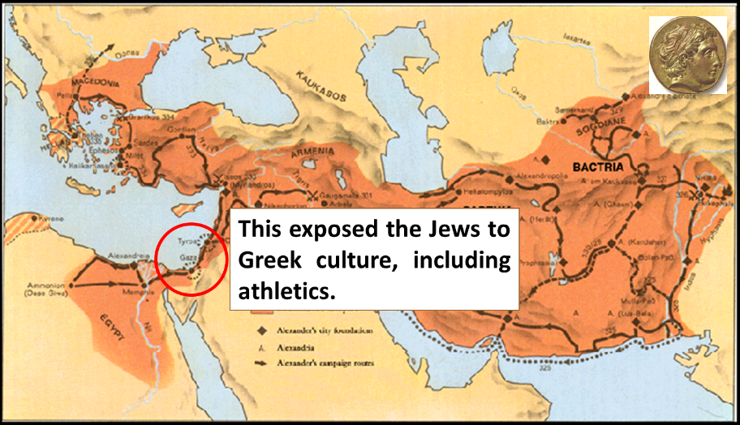
THE MILITARY PROGRESSION & EMPIRE OF ALEXANDER THE GREAT

Slide 15
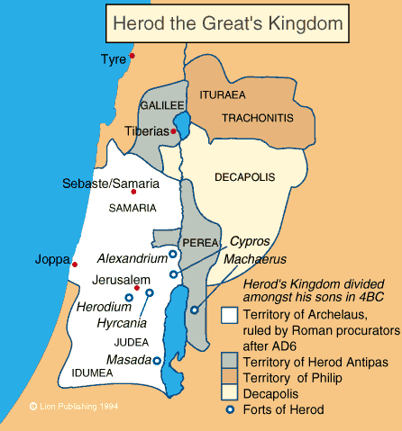
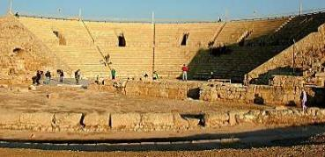
Keep your eyes on the goal
In 12 BC Herod the Great, ruler of Israel, provided substantial financial support for the Olympics, paid for by taxing Jews.

Slide 16
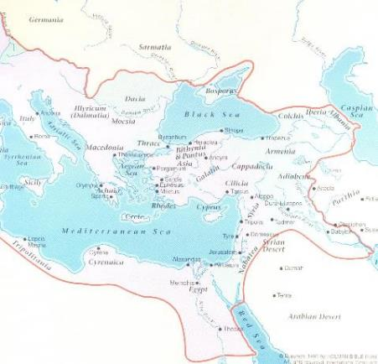
Keep your eyes on the goal
Hebrews was written to Jews living in the Gentile lands, where athletics was priority.

Slide 17
Outline
Preliminary Comments
The Book of Hebrews is Special
Historical Background Information
Functioning Temple in Jerusalem
Backdrop of Athletic Competition
Chiasitic Pattern
Exposition
Conclusion

Slide 18
Jesus, the center of Hebrews 12:1-2
¹ Therefore, since we have so great a cloud of witnesses surrounding us, let us also lay aside every encumbrance and the sin which so easily entangles us, and let us run with endurance the race that is set before us, ² fixing our eyes on
Jesus,
the author and perfecter of faith, who for the joy set before Him endured the cross, despising the shame, and has sat down at the right hand of the throne of God.

Slide 20
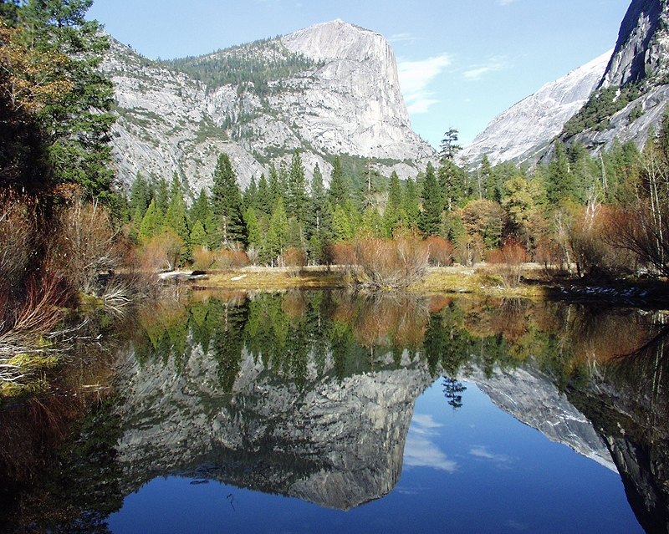
Chiasm: a mirror image in written form

Slide 21
Our race
What we’re called to be doing
What He did & is doing
His race

Slide 22
Both actions are in heaven

Slide 23
Both lay aside what would limit progress

Slide 24
Both endure in what is set before

Slide 25
The emphasis & turning point

Slide 26
Jesus, the center of Hebrews 12:1-2
¹ Therefore, since we have so great a cloud of witnesses surrounding us, let us also lay aside every encumbrance and the sin which so easily entangles us, and let us run with endurance the race that is set before us, ² fixing our eyes on
Jesus,
the author and perfecter of faith, who for the joy set before Him endured the cross, despising the shame, and has sat down at the right hand of the throne of God.

Slide 27
Outline
Preliminary Comments
The Book of Hebrews is Special
Historical Background Information
Functioning Temple in Jerusalem
Backdrop of Athletic Competition
Chiasitic Pattern
Exposition
Conclusion

Slide 28
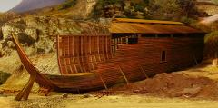
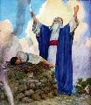
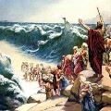
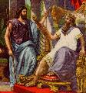
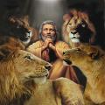
Hebrews 12:1 (NASB95)
¹ Therefore, since we have so great a cloud of witnesses surrounding us, let us also lay aside every encumbrance and the sin which so easily entangles us, and let us run with endurance the race that is set before us, ² fixing our eyes on Jesus,…
by faith...
Notes:
Hebrews 12:1
These words point back to the prior chapter (chapter 11), where the author of Hebrews had given some characteristics of faith, & then listed a series of Old Testament saints, telling what they did & what they endured, ‘by faith’.

Slide 29
Hebrews 12:1 (NASB95)
¹ Therefore, since we have so great a cloud of witnesses surrounding us, let us also lay aside every encumbrance and the sin which so easily entangles us, and let us run with endurance the race that is set before us, ² fixing our eyes on Jesus,…
by faith...
Notes:
Hebrews 12:1

Slide 30
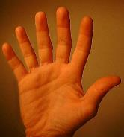
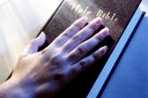
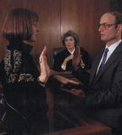
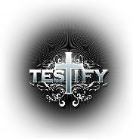
Hebrews 12:1 (NASB95)
¹ Therefore, since we have so great a cloud of witnesses surrounding us, let us also lay aside every encumbrance and the sin which so easily entangles us, and let us run with endurance the race that is set before us, ² fixing our eyes on Jesus,…
Notes:
‘Witnesses’ most often means those who give testimony, often with a legal sense or at least testifying to something considered important. But the Greek word for witnesses (martus) can also mean ‘martyrs’ (testifying by dying for the truth) or in this context, they are spectators

Slide 31
Hebrews 12:1 (NASB95)
¹ Therefore, since we have so great a cloud of witnesses surrounding us, let us also lay aside every encumbrance and the sin which so easily entangles us, and let us run with endurance the race that is set before us, ² fixing our eyes on Jesus,…
Notes:
The English ‘let us… lay aside’ is translated from a Greek word that is cast as an invitation & exhortation, calling the believers to lay aside anything which would hinder their ‘athletic’ pursuit of the spiritual goal. Except for Acts 7:58, all use of this word is for setting aside sin. (cf. Rom. 13:12; Eph. 4:22, 25; Col. 3:8; Jam. 1:21; 1 Peter 2:1)

Slide 32
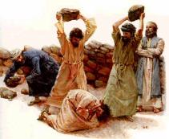
Acts 7:57–58 (NASB95)
⁵⁷ But they cried out with a loud voice, and covered their ears and rushed at him with one impulse. ⁵⁸ When they had driven him out of the city, they began stoning him; and the witnesses laid aside their robes at the feet of a young man named Saul (cf. Rom. 13:12; Eph. 4:22, 25; Col. 3:8; Jam. 1:21; 1 Peter 2:1).

Slide 33
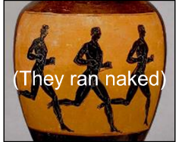
Hebrews 12:1 (NASB95)
¹ Therefore, since we have so great a cloud of witnesses surrounding us, let us also lay aside every encumbrance and the sin which so easily entangles us, and let us run with endurance the race that is set before us, ² fixing our eyes on Jesus,…
Notes:
These words call to mind the things that can limit our spiritual progress. Physically, that meant extra body weight & extra clothing – especially loose & lengthy garments. But in spiritual terms, this means sins that hinder our fellowship with the Lord & anything in the way.

Slide 34
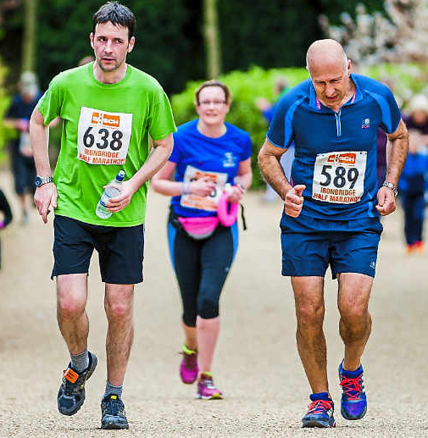
Hebrews 12:1 (NASB95)
¹ Therefore, since we have so great a cloud of witnesses surrounding us, let us also lay aside every encumbrance and the sin which so easily entangles us, and let us run with endurance the race that is set before us, ² fixing our eyes on Jesus,…
Notes:
These words picture the daily life of we who believe as a long race, in which our endurance is the critical characteristic in our running the race. The author of Hebrews used the Greek word for ‘set before’ three times (twice here), each time referring to ‘a necessary goal’. (cf. (6:18; 12:1, 2)

Slide 35
Hebrews 12:1 (NASB95)
¹ Therefore, since we have so great a cloud of witnesses surrounding us, let us also lay aside every encumbrance and the sin which so easily entangles us, and let us run with endurance the race that is set before us, ² fixing our eyes on Jesus,…
Notes:
In the athletic tradition & training, the serious competitor would fix his eyes upon the goal, not only physically, but also mentally, focusing upon the goal & also setting aside any mental distraction or competing focus. Paul likewise presented this picture in Philippians 3:12-14.

Slide 36
Philippians 3:12-14 (NASB95)
¹² Not that I have already obtained it or have already become perfect, but I press on so that I may lay hold of that for which also I was laid hold of by Christ Jesus. ¹³ Brethren, I do not regard myself as having laid hold of it yet; but one thing I do: forgetting what lies behind and reaching forward to what lies ahead, ¹⁴ I press on toward the goal for the prize of the upward call of God in Christ Jesus.
Notes:
The goal was the athlete’s visual fixed focus & the singular mental focus.

Slide 37
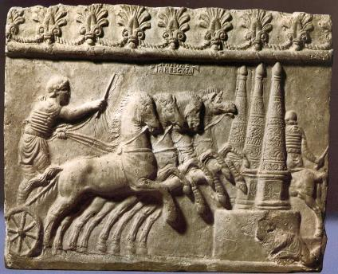
Philippians 3:14a (NASB95) “…toward the goal for the prize…”
The post at the finish was the goal toward which the runner or chariot racer would look, fixing his eye on it (Hebrews 12:2).

Slide 38
Hebrews 12:1-2a (NASB95)
¹ Therefore, since we have so great a cloud of witnesses surrounding us, let us also lay aside every encumbrance and the sin which so easily entangles us, and let us run with endurance the race that is set before us, ² fixing our eyes on Jesus,…
Notes:
There is another biblical principle that is also behind these words: in the same way that human beings have senses for perceiving the physical world, we human beings are also equipped with senses for perceiving the spiritual world, but their ability to sense varies.

Slide 39
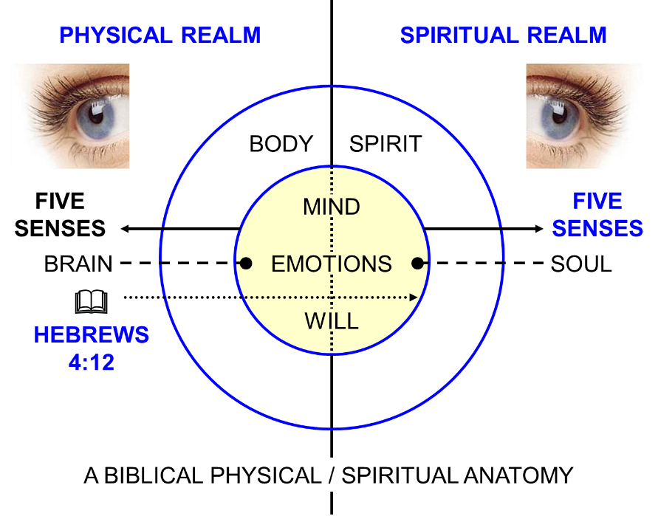

Slide 40
*An analogy explains an idea or thing by comparing it to something that is familiar; a comparison between two things, typically for the purpose of explanation or clarification.

Slide 41
Hebrews 12:1-2a (NASB95)
¹ Therefore, since we have so great a cloud of witnesses surrounding us, let us also lay aside every encumbrance and the sin which so easily entangles us, and let us run with endurance the race that is set before us, ² fixing our eyes on Jesus,…
Notes:
Jesus is not only the one on whom we fix our spiritual focus, with eyes of our heart, but the center point & turning point of this passage.
Though a great variety of things will happen to us in this life, though a great many things will clamor for our attention, our call is clear: Jesus

Slide 42
Jesus, the center of Hebrews 12:1-2
¹ Therefore, since we have so great a cloud of witnesses surrounding us, let us also lay aside every encumbrance and the sin which so easily entangles us, and let us run with endurance the race that is set before us, ² fixing our eyes on
Jesus,
the author and perfecter of faith, who for the joy set before Him endured the cross, despising the shame, and has sat down at the right hand of the throne of God.

Slide 43
Hebrews 12:1-2 (NASB95)
¹ Therefore, since we have so great a cloud of witnesses surrounding us, let us also lay aside every encumbrance and the sin which so easily entangles us, and let us run with endurance the race that is set before us, ² fixing our eyes on Jesus, the author and perfecter of faith, who for the joy set before Him endured the cross, despising the shame, and has sat down at the right hand of the throne of God.
Notes:
Hebrews 12:2, from the word ‘Jesus’ on
From here, the author of Hebrews turns from the key aspects of our running the spiritual race, ending with fixing our eyes on Jesus, to Jesus Himself: who He is & what He has done & what He is doing.
As he does so, he pictures Christ as having run a spiritual race as well.

Slide 44
Hebrews 12:2b (NASB95)
² …Jesus, the author and perfecter of faith, who for the joy set before Him endured the cross, despising the shame, and has sat down at the right hand of the throne of God.
Notes:
Hebrews 12:2, from the word ‘Jesus’ on
A clear singular answer: Jesus
To everything in Judaism that was tempting the Jews to slide back into its grasp, the author of Hebrews had a clear, singular answer: Jesus.

Slide 45
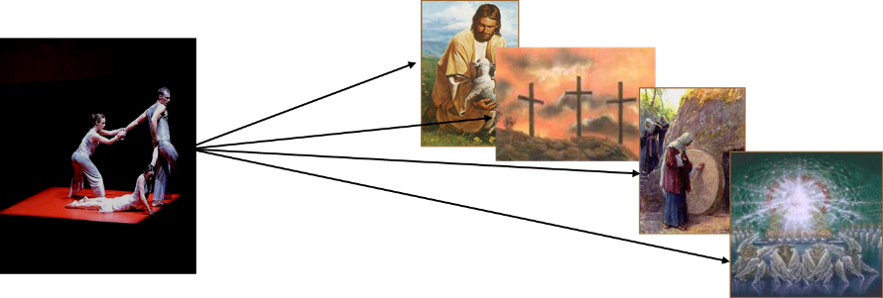
Hebrews 12:2b (NASB95)
² …Jesus, the author and perfecter of faith, who for the joy set before Him endured the cross, despising the shame, and has sat down at the right hand of the throne of God.
Notes:
Hebrews 12:2, from the word ‘Jesus’ on
A clear singular answer: Jesus
To everything in our own past that tempts us to slide back into its grasp, we’ll find the author of Hebrews has a clear, singular answer: Jesus

Slide 46
Hebrews 12:2b (NASB95)
² …Jesus, the author and perfecter of faith, who for the joy set before Him endured the cross, despising the shame, and has sat down at the right hand of the throne of God.
Notes:
To ‘author’ something is to be its source & to begin it.
To perfect something is to bring it to completion, as defined by supreme quality.
Christ is both of those things.
He defines how & why we are Christians today & He will define what it will mean for us to be “in Him” when this world’s days are not even a memory.

Slide 47
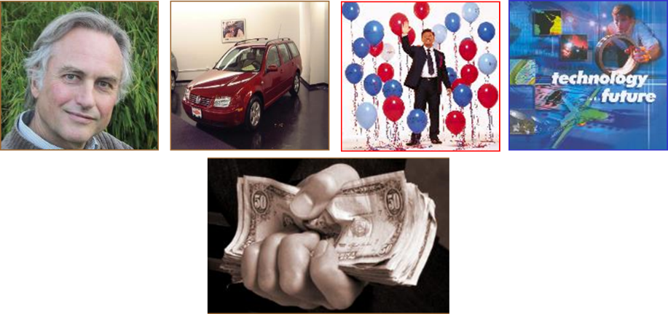
About this thing called ‘faith’
Notes:
About that thing called ‘faith’
By nature, humans are ‘creatures of faith’ – even the very outspoken atheist or agnostic has great faith!
The world will offer us a great many options for ‘things to put our faith in’.

Slide 48
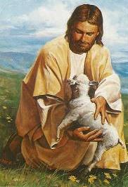
About this thing called ‘faith’
Notes:
About that thing called ‘faith’
But there is only one object of our ultimate faith who is worthy from start to finish: Jesus Christ…the One author & the perfecter of faith, who has finished His race, simply asking that we keep looking at Him.

Slide 49
Hebrews 12:2b (NASB95)
² …Jesus, the author and perfecter of faith, who for the joy set before Him endured the cross, despising the shame, and has sat down at the right hand of the throne of God.
Notes:
What motivated Jesus to die on the cross for our sins?
Was He just the ultimate ‘glutton for punishment’?
Was He just pressured into it by God the Father & the Holy Spirit?
This verse tells us something phenomenal: ‘…for the joy set before Him, He endured the cross…’

Slide 50
Hebrews 12:2b (NASB95)
² …Jesus, the author and perfecter of faith, who for the joy set before Him endured the cross, despising the shame, and has sat down at the right hand of the throne of God.
Notes:
The Greek word here translated as ‘despised’ means, in this context, to so discount the shame of the cross as not worthy of consideration. Was the cross shameful?

Slide 51
DON'T MESS WITH ROME!

Slide 52
Hebrews 12:2b (NASB95)
² …Jesus, the author and perfecter of faith, who for the joy set before Him endured the cross, despising the shame, and has sat down at the right hand of the throne of God.
Psalm 110:1 (NASB95)
The Lord says to my Lord: “Sit at My right hand Until I make Your enemies a footstool for Your feet.”
Notes:
The Greek word translated ‘has sat down’ is in the perfect tense: a completed past action with ongoing results into the future.
Jesus Christ has taken the seat of authority at the right hand (the hand of power & salvation) of God.
This message is given in a prophetic & messianic Psalm -110 - the most quoted New Testament passage out of the Old Testament.

Slide 53
Ephesians 1:3 (NASB95)
³ Blessed be the God and Father of our Lord Jesus Christ, who has blessed us with every spiritual blessing in the heavenly places in Christ,
Notes:
That is also the very place where each believer is both blessed & seated with Christ right now! (Eph. 1:3; 2:6)

Slide 54
Hebrews 12:2b (NASB95)
² …Jesus, the author and perfecter of faith, who for the joy set before Him endured the cross, despising the shame, and has sat down at the right hand of the throne of God.
Notes:
Hebrews 12:2 says that Christ is already (now) seated there in the heavenlies, which is why we who believe can be seated there with Him!

Slide 55
Ephesians 2:4–7 (NASB95)
⁴ But God, being rich in mercy, because of His great love with which He loved us, ⁵ even when we were dead in our transgressions, made us alive together with Christ (by grace you have been saved), ⁶ and raised us up with Him, and seated us with Him in the heavenly places in Christ Jesus, ⁷ so that in the ages to come He might show the surpassing riches of His grace in kindness toward us in Christ Jesus.

Slide 56
Ephesians 2:4–7 (NASB95)
⁴ But God, being rich in mercy, because of His great love with which He loved us, ⁵ even when we were dead in our transgressions, made us alive together with Christ (by grace you have been saved), ⁶ and raised us up with Him, and seated us with Him in the heavenly places in Christ Jesus, ⁷ so that in the ages to come He might show the surpassing riches of His grace in kindness toward us in Christ Jesus.
Notes:
What is the reason that you have been seated with Christ in the heavenlies, where you are ‘in Christ’?
What purpose could there be in it?

Slide 57
Outline
Preliminary Comments
The Book of Hebrews is Special
Historical Background Information
Functioning Temple in Jerusalem
Backdrop of Athletic Competition
Chiasitic Pattern
Exposition
Conclusion

Slide 58
CONCLUSION

Slide 59
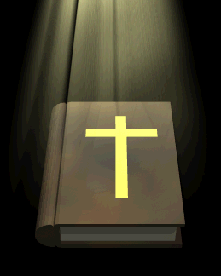
FIXING OUR EYES ON JESUS
Fixing our eyes on Jesus, by beholding Him though God’s written word and so being changed from glory to glory (2 Corinthians 3:18).

Slide 60
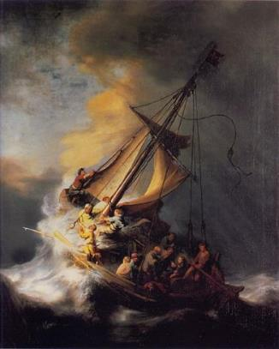
FIXING OUR EYES ON JESUS
Fixing our eyes on Jesus, the one whose glory John and the apostles saw and through whose eyes we still behold Him (John 1:14).

Slide 61
FIXING OUR EYES ON JESUS
Fixing our eyes on Jesus, for the very purpose of fellowship – with each other, with the Father and with Him, and that our joy in Him may be full (1 John 1:1-4).

Slide 62
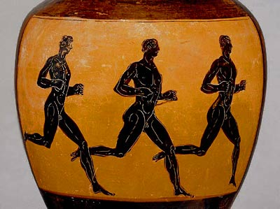
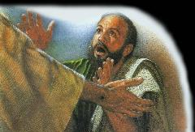
FIXING OUR EYES ON JESUS
Fixing the eyes of our hearts on Jesus, laying aside every hindrance, knowing that He is already seated and we are seated with Him in the heavenlies (Heb. 12:1-2).
Laying aside every encumbrance

Slide 63
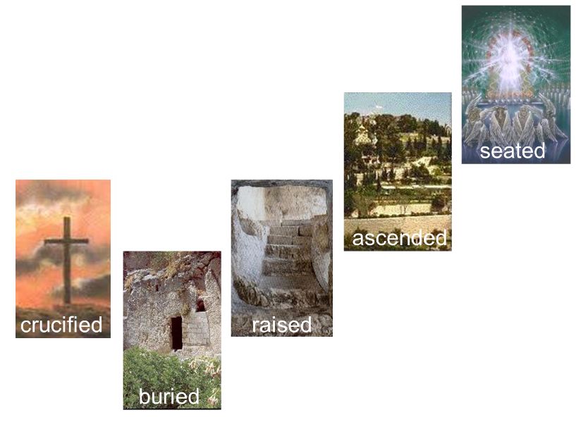
FIXING OUR EYES ON JESUS
Who for the joy set before Him endured the cross…and has sat down…

Slide 64
We are called to behold the living word of God through the written word of God, until the day that we behold Him face to face (1 John 3:2).

