Slide 1

THE BOOK OF DANIEL
Dr. Andy Woods

Slide 2

Message
Times of the Gentiles are revealed prophetically (2, 7, 8-12) and ethically (1, 3-6)

Slide 3

Synthetic Outline
Historical (1-7):
  Daniel interprets, 3rd person, gentile nations
  Intro “Hebrew” (1)
  Aramaic chiasm (2-7)

Slide 4
Synthetic Outline
Historical (1-7):
  Daniel interprets, 3rd person, gentile nations
  Intro “Hebrew” (1)
  Aramaic chiasm (2-7)

Slide 5
Synthetic Outline
Historical (1-7):
  Daniel interprets, 3rd person, gentile nations
  Intro “Hebrew” (1)
  Aramaic chiasm (2-7)

Slide 6

Synthetic Outline
  Chiasm “Aramaic” ( 2-7)
1. Gentile History (2)
  2. Protection (3)
    3. Revelation to a gentile king (4)
    3. Revelation to a gentile king (5)
  2. Protection (6)
1. Gentile history (7)

Slide 7
Synthetic Outline
Prophetic (8-12):
  Angel interprets, 1st person, Jewish nation, Hebrew
  Ram & Goat (8)
  70 weeks (9)
  Final vision (10-12)

Slide 8
Synthetic Outline
Prophetic (8-12):
  Angel interprets, 1st person, Jewish nation, Hebrew
  Ram & Goat (8)
  70 weeks (9)
  Final vision (10-12)

Slide 9

Chapter 9 Outline
The Setting (1-2)
Daniel’s prayer (3-19)
Gabriel’s arrival (20-23)
The Seventy Weeks Prophecy (24-27)

Slide 10
Chapter 9 Outline
The Setting (1-2)
Daniel’s prayer (3-19)
Gabriel’s arrival (20-23)
The Seventy Weeks Prophecy (24-27)

Slide 11
I. The Setting (1-2)
Historical setting (v.1)
Prophetic setting (v.2)

Slide 12
CHAPTER AND VERSE IN DANIEL | CHRONOLOGICAL DATE | BIBLICAL DATE
1:1 | 605 | 3rd year of Jehoiakim
2:1 | 603 | 2nd year of Nebuchadnezzar
5 | Sat. night 10/12/539 (Hoehner)
7:1 | 553 | 1st year of Belshazzar
8:1 | 551 | 3rd year of Belshazzar
9:1 | 538 | 1st year of Darius
10:1 | 536 | 3rd year of Cyrus

Slide 13
Daniel’s Age
CHAPTER | EVENTS | AGE
1 | Taken to Babylonian captivity | 15
2 | Interpreting Nebuchadnezzar’s 1st dream (huge image) | 17
3 | Daniel’s 3 friends cast into the fiery furnace | 19 or 20
4 | Interpreting Nebuchadnezzar’s 2nd dream (huge tree) | 45-50
5 | Interpreting handwriting of the wall at Belshazzar’s feast | Early 80’s
6 | Delivered from the den of lions | c.83
7-8 | Daniel’s visions and dreams | Mid-60’s
9 | Daniel’s seventy “sevens” prophecy | Early-80’s
10-12 | Final dreams and visions | Mid-80’s

Slide 14
I. The Setting (1-2)
Historical setting (v.1)
Prophetic setting (v.2)

Slide 15
SETTING : PROPHETIC
V.2
70 YEAR CAPTIVITY ABOUT TO END
  Jeremiah 25:11; 29:10
  Prophecy provides important information
  Prophecy gives insight into current events
  Why 70 years?
    Lev. 25:1-5; 26:33-35; 2 Chron. 36:21

Slide 16
Chapter 9 Outline
The Setting (1-2)
Daniel’s prayer (3-19)
Gabriel’s arrival (20-23)
The Seventy Weeks Prophecy (24-27)

Slide 17
Chapter 9 Outline
The Setting (1-2)
Daniel’s prayer (3-19)
Gabriel’s arrival (20-23)
The Seventy Weeks Prophecy (24-27)

Slide 18
THE ARRIVAL OF GABRIEL
V.20-23
V.20-21
  Gabriel is the mediary
  Gabriel’s previous involvement (8:16)
V.22
  Gabriel came to give Daniel insight
  Daniel’s misconception of the kingdom’s coming after 70 years
V.23
  Daniel is highly esteemed

Slide 19
THE ARRIVAL OF GABRIEL
V.20-23
V.20-21
  Gabriel is the mediary
  Gabriel’s previous involvement (8:16)
V.22
  Gabriel came to give Daniel insight
  Daniel’s misconception of the kingdom’s coming after 70 years
V.23
  Daniel is highly esteemed

Slide 20
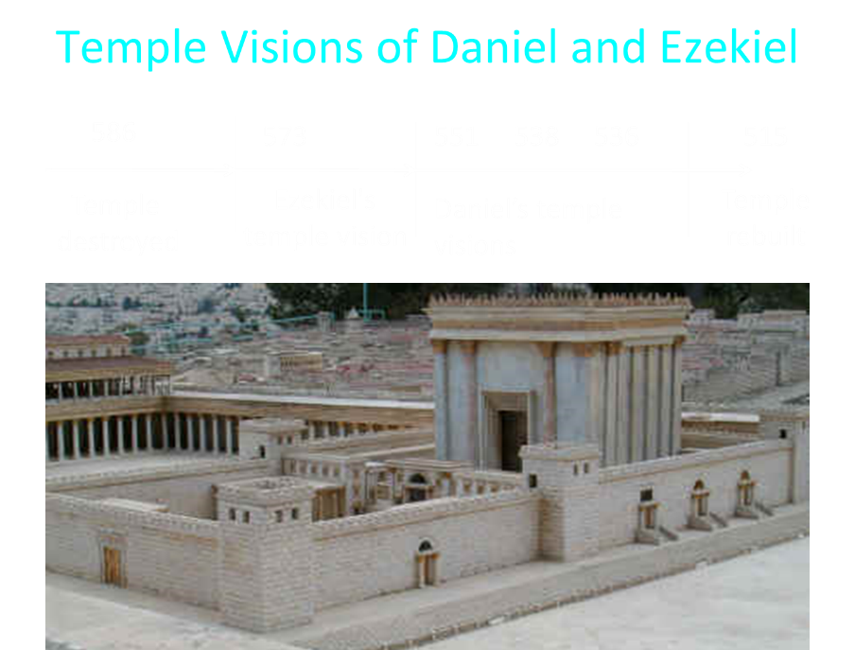

Slide 21
THE ARRIVAL OF GABRIEL
V.20-23
V.20-21
  Gabriel is the mediary
  Gabriel’s previous involvement (8:16)
V.22
  Gabriel came to give Daniel insight
  Daniel’s misconception of the kingdom’s coming after 70 years
V.23
  Daniel is highly esteemed

Slide 22

Matthew 24:15
“Therefore when you see the abomination of desolation which was spoken of through Daniel the prophet, standing in the holy place (let the reader understand).”

Slide 23


Statue
&
Stone

Slide 24
THE ARRIVAL OF GABRIEL
V.20-23
V.20-21
  Gabriel is the mediary
  Gabriel’s previous involvement (8:16)
V.22
  Gabriel came to give Daniel insight
  Daniel’s misconception of the kingdom’s coming after 70 years
V.23
  Daniel is highly esteemed

Slide 25
Chapter 9 Outline
The Setting (1-2)
Daniel’s prayer (3-19)
Gabriel’s arrival (20-23)
The Seventy Weeks Prophecy (24-27)

Slide 26
Conclusion

Slide 27
Chapter 9 Outline
The Setting (1-2)
Daniel’s prayer (3-19)
Gabriel’s arrival (20-23)
The Seventy Weeks Prophecy (24-27)

