Slide 1
The Protestant Reformation: The Good, The Bad, and The Ugly Session 10
Andy Woods, Th.M.., JD., PhD.
Sr. Pastor, Sugar Land Bible Church
President Chafer Theological Seminary

Slide 2
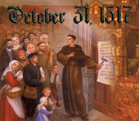
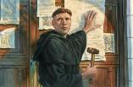
Introduction
Oct 31, 1517
500 years
Far reaching impact
Partial restoration
Restoration of a hermeneutic
Selectively applied
Subsequent generations applied consistently
Preview

Slide 3
Overview
The early church
The Alexandrian eclipse
The Dark Ages
The contribution of the Protestant Reformers
The Reformers’ incomplete revolution
Reformed Theology today
Dispensationalism & the completed revolution
Looking back 500 years later
Notes:
Outline

Slide 4
Overview
THE EARLY CHURCH
The Alexandrian eclipse
The Dark Ages
The contribution of the Protestant Reformers
The Reformers’ incomplete revolution
Reformed Theology today
Dispensationalism & the completed revolution
Looking back 500 years later
Notes:
Outline

Slide 5
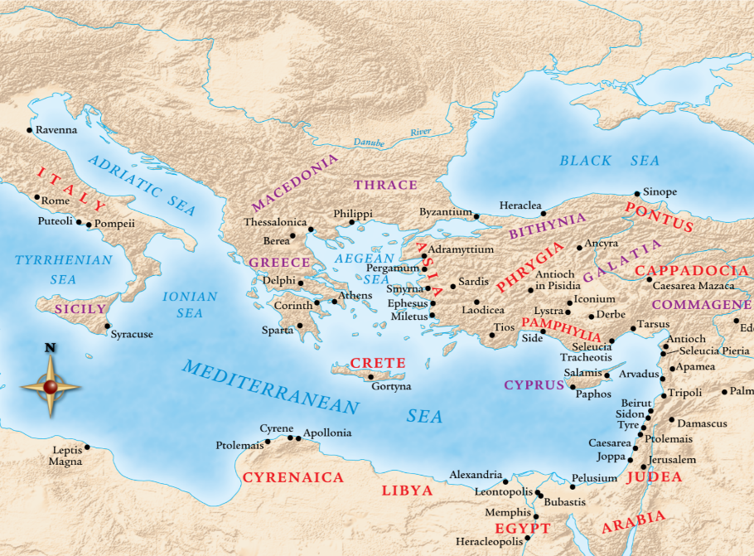

Slide 6
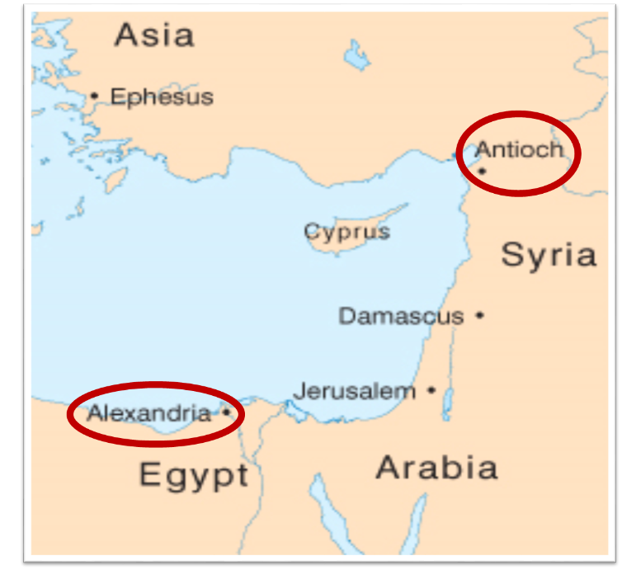

Slide 7
Overview
The early church
THE ALEXANDRIAN ECLIPSE
The Dark Ages
The contribution of the Protestant Reformers
The Reformers’ incomplete revolution
Reformed Theology today
Dispensationalism & the completed revolution
Looking back 500 years later
Notes:
Outline

Slide 10
Dangers of Allegorization – Philo

Slide 11
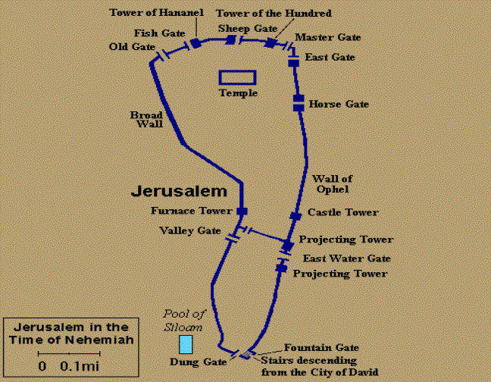
Dangers of Allegorization
Gates of Nehemiah 3

Slide 12
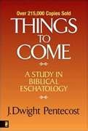
Dangers of Allegorization
Text is not being interpreted
Authority is transferred from text to interpreter
There is no way to test the interpreter
No mechanism for controlling the interpreter’s imagination
Pentecost, Things to Come, pps. 4-5

Slide 13
What Caused the Shift Into Allegorism?
Need for immediate relevance
Incorporation of human philosophy into interpretation
Gnostic dualism (Gen. 1:31; 1 John 2:22; 4:2-3; Acts 17:32; 1 Cor. 15:12)
Decline of the church's Jewish population
Constantine’s Edict of Milan (A.D. 313)
AD 70 and Hadrian’s (A.D. 117–138)“Palestine”
Notes:
Outline

Slide 14
Overview
The early church
The Alexandrian eclipse
THE DARK AGES
The contribution of the Protestant Reformers
The Reformers’ incomplete revolution
Reformed Theology today
Dispensationalism & the completed revolution
Looking back 500 years later
Notes:
Outline

Slide 15
III. The Dark Ages (or the Middle Ages)
Lasted from the 4th to the 16th centuries
Obsolescence of prophetic studies
Domination of Augustinian Amillennialism
Only one church: Roman Catholicism
The Bible is removed from the people
Allegorization
Illiteracy
Mass read in Latin
Sale of indulgences
Anti-Semitism
Church in need of rescue
Notes:
Outline

Slide 16
Overview
The early church
The Alexandrian eclipse
The Dark Ages
THE CONTRIBUTION OF THE PROTESTANT REFORMERS
The Reformers’ incomplete revolution
Reformed Theology today
Dispensationalism & the completed revolution
Looking back 500 years later
Notes:
Outline

Slide 17
IV. Contribution of the Protestant Reformers
Preparation of the Reformers
Emphasis on literal interpretation
Denunciation of allegorization
Rejection of church tradition as a guide
Priesthood of all believers
Bible translations
Literacy
Basis for the American system of governance
Five solas
Rejection of celibacy of the priesthood
The ultimate sacrifice
Rejoice
Notes:
Outline

Slide 18
Overview
The early church
The Alexandrian eclipse
The Dark Ages
The Contribution of the Protestant Reformers
THE REFORMERS’ INCOMPLETE REVOLUTION
Reformed Theology today
Dispensationalism & the completed revolution
Looking back 500 years later
Notes:
Outline

Slide 19
V. The Reformers’ Incomplete Revolution
Protology
Selective literalism
Did not deal with eschatology in depth
Retention of Augustinian Amillennialism
Antichrist & Babylon = Pope and Papacy
Dragged vestiges of Roman Catholicism with them
Initially desired to remain Catholics
Infant baptism
Consubstantiation
Church = the earthly kingdom
Anti-Semitism
Reasons for their inconsistency
Laid the groundwork for future generations
Notes:
Outline

Slide 20
V. The Reformers’ Incomplete Revolution
Protology
Selective literalism
Did not deal with eschatology in depth
Retention of Augustinian Amillennialism
Antichrist & Babylon = Pope and Papacy
Dragged vestiges of Roman Catholicism with them
Initially desired to remain Catholics
Infant baptism
Consubstantiation
Church = the earthly kingdom
Anti-Semitism
Reasons for their inconsistency
Laid the groundwork for future generations
Notes:
Outline

Slide 21
V. The Reformers’ Incomplete Revolution
Protology
Selective literalism
Did not deal with eschatology in depth
Retention of Augustinian Amillennialism
Antichrist & Babylon = Pope and Papacy
Dragged vestiges of Roman Catholicism with them
Initially desired to remain Catholics
Infant baptism
Consubstantiation
Church = the earthly kingdom
Anti-Semitism
Reasons for their inconsistency
Laid the groundwork for future generations
Notes:
Outline

Slide 22
V. The Reformers’ Incomplete Revolution
Protology
Selective literalism
Did not deal with eschatology in depth
Retention of Augustinian Amillennialism
Antichrist & Babylon = Pope and Papacy
Dragged vestiges of Roman Catholicism with them
Initially desired to remain Catholics
Infant baptism
Consubstantiation
Church = the earthly kingdom
Anti-Semitism
Reasons for their inconsistency
Laid the groundwork for future generations
Notes:
Outline

Slide 23
V. The Reformers’ Incomplete Revolution
Protology
Selective literalism
Did not deal with eschatology in depth
Retention of Augustinian Amillennialism
Antichrist & Babylon = Pope and Papacy
Dragged vestiges of Roman Catholicism with them
Initially desired to remain Catholics
Infant baptism
Consubstantiation
Church = the earthly kingdom
Anti-Semitism
Reasons for their inconsistency
Laid the groundwork for future generations
Notes:
Outline

Slide 24
Augustine
The City of God, trans., Marcus Dods (NY: Random House, 1950), Book XX, chap. 9, p. 725-26.
Augustine wrote, “the saints reign with Christ during the same thousand years, understood in the same way, that is, of the time of His first coming” and “Therefore the Church even now is the kingdom of Christ, and the kingdom of heaven. Accordingly, even now His saints reign with Him.”

Slide 25
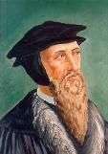
“Augustine is so wholly with me, that if I wished to write a confession of my faith, I could do so with all fullness and satisfaction to myself out of his writings.”
John Calvin
John Calvin, “A Treatise on the Eternal Predestination of God,” in John Calvin, Calvin’s Calvinism, trans. Henry Cole (Grandville, MI: Reformed Free Publishing Association, 1987), 38

Slide 26
John Calvin
Institutes of the Christian Religion, III, xxv, 5.
“But Satan has not only befuddled men’s senses to make them bury with the corpses the memory of resurrection; he has also attempted to corrupt this part of the doctrine with various falsifications…Now their fiction is too childish either to need or to be worth a refutation. And the Apocalypse, from which they undoubtedly drew a pretext for their error, does not support them. For the number ‘one thousand’ [Rev. 20:4] does not apply to the eternal blessedness of the church but only to the various disturbances that awaited the church, while still toiling on earth…Those who assign the children of God a thousand years in which to enjoy the inheritance of the life to come do not realize how much reproach they are casting upon Christ and his Kingdom.”

Slide 27
“But by this public call, the Gentiles were not only made equal to the Jews, but seemed to be substituted into their place, as if the Jews had been dead.”
John Calvin
Institutes of the Christian Religion, II, xi, 12.

Slide 28
In his sermon on 2 Samuel 24:24, Calvin declares: “Now the Jews are cut off like rotten limbs. We have taken their place.”
John Calvin
John Calvin, Supplementa Calviniana, I, 766, 12f; quoted in Selderhuis, Calvin Handbook, 145.

Slide 29
Calvin also declares them [Israel] to be “cut off from everything,” adding haughtily, “and we have succeeded them in their place.”
John Calvin
John Calvin, Supplementa Calviniana, II, 36, 28f; Sermon on Isa. 14:2; quoted in Selderhuis, Calvin Handbook, 145.

Slide 30
“This passage is explained in various ways. I pass by the dreams of the Jews, who apply all passages of this kind to the temporal reign of the Messiah, which they have contrived by their own imagination.... I willingly view this passage as referring to Judea, and afterwards to other parts of the world.... Let us now see when this prophecy was fulfilled, or shall be fulfilled. The Lord began some kind of restoration when he brought his people out of Babylon: but that was only a foretaste, and, therefore, I have no hesitation in saying that this passage, as well as others of a similar kind, must refer to the kingdom of Christ; and in no other light could it be viewed, if we compare it with other prophecies.”
John Calvin
Commentary on Isaiah 35:1
Isaiah 35:1— “The wilderness and the solitary place shall be glad.”

Slide 31
“Here the Prophet describes the felicity which shall be under the reign of Christ: and we know that whenever the Prophets set forth promises of a happy and prosperous state to God’s people, they adopt metaphorical expressions, and say, that abundance of all good things shall flow, that there shall be the most fruitful produce, that provisions shall be bountifully supplied; for they accommodated their mode of speaking to the notions of that ancient people; it is therefore no wonder if they sometimes speak to them as to children. At the same time, the Spirit under these figurative expressions declares, that the kingdom of Christ shall in every way be happy and blessed, or that the Church of God, which means the same thing, shall be blessed, when Christ shall begin to reign.”
John Calvin
Commentary on Amos 9:13
Amos 9:13—“Behold the days come, saith the LORD, that the plowman shall overtake the reaper, and the treader of grapes him that soweth seed: and the mountains shall drop sweet wine, and all the hills shall melt.”

Slide 32
“For as we are dull and entangled in earthly thoughts, our minds can hardly rise up to heaven, though the Lord with a clear voice invites us to himself. The Prophet then, in order to aid our weakness, adds a vivid representation, as though God stood before their eyes. Stand, he says, shall his feet on the mount of Olives. He does not here promise a miracle, such as even the ignorant might conceive to be literal; nor does he do this in what follows, when he says, The mount shall be rent…half…to the east and half to the west. This has never happened, that mount has never been rent: but as the Prophet could not, under those grievous trials, which might have overwhelmed the minds of the godly a hundred times, have extolled the power of God…without employing a highly figurative language, he therefore accommodates himself, as I have said, to the capacity of our flesh.”
John Calvin
Commentary on Zechariah 14:4
Zechariah 14:4—“And his feet shall stand in that day upon the mount of Olives…and the mount of Olives shall cleave in the midst thereof toward the east and toward the west….”

Slide 33
Renald Showers
John Ankerberg and Renald Showers, The Most Asked Prophecy Questions (Chattanooga, TN: ATRI, 2000), 328.
Showers explains, “The Lutheran, Reformed, and Anglican Reformers rejected Premillennialism as being ‘Jewish opinions.’ They maintained the Amillennial view which the Roman Catholic Church had adopted from Augustine.”

Slide 34
Barry Horner
Future Israel: Why Christian Anti-Judaism Must Be Challenged, ed. E. Ray Clendenen, NAC Stuides in Bible & Theology (Nashville, TN: Baker, 2007), 155-60.
“The inheritance from the Augustinian tradition that modern Europe received, notwithstanding the opposition of Melanchthon and others to Luther's excesses, resulted in a continuance of an eschatology that upheld the essentially anti-Judiac thesis, namely, the transference of blessings, formerly promised to Israel, to the Christian church for it's fulfillment...On a much larger scale the reformed movement maintained its allegiance to Augustinian eschatology, which essentially found authoritative expression in the writings of Francis Turretin (1623–1687) who studied at Calvin's academy in Geneva and later taught there for 30 years. His monumental Institutes of Elenctic Theology became the . . .

Slide 35
Barry Horner
Future Israel: Why Christian Anti-Judaism Must Be Challenged, ed. E. Ray Clendenen, NAC Stuides in Bible & Theology (Nashville, TN: Baker, 2007), 155-60.
…of reformed doctrine. Not surprisingly, his quotations of Augustine are copious, even far exceeding references to Calvin. Consequently, Turretin's eschatology is almost predictable...Of course such a mass incorporation into the church is to the exclusion of any perpetuation of Jewish identity. In classic Augustinian fashion, there is token recognition of Jewish individuality for a time, though any form of Jewish restoration was considered to be a gross form of chiliasm. Turretin's Institutes became the central textbook for systematic theology in American Ivy League colleges during the later half of the 18th century. It is not surprising that the early theologians of Princeton Theological Seminary highly esteemed this most influential legacy, and of course it's eschatology.”

Slide 36
V. The Reformers’ Incomplete Revolution
Protology
Selective literalism
Did not deal with eschatology in depth
Retention of Augustinian Amillennialism
Antichrist & Babylon = Pope and Papacy
Dragged vestiges of Roman Catholicism with them
Initially desired to remain Catholics
Infant baptism
Consubstantiation
Church = the earthly kingdom
Anti-Semitism
Reasons for their inconsistency
Laid the groundwork for future generations
Notes:
Outline

Slide 38
Revelation 17:9-10
“Here is the mind which has wisdom. The seven heads are seven mountains on which the woman sits, ¹⁰ and they are seven kings; five have fallen, one is, the other has not yet come; and when he comes, he must remain a little while.”

Slide 39
Daniel 2:37-38
You, O king, are the king of kings, to whom the God of heaven has given the kingdom, the power, the strength and the glory; ³⁸ and wherever the sons of men dwell, or the beasts of the field, or the birds of the sky, He has given them into your hand and has caused you to rule over them all. You are the head of gold.

Slide 40
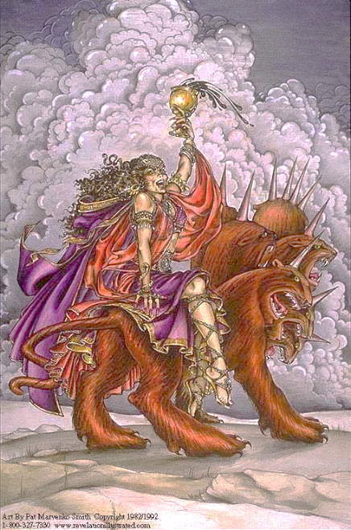

Slide 41
Revelation 17:3
“And he carried me away in the Spirit into a wilderness; and I saw a woman sitting on a scarlet beast, full of blasphemous names, having seven heads and ten horns.”

Slide 42
Martin Luther
"Against the Roman Papacy, an Institution of the Devil," in Luther's Works, ed. Eric. W. Gritsch (Philadelphia, PA: Fortress Press, 1966), 273-74.
“No man can believe what an abomination the papacy is. A Christian does not have to be of low intelligence, either, to recognize it. God himself must deride him in the hellish fire, and our Lord Jesus Christ, St. Paul says in II Thessalonians 2 [:8] will slay him with the breath of his mouth and destroy him by his glorious coming." I only deride, with my own weak derision, so that those who now live and those who will come after us should know what I have thought of the pope, the damned antichrist, and so that whoever wishes to be a Christian may be warned against such an abomination.”

Slide 43
John Calvin
Calvin, Institutes, IV, ii, 12.
“However, when we categorically deny to the papists the title of the church, we do not for this reason impugn the existence of churches among them. Rather, we are only contending about the true and lawful constitution of the church, required in the communion not only of the sacraments (which are the signs of profession) but also especially of doctrine. Daniel [Dan. 9:27] and Paul [2 Thess. 2:4] foretold that Antichrist would sit in the Temple of God. With us, it is the Roman pontiff we make the leader and standard bearer of that wicked and abominable kingdom. The fact that his seat is placed in the Temple of God signifies that his reign was not to be such as to wipe out either the name of Christ or of the church. From this it therefore is evident that we by no means deny that the churches under his tyranny remain churches. But these he has profaned by his sacrilegious impiety, afflicted by his inhuman domination, corrupted and well-nigh killed by his evil and deadly doctrines, which are like poisoned drinks. In them Christ lies hidden, half buried, the gospel overthrown, piety scattered, the worship of God nearly wiped out. In them, briefly, everything is so confused that there we see the face of Babylon rather than that of the Holy City of God.”

Slide 44
V. The Reformers’ Incomplete Revolution
Protology
Selective literalism
Did not deal with eschatology in depth
Retention of Augustinian Amillennialism
Antichrist & Babylon = Pope and Papacy
Dragged vestiges of Roman Catholicism with them
Initially desired to remain Catholics
Infant baptism
Consubstantiation
Church = the earthly kingdom
Anti-Semitism
Reasons for their inconsistency
Laid the groundwork for future generations
Notes:
Outline

Slide 45
Daniel 7:12
“As for the rest of the beasts, their dominion was taken away, but an extension of life was granted to them for an appointed period of time.”

Slide 46
V. The Reformers’ Incomplete Revolution
Protology
Selective literalism
Did not deal with eschatology in depth
Retention of Augustinian Amillennialism
Antichrist & Babylon = Pope and Papacy
Dragged vestiges of Roman Catholicism with them
Initially desired to remain Catholics
Infant baptism
Consubstantiation
Church = the earthly kingdom
Anti-Semitism
Reasons for their inconsistency
Laid the groundwork for future generations
Notes:
Outline

Slide 47
V. The Reformers’ Incomplete Revolution
Protology
Selective literalism
Did not deal with eschatology in depth
Retention of Augustinian Amillennialism
Antichrist & Babylon = Pope and Papacy
Dragged vestiges of Roman Catholicism with them
Initially desired to remain Catholics
Infant baptism
Consubstantiation
Church = the earthly kingdom
Anti-Semitism
Reasons for their inconsistency
Laid the groundwork for future generations
Notes:
Outline

Slide 48
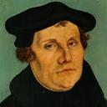
Martin Luther
Alister E. McGrath, Reformation Thought: An Introduction (Grand Rapids: Baker, 1995), 179.
He believed that “such sacraments could generate faith; and hence baptism could generate faith of an infant.”
Notes:
Outline

Slide 49
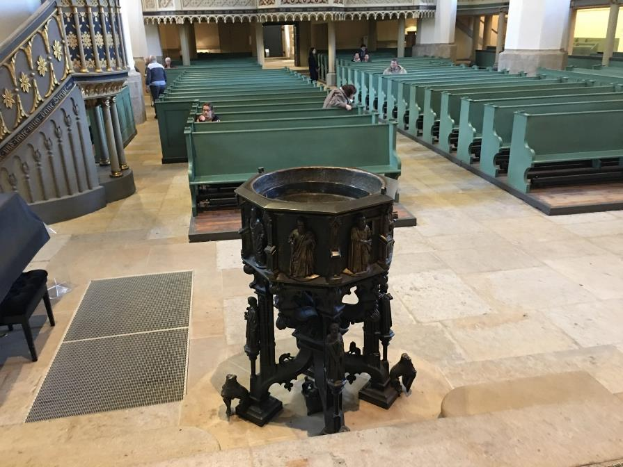

Slide 50
V. The Reformers’ Incomplete Revolution
Protology
Selective literalism
Did not deal with eschatology in depth
Retention of Augustinian Amillennialism
Antichrist & Babylon = Pope and Papacy
Dragged vestiges of Roman Catholicism with them
Initially desired to remain Catholics
Infant baptism
Consubstantiation
Church = the earthly kingdom
Anti-Semitism
Reasons for their inconsistency
Laid the groundwork for future generations
Notes:
Outline

Slide 51
Martin Luther
Emir Caner, "Balthsar Hubmaier and His Theological Participation in the Reformation: Ecclesiology and Soteriology," Faith and Mission 21, no. 1 (2003): 42.
Caner explains, “Luther denied the doctrine of Transubstantiation, rejecting any molecular change of the elements. Consubstantiation, a term never employed by Luther, is used to explain his view that the body and blood are present ‘in, with, and under’ the bread and wine.”
Notes:
Outline

Slide 52
Luke 22:19-20
“And when He had taken some bread and given thanks, He broke it and gave it to them, saying, ‘This is My body which is given for you; do this in remembrance of Me.’ ²⁰And in the same way He took the cup after they had eaten, saying, ‘This cup which is poured out for you is the new covenant in My blood.’”

Slide 53
V. The Reformers’ Incomplete Revolution
Protology
Selective literalism
Did not deal with eschatology in depth
Retention of Augustinian Amillennialism
Antichrist & Babylon = Pope and Papacy
Dragged vestiges of Roman Catholicism with them
Initially desired to remain Catholics
Infant baptism
Consubstantiation
Church = the earthly kingdom
Anti-Semitism
Reasons for their inconsistency
Laid the groundwork for future generations
Notes:
Outline

Slide 54
Augustine
The City of God, trans., Marcus Dods (NY: Random House, 1950), Book XX, chap. 9, p. 725-26.
Augustine wrote, “the saints reign with Christ during the same thousand years, understood in the same way, that is, of the time of His first coming” and “Therefore the Church even now is the kingdom of Christ, and the kingdom of heaven. Accordingly, even now His saints reign with Him.”

Slide 55
Augustine
Augustine, “Advice to Marcellinus on the Punishment of Donatists,” AD 412; Tr. J. G. Cunningham, Letters of Augustine, II, 169ff. In Stevenson, Creeds, Councils, and Controversies, 213.
In matters of church discipline Calvin imitated Augustine’s totalitarian style of government. Augustine, it will be remembered, advised Marcellinus, an African governor, to punish the Donatists (a Christian sect who objected to certain Church practices), “not by stretching them on the rack, nor by furrowing their flesh with iron claws, nor by scorching them with flames, but by beating them with rods.”

Slide 56
“Augustine is so wholly with me, that if I wished to write a confession of my faith, I could do so with all fullness and satisfaction to myself out of his writings.”
John Calvin
John Calvin, “A Treatise on the Eternal Predestination of God,” in John Calvin, Calvin’s Calvinism, trans. Henry Cole (Grandville, MI: Reformed Free Publishing Association, 1987), 38

Slide 57
John Calvin
Encyclopedia Judaica (Jerusalem: Keter Publishing, 1971), 66.
Here, Calvin sought to reconstruct a society through the imposition of the Mosaic Law, “which he tried to imitate as much as possible in his new Christian republic in Geneva.”

Slide 58
John Calvin
James Edward McGoldrick, "Introducing John Calvin: The Reformer's Preparation," Reformation and Revival 10, no. 4 (2001): 21.
“A measure of legalism became apparent in Geneva, as the consistory put the lives of church members under continuous review and applied discipline to offenders. Church attendance was compulsory. Eating fish on Fridays was forbidden, as were attendance at theaters, dancing, cardplaying, and criticism of pastors. All heretical teaching was deemed subversive and subject to penalties under criminal law. Flagrant infractions could lead to banishment, imprisonment, and in extreme cases death. Judicial torture was common procedure.”

Slide 59
The Encyclopaedia Judaica refers to Calvin’s “despotic theocratic regime in Geneva.”
John Calvin
“Calvin, John,” in Encyclopaedia Judaica, Vol. 5, 67.

Slide 60
“The execution of Servetus is the greatest blot on Calvin’s life” and reveals “that vindictive streak which sometimes disgraced the character of the Reformer.”
John Calvin
Lewis Lupton, A History of the Geneva Bible, Vol. 2 (London: Olive Tree, 1969), 23–24.

Slide 61
V. The Reformers’ Incomplete Revolution
Protology
Selective literalism
Did not deal with eschatology in depth
Retention of Augustinian Amillennialism
Antichrist & Babylon = Pope and Papacy
Dragged vestiges of Roman Catholicism with them
Initially desired to remain Catholics
Infant baptism
Consubstantiation
Church = the earthly kingdom
Anti-Semitism
Reasons for their inconsistency
Laid the groundwork for future generations
Notes:
Outline

Slide 62
Luther and Antisemitism
95 Theses (1517)
Excommunication (1521)
“Jesus Was Born a Jew” (1523)
“Of the Jews and Their Lies” (1543)
“Of the Unknowable Name and the Generations of the Messiah” (1543)
Several sermons in Eisleben (1546)
Groundwork laid for Nazi Germany

Slide 63
Luther and Antisemitism
95 Theses (1517)
Excommunication (1521)
“Jesus Was Born a Jew” (1523)
“Of the Jews and Their Lies” (1543)
“Of the Unknowable Name and the Generations of the Messiah” (1543)
Several sermons in Eisleben (1546)
Groundwork laid for Nazi Germany

Slide 64
Luther and Antisemitism
95 Theses (1517)
Excommunication (1521)
“Jesus Was Born a Jew” (1523)
“Of the Jews and Their Lies” (1543)
“Of the Unknowable Name and the Generations of the Messiah” (1543)
Several sermons in Eisleben (1546)
Groundwork laid for Nazi Germany

Slide 65
Luther and Antisemitism
95 Theses (1517)
Excommunication (1521)
“Jesus Was Born a Jew” (1523)
“Of the Jews and Their Lies” (1543)
“Of the Unknowable Name and the Generations of the Messiah” (1543)
Several sermons in Eisleben (1546)
Groundwork laid for Nazi Germany

Slide 66
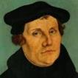
Martin Luther
Jesus Was Born a Jew (1523).
“If I had been a Jew and had seen such dolts and blockheads govern and teach the Christian faith, I would sooner have become a hog than a Christian. They have dealt with the Jews as if they were dogs rather than human beings; they have done little else than deride them and seize their property. When they baptize them they show them nothing of Christian doctrine or life, but only subject them to popishness and monkery…If the apostles, who also were Jews, had dealt with us Gentiles as we Gentiles deal with the Jews, there would never have been a Christian among the Gentiles…."
Notes:
Outline

Slide 67
Martin Luther
Jesus Was Born a Jew (1523).
“When we are inclined to boast of our position we should remember that we are but Gentiles, while the Jews are of the lineage of Christ. We are aliens and in-laws; they are blood relatives, cousins, and brothers of our Lord. Therefore, if one is to boast of flesh and blood, the Jews are actually nearer to Christ than we are…If we really want to help them, we must be guided in our dealings with them not by papal law but by the law of Christian love. We must receive them cordially, and permit them to trade and work with us, that they may have occasion and opportunity to associate with us, hear our Christian teaching, and witness our Christian life. If some of them should prove stiff-necked, what of it? After all, we ourselves are not all good Christians either."
Notes:
Outline

Slide 68
Luther and Antisemitism
95 Theses (1517)
Excommunication (1521)
“Jesus Was Born a Jew” (1523
“Of the Jews and Their Lies” (1543)
“Of the Unknowable Name and the Generations of the Messiah” (1543)
Several sermons in Eisleben (1546)
Groundwork laid for Nazi Germany

Slide 69
Christian Anti-Semitism
“First, their synagogues should be set on fire…Secondly, their homes should likewise be broken down and destroyed… Thirdly, they should be deprived of their prayer books and Talmuds…”

Slide 70
Christian Anti-Semitism
“…Fourthly, their rabbis must be forbidden under threat of death to teach any more… Fifthly, passport and traveling privileges should be absolutely forbidden to the Jews… Sixthly, they ought to be stopped from usury (charging interest on loans…”

Slide 71
Christian Anti-Semitism
“Seventhly, let the young and strong Jews and Jewesses be given the flail, the ax, the hoe, the spade, the distaff, and spindle, and let the earn their bread by the sweat of their noses…We ought to drive the rascally lazy bones out of our system...”

Slide 72
Christian Anti-Semitism
“…Therefore away with them… To sum up, dear princes and nobles who have Jews in your domains, if this advice of mine does not suit you, then find a better one so that you and we may all be free of this insufferable devilish burden–the Jews.”
Martin Luther, Concerning the Jews and Their Lies, cited in Michael Brown’s Our Hands Are Stained with Blood, pp. 14-15.

Slide 73
Luther and Antisemitism
95 Theses (1517)
Excommunication (1521)
“Jesus Was Born a Jew” (1523)
“Of the Jews and Their Lies” (1543)
“Of the Unknowable Name and the Generations of the Messiah” (1543)
Several sermons in Eisleben (1546)
Groundwork laid for Nazi Germany

Slide 74
Luther and Antisemitism
95 Theses (1517)
Excommunication (1521)
“Jesus Was Born a Jew” (1523)
“Of the Jews and Their Lies” (1543)
“Of the Unknowable Name and the Generations of the Messiah” (1543)
Several sermons in Eisleben (1546)
Groundwork laid for Nazi Germany

Slide 75
Luther and Antisemitism
95 Theses (1517)
Excommunication (1521)
“Jesus Was Born a Jew” (1523)
“Of the Jews and Their Lies” (1543)
“Of the Unknowable Name and the Generations of the Messiah” (1543)
Several sermons in Eisleben (1546)
Groundwork laid for Nazi Germany

Slide 76
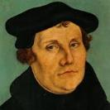
The Encyclopaedia Judaica says “Short of the Auschwitz oven and the extermination, the whole Nazi holocaust is pre-outlined here.”
Martin Luther
“Luther, Martin,” in Encyclopaedia Judaica, Vol. 8, 693.

Slide 77
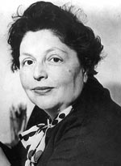
“…both Luther and Hitler were obsessed by the ‘demonologized universe’ inhabited by the Jews.”
Lucy Dawidowicz
“Luther, Martin,” in Encyclopaedia Judaica, Vol. 8, 693.

Slide 78
Olivier J. Melnick Oliver J. Melnick, End-Times Antisemitism: A New Chapter in the Longest Hatred (Tustin, CA: Hope For Today Publications, 2017), 89, 92.
“In 1543, when the Jewish community didn't meet his expectations, Luther published the book Of the Jews and Their Lies, where his description of the Jewish people is so venomous that Hitler was quoted saying that he was just finishing up what Luther started...As a matter of fact, many scholars and historians believe that Luther's view of the Jews had a profound effect on Germans for centuries to come and also had a serious influence on Hitler's ideology and implementing the final solution to the Jewish question. The connection between Luther and Hitler is not difficult to make.”

Slide 79
Thomas D. Ice Thomas D. Ice, “Yad Vashem and the Holocaust,” online: www.pre-trib.org, accessed 19 August 2017, 2.
“We learned at the conference that Hitler was not alone in his irrational desire to murder Jews it was embedded in the German, Austrian, and Eastern European nations. The original source for such anti-Semitism goes back to the common experience of all of Europe’s medieval Roman Catholic Jew-hatred. Most of the people throughout Europe did not have to be taught by Hitler or the Nazis to hate the Jews, it was endemic in their culture for hundreds of years. When the Nazis crystalized their anti-Semitism into murdering the Jews as a virtue, they already had a willing mass of people ready to join their crusade. After all, Hitler quoted the founder of the Reformation three times in Mein Kampf and called Martin Luther one of the greatest Christians in all of history. It is not surprising (for the most part) the German clergy were great Hitler enthusiasts since almost all of them were liberal and held to replacement theology.”

Slide 80
Lutheran Statement https://www.ccjr.us/dialogika-resources/documents-and-statements/interreligious/759-lwfijcic1983
“We Lutherans take our name and much of our understanding of Christianity from Martin Luther. But we cannot accept or condone the violent verbal attacks that the Reformer made against the Jews…The sins of Luther’s anti-Jewish remarks, the violence of his attacks on the Jews, must be acknowledged with deep distress. And all occasions for similar sin in the present or the future must be removed from our churches…Lutherans of today refuse to be bound by all of Luther’s utterances on the Jews.”

Slide 81
Matthew 16:13-23 (NASB)
¹⁶ Now when Jesus came into the district of Caesarea Philippi, He was asking His disciples, “Who do people say that the Son of Man is?”…¹⁶ Simon Peter answered, “You are the Christ, the Son of the living God.” ¹⁷ And Jesus said to him, “Blessed are you, Simon Barjona, because flesh and blood did not reveal this to you, but My Father who is in heaven. ¹⁸ I also say to you that you are Peter, and upon this rock I will build My church; and the gates of Hades will not overpower it. ¹⁹ I will give you the keys of the kingdom of heaven; and whatever you bind on earth shall have been bound in heaven, and whatever you loose on earth shall have been loosed in heaven.”

Slide 82
Matthew 16:13-23 (NASB)
²⁰ Then He warned the disciples that they should tell no one that He was the Christ.²¹ From that time Jesus began to show His disciples that He must go to Jerusalem, and suffer many things from the elders and chief priests and scribes, and be killed, and be raised up on the third day. ²² Peter took Him aside and began to rebuke Him, saying, “God forbid it, Lord! This shall never happen to You.” ²³ But He turned and said to Peter, “Get behind Me, Satan! You are a stumbling block to Me; for you are not setting your mind on God’s interests, but man’s.

Slide 83
John Calvin
Commentary on the Prophet Daniel (Vol 1, p. 185). Bellingham, WA: Logos Bible Software. Commentary on Daniel 2:44-45. (2010).
“But here he [the rabbi] not only betrays his ignorance, but his utter stupidity, since God so blinded the whole people that they were like restive dogs. I have had much conversation with many Jews: I have never seen either a drop of piety or a grain of truth or ingenuousness—nay, I have never found common sense in any Jew. But this fellow, who seems so sharp and ingenious, displays his own impudence to his great disgrace.”

Slide 84
Calvin repeatedly refers to the Jews as “profane unholy sacrilegious dogs,” describing them as “a barbarous nation” and “the people of Israel rejected by God.”
John Calvin
1. John Calvin, Ioannis Calvini opera quae supersunt Omnia, 50, 307; Sermon on Gal. 1:6–8; quoted in Selderhuis, Calvin Handbook, 145; 2. John Calvin, Supplementa Calviniana, V, 145, 10; Sermon on Mic. 40b–11; quoted in Selderhuis, Calvin Handbook, 145; 3. John Calvin, Ioannis Calvini opera quae supersunt Omnia, 27, 6; Sermon on Deut. 10:1–8; quoted in Selderhuis, Calvin Handbook, 145.

Slide 85
V. The Reformers’ Incomplete Revolution
Protology
Selective literalism
Did not deal with eschatology in depth
Retention of Augustinian Amillennialism
Antichrist & Babylon = Pope and Papacy
Dragged vestiges of Roman Catholicism with them
Initially desired to remain Catholics
Infant baptism
Consubstantiation
Church = the earthly kingdom
Anti-Semitism
Reasons for their inconsistency
Laid the groundwork for future generations
Notes:
Outline

Slide 86
V. The Reformers’ Incomplete Revolution
Protology
Selective literalism
Did not deal with eschatology in depth
Retention of Augustinian Amillennialism
Antichrist & Babylon = Pope and Papacy
Dragged vestiges of Roman Catholicism with them
Initially desired to remain Catholics
Infant baptism
Consubstantiation
Church = the earthly kingdom
Anti-Semitism
Reasons for their inconsistency
Laid the groundwork for future generations
Notes:
Outline

Slide 87
CONCLUSION

Slide 88
V. The Reformers’ Incomplete Revolution
Protology
Selective literalism
Did not deal with eschatology in depth
Retention of Augustinian Amillennialism
Antichrist & Babylon = Pope and Papacy
Dragged vestiges of Roman Catholicism with them
Initially desired to remain Catholics
Infant baptism
Consubstantiation
Church = the earthly kingdom
Anti-Semitism
Reasons for their inconsistency
Laid the groundwork for future generations
Notes:
Outline

Slide 89
NEXT WEEK
The early church
The Alexandrian eclipse
The Dark Ages
The Contribution of the Protestant Reformers
The Reformers’ Incomplete Revolution
REFORMED THEOLOGY TODAY
Dispensationalism & the completed revolution
Looking back 500 years later
Notes:
Outline

